Slide 1


感恩遇见，相互成就，本课件资料仅供您个人参考、教学使用，严禁自行在网络传播，违者依知识产权法追究法律责任。
更多教学资源请关注
公众号：溯恩英语
知识产权声明

Slide 2

---2024-8 浙江强基
人与自我之比赛篇
郑素红

Slide 3

读原文:
"MEATLOAF AGAIN?" I stared at the plate with a feeling of disappointment.
My mom knew how to make seven meals. That was all. She kept all seven recipes labeled with a day of the week. That day was Meatloaf Monday. Again.
"It's just，it had been Tuna Tuesdays and Spaghetti Saturdays for, like, my entire life.
Not every meal had to start with the same letter as a day of the week. "
My mom's eyes flashed. But she said nothing. I knew she didn't consider learning new recipes due to her overwhelming stress.
The next day I was sitting next to Tania, whose dad was the best cook, in our school's brand-new-since-six-months-ago kitchen classroom. Everything, the tables, the stove, the pots and pans shone and sparkled. I was about to ask Tania about a new recipe，but Mr. Bruin, our teacher, interrupted.
"I've got exciting news." he said. Exciting news? The class stopped talking and looked expectantly at Mr. Bruin. "To finish off our unit on kitchen skills, we were having a competition where you didn't have a recipe and you had to make something with whatever ingredients the judges gave you. "

Slide 4
“ An eager murmur traveled through the class. " You've learned a lot this term--- accurate measuring, food prep, cooking techniques. Just add some creativity to the mix. "
"Will there be prizes?" asked Samantha.
"Absolutely! And the first-place prize was the newest book in the Cave of the Dragons series." said Mr. Bruin, holding up a copy for everyone to see.
The class erupted into squeals and cheers. Cave of the Dragons was the best book series ever! It had been sold out everywhere. During the break, all anyone could talk about was the cooking competition. "I'm totally going to win," said Tania. "Genes, like, cooking was in my DNA. " And if there was some sort of cooking gene, my mom definitely didn't have it. So if I wanted to win, I needed to practise and innovate.
Para1: After school. I told my mom my plan.
Para2: The day of the competition arrived, and the kitchen classroom was filled with activity.

Slide 5
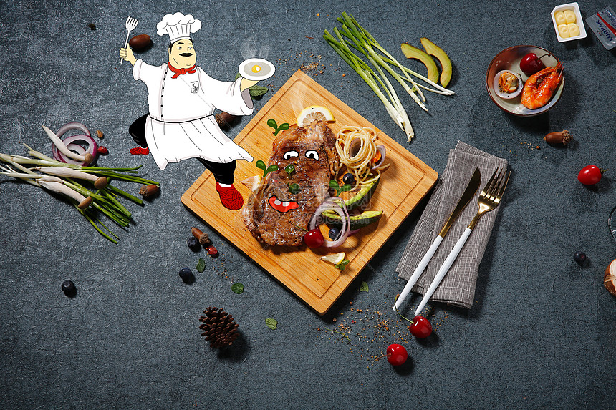
Mom
only knew how to make seven meals
"MEATLOAF AGAIN?" I stared at the plate with a feeling of disappointment.
My mom knew how to make seven meals. That was all. She kept all seven recipes labeled with a day of the week. That day was Meatloaf Monday. Again.
"It's just，it had been Tuna Tuesdays and Spaghetti Saturdays for, like, my entire life.
Not every meal had to start with the same letter as a day of the week. "
My mom's eyes flashed. But she said nothing. I knew she didn't consider learning new recipes due to her overwhelming stress.
Analyze Characters
I
not satisfied with mom’s meals

Slide 6
Tania
my classmate confident proud of her cooking skills
The next day I was sitting next to Tania, whose dad was the best cook, in our school's brand-new-since-six-months-ago kitchen classroom. Everything, the tables, the stove, the pots and pans shone and sparkled. I was about to ask Tania about a new recipe，but Mr. Bruin, our teacher, interrupted.
…
The class erupted into squeals and cheers. Cave of the Dragons was the best book series ever! It had been sold out everywhere. During the break, all anyone could talk about was the cooking competition. "I'm totally going to win," said Tania. "Genes, like, cooking was in my DNA. " And if there was some sort of cooking gene, my mom definitely didn't have it. So if I wanted to win, I needed to practise and innovate.
Analyze Characters
Mr. Bruin
our teacher

Slide 7
Samantha
my classmate eager to participate in the creative cooking competition
“ An eager murmur traveled through the class. " You've learned a lot this term--- accurate measuring, food prep, cooking techniques. Just add some creativity to the mix. "
"Will there be prizes?" asked Samantha.
"Absolutely! And the first-place prize was the newest book in the Cave of the Dragons series." said Mr. Bruin, holding up a copy for everyone to see.
Analyze Characters

Slide 8
Conflict 1: Mom lacks creativity in cooking meals.
Analyze conflicts
solution1: Mom would try new recipes with me .
Conflict 2: Participants should make something with whatever ingredients the judges gave you. "
.
solution 2: I would practice and innovate cooking at home with different ingredients and various recipes .

Slide 9

Read for elements
characters：I Mom Tania Mr. Bruin Samantha Judges
(Major roles in Para1: I , Mom ;
Major roles in Para2: I ; contestants like Tania , Samanths
Minor roles in Para2: Mr. Bruin, Judges, Mom )
2. narrative perspective: first-person ( I )
time： before / during / after the cooking competition
place： Para1: at home ;
Para2: in the school kitchen classroom
5. Event : a cooking competition

Slide 10

5.story line
The prize was a book of a popular series .
Climax
Participants should make something with the ingredients offered by judges without referring to any recipe.
Para1: After school. I told my mom my plan.
My classmates were eager to participate in the competition.
Tania was confident and proud of her cooking.
Para2: The day of the competition arrived, and the kitchen classroom was filled with activity.
Mr. Bruin announced a cooking competition.
My mom knew how to make seven meals. That was all.
background
Ending
Beginning

Slide 11

Read for clues and echoes
hidden clues | echoes
"MEATLOAF AGAIN?" I stared at the plate with a feeling of disappointment. My mom knew how to make seven meals. That was all. She kept all seven recipes labeled with a day of the week. That day was Meatloaf Monday. Again. "It's just，it had been Tuna Tuesdays and Spaghetti Saturdays for, like, my entire life. Not every meal had to start with the same letter as a day of the week. " My mom's eyes flashed. But she said nothing. I knew she didn't consider learning new recipes due to her overwhelming stress. | 1. But I insisted on experimenting with different ingredients every day, happily saying goodbye to Meatloaf Monday, Tuna Tuesdays and Spaghetti Saturdays. Though far from the best chef, Mom searched for recipes over a cooking app, racking her wits to guide me to cook meals with creativity added.

Slide 12
Read for clues and echoes
hidden clues | echoes
"I've got exciting news." he said. Exciting news? The class stopped talking and looked expectantly at Mr. Bruin. "To finish off our unit on kitchen skills, we were having a competition where you didn't have a recipe and you had to make something with whatever ingredients the judges gave you. | 3. After what seemed like centuries, a wide variety of dishes were eventually created with the ingredients provided.

Slide 13
Read for clues and echoes
hidden clues | echoes
The class erupted into squeals and cheers. Cave of the Dragons was the best book series ever! It had been sold out everywhere. During the break, all anyone could talk about was the cooking competition. "I'm totally going to win," said Tania. "Genes, like, cooking was in my DNA. " And if there was some sort of cooking gene, my mom definitely didn't have it. So if I wanted to win, I needed to practise and innovate. | 4. The unforgettable competition/ experience taught me a valuable lesson—Practice makes perfect. // (130) It is not DNA but practice that makes perfect. .

Slide 14
心理描写
神态描写
动作描写
外貌描写
环境描写
对话描写
语言
无灵主语
动作链
分词作状语
With 复合结构
独立主格
从句
倒装句
虚拟语气
强调句
长短句结合
考生构思情节的同时，要考虑合适的语言句式以及修辞

Slide 15
Plot the continuation story
Para1: After school. I told my mom my plan.
Para2: The day of the competition arrived, and the kitchen classroom was filled with activity.
Link1: How did Mom react? What did she say to me?
Body: How did I feel? What did I do? How did we make joint efforts to prepare for the coming cooking competition ?
Link2: How was my current cooking?
Link3: What was the atmosphere?
Body: What did competitors do? What was the final result?
( How did I/ mom feel? )
Theme: What lesson did the experience demonstrate?

Slide 16
Design link1
The class erupted into squeals and cheers. Cave of the Dragons was the best book series ever! It had been sold out everywhere. During the break, all anyone could talk about was the cooking competition. "I'm totally going to win," said Tania. "Genes, like, cooking was in my DNA. " And if there was some sort of cooking gene, my mom definitely didn't have it. So if I wanted to win, I needed to practise and innovate.
Para1: After school. I told my mom my plan.
Link1A: Hearing my incredible ambition, she looked at me like I'd grown a second head. "What? A cooking competition? You want me to help? ” she exclaimed, eyes wide with horror.

Slide 17
Design link1
At this moment, Gunter pointed towards the waiting hall of the bus station. There at the entrance, was a cash machine. I jumped out of the car, made a mad run for the machine, and popped my card in, only to read the message, "Out of order. Sorry."
Para1: After school. I told my mom my plan.
Link1B: She seemed hesitant at first, probably worried about her limited cooking skills. But seeing my determination, she agreed to help.

Slide 18
Design link2
Para1: After school. I told my mom my plan.
Para2: The day of the competition arrived, and the kitchen classroom was filled with activity.
Link2 A: But I insisted on experimenting with different ingredients every day, happily saying goodbye to Meatloaf Monday, Tuna Tuesdays and Spaghetti Saturdays.

Slide 19
Design link2
Para1: After school. I told my mom my plan.
Para2: The day of the competition arrived, and the kitchen classroom was filled with activity.
Link2B: As the days passed, our kitchen was filled with delicious aromas and a sense of anticipation. I was nervous but excited, knowing that every practice session was bringing me closer to my goal.

Slide 20
Design link3
Para2: The day of the competition arrived, and the kitchen classroom was filled with activity.
Link3A： Contestants were running around like headless chickens and the noise was louder than a rock concert. When the judges announced the start, it was like a bomb went off.

Slide 21
Design link3
Para2: The day of the competition arrived, and the kitchen classroom was filled with activity.
Link3B: The air was electric with excitement and tension. Competitors were bustling around, arranging their workstations and double-checking their ingredients. As the judges announced the start, everyone sprang into action.

Slide 22
Design ending
Para2: The day of the competition arrived, and the kitchen classroom was filled with activity.
Ending A: （幽默式结尾----回扣原文Tania 对自己的评价 ）
It was I who won the dream book of Cave of the Dragons. The unforgettable competition taught me a valuable lesson—It is not DNA but practice that makes perfect.

Slide 23
Design ending
Para2: The day of the competition arrived, and the kitchen classroom was filled with activity.
Ending B: （哲理式结尾----回扣原文最后一段最后一句Practise）
It was I who won the dream book of Cave of the Dragons. The unforgettable competition taught me a valuable lesson—Practice makes perfect.

Slide 24
Design ending
Para2: The day of the competition arrived, and the kitchen classroom was filled with activity.
Ending C: （回扣原文最后一段最后一句）
Never in my wildest dream had I imagined that I won the first place and got my dream award. It dawned on me that practice and innovation made my success.

Slide 25
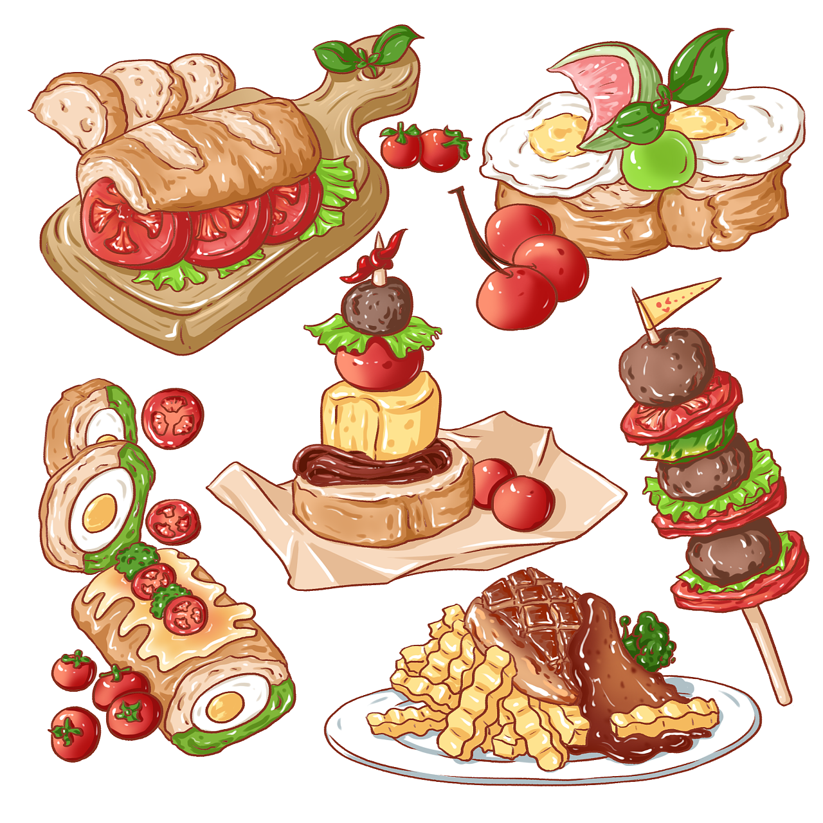
习作一 比较诙谐幽默的文风 与原文贴合度高一点
Para1: After school. I told my mom my plan.
Hearing my incredible ambition, she looked at me like I'd grown a second head. "What? A cooking competition? You want me to help? ” she exclaimed, eyes wide with horror. But after some begging and pleading with a bit of puppy-dog eyes, she caved. Iron-willed, we embarked on a crazy cooking adventure. We rushed to a nearby supermarket, looking for ingredients like treasure hunters. Though far from the best chef, Mom searched for recipes over a cooking app, racking her wits to guide me to cook meals with creativity added. It was no exaggeration to say that we had some epic fails too. But I insisted on experimenting with different ingredients every day, happily saying goodbye to Meatloaf Monday, Tuna Tuesdays and Spaghetti Saturdays. (124)

Slide 26
Para2: The day of the competition arrived, and the kitchen classroom was filled with activity. Contestants were running around like headless chickens and the noise was louder than a rock concert. When the judges announced the start, it was like a bomb went off. Pots and pans were flying everywhere, and it looked like a food fight was about to break out. Confident Tania, with cooking in her DNA, was showing off her genius. Me? I was sweating bullets but determined. After what seemed like centuries, dishes were created with the ingredients provided eventually. Then came the critical moment---it was time that the judges tasted our creations. When they announced the winner, I couldn't believe my ears! It was I who won the dream book of Cave of the Dragons. The unforgettable experience taught me a valuable lesson---It is not DNA but practice that makes perfect.

Slide 27
习作2
Paragraph 1: After school, I told my mom my plan. She seemed hesitant at first, probably worried about her limited cooking skills. But seeing my determination, she agreed to help. We surfed the Internet for unique recipes downloaded some popular cooking apps and spent numerous hours carefully selecting fresh ingredients in the nearby grocery store. Back home, we practiced different cooking techniques and experimented with various flavor combinations. Mom even shared some of her childhood cooking memories, which inspired me further. As the days passed, our kitchen was filled with delicious aromas and a sense of anticipation. I was nervous but excited, knowing that every practice session was bringing me closer to my goal. （104）

Slide 28
Para2: The day of the competition arrived, and the kitchen classroom was filled with activity. The air was electric with excitement and tension. Competitors were arranging their workstations, double-checking their ingredients. As the judges announced the start, everyone sprang into action. Tania, like a master chef at a five-star restaurant, handled everything with grace and confidence. Taking a deep breath, I concentrated on my own creation. I carefully measured the ingredients, remembering all the practice sessions and the tips my mom and I had learned. Time flying by, our dishes were presented to the judges. Never in my wildest dream had I imagined that I won the first place and got my dream award. It dawned on me that practice and innovation made my success. （110）

Slide 29
语料参考： 1. Guided patiently by mom, I continued to practice and made steady progress as the days rolled on. 2. I even pictured the crowd pointing and laughing because I ended up being the last in the competition, which urged me to work harder than before. 3. After several failed trials in the kitchen, I was totally in despair. However, mom cheered me up, saying that failure is the mother of success. 4. With butterflies in my stomach, I was waiting for the beginning of the game.

Slide 30
语料参考： 5. The atmosphere was thick with excitement, tension and anticipation. Everyone was eager to strut his stuff. 6. As soon as the competition kicked off, all contestants sprang into action, immersed in cooking their best dishes. 7. My creation stood out in the culinary contest and I was declared/ announced to be the first place! 8. In the end, my creation was awarded the first place because of its uniqueness and creativity.

Slide 31

比赛类的写作模板请参考笔者在溯恩发表的课件
2024年5月浙江省五校联盟读后续写
我的第一次舞台秀

