Slide 1



感恩遇见，相互成就，本课件资料仅供您个人参考、教学使用，严禁自行在网络传播，违者依知识产权法追究法律责任。
更多教学资源请关注
公众号：溯恩英语
知识产权声明

Slide 2
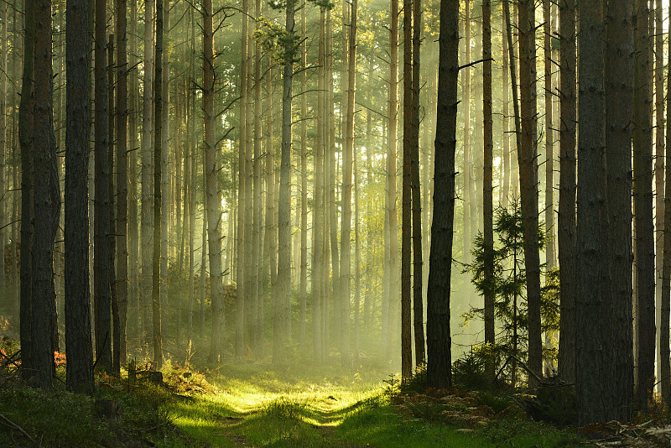

---2024-8 浙江七彩联盟
人与自然遇困篇
郑素红

Slide 3
读原文:
As the golden sun was sailing higher and higher in the east, casting its warm glow over the town, Emily, a keen photographer, started a solo journey to the famed Old Pine Scenic Area, well known for its centuries-old pine forests and winding paths. She anticipated a day filled with peaceful beauty and the opportunity to touch nature in its purest form.
Upon arrival, Emily was charmed by the quietness and splendidness of the overgrown pines that towered above, their branches whispering tales of old in the gentle morning breeze. With her camera in hand, she ventured deeper into the heart of the forest, each step further immersing her in the lively picture of greens and earthy browns.
The paths of Old Pine were many, weaving through the forest like threads of a vast, tangled (缠结的) web. Initially, Emily followed the marked trails, snapping photos of dew-kissed (带着露珠的)spider webs and squirrels dashing through the underbrush. However, as the morning turned into afternoon, she decided to stray from the beaten path to explore a more hidden area, rumored to house the eldest and most majestic pine in the reserve.
The deeper she wandered, the quieter the forest grew, except for the occasional rustle of leaves and distant birds. Focused intently on her photography, Emily scarcely noticed the shifting shadows and the subtle change in the forest. She then realized it was getting late but she had not yet found the eldest pine. And she had not only strayed off the path but was now thoroughly lost.
Panic fluttered in her chest. She attempted to backtrack, hoping to find familiar landmarks, but the forest seemed to have rearranged itself behind her. the trees stood pitiless, their trunks like silent guards that offered no guidance. With her phone's signal frustratingly absent in the thick forest, Emily felt a surge of helplessness.

Slide 4
The deeper she wandered, the quieter the forest grew, except for the occasional rustle of leaves and distant birds. Focused intently on her photography, Emily scarcely noticed the shifting shadows and the subtle change in the forest. She then realized it was getting late but she had not yet found the eldest pine. And she had not only strayed off the path but was now thoroughly lost.
Panic fluttered in her chest. She attempted to backtrack, hoping to find familiar landmarks, but the forest seemed to have rearranged itself behind her. The trees stood pitiless, their trunks like silent guards that offered no guidance. With her phone's signal frustratingly absent in the thick forest, Emily felt a surge of helplessness.
Para1: Emily remembered reading about the importance of staying calm when lost.
Para2: Nodding eagerly, Emily explained her situation to the local man.

Slide 5
Emily
a keen photographer brave bold
Analyze Characters
the local man
a kind and helpful stranger Emily encountered in the forest

Slide 6
Conflict : Emily was lost in the pine forest while looking for the oldest pine with her phone's signal frustratingly absent .
Analyze conflicts
Solution 1: Emily tried her own ways to help herself.
Solution 2: The local man helped her out of trouble.

Slide 7
Read for elements
characters： Emily the local man
2. narrative perspective: third-person ( she )
time： morning/ afternoon / late afternoon (sunset)
place： in the forest
Event : Emily’s being lost during her solo journey
through the pine forest

Slide 8

With her phone's signal frustratingly absent in the thick forest, Emily felt a surge of helplessness.
Climax
5.story line
She then realized it was getting late but she had not yet found the eldest pine. And she had not only strayed off the path but was now thoroughly lost.
Para1: Emily remembered reading about the importance of staying calm when lost.
As the morning turned into afternoon, she decided to stray from the beaten path to explore a more hidden area, rumored to house the eldest and most majestic pine in the reserve.
Para2: Nodding eagerly, Emily explained her situation to the local man.
she ventured deeper into the heart of the forest.
Emily started a solo journey to the famed Old Pine Scenic Area.
background
Ending
Beginning

Slide 9
Read for clues and echoes
hidden clues | echoes
As the golden sun was sailing higher and higher in the east, casting its warm glow over the town, Emily, a keen photographer, started a solo journey to the famed Old Pine Scenic Area, well known for its centuries-old pine forests and winding paths. She anticipated a day filled with peaceful beauty and the opportunity to touch nature in its purest form. | 1. The setting sun cast its weak glow through branches, which ignited a glimmer of hope. She resolved to follow the sun, confident that it would navigate her through the pine forest. 2. Hearing of Emily’s solo adventurous exploration in the forest, the local man thumbed up at Emily for her bravery and determination.

Slide 10
Read for clues and echoes
hidden clues | echoes
As the golden sun was sailing higher and higher in the east, casting its warm glow over the town, Emily, a keen photographer, started a solo journey to the famed Old Pine Scenic Area, well known for its centuries-old pine forests and winding paths. She anticipated a day filled with peaceful beauty and the opportunity to touch nature in its purest form. | 3. The day was infused with placid beauty , the chance to experience the purest nature and the beautiful mind of a total stranger.

Slide 11
Read for clues and echoes
hidden clues | echoes
The deeper she wandered, the quieter the forest grew, except for the occasional rustle of leaves and distant birds. Focused intently on her photography, Emily scarcely noticed the shifting shadows and the subtle change in the forest. She then realized it was getting late but she had not yet found the eldest pine. And she had not only strayed off the path but was now thoroughly lost. | 4. What Emily never expected was that he volunteered to guide Emily to the eldest pine. Upon arrival, Emily snapped photos of the most famed pine tree, her heart beating wildly with thrill.

Slide 12
Read for clues and echoes
hidden clues | echoes
Panic fluttered in her chest. She attempted to backtrack, hoping to find familiar landmarks, but the forest seemed to have rearranged itself behind her. The trees stood pitiless, their trunks like silent guards that offered no guidance. With her phone's signal frustratingly absent in the thick forest, Emily felt a surge of helplessness. | 5. “Don’t panic!” Emily thought to herself, with firmness in her eyes.

Slide 13
心理描写
神态描写
动作描写
外貌描写
环境描写
对话描写
语言
无灵主语
动作链
分词作状语
With 复合结构
独立主格
从句
倒装句
虚拟语气
强调句
长短句结合
考生构思情节的同时，要考虑合适的语言句式以及修辞

Slide 14
Plot the continuation story
Para1: Emily remembered reading about the importance of staying calm when lost.
Para2: Nodding eagerly, Emily explained her situation to
the local man.
.
Link1: What did she say to calm down?
Body: What did Emily do then to help herself? How did Emily feel when she found some helpful signs around her?
Link2: Whom did she come across? What did the man say to her?
Link3: How did the local man react to Emily’s explanation?
Body: What did he do ? What was the result? How did Emily feel? And what did she do?
Theme: What lesson did the experience demonstrate?

Slide 15
Design link1
Panic fluttered in her chest. She attempted to backtrack, hoping to find familiar landmarks, but the forest seemed to have rearranged itself behind her. The trees stood pitiless, their trunks like silent guards that offered no guidance. With her phone's signal frustratingly absent in the thick forest, Emily felt a surge of helplessness.
Para1: Emily remembered reading about the importance of staying calm when lost.
Link1A: “Don’t panic!” Emily thought to herself, with firmness in her eyes. Taking a deep breath, she looked around, trying to orient herself in the forest maze.

Slide 16
Design link1
Panic fluttered in her chest. She attempted to backtrack, hoping to find familiar landmarks, but the forest seemed to have rearranged itself behind her. The trees stood pitiless, their trunks like silent guards that offered no guidance. With her phone's signal frustratingly absent in the thick forest, Emily felt a surge of helplessness.
Para1: Emily remembered reading about the importance of staying calm when lost.
Link1B: Recalling adventurous stories that she had read before, she came up with a good idea. Closing her eyes, she took a deep breath, listening attentively for the sound of running water, which meant a stream leading her out of trouble.

Slide 17
Design link2
Para1: Emily remembered reading about the importance of staying calm when lost.
Para2: Nodding eagerly, Emily explained her situation to the local man.
Link2 A: After what seemed like centuries, a local man approached her and asked if she was lost, with a concerned look on his face.

Slide 18
Design link2
Para1: Emily remembered reading about the importance of staying calm when lost.
Para2: Nodding eagerly, Emily explained her situation to the local man.
Link2 B: After what seemed like centuries, a local man turned up and asked if she needed some help , with a concerned look on his face.

Slide 19
Design link3
Para2: Nodding eagerly, Emily explained her situation to the local man.
Link3A： Hearing of Emily’s solo adventurous exploration in the forest, the local man thumbed up at Emily for her bravery and determination.

Slide 20
Design link3
Para2: Nodding eagerly, Emily explained her situation to the local man.
Link3B: A big smile blossoming across his face, he reassured Emily gently, “Don’t worry. I’ll help you get out of here. ”

Slide 21
Design ending
Para2: Nodding eagerly, Emily explained her situation to the local man.
Ending A: （----回扣原文第一段Emily 的期待）
The day was filled with peaceful beauty, the chance to experience nature in its purest form and an unexpected dilemma, which were all recorded in her camera and turned into vivid memories.

Slide 22
Design ending
Para2: Nodding eagerly, Emily explained her situation to the local man.
Ending B: （回扣原文第一段最后一句）
That day was infused with the peaceful beauty of nature and an unexpected encounter with a beautiful mind of a total stranger. That was one of the most wonderful days in Emily’s life.

Slide 23
Design ending
Para2: Nodding eagerly, Emily explained her situation to the local man.
Ending C: （所有的经历最终会成为美好的回忆）
The beauty of the centuries-old pine forest and the golden heart of that stranger were engraved in Emily’s memory permanently.

Slide 24

Para1: Emily remembered reading about the importance of staying calm when lost. “Don’t panic!” Emily thought to herself, with firmness in her eyes. Taking a deep breath, she looked around, trying to orient herself in the forest maze. The setting sun cast its weak glow through branches, which ignited a glimmer of hope. She resolved to follow the sun, confident that it would navigate her through the pine forest. As she was walking among the centuries-old pine trees, a figure in the distance came into her sight. Overwhelmed with an enormous sense of excitement, Emily yelled for help at the top of her lungs. After what seemed like centuries, a local man turned up and asked if she was lost, with a concerned look on his face. (114)

Slide 25

Para2: Nodding eagerly, Emily explained her situation to the local man. Hearing of Emily’s solo adventurous exploration in the forest, the local man thumbed up at Emily for her bravery and determination. What Emily never expected was that he volunteered to guide Emily to the eldest pine. Upon arrival, Emily snapped photos of the most famed pine tree, her heart beating wildly with thrill. In the sunset-bathed forest, the local man introduced diverse plants and animals to Emily. Night fell and Emily found her way back home, led by the warm-hearted local man. The day was filled with peaceful beauty, the chance to experience nature in its purest form and an unexpected dilemma, which were all recorded in her camera and turned into vivid memories. (113)

Slide 26
Para2 Version 2
Para2: Nodding eagerly, Emily explained her situation to the local man. A big smile blossoming across his face, he reassured Emily gently, “Don’t worry. I’ll help you get out of here. ” Apparently, the local man knew the forest quite well and was familiar with the circumstances. As he led the way ahead of Emily, he shared with Emily legends and myths about diverse plants and animals in the forest. Emily was grateful for his generous help and rich knowledge. Time ticking by, Emily eventually returned to the familiar beaten path. Emily conveyed her cordial gratitude to the forest angel before saying goodbye. The beauty of the centuries-old pine forest and the golden heart of that stranger were engraved in Emily’s memory permanently. (110)

Slide 27
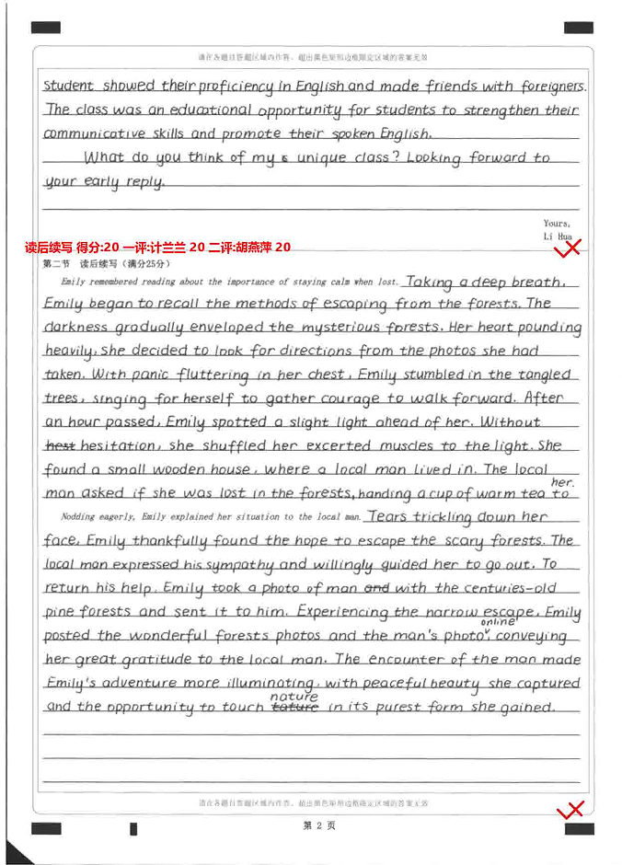
双评均为20分
卷面清楚字迹美观颜值高
3处衔接非常自然贴切，语言丰富；表达流畅
结尾与原文第一段尾句呼应，浑然一体。确为不可多得的佳作。

Slide 28
人与自然的高考真题汇总：
1. 2017年6月 阿拉斯加与狼骑行
2. 2018年6月 骑马遇兔迷路森林 （与本文类似）
3. 2020年1月 波比的小狗
4. 2020年7月 不速之客北极熊
5. 2023年1月 人鸟情未了

Slide 29
人与自然的高考真题汇总：
总体分为两大类：
人与动物类：①人与动物和谐相处②人与动物互救互助（脱困类）
人与自然类：①人在自然中美好的体验②人在自然中遇困自主脱困或被动脱困（通常有好心人或专业救援人员及时救助）

