Slide 1


感恩遇见，相互成就，本课件资料仅供您个人参考、教学使用，严禁自行在网络传播，违者依知识产权法追究法律责任。
更多教学资源请关注
公众号：溯恩英语
知识产权声明

Slide 2
2024年8月
强基联盟高三试题讲评
浙江省海亮实验中学 陈虹

Slide 3

题型概况
01

Slide 4
题型 | 话题 | 体裁 | 词数
阅读A | 人与社会:An introduction of the Natural Center | 应用文 | 247
阅读B | 人与社会:Stroke survivor finds joy, purpose in wheelchair basketball. | 记叙文 | 405
阅读C | 人与自然：Rising AC use isolates us from nature and community. | 议论文 | 362
阅读D | 人与自然 Study uncovers genes behind chickadees' spatial memory. | 说明文 | 379
七选五 | 人与自我 Coping strategies for life's overwhelming feelings. | 说明文 | 252
完型填空 | 人与社会 Realization of an old man's Space Dream | 记叙文 | 328
语法填空 | 人与社会 Innovative erhu concert defies traditional Chinese music norms | 新闻报道 | 298
单击此处添加文本

Slide 5
阅读理解
02

Slide 6
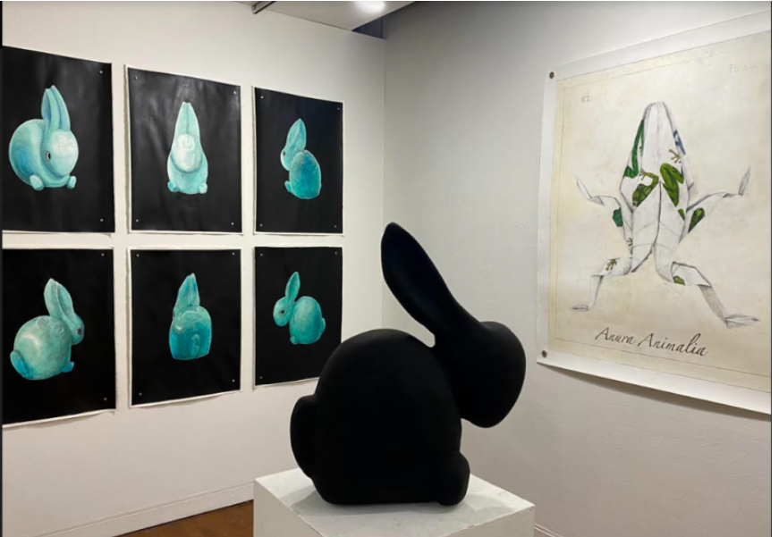
A 篇
An introduction of the Natural Center
本文是the Natural Center这个艺术展览的相关介绍。阐述了这个展览的理念、作者的创作目的，以及展中比较特别的作品。

Slide 7
A 篇
展览目的
21.what does Aaron Delehanty intend to do through The Natural center?
A. To praise humans as animals.
B. To challenge the natural world.
C. To integrate mankind into nature.
D. To systemize the human world.
细节理解题
第二段：Artist Aaron Delehanty explores questions such as these through his work The Natural center.
reconcile...with...与...一致；与...和解
第一段最后一句： How do we reconcile (使和谐一致) our idea of humanity with our idea of nature, as we are animals ourselves?

Slide 8
细节理解题
22. what can you do in the exhibit?
A. Make unique sculptures. B. Admire fascinating artworks.
C. Enjoy comfortable music. D. observe various living creatures.
第三段：Each one of the mixed media paintings and sculptures intertwines (交织) themes of nature and humanity, ....
第四段：... is the watercolor series...; The exhibit also houses four sculpted cranes,....

Slide 9
23. In which section of the magazine may the text appear?
A. Gardening. B. Health. C. wildlife. D. Art.
推理判断题
根据文章内容可知，是一个艺术展览的介绍，所以应该放在“艺术”板块。
Tips:对文章出处的考查，通常需要注意以下几点：
文章内容与板块特点的匹配：不同板块的文章有其特定的内容和语言风格。
文章的语言和结构特点：注意文章使用的特定术语、语言风格以及结构布局，这些特点可以为判断文章可能的板块提供线索。
作者的背景和观点：作者的专业背景和在文章中表达的观点，可能暗示了文章更可能出现在杂志的哪个板块。
注意文章的开头和结尾：开头可能会设定文章的基调和目的，而结尾可能会有总结或号召性的语言，有助于判断文章的板块。
注意文章的时效性和目的性：时效性强的文章可能来自新闻板块，而目的性明确的文章可能来自特写或评论板块。
利用文章中的插图和图表：这些视觉元素有时也能提供关于文章板块的线索。

Slide 10
语料积累
描述人与自然关系的语料
Often, we don’t imagine humans as a part of the natural landscape, instead viewing ourselves and our creations as separate and distinct from the organic world around us.
通常，我们不会把人类想象成自然景观的一部分，而是把我们自己和我们的创造物视为与我们周围的有机世界截然不同的东西。
后缀 "-ize" 通常用于将名词或形容词转化为动词，表示“使成为...”或“使...化”的动作。如："realize"（实现）和 "modernize"（使现代化）
单词积累
systemize vt 使...分类；使...系统化
unnaturalness n 违反常态；非自然性
prominently adv 显著地
imagery n 一组图片；意象，形象化描述

Slide 11
长难句分析
Each one of the mixed media paintings and sculptures intertwines (交织) themes of nature and humanity, exploring feelings of unnaturalness or discomfort in the spaces where they meet.
定语
主语
谓语
宾语
定语
（
）
（
定语
定语
定语从句
）
每一件混合媒介的绘画和雕塑作品都交织着自然和人类的主题，探索它们相遇时产生的不自然或不适的感觉。

Slide 12

B 篇
Stroke survivor finds joy, purpose in wheelchair basketball
本文通过第一人称的视角，讲述了罗斯·金（Rose Chin）在经历中风和部分瘫痪后，如何克服困难，通过参与轮椅篮球队重拾自信和独立性的故事。

Slide 13
24.Why did Chin try out for the wheelchair basketball team?
A. she was passionate about the sports.
B. she was inspired by a social worker.
C. she gained the support from the team.
D. she wanted to test the effect of therapy.
推理判断题
第二段： she started to glimpse a future for herself. .... her social worker suggested she should try a sport.“ she mentioned the wheelchair basketball team and I decided to give it a try ,...

Slide 14
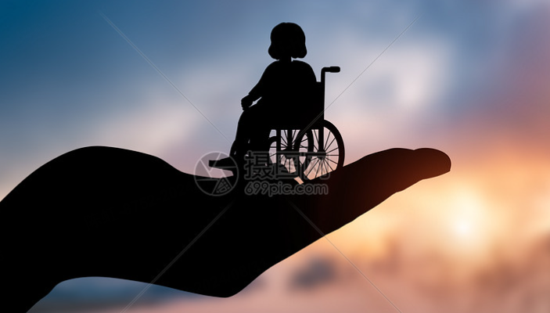
推理判断题
25. What did Chin experience during the first two attempts?
A. A mental struggle. B. A frustrating rejection.
C. A warm welcome. D. A hard training session.
第三段：“ I looked through the window and just thought :‘I can’t do this , ’”she says. “ The third time ,

Slide 15
知识补充：全球常用通讯应用程序
WhatsApp：全球最流行的即时通讯工具
Telegram：注重隐私保护的即时通讯应用
WeChat (微信)：在中国非常流行的通讯应用
Facebook Messenger：与Facebook社交网络紧密结合的通讯应用
Skype：由微软开发的通讯工具，支持高质量的视频通话和语音通话
Viber：支持公众账号和贴纸
Line：在日本和亚洲其他地区流行的通讯应用
Signal：以安全性著称的通讯应用，提供端到端加密的消息和通话功能
Slack：专为团队协作设计的通讯工具
KakaoTalk：在韩国流行的通讯应用
26. What does chin think of the team?
A. It relieves her aging anxiety. B. It feels like a happy family.
c. It has brilliant basketball players. D. It helps her enjoy some jokes.
推理判断题
第四段：...“ we very quickly became a little family with a WhatsApp group full of jokes , ”she laughs...

Slide 16
推理判断题
27. which of the following can best describe chin?
A. Modest and cheerful. B. Talented and creative.
C. Confident and honest. D. Independent and kind.
Tips:近五年高考英语中，询问人物性格时用到的形容词：
Optimistic（乐观的） Independent（独立的） Active（活跃的）
Able（能干的） Adaptable（适应性强的） Aggressive（好斗的）
Ambitious（有雄心壮志的） Analytical（善于分析的）
Aspiring（有志气的） Capable（有能力的） Competent（能胜任的）
Cooperative（有合作精神的） Creative（富有创造力的）
Dedicated（有奉献精神的） Dependable（可靠的）
independent
kind
最后一段： I feel so independent... I want us to raise more money to get more equipment so we can encourage others to join. ...

Slide 17

佳句欣赏
She started to glimpse a future for herself.
glimpse: n/v 短暂的一瞥或隐约的看见，通常用来描述用来描述对各种事物的短暂或不完整的视觉体验、初步理解。
在本句中，它表达了她开始看到了自己未来的可能，尽管可能还不是很清晰或具体。这句话传达了一种乐观的情绪，意味着她对未来有了一定的期待和希望。

Slide 18
语料积累
身体状况相关的语料
paralyse vt 使...瘫痪 stroke n 中风
其他语料
enlist v (使)参军；争取；支持；招募
Age doesn't come into it.
年龄不是一个考虑的因素或者不相关。

Slide 19
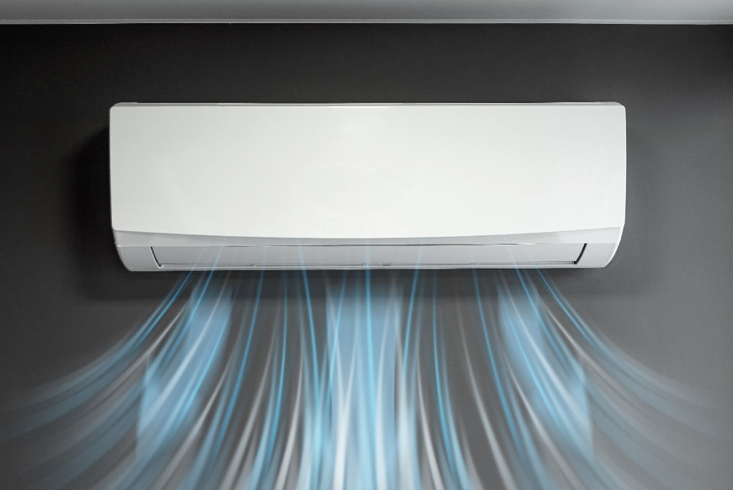
C 篇
Rising AC use isolates us from nature and community.
本文讨论了空调使用在过去30年中的爆炸性增长，以及这种增长对美国社会和个人生活方式的影响。

Slide 20
Air conditioning use has exploded in the last 30years. According to U. S. Census data in 1993, just about three-quarters of single family homes in the Midwest had air conditioning. In the west and Northeast , it was just about half. Now , all regions are pushing 100percent air conditioning coverage. In the south , it’s been at about 100percent since the early 1990s.
As the cost of air conditioning installation has gone down , and temperatures have gone up , Americans have been offered an opportunity for a steady indoor temperature year-round , regardless of the weather outside. This drive for comfort forces us to disconnect from what’s happening all around us. A conditioned climate allows us to completely ignore the changing seasons and our warming planet. Only listening to people who agree with us-or trying to silence those who disagree-creates our own , individually conditioned realities.
New York University professor and social psychologist Jonathan Haidt showed how the comforts of conveniences“atomize”our social structures. Each new technology that makes our lives easier also makes us less reliant on other people. Haidt’s big focus is on smartphones and social media , as explored in his recent book , but our society was cracking off into smaller and smaller pieces long before we had the robots in our pockets.
Cars allowed us to shop in other towns , reducing reliance on local businesses. A television set gave something for people to do in the evenings , reducing the need to hang out with neighbors , and by extension , eroding community structures and institutions ( often called “ third places , ”in contrast to work and home) . Air conditioning allowed us to stay inside in the heat , limiting a play-based childhood where kids run around with each other and make their own fun.
What if we all turned off the air conditioning for a bit , opened our windows , and truly experienced life as it was happening , not what we manufactured it to be? we might be a little less comfortable , but maybe a little more connected.
背景信息
论点
论
据
反思与建议

Slide 21
推理判断题
28. what can we infer from the first two paragraphs?
A. Air conditioning easily shapes our individual personality.
B. Air conditioned houses are more comfortable than others.
C. Air conditioning can reduce our connection with the world.
D. Air conditioning is accessible to every household in the Us
从文章结构可知，前两段是在阐述文章的论点，因此本题实质是在询问论点。第二段： This drive for comfort forces us to disconnect from what’s happening all around us.

Slide 22
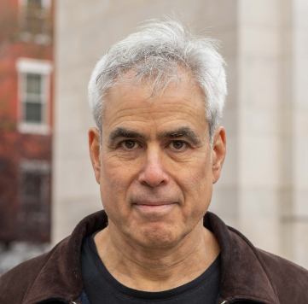
29. Why does the author mention Haidt?
A. To promote his recent book.
B. To illustrate technological advances.
C. To praise human self-reliance.
D. To reveal the harm of air conditioning.
推理判断题
知识补充： Jonathan Haidt
Jonathan Haidt is a social psychologist at New York University’s Stern School of Business（斯特恩商学院）.
Haidt’s research examines the intuitive（直觉） foundations of morality（道德）, and how morality varies across cultural and political divisions（分歧）.
从文章结构可知，第三段引用Haidt的观点是作为论据证明文章的观点---“Air conditioning”的坏处.

Slide 23
30. What does the word“eroding”underlined in paragraph 4 refer to?
A. Constructing. B. Destroying. C. Avoiding. D. Improving.
第四段：从Cars allowed us ..., reducing .... A television set gave ...., reducing ....,可知，“eroding”也是负面含义
词义猜测题
31. Which of the following is the best title for the text?
A. Turn off Air conditioning for a Bit
B. Experience your Life to the Fullest
C. Keep Away from Air conditioned Houses
D. Never create our own conditioned Realities
主旨大意题
议论文的标题通常是关于明确的主题或者反映论点。本文的论点是AC对人类的坏处，呼吁人们要减少对AC的使用。

Slide 24
长难句分析
Air conditioning allowed us to stay inside in the heat , limiting a play-based childhood where kids run around with each other and make their own fun.
（
）
主语
谓语
直接宾语
间接宾语
地点状语
（
结果状语
定语从句
）
空调让我们在炎热的天气里待在室内，限制了孩子们互相追逐并自娱自乐的玩耍的童年。

Slide 25
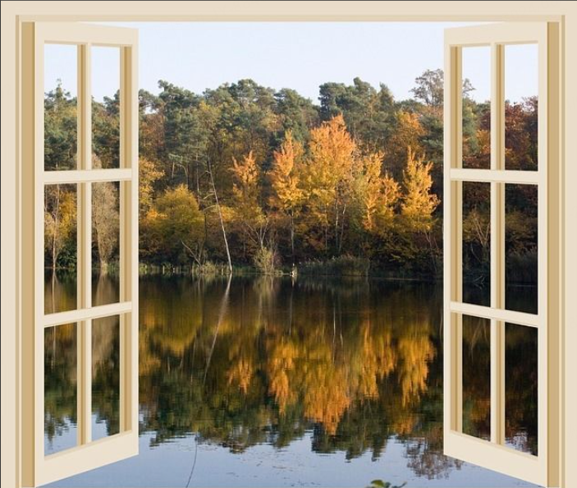
语料积累
explode v 爆炸
installation n 安装
drive n 驱动力
reliant adj 依赖的；依靠的
crack off 断裂；折断
by extension 引申开来
manufacture v 生产，制造

Slide 26
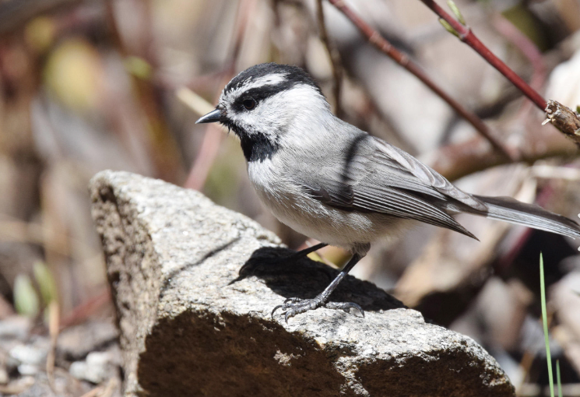
D 篇
Study uncovers genes behind chickadees' spatial memory.
这篇报道介绍了关于山雀空间记忆能力的研究。

Slide 27
Mountain chickadees (山雀) have some of the strongest spacial memories in the animal kingdom. New research reveals the genes involved and sheds light on how a changing climate may influence the evolution of this particular skill.
In a new study , researchers at the University of colorado Boulder and the University of Nevada , Reno identify nearly a hundred genes associated with the birds’spacial memory , or ability to recall the locations of objects. The paper also suggests a potential balance may exist between having a solid long-term memory and being able to quickly remove old memories to form new ones.
Taylor , the director of 、CU Boulder ’s Mountain Research station and his associates at the University of Nevada , Reno, lead by biologist professor vladimir pravosudov , designed a novel technique to assess the spacial memory of wild mountain chickadees. They hung various feeder groups in California’s sierra Nevada mountains , each with eight seed-filled bird feeders. Each feeder has a gate equipped with a radio frequency reader capable of detecting a tag placed on chickadees by researchers. The scientists then configured (设定) each gate to only open to specific birds , forcing the chickadees to remember which feeders would open to them. Pravosudov and his team then counted how many times each chickadee landed on the wrong feeders before they recalled the right one.
Using blood samples , the CU Boulder team sequenced (测定序列) the whole genome of 162 tagged chickadees , resulting in the largest dataset ever collected for examining the genetic basis of chickadee cognitive ability. The team discovered 97genes involved in chickadee spacial learning and memory by comparing the birds’ genomes to their performance on the feeder test.
The findings could help biologists better understand the evolution of spacial memory in animals , including humans.“ Chickadees are impressive birds , ”said scott Taylor.“ They can remember tens of thousands of locations where they store food across an entire winter and a new set of those the next winter. Their spacial memory is much more developed than many other birds that don’t have to have this strategy to survive cold winters. ”
研究背景
研究团队和方法
实验过程
研究结果
研究意义

Slide 28
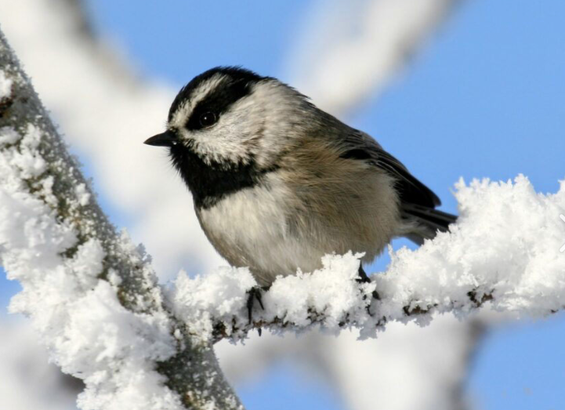
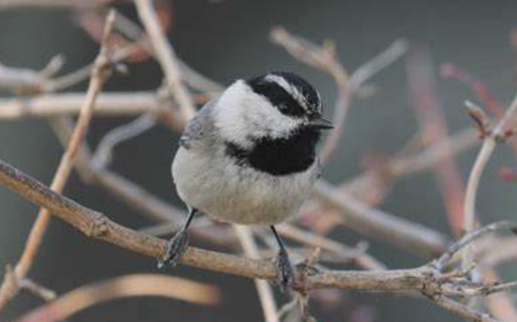
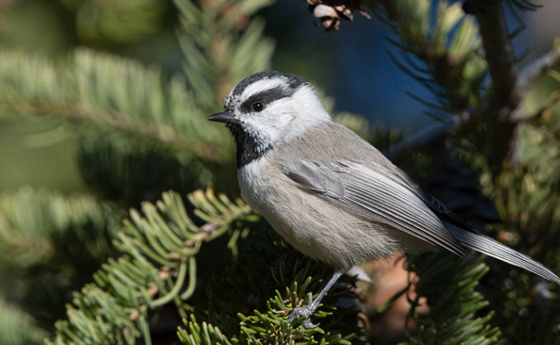
32. What do we know about mountain chickadees’ spacial memories?
A. They are linked with a hundred relevant genes.
B. They maintain a good balance in locating objects.
C. They are considered powerful in the animal world.
D. They might account for the slow change of climate.
细节理解题
本题是对山雀空间记忆能力地位的提问，可知属于研究背景部分，根据文章结构，定位第一段： Mountain chickadees (山雀) have some of the strongest spacial memories in the animal kingdom.

Slide 29
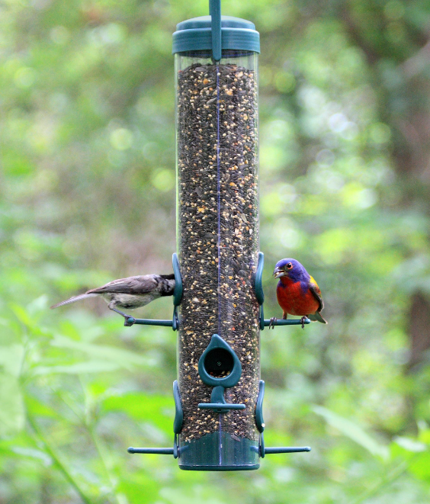
细节理解题
33. What can a radio frequency reader do in the test?
A. Lower the error rate of the chickadees.
B. Count the times each chickadee failed.
C. Collect the food information of a feeder.
D. Identify the chickadee landing on a feeder.
“a radio frequency reader ”是研究过程中利用的工具，定位第三段：... a radio frequency reader capable of detecting a tag placed on chickadees by researchers... and his team then counted how many times each chickadee landed on the wrong feeders before they recalled the right one.

Slide 30
34. What does paragraph 4 focus on about the study?
A. Blood sampling. B. Genes involved.
C. Ability comparing. D. Data gathered.
主旨大意题
从文章结构可知，第四段是研究的结果：...the CU Boulder team sequenced (测定序列) the whole genome of 162 tagged chickadees,he team discovered 97 genes involved in...
35. What does Scott Taylor imply in the last paragraph?
A. Chickadees possess amazing evolutionary capability.
B. Many other birds should improve their spacial memory.
C. Food storage is vital to the survival of animals in winter.
D. Chickadees’ spacial memory carries them through winter.
推理判断题
最后一段： “Their spacial memory is much more developed than many other birds that don , t have to have this strategy to survive cold winters.”暗示空间记忆能力帮助山雀度过寒冬。

Slide 31
长难句分析
Using blood samples , the CU Boulder team sequenced the whole genome of 162 tagged chickadees , resulting in the largest dataset ever collected for examining the genetic basis of chickadee cognitive ability.
主语
谓语
（
）
宾语
（
结果状语
目的状语
）
研究团队使用了血液样本，对162只被标记的山雀进行了全基因组测序，这一工作产生了有史以来最大的数据集，用于研究山雀认知能力的遗传基础。

Slide 32
语料积累
与生物学相关的语料
spatial memory 空间记忆 genes n 基因
evolution n 进化 cognitive ability 认知能力
genome n 基因组 animal kingdom 动物界
long-term memory 长期记忆
seed-filled bird feeders 装有种子的鸟食器
frequency reader 频率读取器
其他语料
new research（新研究） long-term memory（长期记忆）
tags（标签） novel technique（新技术）
account for 解释，说明；占比，占据

Slide 33

七选五
Coping strategies for life's overwhelming feelings.
本文提供了一些有效的应对方法，帮助人们处理生活中的压抑、挫败或缺乏兴趣等情绪，并重新掌控自己的生活。

Slide 34
Do you feel overwhelmed, frustrated, or uninterested in life lately? 36 There are some effective ways to deal with these feelings and regain control over your life.
解析：该句的位置在说明文的第一段，是在引出话题，上文以问题的方式陈述现象，后文是解决这些现象的方法，所以B项承上启下,“you do”指上文的感觉，“you’are not alone”承接下文大家适用的方法
A. Do things that make you feel good.
B. If you do, know that you’re not alone.
C. Acknowledge and accept your feelings.
D. Allow yourself to think and process without judgment.
E. They can help you identify your feelings and the causes of them.
F. When you’re lost , it’s normal to lean into these unhealthy routines.
G. So, identify your top priorities and focus your time and energy on them.

Slide 35
37
If you’ re feeling lost, the first step to regaining direction is to admit your feelings to yourself. Remind yourself that it’s perfectly normal to feel disappointed, or unfulfilled sometimes-everybody does at some point! These feelings are natural reactions to overwhelming events or changes.
解析：本题考查小标题。是对整段的总结。从“admit...”可知要“承认自己的感觉，与C项中“acknowledge...your feelings”同一含义。从“remind...it’s ...normal to feel ...”,与C项中“accept your feelings”同一含义。
A. Do things that make you feel good.
B. If you do, know that you’re not alone.
C. Acknowledge and accept your feelings.
D. Allow yourself to think and process without judgment.
E. They can help you identify your feelings and the causes of them.
F. When you’re lost , it’s normal to lean into these unhealthy routines.
G. So, identify your top priorities and focus your time and energy on them.

Slide 36
Ask yourself why you’re feeling lost.
You don’t have to unearth the answer right away. Just ask yourself introspective (内省 的) questions while journaling or meditating to turn your attention inward. 38 The journey to find your way again is highly personal and there are no right or wrong feelings to have!
解析：承上启下。根据小标题可知本段的策略是要自己思考。从上文的自省方法，再联系下文 ，把过程比作旅行.与D项中的“think and process”意思一致。
A. Do things that make you feel good.
B. If you do, know that you’re not alone.
C. Acknowledge and accept your feelings.
D. Allow yourself to think and process without judgment.
E. They can help you identify your feelings and the causes of them.
F. When you’re lost , it’s normal to lean into these unhealthy routines.
G. So, identify your top priorities and focus your time and energy on them.

Slide 37
Replace negative behavior or habits with healthier routines.
Do you have any less-than-helpful habits that weigh you down, like endlessly scrolling through social media or snapping at loved ones when you’re stressed? 39 Instead, swap these habits with new, positive ones.
E. They can help you identify your feelings and the causes of them.
F. When you’re lost , it’s normal to lean into these unhealthy routines.
G. So, identify your top priorities and focus your time and energy on them.
解析：承上启下。上文都是不好的行为，下文“Instead”可知本句意思是养成这些坏习惯，故F项“陷入这些不健康的日常是正常的”是正确选项。

Slide 38
Work with a mental health professional if you’re stuck.
It’s normal to need outside guidance to find your way in life again. If you find yourself at a loss for what to do next or aren’t sure how to cope with your feelings, see a therapist or counselor. 40 Additionally, they can show you how to make meaningful changes in your life to make you happier, healthier, and more enthusiastic about the future.
解析：E项中的“they”就代表前文的“a therapist or counselor”。后文中的“Additionally, they can show you ...”可知本句也是“they”的作用。
E. They can help you identify your feelings and the causes of them.
F. When you’re lost , it’s normal to lean into these unhealthy routines.
G. So, identify your top priorities and focus your time and energy on them.

Slide 39
长难句分析
Do you have any less-than-helpful habits that weigh you down, like endlessly scrolling through social media or snapping at loved ones when you’re stressed?
（
）
主语
谓语
宾语
定语从句
插入语
你是否有一些使你感到负担的不太有帮助的习惯，比如在压力大时无休止地刷社交媒体或对亲人发脾气？

Slide 40
小知识： 单词 "overwhelm" 由几个部分组成，其中包括词根和词缀：
词根 "whelm" 来自古英语 "wealman" 或 "whelm"，意味着“淹没”或“翻船”。这个词根与水和淹没的概念有关。前缀 "over-" 在这里表示“超过”或“过于”，它加强了词根的意义，表示某种程度的超越或压倒性。
将这两部分结合起来，“overwhelm” 这个单词的字面意思是“淹没或压倒”，在现代英语中，它通常用来描述某人或某事因为情感、工作量或其他压力而感到不知所措或无法应对的状态。
语料积累
与心理相关的语料
overwhelmed adj 不知所措的
overwhelming adj 压倒性的；难以抗拒的
meditate vi 冥想；沉思
weigh sb down 压垮某人
其他语料
scroll through 滚动浏览
snap at 追咬；对...发火
acknowledge 承认 lean into 全力投入

Slide 41
完形填空
03

Slide 42
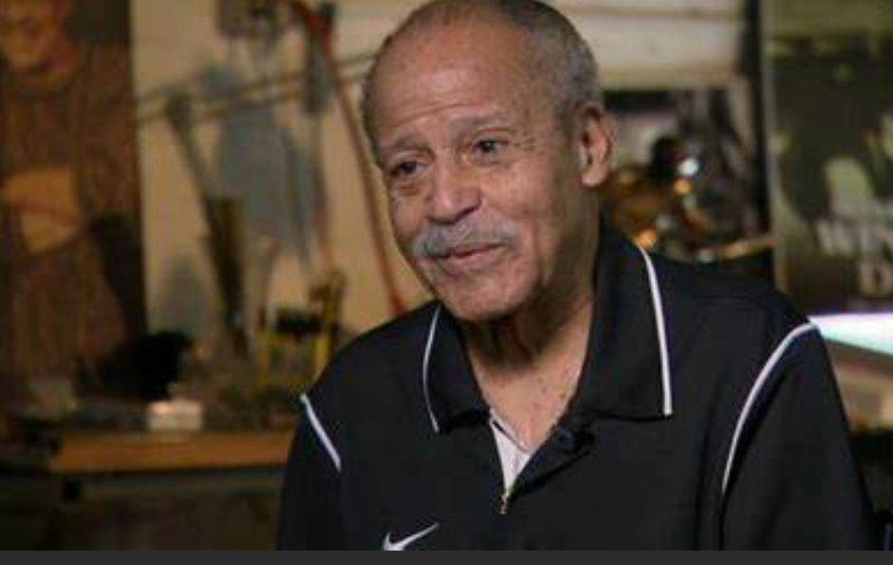
Realization of an old man's Space Dream
文章讲述了90岁的Edward J. Dwight Jr. 即将实现他的太空梦想，他将成为年龄最大的太空旅行者。文章还提到了太空飞行对老年人健康的潜在影响，以及专家对飞行安全性的评估。

Slide 43
Edward J. Dwight Jr. has waited a long time for his ride into space. In the 1960s , he seemed ready to become America ’s first Black 41 . That dream was never realized. Now , at age 90, he’s about to finally get his 42 , aboard a Blue origin rocket.“ They called me up and asked me if I was 43 . And of course I said yes , ”Dwight says.
While Dwight won’t be the first African American in space-that 44 went to Guion Bluford Jr. in 1983-he will be the oldest person to go there , 45 star Trek actor william shatner , who flew aboard a Blue origin rocket in 2021. For many his age , a journey into space would seem 46 . Dwight says he’s ready to go. He points out that the difficulties of his upcoming 47 won’t be much different from what he 48 as a test pilot in the Air Force.“ I’ve pulled more G’s than any person on Earth , ”he 49 it with a bitter smile.
小知识： get one’s shot 得到这个机会
这个短语起源于体育领域，如篮球或足球，其中 "shot" 指的是尝试得分的机会。随着时间的推移，这个短语被广泛应用于更广泛的情境，包括尝试新事物、抓住机会或面对挑战。
在不同的语境中，"get one's shot" 可以有不同的含义，但核心思想是利用你得到的机会，不管结果如何。这个短语的流行可能也受到了流行文化的影响，比如歌曲、电影和电视节目中的使用，使其成为了日常英语中的一个常见表达。
小知识： "edge out" 是一个常用的英语短语，用来描述某人或某物在竞争中以微弱的优势胜过其他人或事物。这个短语暗示胜利并非轻易获得，而是需要努力和决心。它通常用于体育比赛、商业竞争或任何形式的较量中，表示以微弱差距或在最后时刻超越对手。
41. A. student B. astronaut C. customer D. expert
42. A. name B. shot C. money D. job
43. A. convinced B. excited C. interested D. confused
44. A. honor B. wonder C. account D. prize
45. A. paying back B. edging out C. running after D. laughing at
46. A. unthinkable B. possible C. essential D. invaluable
47. A. risk B. test C. flight D. training
48. A. imagined B. researched C. experienced D. dreamed
49. A. realizes B. puts C. doubts D. shows
He put it like that:引用某人原话或转述某人说法的方式

Slide 44
Space health expert Dorit Donoviel says the 11-minute flight means many of the 50 about the long-term effects of deep-space missions won’t come into play.“ The main thing we worry about is the G forces , ”says Donoviel. 51 , she points out that the seats are 52 at 20 or 30 degrees. “ As you’re experiencing the G-forces , you’re getting it through the 53 , which is not affecting your head , ”Donoviel says.“ It’s distributed through the chest , which really shouldn’t 54 very much. ”
And then there’s the landing. “ It’s not even a controlled crash. It’s a crash , ”Donoviel says. Still , she 55 no issues.
be concerned about 对...感到担心
be concerned with 与...有关
concerning prep 关于，涉及
50. A. benefits B. solutions C. regulations D. concerns
51. A. Eventually B. Consequently C. somehow D. However
52. A. reserved B. produced C. angled D. exchanged
53. A. seat B. chest C. door D. foot
54. A. work B. matter C. speed D. fail
55. A. promises B. encounters C. remembers D. discusses

Slide 45
长难句分析
He points out that the difficulties of his upcoming flight won’t be much different from what he experienced as a test pilot in the Air Force.
主语
谓语
主语
宾语从句
谓语
（
）
表语
宾语从句
他指出，他即将进行的飞行所面临的困难，与他作为空军试飞员时所经历的相比，不会有很大的不同。

Slide 46
语料积累
astronaut n 宇航员 African American 非裔美国人
test pilot n 试飞员 Air Force n 空军
G-forces n 重力加速度 distributed v 分布
long-term effects n 长期影响 deep-space missions 深空任务
angle v 倾斜 aerospace n 航空航天
get one’s shot 得到这个机会
edge out 取代
encounter vt 偶遇

Slide 47
语法填空
03

Slide 48
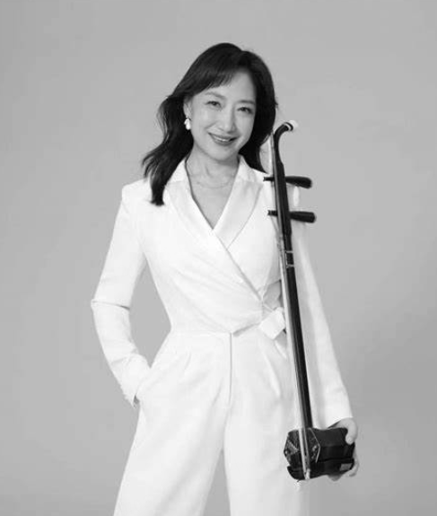
Innovative erhu concert defies traditional Chinese music norms.
这篇文章介绍了二胡演奏家姜建华在北京国家中心举办的一场创新音乐会。这场融合了古典和西方音乐元素的音乐会，是蒋建华致力于在全球推广二胡艺术的体现，旨在为观众带来难忘的音乐体验。

Slide 49
Erhu virtuoso Jiang Jianhua will offer 56 unique concert at Beijing’s National centre. This will challenge how people 57 (traditional) think about chinese music. Jiang will collaborate with a pipa player , a jazz pianist , and a cellist to present the erhu differently , 58 ( show) it can be versatile beyond solo acts.
Jiang , 59 (retire) from the central conservatory of Music , arranges music that emphasizes the erhu’s emotional range and cultural importance. The program 60 (include) adaptations of classical chinese music and western compositions.
a
56. 冠词
首字母是元音，但不定冠词却只能用“a”,为什么？
有些单词虽然以元音字母开头，但发音却是以辅音音素开头，因此前面会使用 "a"。这种情况通常是因为单词的首字母不发音或者发音为一个辅音音素。
例：a European（"E" 在这里不发音， "u" 发音为 /ˈjʊə/，其中的 /j/ 是一个辅音音素）
a one-piece swimsuit - "one" 通常以 "an" 开头，但当 "one" 用作数字 "1" 的时候，发音为 /wʌn/，以辅音音素 /w/ 开头
traditionally
57. 词性转换
强调状态,要用sb is retired. 故和逻辑主语Jiang之间是被动的关系
showing
58. 非谓语动词
retired
59. 非谓语动词
includes
60. 谓语动词

Slide 50
This fusion concert is a testament to Jiang’s lifelong dedication to innovating and promoting the erhu 61 the global stage. Her artistic vision , 62 respects the erhu’s history , is shared by other performers. They too see the value in maintaining chinese musical traditions while adopting modern styles.
The concert promises to be a(n) 63 (forget) experience , where the audience can expect an emotional journey through the evocative sounds of the erhu , presented in a fresh 64 engaging manner. Jiang’s commitment to her craft is evident in her daily practice and her collaborations with international 65 (musician) , which have not only expanded the erhu’s audience but inspired a new approach to playing the instrument.
一个单词以重读闭音节结尾，并且以单个辅音字母结尾，那么在添加一个后缀（如 "-ly" 来形成副词; “able”来形成形容词）时，通常需要双写最后一个辅音字母。
on
61. 介词
which
62. 非限定性定语从句
unforgettable
63. 词性转换
and
64. 并列连词
musicians
65. 名词的单复数

Slide 51
长难句分析
The concert promises to be an unforgettable experience , where the audience can expect an emotional journey through the evocative sounds of the erhu , presented in a fresh and engaging manner.
主语
谓语
表语
（
主语
谓语
定语从句
宾语
状语
）
（
）
定语
这场音乐会承诺将是一个难忘的体验，观众可以期待通过二胡感人的声音进行一次情感之旅，这种体验将以一种新颖且引人入胜的方式呈现。

Slide 52
语料积累
与音乐相关的语料
virtuoso n 演奏家，大师 pipa player n 琵琶演奏者
jazz pianist 爵士钢琴家 cellist n 大提琴手
versatile adj 多才多艺的
central conservatory of Music 中央音乐学院
artistic vision 艺术视野 craft n 工艺，技艺
与活动相关的语料
emphasize v 强调 adaptation n 改编
fusion n 融合 testament n 证明，证据
lifelong dedication 终身奉献 innovate v 创新
maintain v 保持 evocative adj 唤起情感的
engaging adj 吸引人的 commitment n 承诺，投入

Slide 53
感谢您的观看

