Slide 1


感恩遇见，相互成就，本课件资料仅供您个人参考、教学使用，严禁自行在网络传播，违者依知识产权法追究法律责任。
更多教学资源请关注
公众号：溯恩英语
知识产权声明

Slide 2
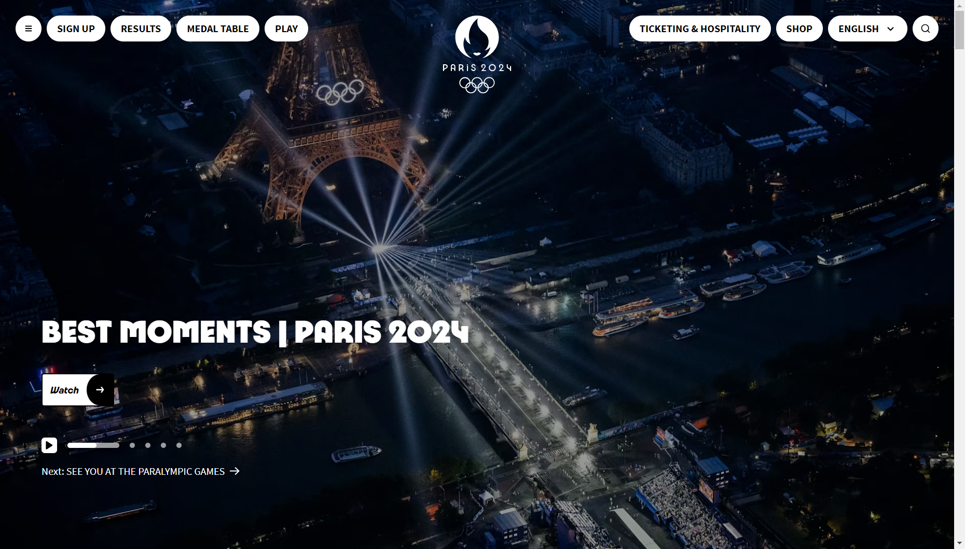
People of Achievement
Non-restrictive relative clauses
南浔高级中学 钱静

Slide 3

About Paris

Slide 4
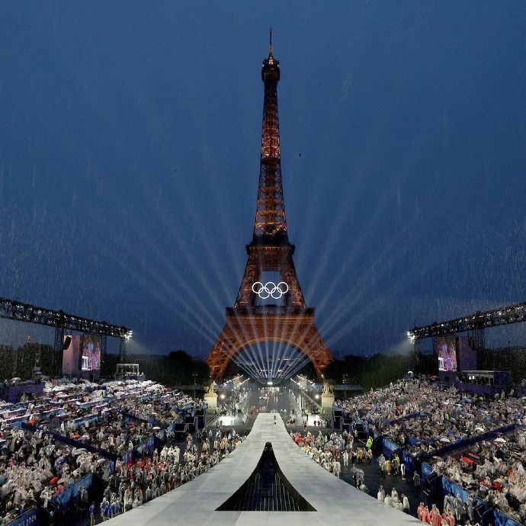
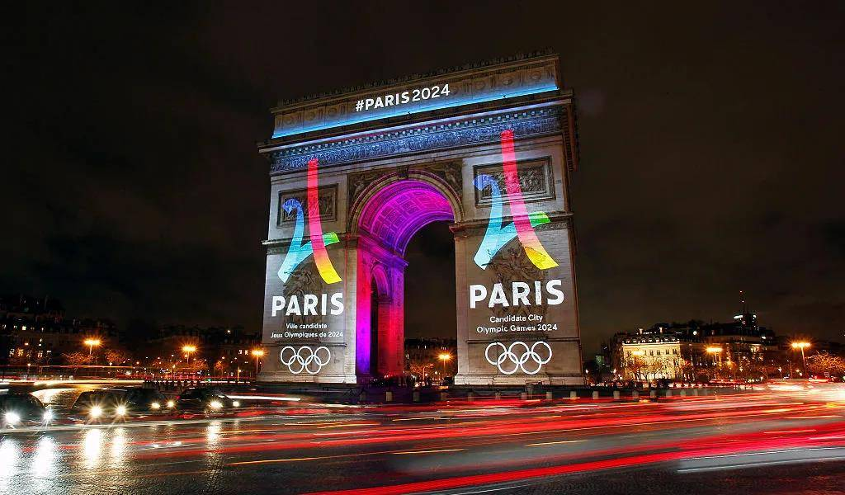
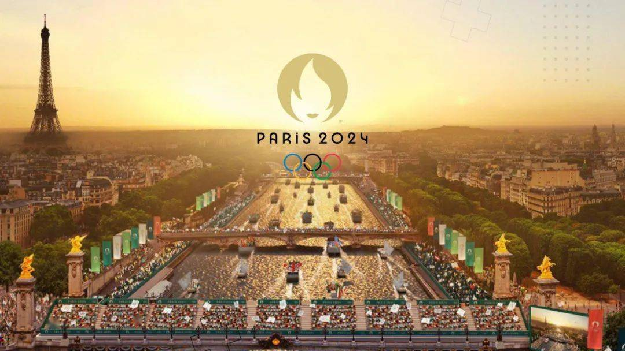
Paris, the City of Love, 1._________(gear准备) up to welcome athletes from around the globe for the 2024 Olympic Games, 2. _________ the streets are lined with flags and banners, creating a festive atmosphereFrom the opening ceremony beneath the Eiffel Tower 3.__________ the thrilling competitions along the banks of the Seine, every moment will be a 4.__________(harmony) blend of history and modernity. The Paris Olympics not only carry the dreams 5.__________ sweat of athletes, but also serve 6.__________ a vital platform for showcasing national cultures and 7.__________(foster) international exchanges. The Paris Olympics is not merely a stage for 8.__________(athlete) competition; it is also a bridge for cultural exchanges, 9. __________ connects people from all corners of the world. Through the Games, we can delve 10.__________(deep) into France's history, art, cuisine, and unique lifestyle.
is gearing
where
to
harmonious
and
as
fostering
athletic
which
deeper

Slide 5
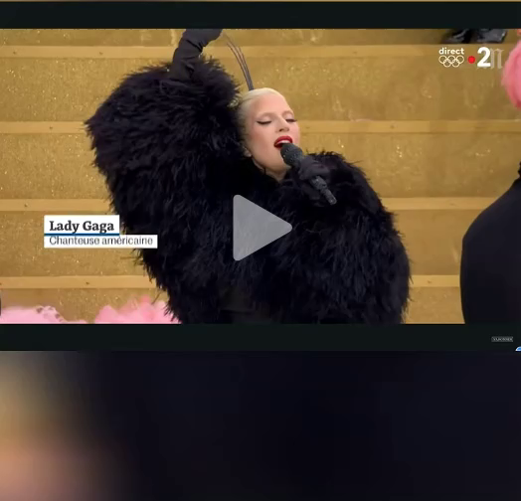
About the Opening Ceremony

Slide 6
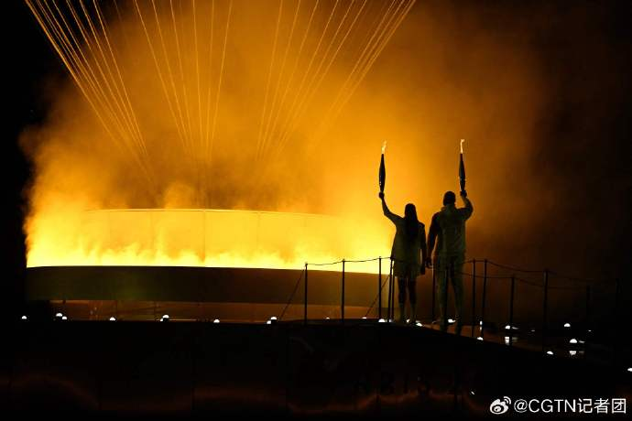
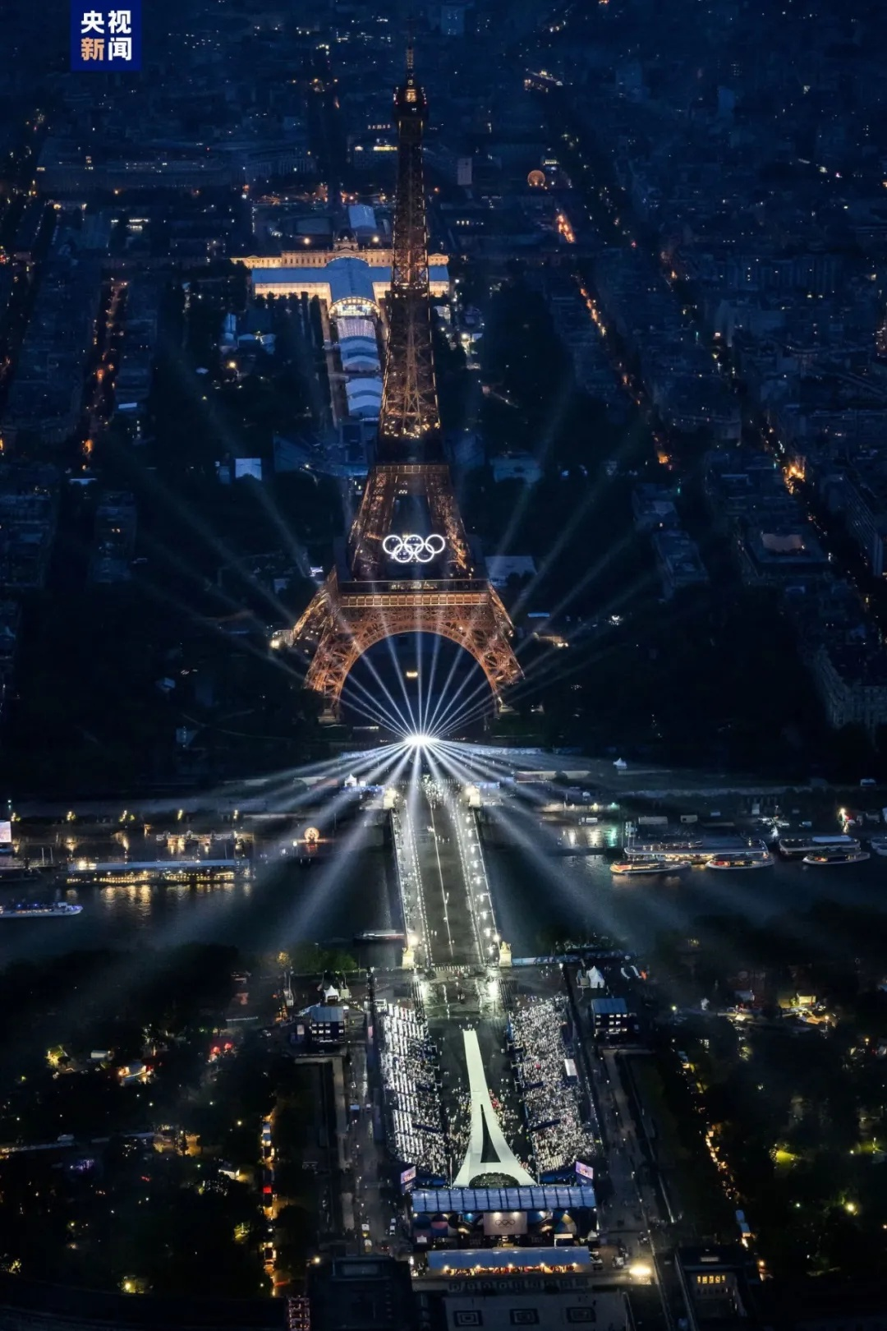
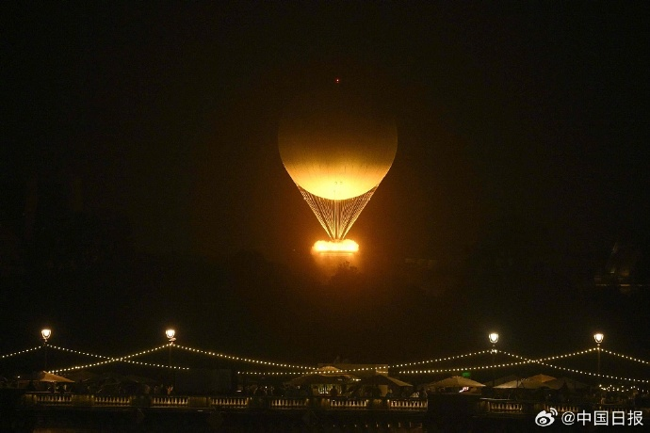
which marks the third time France has hosted the Summer Olympics
The 2024 Paris Olympics, ___________________________________________________ after 1900 and 1924, is also the first in Olympic history to hold its opening ceremony in an open urban space.
which指代名词、代词、整个句子或主句的一部分，在从句中充当主语或宾语
2024年巴黎奥运会是法国继1900年和1924年之后第三次举办夏季奥运会，也是奥运史上首次在开放的城市空间举行开幕式。
when the Olympic flame was lit up
In the early morning of July 27, 2024, ______________________________ in the Tuileries Garden, the long-awaited sports festival, the Paris Olympics was started.
2024年7月27日清晨，当奥运圣火在杜乐丽花园点燃时，标志着期盼已久的体育盛会——巴黎奥运会正式拉开帷幕。
when指代时间，在从句中充当时间状语，可用介词+which替换

Slide 7
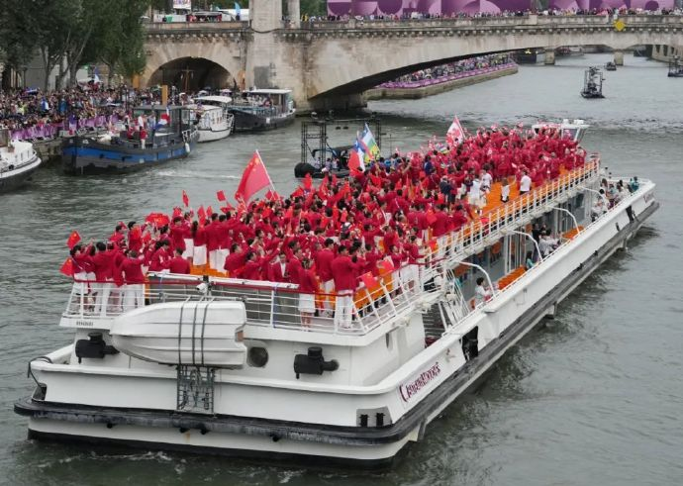
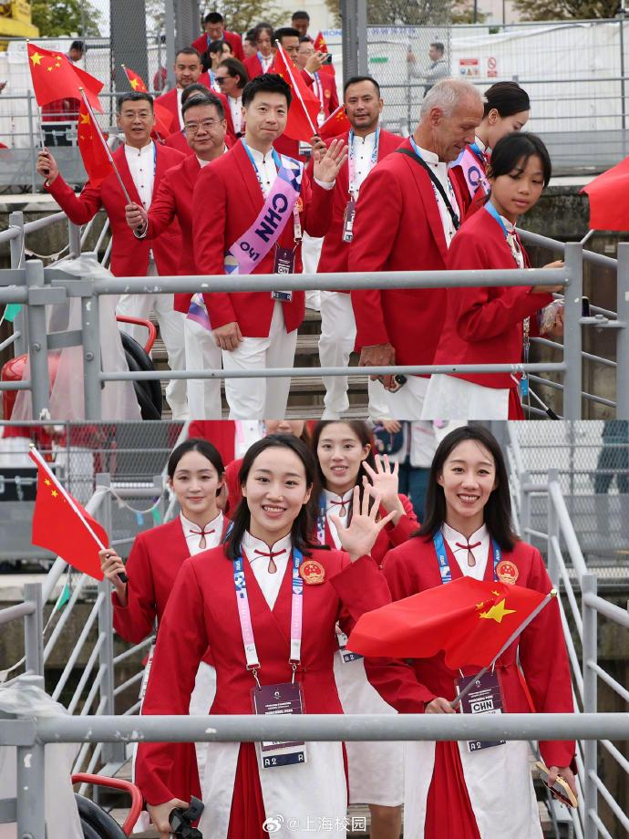
where the opening ceremony of the 2024 Paris Olympics broke tradition
On the Seine River, _________________________________________________________ by taking place on water, delegations from various countries sailed through the heart of Paris, ultimately arriving at the Trocadero Plaza.
在塞纳河上，2024年巴黎奥运会开幕式打破了传统，首次在水上举行，各国代表团乘船穿越巴黎的心脏地带，最终抵达特罗卡德罗广场。
where指代地点，在从句中充当地点状语，可用介词+which替换
For the Chinese delegation at the opening ceremony of the 2024 Paris Olympics, Chinese table tennis player Ma Long and synchronized swimmer Feng Yu, ____________________
___________________ , led the team into the stadium.
whom/who they chose
as flag bearers
在2024年巴黎奥运会开幕式上，中国代表团选择了中国乒乓球运动员马龙和花样游泳运动员冯雨作为旗手，引领队伍进入体育场。
who指代人，在从句中充当主语或宾语；whom指代人，在从句中充当宾语

Slide 8
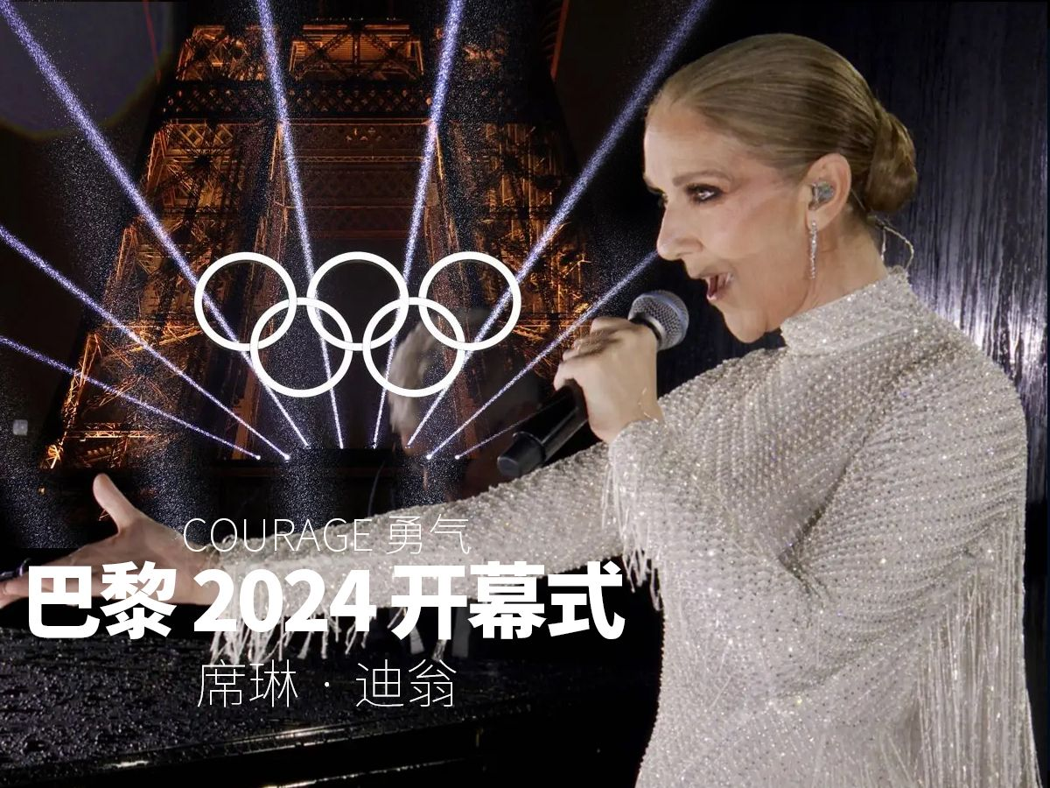
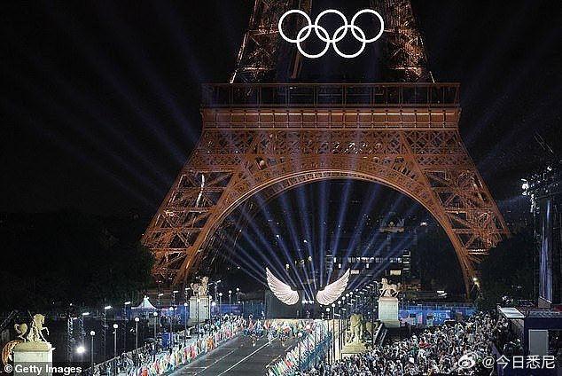
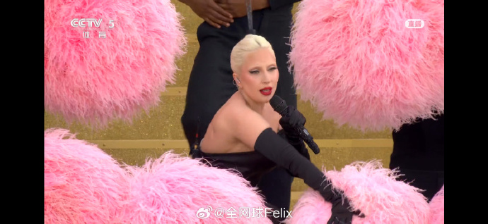
Renowned artists like Lady Gaga and Celine Dion captivated the audience with their grand appearances, ______________________________________________________________.
whose electrifying performances added a touch of glamour to the evening
像Lady Gaga和席琳·迪翁这样的知名艺术家以他们盛大的出场吸引了观众，他们激动人心的表演为当晚增添了一抹魅力。
where指代地点，在从句中充当地点状语，可用介词+which替换
whose指代人或物，在从句中充当主语或宾语的定语
of whom the electrifying performances added a touch of glamour to the evening
the electrifying performances of whom added a touch of glamour to the evening
whose指代人或物，在从句中充当主语或宾语的定语

Slide 9
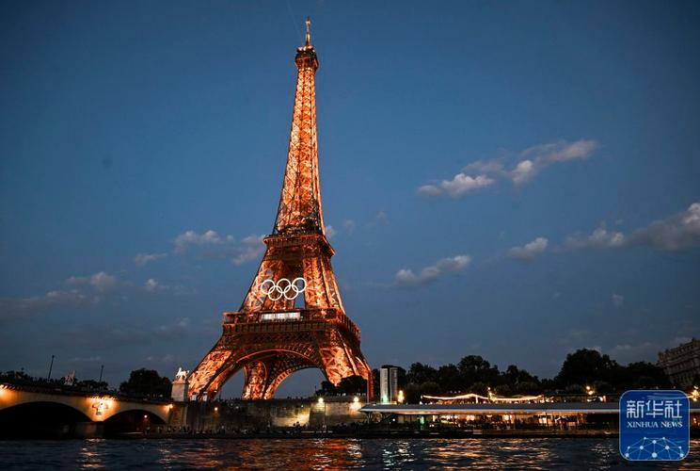
The Eiffel Tower, _____________________________ prominently against the Seine River's nightscape, added an unparalleled visual spectacle to the opening ceremony of the 2024 Paris Olympics.
whose iconic outline stood out
埃菲尔铁塔, 它那标志性的轮廓在塞纳河的夜景中格外突出，为2024年巴黎奥运会开幕式增添了无与伦比的视觉盛宴。
of which the iconic outline stood out
the iconic outline of which stood out
Tip:
whose + n.
= of which/whom + the + n.
= the + n. + of which/whom

Slide 10
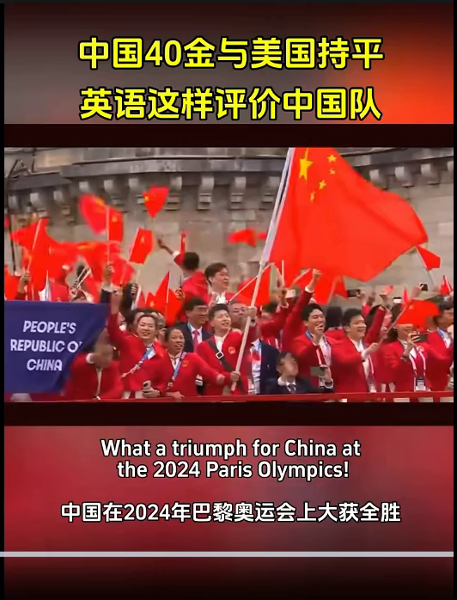
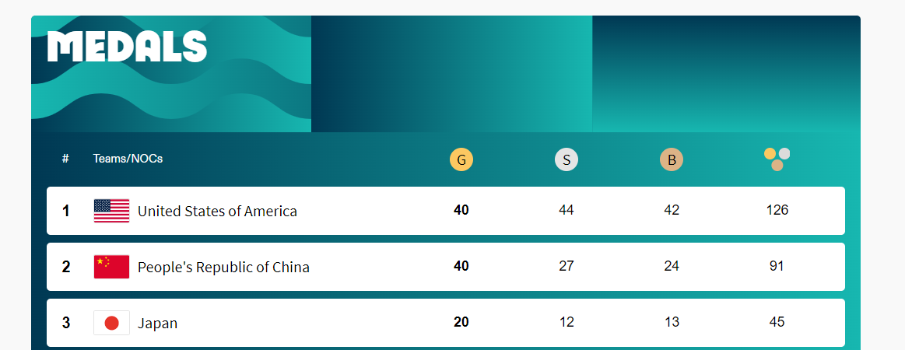
What a triump!
What a triumph for China at the 2024 Pais Olympics. The Chinese delegation has delivered an extraordinary performance securing 40 gold, 27 silver and 24 bronze medals, _________________
_______________________________________ (创下了境外比赛中的最佳成绩新纪录)This achievement marks a significant moment in sports history, as China challenges the dominance of the United States on the global stage.
which set a new record for their best ever results in an overseas competition.

Slide 11
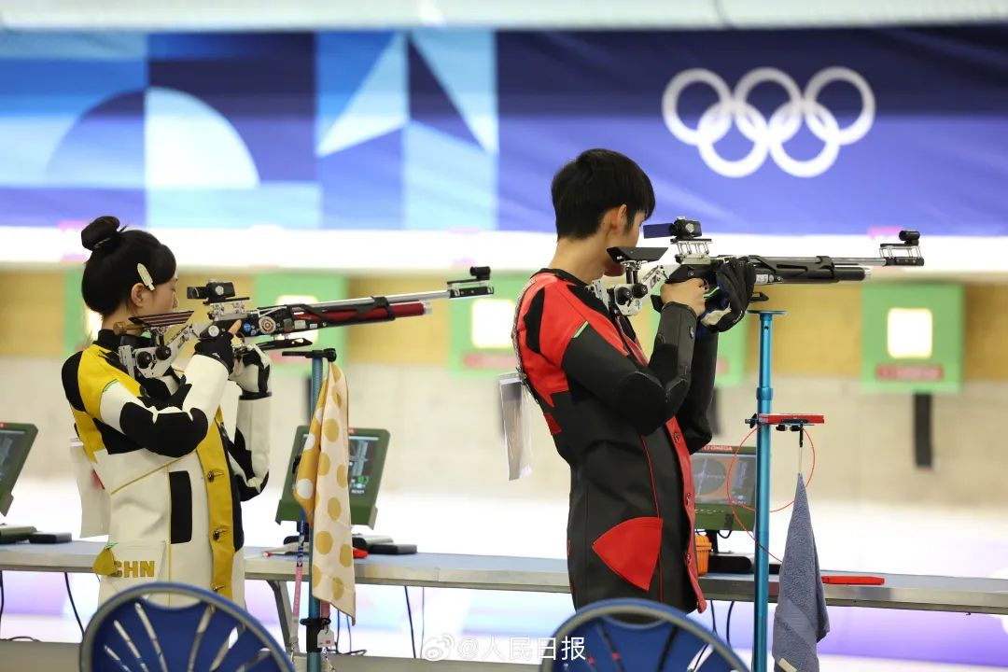
who secured China's first gold medal at the Paris Olympics
Inspiring Moments
Sheng Lihao and Huang Yuting, ________
___________________________________
_____________(他们夺得了巴黎奥运会的首枚金牌) and also marked the first gold of the Games in the 10m mixed team air rifle event，have made remarkable achievements.
Sheng Lihao and Huang Yuting, ______
______________________________________________________________________________________________（他们在10米气步枪混合团体赛中的胜利标志着中国在巴黎奥运会上夺得首枚金牌，同时也是该届奥运会的首枚金牌）, shone brightly on the international stage.
Sheng Lihao and Huang Yuting
the Paris Olympics 10m mixed team air rifle event
whose victory in the 10m mixed team air rifle event marked China's first gold medal at the Paris Olympics and the first gold of the Games

Slide 12
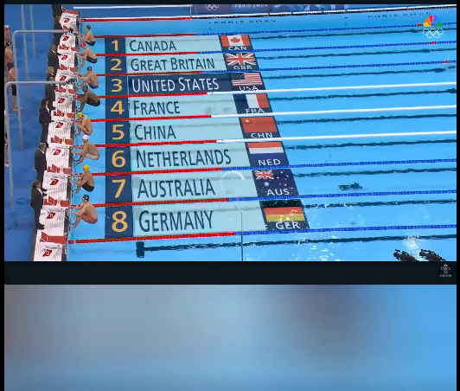

Slide 13
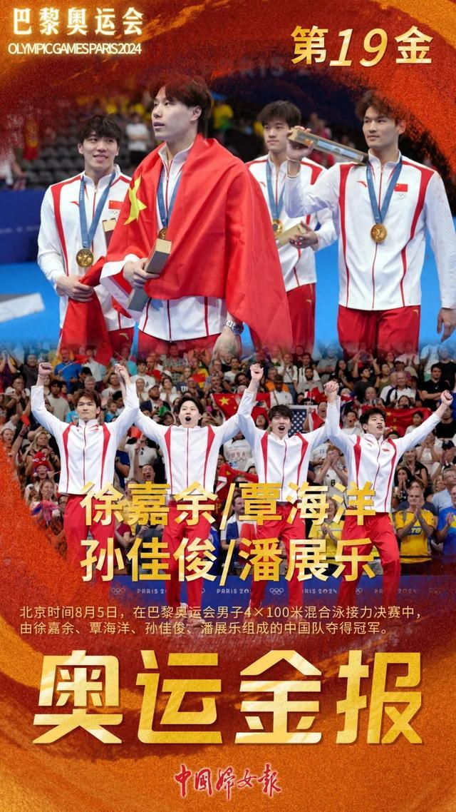
Inspiring Moments
who triumphed over the USA's 40-year dominance
The Chinese swimming team, ________ _____________________________________ in the men's 4x100m medley relay final at the 2024 Paris Olympics, showed outstanding skill and talent.
(broke the 40-year gold medal monopoly of the United States in the men's 4x100m medley relay final)
在2024年巴黎奥运会男子4x100米混合泳接力决赛中，中国游泳队打破了美国长达40年的霸主地位，展现了卓越的技能和天赋。（打破了美国在男子4x100米混合泳接力决赛中长达40年的金牌垄断）

Slide 14

Inspiring Moments
Chinese diver Quan Hongchan demonstrated
____________________________________ in the 2020 Tokyo Olympics, successfully defending her gold medal in the women's 10m platform event at the Paris Olympics.
Quan Hongchan's dives in the women's 10m platform final at the 2024 Paris Olympics were _______ a perfect blend of grace, power, and precision ________ audiences witnessed, which secured her the gold medal.
the same level of excellence as she displayed
中国跳水运动员全红婵在2024年巴黎奥运会女子10米跳台项目中展现了与2020年东京奥运会同等的卓越水平，成功卫冕金牌。
as引导限制性定语从句时先行词常被the same,such, so等修饰, 在定语从句中作主语、宾语或表语
such
as
在2024年巴黎奥运会女子10米跳台决赛中，全红婵的跳水动作完美融合了优雅、力量和精准，正如观众所见证的那样，这为她赢得了金牌。

Slide 15
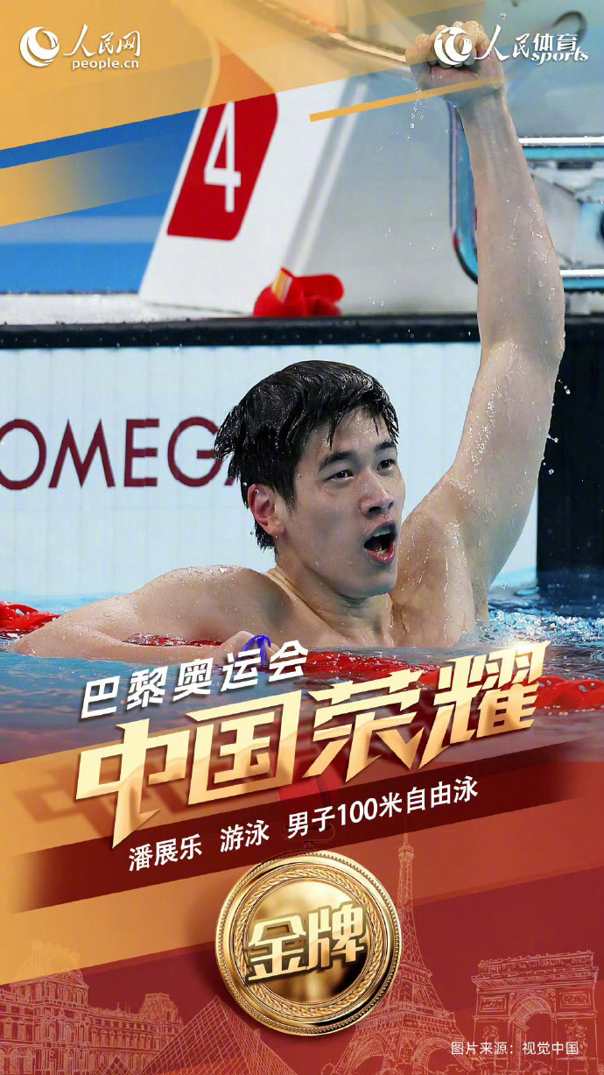
Inspiring Moments
As is known to all
As we all know, China's swimmer Pan Zhanle
broke the world record
______________________________________
____________________ and won the gold medal in the men's 100m freestyle, a historic achievement for Chinese swimming.
众所周知，中国游泳运动员潘展乐打破了世界纪录，赢得了男子100米自由泳金牌，这是中国游泳史上的历史性成就。

Slide 16
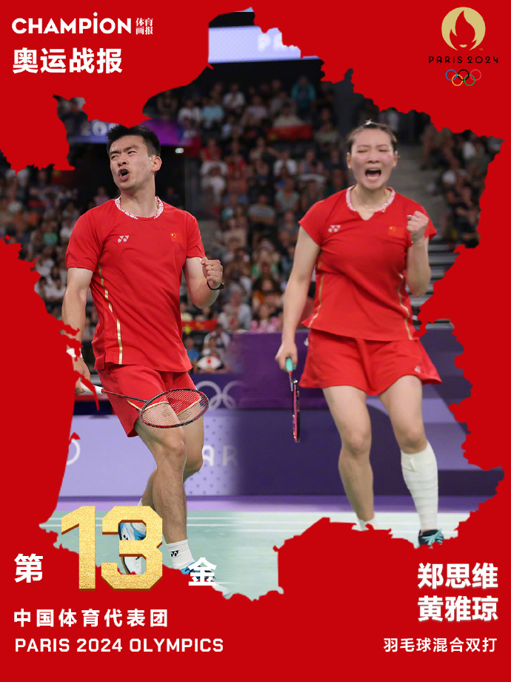
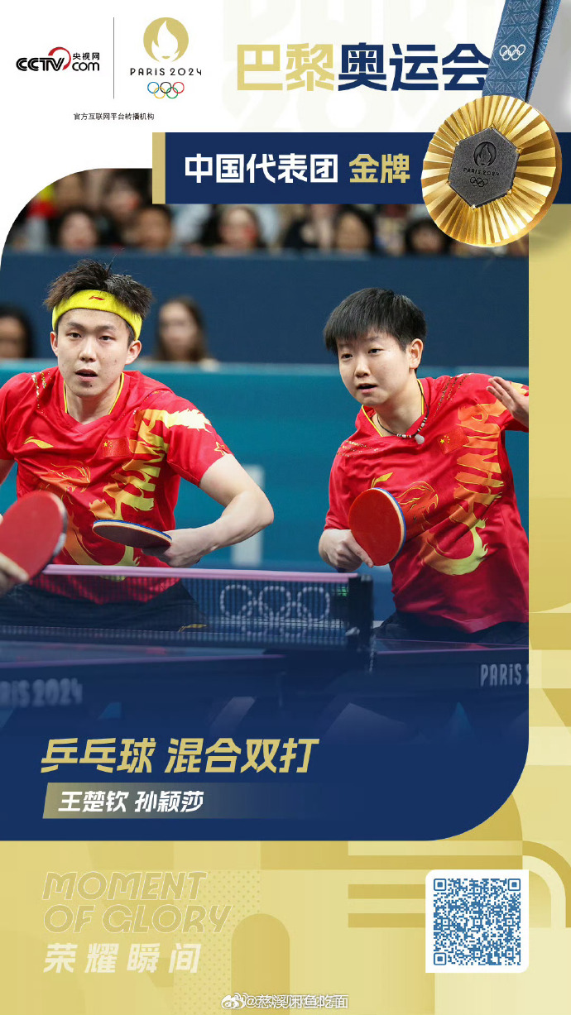
★as引导非限制性定语从句,指代整个主句内容,从句可置于句首、句中或句尾。
★as引导非限制性定语从句,有“如,似,正像”的含义。
As we had expected
____________________, China's badminton pair Zheng Siwei and Huang Yaqiong secured the gold medal in the mixed doubles final, demonstrating their dominance in the sport on the world's biggest stage.
正如我们所预期的那样，中国羽毛球组合郑思维和黄雅琼在混双决赛中夺得金牌，在世界最大舞台上展示了他们在该项目的统治力。
As is reported
_______________, China's table tennis stars Wang Chuqin and Sun Yingsha clinched the gold medal in the mixed doubles event, adding to China's long list of table tennis triumphs at the Olympics.
据报道，中国乒乓球明星王楚钦和孙颖莎在混双项目中夺得金牌，为中国在奥运会上的乒乓球辉煌战绩再添一笔。

Slide 17
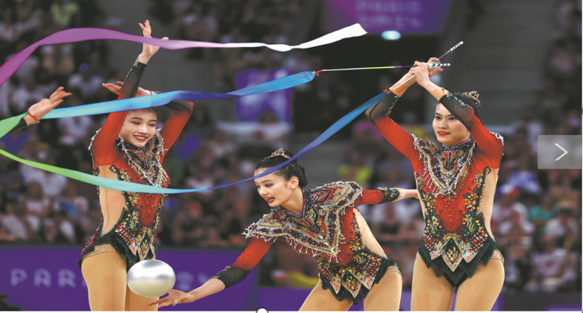
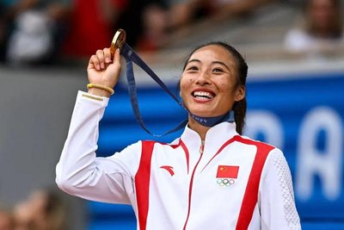
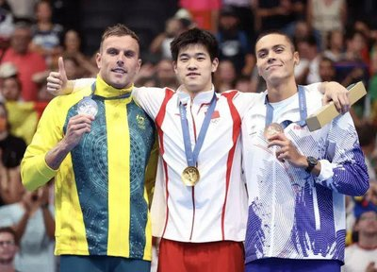
About sportsmanship
whom
The young "post-00s" athletes became the protagonists on the field, all of ________ showed the world the style of a new generation of Chinese athletes with the vitality of youth and fearless courage.
The biggest surprise came from 20-year-old Pan Zhanle. He owed his success to his daily training routine, ________ ________ he wouldn’t have made such a great breakthrough.
without
which
for
Athletes face much greater pressure in the Olympics than in other competitions, ________ ________ we should show understanding and compassion for athletes who make mistakes or fail to meet expectations during the Olympics.
which
介词+关系代词
先行词指人时关系代词用 whom,不可用 who/that
先行词指物时关系代词用 which,不能用that
Tip: 介词选择的三原则:
根据先行词的习惯搭配;
根据从句中谓语动词的习惯搭配;
根据从句所表达的意义。

Slide 18
Review
定义
用作定语的从句，即用来修饰名词或代词的从句
指人：主：that/ who/ as
宾：that/ who/ whom/ as/ 省
定：whose
与先行词关系紧密
关系代词
指物：主：that/ which/ as
宾：that/ which/ as/ 省
定：whose
限定性
定语
从句
分类
关系副词：
when(时间)，where(地点)，why(原因)
非限定性
who/ whom/ which/ whose/ as/ when/ where
与先行词关系不是很紧密，只起修饰作用
The 2024 Olympics which was successfully held in Paris left a deep impression on me.
举例
The Chinese athletes made great achievements in the 2024 Olympics, which left a deep impression on me.

Slide 19
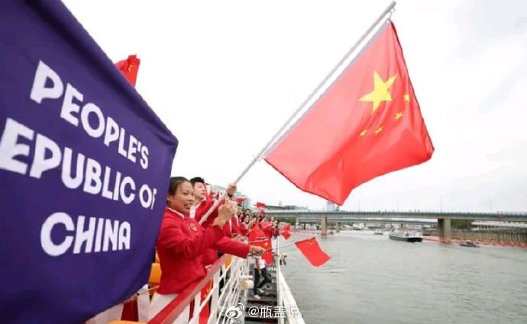
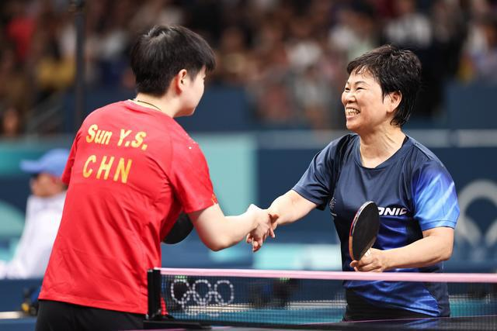
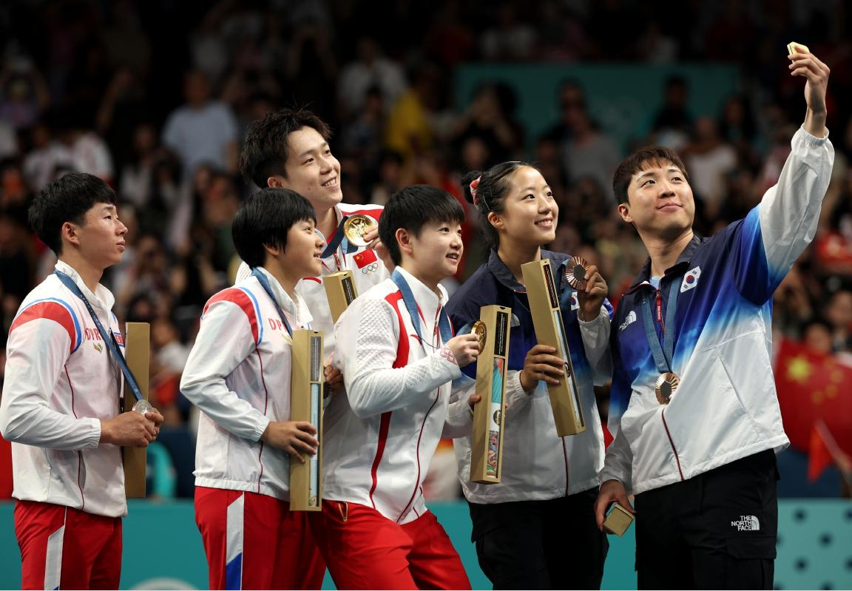
Assignment: Writing
刚刚结束的巴黎奥运会给我们留下了很多精彩的时刻。现在校英文报正在征集题为“The most Inspiring Moment in the Paris Olympics”，请你用英语写一篇短文投稿，介绍令你最激动的时刻。
内容包括：1.该时刻的介绍；2.你的感受。
注意：1. 词数100左右； 2.可以适当增加细节，以使行文连贯。
The most Inspiring Moment in the Paris Olympics

Slide 20
The most Inspiring Moment in the Paris Olympics
During the 2024 Paris Olympics, Chinese athletes left numerous impressive moments on the field, among which the men's 4x100m medley relay inspired me most.
The Chinese team, which consists of Xu Jiayu, Qin Haiyang, Sun Jiajun and Pan Zhanle, created a dramatic turn. Although the relay began with a narrow lead, during the butterfly leg, France took the lead with the USA close behind, pushing China into the third place. This was when Pan Zhanle made a decisive difference. He powered through the water with exceptional speed, ensuring that China reached the wall first.
With the thunderous applause and exciting cheers, I couldn’t help crying. They dare to fight and compete under great pressure, and break through their own limits in the face of challenges, which is the image of the Olympic spirit. China’s athletes have demonstrated their capacity to redefine the limits of human performance, leaving an indelible mark on Olympic history.

