Slide 1


感恩遇见，相互成就，本课件资料仅供您个人参考、教学使用，严禁自行在网络传播，违者依知识产权法追究法律责任。
更多教学资源请关注
公众号：溯恩英语
知识产权声明

Slide 2






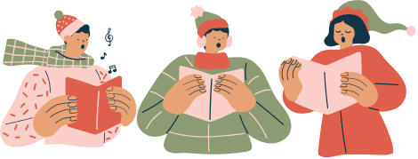
A Christmas Carol
圣诞欢歌
杭州第四中学 张雨舸

Slide 3
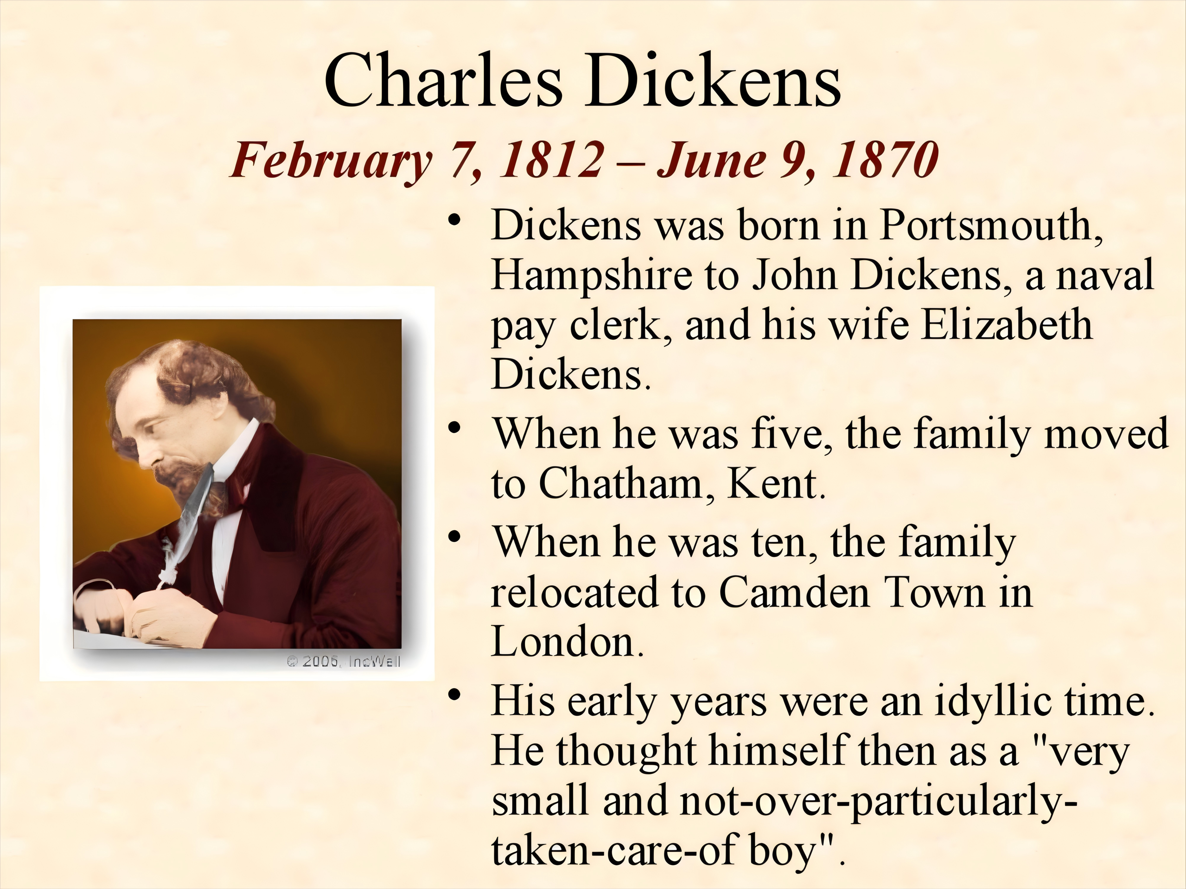


Slide 4
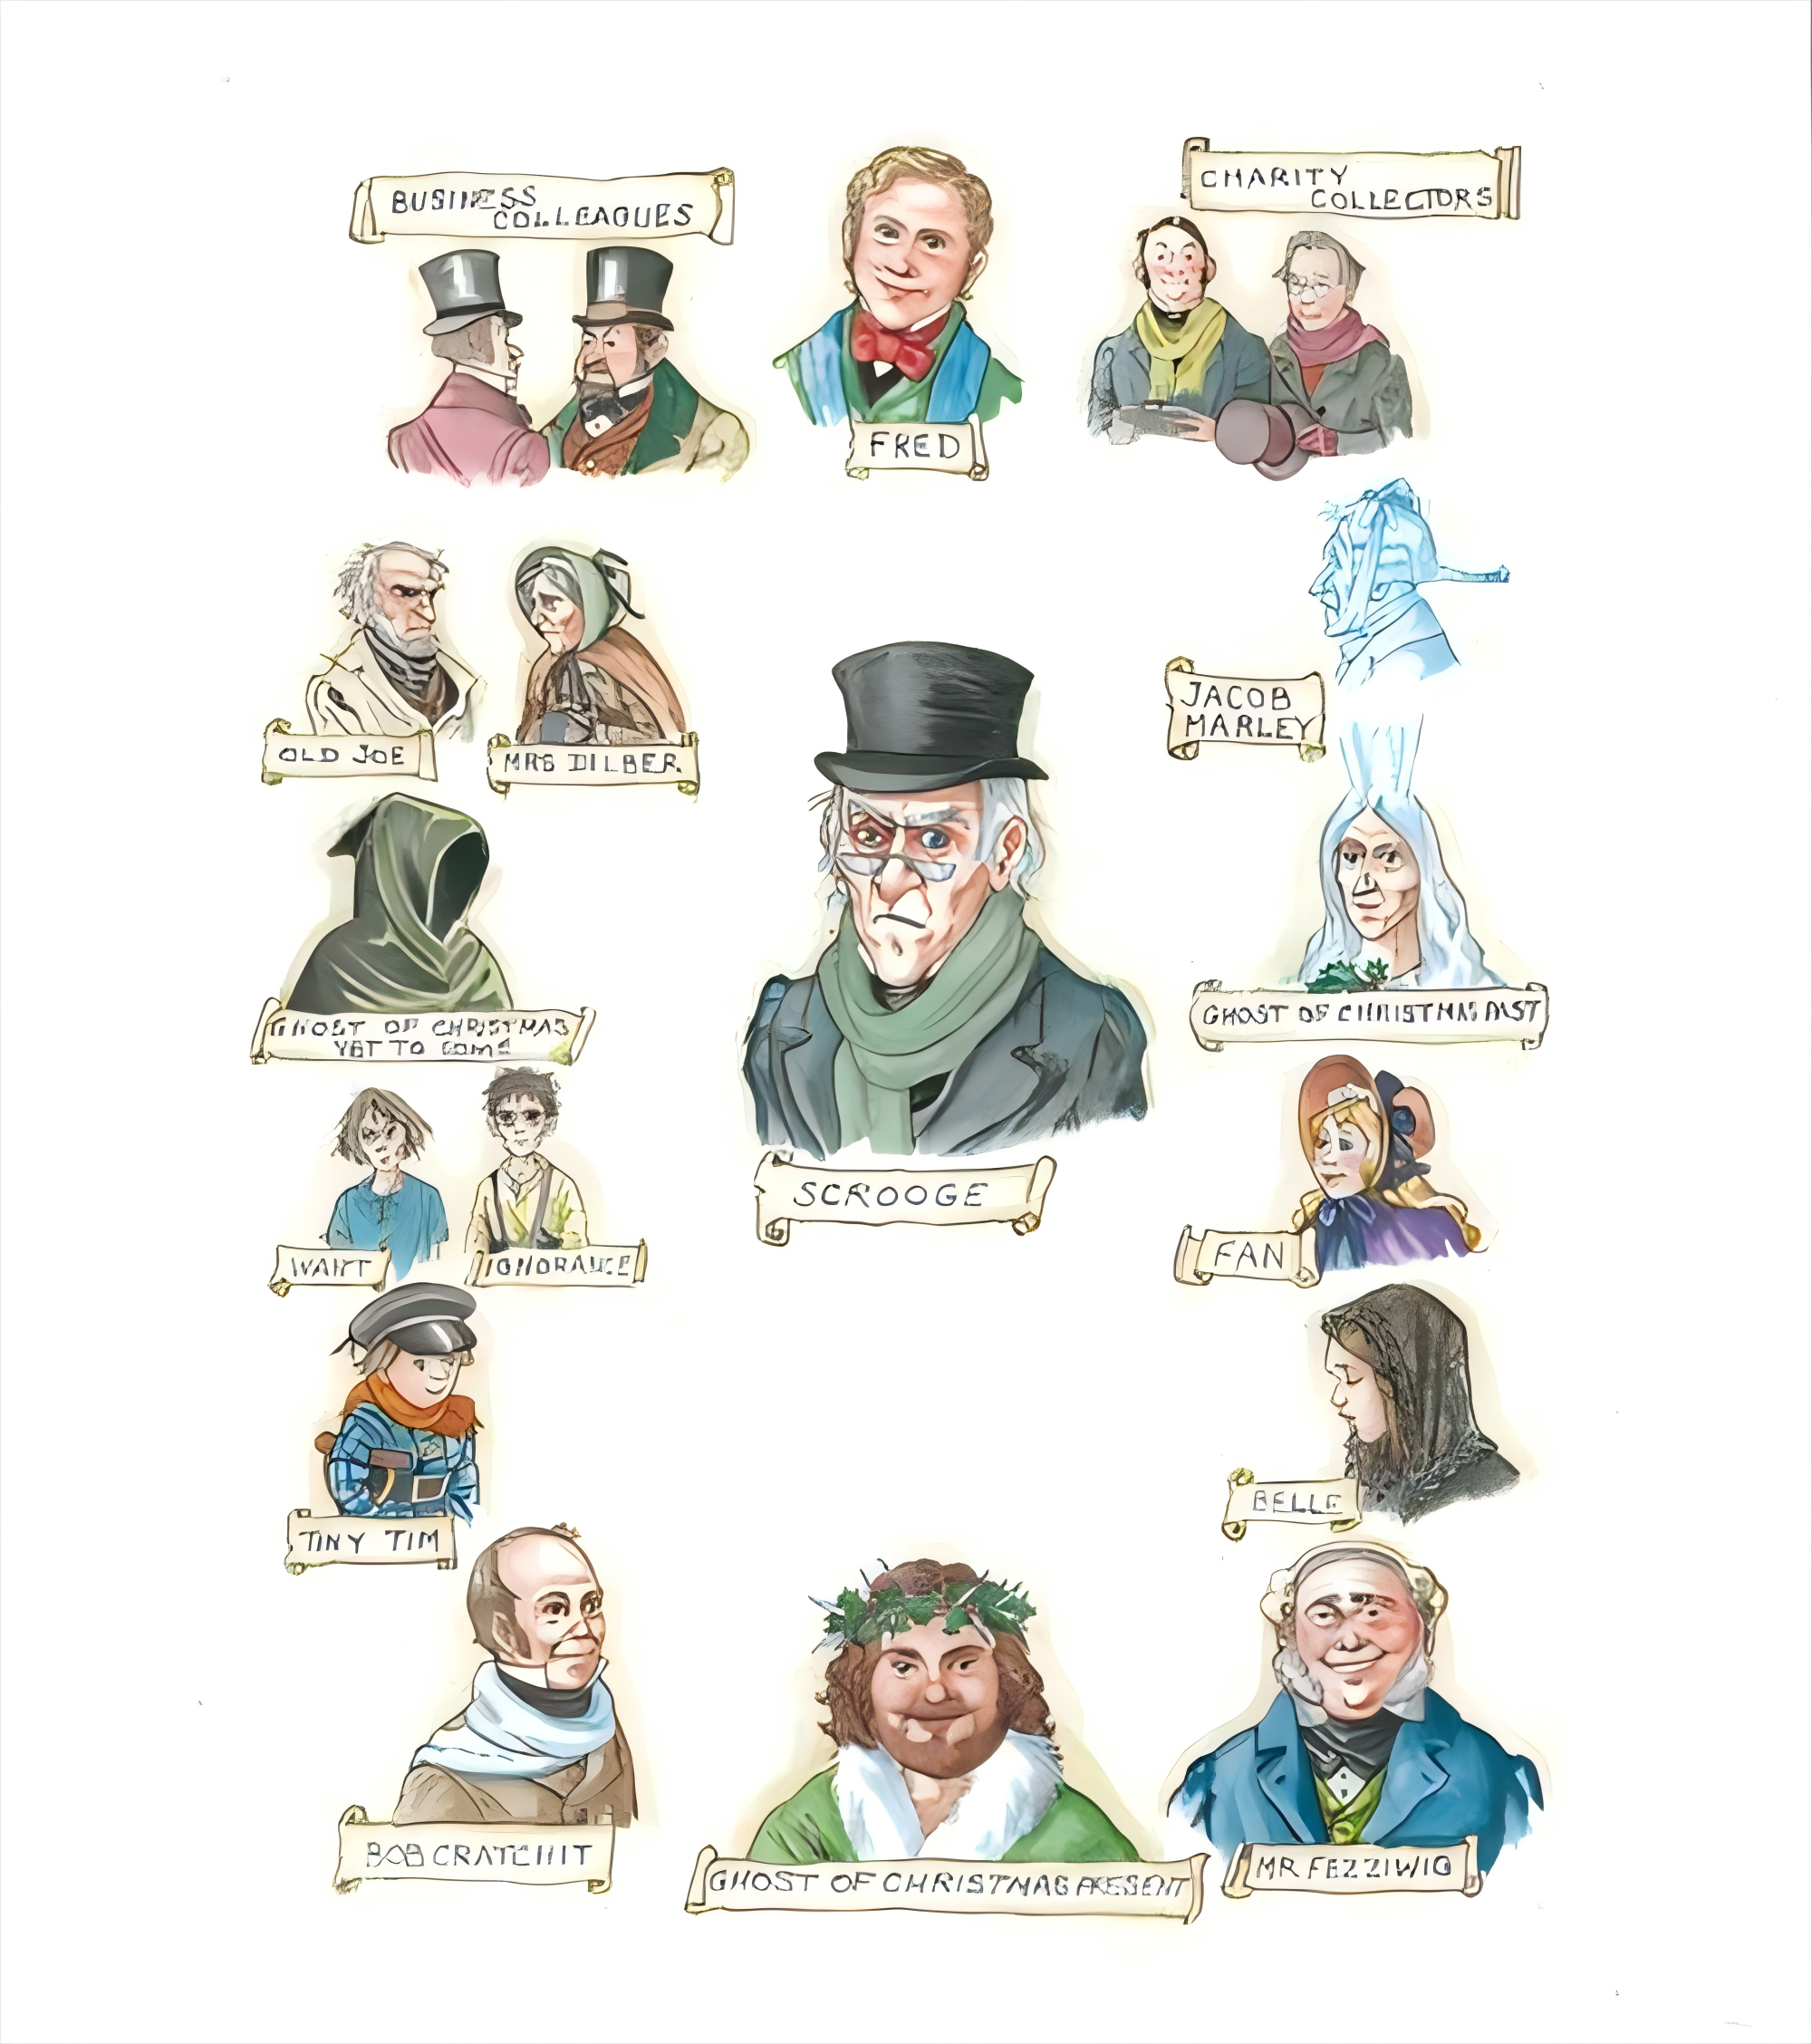
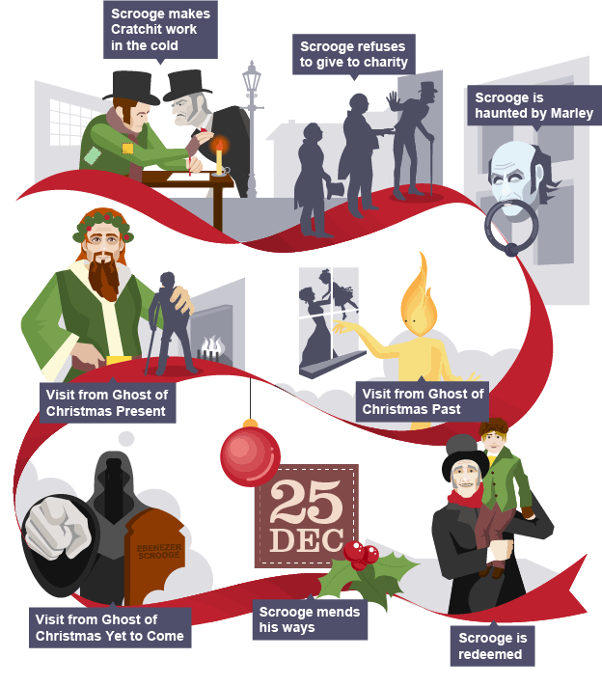
Characters
Plot

Slide 5






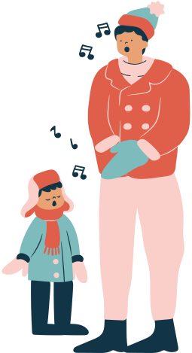
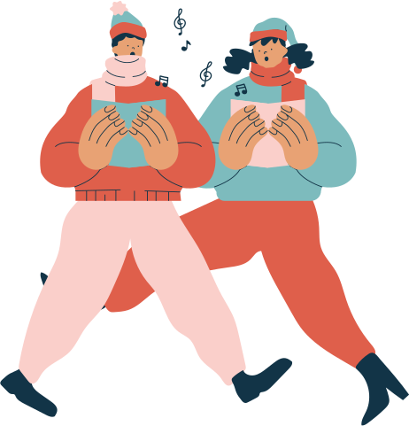
TRUE/FALSE Questions
F
Q1. Scrooge appears to want his employees to be warm and happy.
F
Q2. Scrooge is able to talk to the boys that he went to school with.
T
Q3. Scrooge is given another chance at last.

Slide 6
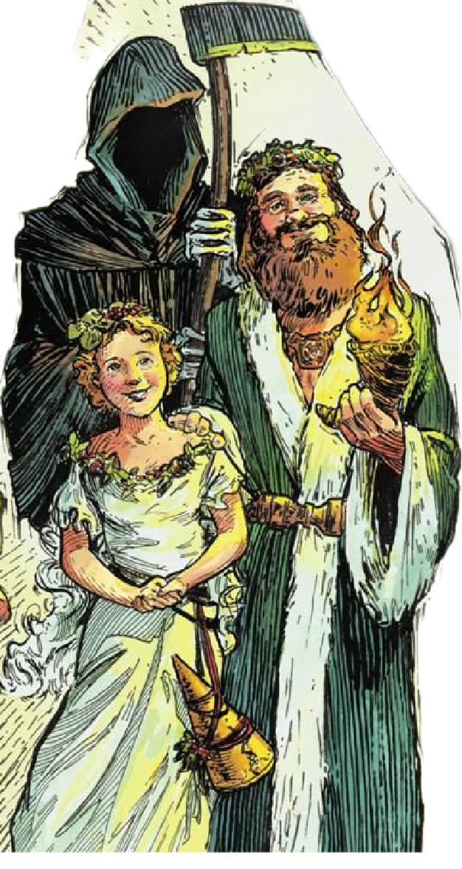
Q4: What does Scrooge say in response to "Merry Christmas"?
"Bah, Humbug! /ˈhʌmˌbʌɡ/"
Q5: What is the name of Scrooge's overworked and underpaid employee?
Bob Cratchit /ˈkrætʃɪt/
Q6: How many spirits are there in the story?

Slide 7
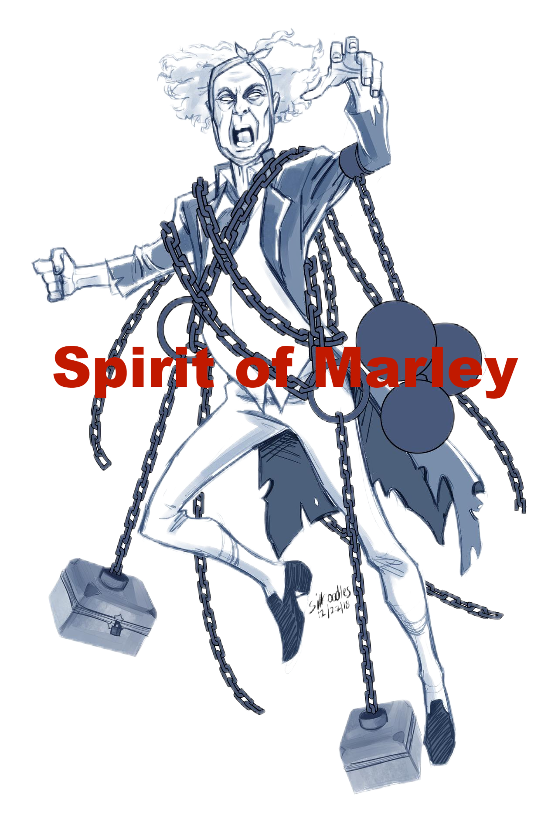

Symbol
Around its middle was a long chain, which had money-boxes, keys, bank books, and heavy purses on it.
Symbolism: the use of symbols to represent ideas
C
symbolized by
Hot Springs
I thought only about making
money, not about being kind and helpful to other people.
Symbolize
A
B
Sins
Selfishness
Wuyi County
Health&
Relaxation

Slide 8

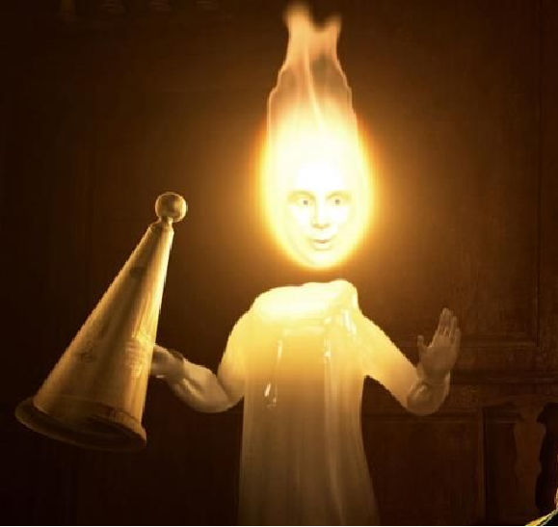
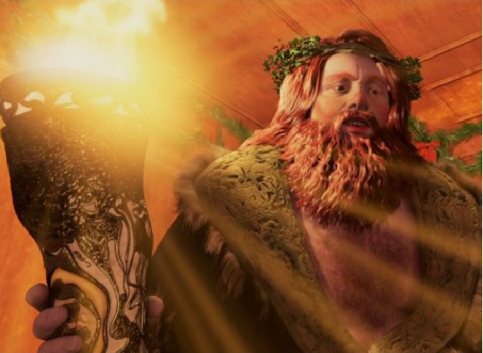
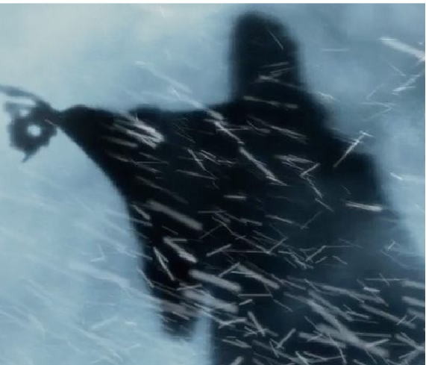

a bright,
clear light
a long black robe
a torch

Slide 9
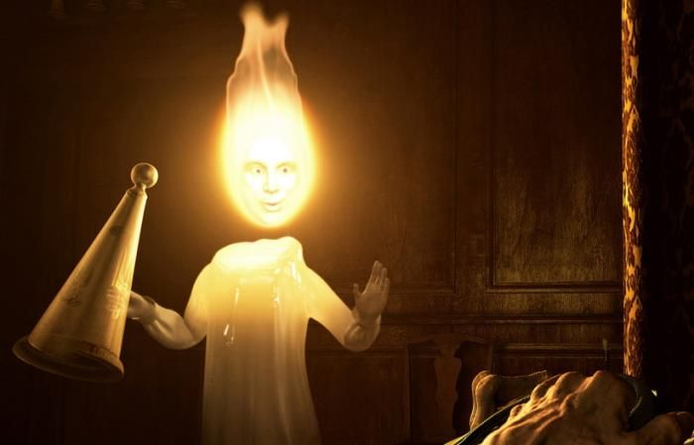
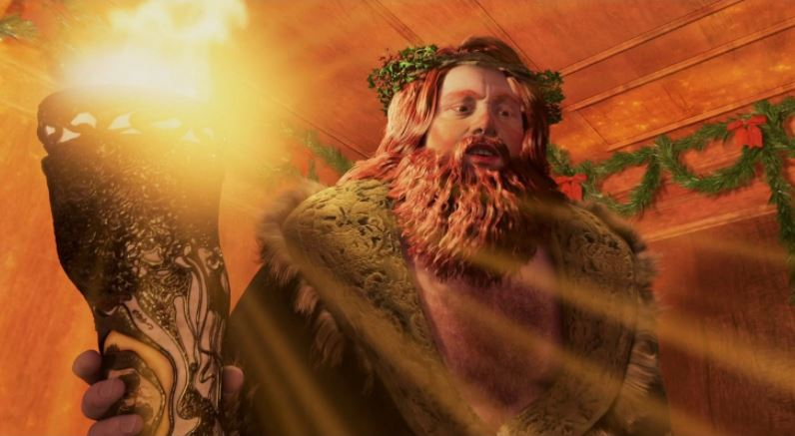
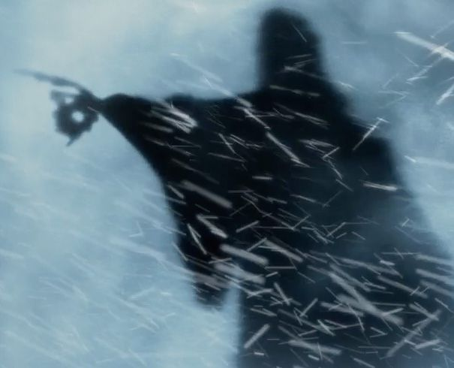
 | Seeing | Hearing | Response
Spirit of Past | ____________ were on horses, in carts and poor forgotten _______________. | _____________, _____________ a merry Christmas. | Feel r_______________ about not giving the boy anything.
Spirit of Present | His nephew, Fred and friends were _________________. | They _____________ to Scrooge’s health. | Express _______________ to Fred, feeling a_______________.
Spirit of Future | The Spirit ____________ to his ____________. | The Spirit gave _____________ reply. | Feel t_______________, _______________ to the ground, promising to be _______________ to others.
Schoolboys
laughing
regretful
wishing
past self
drank
thanks
talking about him
appreciated
terrified
pointed
fell
no
gravestone
good

Slide 10
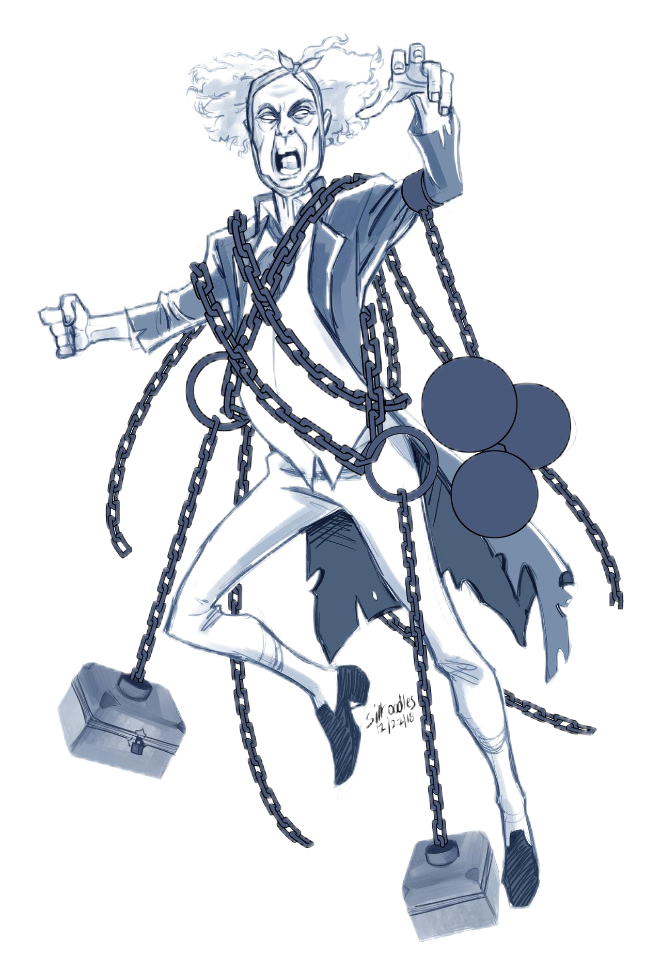

Design the fifth spirit
a long black rope
a torch
?
Chain
a bright, clear light

Slide 11
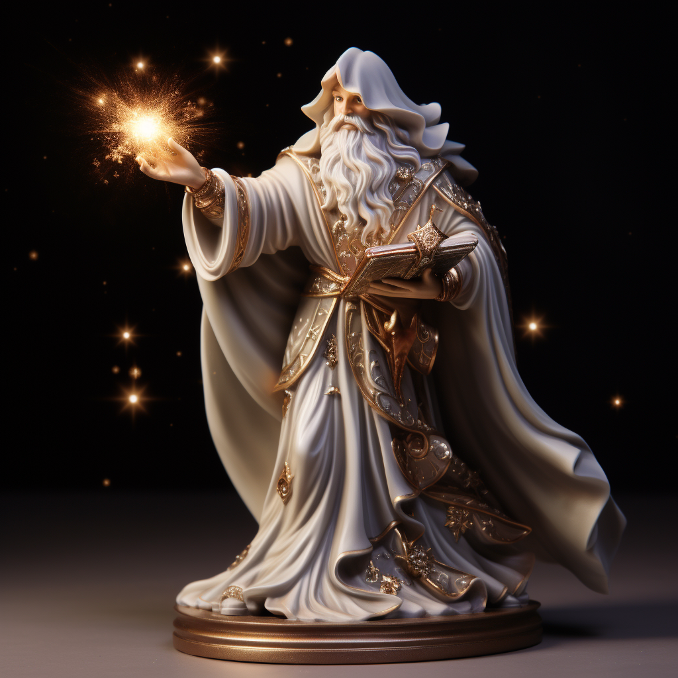


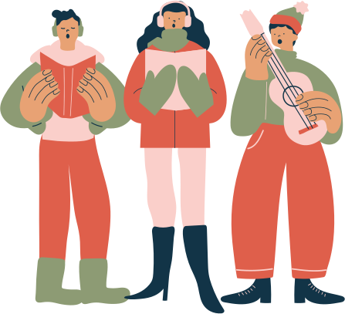
It is a friendly figure glowing in a starry robe, pointing to bright spots in life. With a radiant smile and a calming voice, it shows how we're all connected like stars in the sky. The spirit brings hope and change, lighting up the dark with warmth.
The Spirit of Future
The Spirit of Present
The Spirit of Past

Slide 12
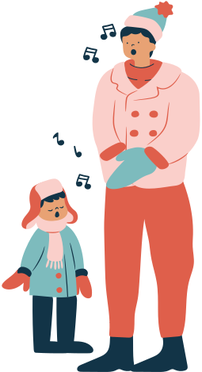




Homework
Write a passage (approximately 100 words) based on the designed fifth spirit. The beginning sentence has been given.

Slide 13
Repetition: “Bah! Humbug!” It emphasizes Scrooge’s attitude.
Simile: A comparison bewteen two things using as and like.
“The fog covered everything, like a thick grey blanket.”
Foreshowding: Hinting at events that will occur later in the story. The mention of Marley's ghost and the warning it brings foreshadows Scrooge's own spiritual journey.

