Slide 1


感恩遇见，相互成就，本课件资料仅供您个人参考、教学使用，严禁自行在网络传播，违者依知识产权法追究法律责任。
更多教学资源请关注
公众号：溯恩英语
知识产权声明

Slide 2


高三名校协作体考试
应用文讲评
note writing
Book2 Unit 4 Reading for Writing

Slide 3
1. The format（格式）
“Hey，my friend”
Dear XXX,
The beginning:_______________________________________
The body: _______________________________________
The Close: _______________________________________
Yours,
Li Hua
Dear XXX,
The beginning:_______________________________________
The body: _______________________________________
The end: _______________________________________
Yours,
Li Hua
【Salutation】
the background + the purpose
a farewell/ an apology/a reminder
/an acknowledgement
the wish/expectation
【Signature】

Slide 4
2. A glimpse of a note
定义:便条/留言条是一种简单形式的书信.
特点:格式简单，内容简短。
要求:内容简明扼要，文字简洁明了。讲清谁写的，写给谁，什么事以及什么时候写的等。留言条的日期可以写上年、月、日，也可以写上星期几或星期几上、下午，或者只写几日，几点钟也行。日期多写在正文右上角。
分类:便条根据其用途可分成祝贺便条、慰问便条、致谢便条、道歉便条、邀请便条、约会便条、请求便条。
Dear XXX,
The beginning:_______________________________________
The body: _______________________________________
The end: _______________________________________
Yours,
Li Hua

Slide 5
3. A deep insight into the writing
审题
第一节：应用文写作（满分 15 分）
假定你是李华，即将结束在巴黎的暑期交换学习。离别之际，你为一起学习的英国室友 Chris 准备了一份礼物。请为这份礼物附上一张便条， 内容包括：
1.礼物简介；2.意义阐述；3. 临别祝福
Genre： ____________________________________
Tense： ____________________________________
Person：____________________________________
Key points：________________________________
a note
the present tense + the future tense, the past tense
the first person + the second person
brief introduction+ the meaning; wish

Slide 6
Part 1
The beginning: the background + the purpose
写便条的背景：根据“即将结束在巴黎的暑期交换学习”
写便条的目的：告知“准备了一份道别礼物”
1.临近离别之时，我精心挑选了一份礼物送给你，它象征着我们共同度过的美好时光。
With the time of departure around the corner, I ________________________
___________, which _____________________________________.
2.面对面地挥手告别对我来说真的很难。所以，这份礼物是为你准备的，它提醒着我
们真挚的友谊。
It’s really hard for me to ________________________________. Thus, this gift
is in store for you as _________________________________.
have elaborately selected
a gift for you
symbolized the brilliant time we've spent
bid you a tearful farewell face to face
a reminder of our genuine friendship
logical thinking

Slide 7
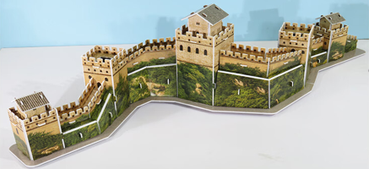
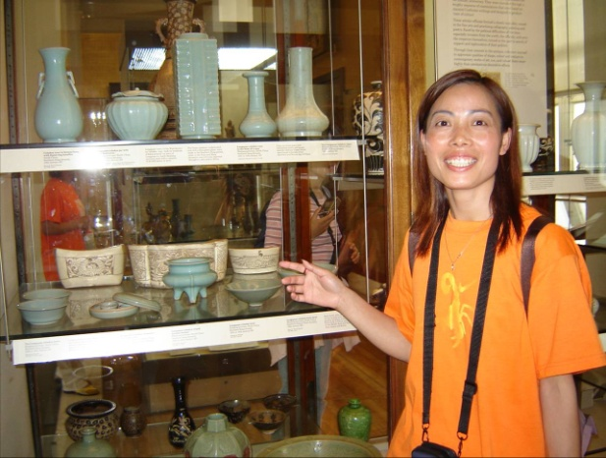
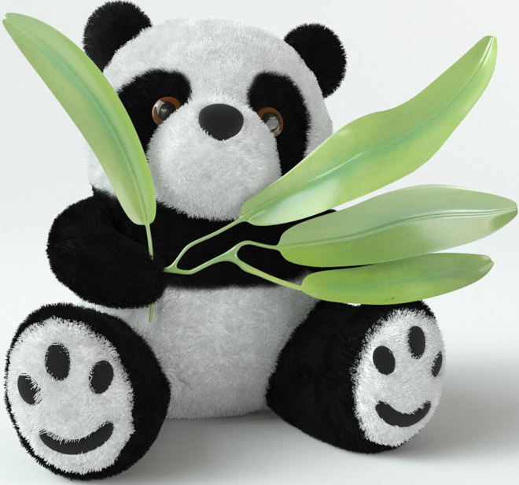
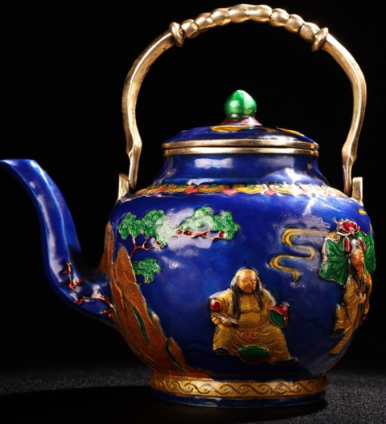
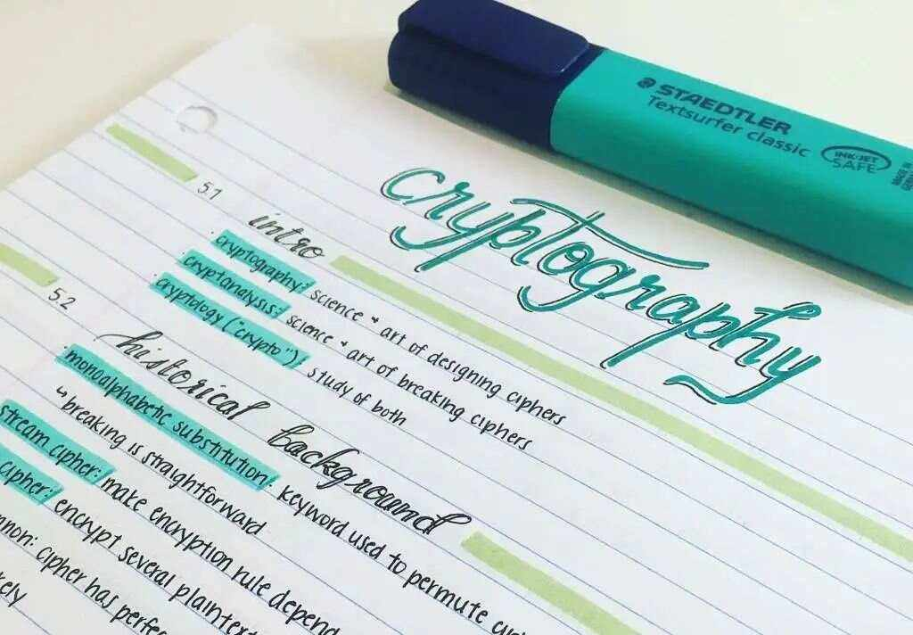

Part 2
creative thinking
The body: the brief introduction + the meaning
The gift for your friend:
a photo/ a portrait
a teapot
a model of...
a doll panda
a Chinese knot
a water color painting
Chinese calligraphy
a paper cutting
a notebook
a work, such as _________________

Slide 8
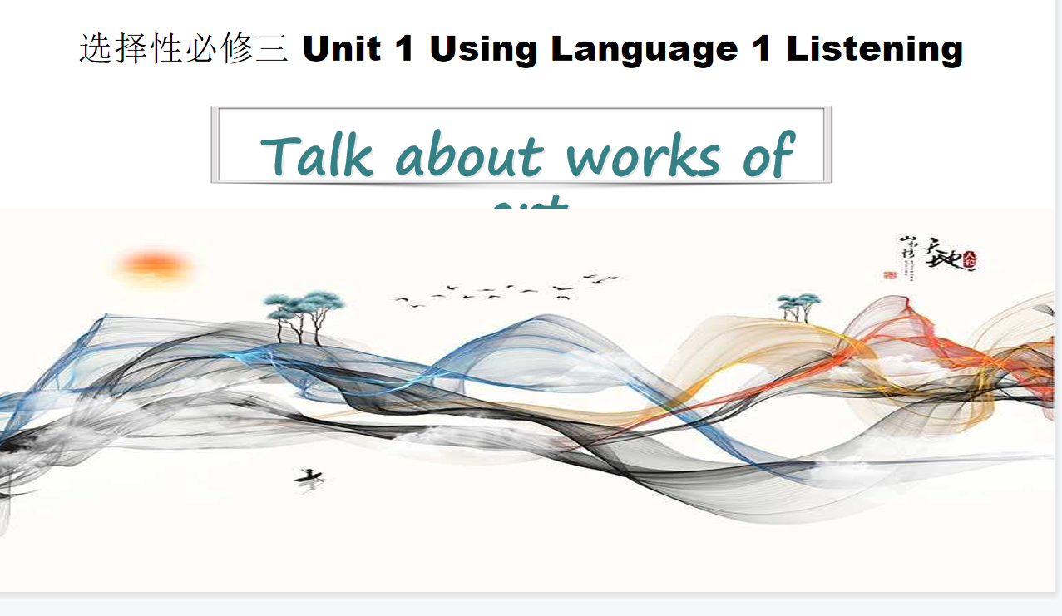
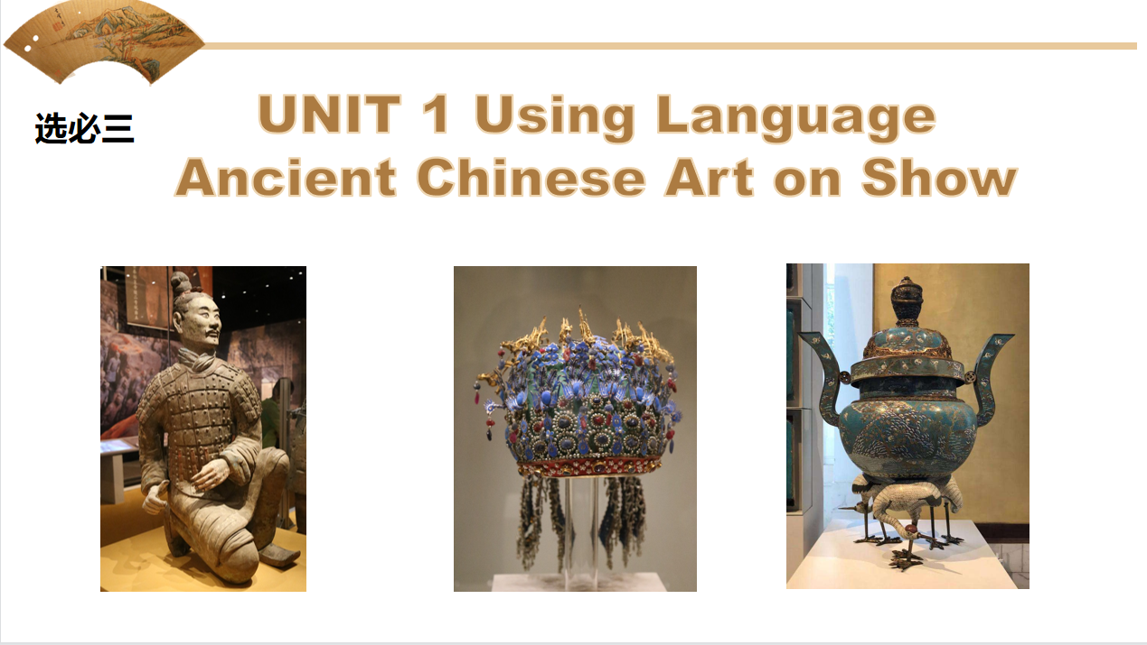
Part 2
The body: the brief introduction + the meaning
a teapot
How to introduce?
Purchased from my hometown
the source
___________________________, the teapot
has accompanied me for five years.
the material
delicate china/purple clay
It is made of ________________________.
◆教材话题语言溯源
the appearance
Graceful and elegant, the teapot is
_______________________________
(它们外观精美、品质上乘).
with _______________（精致的曲线）.
of exceptional beauty and quality
...
delicate curves

Slide 9
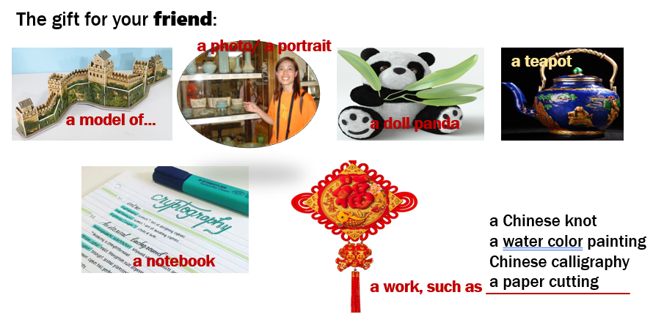
Part 2
creative thinking
Group work:
How do you introduce your gift ?
【话题词块】
●追溯到____________ ●原产于；...的家园________________
●...的象征/象征着...________________ ●捕捉到画面 _____________
●闪亮的红色织物____________________ ●精美的瓷器 __________________
●作为提醒__________________ ●承载着丰富的文化内涵___________________
dating from/date back to
be native to
a symbol of.../ symbolize...
capture the picture
glistening red fabric
delicate china
serve as a reminder
carry rich cultural connotations
Appreciation 1（小组合作作品）

Slide 10

Part 2
creative thinking
Group work:
How do you introduce your gift ?
Appreciation 2（名校高分作文）
The gift, a piece of traditional Chinese calligraphy written by
myself, contains renowned Chinese poems dating from Tang
dynasty to Qinq dynasty, all of which conveys emotional
feelings, ranging from broad aspirations to the genuine
relationship with friends. 【镇海中学】

Slide 11

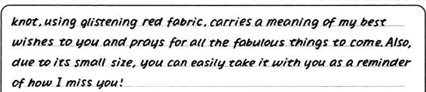
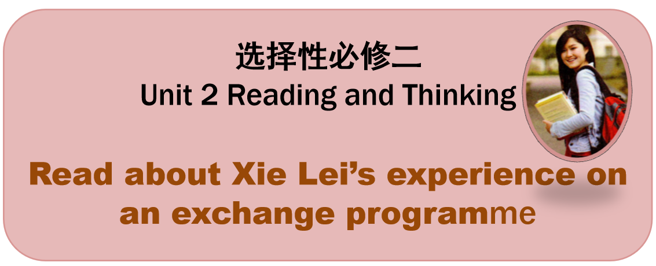
Part 2
The body: the brief introduction + the meaning
价值观
文化意识
What’s the gift’s meaning?
围绕“礼物本身”，从“个人意义”与“社交意义”两个角度出发讨论。
make a cup of tea and have a good taste of it
You might as well _______________________________________, escaping pressure
from _______________. Most important of all, the teapot symbolizes ___________
________________, from which you can gain a glimpse of _____________________.
It is not only _______________________but also _____________________________.
它不仅是泡茶的工具，更承载着深厚的文化底蕴和人们
对美好生活的祈愿翻.
academic study
blessings and
auspiciousness
◆教材主题意义溯源
It is not only a tool for brewing tea, but also carries profound
cultural heritage and people’s wishes for a better life.

Slide 12
Part 3
The close: wish/expectation+隐藏要点
因为试题设定的是“一起学习”，从祝福的角度来说可祝对方学业顺利的。
围绕试题本身展开“祝福” 。
隐藏要点（1分）：试题有提到“巴黎”，可围绕“巴黎”写一点抒情。
情感培养
1. No matter where life takes us, we will always have Paris — the bond that
was forged under its iconic skyline.
无论生活把我们带到哪里，我们都会永远拥有巴黎——在它的标志性天际线
下建立起来的纽带。【挖掘隐藏要点抒发情感】
2.Presenting the gift, I bid my earnest farewell to you and may you a bright
future!献上这份礼物，我诚挚地向您道别，愿您前程似锦！【首位呼应+祝福】
学生习作的问题：
过于官方、过于客套
生搬硬套、缺乏情感

Slide 13
Possible Version
Dear Chris,
As our unforgettable summer exchange in Paris comes/draws to a close, I’ve compiled a handmade photo album that captures our shared experiences during this summer as a farewell gift.
The album is a mosaic of our friendship, with each photo a piece of our story. From our first awkward introductions to our deep conversations over coffee, from our collaborative projects to our exhilarating cheers at the Olympic games, these images document not only our growth but also the bond we’ve formed. It's a visual diary of our laughter, our triumphs, and the memories we’ve created side by side.
I extend my best wishes for your future and also eagerly anticipate the day you visit China. May this album be a treasured reminder of our time together and the friendship we’ve built.
Yours,
Li Hua

