Slide 1


感恩遇见，相互成就，本课件资料仅供您个人参考、教学使用，严禁自行在网络传播，违者依知识产权法追究法律责任。
更多教学资源请关注
公众号：溯恩英语
知识产权声明

Slide 2

The World
September 1st-15th, 2024

Slide 3
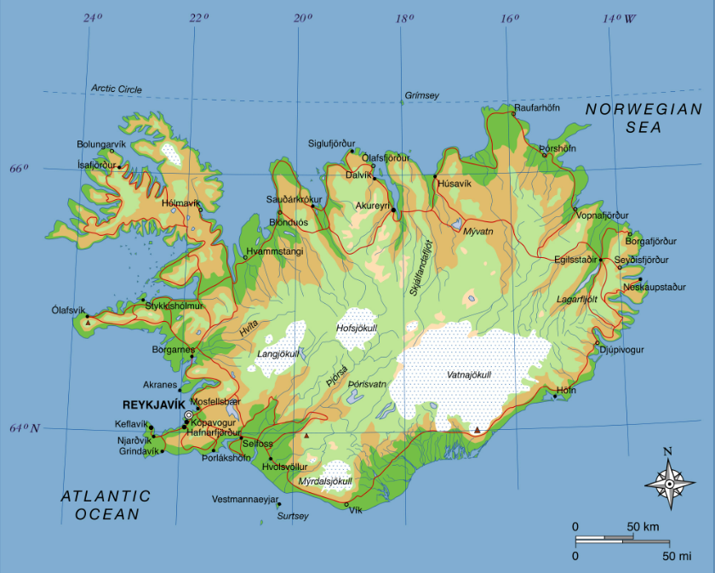
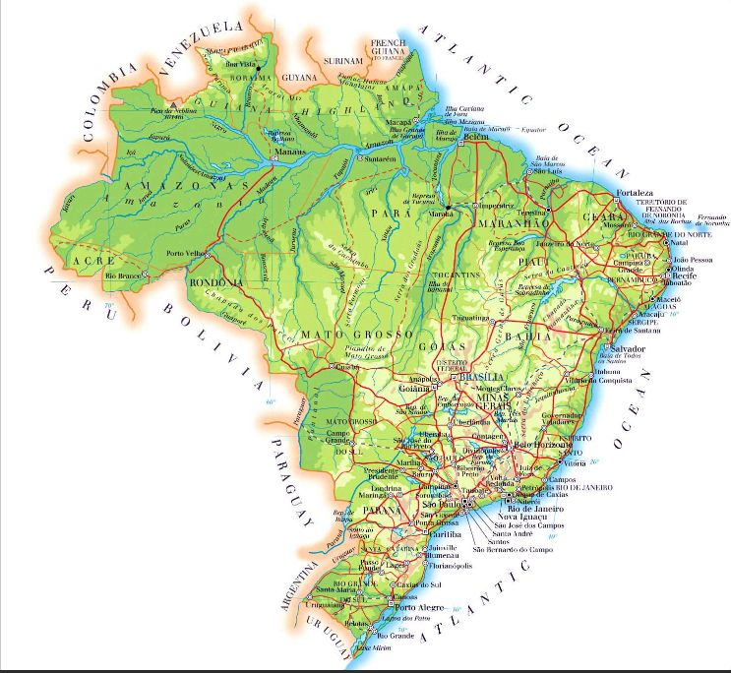
1. The world at a glance 看世界

Slide 4
Text Completion
The Week (September 6, 2024 P8)
Breidamerkurjokull glacier, Iceland
American killed: An ice cave in the Breidamerkurjokull glacier collapsed this week while a tour group was exploring it, killing an American man and injuring an American woman. Breidamerkurjokull, a tongue flowing from Iceland’s largest glacier, is a popular site for tourists—__________ (particular) Americans, who made up nearly a third of all international tourists to Iceland last year. But climate change is warming Iceland three times as fast as the rest of the planet, and the tragedy has ignited a debate around the safety of ________ (allow) tourists to visit glaciers during warm summer months. “This should only _______ (do) in the fall, in October or November, _____ the melting is over and there is more _______ (stable),” glaciologist Helgi Bjornsson told the newspaper Morgunbladid.
Miranda, Brazil
Wetlands ablaze: Wildfires have blackened 7000 square miles—an area as large as New Jersey—and killed endangered animals in Brazil’s Pantanal, the world’s biggest tropical wetland and one of its most important biodiversity sanctuaries. The wetland is normally flooded, ____ it has been dried out by years of drought _______ (blame) on deforestation and climate change, and fires have been burning there for months. ___ UNESCO world heritage site covering 68000 square miles, the Pantanal is home ___ threatened species like the giant otter as well as the world’s _______ (high) concentrations of jaguars and caimans. “We’re watching the biodiversity of the Pantanal disappear into ash,” said Gustavo Figueiroa of the conservation non-profit SOS Pantanal.
particularly
allowing
be done
when
stability
but
blamed
A
to
highest

Slide 5
Reading Comprehension
1. Which of the following statements is correct?
A. It is normally safe to explore an ice cave during summer time in Iceland.
B. The collapse of an ice cave in Iceland killed two American tourists.
C. Wildfires have burned New Jersey and killed animals in Pantanal.
D. The biodiversity of the Pantanal has suffered a lot for years.
2. What may be the common cause of these two tragedies?
A. Deforestation. B. Pollution.
C. Climate change. D. Habitat loss.

Slide 6
Vocabulary
1. ablaze: burning quickly and strongly 猛烈燃烧
Shops, houses, and vehicles were set ablaze.
店铺、房子和车辆全都陷于火海。
2. sanctuary: an area where wild birds or animals are protected and encouraged to breed 鸟兽保护区；禁售区
As Yellowstone bears increasingly wander outside the sanctuary of the park, they run an ever-greater risk of getting shot. 随着黄石公园的熊越来越多地在保护区外游荡，它们被射杀的风险也越来越大。
Translation
整幢大楼很快就熊熊燃烧起来。
The whole building was soon ablaze.
Translation
过多的旅游可能会导致这个保护区更快地被破坏。
Too much tourism could lead to a more rapid destruction of this sanctuary.

Slide 7
Translation
But climate change is warming Iceland three times as fast as the rest of the planet, and the tragedy has ignited a debate around the safety of allowing tourists to visit glaciers during warm summer months.
但气候变化使冰岛变暖的速度是全球其他地区的三倍，这一悲剧引发了一场关于在温暖的夏季允许游客参观冰川是否安全的辩论。
The wetland is normally flooded, but it has been dried out by years of drought blamed on deforestation and climate change, and fires have been burning there for months. A UNESCO world heritage site covering 68000 square miles, the Pantanal is home to threatened species like the giant otter as well as the world’s highest concentrations of jaguars and caimans.
这片湿地通常是被洪水淹没的，但由于森林砍伐和气候变化导致的多年干旱，它已经干涸了，大火已经在那里燃烧了几个月。潘塔纳尔被联合国教科文组织列为世界遗产，占地68000平方英里，是巨型水獭等濒危物种的家园，也是世界上美洲虎和凯门鳄最集中的地方。

Slide 8
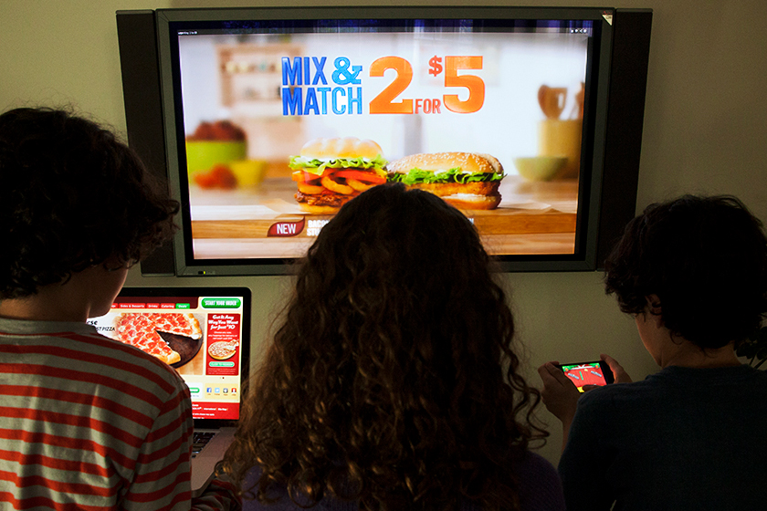
2. Junk food adverts banned before 9pm to take weight off NHS
英国拟晚9点前禁放垃圾食品广告

Slide 9
Text Completion
The Times (September 13, 2024 P1&6)
Junk food adverts will be banned on social media and pre-watershed television next year in the first of several tough public health measures that Sir Keir Starmer says ____ (be) essential to save the NHS.
As the budget watchdog warned that Britain’s worsening health would blow a £100 billion hole in the public finances, the prime minister said the government had “just got to be more ambitious”. Promising to set out ______ (far) preventive measures next spring in a ten-year health plan, he said he was “absolutely _________ (convince)” that government had to do more. “Of course, there’s diet, there’s healthy lifestyle, etc — we are going to have to get into that space,” he said.
Supervised toothbrushing and a ban on energy drinks in schools have already been promised, and more measures will be drawn up within months. The case for tough action has been bolstered by a report from the Office for Budget Responsibility, ______ head, Richard Hughes, said the state of Britain’s health was “the single biggest driver of the long-term ___________ (sustainable) of the UK’s public finances”.
___ the decline in Britons’ health over the past decade continues, it will increase borrowing by 4.1 per cent of GDP more than previous ________ (estimate), the OBR says. This would at present be equivalent ___ more than £100 billion. ____ the OBR says that if this trend could be reversed, it would lower borrowing by a similar amount through less spending on the NHS and sickness benefits, while _________ (increase) tax revenue.
are
further
convinced
whose
sustainability
If
estimates
to
But
increasing

Slide 10
Vocabulary
1. watchdog: a person or group of people whose job is to check that companies are not doing anything illegal or ignoring people’s rights (监督公司活动及监护人们权利的)监察人，监督团体
An anti-crime watchdog group was funded by New York businesses.
一个由纽约商界资助的反犯罪监察团体成立。
2. bolster: to improve sth or make it stronger 改善；加强
Hopes of an early cut in interest rates bolstered confidence.
利率有望早日下调，从而增强了人们的信心。
Translation
政府设立了一个监督机构来监督海外援助预算。
The government created a watchdog to monitor the overseas aid budget.
Translation
英国可以自由制定政策以振兴经济。
Britain is free to adopt policies to bolster its economy.

Slide 11
Translation
The case for tough action has been bolstered by a report from the Office for Budget Responsibility, whose head, Richard Hughes, said the state of Britain’s health was “the single biggest driver of the long-term sustainability of the UK’s public finances”.
英国预算责任办公室的一份报告支持了采取强硬行动的做法。该办公室负责人理查德•休斯表示，英国的健康状况是“英国公共财政长期可持续性的最大推动力”。
If the decline in Britons’ health over the past decade continues, it will increase borrowing by 4.1 per cent of GDP more than previous estimates, the OBR says. This would at present be equivalent to more than £100 billion.
英国预算责任办公室表示，如果过去10年英国人健康状况下降的趋势持续下去，将导致借款占GDP的比例增加4.1%，高于此前的估计。这相当于目前超过1000亿英镑。

Slide 12
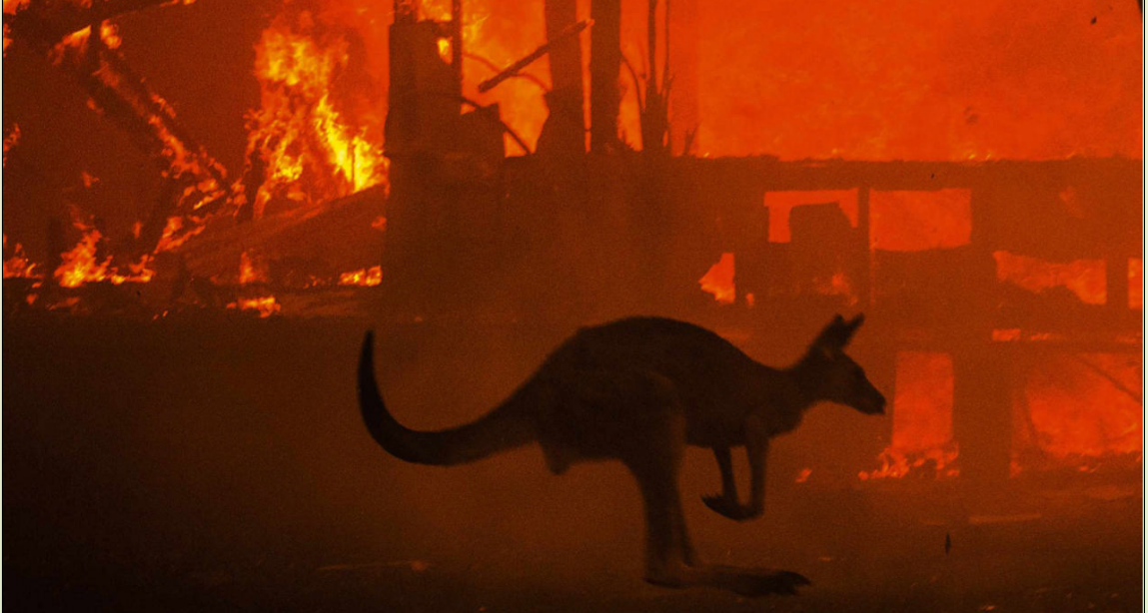
3. Tiny satellites detect fire
微型卫星探测火灾

Slide 13
Text Completion
BBC Wildlife (June 2024 P14)
increasingly
Early detection of wildfires is becoming __________ (increase) important, especially in places like Australia - in the summer of 2019-20, more than 12 million hectares, ___ area roughly the size of England, _____________ (impact).
Now help is at hand, thanks to scientists from the University of South Australia, ____ have found a way to use satellites and artificial intelligence (AI) to increase wildfire detection rates. The key innovation is to put AI-enabled software into tiny satellites, ______ (call) cubesats, that weigh just a few kilograms. The first cubesat, Kanyani, launched ___ 2nd July, says lead researcher and geospatial scientist Stefan Peters, “and our onboard fire smoke detection ________ (solve) will be ___________ (operation) by 2025.”
When it is, it should be possible to reliably detect wildfires in less than one hour. During a past fire event in the Coworong of South Australia, the AI approach took less than 14 minutes to detect smoke and relay the data. Reducing the impact of wildfires has other ________ (benefit). According to WWF Australia, the 2019-20 wildfire season released some 400-700 million tonnes of carbon dioxide. The cost of _________(replace) these carbon stocks was estimated at between AU$1-2.8 billion. In the light of these statistics, investing in early detection would surely pay dividends.
an
were impacted
who
called
on
solution
operational
benefits
replacing

Slide 14
Vocabulary
1. in the light of: because of; according to 因为；根据
In the light of recent incidents, we take particular care of personal belongings. 鉴于最近发生的事件，我们特别注意个人物品。
2. pay dividends: to produce great advantages or profits 有所收获；产生效益
Steps taken now to maximize your health will pay dividends later on. 现在采取措施充分重视你的健康将来就会有回报。
Translation
他根据进一步的研究重写了那部书。
He rewrote the book in the light of further research.
Translation
经常运动最终会对身体大有好处的。
Exercising regularly will pay dividends in the end.

Slide 15
Translation
Early detection of wildfires is becoming increasingly important, especially in places like Australia - in the summer of 2019-20, more than 12 million hectares, an area roughly the size of England, were impacted.
早期发现野火正变得越来越重要，尤其是在澳大利亚这样的地方——2019至 2020年夏天，超过1200万公顷的土地受到影响，面积与英格兰大致相当。
The cost of replacing these carbon stocks was estimated at between AU$1-2.8 billion. In the light of these statistics, investing in early detection would surely pay dividends.
替换这些碳储备的成本估计在10-28亿澳元之间。根据这些统计数据，早期检测的投资肯定会带来回报。

Slide 16
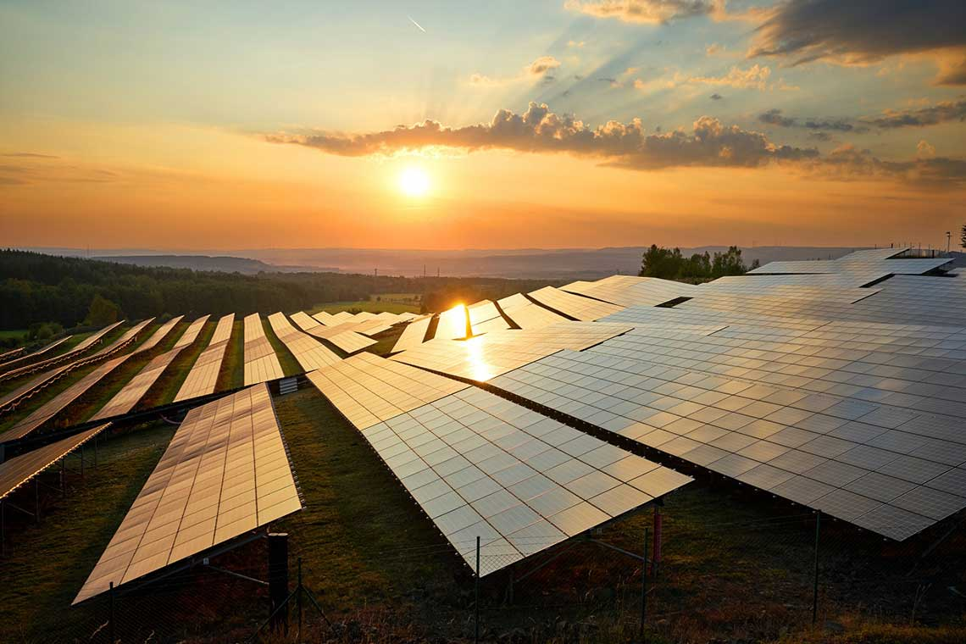
4. Grid has greenest ever summer as fossil fuel use falls below 20%
英国电网迎来了有史以来最环保的夏季

Slide 17
Text Completion
The Guardian (7 September 2024 P15)
Great Britain’s electricity system has recorded its greenest-ever summer after ________ (grow) numbers of wind and solar farms cut the need for gas power stations to fresh lows.
Analysis of energy _________ (generate) data, commissioned by the Guardian, revealed that Britain’s reliance ___ fossil fuels fell in August to less than one-fifth of all electricity, or 4 terawatt hours (TWh), the lowest ever level for a one-month period.
This allowed the carbon intensity of the power grid to plummet to the lowest level recorded for a single month, at 144g of CO₂ per kilowatthour in August, 40% ______ (low) than in the same month last year, according to the analysis.
The data, ________ (analyse) by the energy thinktank Ember, showed that the record lows were sustained even when averaged over the summer months from June to August, ________ (mean) the grid experienced its greenest summer ever.
The Labour government ____ (aim) to run the UK’s power grid on virtually zero-carbon electricity by 2030 thanks to __ surge in new wind and solar farms. Its flagship auction this week for renewable energy subsidies awarded contracts for 131 new projects, or enough new clean electricity to power 11m UK homes. _________, it secured just half the off shore wind capacity needed every year for the rest of the decade if the government is ______ (hit) its net zero target.
growing
generation
on
lower
analysed
meaning
aims
a
However
to hit

Slide 18
Vocabulary
1. plummet: to fall suddenly and quickly from a high level or position 暴跌
Share prices plummeted to an all-time low. 股票价格暴跌到历史最低点。
2. surge: a sudden increase in the amount or number of sth; a large amount of sth （数量的）激增
We are having trouble keeping up with the recent surge in demand.
对于近来出现的需求猛增，我们难以应对。
Translation
房价近几个月来暴跌。
House prices have plummeted in recent months.
Translation
最近房价飞涨。
There has been a surge in house prices recently.

Slide 19
Translation
Great Britain’s electricity system has recorded its greenest-ever summer after growing numbers of wind and solar farms cut the need for gas power stations to fresh lows.
英国电力系统创下了有史以来最环保的夏季纪录，因为越来越多的风能和太阳能农场将对天然气发电站的需求降至新低。
The data, analysed by the energy thinktank Ember, showed that the record lows were sustained even when averaged over the summer months from June to August, meaning the grid experienced its greenest summer ever.
能源智库Ember分析的数据显示，即使在6月至8月的夏季月份平均下来，也保持了创纪录的低点，这意味着电网经历了有史以来最环保的夏季。

Slide 20
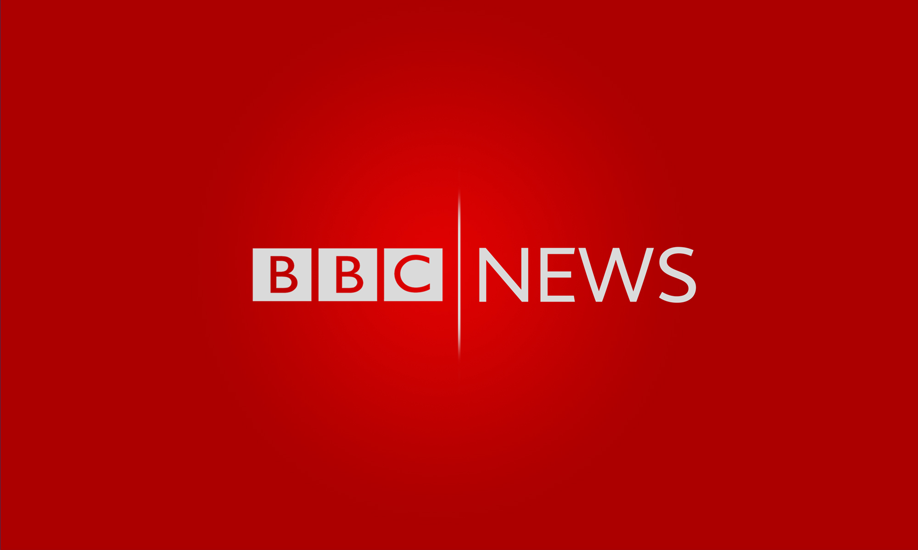
5. BBC News 09/02/2024

Slide 21

Dictation
Kamala Harris has used her first broadcast interview of the US election campaign to set out her vision for what she would do if she becomes president, pledging to offer ________________. Speaking to CNN, the Vice President and Democratic Party nominee defended her shift in position on some key issues, saying her ______ had not changed.
The Israeli military says it has killed three Palestinians who it says were from Hamas on the third day of a major operation in the West Bank. ____________ say the men’s cars were struck by an Israeli drone.
The bodies of three __________________ have been found in a collapsed tunnel in Thailand. Rescue workers had been searching for the missing men since an accident last Saturday.
Typhoon Shanshan is continuing to batter much of Japan with strong winds and ____________. At least four people have been killed since it made landfall on Thursday.
Germany has deported 28 Afghan nationals back to Kabul. They are the first deportations to Afghanistan since the Taliban __________ three years ago. A German government spokesman said the deportees were all convicted criminals.
An Aboriginal teenager has died by suicide at a youth prison in Australia. The boy’s death is the second of an Indigenous teenager in youth ________ in the state of Western Australia since last October.
Tributes have been paid to New Zealand’s Maori king, Tūheitia Pōtatau Te Wherowhero VII, who has died at the age of 69. He is seen as a ________ figure.
Forty-two gold medals are __________ on day two of the Paralympic Games in Paris. Friday sees the opening day of athletics, with the Tunisian Raoua Tlili bidding for her fourth shot put title _______. The women’s and men’s long jump competitions are taking part.
a new way forward
values
Eyewitnesses
construction workers
torrential rain
took power
detention
unifying
up for grabs
in a row

Slide 22
Vocabulary
1. batter: to hit sb/sth hard many times, especially in a way that causes serious damage 连续猛击；殴打
The country has been battered by winds of between fifty and seventy miles an hour. 该国遭受到时速高达50至70英里的大风袭击，破坏严重。
2. convict: to decide and state officially in court that sb is guilty of a crime
定罪；宣判...有罪
There was insufficient evidence to convict him.
没有足够证据给他定罪。
Translation
狂风一直在北岸肆虐。
Severe winds have been battering the north coast.
Translation
他被判犯有盗窃罪。
He was convicted of theft.

Slide 23
Translation
Kamala Harris has used her first broadcast interview of the US election campaign to set out her vision for what she would do if she becomes president, pledging to offer a new way forward. Speaking to CNN, the Vice President and Democratic Party nominee defended her shift in position on some key issues, saying her values had not changed.
卡玛拉·哈里斯在接受美国大选的首次广播采访时，阐述了如果她成为总统，她将做些什么，并承诺提供一条新的前进道路。在接受CNN采访时，副总统兼民主党候选人为自己在一些关键问题上的立场转变进行了辩护，称自己的价值观没有改变。
Forty-two gold medals are up for grabs on day two of the Paralympic Games in Paris. Friday sees the opening day of athletics, with the Tunisian Raoua Tlili bidding for her fourth shot put title in a row. The women’s and men’s long jump competitions are taking part.
巴黎残奥会第二天将会产生42枚金牌。星期五是田径比赛的开幕日，突尼斯选手拉瓦·特里利将力争夺取她连续第四个铅球冠军。女子和男子跳远比赛正在进行中。

