Slide 1


感恩遇见，相互成就，本课件资料仅供您个人参考、教学使用，严禁自行在网络传播，违者依知识产权法追究法律责任。
更多教学资源请关注
公众号：溯恩英语
知识产权声明

Slide 2
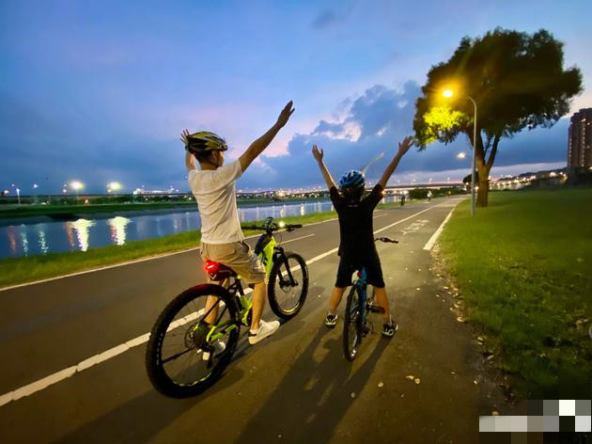

Race at River’s Edge
---2024-9 浙江嘉兴基础测试
人与社会之助人篇
郑素红

Slide 3
读原文:
Race at River’s Edge
Like me, my cousin Gabriel is into riding bikes. He’s 16 and I’m allowed to join him on longer rides because we’ re training for a charity cycling event.
One day, after checking our tires(轮胎), we set out for Tournus. Upon arrival, Gabriel and I parked our bikes near the river and walked to the town square. We’d just ridden 33 kilometers, and we were starving. We planned to get lunch and then ride to Mâcon, a small city in France on the Saône River.
It was market day. Locals were busy filling their baskets with groceries. Tourists hunted for gifts. Gabriel and I bought a long, thin loaf of bread and some Brie, a soft cheese which tasted awesome.
As we ate, I noticed a girl wearing a USA Basketball T- shirt. She smiled at us. Basketball is big in France too. You can even watch NBA games on TV. The girl stopped to buy some bread with her mum.

Slide 4
I saw them again by the river. They sat on a bench enjoying their food in front of a long, narrow riverboat named Voyageur. Then they boarded the boat. It was preparing to leave. Suddenly, I spotted a colorful shopping bag on the bench. The girl had left it! I looked up. Some passengers were gathering on the upper deck(甲板) of the riverboat, including the girl and her mum. I held up the bag and waved it to get their attention while Gabriel called to them.
When the girl noticed the bag, she opened her mouth in surprise. But her face fell as the boat started to pull away from the dock(码头). She didn’t think she’d get the stuff back.
Running alongside the boat, Gabriel learned from a sailor that the boat’s next stop was Mâcon —— our destination as well. It would take the boat just under two hours at a speed of 22 kilometers per hour. “ What can we do then?” he said.
Para1: “ We have to find a way to return it.” I replied.
Para2: Then it happened: pffft! Flat tire!

Slide 5
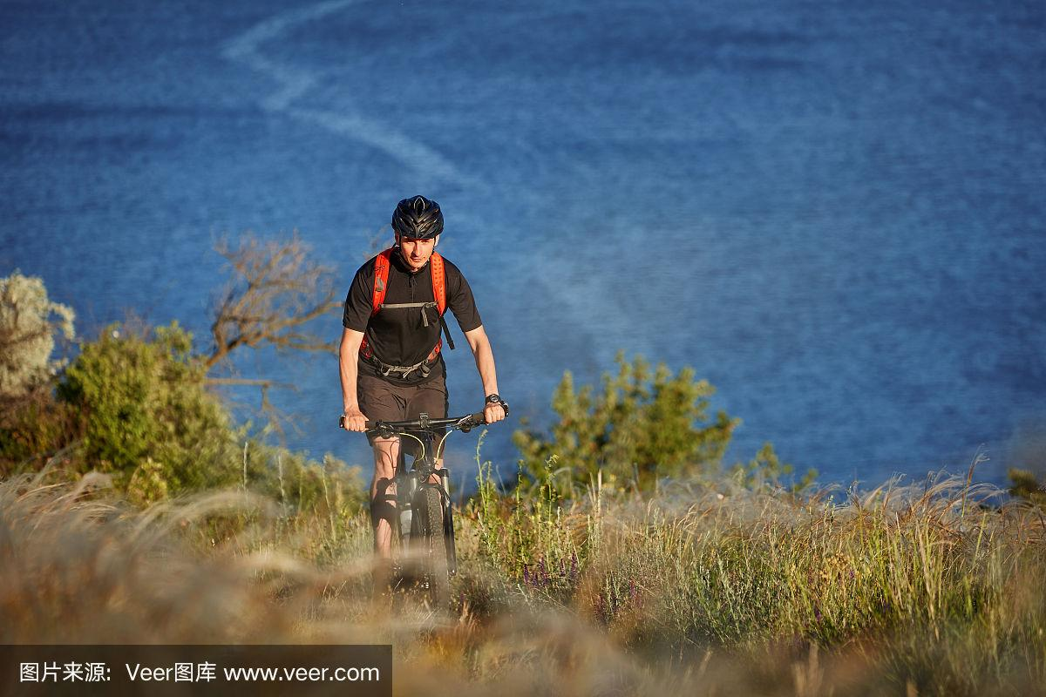
Read for elements
Major characters： Gabriel I
（supporting characters the girl , the girl’s mum)
2. narrative perspective: first-person ( I )
3. time：one day
place： at the river’s edge
event: send the shopping bag to the girl ( its owner)

Slide 6
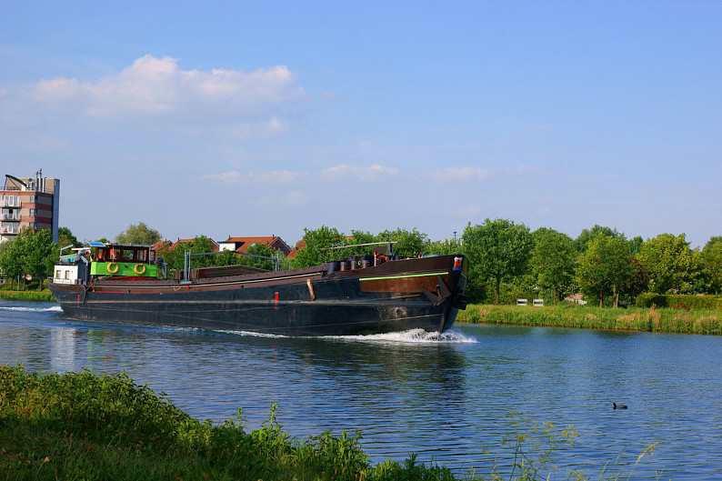
Conflict1 : The girl left her colorful shopping bag on a bench and boarded a riverboat .
Analyze conflicts
solution1: Gabriel and I raced to the next stop to send the bag to the girl .
Conflict 2: Flat tire!
solution 2: Gabriel fixed the flat tire with tools available.

Slide 7

5.story
line
Running alongside the boat, Gabriel learned from a sailor that the boat’s next stop was Mâcon —— our destination as well.
Climax
Para1: “ We have to find a way to return it.” I replied.
I held up the bag and waved at her and the girl noticed the bag. She didn’t think she would get the stuff back.
They boarded the riverboat and left a shopping bag on the bench.
Para2: Then it happened: pffft! Flat tire!
I noticed a girl wearing a USA Basketball T- shirt.
we set out for Tournus and paused for lunch.
Gabriel and I trained for a charity cycling event.
background
Ending
Beginning

Slide 8
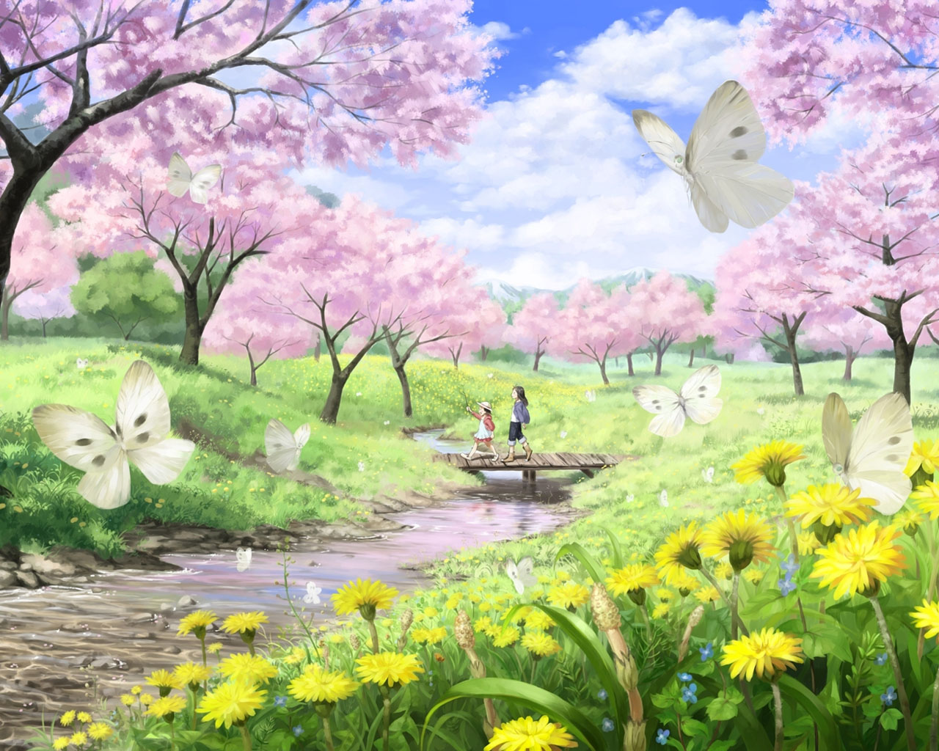
Read for clues and echoes
hidden clues | echoes
One day, after checking our tires(轮胎), we set out for Tournus. Upon arrival, Gabriel and I parked our bikes near the river and walked to the town square. We’d just ridden 33 kilometers, and we were starving. We planned to get lunch and then ride to Mâcon, a small city in France on the Saône River. | 1. As we approached our bikes parked near the river, we exchanged a look and exclaimed in unison, “ Let’s ride to Mâcon !” Thrilled at the brilliant idea, Gabriel and I packed up, mounted our bikes and set out for our destination.

Slide 9
Read for clues and echoes
hidden clues | echoes
…We’d just ridden 33 kilometers, and we were starving. We planned to get lunch and then ride to Mâcon, a small city in France on the Saône River. It was market day. Locals were busy filling their baskets with groceries. Tourists hunted for gifts. Gabriel and I bought a long, thin loaf of bread and some Brie, a soft cheese which tasted awesome. | 2. With renewed energy from bread and Brie, we packed up, hopped on to our bicycles and hit the road.

Slide 10
Read for clues and echoes
hidden clues | echoes
When the girl noticed the bag, she opened her mouth in surprise. But her face fell as the boat started to pull away from the dock(码头). She didn’t think she’d get the stuff back. | 3. Her face lit up as we returned the colorful shopping bag to her. 4. What she never expected was that due to our generous help, she reunited with her shopping bag .

Slide 11
Read for clues and echoes
hidden clues | echoes
Running alongside the boat, Gabriel learned from a sailor that the boat’s next stop was Mâcon —— our destination as well. It would take the boat just under two hours at a speed of 22 kilometers per hour. | 5. Gabriel and I cycled as fast as we could, hoping to catch up with the riverboat at Mâcon .

Slide 12
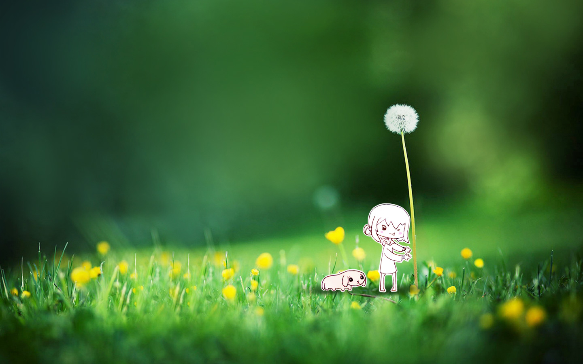
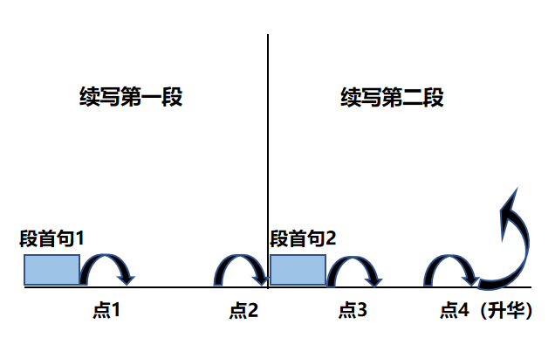
Plot Continuation
点1：位于续写第一段段首，流畅衔接前面的故事（常与原文最后一段呼应）和第一段段首语；
点2：位于续写第一段段尾，流畅衔接第二段段首句；
点3：位于续写第二段段首，续写衔接第二段段首语；
点4：文章结尾升华，给予读者正能量，揭示和强调主题。

Slide 13
Plot the continuation story
Para1: “ We have to find a way to return it.” I replied.
Para2: Then it happened: pffft! Flat tire!
Link1: What way did we find next?
Body: What did we do? How did we feel?
Link2: What did we expect of the bag?
Link3: How did I feel?
Body: Who dealt with the flat tire? After fixing the bike, what did we do? Did we return the bag to the girl? How did we or the girl or the girl’s mother feel?
Theme: What lesson did the experience demonstrate?

Slide 14
心理描写
神态描写
动作描写
外貌描写
环境描写
对话描写
语言
无灵主语
动作链
分词作状语
With 复合结构
独立主格
从句
倒装句
虚拟语气
强调句
长短句结合
考生构思情节的同时，要考虑合适的语言句式以及修辞

Slide 15
Design link1
…When the girl noticed the bag, she opened her mouth in surprise. But her face fell as the boat started to pull away from the dock(码头). She didn’t think she’d get the stuff back.
Running alongside the boat, Gabriel learned from a sailor that the boat’s next stop was Mâcon —— our destination as well. It would take the boat just under two hours at a speed of 22 kilometers per hour. “ What can we do then?” he said.
Para1: “ We have to find a way to return it.” I replied.
Link1A: Staring at the colorful shopping bag, Gabriel nodded in agreement. After exchanging our thoughts, We made a decision to ride as fast as we could to Mâcon and reach the dock before the riverboat arrived.

Slide 16
Design link1
…When the girl noticed the bag, she opened her mouth in surprise. But her face fell as the boat started to pull away from the dock(码头). She didn’t think she’d get the stuff back.
Running alongside the boat, Gabriel learned from a sailor that the boat’s next stop was Mâcon —— our destination as well. It would take the boat just under two hours at a speed of 22 kilometers per hour. “ What can we do then?” he said.
Para1: “ We have to find a way to return it.” I replied.
Link1B: As we approached our bikes parked near the river, we exchanged a look and exclaimed in unison, “ Let’s ride to Mâcon !”

Slide 17
Design link2
Para1: “ We have to find a way to return it.” I replied.
Para2: Then it happened: pffft! Flat tire!
Link2 A: Everything went super smoothly and we were getting nearer and nearer to our destination --- Mâcon despite our breathlessness.

Slide 18
Design link2
Para1: “ We have to find a way to return it.” I replied.
Para2: Then it happened: pffft! Flat tire!
Link2B: Undoubtedly, the bag would go back to its owner as we expected, which infused our hearts with delight and anticipation.

Slide 19
Design link3
Para2: Then it happened: pffft! Flat tire!
Link3A：Unexpectedly, my bicycle broke down, which brought my heart into my mouth. The riverboat wouldn’t stop to wait for us! We were out of time!

Slide 20
Design link3
Para2: Then it happened: pffft! Flat tire!
Link3B: My heart sank as my eyes fell on the flat tire. Never in my wildest dream had I imagined such an unexpected disaster happened midway.

Slide 21
Design ending
Para2: Then it happened: pffft! Flat tire!
Ending A: （情景式结尾 –回扣女孩重获购物袋时脸上的笑容）
The satisfaction of seeing a bright smile blossoming across her face was just incomparable.

Slide 22
Design ending
Para2: Then it happened: pffft! Flat tire!
Ending B: （情景式结尾----回扣原文女孩的笑容）
An enormous wave of surprise overwhelmed her as she took the shopping bag from our hands. Showered with numerous thanks from the mother and the girl, we said goodbye and continued our journey.

Slide 23
Design ending
Para2: Then it happened: pffft! Flat tire!
Ending C: （哲理式结尾----回扣原文女孩的笑容）
The unforgettable experience served as a reminder that a small gesture of kindness makes the world so beautiful. / the world a beautiful place to live in.

Slide 24
习作
Para1: “ We have to find a way to return it.” I replied.
Staring at the colorful shopping bag, Gabriel nodded in agreement. After exchanging our thoughts, We made a resolution to ride as fast as we could to Mâcon and reach the dock before the riverboat arrived. With renewed energy from bread and Brie, we packed up, hopped on to our bicycles and hit the road. The gentle breeze caressing our face, Gabriel and I cycled along the river bank like flying arrows. Meanwhile, we kept our eyes on the riverboat Voyageur for fear that it would vanish from the river. Time fleeting, we burst into cheers as we were approaching our destination--- Mâcon. Undoubtedly, the bag would go back to its owner as we expected, which infused our hearts with delight and anticipation. （123）

Slide 25
Para2: Then it happened: pffft! Flat tire!
My heart sank as my eyes fell on the flat tire. Never in my wildest dream had I imagined such an unexpected disaster happened midway. As an experienced cyclist, Gabriel, took out some tools and set out to fix it right away. I stood by, with my eyes fixed on the fast-moving riverboat, which was almost out of sight. No sooner had Gabriel exclaimed “Bingo!” than we embarked on the rest journey. With butterflies in stomach, we pedaled even harder, legs burning. Our painstaking efforts paid off ! We made it to Mâcon . The moment the riverboat called at the dock, we rushed over and returned the bag to the girl. The satisfaction of seeing a bright smile blossoming across her face was just incomparable. （124）

Slide 26
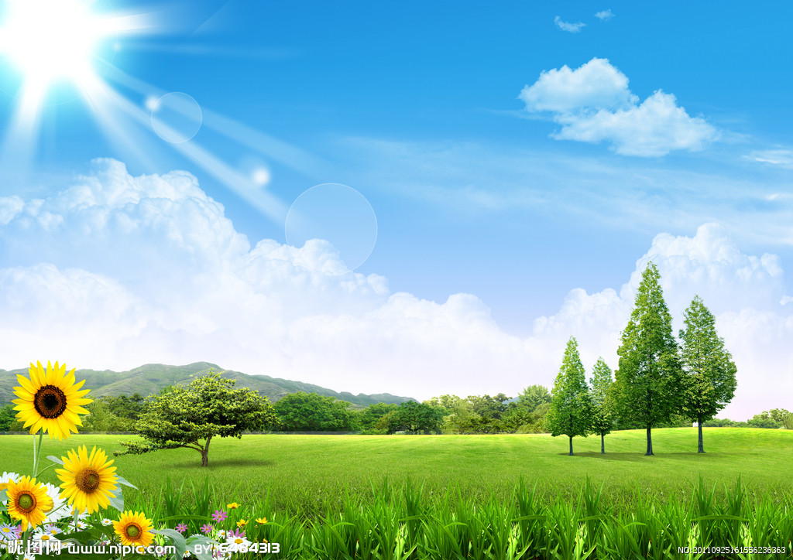
人与社会之助人篇语料
When I saw the bright smile blossom across her face, an enormous sense of pride surged inside me.
At the thought of her sadness for losing her shopping bag, I pedaled harder than before.
A small gesture of kindness did make a huge difference to the homeless.
Exhausting as the painstaking race on the river’s edge was, it served as a reminder –Roses given, fragrance in hand.
Showered with endless thanks from the girl and her mother,
we waved goodbye and continued our cycling journey back
home.
6. The satisfaction of seeing a bright smile blossoming across her face was just incomparable.

