Slide 1



感恩遇见，相互成就，本课件资料仅供您个人参考、教学使用，严禁自行在网络传播，违者依知识产权法追究法律责任。
更多教学资源请关注
公众号：溯恩英语
知识产权声明

Slide 2




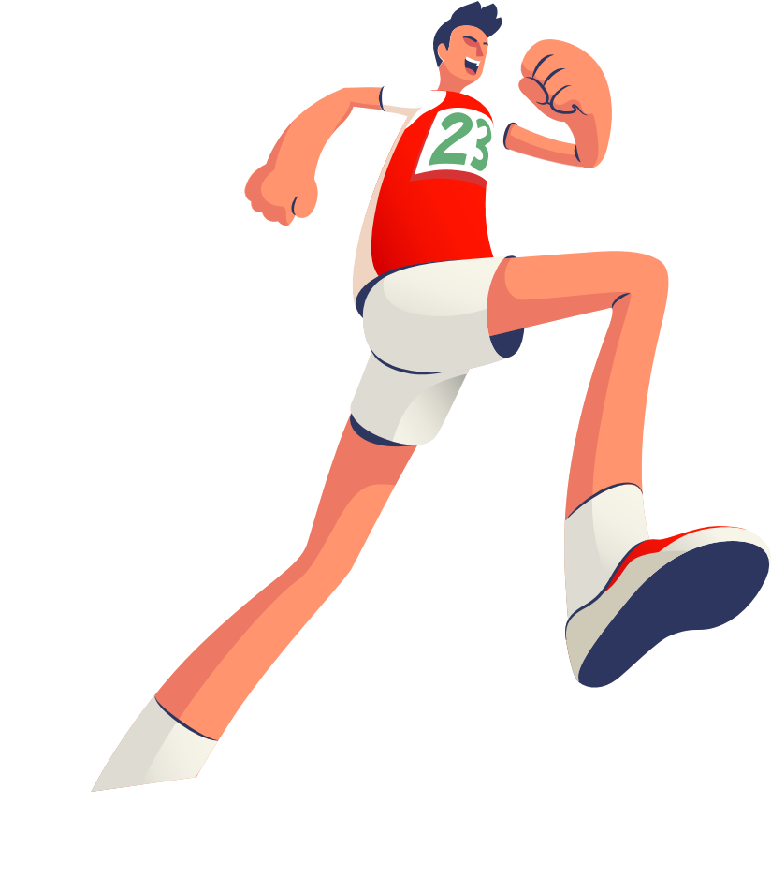



The Ultimate Trainers
Chapter I: The Perfect Trainers
Good English
Notes:
VCG41N1226331540 VCG211253393377

Slide 3
Teaching Objectives:
（1） Language Objectives
1. know the author of the story;
2. be able to understand the content of the story, grasp the main characters’ traits and complete writing tasks related to the story.
（2） Non-language Objectives:
grasp the true meaning of the competition (such as the true
sportsmanship) and hold a right attitude towards the winning of competition.

Slide 4



Read for author
He is an award-winning (一流的) children's author.
He was born in Manchester and attended Emmanuel College, Cambridge, and Manchester University. After completing two Masters' degrees (in Classics and Philosophy), he taught English in Istanbul for a year. After returning to the UK, he taught English as a foreign language for several years, and it was around this time that he published his first book, Zargon Zoo (1991).
Four years later, he published Bug Muldoon : the Garden of Fear, and relocated with his family to Wisconsin, United States, where he works as a freelance (自由职业的)writer and editor.
Paul Shipton
(born 1963)

Slide 5

Chapter I: The Perfect Trainers
Chapter 2: Kevin Beadle
Chapter 3: Jake Tries them out
Chapter 4: Anna works it out
Chapter 5: It won't prove anything
Chapter 6: Jake makes up his mind
Chapter 7: Where are the trainers?
Chapter 8: The big race
Chapter 9: The trainers get their own back
Chapter 10: Back to whenever

Slide 6

disappearance
function&
arguments
Chapter 6: Jake makes up his mind
Chapter 7: Where are the trainers?
Chapter 8: The big race
Chapter 2: Kevin Beadle
Chapter 3: Jake Tries them out
Chapter 4: Anna works it out
Chapter 5: It won't prove anything
Chapter 9: The trainers get their own back
truth&
return
Chapter I: The Perfect Trainers
appearance
Chapter 10: Back to whenever

Slide 7
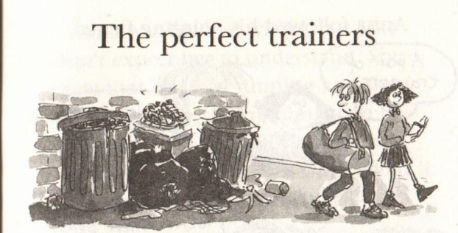
Chapter I
Who found them? Where and whose?
How was the condition of them?
What did people in the picture do with them?

Slide 8
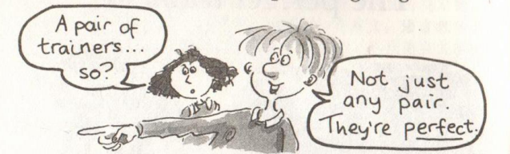
Read for content
Who found the trainers? Where were the trainers found? and whose are they?
what (object) | a pair of traners
where(location)
how (condition size)
whose (owner)
on top of a cardboard box next to a pile of rubbish bins
deserted/abandoned
brand new; in good shape;
Jake’s size
?

Slide 9
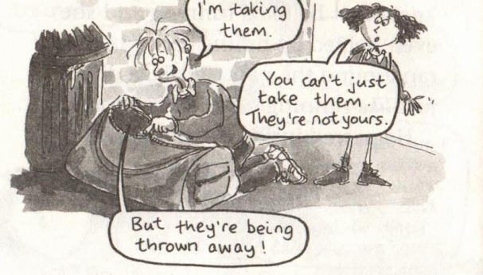
Read for thinking
Read for content
in exhilaration
How did Jake feel when meeting the trainers?
What do you think of Jake’s act of keeping them?
What did they do with the trainers?

Slide 10
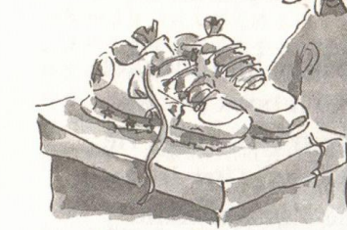
Found
Are these your trainers? I found a pair of trainers on top of a cardboard box next to a pile of rubbish bins outside our teaching building, which is approximately size 37. The shoes look new and in good condition. My name is Jake from class 1. If these shoes belong to you, please come to my classroom (room 101, building 1) to get it.

Slide 11
Read for language
Find out Jack’s actions before and after he found the trainers.
vHe just gazed at the trainers. 他盯着运动鞋。
vHe edged closer. 他小心地走上前去
vHe peered inside the trainers. 往里面仔细看
vJack unzipped his school bag. 杰克拉开书包的拉链。
vHe stuffed the trainers into his bag. 把跑鞋塞进书包里

Slide 12
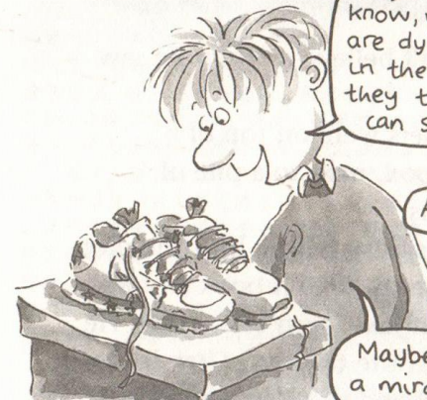
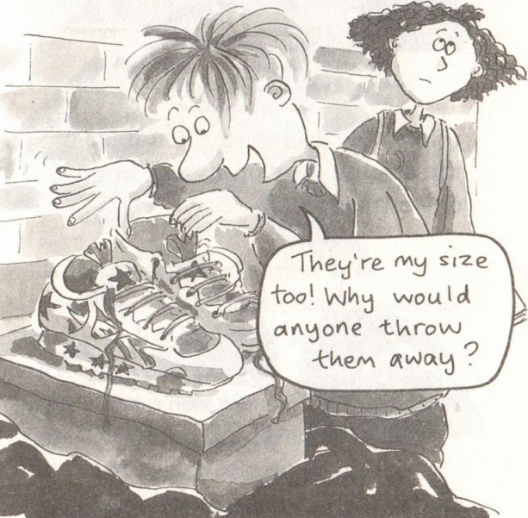
Read for language
vHe just gazed at the trainers. 他盯着运动鞋。
He peered inside the trainers. 往里面仔细看
gaze at= stare at n./v.:to look steadily at sb/sth for a long time, 凝视；注视；盯着 eg. He met her gaze.目光相遇
peer into/at: v. to look closely or carefully at sth, especially when you cannot see it clearly仔细看；端详 (peer n. 同龄人)

Slide 13
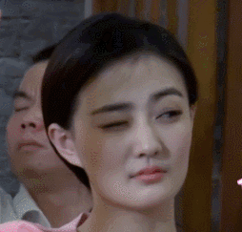
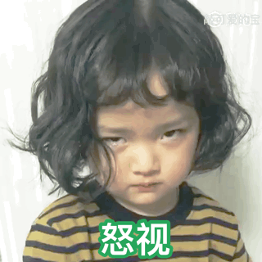

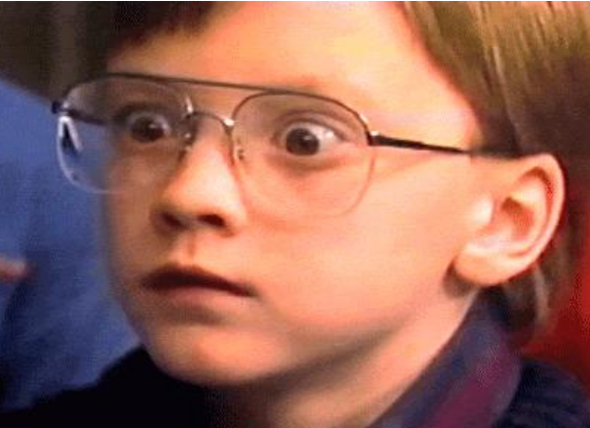
Glance at: To give a quick, short look at something or someone
Glimpse at: To see something or someone for a very short time or only partly
Glare at: To look directly and continuously at someone or something in an angry way
glance at: n./v give a quick, short look at sth or sb瞥一眼
glimpse at: n./v.see sth or sb for a very short time or only partly瞥见
glare at: n./v.look directly and continuously at sb or sth in an angry way怒视
peek at:n./v. to look at sth quickly and secretly because you should not be looking at it窥视；偷看 eg. She peeked at the gift before her birthday.
gape at :n./v. look in great surprise at sb or soth, especially with an open mouth目瞪口呆地注视

Slide 14
Fill in the blanks with the above words.请用上面的表示“看”的动词填空
He ______at the sunset with a feeling of peace.
He _______at the photo through his glasses.
The teacher _______at the noisy students, demanding silence.
I only ________at her as she walked by.
The little girl ______ into the box, her eyes widening with delight at the sight of the new puppy.
We ______ in amazement at her incredible performance.
gazed /stared
peered
glared
glimpsed/glanced
peek
gape

Slide 15
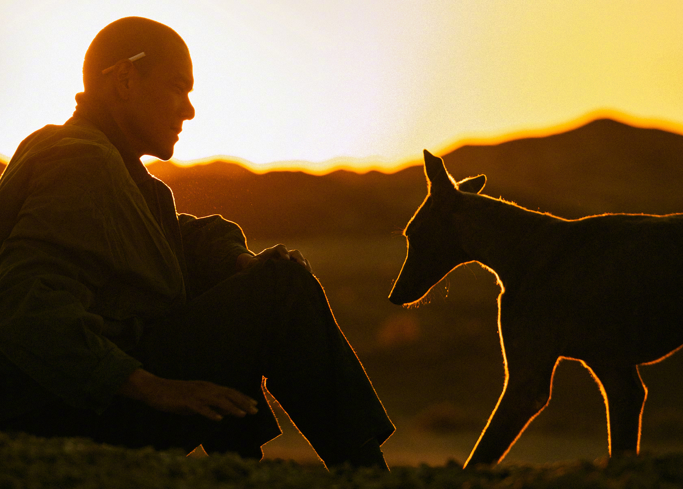
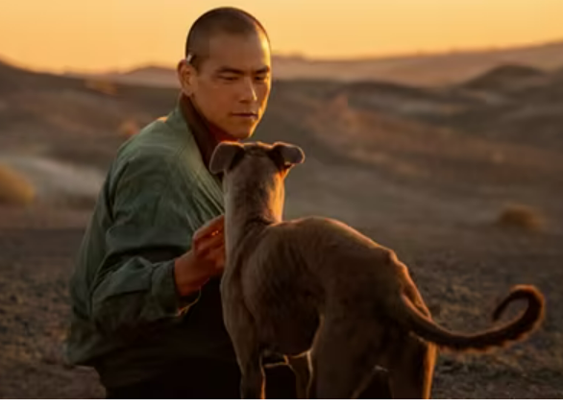
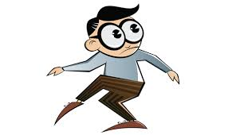
vHe edged closer. 他小心地走上前去 vt. move slowly 徐徐移动）
The dog edged slowly towards the man, and sat next to him.
vThe thief tiptoed carefully, trying not to wake up the sleeping woman.
on the edge of +n. (tears/despair... )/vting(breaking down)几乎要...
She was on the edge of tears when she heard the disappointing news.
tiptoe:v. 踮着脚走，蹑手蹑脚地走；

Slide 16
vJake unzipped his school bag.
vHe stuffed the trainers into his bag.
杰克拉开书包的拉链。
(unzip -pp-vt. 拉开)
把跑鞋塞进书包里
(stuff
[ VN+ adv./prep.] to push sth quickly and carelessly into a small space把…塞进（或填进）
•She stuffed the money under a cushion.她把钱塞到软垫底下。

Slide 17
1. 他透过窗户仔细看，想看看敲门的是谁。(peer)
He peered through the window to see who was knocking at the door.
2. 出于好奇，她慢慢靠近那幅神秘的画。(edge)
Curiosity driving her, she edged closer to the mysterious painting.
Out of curiosity,...
3. 我仔细地拉开背包的拉链，将必需品——一件保暖的夹克、一张地图和一个指南针——塞了进去，确保我为即将到来的冒险做好了准备。(unzip; stuff)
I carefully unzipped my backpack to stuff in the essentials: a warm jacket, a map, and a compass, ensuring I was prepared for the adventure ahead.
4. 他急忙抬起头，眼睛与老师严厉的目光相遇。(gaze)
He hurriedly lifted his head, his eyes meeting his teacher’s severe gaze.

Slide 18
