Slide 1


感恩遇见，相互成就，本课件资料仅供您个人参考、教学使用，严禁自行在网络传播，违者依知识产权法追究法律责任。
更多教学资源请关注
公众号：溯恩英语
知识产权声明

Slide 2





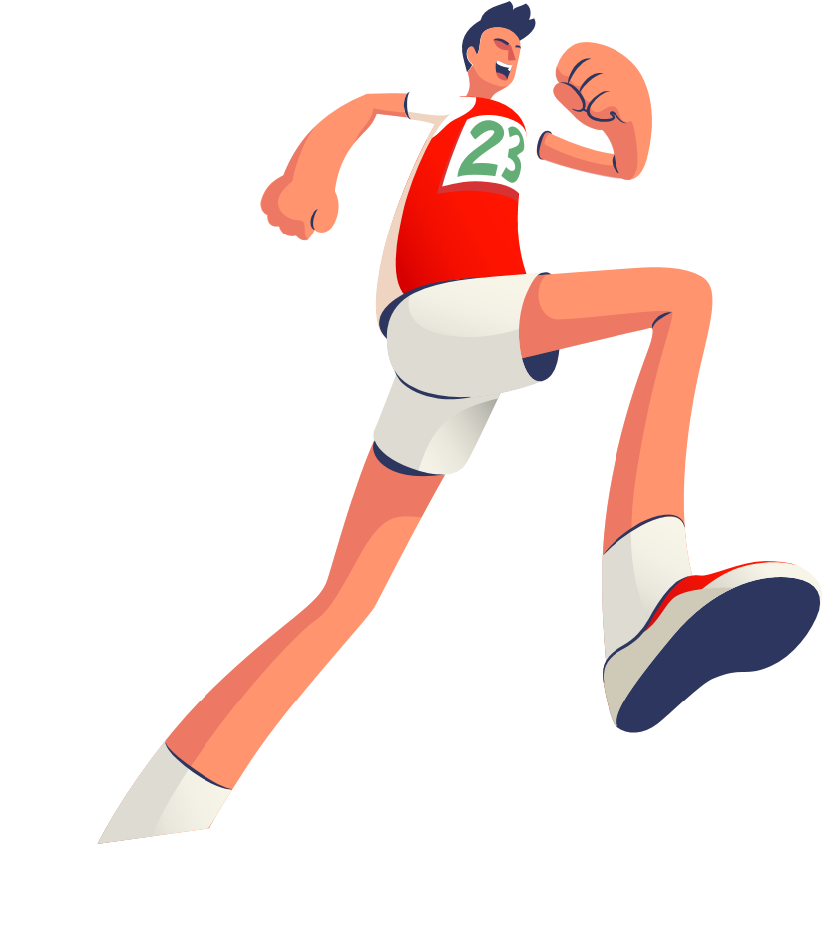


The Ultimate Trainers
Chapter 2-3
Good English
Notes:
VCG41N1226331540 VCG211253393377

Slide 3

Teaching Objectives:
Language Objectives:
1. know the author of the story;
2. be able to understand the content of the story, grasp the main characters’ traits and complete writing tasks related to the story.
Non-language Objectives:
grasp the true meaning of the competition (such as the true
sportsmanship) and hold a right attitude towards the winning of competition.

Slide 4

Chapter 6: Jake makes up his mind
Chapter 7: Where are the trainers?
Chapter 8: The big race
Chapter 2: Kevin Beadle
Chapter 3: Jake Tries them out
Chapter 4: Anna works it out
Chapter 5: It won't prove anything
Chapter 9: The trainers get their own back
Chapter I: The Perfect Trainers
Chapter 10: Back to whenever

Slide 5
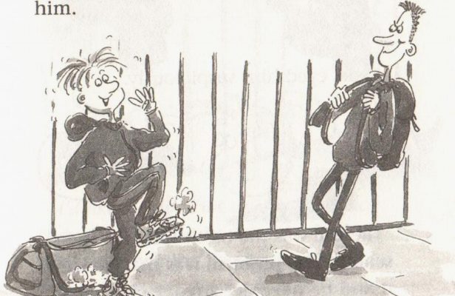
Chapter 2 Kevin Beadle
Who is Kevin Beadle?
How is he?

Slide 6
Beadle was the best runner in the school. The problem was that he knew it and he never let anyone else forget it either. Ever since Jake had joined the cross-country team, Kevin had been picking on him.'They won't help, you know, ' sneered Beadle.' It doesn't matter if you run in snazzy(/ˈsnæzi/时髦的) trainers, flip-flops, or old army boots, Jake Crandall! The only thing you'll see of me in the Championships is a cloud of dust! 'He walked away laughing.
Who is Kevin Beadle?
How is he?
talented but
boastful; impolite; unkind; he is a bully
If you were Jake how would you respond to his behavior?

Slide 7
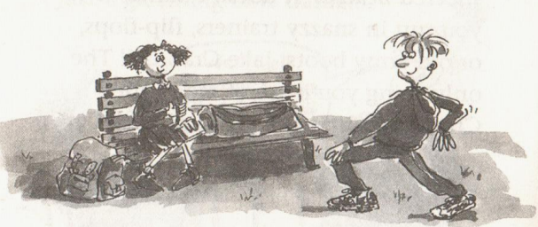
Chapter 3 Jake Tries them out
How did Jake feel after trying?

Slide 8
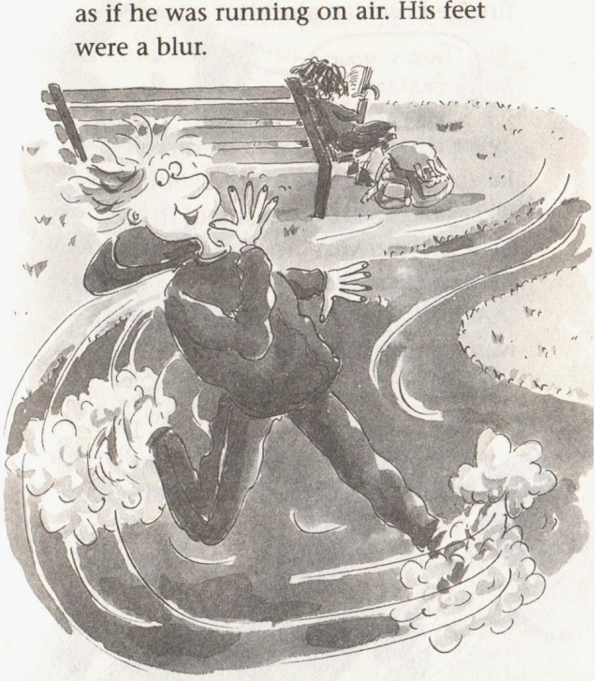
Usually Jake set out at a light jog at first. But today was different. He reached top speed straight away. He didn't plan it- it just happened. It felt as if he was running on air. His feet were a blur....
But the second lap was faster yet.Jake zoomed round and he didn't even feel out of breath. Not at all! In fact,he felt wonderful. And he was still picking up speed!
The third lap flashed by too. This was
normally the time when Jake got a stitch
in his side and his breath began to wheeze.
Not today. He zoomed around the park and
he still felt completely fresh.
They are _______-saving; ___________-enhancing
effort performance

Slide 9
Read for language
Jake usually liked Thursdays at school,but that day seemed to drag on forever.
drag on : to go on for too long拖得太久；持续太久
The dispute has dragged on for months.这场争论没完没了地持续了数月。
drag by : (of time时间 ) to pass very slowly过得很慢/拖沓地进行
•The last few weeks of the summer really dragged by.夏天最后的几个星期过得真是慢啊。

Slide 10
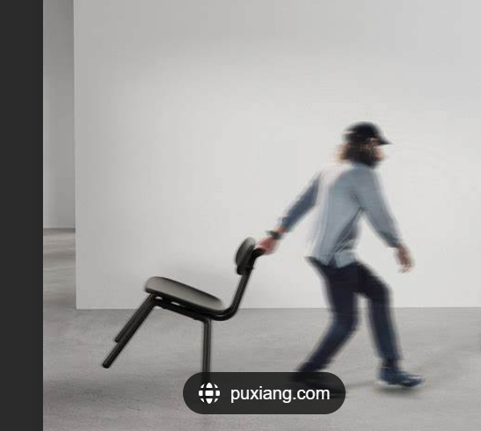
drag /dræɡ/ ( -gg- )
1. [ + adv./prep.] pull with effort and difficulty（使劲而吃力地）拖，拉，拽，扯
•I dragged the chair over to the window.
2. [ + adv./prep.] to move yourself slowly and with effort缓慢而费力地移动（或行进）
•I managed to drag myself out of bed.

Slide 11
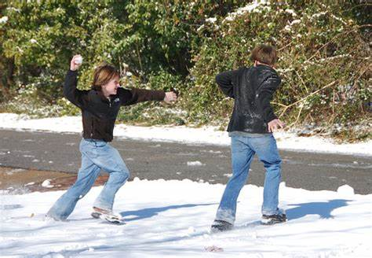
When the bell finally rang, he pelted to the changing rooms and got ready.
1.~ sb (with sth)to attack sb by throwing things at them向…投掷
•The children pelted him with snowballs.
2.~ (down)( of rain雨 ) to fall very heavily倾泻；下得很大
3.[ V+ adv./prep.] =dash飞跑
•We pelted down the hill after the car.

Slide 12

The bigger boy sneered when he saw Jake's gleaming new trainers.
sneer (at sb/sth) 嘲笑；讥讽；嗤笑
[ V]•He sneered at people who liked pop music.
gleam /ɡliːm/ to shine with a pale clear light发微光；隐约闪光；闪烁
•The moonlight gleamed on the water.
月光照在水面上泛起粼粼波光。

Slide 13

Jake eyed him suspiciously.
eye /aɪ/ n.v. (eye·ing or eying eyed eyed)
[ VN] to look at sb/sth carefully, especially because you want sth or you are suspicious of sth注视；审视；细看
•They couldn't help eyeing the cakes hungrily.

Slide 14
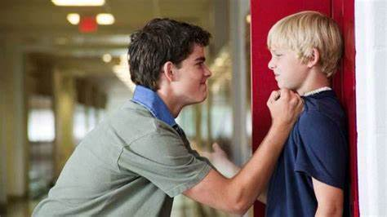
Kevin had been picking on him.
欺负某人
.
He gets picked on by other boys because he is so small.

Slide 15
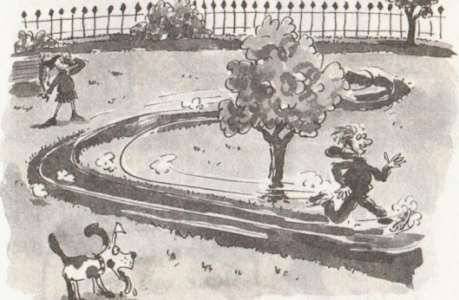
Find out two words in chapter 3 indicating sb runs fast.
He called out his lap time as he whizzed by.
Jake zoomed around and he didn't even feel out of breath.picking up speed(加速)
whiz whizzing whizzed whizzes
: If sth whizzes somewhere, it moves very fast. 嗖嗖地快速移动
• They heard bullets continue to whiz over their heads.
他们听到子弹不断在他们头顶上嗖嗖飞过。
zoom:
[ V+ adv./prep.] to move or go somewhere very fast快速移动；迅速前往
Traffic zoomed past us.车辆从我们身边疾驰而过。

Slide 16
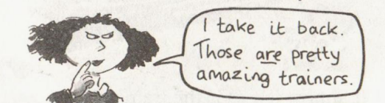
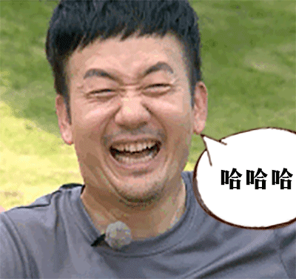
Jack shook his head and grinned, but Anna just narrowed her eyes.
眯眼
grin /ɡrɪn/ ( -nn- )
v. ~ (at sb)to smile widely露齿而笑；咧着嘴笑；龇着牙笑
•She grinned amiably at us.她咧着嘴向我们亲切地微笑。
He was grinning from ear to ear .他笑得合不拢嘴。
n.
•She gave a broad grin .她咧着嘴大笑。

