Slide 1



感恩遇见，相互成就，本课件资料仅供您个人参考、教学使用，严禁自行在网络传播，违者依知识产权法追究法律责任。
更多教学资源请关注
公众号：溯恩英语
知识产权声明

Slide 2
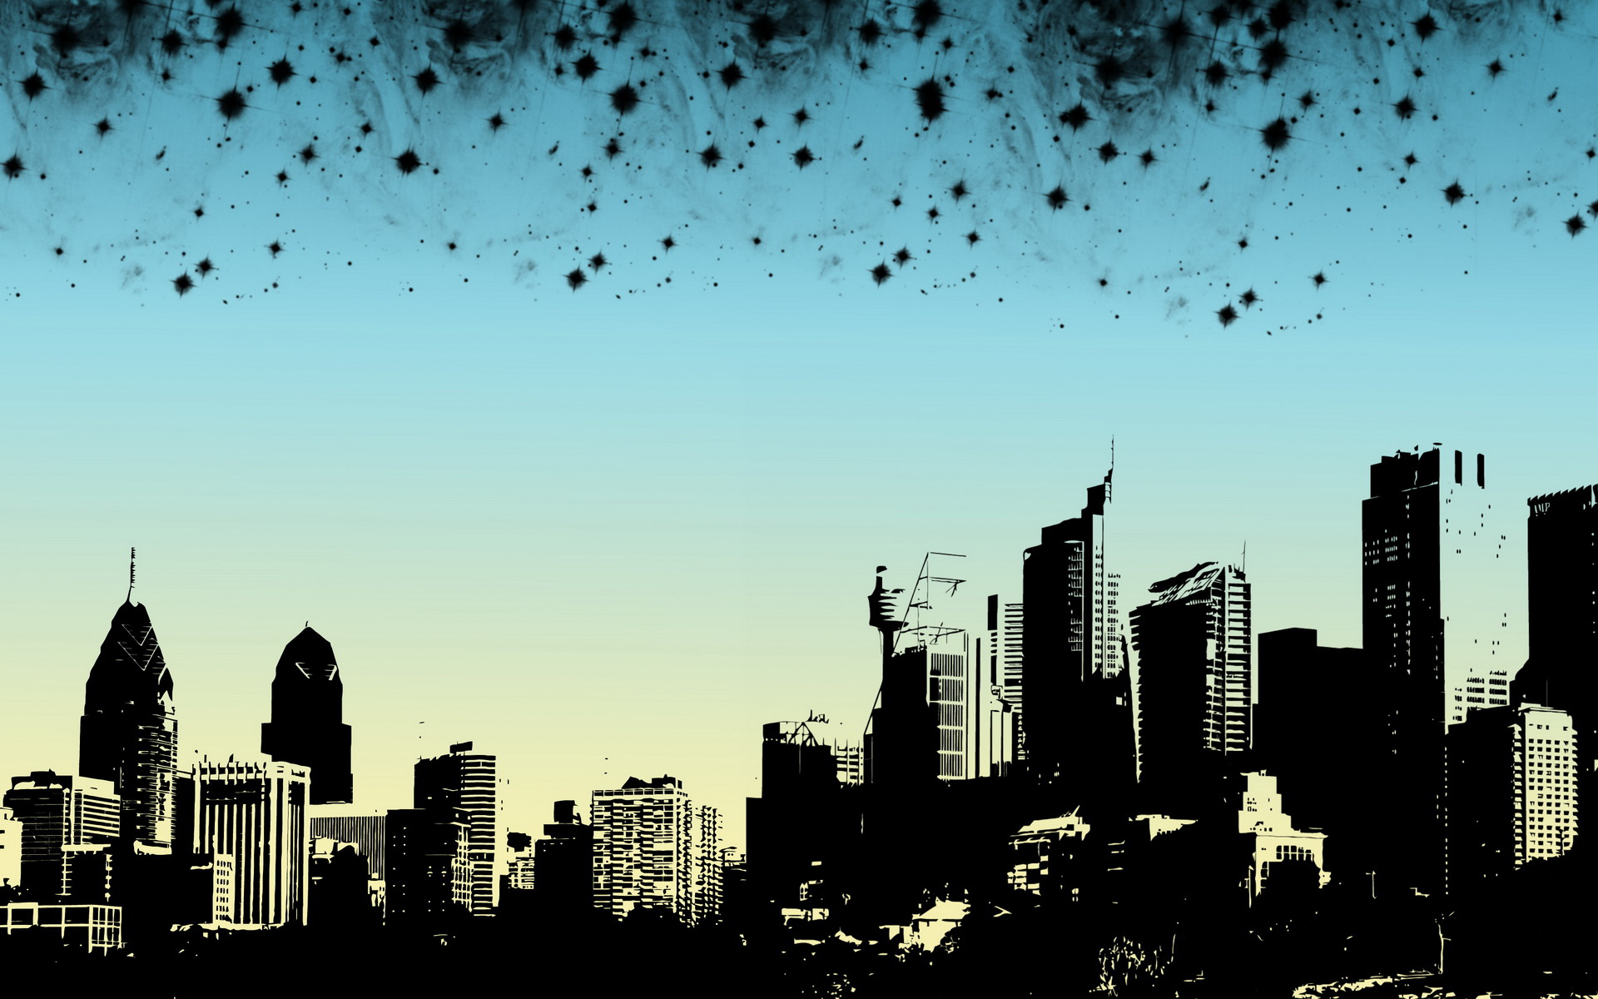
Unit 4 Natural Disasters
Unit 4 Natural Disasters
Reading and Thinking
Reading and Thinking

Slide 3
Learning Objectives
1
Figure out the text type and the structure of the passage;
2
Recognize some expressions and language feature about literary literature;
3
Describe a natural disaster with what we learned and be clear of how to reduce mortality.

Slide 4
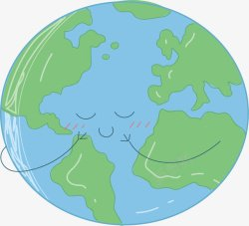
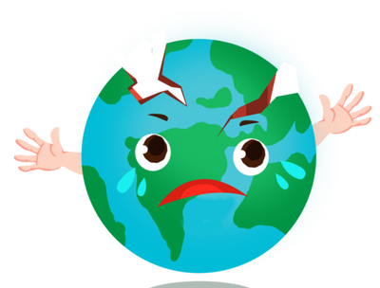
Lead in
1.What can you see in the picture?
2.What is she doing?
3.Can the earth sleep?
4. If the earth didn't sleep,what
would happen?

Slide 5
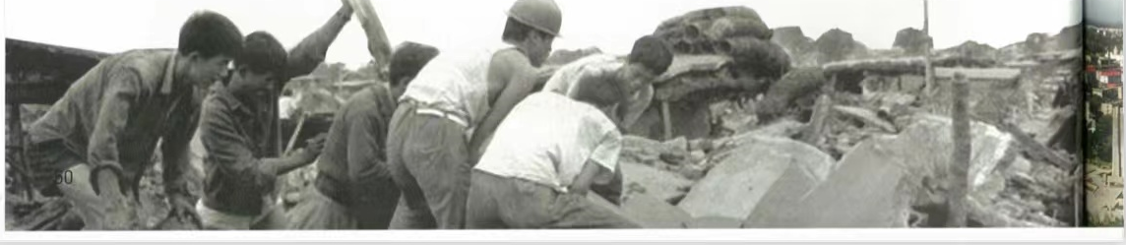
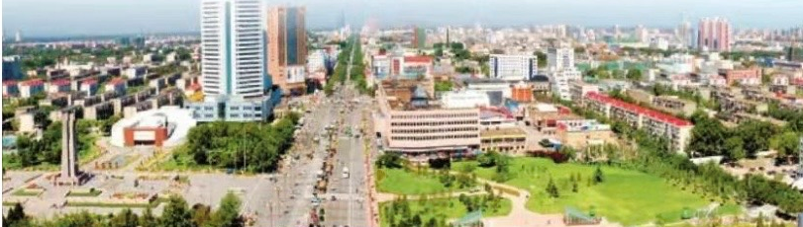
Prediction
If you were a reporter, what information would be reported to the world based
on the title and pictures?
The Night the Earth Didn’t Sleep
A terrible________(what) happened in____________(where)_______________( when), causing great________, but with the help of______________(who), the city _______________(what result).
earthquake
Tangshan
at night
damage
whole nation
has been rebuilt

Slide 6
Read for main idea
earthquake
A terrible________(what) happened in____________(where)_______________( when), causing great________, but with the help of______________(who), the city _______________(what result).
Tangshan
at night
damage
whole nation
has been rebuilt

Slide 7
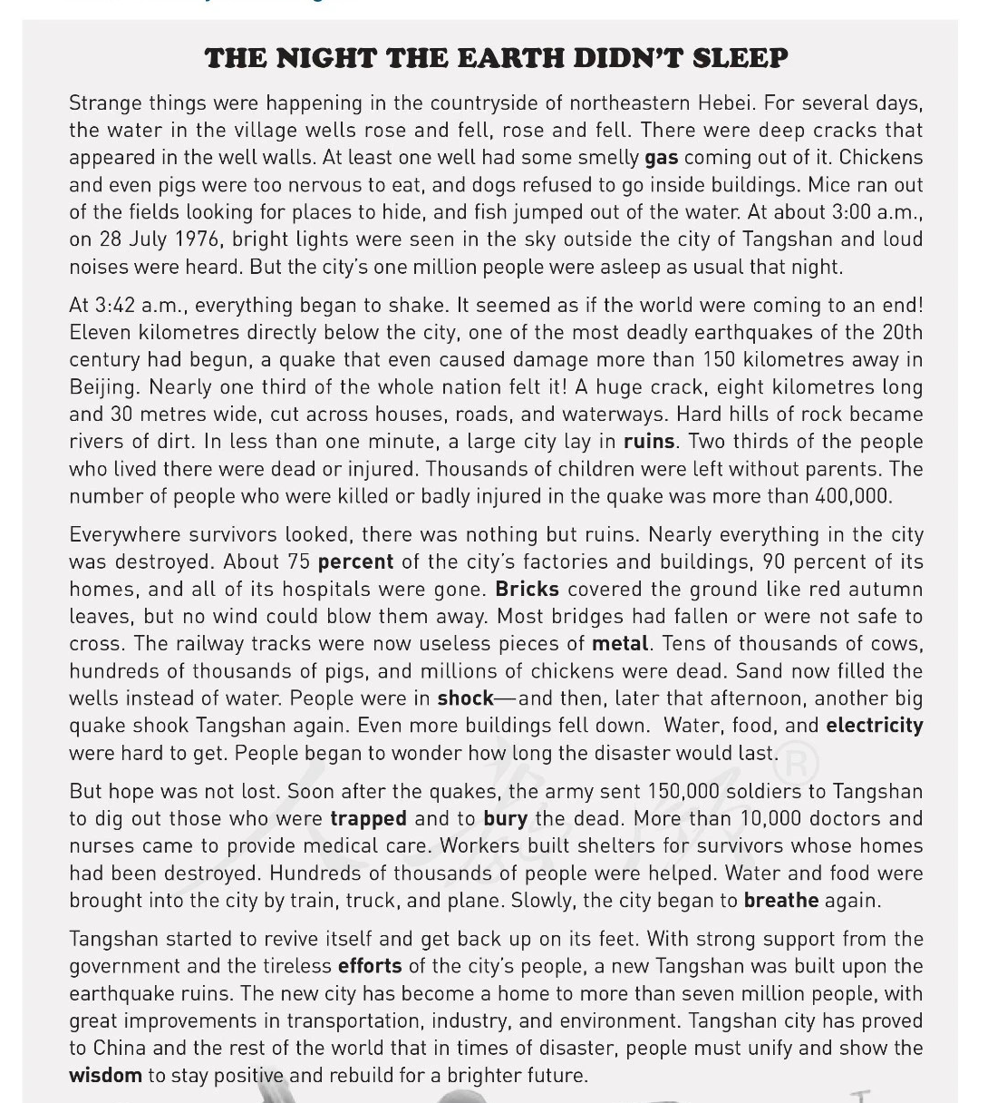
Read for main idea
Underline the topic sentence in each para. and summarize it in one phrase.
Reading tip 1: To get the main idea of each para.,pay attention to the first or last sentence.

Slide 8
Read for main idea
Underline the topic sentence in each para. and summarize it in one phrase.
Para.1:_________ before the earthquake.
Para.2:The _______of the big earthquake.
Para.3:The _______of the earthquake.
Para.4:The__________work
Para.5: The__________of the city

Slide 9
Read for structure
Underline the topic sentence in each para. and summarize it in one phrase.
Para.1:Strange sights before the earthquake.
happening
Para.2:The _________ of the big earthquake.
Reading tip 2: Guess the meaning of news words based on context（上下文）.
destructive
effects
Para.3:The ____________of the
earthquake.
rescue
Para.4:The ______ work
revival
Para.5: The __________of the city

Slide 10
Read for structure
How many parts can the passage be further divided into?
Para.1:Before the earthquake
Para.1:Strange sights before the earthquake.
happening
Para.2:The _________ of the big earthquake.
Para.2-3: During the earthquake
Para.3:The destructive _________ of the
earthquake.
effects
rescue
Para.4:The ______ work
Para.4-5:After the earthquake
revival
Para.5: The __________of the city

Slide 11
Read for structure
How is the passage developed?
Para.1:strange sights before the earthquake.
The passage is developed in the order of___________.
time
Para.2-3: damage during the earthquake.
Para.4-5:rescue work after the earthquake.

Slide 12
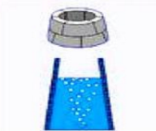
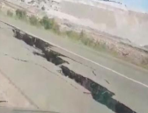
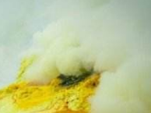




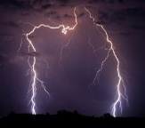
Read for details
Part1:Describe the strange sights before the earthquake according to the pictures.
for several
days
rose and fell
The water in the well____________.
deep cracks
___________appeared in the well walls.
smelly gas
__________came out of the cracks.
too nervous to
Chickens and pigs were________________ eat.
refused to go
Dogs ____________ inside the buildings.
ran out
Mice ______ of the fields.
at about 3:00 a.m.
jumped out
Fish _________ of the water.
bright lights were seen
_______________in the sky and loud noises were
heard.

Slide 13
Read for details
Part1:Do you think they are warning signs? and why?(这个问题待定！！口头问一下过度到下个问题即可）
for several
days
The water in the well____________.
___________appeared in the well walls.
__________came out of the cracks.
Chickens and pigs were_____________ eat.
Dogs ____________ inside the buildings.
Mice ______ of the fields.
at about 3:00 a.m.
Fish _________ of the water.
_______________in the sky and loud noises were
heard.

Slide 14
Read for details
Part1: How to understand the last sentence in para.1“But the city's one million people were asleep as usual that night. ”?
People were not aware of strange signs, and knew nothing about the earthquake at that time,so they didn’t get prepared.

Slide 15
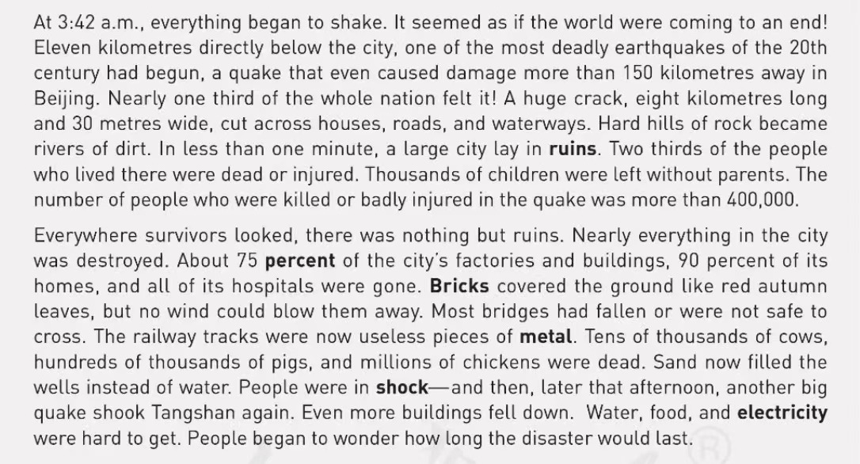
Read for details
Part2: Can you find some supporting evidence to show the great damage?

Slide 16
Read for language feature
Part2: How does the writer show the damage? And why?
Using numbers can be objective(客观的），and convincing（令人信服的） .
A huge crack, eight kilometres long and 30 metres wide, cut across houses, roads, and waterways.
Two thirds of the people who lived there were dead or injured. Thousands of children were left without parents. The number of people who were killed or badly injured in the quake was more than 400.000.
About 75 percent of the city's factories and buildings, 90 percent of its homes, and all its hospitals were gone.
Tens of thousands of cows, hundreds of thousands of pigs, and millions of chickens were dead.

Slide 17
Read for language feature
Part2: What aspect did the earthquake cause damage to ?
A huge crack, eight kilometres long and 30 metres wide, cut across houses, roads, and waterways.
About 75 percent of the city's factories and buildings, 90 percent of its homes, and all its hospitals were gone.
Thousands of children were left without parents. The number of people who were killed or badly injured in the quake was more than 400.000.
Two thirds of the people who lived there were dead or injured.
Tens of thousands of cows, hundreds of thousands of pigs, and millions of chickens were dead.
cause damage to city’s construction(建设）
cause damage to people’s mental and physical health
cause damage to animal’s lives

Slide 18
Read for language feature
Part2: Besides numbers, what kind of figure of speech(修辞）did the writer use to show its damage?
personification（拟人）：the practice of representing objects, qualities, etc. as humans, in art and literature
metaphor（暗喻）：a word or phrase that compares sth to sth else, not using the words “like” or “as”
simile（明喻）：a word or phrase that compares sth to sth else，using the words “like” or “as”
exaggeration（夸张）：a statement or description that make sth seem larger, better, worse than it really is

Slide 19
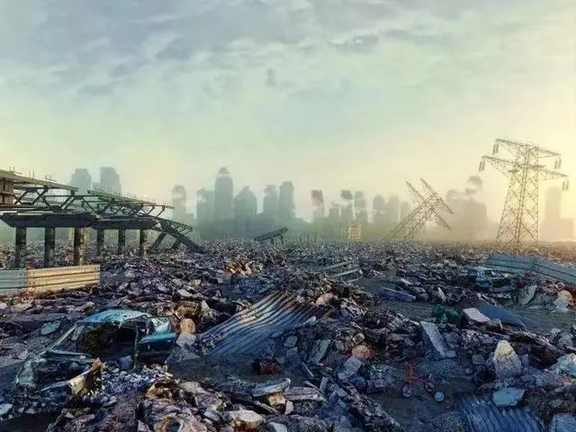
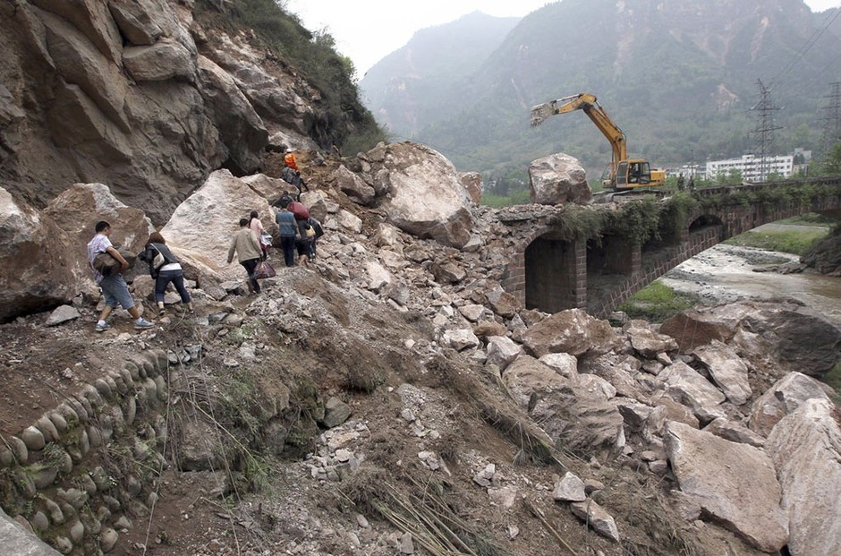
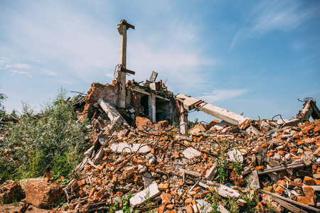
Read for language feature
Part2: Besides numbers, what kind of figure of speech(修辞）did the writer use to show its damage?
A. metaphor 暗喻
B. simile 明喻
C. personification拟人
D. exaggeration夸张
It seemed as if the world were coming to an end! （Para.2; Line 1)
Hard hills of rock became rivers of dirt.(Para.2; Line 5)
Bricks covered the ground like red autumn leaves, but no wind could blow them away. (Para.3; Line3)

Slide 20
Read for language feature
Part2: Besides numbers, what kind of figure of speech(修辞）did the writer use to show its damage?
Using figure of speech gives us vivid and impressive picture .
A. metaphor 暗喻
B. simile 明喻
C. personification拟人
D. exaggeration夸张
It seemed as if the world were coming to an end! （Para.2; Line 1)
Hard hills of rock became rivers of dirt.(Para.2; Line 5)
Bricks covered the ground like red autumn leaves, but no wind could blow them away. (Para.3; Line3)
D. exaggeration夸张
A. metaphor 暗喻
B. simile 明喻

Slide 21
Read for language feature
What is probably the text type?
A. narration（记叙文 ）
B. exposition（说明文）
C. argumentation（议论文）
D. literary journalism（文学新闻）

Slide 22
Read for language feature
What is probably the text type?
objective and convincing（令人信服的）--data/number
vivid and impressive --figure of speech (metaphor/simile/personification/exaggeration）
A. narration（记叙文 ）
B. exposition（说明文）
C. argumentation（议论文）
D. literary journalism（文学新闻）
“Showing”is more powerful than“telling”in conveying meanings and emotions

Slide 23
Further thinking
Part2: Why did it cause such great damage? Please think about it from the following aspects(层面）.
the magnitude（震级） of earthquake：
time it happened：
people:
technology:
...

Slide 24
Further thinking
Part2: Why did it cause such great damage? Please think about it from the following aspects(层面）.
the magnitude（震级） of earthquake：
time it happened：
people:
technology:
...
has a magnitude of 7.8
early in the morning--fall asleep--no time to escape
have little awareness of earthquake
lack(缺少）early warning systems （earthquake prediction and monitoring system）--fail to provide advanced notice& get prepared

Slide 25

Further thinking
Try to voice-over (配音）for this video.
Q:If you had experienced the earthquake in Tangshan, what would you feel?

Slide 26
Further thinking
Part2: If you had experienced the earthquake in Tangshan, what would
you feel? （配音选择重要数据以及修辞的几个句子）
插入唐山地震视频，最好吻合 p2p3，一边放 一边找个学生有感情的配音，为此问题形成情感上的共鸣，引出问题 如果你在经历，你是什么感受？（承上启下）

Slide 27
Read for details
Part3: How did the people in Tangshan feel and why?
But hope was not lost. Soon after the quakes, the army sent 150,000 soldiers to Tangshan to dig out those who were trapped and to bury the dead. More than 10,000 doctors and nurses came to provide medical care. Workers built shelters for survivors whose homes had been destroyed. Hundreds of thousands of people were helped. Water and food were brought into the city by train, truck, and plane. Slowly, the city began to breathe again.
Tangshan started to revive itself and get back up on its feet. With strong support from the government and the tireless efforts of the city's people, a new Tangshan was built upon the earthquake ruins. The new city has become a home to more than seven million people, with great improvements in transportation, industry, and environment. Tangshan city has proved to China and the rest of the world that in times of disaster, people must unify and show the wisdom to stay positive and rebuild for a brighter future.

Slide 28
Read for details
Part3: How did the people in Tangshan feel and why?
But hope was not lost. Soon after the quakes, the army sent 150,000 soldiers to Tangshan to dig out those who were trapped and to bury the dead. More than 10,000 doctors and nurses came to provide medical care. Workers built shelters for survivors whose homes had been destroyed. Hundreds of thousands of people were helped. Water and food were brought into the city by train, truck, and plane. Slowly, the city began to breathe again.
Tangshan started to revive itself and get back up on its feet. With strong support from the government and the tireless efforts of the city's people, a new Tangshan was built upon the earthquake ruins. The new city has become a home to more than seven million people, with great improvements in transportation, industry, and environment. Tangshan city has proved to China and the rest of the world that in times of disaster, people must unify and show the wisdom to stay positive and rebuild for a brighter future.

Slide 29
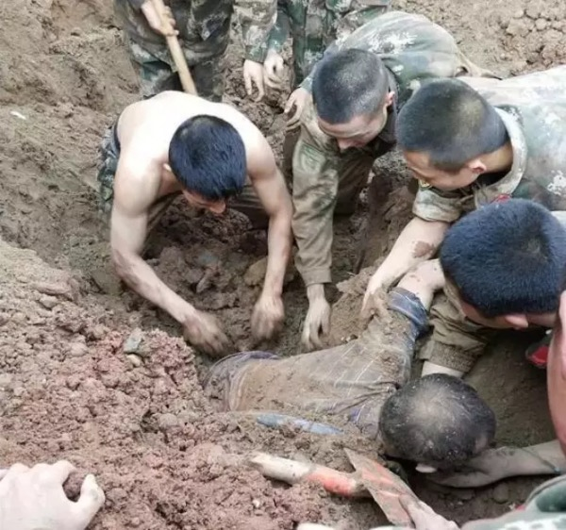
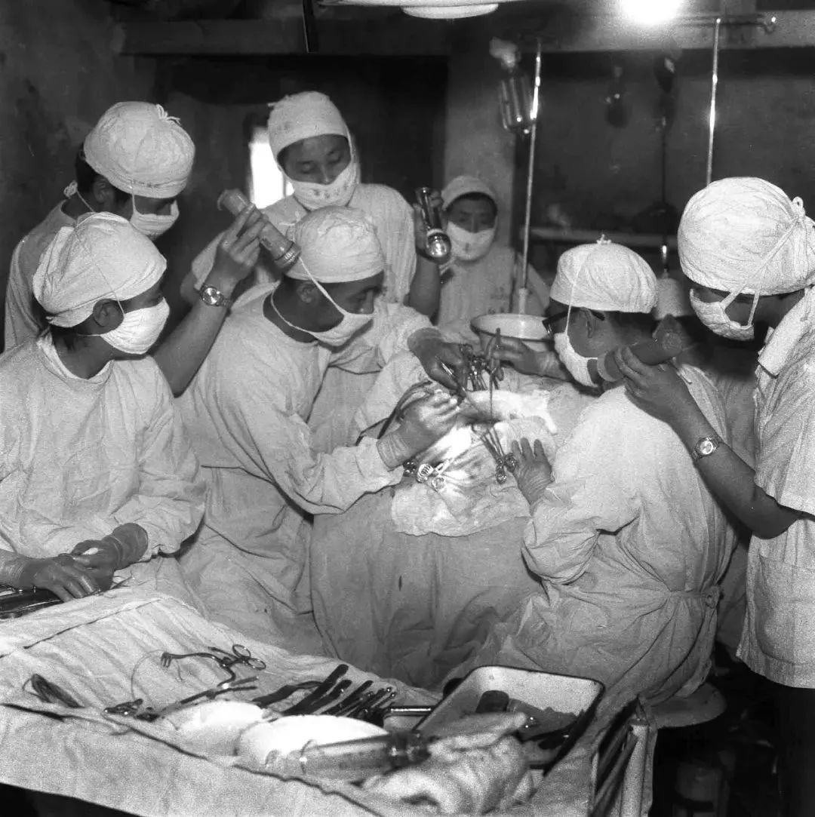
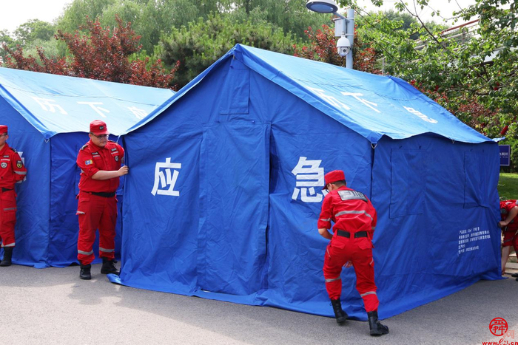

Read for details
Part3: Who came to the rescue? What did they do?
But hope was not lost. Soon after the quakes, the army sent 150,000 soldiers to Tangshan to dig out those who were trapped and to bury the dead. More than 10,000 doctors and nurses came to provide medical care. Workers built shelters for survivors whose homes had been destroyed. Hundreds of thousands of people were helped. Water and food were brought into the city by train, truck, and plane. Slowly, the city began to breathe again.
Tangshan started to revive itself and get back up on its feet. With strong support from the government and the tireless efforts of the city's people, a new Tangshan was built upon the earthquake ruins. The new city has become a home to more than seven million people, with great improvements in transportation, industry, and environment. Tangshan city has proved to China and the rest of the world that in times of disaster, people must unify and show the wisdom to stay positive and rebuild for a brighter future.

Slide 30
Read for details
Part3: Who came to the rescue? What did they do?
But hope was not lost. Soon after the quakes, the army sent 150,000 soldiers to Tangshan to dig out those who were trapped and to bury the dead. More than 10,000 doctors and nurses came to provide medical care. Workers built shelters for survivors whose homes had been destroyed. Hundreds of thousands of people were helped. Water and food were brought into the city by train, truck, and plane. Slowly, the city began to breathe again.
Tangshan started to revive itself and get back up on its feet. With strong support from the government and the tireless efforts of the city's people, a new Tangshan was built upon the earthquake ruins. The new city has become a home to more than seven million people, with great improvements in transportation, industry, and environment. Tangshan city has proved to China and the rest of the world that in times of disaster, people must unify and show the wisdom to stay positive and rebuild for a brighter future.

Slide 31
Read for details
Part3:What does the writer mean by “Slowly, the city began to breathe again.”
But hope was not lost. Soon after the quakes, the army sent 150,000 soldiers to Tangshan to dig out those who were trapped and to bury the dead. More than 10,000 doctors and nurses came to provide medical care. Workers built shelters for survivors whose homes had been destroyed. Hundreds of thousands of people were helped. Water and food were brought into the city by train, truck, and plane. Slowly, the city began to breathe again.
Tangshan started to revive itself and get back up on its feet. With strong support from the government and the tireless efforts of the city's people, a new Tangshan was built upon the earthquake ruins. The new city has become a home to more than seven million people, with great improvements in transportation, industry, and environment. Tangshan city has proved to China and the rest of the world that in times of disaster, people must unify and show the wisdom to stay positive and rebuild for a brighter future.

Slide 32
Read for details
Part3:What does the writer mean by “Slowly, the city began to breathe again.”
But hope was not lost. Soon after the quakes, the army sent 150,000 soldiers to Tangshan to dig out those who were trapped and to bury the dead. More than 10,000 doctors and nurses came to provide medical care. Workers built shelters for survivors whose homes had been destroyed. Hundreds of thousands of people were helped. Water and food were brought into the city by train, truck, and plane. Slowly, the city began to breathe again.
Tangshan started to revive itself and get back up on its feet. With strong support from the government and the tireless efforts of the city's people, a new Tangshan was built upon the earthquake ruins. The new city has become a home to more than seven million people, with great improvements in transportation, industry, and environment. Tangshan city has proved to China and the rest of the world that in times of disaster, people must unify and show the wisdom to stay positive and rebuild for a brighter future.
?

Slide 33
Read for details
Part3: What does the writer mean by “Slowly, the city began to breathe again.”
But hope was not lost. Soon after the quakes, the army sent 150,000 soldiers to Tangshan to dig out those who were trapped and to bury the dead. More than 10,000 doctors and nurses came to provide medical care. Workers built shelters for survivors whose homes had been destroyed. Hundreds of thousands of people were helped. Water and food were brought into the city by train, truck, and plane. Slowly, the city began to breathe again.
Tangshan started to revive itself and get back up on its feet. With strong support from the government and the tireless efforts of the city's people, a new Tangshan was built upon the earthquake ruins. The new city has become a home to more than seven million people, with great improvements in transportation, industry, and environment. Tangshan city has proved to China and the rest of the world that in times of disaster, people must unify and show the wisdom to stay positive and rebuild for a brighter future.

Slide 34
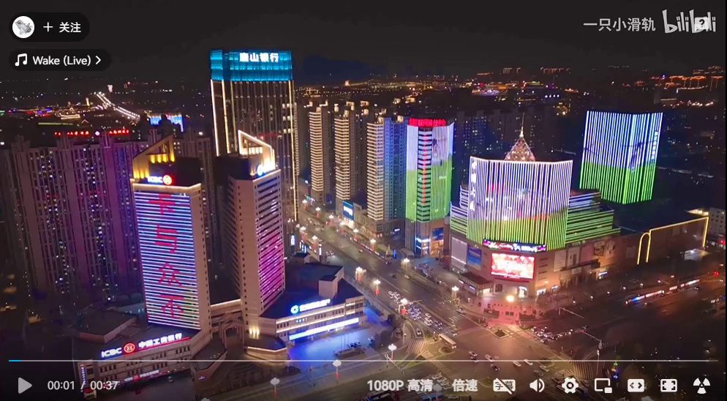
The city of Tangshan has now taken on a new look.

Slide 35
Further thinking
Part3: What can we learn from the event?
Tangshan city has proved to China and the rest of the world that in times of disaster, people must unify and show the wisdom to stay positive and rebuild for a brighter future.
When disaters struck, help from all sides.
一方有难，八方支援！

Slide 36
Group discussion
What else can we do in face of natural disaster?

Slide 37

Group work
What else can we do in face of natural disaster?
 | before | during | after
Technology：early warning system/ predict and monitor/rescue robot
People： （awareness意识/basic knowledge/stay calm&keep positive）
Building& infrastructure：（基础建设） （solid enough to stand up to.../build shelters)
Rescue work (army/doctors/workers/government...）

Slide 38
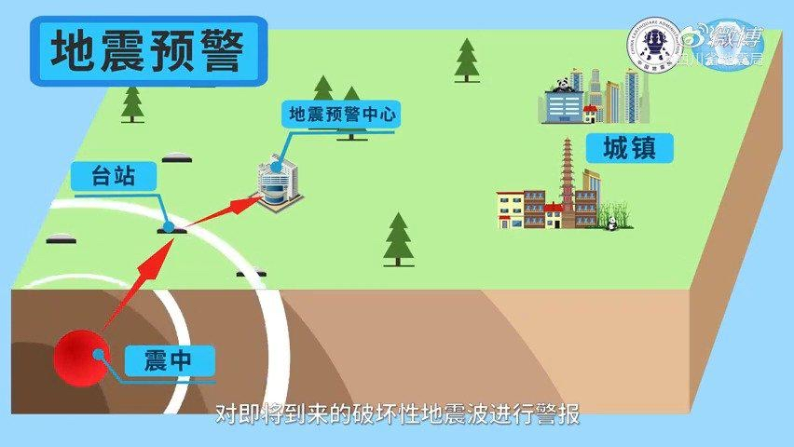
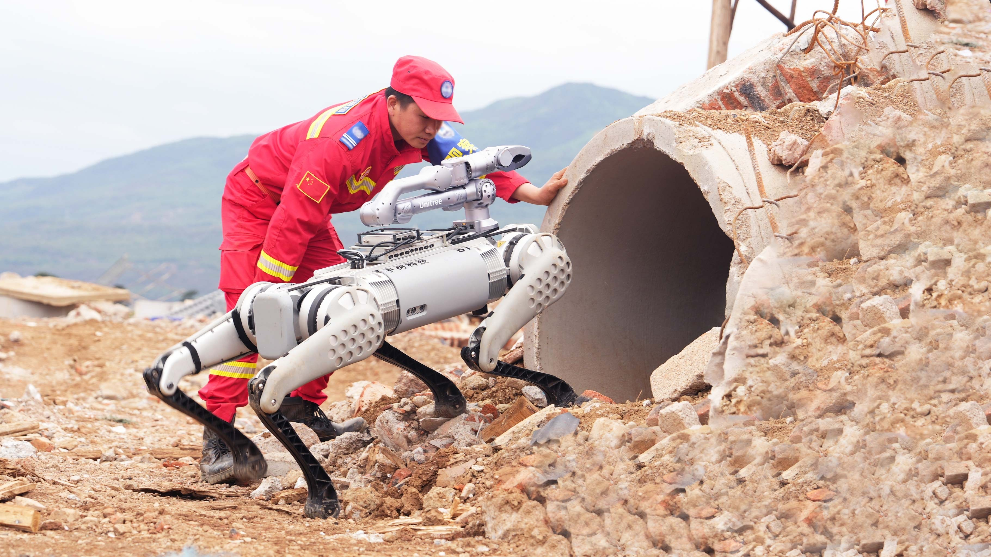
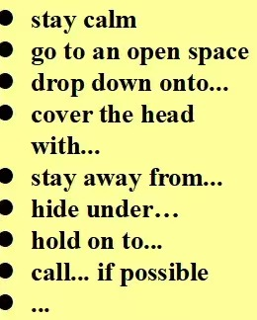
Group work
What else can we do in face of natural disaster?
 | before | during | after
Technology：early warning system/ predict and monitor/rescue robot
People： （awareness意识/basic knowledge/stay calm&keep positive）
Building& infrastructure：（基础建设） （solid enough to stand up to.../build shelters)
Rescue work (army/doctors/workers/government...）

Slide 39



Group work
2.How to reduce mortality in face of natural disaster?
Group leader | Group member A | Group member B | Other group members
Assign tasks | Make a presentation | take note of key points | Contribute ideas

Slide 40
Show time
2.How to reduce mortality in face of natural disaster?
Group leader | Group member A | Group member B | Other group members
Assign tasks | Make a presentation | take note of key points | Contribute ideas

Slide 41
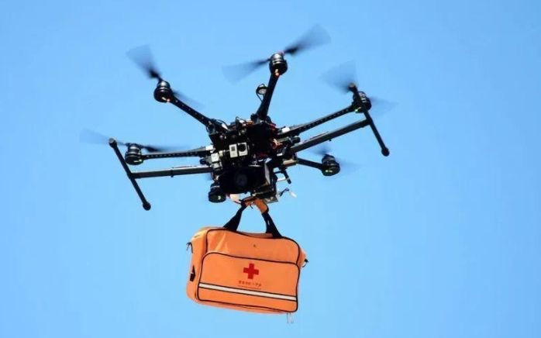
Group work
How to reduce death rate in face of natural disaster?
 | before | during | after
Technology：early warning system/ predict and monitor
People： （awareness意识/basic knowledge）
Building& infrastructure：（基础建设） （solid enough to stand up to...)
Rescue work (army/doctors/workers/government...）

Slide 42
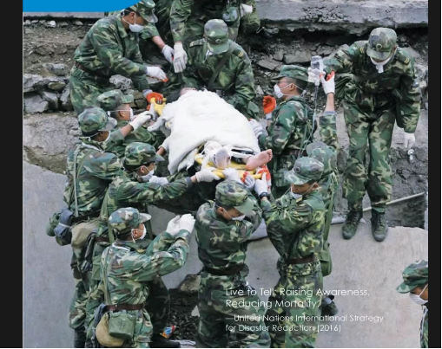
Live to tell: Raising awareness, reducing mortality.
--United Nations International Strategy for Disater Reduction

Slide 43
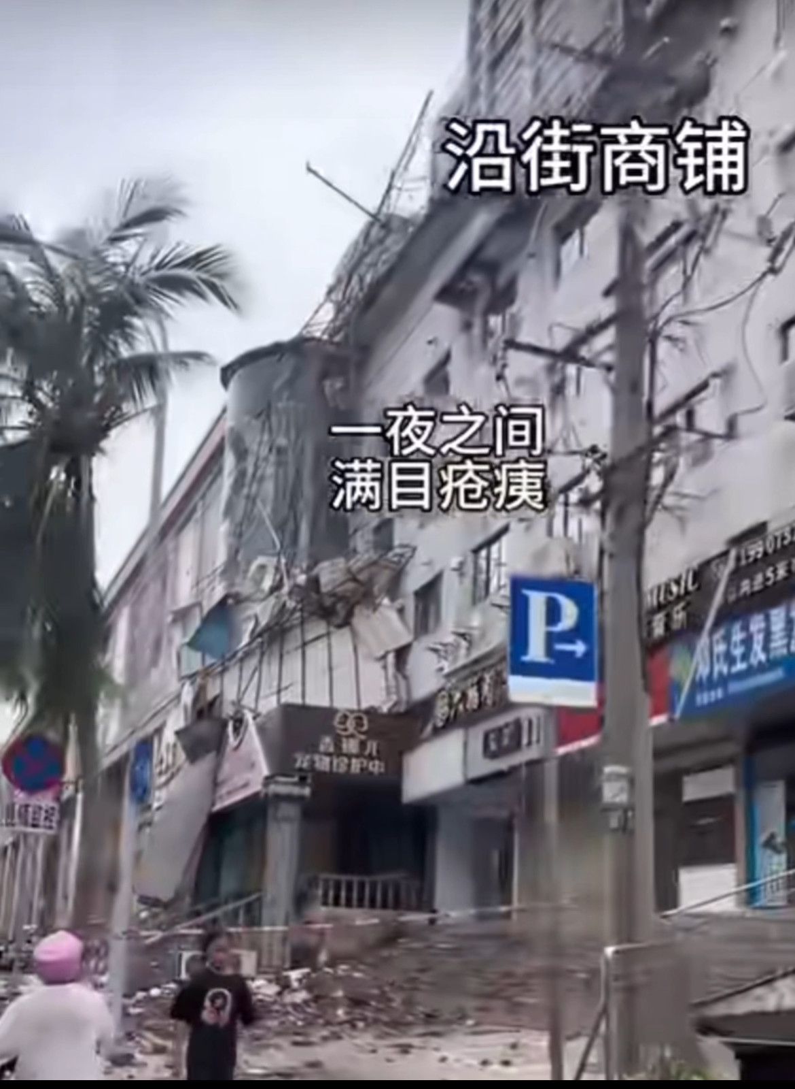
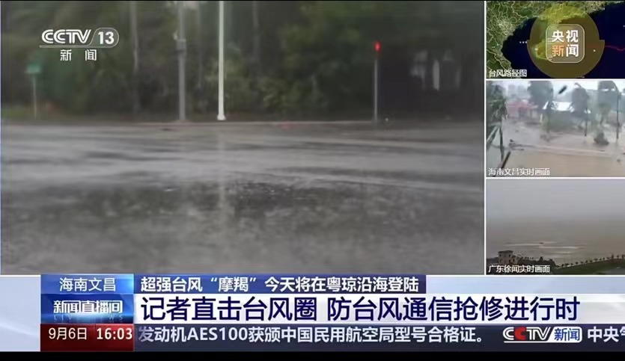
Assignment
Based on what we learned about the earthquake, can you make a news report for the natural disaster happening around us?
key points: time/place/event &destructive damage& rescue work
language feature: numbers& figure of speech

