Slide 1


感恩遇见，相互成就，本课件资料仅供您个人参考、教学使用，严禁自行在网络传播，违者依知识产权法追究法律责任。
更多教学资源请关注
公众号：溯恩英语
知识产权声明

Slide 2









采用要点分解三段式突破活动类应用文
以安徽六校教育研究会2025届高三年级入学素质测试应用文为例：
校园新闻报道：
拒绝校园霸凌
刘艳

Slide 3
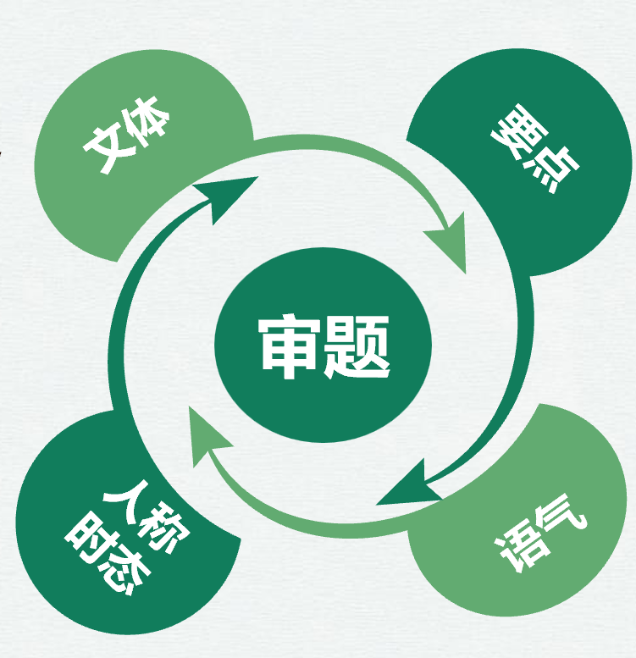

安徽六校教育研究会2025届高三年级入学素质测试
1 拒绝校园霸凌”的主题活动
2 活动相关情况；
3 你的感悟；
假定你是李华，你校组织了一次“拒绝校园霸凌”的主题活动（Say No to Campus Bullying）。请给校英文报写一篇报道，内容包括：
1．活动相关情况；
2．你的感悟；
注意：写作词数应为80左右。
Say No to Campus Bullying
新闻报道
德育
第三人称，
一般过去时、+一般现在时
建议专门一张PPT讲清楚“要点分解三段法”，作为本堂课重要的方法和技能
新闻报道，正式、严谨、简明
要点的分解？
采用要点分解三段法

Slide 4

新闻报道首段：导语（分解要点）扼要概括新闻的核心内容，即发生了何事
语气特点：正式、严谨、简明
常用句型：1. A significant event, which aimed to [purpose], was organized by [organizer] yesterday.
2. An important conference, whose topic was [topic], was held by [host] recently.
3. A remarkable exhibition, with the theme of [theme], was launched by [sponsor] last week.
4. A special ceremony, which focused on [focus], was conducted by [performer] this month.
5. In an effort to.. ，a meaningful activity, was arranged by [arranger] earlier this week.
上周，为了提高学生对校园霸凌危害的认识并促进和谐校园环境，我们学校在校园里举办了一场以拒绝校园霸凌为主题的活动。该活动取得了显著成效。 （非限制性定语从句/ 无灵主语）
Last week, in an effort to raise students‘ awareness of the harm of campus bullying and promote a harmonious campus environment, our school held an activity themed around rejecting campus bullying at the campus，which achieved remarkable results.非限制性定语从句
Last week saw an activity themed around rejecting campus bullying take place in the school, aiming to raise students' awareness of the perils of campus bullying and promote a harmonious campus environment. The activity achieved remarkable results. （无灵主语）

Slide 5
新闻报道body （分解要点） ：活动相关情况
语气特点：正式、严谨、简明
分解要点
举办反霸凌主题讲座，邀请专家为学生讲解校园霸凌的危害及应对方法。
活动相关情况
Hold anti-bullying lectures and invite experts to explain the harms of campus bullying and coping methods to students.
组织学生进行反霸凌主题的话剧表演，通过生动的演绎让学生更深刻地认识霸凌行为。
反霸具体凌活动？
Organize students to perform anti-bullying themed dramas. Through vivid interpretations, students can have a deeper understanding of bullying behaviors.
活动形式类型：
开展反霸凌主题征文比赛，鼓励学生用文字表达对霸凌的看法和反对霸凌的决心。
Launch an anti-bullying themed essay competition to encourage students to express their views on bullying and their determination to oppose bullying in words.
进行班级反霸凌主题班会，让学生们分享自己对霸凌的认识和经历，共同探讨如何防止霸凌。
Conduct anti-bullying themed class meetings to let students share their understanding and experiences of bullying and jointly discuss how to prevent bullying.

Slide 6

语料积累：校园活动的常见类型和形式：
Competition types: Subject knowledge competitions to stimulate students' enthusiasm for learning; sports events such as track and field meets and basketball games to enhance students' physical fitness; art competitions such as painting competitions and singing competitions to cultivate students' artistic literacy.
Speech types: Themed speech competitions to exercise students' expression ability and logical thinking; interactive speech sessions after expert lectures for students to share their insights and feelings.
Class meeting types: Themed class meetings to discuss and learn around specific themes such as safety education and civilized etiquette; achievement reporting class meetings for students to display the results of group activities.
Exhibition types: Exhibitions of students' excellent works including calligraphy, paintings, and handicrafts; exhibitions of scientific and technological achievements to display students' technological innovation works.
Practice types: Social practice activities such as community service and volunteer activities to cultivate students' sense of social responsibility
Signature activity types: By organizing signature activities such as anti-bullying signatures and environmental protection initiative signatures, students can express their support and commitment to specific themes, enhancing their sense of participation and responsibility.

Slide 7
新闻报道body （分解要点） ：活动相关情况
语气特点：正式、严谨、简明
分解要点：活动相关情况：时间顺序介绍+平行结构顺序
活动相关情况
时间顺序介绍
首先，在礼堂举行了一场反霸凌专家讲座。专家们生动地阐述了霸凌的危害，并提供了切实可行的解决方案。学生们专心致志地聆听。接着，各个教室举行了主题班会。学生们热情地分享了他们对霸凌的看法和经历，并就预防措施进行了深入讨论。最后，发起了签名活动。学生们聚集在校园广场，在反霸凌横幅上签名。这标志着活动达到了高潮，进一步增强了反霸凌活动的影响力。
First, an expert lecture on anti-bullying was held in the auditorium. Experts vividly expounded on the harms of bullying and offered practical solutions. Students listened intently. Then, themed class meetings were held in each classroom. Students passionately shared their views and experiences on bullying and engaged in in-depth discussions on preventive measures. Finally, a signature activity was launched. Students gathered in the campus square and signed their names on the anti-bullying banner. This marked the climax of the activity and further boosted the impact of the anti-bullying campaign.

Slide 8
语料积累：校园活动的按时间表达的过渡词：
开始表达：
- The activity opened with...
- The activity began with...
- Start with... to kick off the activity.
活动高潮:
reach the high point of the activity（达到活动的高点）
hit the climax of the activity（触及活动的高潮）
be the peak moment of the activity（是活动的巅峰时刻）
结束表达：
- The activity ended with...
- The activity concluded with...
- Finish with... to bring the activity to a close.
时间过渡词：
First/Firstly/At first/Initially
Then/Next/Afterthat/Subsequently
Finally/At last/In the end/Eventually
Meanwhile/At the same time

Slide 9
新闻报道body （分解要点） ：活动相关情况
语气特点：正式、严谨、简明
分解要点：活动相关情况：时间顺序介绍+平行结构顺序
活动相关情况
平行结构介绍
在我们的校园里，举行了一系列反霸凌活动。有一场专家讲座，专业人士生动地阐述了霸凌的危害并提供了实际解决方案。还有一个签名活动，学生们聚集在校园广场，在反霸凌横幅上签名以表明他们反对霸凌的立场。此外，还举行了主题班会，在班会上学生们热情地分享他们对霸凌的看法和经历，并就预防措施进行深入讨论。
In our campus, a series of anti-bullying activities were held. There was an expert lecture where professionals vividly expounded on the harms of bullying and offered practical solutions. There was also a signature activity in which students gathered in the campus square and signed their names on the anti-bullying banner to show their stance against bullying. Additionally, themed class meetings were held, during which students passionately shared their views and experiences on bullying and engaged in in-depth discussions on preventive measures.

Slide 10
语料积累：校园活动的按总分，平行结构：
总起：
1 The school organized a wide variety of anti-bullying activities.
2. There were a large number of diverse anti-bullying activities held in the school.
3. The school carried out a series of plentiful and engaging anti-bullying activities.
4. A host of abundant anti-bullying activities were held in the school.
5. The school offered a multitude of rich anti-bullying activities.
展开：
用于列举具体活动 For instance / For example / Such as：例如
Specifically / In particular：特别地，具体来说
表示进一步阐述-additionally / further / again / once more
表示强调程度加深even more / still more / all the more
表示“而且”“并且”and then / and also / and besides / and on top of that

Slide 11
新闻报道尾段 （分解要点）：感悟，评论
对受害者的同情与理解
Sympathy and understanding for victims：
Experience the physical and mental pain suffered by victims and enhance empathy.
Recognize the long-term impacts that school bullying may bring to victims.
对霸凌行为的认识
Understanding of bullying behaviors
Understand the various forms of bullying behaviors, such as verbal bullying, physical bullying, and relational bullying.
Understand the causes of bullying behaviors, such as family environment and personal character.
自身的责任与行动
One's own responsibilities and actions
Realize that one has the responsibility to maintain the harmony and safety of the campus.
Learn the correct methods to deal with school bullying, such as reporting in time and providing support.

Slide 12
下水作文
Say No to Campus Bullying
Last week saw an activity themed around rejecting campus bullying take place in the school, aiming to raise students' awareness of the perils of campus bullying and promote a harmonious campus environment.
First, an expert lecture on anti-bullying was held in the auditorium. Experts vividly expounded on the harms of bullying and offered practical solutions. Students listened intently. Then, themed class meetings were held in each classroom. Students passionately shared their views and experiences on bullying and engaged in in-depth discussions on preventive measures. Finally, a signature activity was launched. Students gathered in the campus square and signed their names on the anti-bullying banner. This marked the climax of the activity and further boosted the impact of the anti-bullying campaign.
This activity has made us deeply realize the importance of opposing bullying. Campus should be a haven of safety and respect. We must join hands to create a harmonious learning environment for every student. Let's firmly say no to campus bullying and strive for a better school.
首段：新闻导语（要点：时间，地点，人物，事件）
用无灵主语 增强表达效果
body：新闻报道body （分解要点） ：活动相关情况
1 活动的形式：
expert lecture，
themed class meetings ，
signed their names on the anti-bullying banner
2 按时间顺序介绍活动相关情况
新闻报道尾段 （分解要点）：感悟
意识+感悟+ 行动

Slide 13
参考范文
Say No to Campus Bullying
In an effort to fight against campus bullying, our school organized the “Say No to Campus Bullying” event at 8 :00 on June 26th, which brought together students, teachers and parents in the school hall.
The event started with an inspiring speech given by our principal, highlighting the significance of maintaining a safe and joyful learning atmosphere. Then, to creatively express our anti-bullying message, we held a paper-making competition, allowing students to convey their thoughts through their entries. The event ended with an interesting play that showed the consequences of bullying and the need for empathy.
The event reminded us that we all have a role in making a harmonious and safe school for everyone. We’re committed to making our school a welcoming and caring place for all.
首段：新闻导语（要点：时间，地点，人物，事件）
定语从句补充效果
body：新闻报道body （分解要点） ：活动相关情况
1 活动的形式：
inspiring speech ，
a paper-making competition，
interesting play
2 按时间顺序介绍活动相关情况
新闻报道尾段 （分解要点）：感悟
重要性+ 行动

Slide 14

2025高考加油

