Slide 1

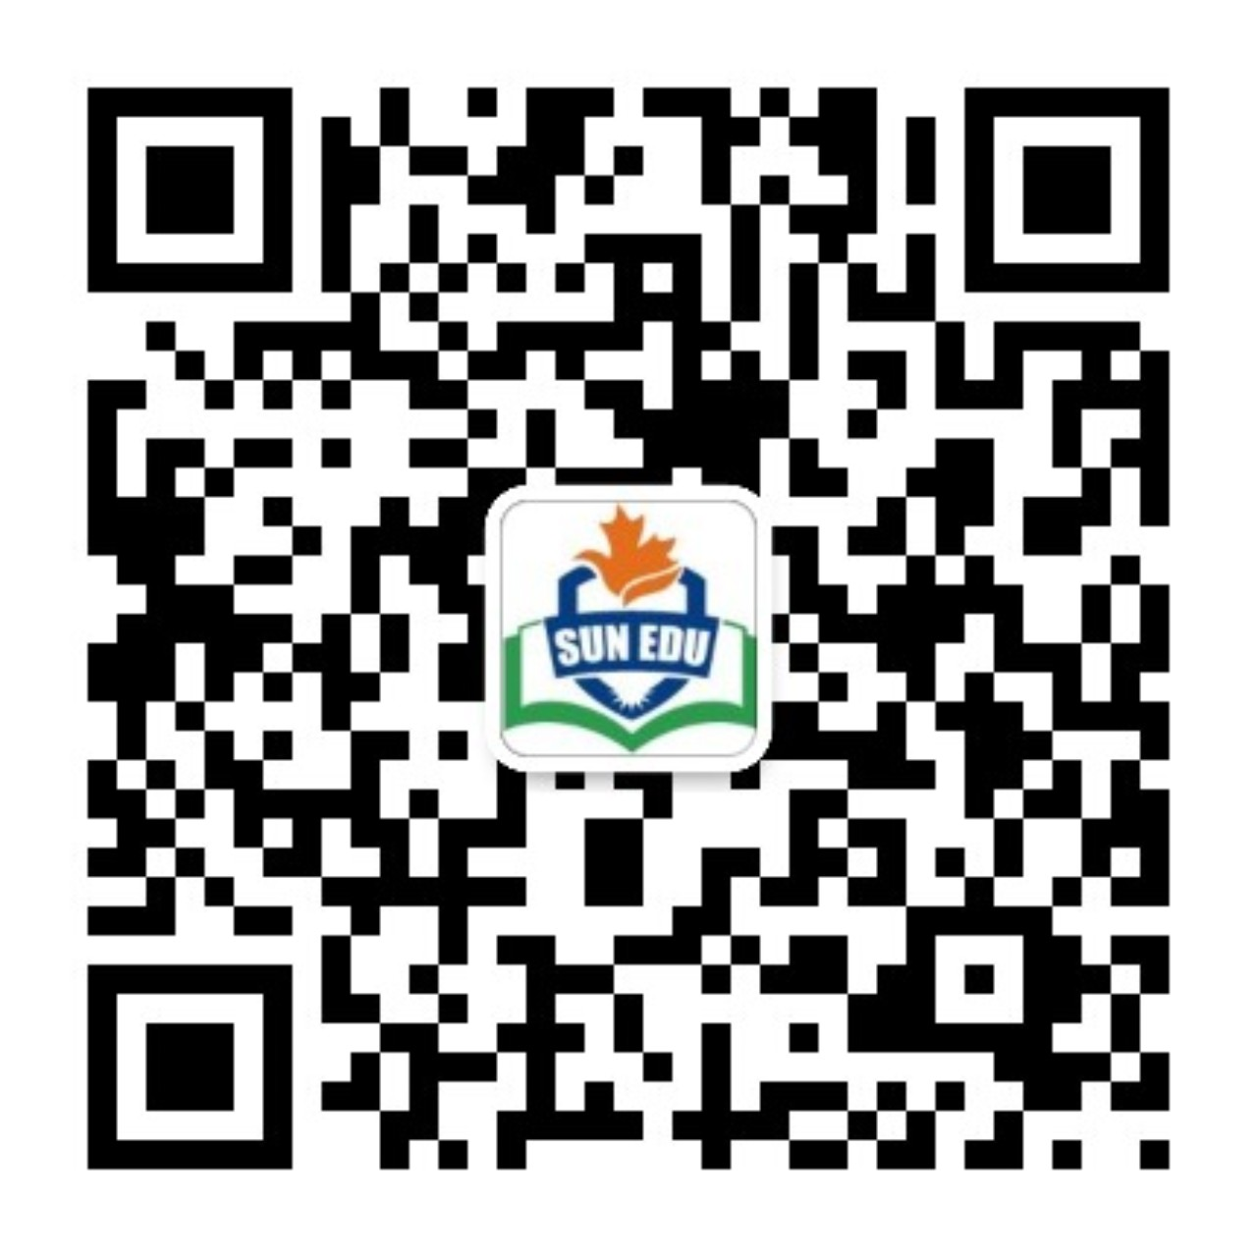
感恩遇见，相互成就，本课件资料仅供您个人参考、教学使用，严禁自行在网络传播，违者依知识产权法追究法律责任。
更多教学资源请关注
公众号：溯恩英语
知识产权声明

Slide 2
2024年高三浙南联盟 应用文写作分析
Reading A Book Together

Slide 3
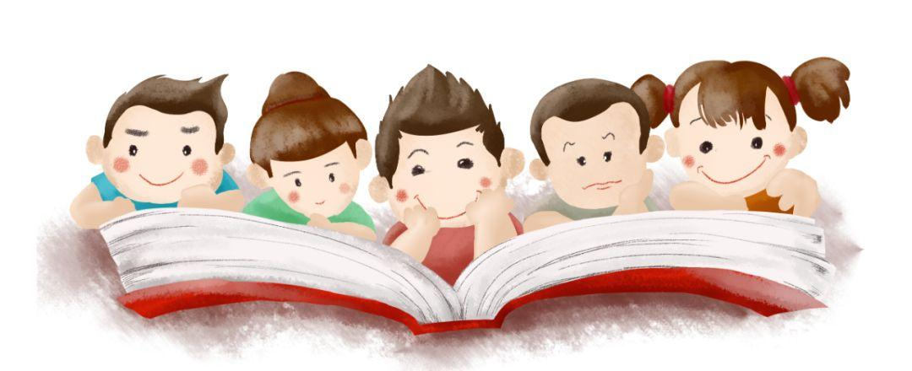
Lead in
Which is the most difficult part for you in this writing assignment?
Possible Difficulties:
1.construct the structure of the writing
2.introduce the selective book
3.describe the specific procedures of a collective reading
4.express the harvest of the event
...

Slide 4
Analyze
past tense
topic
I/we
假定你是李华，上周五你们班组织了“共读一本书”（Reading A Book Together）的阅读分享活动，你的英国朋友对此很感兴趣。请你给他写一封邮件分享这次经历，内容包括：
（1）活动介绍；
（2）你的收获。
注意：
（1）写作词数应为80左右；
（2）请按如下格式在答题纸的相应位置作答。
Email
What s the main idea of each paragraph?
P1
P2
P3
活动总体介绍
（目的，时间，地点，举办者…）
活动具体过程
活动收获

Slide 5
Brainstorm
to cultivate questioning and evaluation abilities
to open our eyes to different perspectives
P1
the purpose of this activity
to learn to listen and express ideas within a collaborative setting
to enhance language proficiency
to create collective learning within our class
to create an interactive atmosphere
to enable reading more enjoyable
to fuel our passion for reading
(alternatives:foster our love
spark our enthusiasm
stimulate reading interest)

Slide 6

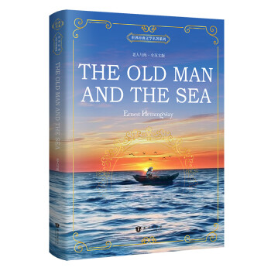

Brainstorm
P2
How can we introduce the book we read collectively?
The book’s name and theme should be included. And describe them briefly.

Slide 7
Appreciate
1.With themes of independence, love, and the struggle for dignity, Jane Eyre is a compelling literary masterpiece.
2.Jane Eyre is a novel that delves into the themes of female independence, love, and the pursuit of dignity.
3.Jane Eyre is a timeless/immortal tale that revolves around the central themes of female autonomy, love, and the quest for dignity.
一部引人入胜的文学杰作
探讨
一个围绕着中心主题...的
不朽的故事

Slide 8
Appreciate
4.Exploring themes of ambition, love, and the fleeting nature of wealth, The Great Gatsby is a compelling literary masterpiece.
Imitate
Exploring themes of perseverance, the relentless battle with the elements, and the quest for one's pride, The Old Man and the Sea is a literary masterpiece.

Slide 9

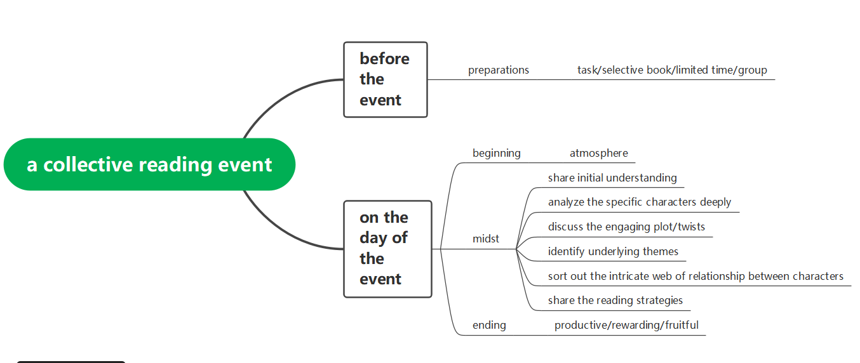
Fill in the mind map
P2
What were the specfic procedures included in reading a book collectively?

Slide 10
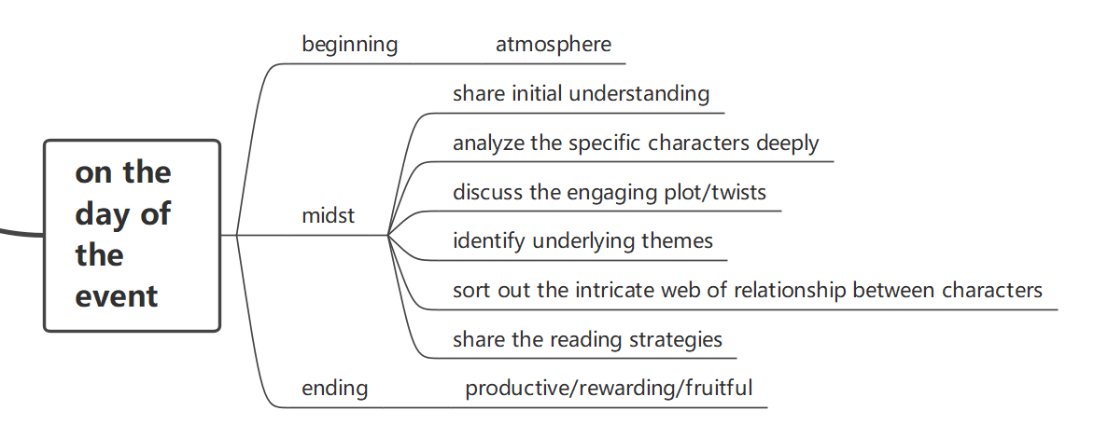
Fill in the mind map

Slide 11
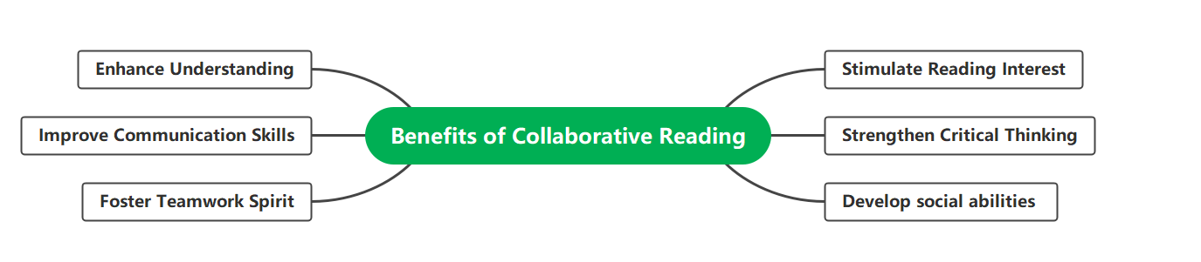
Harvest
What did I harvest in reading a book collectively?

Slide 12
Ending of the compositon
If you were here, you would love it too. I hope we have the chance to read a book together.Best wishes.
I truly believe that such activities foster a love for reading and create a supportive learning community. If you ever have the opportunity to participate in a similar event, I highly recommend it!
Eager to hear your thoughts about this book or activity and if there are any book clubs or reading activities you've enjoyed in your community.
01
02
03

Slide 13
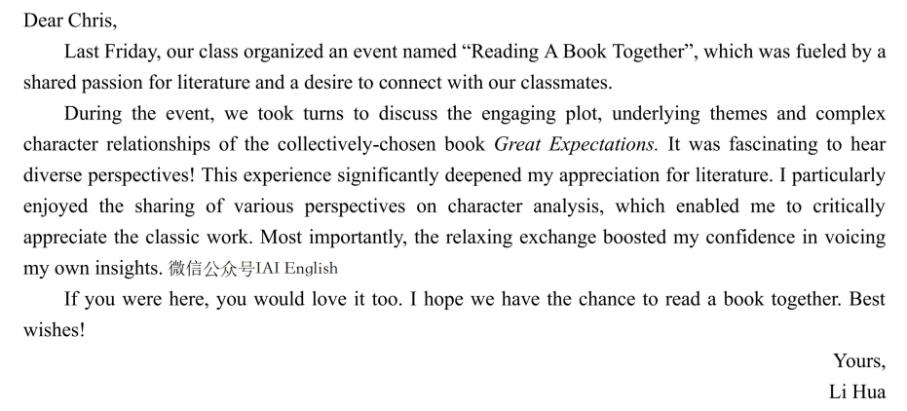

Sample writing one

Slide 14
Sample writing two
Dear Chris,
Last Friday witnessed an event titled “Reading A Book Together”,which turned out to be a hit. It was initiated by our teacher as a way to fuel our passion for reading and create a collective learning within our class. I can’t wait but share this captivating activity with you!
Before that day,we were all assigned a selective book”The Old Man and the Sea”, a compelling masterpiece,exploring themes of extraordinary courage and perseverance. On the day of the activity, an atmosphere of anticipation and excitement permeated the air. As scheduled, we started by sharing our initial understanding to the book, followed by a deeper analysis of specific characters and plot twists. It was fascinating to hear how differently each of us interpreted the same passages or characters. Some of us connected the story to our own lives, while others focused on the literary techniques used by the author. One of the highlights was the sharing of character analysis, which offered me a golden chance to appreciate the classic work critically.
In conclusion, not only did I foster a love for reading, but also the confidence in voicing my own insights was boosted.Eager to hear your thoughts about this book or activity and if there are any book clubs or reading activities you've enjoyed in your community.
Yours,
Li Hua

Slide 15

Thank you!

