Slide 1


感恩遇见，相互成就，本课件资料仅供您个人参考、教学使用，严禁自行在网络传播，违者依知识产权法追究法律责任。
更多教学资源请关注
公众号：溯恩英语
知识产权声明

Slide 2
Online Cross-cultural Communication
线上·跨文化交流
10月天域名校协作体应用文讲评

Slide 3
目录
contents
01
审题分析
02
分段语料
03
范文赏析
04
迁移延伸

Slide 4
01
审题分析

Slide 5

原题呈现
Time
Event
假设你是李华，上周你校与国外友好学校举行了线上跨文化展示交流活动，活动丰富多彩，如书法、武术、剪纸等。请你写一封邮件给你的英国笔友Jerry，分享你参加此次活动的经历，内容包括:
1.你展示的中国文化元素及原因;
2.你的感悟。
注意:
1.写作词数应为80个左右;
2.开头和结尾已给出，不计入总词数。
Dear Jerry,
I'm writing to share with you an online cross-cultural exhibition exchange activity held last week.
——————————————————————————————————————————
——————————————————————————————————————————
——————————————————————————————————————————
——————————————————————————————————————————
Looking forward to hearing from you soon.
Li Hua
Genre
Purpose

Slide 6
和2024.06真题比较
假定你是李华,上周五你们班组织了“共读一本书”(Reading A Book Together)的阅读分享活动,你的英国朋友Chris对此很感兴趣。请你给他写一封邮件分享这次经历,内容包括:
1.活动介绍;
2.你的收获。
假设你是李华，上周你校与国外友好学校举行了线上跨文化展示交流活动，活动丰富多彩，如书法、武术、剪纸等。请你写一封邮件给你的英国笔友Jerry，分享你参加此次活动的经历，内容包括:
1.你展示的中国文化元素及原因;
2.你的感悟。
假定你是李华，你们班上周五在公园上了一节美术课，请给英国好友Chris写一封邮件分享你的经历，内容包括：
1. 你的作品内容；
2. 你的感想。
 | 左边题目 | 右边题目
情境载体 | 分享信 | 分享信
作者立场 | 代表学校 | 代表自己
写作要点 | 活动内容+感受 | 作品内容+感想
语气态度 | 客观叙述事件+主观感受+收获 | 主观感受+思考

Slide 7
02
分段语料

Slide 8
首段：活动内容介绍
万能内容
【总起句】The online cross-cultural exchange event, held in collaboration with our partner school abroad last week, was a vibrant affair that celebrated the diversity of global traditions.
【分句】We commenced with a captivating demonstration of calligraphy, an art form that embodies the essence of Chinese culture, through which we fully immersed ourselves in the elegance and depth of this ancient practice.
What followed was a thrilling martial arts performance, showcasing the discipline and strength that underpin this iconic aspect of Chinese heritage.
Throughout the event, the highlight was when participants were encouraged to share their distinctive insights and perspectives, fostering a deeper understanding and appreciation of the cultural nuances and values that define our respective nations.

Slide 9
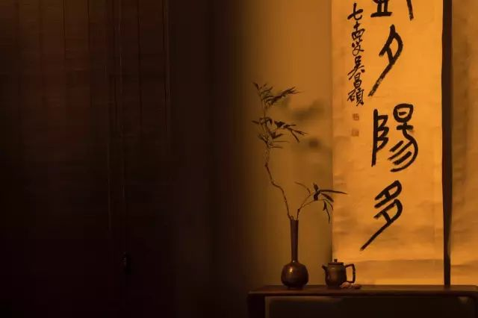
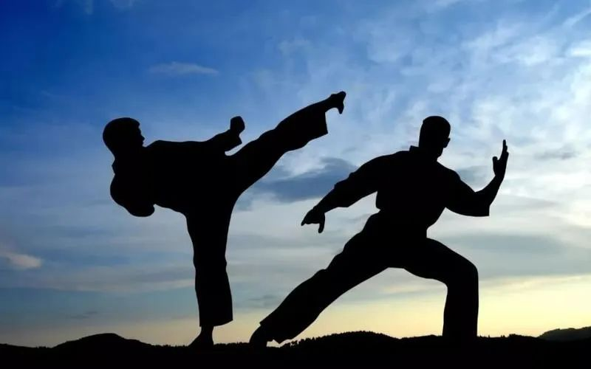
首段：活动内容介绍
角度1: 书法
At the event, I presented the art of Chinese calligraphy on behalf of our school. I chose this because it's not just an art form, but a reflection of our history and philosophy. Holding the brush and watching the ink dance on paper was a mesmerizing experience. It was rewarding to see the fascination in the eyes of our foreign peers as they tried their hand at it.
角度2：武术
I demonstrated a Kung Fu routine, one of the most recognized martial arts in China. I chose to showcase this because it embodies not only physical strength and discipline but also the spiritual and philosophical aspects of our culture. Practicing Kung Fu is about achieving harmony, balance, and the pursuit of inner peace.

Slide 10
活动感受
角度1：自豪成就感
As the online cross-cultural exchange event unfolded, I couldn't help but feel a profound sense of accomplishment and pride.
Witnessing the seamless blend of diverse cultures through activities like calligraphy, martial arts, and paper-cutting, I was reminded of the power of unity and collaboration.
It was a humbling experience that highlighted the value of hard work and dedication in preserving and promoting our rich cultural heritage.
角度2：共鸣与尊重
Participating in the online cross-cultural exchange event with our foreign counterparts, I was struck by a sense of collective pride and mutual respect.
As we engaged in activities such as calligraphy, martial arts, and paper-cutting, I realized that each form of cultural expression carries its own significance and deserves our reverence.
It was a humbling reminder that every aspect of our shared human experience, no matter how seemingly trivial, holds value and deserves our respect.

Slide 11
活动感受
角度3：开眼经历
The online cross-cultural exchange event with our international partner school proved to be an eye-opening and transformative experience. Through a diverse array of activities, such as calligraphy, martial arts, and paper-cutting, we were exposed to the rich tapestry of global traditions. It was a profound reminder that labor, in all its forms, should be honored and cherished as a reflection of our shared humanity and the invaluable contributions of each culture to the world's heritage.
相关语料表达
1.feel inspired to actively engage in cross-cultural learning and appreciate the joy that comes from sharing our cultural heritage
2.embrace the idea that every cultural tradition holds its own significance
3.acknowledge the satisfaction derived from contributing to cultural diversity
4.gain a new perspective on the dignity of cultural traditions
5.appreciate the value of hard work and dedication in preserving cultural heritage
6.realize the profound impact of cultural exchange on fostering mutual understanding
7.understand the joy that comes from discovering new aspects of the world
8.embrace the idea that every cultural tradition holds its own unique charm
9.acknowledge the satisfaction derived from expanding our cultural knowledge and understanding

Slide 12
03
范文赏析

Slide 13
官方范文
I'm writing to share with you an online cross-cultural exhibition exchange activity held last week.
In this activity I chose to showcase Chinese calligraphy as it is an integral part of our culture that dates back thousands of years. Featuring diverse and distinctive styles, Chinese calligraphy, whose tools and materials are well-known“the Four Treasures of the Study", conveys the writer's unique characters, rich thoughts and emotions. Not only does it reflect the beauty and elegance of the Chinese language but also embodies the spirit and philosophy of our people.
Participating in this event has broadened my horizons and deepened my understanding of cultural diversity. It has also reminded me of the power of art in bridging gaps between different cultures and fostering mutual understanding and respect. Looking forward to hearing from you soon.

Slide 14
下水作文
I'm writing to share with you an online cross-cultural exhibition exchange activity held last week.
To begin with, we commenced with a captivating demonstration of calligraphy, an art form that embodies the essence of Chinese culture, through which we fully immersed ourselves in the elegance and depth of this ancient practice. What followed was a thrilling martial arts performance, showcasing the discipline and strength that underpin this iconic aspect of Chinese heritage. Throughout the event, the highlight was when participants were encouraged to share their distinctive insights and perspectives, fostering a deeper understanding and appreciation of the cultural nuances and values that define our respective nations.
The event, held in collaboration with our partner school abroad last week, was a humbling reminder that every aspect of our shared human experience, no matter how seemingly trivial, holds value and deserves our respect.
在此录入上述图表的描述说明，在此录入上述图表的描述说明，在此录入上述图表的描述说明。
添加标题
在此录入上述图表的描述说明，在此录入上述图表的描述说明，在此录入上述图表的描述说明。
在此录入上述图表的描述说明，在此录入上述图表的描述说明，在此录入上述图表的描述说明。

Slide 15
04
迁移延伸

Slide 16
类似主题：2025年江浙皖
10月联考
假定你是李华，上周末你们全家去户外露营。请你给英国朋友Chris写一封邮件分享这次经历，内容包括:
(1)露营过程
(2)你的感想。
单击此处添加本单击此处添加单单击此处添加文本单击此处添加单
单击此处添加文本单击此处添加单单击此处添加文本单击此处添加单

Slide 17
官方范文
Dear Chris,
I’m writing to share with you a camping experience my family engaged in last weekend. It was our first time on a camping trip, in which my family slept under the stars in the Wilderness Park. We had no sooner set up the tent than it started to rain. While we enjoyed the sound of the rain dripping on our tent,，playing games and chatting about our daily life stories, mom prepared some snacks and drinks for us. We made wet-weather camping fun.
I’m grateful for the camping trip. Not only did I enjoy the beauty of nature, but I learned there is plenty of entertainment to be found in exploring nature.
Your task：简要点评这篇范文

Slide 18
Thanks
10月天域联考应用文讲解

