Slide 1


感恩遇见，相互成就，本课件资料仅供您个人参考、教学使用，严禁自行在网络传播，违者依知识产权法追究法律责任。
更多教学资源请关注
公众号：溯恩英语
知识产权声明

Slide 2


客观题试卷讲评
2024年10月
浙南名校联盟第一次联考
基于语篇分析的解构与建构
—— 常山一中 吴俊峰

Slide 3




阅读理解基本策略
1. 用有限的词汇 获取 最有用信息
用有限的时间 获取 最精准答案
2. 科学打开阅读理解的方式：
① 找到主题句/文章主旨大意（一般在第一段）
② 了解文章的框架结构/语篇组织（what/ why/ how/ whether）
③ 做题与看文章同步交替进行（题目=阅读提纲）
3. C、D篇：
①科学研究类说明文往往第一段呈现研究发现或结论（文章主旨）
● ②路标词，带出作者真正写作意图：However, but, in fact, actually；
studys find out (研究发现/表明…)
4. 先做 单点信息题（猜词，态度、段落或文章主旨）
再做 多点信息题（细节理解；文章主旨）
Notes:
联系 系统 真实挑战
应用 迁移
大概念不是法则，从左到右，先算个位后算十位，从低位到高位。 乘除法规则运算：先分后合
最核心的是什么？
基于知识技能 高于知识技能 的思想 理念 认识 准则
自主学习能力
选择不同的工具进行测量，能够准确表示。高楼 大树 不能测量可以选择参照物估测。
真实的 挑战性
教室的高 楼房的高
大概念可以是各种形式的体现：一个词、一个短语、一个句子或者一个问题
站位很高，长远的目标，指向学生核心素养，抓住大概念，抓住基本问题，实现预期结果和目标

Slide 4

阅读理解满分思维策略——精通词义延伸方式和过程
①主题句本身会包含核心话题和决定语篇发展方向的控制性信息，主要陈述部分则需要将控制性信息进行语义延展，为支撑主题句服务。
②利用关键词重复来突出并强化主旨。核心关键词存在复现的关系，围绕同一主题前后呼应，形成词汇链和语义链，使文本语际间实现语义上的衔接和连贯。
③利用语义场保证主题和语义传递取得统一（信息流flow的桥梁通道）。 阅读过程中要善于扫描同词/同话题词，建构语义场，搭建信息流flow的通道。尤其注意paraphrase(释文，改述，换说)的地方往往是题眼。
“哒哒哒--达达”信息搭桥法
Notes:
联系 系统 真实挑战
应用 迁移
大概念不是法则，从左到右，先算个位后算十位，从低位到高位。 乘除法规则运算：先分后合
最核心的是什么？
基于知识技能 高于知识技能 的思想 理念 认识 准则
自主学习能力
选择不同的工具进行测量，能够准确表示。高楼 大树 不能测量可以选择参照物估测。
真实的 挑战性
教室的高 楼房的高
大概念可以是各种形式的体现：一个词、一个短语、一个句子或者一个问题
站位很高，长远的目标，指向学生核心素养，抓住大概念，抓住基本问题，实现预期结果和目标

Slide 5





一分钟精准秒杀A篇的思维策略
—— 语篇解构
语义建构
Most of us could benefit from washing our bedding more often. Sheets, pillowcases, and mattresses can harbor dirt, germs and allergens (过敏原) that affect our skin and overall health. But what’s the sweet spot for washing frequency? Our website asked experts to share their preferred intervals (间隔) and tips on how to do it well.
Pillowcases
Pillowcases are the landing pad for your skin, hair and all the oils and dirt carried with them. It is recommended that pillowcases should be washed at least once a week. People who have sensitive skin or allergies often benefit from a more frequent routine, like every three to four days. To help clean cases last longer, shower before bed. And don’t forget your pillows: washing them once per season is the sweet spot.
Sheets
At a minimum, you should wash your sheets once a week. But a variety of factors call for more frequent washing. One is the summer heat, since sweat “can lead to bacteria and odor on our sheets.” Plus, allergens like pollen can travel inside with you, so washing more frequently can help reduce symptoms.
Mattresses
Every time you strip the bedding, let the mattress breathe for a bit rather than immediately putting on a new set of sheets. “Leave it for a few hours with some windows open.” Still air and covered mattresses encourage dust mites and allergens to thrive. Vacuum (用吸尘器吸) it two to three times a year. If it smells, sprinkle on a thin layer of baking soda, let it sit for a few hours. And then vacuum it up.
21. Which of the following bedding is adviscd to be cleaned once per season?
A. Pillowcases. B. Pillows.
C. Sheets. D. Mattresses.
23. Where is the text probably taken from?
A. A lifestyle website.
B. A health magazine.
C. A medical journal.
D.A product bandbook.
Our website asked experts to share their preferred intervals (间隔) and tips on how to do it well.
强化敏感捕捉关键信息的意识与能力：
单点直接信息题（带问题寻读跳读---获取文本信息--选项对号入座）。用题干中能体现该句主题或中心的名词作为定位词，在文中迅速定位，如：21题抓关键词： once per season；23题抓关键词：website 和washing
语篇结构快定位，信息采集巧加工
1.快速读第一段，获取文章主旨大意: 网站邀请专家分享洗涤洗床上用品（床单、枕套和床垫）频率以及如何做好的建议。
2.题干关键词快速回到原文定位信息源（题目=阅读提纲；题目→形成问题链）

Slide 6


一分钟精准秒杀A篇的思维策略
—— 语篇解构
语义建构
Mattresses
Every time you strip the bedding, let the mattress breathe for a bit rather than immediately putting on a new set of sheets. “Leave it for a few hours with some windows open.” Still air and covered mattresses encourage dust mites and allergens to thrive. Vacuum (用吸尘器吸) it two to three times a year. If it smells, sprinkle on a thin layer of baking soda, let it sit for a few hours. And then vacuum it up.
22. Which is a proper way to clean the mattress?
A. Exposing it to fresh air for a few minutes.
B. Vacuuming it up before spraying baking soda.
C. Removing the bedding and leaving it for a while.
D. Placing new sheets instantly when making the bed.
A. Exposing it to fresh air
=_{原文}Leave it with some windows open
for a few minutes
≠_{原文} for a few hours.
B. Vacuuming it up before...
≠_{原文} let it sit for a few hours. And then vacuum it up.
spraying baking soda.
=_{原文}sprinkle on a thin layer of baking soda,
D. Placing new sheets instantly when making the bed. =_{原文}immediately putting on
≠_{原文} rather than immediately putting on a new set of sheets.
22题：警惕“张冠李戴/ 偷梁换柱”的逻辑错误
干扰项与原文高度相似，一半是一半非，似是而非。命题者在不易引人注意的地方换了一两个词汇造成句意的改变；或者把一个事物的特征说成是另一个事物的特征；或者把他人的观点说成是作者的观点。
正确答案通常是对原文信息的同义改写，其全部信息一定都能从文中找到依据和逻辑关联。Removing the bedding = strip the bedding； leaving it for a while = breathe for a bit

Slide 7


A篇语料整理
语义场建构；改述释义；高频课外单词语境记忆
8.专业工作技能 实践基本工作技能 9.手工制作珠宝 10. 无需注册。 先到先得。 | = altruistic_{利他主义的，无私的} /selfless behavior
1.……的最佳点/最佳位置
2.把床上用品拿开，放一段时间。=脱掉被褥，让床垫透透气
3.撒上一层薄薄的小苏打粉。
1. the sweet spot for...
2.Remove the bedding and leaving it for a while.
= Strip_{脱去衣服；除去} the bedding, and let the mattress breathe for a bit
3.sprinkle_{撒，洒；用……点缀} =spray_{喷，喷洒（液体）} on a thin layer of baking soda.

Slide 8

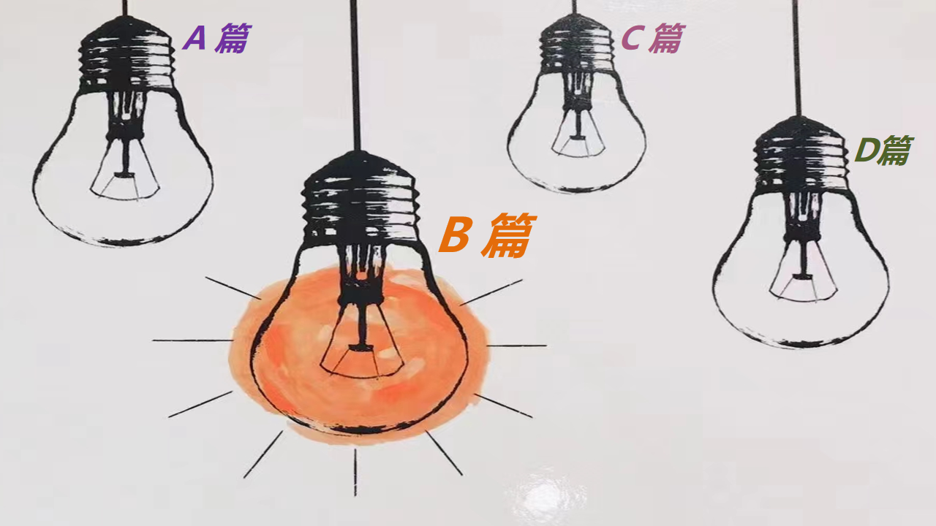
两分钟精准秒杀B篇的思维策略
语篇解构
—— 语义建构
逻辑建构
Over the decades, Yasmeen Lari, Pakistan’s first female architect, has won much recognition as an architect and environmentalist.
...
In 2013, when Lari was giving a tour of a village that had been rebuilt after destructive floods, she watched the villagers show off the buildings she had designed. “Our old buildings used to leak when it rained, but these stay dry inside,” one villager told Lari. Pakistan’s location and melting glaciers place it within the top ten countries most impacted by climate change. Lari’s shelters, made with local sustainable materials such as bamboo, mud and lime, can better withstand disasters. Her insistence on low-cost, zero-waste and zero-carbon buildings reflects her commitment to the planet.
At age 83, Yasmeen Lari is still working on zero-carbon designs and self-sustaining villages. When she accepted the Royal Institute of British Architects Gold Medal, she said, the honour “has strengthened my mission”.
27. What was her mission according to Lari?
A. To call for zero-carbon lifestyles.
B. To help poor people build houses.
C. To develop sustainable construction materials.
D. To construct environmentally-friendly buildings.
27题：警惕“以偏概全”的逻辑错误
ABC选项干扰性极强，这是最常见的主旨题干扰选项。命题人通常会用仅在文章某一段或者某两段中岀现的细节信息来设置干扰，这样的选项以偏概全，无法充当文章或段落的主旨。
正确选项中主旨往往比较突出，而干扰项的设置通常是过泛、过偏、过窄或与主旨过远几种现象.
D选项呼应首段environmentalist，并能概括提炼“low-cost, zero-waste and zero-carbon，self-sustaining”等信息，综合而成“environmentally-friendly”
快速从尾段获取人物、情节、情感到位
快速锁定27题；再迅速扫描第一段与尾段呼应，秒杀D选项。

Slide 9
两分钟精准秒杀B篇的思维策略
语篇解构
—— 语义建构
逻辑建构
Over the decades, Yasmeen Lari, Pakistan’s first female architect, has won much recognition as an architect and environmentalist.
When Lari was young, she had an unconventional upbringing. Her father was a progressive civil service officer who often talked about the housing crisis and need for architects, which impressed Lari greatly. At age 17, she was admitted to the architecture school at Oxford Brookes University as one of only five women in the class.
After graduation, as her buildings rose, Lari’s renown grew. She held senior positions in national and international architectural groups. “It was a very heady experience,” she says. Yet she found ways to stay grounded. Soon the discomfort with commercial projects grew in her-with their creative freedom, large budgets and luxurious materials. She could no longer justify fashioning buildings out of unsustainable materials when millions had limited access to housing, sanitation (公共卫生) and water. “Architects can no longer work for just the one percent,” she says, “That doesn’t allow them to serve humanity as much as they could.”
In 2013, when Lari was giving a tour of a village that had been rebuilt after destructive floods, she watched the villagers show off the buildings she had designed. “Our old buildings used to leak when it rained, but these stay dry inside,” one villager told Lari. Pakistan’s location and melting glaciers place it within the top ten countries most impacted by climate change. Lari’s shelters, made with local sustainable materials such as bamboo, mud and lime, can better withstand disasters. Her insistence on low-cost, zero-waste and zero-carbon buildings reflects her commitment to the planet.
At age 83, Yasmeen Lari is still working on zero-carbon designs and self-sustaining villages. When she accepted the Royal Institute of British Architects Gold Medal, she said, the honour “has strengthened my mission”.
24. What made Lari take an interest in architecture?
A. Shortage of female architects.
B. Traditional parenting values.
C. Her father’s influence in childhood.
D. Admission to an architecture school.
26. What did the villager think of the house designed by Lari?
A. Cost-effective.
B. Material-saving.
C. Water-proof.
D. Eco-friendly.
用主题名词定位
用题干中能体现该句主题或中心的名词作为定位词，在文中迅速定位。如：
24题.interest
26题.the villager

Slide 10
两分钟精准秒杀B篇的思维策略
语篇解构
—— 语义建构
逻辑建构
After graduation, as her buildings rose, Lari’s renown grew. She held senior positions in national and international architectural groups. “It was a very heady experience,” she says. Yet she found ways to stay grounded. Soon the discomfort with commercial projects grew in her-with their creative freedom, large budgets and luxurious materials. She could no longer justify fashioning buildings out of unsustainable materials when millions had limited access to housing, sanitation (公共卫生) and water. “Architects can no longer work for just the one percent,” she says, “That doesn’t allow them to serve humanity as much as they could.”
In 2013, when Lari was giving a tour of a village that had been rebuilt after destructive floods, she watched the villagers show off the buildings she had designed. “Our old buildings used to leak when it rained, but these stay dry inside,” one villager told Lari. Pakistan’s location and melting glaciers place it within the top ten countries most impacted by climate change. Lari’s shelters, made with local sustainable materials such as bamboo, mud and lime, can better withstand disasters. Her insistence on low-cost, zero-waste and zero-carbon buildings reflects her commitment to the planet.
At age 83, Yasmeen Lari is still working on zero-carbon designs and self-sustaining villages. When she accepted the Royal Institute of British Architects Gold Medal, she said, the honour “has strengthened my mission”.
25. Which statement about architects may Lari agree with?
A. They should center on the well-being of the general public.
B. They should spend millions of dollars in fashioning buildings.
C. They should be a hundred percent committed to their mission.
D. They should use luxurious materials to display their creativity.
利用题文同序定位信息
题文同序是指命题人会根据文章中信息出现的先后依次命制各个小题。 因此， 在同一篇文章下面的各个小题，其答题信息点会在文中从上到下或从前到后依次出现。
根据此原则定位25题的信息在文本的第三段

Slide 11
B篇语料整理
语义场建构；改述释义；高频课外单词语境记忆
9.手工制作珠宝 10. 无需注册。 先到先得。 | = altruistic_{利他主义的，无私的} /selfless behavior
1.以公众福利为中心的:
①这使他们不能尽其所能为人类服务。
②当数以百万计的人无法获得住房、卫生设施和水时，她再也无法证明用不可持续的/奢华的材料建造建筑是合理的。
2.非常令人兴奋的经历/ 防水/ 进步的公务员
1.center on the well-being of the general public：
①That doesn’t allow them to serve humanity as much as they could.
②She could no longer justify_{是……的正当理由；对……作出解释，为……辩解} fashioning buildings out of unsustainable / luxurious materials when millions had limited access to housing, sanitation and water.
概括、推理、归纳的高阶思维
2.a very heady_{兴奋的；任性的；使人头晕的；令人陶醉的} experience / water-proof / a progressive civil service officer
善于捕捉一些意义相同、相似的词。the general public = humanity = millions 联系在一起，形成语义链和逻辑思维。
利用前后句中上下义词的同义关系常常可以很轻松地解题。well-being上义词，下义词housing, sanitation and water，上下义词和同一范畴词，上义词包含了下义词，或可以说下义词是上义词的一个子集。

Slide 12



C篇快速高分突破思维策略
——语篇解构
Theme
From the swinging rhythms of the 1950s to the autotuned hooks of today, pop music has undergone a remarkable transformation. But what exactly has changed, and how can we measure it?
Researchers identify two major “melodic (旋律的) revolutions” in pop music history: one in 1975 and another in 2000. These turning points mark significant shifts in the structure and complexity of hit melodies. Interestingly, these musical milestones aren’t perfectly in line with the revolutions in harmony and tone color, suggesting that different aspects of music may evolve at different rates.
During these revolutions, melodies have generally become simpler, both in terms of pitch (音高) and rhythm. Modern pop hits tend to use a smaller range of notes and simpler rhythmic patterns compared to those from the 1950s and 60s. At the same time, there was a dramatic increase in “note density”—the number of notes squeezed into each second of music. This means that while today’s pop melodies might be simpler in structure, they’re often delivered more rapidly, creating a sense of energy and urgency that wasn’t as common in earlier decades.
There are several interesting possibilities for what is happening. One theory suggests that as other aspects of music production—like complex electronic beats and richly layered instrumentation—have become more sophisticated, melodies have had to simplify to maintain a balance. Another explanation points to the changing landscape of music consumption. In an era of streaming and social media, where listeners can skip to the next song in seconds, there may be more pressure to create tunes that grab attention instantly. This could favor simpler, more repetitive melodies that are easy to remember and sing along to.
Relationships between different musical features have also become stronger in recent years. For example, in post-2000 pop hits, melodies with more notes per second tend to be less complex in terms of pitch variety. This suggests that modern pop songwriting may be following stricter patterns than in the past.
From the swinging rhythms of the 1950s to the autotuned hooks of today, pop music has undergone a remarkable transformation. But what exactly has changed, and how can we measure it?
Researchers identify two major “melodic (旋律的) revolutions” in pop music history: one in 1975 and another in 2000. These turning points mark significant shifts in the structure and complexity of hit melodies. Interestingly, these musical milestones aren’t perfectly in line with the revolutions in harmony and tone color, suggesting that different aspects of music may evolve at different rates.
During these revolutions, melodies have generally become simpler, both in terms of pitch (音高) and rhythm. Modern pop hits tend to use a smaller range of notes and simpler rhythmic patterns compared to those from the 1950s and 60s. At the same time, there was a dramatic increase in “note density”—the number of notes squeezed into each second of music. This means that while today’s pop melodies might be simpler in structure, they’re often delivered more rapidly, creating a sense of energy and urgency that wasn’t as common in earlier decades.
There are several interesting possibilities for what is happening. One theory suggests that as other aspects of music production—like complex electronic beats and richly layered instrumentation—have become more sophisticated, melodies have had to simplify to maintain a balance. Another explanation points to the changing landscape of music consumption. In an era of streaming and social media, where listeners can skip to the next song in seconds, there may be more pressure to create tunes that grab attention instantly. This could favor simpler, more repetitive melodies that are easy to remember and sing along to.
Relationships between different musical features have also become stronger in recent years. For example, in post-2000 pop hits, melodies with more notes per second tend to be less complex in terms of pitch variety. This suggests that modern pop songwriting may be following stricter patterns than in the past.
路标词
28. What change has taken place in pop music over the years?
29. Which of the following may contribute to the revolution of pop music?
30. What can we infer from the last paragraph?
A. Pop songwriting might be more flexible in the past.
B. Modern pop music prioritizes simplicity in melody.
C. Post-2000 pop hits feature complexity in pitch variety.
D. Relationships between musical elements are invariable.
31. What’s the purpose of the text?
A. To prove a viewpoint.
B. To remove some doubts.
C. To illustrate a principle.
D. To analyze a phenomenon.
What
Why
How

Slide 13
C篇语料整理
语义场建构；改述释义；高频课外单词语境记忆
9.手工制作珠宝 10. 无需注册。 先到先得。 | = altruistic_{利他主义的，无私的} /selfless behavior
1.现代流行歌曲创作可能比过去遵循更严格的模式。=流行歌曲创作在过去可能更加灵活。
2. 经历了非凡的转变
3. 找出两个主要的旋律革命
4.这些转折点标志着热门旋律的结构和复杂性的重大转变
5. 以不同的速度进化
1. modern pop songwriting may be following stricter patterns than in the past. = Pop songwriting might be more flexible in the past.
2. undergone a remarkable transformation
3. identify two major melodic revolutions
4.These turning points mark significant shifts in the structure and complexity of hit melodies
5. evolve at different rates
transformation-transform /revolutions-revolve-revolutionary /shifts /evolve-evolution-evolutionary 与change建构语义场,使文本语际间实现语义上的衔接和连贯。

Slide 14
C篇快速高分突破思维策略
——语义建构
From the swinging rhythms of the 1950s to the autotuned hooks of today, pop music has undergone a remarkable transformation. But what exactly has changed, and how can we measure it?
Researchers identify two major “melodic (旋律的) revolutions” in pop music history: one in 1975 and another in 2000. These turning points mark significant shifts in the structure and complexity of hit melodies. Interestingly, these musical milestones aren’t perfectly in line with the revolutions in harmony and tone color, suggesting that different aspects of music may evolve at different rates.
During these revolutions, melodies have generally become simpler, both in terms of pitch (音高) and rhythm. Modern pop hits tend to use a smaller range of notes and simpler rhythmic patterns compared to those from the 1950s and 60s. At the same time, there was a dramatic increase in “note density”—the number of notes squeezed into each second of music. This means that while today’s pop melodies might be simpler in structure, they’re often delivered more rapidly, creating a sense of energy and urgency that wasn’t as common in earlier decades.
28. What change has taken place in pop music over the years?
A. Denser notes. B. Bigger range of pitch.
C. More complex rhythms. D. More diverse tone colors.
本题是细节理解题，
难点在paraphrase同义信息匹配：
A项：Denser notes
=_{原文}a dramatic increase in note density ；
dense adj.密集的；浓厚的; 密度大的
density n. 稠密，密集；密度
B项：Bigger range of pitch
C项：More complex rhythms
≠_{原文} become simpler, both in terms of pitch and rhythm
D. More diverse tone colors
≠_{原文} simpler in structure
段落翻译： 在这些变革中，旋律在音高和节奏方面都变得更加简单。与上世纪五六十年代的流行歌曲相比，现代流行歌曲倾向于使用更小范围的音符和更简单的节奏模式。与此同时，“音符密度”——音乐中每一秒钟的音符数量——也有了戏剧性的增加。这意味着，虽然今天的流行旋律在结构上可能更简单，但它们往往传递得更快，创造出一种能量和紧迫感，这在过去几十年里并不常见。

Slide 15

C篇快速高分突破思维策略
—— 逻辑建构
There are several interesting possibilities for what is happening. One theory suggests that as other aspects of music production—like complex electronic beats and richly layered instrumentation—have become more sophisticated, melodies have had to simplify to maintain a balance. Another explanation points to the changing landscape of music consumption. In an era of streaming and social media, where listeners can skip to the next song in seconds, there may be more pressure to create tunes that grab attention instantly. This could favor simpler, more repetitive melodies that are easy to remember and sing along to.
music consumers’
for music consumer
29. Which of the following may contribute to the revolution of pop music?
A. The difficulty in creating catchier tunes.
B. The conventional patterns to enjoy music.
C. The convenience of switching between songs.
D. The need to balance increasingly intense beats.
创作更吸引人的曲调的困难
欣赏音乐的传统模式
在歌曲之间切换的便利性
需要平衡越来越强烈的节拍
段落翻译： 对于正在发生的事情，有几种有趣的可能性。一种理论认为，随着音乐制作的其他方面——如复杂的电子节拍和丰富的层次乐器——变得越来越复杂，旋律不得不简化以保持平衡。另一种解释指出了音乐消费格局的变化。在一个流媒体和社交媒体的时代，听众可以在几秒钟内跳到下一首歌曲，创作出能够立即吸引注意力的曲调可能会有更大的压力。这可能有利于更简单，更重复的旋律，容易记住和一起唱。
推理判断题中的正确选项是依据统一语境_{(如本题中的consumption)}的观点和事实推断出的符合逻辑的结论或观点：simpler, more repetitive melodies that are easy (for music consumer) to remember and sing along to
→ grab (music consumers’) attention instantly
→ listeners can skip to the next song in seconds
=The convenience of switching between songs

Slide 16

基于语义连贯的阅读理解满分策略
1. 概念成分上的照应性
2. 命题发展的索引性
(命题发展的线条，信息互有关联）
建构
语义链和语义场
3. 语用推理上的顺应性
4. 语篇信息在逻辑上的链接性
What?/ Why?
Notes:
联系 系统 真实挑战
应用 迁移
大概念不是法则，从左到右，先算个位后算十位，从低位到高位。 乘除法规则运算：先分后合
最核心的是什么？
基于知识技能 高于知识技能 的思想 理念 认识 准则
自主学习能力
选择不同的工具进行测量，能够准确表示。高楼 大树 不能测量可以选择参照物估测。
真实的 挑战性
教室的高 楼房的高
大概念可以是各种形式的体现：一个词、一个短语、一个句子或者一个问题
站位很高，长远的目标，指向学生核心素养，抓住大概念，抓住基本问题，实现预期结果和目标

Slide 17


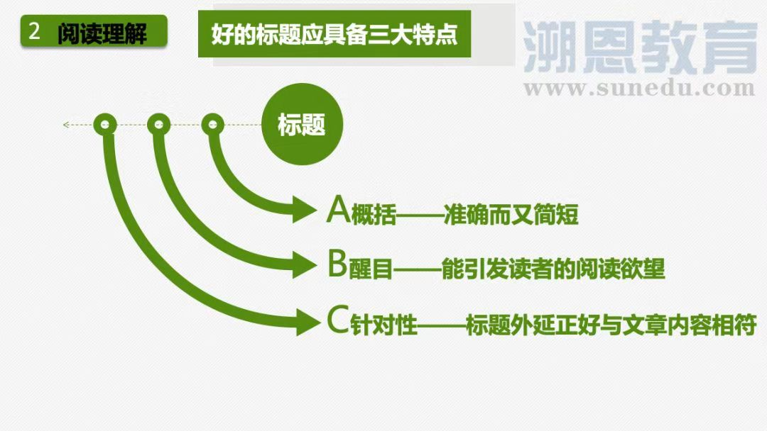

D篇快速高分突破思维策略
——语篇解构
Tipping points, also known as critical transitions (转变), are mathematical cliff-edges influencing everything in our life. The financial crisis of 2007-09 is often described as one. So is the moment that covid-19 went global. Anyone can spot a tipping point after it’s been crossed. But it is extremely difficult to spot them before they happen.
Computer scientists in China now show that artificial intelligence (AI) can help. In a recent study, the researchers accurately predicted the beginning of tipping points in complicated systems with the help of machine-learning algorithms (算法). It could help solve real-world problems, such as predicting floods and power failure.
To simplify their calculations, the team reduced all such problems to ones taking place within a large network of interacting nodes (节点), the individual elements within a large system. In a financial system, for example, a node might represent a company. The team then designed two artificial neural (神经的) networks to analyze such systems.
To train their model, the researchers firstly turned to simplified theoretical systems in which tipping points are known to occur. Once the model could predict these transitions, it was applied to the real-world problem of how tropical forests turn to savannah (稀树草原). This has happened many times on Earth, but the details remain mysterious. The researchers first analyzed the data from three central African regions in the past 20 years and identified the tipping points. They then wanted to see if training their algorithm on data from two of these regions could enable it to correctly predict a transition point in the third. It could.
The team then asked the algorithm to identify the conditions that drove the shift. The answer was, as expected, down to annual rainfall. But the AI was able to go further. The AI detailed that a slight decrease in rainfall from 1,800 mm to 1,630 mm led to a minor 5% drop in tree cover, but a further decrease to 1,620 mm caused a significant 30% drop. This would be a textbook critical transition. And by predicting it from the raw data, the researchers say they have broken new ground in this field.
The team are now trying to discover what specific features the Al identifies to make these predictions, which could help better predict everything from infectious outbreaks to the next stock market crash.
路标词
路标词
标题蕴含文章的核心要义，高度凝练语篇内容，
标题是主题句的浓缩，根据路标词找到本文的主题句（在第二段）；
文章标题通常会包含文章中反复出现的高频核心词汇或者它的同义词或上义词。
主旨大意标题类 解题策略：
从词汇特性角度体现主题的概括性： 浏览全文，扫描有关描述人或事特征的相关词汇，建构主题相关的语义场，形成信息流。如本文三个核心主题词，在标题中，缺一不可。
35. Which of the following could be the best title of the passage?
A. The Analysis of Rainfall: AI and Tree Cover
B. Spotting Tipping Points: A Big Challenge for AI
C. Machine Learning: Predicting Critical Moment
D. Critical Transitions: The Key to Making Predictions
32. How did the team simplify the calculations?
33. Why was the algorithm trained on data from two central African regions?
34. What breakthrough did the AI make in the study?
×

Slide 18
D篇快速高分突破思维策略
—— 语义建构、逻辑建构
To simplify their calculations, the team reduced all such problems to ones taking place within a large network of interacting nodes (节点), the individual elements within a large system. In a financial system, for example, a node might represent a company. The team then designed two artificial neural (神经的) networks to analyze such systems.
段落翻译： 为了简化他们的计算，该团队将所有这些问题简化为发生在大型交互节点网络中的问题，即大型系统中的单个元素。例如，在金融系统中，一个节点可能代表一个公司。该团队随后设计了两个人工神经网络来分析这些系统。
32. How did the team simplify the calculations?
A. By limiting the problems within a large network.
B. By focusing on the individual elements in a network.
C. By transforming the problems into ones in a network.
D. By reducing the number of problems in each network.
32题考查高阶思维的类比，比较，推断，迁移的能力
比喻、对比、举例等特殊表达处往往是考点，学生要以原文内容为依据，分析语篇内在逻辑，由例举事实，审视阐释“the team reduced all such problems to ones taking place within a large network of interacting nodes, the individual elements within a large system.”抽象概念。
由举例中的 a node might represent a company，可知为简化计算，采用系统化建模的方式（how）, 所以建构语义逻辑 a node might represent a company可以转化为→a problem→the individual element → interacting node; a large system可以转化为→a large network（回归主题词 AI）。 所以reduced all such problems within a large system 即 transform interacting nodes into a large network。

Slide 19
D篇快速高分突破思维策略
语篇解构
—— 语义建构
逻辑建构
To train their model, the researchers firstly turned to simplified theoretical systems in which tipping points are known to occur. Once the model could predict these transitions, it was applied to the real-world problem of how tropical forests turn to savannah (稀树草原). This has happened many times on Earth, but the details remain mysterious. The researchers first analyzed the data from three central African regions in the past 20 years and identified the tipping points. They then wanted to see if training their algorithm on data from two of these regions could enable it to correctly predict a transition point in the third. It could.
33. Why was the algorithm trained on data from two central African regions?
A. To improve its ability of prediction.
B. To check its analysis of the data.
C. To perfect its solutions to problems.
D. To test the accuracy of its prediction.
段落翻译： 为了训练他们的模型，研究人员首先求助于已知发生临界点的简化理论系统。一旦该模型能够预测这些转变，它就被应用于热带森林如何变成大草原的现实问题(稀树草原)。这种情况在地球上发生过很多次，但细节仍然是个谜。研究人员首先分析了过去20年中非三个地区的数据，并确定了拐点。然后，他们想看看在其中两个区域的数据上训练他们的算法是否能使其正确预测第三个区域的拐点。它可以。
建构语义场，秒杀正确答案
阅读过程中要善于扫描同词/同话题词，建构语义场，搭建信息流flow的通道：First---Then---It could 说明实验测试test过程。再通过实验目的Once the model could predict these transitions, it was applied to，秒杀正确答案D选项。

Slide 20
D篇快速高分突破思维策略
—— 语义建构、逻辑建构
The team then asked the algorithm to identify the conditions that drove the shift. The answer was, as expected, down to annual rainfall. But the AI was able to go further. The AI detailed that a slight decrease in rainfall from 1,800 mm to 1,630 mm led to a minor 5% drop in tree cover, but a further decrease to 1,620 mm caused a significant 30% drop. This would be a textbook critical transition. And by predicting it from the raw data, the researchers say they have broken new ground in this field.
34. What breakthrough did the AI make in the study?
A. It revealed the idea that tipping points are predictable.
B. It identified a critical transition point in the tree cover.
C. It confirmed previous theories about rainfall and tree cover.
D. It predicted the future expansion of savannahs in central Africa.
警惕“推理过度，主观臆断”的逻辑错误
C选项干扰性极强，命题人根据原文信息，做了一种貌似合理的推理，让考生掉入陷阱“ rainfall and tree cover”，是没有基于事实与逻辑的推理过度。rainfall是条件the conditions ，而predict the tree cover是结果，也是breakthrough。
务必确保所选答案确有出处，必然能在原文中找到依据的，符合原意，切不可轻信感觉或仅凭常理或按自己主观意愿判断 。
段落翻译： 然后，研究小组要求算法识别驱动这种转变的条件。正如预期的那样，答案归结于年降雨量。但人工智能可以走得更远。人工智能详细说明，降雨量从1800毫米轻微减少到1630毫米，导致树木覆盖面积轻微下降5%，但进一步减少到1620毫米，导致树木覆盖面积显著下降30%。这将是一个教科书式的关键转变。通过对原始数据的预测，研究人员表示，他们在这一领域开辟了新天地。

Slide 21
D篇语料整理
语义场建构；改述释义；高频课外单词语境记忆
9.手工制作珠宝 10. 无需注册。 先到先得。 | = altruistic_{利他主义的，无私的} /selfless behavior
1.引爆点=关键转变/拐点/临界点
2.教科书式的关键转变=突破新领域=突破
3.预测的准确性=正确预测/识别
4.它揭示了一个观点，即临界点是可以预测的
1. tipping points= critical transitions
2. a textbook critical transition
= broke new ground = breakthrough
3. the accuracy of the prediction
= correctly predict / identify
4. It revealed the idea that tipping points are predictable _{(同位语从句)}.

Slide 22
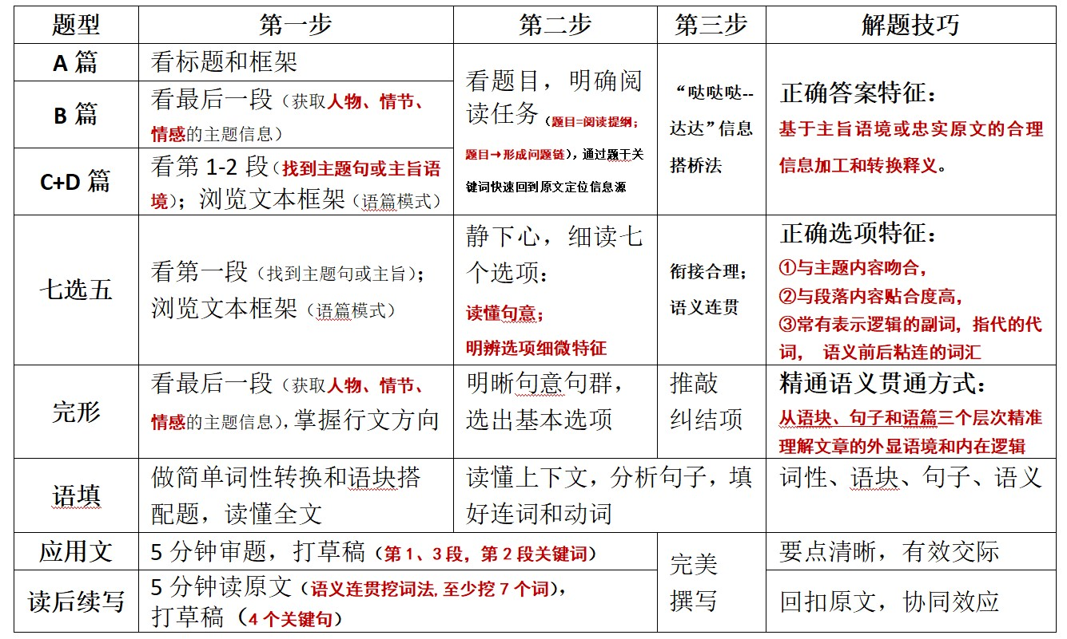
阅读理解路径优化
成功或许不可复制，但一定有最优路径可循
突破思维瓶颈，内化关键能力

Slide 23

标识选项特征，细微能见知著
01
看选项句式：问句（找答句）、祈使句（表建议）、否定句（找肯定关联），时态差异
Features are
clues
02
看选项逻辑词：因果、解释、转折、并列、递进、概括
看选项粘连性：连接（and, and then, but, because, so, or）、替代（one, ones, the same, do so, so, not）、省略、照应（人称代词, 指示代词, 限定词, 比较异同same, similar, equal, likewise, different, other, else, otherwise, in contrast）
03
04
看选项核心概念：文章主题词和段落主题词构成的语义链、语义场
05
看选项情感色彩：情态动词、形容词、副词、动词和名词

Slide 24


七选五高分突破思维策略--找到主题句或主旨;浏览文本框架
多点支撑锁定选项
形投意合确保满分
Holidays abroad are easier than ever thanks to smartphones. With the autumn weather fast approaching, it’s the perfect time of year to jet off and get away from hustles and bustles. 36 Here are some top tips to make sure you’re not caught out on your break abroad.
Treat yourself to a power bank
The batteries inside our phones are typically designed to last for around a day of moderate usage. 37 So you’re going to want some extra support so you don’t end up going AWOL (absent without leave) when your phone dies. That’s why I recommend picking up a USB power bank, which will give you a little bit of extra juice to keep you connected to the rest of the world.
Enable Data roaming (漫游)
38 The good news is that it is easier than ever to stay connected to the net when abroad. Make sure you check with your network provider what your roaming plan is. In many countries it is straightforward to buy a SIM card for a local network, with a much more generous data allowance. 39 If you’ve got a newer phone, it will probably support “eSIM”—where you can simply use an app like Holafly or Airalo while connected to wifi to set yourself up on a new network temporarily.
Download offline application software
And finally, you need to get your apps in order. Once you reach your destination you’ll need a mapping app, and maybe even a translation app—Apple and Google make their own version of both. And modern translation apps are particularly exciting. 40 Then you get a clear translation. Make sure that all of the critical data is downloaded so that apps work offline and you can travel the world like a local. Bon voyage!
电池电量
上网
下载应用软件
A. What good is a phone without Internet access?
B. You simply wave your phone at the scanner instead.
C. In fact, you may not even need a physical card anymore.
D. Why do you need to get your phone ready to be connected?
E. But when you’re away from home, you’re probably using it so much more.
F. You can typically just wave the camera of your phone over pretty much anything.
G. But before leaving for the airport, ensure your phone is ready for the journey ahead!

Slide 25

七选五高分突破思维策略--
读懂七个选项句意;
明辨选项细微特征
多点支撑锁定选项
形投意合确保满分
Holidays abroad are easier than ever thanks to smartphones. With the autumn weather fast approaching, it’s the perfect time of year to jet off and get away from hustles and bustles. 36 Here are some top tips to make sure you’re not caught out on your break abroad.
Treat yourself to a power bank
The batteries inside our phones are typically designed to last for around a day of moderate usage. 37 So you’re going to want some extra support so you don’t end up going AWOL (absent without leave) when your phone dies. That’s why I recommend picking up a USB power bank, which will give you a little bit of extra juice to keep you connected to the rest of the world.
Enable Data roaming (漫游)
38 The good news is that it is easier than ever to stay connected to the net when abroad. Make sure you check with your network provider what your roaming plan is. In many countries it is straightforward to buy a SIM card for a local network, with a much more generous data allowance. 39 If you’ve got a newer phone, it will probably support “eSIM”—where you can simply use an app like Holafly or Airalo while connected to wifi to set yourself up on a new network temporarily.
Download offline application software
And finally, you need to get your apps in order. Once you reach your destination you’ll need a mapping app, and maybe even a translation app—Apple and Google make their own version of both. And modern translation apps are particularly exciting. 40 Then you get a clear translation. Make sure that all of the critical data is downloaded so that apps work offline and you can travel the world like a local. Bon voyage!
电池电量
上网
下载应用软件
A. What good is a phone without Internet access?
B. You simply wave your phone at the scanner instead.
C. In fact, you may not even need a physical card anymore.
D. Why do you need to get your phone ready to be connected?
E. But when you’re away from home, you’re probably using it so much more.
F. You can typically just wave the camera of your phone over pretty much anything.
G. But before leaving for the airport, ensure your phone is ready for the journey ahead!
A .不能上网的手机有什么用?
B.你只需在扫描仪前挥动你的手机。
C.事实上，你可能不再需要一张实体卡了。
D.为什么你需要准备好你的手机来连接?
E.但是当你不在家的时候，你可能会用得更多。
F一般来说，你可以用手机的摄像头拍任何东西。
G.但是在出发去机场之前，确保你的手机准备好了!

Slide 26
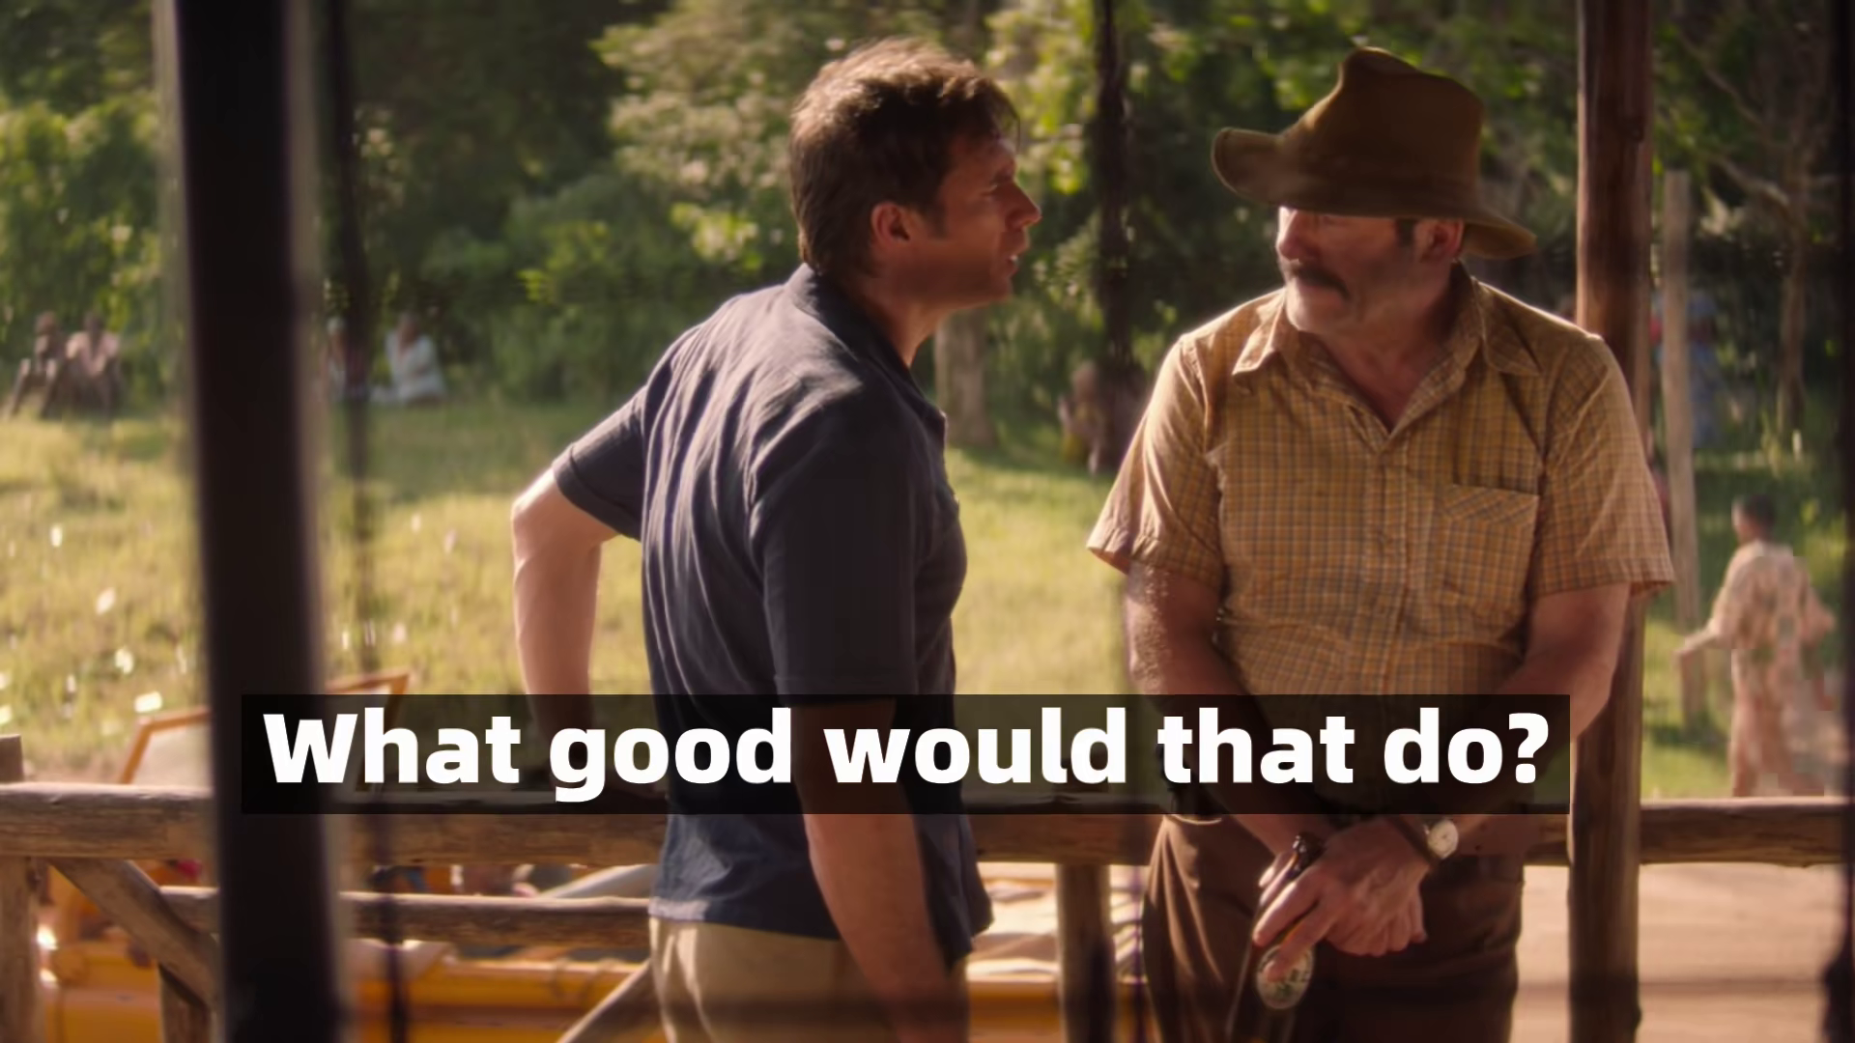
七选五高分突破思维策略--
明辨选项细微特征
空处前后衔接连贯
多点支撑锁定选项
形投意合确保满分
Holidays abroad are easier than ever thanks to smartphones. With the autumn weather fast approaching, it’s the perfect time of year to jet off and get away from hustles and bustles. 36 Here are some top tips to make sure you’re not caught out on your break abroad.
Treat yourself to a power bank
The batteries inside our phones are typically designed to last for around a day of moderate usage. 37 So you’re going to want some extra support so you don’t end up going AWOL (absent without leave) when your phone dies. That’s why I recommend picking up a USB power bank, which will give you a little bit of extra juice to keep you connected to the rest of the world.
Enable Data roaming (漫游)
38 The good news is that it is easier than ever to stay connected to the net when abroad. Make sure you check with your network provider what your roaming plan is. In many countries it is straightforward to buy a SIM card for a local network, with a much more generous data allowance. 39 If you’ve got a newer phone, it will probably support “eSIM”—where you can simply use an app like Holafly or Airalo while connected to wifi to set yourself up on a new network temporarily.
这是一年中乘坐飞机远离喧嚣的最佳时机。
G. But before leaving for the airport, ensure your phone is ready for the journey ahead!
E. But when you’re away from home, you’re probably using it so much more.
A. What good is a phone without Internet access?
C. In fact, you may not even need a physical card anymore.

Slide 27



七选五高分突破思维策略--
明辨选项细微特征
空处前后衔接连贯
多点支撑锁定选项
形投意合确保满分
Download offline application software
And finally, you need to get your apps in order. Once you reach your destination you’ll need a mapping app, and maybe even a translation app—Apple and Google make their own version of both. And modern translation apps are particularly exciting. 40 Then you get a clear translation. Make sure that all of the critical data is downloaded so that apps work offline and you can travel the world like a local. Bon voyage!
下载离线应用软件
最后，你需要让你的应用程序井然有序。一旦你到达目的地，你就需要一个地图应用程序，甚至可能是一个翻译应用程序——苹果和谷歌都有自己的版本。现代翻译应用程序尤其令人兴奋。 40 这样你就会得到一个清晰的译文。确保所有的关键数据都下载了，这样应用程序就可以离线工作，你就可以像当地人一样环游世界。祝您一路顺风!
B. You simply wave your phone at the scanner instead.
F. You can typically just wave the camera of your phone over pretty much anything.

Slide 28
七选五语料整理
语义场建构；改述释义；高频课外单词语境记忆
9.手工制作珠宝 10. 无需注册。 先到先得。 | = altruistic_{利他主义的，无私的} /selfless behavior
1. 随着秋天的来临，这是一年中乘坐飞机远离喧嚣的最佳时机。
2. 给自己一个充电宝/ 适度使用 /多一点电 /擅离职守、矿工、未请假而缺勤
3. 启用数据漫游/更宽裕的数据流量津贴
4. 相反，你只需在扫描仪前挥动你的手机。/你基本上可以用手机的摄像头拍任何东西。
5.你在国外度假时被困 /祝你一路顺风！_{（用于离别时的祝福语，表示对旅行者的祝福和安全的祝愿。）}
1. With the autumn weather fast approaching_{（with复合结构）}, it’s the perfect time of year to jet off and get away from hustles and bustles.
2. treat yourself to a power bank /moderate usage /a little bit of extra juice /go absent without leave
3. enable data roaming / with a much more generous data allowance
4. You simply wave your phone at the scanner instead.
/You can typically just wave the camera of your phone over pretty much anything.
5.you’re not caught out on your break abroad
/Bon voyage! _{（在法语中，Bon 代表“好”）}

Slide 29

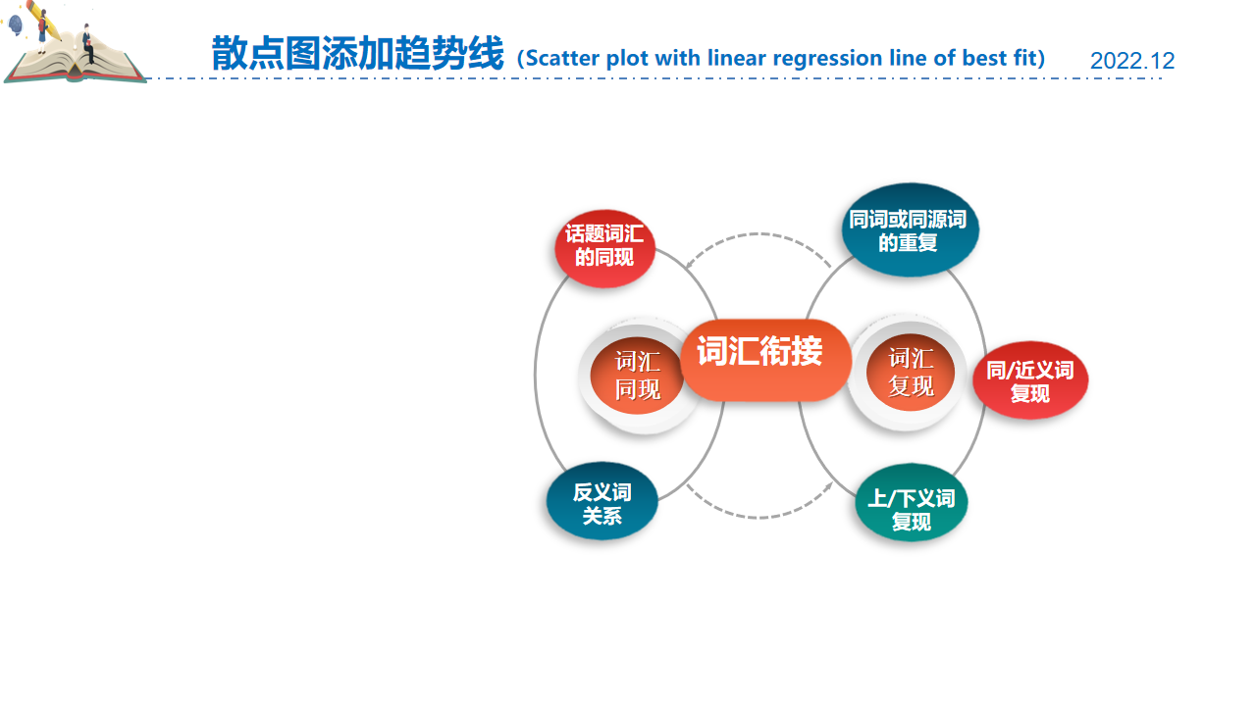

完形填空线索思维导图
clue
线索
1.词汇衔接
_{Lexical cohesion}
并列关系
coordinating relation
递进关系
progressive
relation
转折关系
adversative
relation
2.逻辑关系
_{logical relation}
对比关系
contrast
relation
因果关系
casual
relation
解释关系
explanatory
relation
3.语境
_{context}
固定搭配或概念常识_{(phrase/common sense)}
情感线_{(emotion)}
hook
动作线_{(action)}

Slide 30


完形填空高分突破思维策略:
先读尾段，通览全文，快速答题
I often helped at Grandma’s restaurant on weekends. This Saturday morning, when I was in the alley behind the restaurant, I noticed something 41 . Our dustbins had been knocked over! How could those have fallen? I wondered as I quickly cleaned up the mess, and then headed into the restaurant to help with the 42 rush.
....
It wasn’t long before Grandma appeared in the doorway, a bit surprised. “Grandma, meet my new friend. He loves the smell of your 53 ,” I said. Grandma chuckled. “Well, it looks like I’ll need to 54 our menu to include some cat-friendly dim-sum options.”
“If you do, I think we know who will be first waiting in line every morning!” I said. The cat affectionately rubbed against my leg, as if agreeing with the 55 .
54.语境语意
51. A. Sure enough B. Strange to say C. Worse still D. Out of the blue
52. A. hesitant B. unwilling C. happy D. proud
53. A. dustbin B. blanket C. garage D. cooking
54. A. search B. expand C. check D. limit
55. A. suggestion B. request C. idea D. invitation
最后一段通常是叙事性评议，为了快速理解全文，我们可以直接从最后一段开始读，做到人物、情节、情感的理解到位；有利于通览全文的高度，精准把握故事的发展，可以少走弯路，节省时间，提高解题效率。
53.话题词汇同现
通过后两段可知文章大意：我与猫的初次相识相遇，情感态度副词 friendly 和 affectionately反映我和小猫的友好相处，突显人与自然和谐相处的主题。

Slide 31
完形填空高分突破思维策略
I often helped at Grandma’s restaurant on weekends. This Saturday morning, when I was in the alley behind the restaurant, I noticed something 41 . Our dustbins had been knocked over! How could those have fallen? I wondered as I quickly cleaned up the mess, and then headed into the restaurant to help with the 42 rush.
Early the next morning, when I sat up and looked out of my window, I spotted the dustbins — 43 over yet again! Soon, it started to rain. That was when I noticed two yellow eyes staring back at me. 44 from the dustbin was a little gray cat. I jumped out of bed and 45 down to the alley.
“So you’re the one that knocked over the dustbin!” I said, finally 46 . I watched as the kitty 47 at a container, trying to get
41.逻辑推理
42.语境语意
43.同义词复现
45.语境语意
44.逻辑推理
41. A. fascinating B. strange C. amusing D. scary
42. A. breakfast B. traffic C. shopping D. weekday
43. A. tipped B. rolled C. leant D. ran
44. A. Escaping B. Hiding C. Recovering D. Emerging
45. A. wandered B. raced C. jogged D. marched
45.熟词生义race
疾走，全速行进；
（因害怕、兴奋而）急速跳动/转动；
（发动机）猛转
American economic growth raced ahead. 美国的经济飞速增长。
The hares raced away out of sight.
野兔飞奔而去，很快就看不见了。
Her heart raced uncontrollably.
她控制不住地心跳加速。
43.熟词生义：tip 倒掉（垃圾）；倾倒，倒出；打翻；
tip over: 使翻倒 = turn /knock over =trip over
trip and fall over绊倒
tipsy: 踉跄的，微醉的

Slide 32
完形填空高分突破思维策略
I often helped at Grandma’s restaurant on weekends. This Saturday morning, when I was in the alley behind the restaurant, I noticed something 41 . Our dustbins had been knocked over! How could those have fallen? I wondered as I quickly cleaned up the mess, and then headed into the restaurant to help with the 42 rush.
Early the next morning, when I sat up and looked out of my window, I spotted the dustbins — 43 over yet again! Soon, it started to rain. That was when I noticed two yellow eyes staring back at me. 44 from the dustbin was a little gray cat. I jumped out of bed and 45 down to the alley.
“So you’re the one that knocked over the dustbin!” I said, finally 46 . I watched as the kitty 47 at a container, trying to get
41.逻辑推理
42.语境语意
43.同义词复现
45.语境语意
44.逻辑推理
41. A. fascinating B. strange C. amusing D. scary
42. A. breakfast B. traffic C. shopping D. weekday
43. A. tipped B. rolled C. leant D. ran
44. A. Escaping B. Hiding C. Recovering D. Emerging
45. A. wandered B. raced C. jogged D. marched
45.熟词生义race
疾走，全速行进；
（因害怕、兴奋而）急速跳动/转动；
（发动机）猛转
American economic growth raced ahead. 美国的经济飞速增长。
The hares raced away out of sight.
野兔飞奔而去，很快就看不见了。
Her heart raced uncontrollably.
她控制不住地心跳加速。
43.熟词生义：tip 倒掉（垃圾）；倾倒，倒出；打翻；
tip over: 使翻倒 = turn /knock over =trip over
trip and fall over绊倒
tipsy: 踉跄的，微醉的

Slide 33
完形填空高分突破思维策略
46.逻辑推理
47.逻辑推理
“So you’re the one that knocked over the dustbin!” I said, finally 46 . I watched as the kitty 47 at a container, trying to get the 48 shrimp dumplings inside. With the rain 49 , the poor kitty was too scared to come out of his new hiding spot. Luckily, I had an idea. I approached the cat with a shrimp dumpling and the cat cheered up. Then, I 50 made my way to the garage, where I had placed a blanket on the floor. 51 , attracted by the scent of food, the kitty followed me inside, 52 to be out of the rain.
49.逻辑推理
48.生活常识+语境语意
50.动作线+语境语意
46. A. admitting B. understanding C. reflecting D. wondering
47. A. grabbed B. glanced C. sneezed D. pointed
48. A. well-done B. eye-catching C. half-eaten D. under-cooked
49. A. showing up B. letting up C. easing up D. picking up
50. A. suddenly B. eagerly C. gradually D. slowly
48.合成词：
eye-catching引人注目的
half-eaten 吃了一半
under-cooked煮得欠熟的
考查英语思维和迁移能力的方式，可由合成词的结构+语境推断出词义
downplay 轻视；贬低
upbringing 养育
one-size-fits-all policy 一刀切政策
stay-at-home order 居家规定
shortlist 列入候选人名单
blackmail 敲诈
blueprint 蓝图
lazybones 懒汉
49.熟词生义：pick up
be picked up by police 被警察逮捕
pick up my daughter from school 去学校接女儿
pick up Japanese (偶然地、无意地) 得到；学会 (语言)
pick up the habit of... 养成...习惯
the wind/rain picked up 风/雨速度加快，增强
pick up the bill for... 替某人支付账单
pick up a cold 感染（...病）
the economy has started to pick up 恢复 (健康等)； (贸易、经济) 改善
轻视；贬低
upbringing 养育
one-size-fits-all policy 一刀切政策
stay-at-home order 居家规定
shortlist 列入候选人名单
blackmail 敲诈
blueprint 蓝图
lazybones 懒汉
be picked up by police 被警察逮捕
pick up my daughter from school 去学校接女儿
pick up Japanese (偶然地、无意地) 得到；学会 (语言)
pick up the habit of... 养成...习惯
the wind/rain picked up 风/雨速度加快，增强
pick up the bill for... 替某人支付账单
pick up a cold 感染（...病）
the economy has started to pick up 恢复 (健康等)； (贸易、经济) 改善

Slide 34
完形填空高分突破思维策略
I watched as the kitty 47 at a container, trying to get the 48 shrimp dumplings inside. With the rain 49 , the poor kitty was too scared to come out of his new hiding spot. Luckily, I had an idea. I approached the cat with a shrimp dumpling and the cat cheered up. Then, I 50 made my way to the garage, where I had placed a blanket on the floor. 51 , attracted by the scent of food, the kitty followed me inside, 52 to be out of the rain.
It wasn’t long before Grandma appeared in the doorway, a bit surprised. “Grandma, meet my new friend. He loves the smell of your 53 ,” I said. Grandma chuckled. “Well, it looks like I’ll need to 54 our menu to include some cat-friendly dim-sum options.”
“If you do, I think we know who will be first waiting in line every morning!” I said. The cat affectionately rubbed against my leg, as if agreeing with the 55 .
52.情感线+逻辑推理
51.语境语意
55.语境语意
51. A. Sure enough B. Strange to say C. Worse still D. Out of the blue
52. A. hesitant B. unwilling C. happy D. proud
53. A. dustbin B. blanket C. garage D. cooking
54. A. search B. expand C. check D. limit
55. A. suggestion B. request C. idea D. invitation
51.过渡性短语
Sure enough
Strange to say
Worse still
Out of the blue
果然
说来奇怪
更糟糕的是
突然地（晴朗的天空突然来了一道闪电）

Slide 35

语法填空高分突破思维策略
把握语境，重视语篇（词性-语块-句子-语义）
“Journey to the West”, a classic Chinese novel, has been adapted over the centuries, 56 (appeal) to audiences with its rich narrative and characters. It is the most famous novel in Chinese literature and 57 the country’s most successful cultural exports.
But “Black Myth: Wukong”, released on August 20th, is special. The video game is the first blockbuster release from a Chinese studio. “Black Myth” is a “AAA” game — 58 label that indicates big budgets and high production values.
Many Chinese complained their country’s 59 (ability) to produce a video game as thrilling as “Grand Theft Auto” or “World of Warcraft”, which 60 (originate) in Scotland and America 61 (respective). Now they are hoping “Black Myth” marks the arrival of a new player in the AAA arena. GameScience, the 62 (make) of “Black Myth”, is trying to achieve this goal. The company studied the best titles and historical material to create a game world 63 would feel true to “Journey to the West”. The process took six years, but the determination has paid off.
Xinhua, an official news service, says “Black Myth” has succeeded in “telling China’s story with world-class quality”. A spokesperson for China’s foreign ministry, 64 (delight) at a positive news story about China, has argued that the game’s approval overseas “ 65 (reflect) the appeal of Chinese culture”.
56. appealing 做结果状语
57. among
58. a 同位语
59. inability
60. originated 谓语动词
61. respectively
62.maker
63. that/which 定语从句
64. delighted
be delighted at 做状语
65 reflects 谓语动词

Slide 36
语法填空高分突破思维策略
把握语境，重视语篇（词性-语块-句子-语义）
It is the most famous novel in Chinese literature and 57 the country’s most successful cultural exports.
Many Chinese complained their country’s 59 (ability) to produce a video game as thrilling as “Grand Theft Auto” or “World of Warcraft”, which 60 (originate) in Scotland and America 61 (respective).
57. 关注连词and所表达的“并列+递进”的逻辑关系：
语义决定语法：读懂并列关系很重要， in Chinese literature 和 the country’s most successful cultural exports
考生很容易表面理解 the most famous novel in Chinese literature 和 the country’s most successful cultural exports，但本句and 连接的核心关键词是Chinese literature
和 country’s cultural exports
59. 警惕二次变化，尤其是否定前缀，破解之法是读懂语义：
如：1.The concert promises to be a(n) (forget) experience,where the audience can expect an emotional journey... _{(2024强基联盟8月联考)}
2. A Stone Age bird sculpture (cover) in China could be a “missing link” in our understanding of prehistoric art. _{(2023-2024学年高三四校联考)}
ability 的否定前缀：disability n. 残疾，缺陷；无能力，障碍
inability n. 无能，无力，不能
unforgettable
uncovered

Slide 37



