Slide 1


感恩遇见，相互成就，本课件资料仅供您个人参考、教学使用，严禁自行在网络传播，违者依知识产权法追究法律责任。
更多教学资源请关注
公众号：溯恩英语
知识产权声明

Slide 2
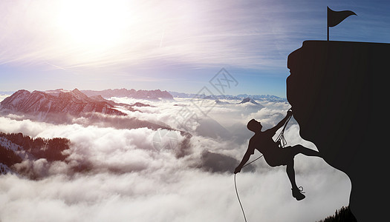
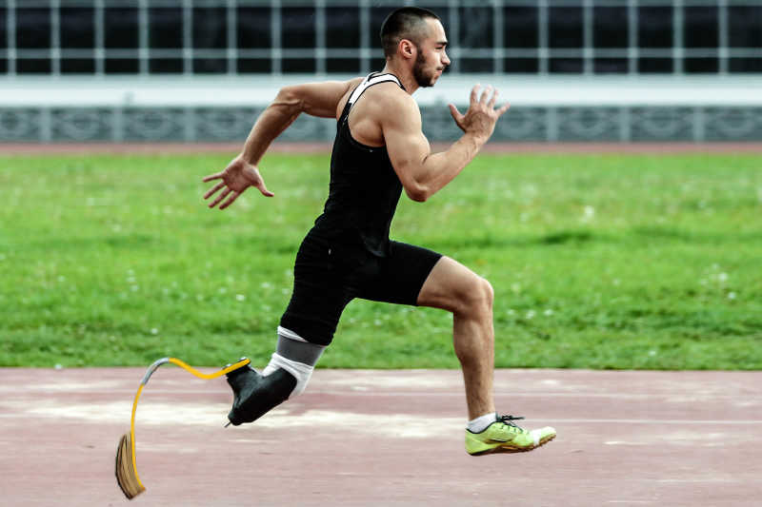

逆境崛起 逐梦半马
---2024-10 江浙皖联考
人与自我之逆境成长篇
郑素红

Slide 3
读原文:
We were near the mountaintop of Tupendo when a rock got moved and hit my lower leg halfway between ankle and knee. The impact cut through both bones and removed a big chunk (块) of my leg. I found myself hanging from a rope,1,600m off the ground, in sharp pain. I was afraid it might just drop off.
After binding it to an ice- axe, my climbing partner abseiled down (缘绳下降) to get help. For two days I lay alone. My leg started to smell pretty bad.
It took six days to get me off the mountain and to a hospital in northern India. The hospital was basic and the next day I was flown to Delhi for emergency surgery and then, when stable enough, back home. In the UK, after nine operations, my doctor recommended an amputation (截肢) if I wanted to be able to walk properly again.

Slide 4
I was very sad. I had been competing in sport since I was a teenager. My physical fitness and love of running felt as if they were an inseparable part of the person I was. I visited a center specializing in prostheses and the consultant there seemed terribly enthusiastic about my prospects as an amputee, telling me I would be walking within six months and maybe even playing football after a year. I found the experience too depressing for words and was determined to put off the decision for as long as possible.
Every night I had the same dream: I would be hobbling along a grassy path using my crutches (拐杖) and then, suddenly, I would lift them up and throw them in the river and I’d start walking, and then running, as if there had never been anything wrong. When I woke, it would take me a few seconds to remember.
Para1: I bought an exercise bike and used it for 30 minutes three times a week.
Para2: Almost 4 years after my accident, I entered a local half marathon.

Slide 5
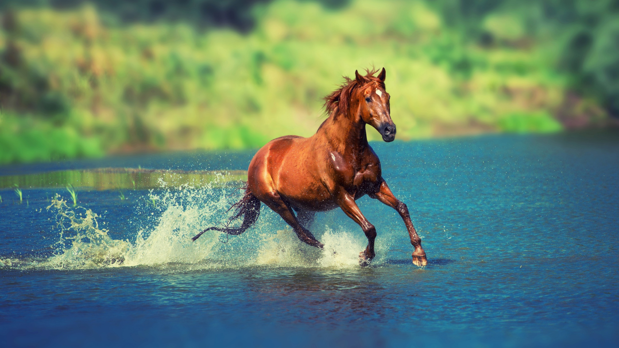
Read for elements
Major characters： I
2. narrative perspective: first-person ( I )
3. time： before , during and after the local half marathon
place： unclear
event: I made full preparation for the local half marathon as an amputee and entered it eventually.

Slide 6
Conflict1 : dream of walk and run without crutches after being amputed .
Analyze conflicts
solution1: exercise on a bike and do running training .
Conflict 2: enter the local half marathon in prostheses
Solution 2: perseverance strong will , optimism , resilience helped to overcome obstacles

Slide 7

5.story
line
Every night I had the same dream: walking and running without crutches.
Climax
Para1: I bought an exercise bike and used it for 30 minutes three times a week.
I was very sad. My physical fitness and love of running felt as if they were an inseparable part of the person I was.
Back in UK, after nine operations, my doctor recommended an amputation (截肢) if I wanted to be able to walk properly again.
Para2: Almost 4 years after my accident, I entered a local half marathon.
It took six days to get me off the mountain and to a hospital in northern India.
I had a terrible accident when climbing the mountain of Tupendo.
background
Ending
Beginning

Slide 8
Read for clues and echoes
hidden clues | echoes
I found myself hanging from a rope,1,600m off the ground, in sharp pain. I was afraid it might just drop off. The hospital was basic and the next day I was flown to Delhi for emergency surgery and then, when stable enough, back home. In the UK, after nine operations, my doctor recommended an amputation (截肢) if I wanted to be able to walk properly again. | 1. Initially, it was extremely challenging and bitter to pedal while wearing a prosthetic limb. The sharp pain in my leg tempted me to give up but I refused, repeatedly reminding myself that I had to be tough and keep pushing forward.

Slide 9
Read for clues and echoes
hidden clues | echoes
I was very sad. I had been competing in sport since I was a teenager. My physical fitness and love of running felt as if they were an inseparable part of the person I was. | 2. Heart infused with pride , I was convinced I was still what I used to be, the person who considered physical fitness and love of running as an inseparable part of my life.

Slide 10
Read for clues and echoes
hidden clues | echoes
Every night I had the same dream: I would be hobbling along a grassy path using my crutches (拐杖) and then, suddenly, I would lift them up and throw them in the river and I’d start walking, and then running, as if there had never been anything wrong. When I woke, it would take me a few seconds to remember. | 3. I pushed myself to work out on the bike in the hope of walking properly and running without crutches in future.

Slide 11
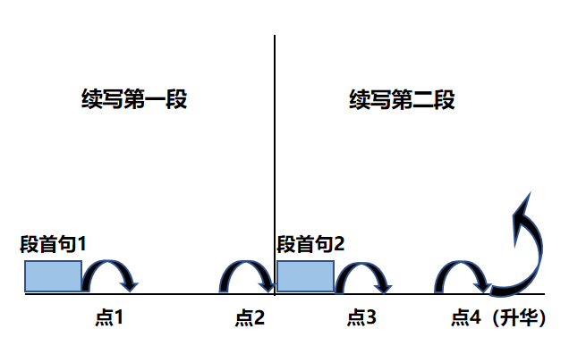
Plot Continuation
点1：位于续写第一段段首，流畅衔接前面的故事（常与原文最后一段呼应）和第一段段首语；
点2：位于续写第一段段尾，流畅衔接第二段段首句；
点3：位于续写第二段段首，续写衔接第二段段首语；
点4：文章结尾升华，给予读者正能量，揭示和强调主题。

Slide 12
Plot the continuation story
Para1: I bought an exercise bike and used it for 30 minutes three times a week.
Para2: Almost 4 years after my accident, I entered a local half marathon.
Link1: Why did I exercise ?
Body: How did I feel? What did I do ?
Link2: How did I train myself for the coming local half marathon?
Link3: How did I feel?
Body: What did I do during the marathon? How did the audience react to my performance?
Theme: What lesson did the experience demonstrate?

Slide 13
心理描写
神态描写
动作描写
外貌描写
环境描写
对话描写
语言
无灵主语
动作链
分词作状语
With 复合结构
独立主格
从句
倒装句
虚拟语气
强调句
长短句结合
考生构思情节的同时，要考虑合适的语言句式以及修辞

Slide 14
Design link1
Para1: I bought an exercise bike and used it for 30 minutes three times a week.
Link1A: I pushed myself to work out on the bike in the hope of walking and running without crutches in future.
Link1B: My goal was to turn up in the competitive sports and redefine my life.

Slide 15
Design link2
Para1: I bought an exercise bike and used it for 30 minutes three times a week.
Para2: Almost 4 years after my accident, I entered a local half marathon.
Link2 A: As the weeks turned into months and months into years, determined and resolute, I increased the intensity and duration of my workouts. It was high time to announce to the world that I could recompete in sports.

Slide 16
Design link2
Para1: I bought an exercise bike and used it for 30 minutes three times a week.
Para2: Almost 4 years after my accident, I entered a local half marathon.
Link2B: This newfound determination became my driving force, urging me to fully prepare for what lay ahead---a local half marathon.

Slide 17
Design link3
Para2: Almost 4 years after my accident, I entered a local half marathon.
Link3A：As I stood at the starting line in prostheses, my heart was pounding with a mixture of excitement and nervousness.
Link3B: The atmosphere was thrilling and electronic. Standing at the starting line, I scanned through the excitedly-cheering audience, memories of my struggles flooding back.

Slide 18
Design ending
Para2: Almost 4 years after my accident, I entered a local half marathon.
Ending A: With this small victory, I had proved to the world and myself that no matter what life throws at us, we can always find the newfound strength, faith and bravery to rise above it and embrace life with courage and optimism.

Slide 19
Design ending
Para2: Almost 4 years after my accident, I entered a local half marathon.
Ending B: （情景式+ 感悟结尾）
Thunderous applauses and cheers exploded for my resilience. The small victory in the local half marathon served as a reminder that it is not disability but persistence that defines my life.

Slide 20
Design ending
Para2: Almost 4 years after my accident, I entered a local half marathon.
Ending C: （结合作者我一路走来的艰辛----回扣登山发生的惨剧结尾）
I had come a long way from that fateful day on the mountain, and this time I rose out of the depths of despair.
Ending C: （结合作者我一路走来的艰辛----回扣我对跑步的热爱结尾）
Heart infused with pride , I was convinced I was still what I used to be, the person who considered physical fitness and love of running as an inseparable part of my life.

Slide 21
Design ending
Para2: Almost 4 years after my accident, I entered a local half marathon.
Ending D: （结合完成半马，我逆袭人生，绽放光芒）
I was now living proof that even in the face of the greatest adversity, one can find the will to rise and shine.

Slide 22
习作1基于各类描写+语法句型的句式拆解： para1:
（动作描写+心理活动） I pushed myself to work out on the bike in the hope of walking and running without crutches in future. （介词短语+动名词）
（心理活动+动作描写）Initially, it was extremely challenging to pedal while wearing a prosthetic limb. （ it句型+ 非谓）
（心理活动+动作描写）The sharp pain in my leg tempted me to give up but I refused, repeatedly reminding myself that I had to be tough. （ 无灵主语句 + 并列句）
（心理活动） With each exercise session on the bike, a
glimmer of hope was reignited in my heart. （ with 结构，无
灵主语句）

Slide 23
习作1基于各类描写+语法句型的句式拆解： para1:
5. （心理活动+动作描写） I started to firmly believe that I could regain my lost enthusiasm for running. （ 宾语从句）
6. （环境描写+心理活动+动作描写）As the weeks turned into months and months into years, determined and resolute, I struggled to run as much as I could. （ As 时间状语从句，二连形+ 夸张）
7. （心理活动+动作描写） Feeling increasingly energized, I felt it was high time to recompete in sport. (非谓语doing sth, sb did sth + it 句型)

Slide 24
习作1基于各类描写+语法句型的句式拆解： Para2:
（ 动作描写+心理活动） As I stood at the starting line in prostheses, my heart was pounding wildly with a mixture of excitement and nervousness. （ As 时间状语，无灵主语句 + with 结构）
（环境场面描写+动作描写） Cheers erupted from the
enthusiastic audience the instant the race began. （ 无灵主语
句+ 时间状语从句）
3. （ 动作描写+环境描写） I took steady steps to keep up with other
runners, the gentle breeze brushing my face. ( sb did sth, 独立主格）
(场景描写+心理活动） Despite the painful slowness and my out- of-
breath state, what emerged from the half marathon was a definite sense
of happiness and freedom. （ 介词短语， 主语从句 ； ）

Slide 25
句式拆解： Para2:
（ 动作描写+心理活动） Crossing the finish line was one of the
most emotional moments in my life. （ 动名词作主语）
（ 心理活动+动作描写） With this small victory, I had proved to
the world and myself that no matter what life throws at us, we
can always recover strength, faith and bravery to rise above it
and embrace life with courage and optimism. ( with 结构， 宾
语 从句 含 让步状语从句，主句二连动 )

Slide 26
习作1
Para1: I bought an exercise bike and used it for 30 minutes three times a week. I pushed myself to work out on the bike in the hope of walking and running without crutches in future. Initially, it was extremely challenging to pedal while wearing a prosthetic limb. The sharp pain in my leg tempted me to give up but I refused, repeatedly reminding myself that I had to be tough. With each exercise session on the bike, a glimmer of hope was reignited in my heart. I started to firmly believe that I could regain my lost enthusiasm for running. As the weeks turned into months and months into years, determined and resolute, I struggled to run as much as I could. Feeling increasingly energized, I felt it was high time to recompete in sport. (117)

Slide 27
Para2: Almost 4 years after my accident, I entered a local half marathon. As I stood at the starting line in prostheses, my heart was pounding wildly with a mixture of excitement and nervousness. Cheers erupted from the enthusiastic audience as the race began. I took steady steps to keep up with other runners, the gentle breeze brushing my face. Despite the painful slowness and my out- of-breath state, what emerged from the half marathon was a definite sense of happiness and freedom. Crossing the finish line was one of the most emotional moments in my life. With this small victory, I had proved to the world and myself that no matter what life throws at us, we can always recover strength, faith and bravery to rise above it and embrace life with courage and optimism. (123)

Slide 28
习作2
Para1: I bought an exercise bike and used it for 30 minutes three times a week. My goal was to involve in the competitive sports and redefine my life. The initial attempts were arduous and exhausting, with lingering pain torturing me. But I held a firm belief that this was the best approach to regaining control over my broken life. My painstaking efforts paid off. Each rotation of the pedals helped to build up my strength, bringing me closer to my goal. Time ticking by, I saw steady progress in my running training. I could feel my faith and my power returning, with a spark of hope reignited inside me. This newfound determination became my driving force, urging me to focus on what lay ahead---a local half marathon. (117)

Slide 29
Para2: Almost 4 years after my accident, I entered a local half marathon. The atmosphere was thrilling and electronic. Standing at the starting line, I scanned through the excitedly-cheering audience, memories of my struggles flooding back. The pain, the perseverance, the resilience and the unwavering belief in myself pieced my broken body together. The race starting, I took several tentative steps in prostheses. Increasing confidence accumulating, I flew like an arrow, just like I did in my dream. Time flying by, the competition ended and I won the first place. Thunderous applauses exploded, emotional tears streaming down my cheeks. I had proven that no matter how difficult life gets, we can overcome any obstacle in our life with determination and a positive attitude. (110) // I had come a long way from that fateful day on the mountain, and this time I rose out of the depths of despair. // I was now living proof that even in the face of the greatest adversity, one can find the will to rise and shine.

Slide 30

人与自我之逆境相关语料
I am physically challenged but I have demonstrated my indomitable spirit by finishing my first half marathon 4 years after that disastrous accident.
Meanwhile, I read lots of inspiring books about Stephen Hawking, Helen Keller, aspiring to obtain spiritual power to bring my life back to normal.
I also watched videos of some Paralympic athletes, who showed extraordinary perseverance and tenacity in the face of adversity.
It dawned on me that it is not physical disability but positive mentality that defines my life.

Slide 31
心理活动描写语料：
Ava’s heart sank when her eyes fell on her parents’ smiling faces.
Ava got into the car, her stomach in knots.
With butterflies in stomach, Emma cleared her throat and began her solo performance.
Fond memories of my mom cooking special dishes in the kitchen, knitting sweaters by the lamp and consoling me when I felt depressed crowded into my mind.
What relieved all the crew of the airport was that the plane landed on the runaway safely.
Overwhelmed with a sense/ wave/ surge/ flood of joy, Little Amy threw herself into mom’s embrace, wrapped her arms around her neck and pressed a kiss on her forehead.
Emily’s heart infused with overwhelming gratitude to the generous helpful stranger, she waved goodbye to him , heading back home.

