Slide 1



感恩遇见，相互成就，本课件资料仅供您个人参考、教学使用，严禁自行在网络传播，违者依知识产权法追究法律责任。
更多教学资源请关注
公众号：溯恩英语
知识产权声明

Slide 2
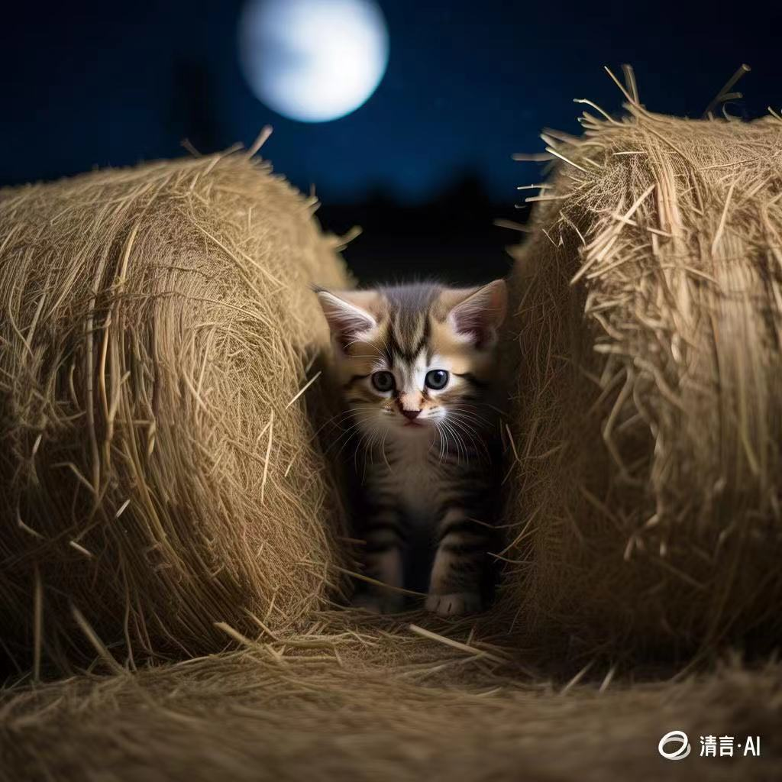

The Kitten in the Hayloft
---2024-10 天域名校
人与自然之动物篇
郑素红

Slide 3
读原文:
Sweat dripped from Callie’s face as she helped her big brother Briggs load hay bales (干草捆) onto the conveyor (输送机). She wasn’t strong enough to lift them herself, but she could at least help drag them into place. The machine chattered noisily while it carried the bales up to the hayloft, where Callie’s dad stacked them.
All was quiet when Callie went inside to feed the horses. But as she filled the water buckets, she thought she heard a faint meow from the hayloft. She climbed the steps to the loft and listened. The sound seemed to be coming from behind the bales. She ran to get her dad and Briggs. Briggs cocked his head. “It’s coming from outside,” he determined. “Just a bird in a tree.” Callie’s dad agreed. “How do you know for sure?” Callie said. “I guess we’ve just got better ears than you,” Briggs joked.

Slide 4
But Callie wasn’t convinced. She checked the hayloft again after supper. “Are you stuck in there, kitty?” she said, pressing an ear to the bales. “Meooow!” Callie raced back to the house. “I heard it again, Dad! Will you please listen once more?” “All right, Cal,” her dad said, turning off the TV. “I’ll go check while you get ready for bed.” A few minutes later, Dad poked his head into Callie’s room. “The only thing I heard out there was a screech owl,” he said. “So stop worrying.” “OK, Dad,” Callie said. “Thanks for checking.”
But she woke in the night thinking about what she’d heard. What if a kitten was trapped behind the bales? She lay on her back, wondering what to do. Finally, she grabbed a flashlight and crept into the barn.
Para1: Once in the barn, she shined the flashlight’s beam toward the ladder.
Para2: Finally, Callie picked up the scared kitten from the corner of the hayloft.

Slide 5
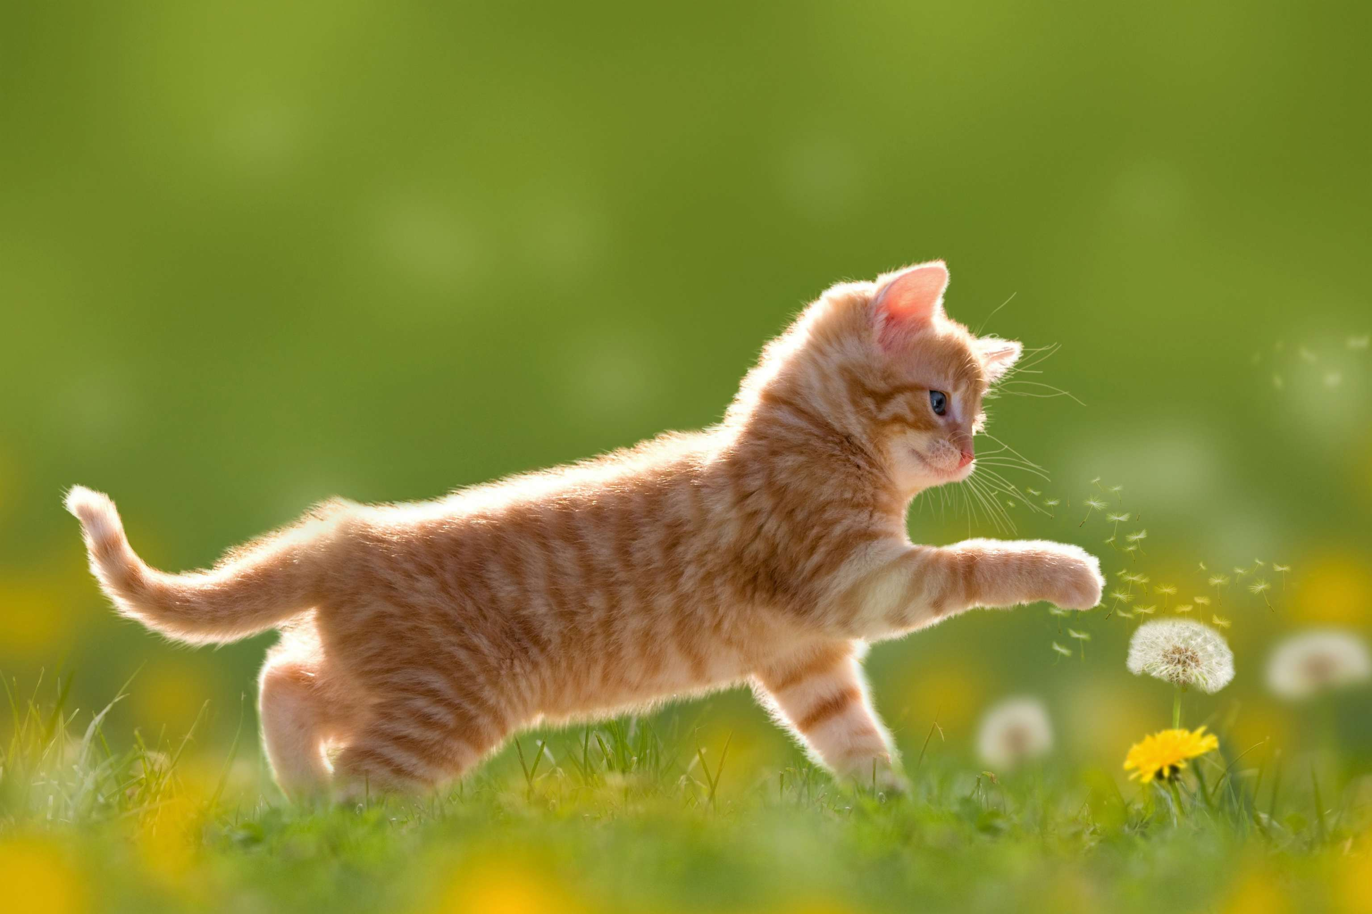
Read for elements
Major roles： Callie & the kitten
Minor roles : Dad & Briggs (her brother)
2. narrative perspective: third-person ( she)
3. time： at night
place： Callie’s house & the hayloft
event: Callie rescued a kitten stuck in the hayloft.

Slide 6
Conflict1 : Callie heard a meow and wondered if a kitten was stuck in the hayloft.
Analyze conflicts
Solution1: She asked Dad and Briggs for their opinions but they thought she made a mistake.
Conflict 2: Before going to bed, Callie asked Dad to check again for the kitten but without any luck.
Solution 2: Still worried, Callie woke in the night, grabbed a flashlight and went to the barn to look for any sign of the kitten.

Slide 7

5.
story
line
She woke in the night , grabbed a flashlight and crept into the barn.
Climax
Para1: Once in the barn, she shined the flashlight’s beam toward the ladder.
While Callie got ready for bed, Dad went checking in on a kitten in the hayloft but in vain.
Para2: Finally, Callie picked up the scared kitten from the corner of the hayloft.
She heard a weak meow from the hayloft but Dad and Briggs thought she was wrong.
Callie helped her Dad and big brother Briggs with the hay bales.
background
Ending
Beginning

Slide 8
Read for clues and echoes
hidden clues | echoes
All was quiet when Callie went inside to feed the horses. But as she filled the water buckets, she thought she heard a faint meow from the hayloft. She climbed the steps to the loft and listened. The sound seemed to be coming from behind the bales. | 1. As she reached the hayloft, a distinct but faint meow came into her ears.

Slide 9
Read for clues and echoes
hidden clues | echoes
She ran to get her dad and Briggs. Briggs cocked his head. “It’s coming from outside,” he determined. “Just a bird in a tree.” Callie’s dad agreed. “How do you know for sure?” Callie said. “I guess we’ve just got better ears than you,” Briggs joked. | 2. Stroking the adorable kitten, Briggs apologized to Callie for his arbitrary judgement.

Slide 10
Read for clues and echoes
hidden clues | echoes
But Callie wasn’t convinced. She checked the hayloft again after supper. “Are you stuck in there, kitty?” she said, pressing an ear to the bales. “Meooow!” Callie raced back to the house. | 3. Finally, she spotted a tiny striped ball of fur stuck behind one of the bales.

Slide 11
Read for clues and echoes
hidden clues | echoes
“I’ll go check while you get ready for bed.” A few minutes later, Dad poked his head into Callie’s room. “The only thing I heard out there was a screech owl,” he said. “So stop worrying.” “OK, Dad,” Callie said. “Thanks for checking.” | 4.A kitten poked her face out of the hay bales, eyes wide with terror. Callie’s heart melted.

Slide 12
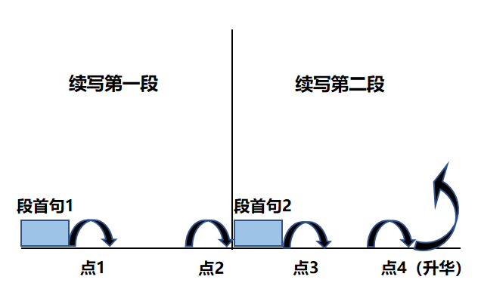
Plot Continuation
点1：位于续写第一段段首，流畅衔接前面的故事（常与原文最后一段呼应）和第一段段首语；
点2：位于续写第一段段尾，流畅衔接第二段段首句；
点3：位于续写第二段段首，续写衔接第二段段首语；
点4：文章结尾升华，给予读者正能量，揭示和强调主题。

Slide 13
Plot the continuation story
Para1: Once in the barn, she shined the flashlight’s beam toward the ladder.
Para2: Finally, Callie picked up the scared kitten from the corner of the hayloft.
Link1: What was the barn like in the night?
Body: What did Callie do? How did she feel ?
Link2: How did Callie find the kitten? How was it?
Link3: How did Callie treat the kitten?
Body: What did the kitten do to Callie? What did Callie do then to help the kitten?
Ending: What was the relation between Callie and the kitten?

Slide 14
心理描写
神态描写
动作描写
外貌描写
环境描写
对话描写
语言
无灵主语
动作链
分词作状语
With 复合结构
独立主格
从句
倒装句
虚拟语气
强调句
长短句结合
考生构思情节的同时，要考虑合适的语言句式以及修辞

Slide 15
Design link1
Para1: Once in the barn, she shined the flashlight’s beam toward the ladder.
Link1A: (呼应the barn） The barn was eerily silent except for the soft sound of her own breathing.
Link1B: （呼应the horses in the barn+ Callie）Seeing their beloved Callie turn up in the barn in the night, the horses looked confused .

Slide 16
Design link2
Para1: Once in the barn, she shined the flashlight’s beam toward the ladder.
Para2: Finally, Callie picked up the scared kitten from the corner of the hayloft.
Link2 A: (呼应第二段所给句 the scared kitten) “There you are!” she whispered softly. A kitten poked her face out of the hay bales, eyes wide with terror. Callie’s heart melted.

Slide 17
Design link2
Para1: Once in the barn, she shined the flashlight’s beam toward the ladder.
Para2: Finally, Callie picked up the scared kitten from the corner of the hayloft.
Link2B: ( 呼应第二段所给句中the scared kitten from the corner of the hayloft) Emerging from behind one of the tall hay bales in the corner was a yellow and white striped kitty, who was meowing in a trembling voice.

Slide 18
Design link2
Para1: Once in the barn, she shined the flashlight’s beam toward the ladder.
Para2: Finally, Callie picked up the scared kitten from the corner of the hayloft.
Link2C: A little striped kitty was trapped in the corner of the hayloft, eyes wide with horror. Its faint meow tugged at Callie’s heartstrings and Callie reached out her hands with great caution.

Slide 19
Design link3
Para2: Finally, Callie picked up the scared kitten from the corner of the hayloft.
Link3A：(呼应 picked up the scared kitten + kindhearted Callie) She cradled it gently in her arms, the little kitten shivering all over..
Link3B: (人猫一见倾心） No sooner had Callie’s fingers touched the cute creature than Callie fell for it, exclaiming, “ You are so adorable!”

Slide 20
Design ending
Para2: Finally, Callie picked up the scared kitten from the corner of the hayloft.
Ending A: (小猫融入大家庭） Undoubtedly, the kitten became a beloved member of the family, bringing them endless joy and laughter.

Slide 21
Design ending
Para2: Finally, Callie picked up the scared kitten from the corner of the hayloft.
Ending B: （情景式+ 感悟结尾）
It was Callie’s care and kindness that rescued the lucky kitty from piles of hay bales. From that night on, accompanied by the kitten, Callie had numerous beautiful moments.

Slide 22
习作: 基于各类描写+语法句型的句式拆解： para1:
( 环境描写） The barn was eerily silent except for the soft sound of her own breathing. （ 介词短语）
(心理活动）The thought of the possibly trapped kitty infused her heart with resolution. （ 无灵主语句）
(动作描写+心理活动）She mustered up all her courage and climbed the shaky ladder slowly and cautiously, her heart pounding wildly in her chest. （ 二连动+二连副+ 独立主格）
（动作描写）As she reached the hayloft, a distinct but faint, helpless meow came into her ears. （时间状语从句，无灵主语句）

Slide 23
5. ( 动作描写） She carefully moved the hay bales, her hands trembling with excitement mingled with anticipation. （ 独立主格）
6. ( 动作描写） Finally, she spotted a tiny striped ball of fur stuck behind one of the bales. （ 非谓语作宾补）
7. ( 动作描写+心理活动） “There you are!” she whispered softly. A kitten poked her face out of the hay bales, eyes wide with terror. Callie’s heart melted. （ 对白+独立主格+无灵主语句）

Slide 24
习作: 基于各类描写+语法句型的句式拆解： para2:
( 动作描写） She cradled it gently in her arms, the little kitten shivering all over. （独立主格）
( 动作描写+心理活动） The kitten snuggled in her warm arms, affectionately rubbing against Callie’s face as if showing her absolute trust. （非谓语伴随动作+拟人修辞）
( 动作描写+环境描写） Callie raced back to the house, her flashlight casting a warm glow on their path in darkness. （独立主格）
( 环境描写） No sooner had she entered her room than she got a small box to create a cozy haven for it. （倒装句+ 非谓语表目的）

Slide 25
习作: 基于各类描写+语法句型的句式拆解： para1:
5. ( 心理活动+动作描写） Lying in relief, the kitten yawned lazily and slept soundly as Callie stroked its fur. （非谓语+二连动+时间状语从句）
6. ( 动作描写） From that moment on, a close bond formed between the cute kitten and Callie. （无灵主语句）
7. ( 动作描写） Undoubtedly, the kitten became a beloved member of the family, bringing them endless joy and laughter. （简单句+ 非谓语表伴随动作）

Slide 26
习作
Para1: Once in the barn, she shined the flashlight’s beam toward the ladder. The barn was eerily silent except for the soft sound of her own breathing. The thought of the possibly trapped kitty infused her heart with resolution. She mustered up all her courage climbed the shaky ladder slowly and cautiously, her heart pounding wildly in her chest. As she reached the hayloft, a distinct but faint, helpless meow came into her ears. She carefully moved the hay bales, her hands trembling with excitement mingled with anticipation. Finally, she spotted a tiny striped ball of fur stuck behind one of the bales. “There you are!” she whispered softly. A kitten poked her face out of the hay bales, eyes wide with terror. Callie’s heart melted. (112)

Slide 27
Para2: Finally, Callie picked up the scared kitten from the corner of the hayloft. She cradled it gently in her arms, the little kitten shivering all over. The kitten snuggled in her warm arms, affectionately rubbing against Callie’s face as if showing her absolute trust. Callie raced back to the house, her flashlight casting a warm glow on their path. No sooner had she entered her room than she got a small box to create a cozy haven for it. Lying in relief, the kitten yawned lazily and slept soundly as Callie stroked its fur. From that moment on, a close bond formed between the cute kitten and Callie. Undoubtedly, the kitten became a beloved member of the family, bringing them endless joy and laughter. (111)

Slide 28
人与动物类读后续写题的故事模型主要有三个出题方向：
一：人与动物和谐相处；人与动物和谐相处，体现在人与动物的亲密互助方面。文章内容主要有圈养动物、家养宠物的趣事囧事；家养宠物陪伴、治愈主人；旅途偶遇动物、救助动物等。
二：人与动物发生冲突（与历险故事类有重合）。人与动物发生冲突往往以人类成功脱险为结局。人类偶遇凶猛动物，遇到危险，设法脱困。在解决问题的过程中，我们注意保护动物的理念，即不能伤害野生动物、不能私自圈养野生动物。
三： 人与动物 趣事类

Slide 29
猫语料：
外貌与神态的描写
The little kitten was as white as snow, with a pink nose sniffing the air. Its eyes were like two bright emeralds, shining with a curious glint.
The kitten was a fluffy ball of gray fur. Its tiny paws were padded with soft cushions, and its long whiskers seemed to sense every slight movement around it.
动作描写
The kitten pounced on the ball of yarn with lightning speed. It slapped at it playfully, its little claws hooking the yarns and sending the ball rolling across the floor.
It tiptoed quietly, lowering its fat body to the ground as if tracking an invisible prey. Then, all of a sudden, it leaped onto the window board and curled up into a ball, exposed to the afternoon warm sunshine lazily .
声音描写：
5. Staring at Callie, the kitten let out a soft, delicate meow, as if begging for a warm
embrace to curl up or a saucer of milk to drink.
6. It purred contentedly as Callie stroked its silky fur, its low rumbling sound filling the
room like a tiny engine.

Slide 30
面部表情语料：
As Ava explained what happened to her mobile phone, her father frowned, wearing a serious look on his face.
Lowering her head in guilt, Ava conveyed her sincere apology to her parents, tears of sadness streaming down her cheeks.
Picking up the cell phone, Ava breathed a sigh of relief, with a big smile blossoming across her face.
She took the lost shopping bag from my hands, tears of joy mingled with gratitude welling up in her eyes.
Eyes shining/ twinkling/ sparkling with extreme excitement, I declared to Mom that I had registered for the cooking competition.
Her face flushed as she admitted breaking her mom’s beloved vase.

