Slide 1


感恩遇见，相互成就，本课件资料仅供您个人参考、教学使用，严禁自行在网络传播，违者依知识产权法追究法律责任。
更多教学资源请关注
公众号：溯恩英语
知识产权声明

Slide 2
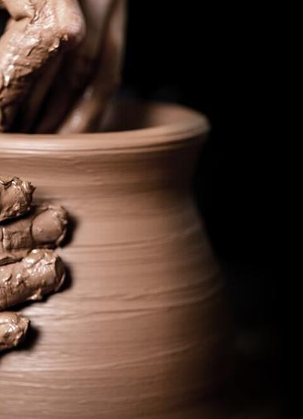
2024年高三强基联盟 应用文写作分析
A Memorable Visit to a Handicraft Workshop

Slide 3
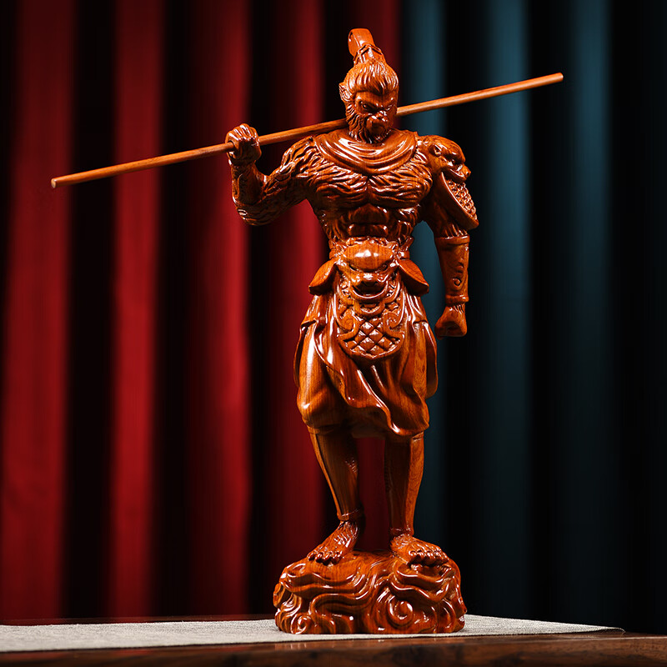
Lead in
Which is the most difficult part for you in this writing assignment?
Possible Difficulties:
1.introduce the local handicraft workshop
2.describe the specific experiences of visiting
a handicraft workshop
3.express the harvest of the event
...

Slide 4
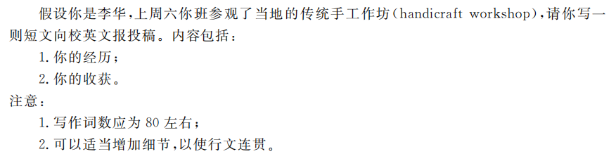
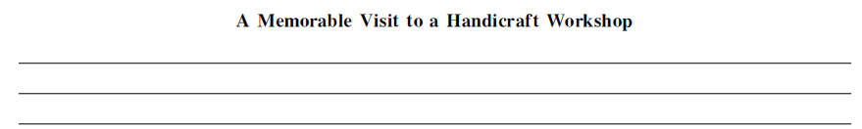
Analyze
past tense
Time
I/our class
topic/event
Genre
contribution
What s the main idea of each paragraph?
P1
P2
P3
活动总体介绍
（目的，时间，地点，举办者,活动...）
活动具体过程 （ 你的具体经历 看到、参与体验的...）
活动收获 （总结+收获+希望）

Slide 5
Brainstorm
where ancient skills are preserved and every piece reflects the artisan's heart and wisdom
P1
where we can uncover the magic of traditional techniques, and feel the stories behind each crafted piece.
where we can immerse in history, and experience the charm of handmade creations
the introduction of a local handicraft workshop,
the cradle of artisan spirit, living fossils of heritage, and birthplace of unique handicrafts

Slide 6
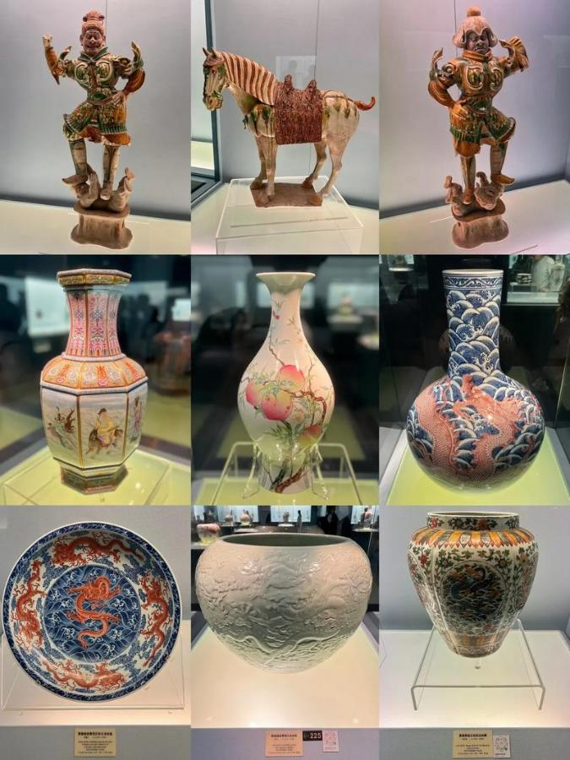
Activity Process
As I stepped into the workshop,
what greeted me was/I was stunned by_________
a wide array of handicrafts/exquisite/delicate ceramics, which is a showcase of artisans' skill
traditional tools and materials, like wood, clay, pots, dyes, inks, and oils used in craft etc. which are the essential elements in craftsmanship
the scent of wood and the soothing sound of hammering
the master craftsmen, whose hands, seasoned by years of practice, deftly shaped raw materials into exquisite works of art

Slide 7
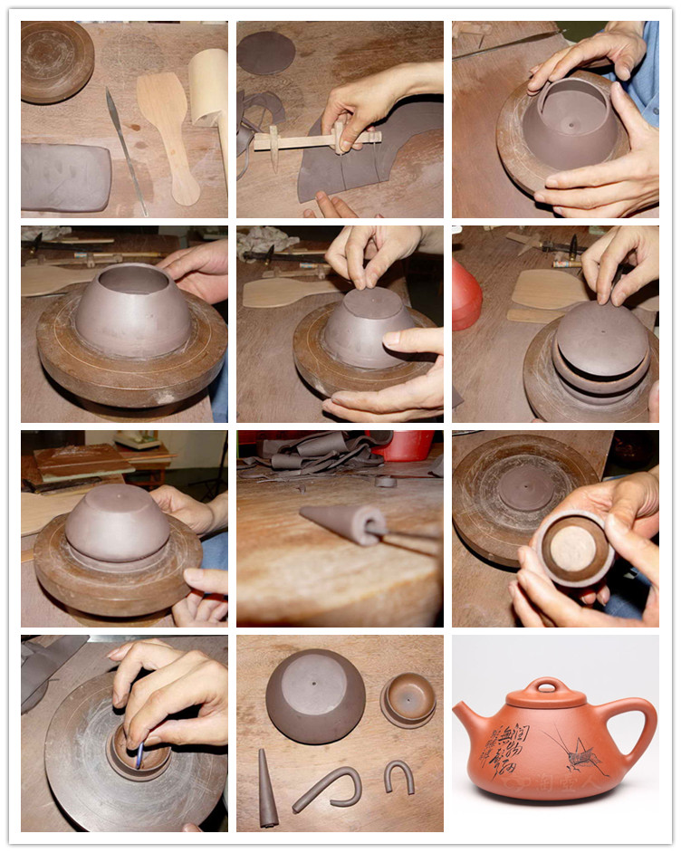
Activity Process
What followed was_________
a patient explaination about the intricate processes behind each creation, ranging from the selection of materials to the final part.
a presentation given by a craftsman about the history of this time-honored local handicraft.
a careful observation about the intricate processes
a communication/interaction with the artisans,which deepened our insights about the culture and stories behind this handicraft

Slide 8
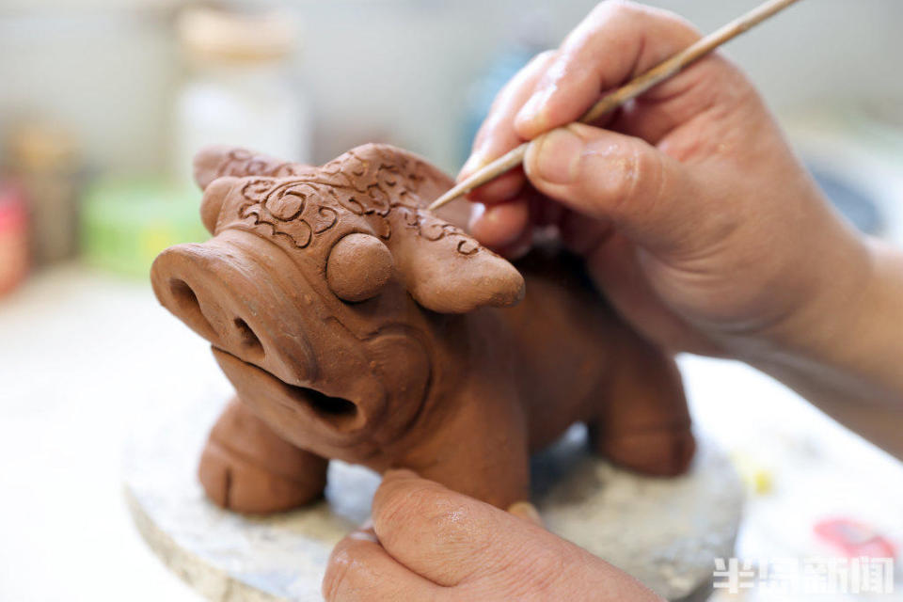
Hands-on activity
One of the highlights was (that)_________
under the guidance of a craftsmen, I attempted to try my hand at wood carving. With the patterns taking shapes under my hand, a surge of unparalleled exhilaration welled up within me.
I embarked on my first attempt at a vase under the guidance of a seasoned craftsmen, which I kept as a reminder of this memorable visit. With the wheel spinning and clay taking form beneath my hand, I was overwhelmed with thrill and satisfaction.
01
02

Slide 9
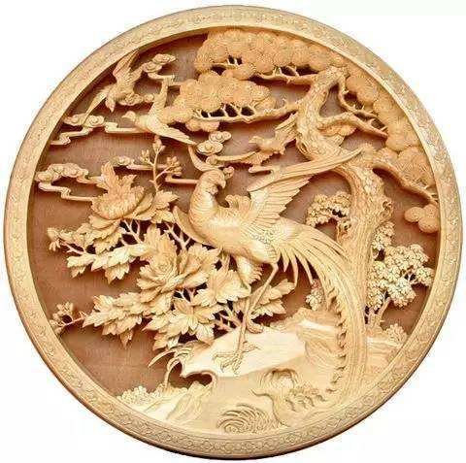
Harvest
What did I harvest in this visit?
Skill and Cultural Awareness‌:
Through this on-site visits, I have ...
deeply felt the exquisiteness and uniqueness of traditional skills
gained a deeper insights into the cultural heritage
‌The Joy of Personal Experience‌:
In the traditional workshop,
savor the charm of traditional skills
arouse/stimulate my interest in traditional culture
deepen my love for traditional culture
‌Cultural Confidence and Inheritance‌
Visiting the traditional workshop has made me...
more confident in my cultural identity
deeply aware of the importance and urgency of inheriting and developing Chinese excellent traditional culture.

Slide 10
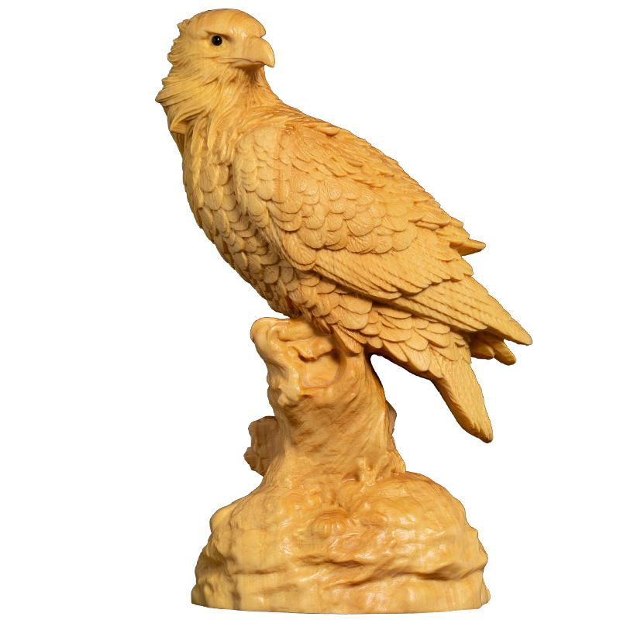
Ending
Ending of the compositon
总结+收获+希望
In conclusion/Overall, the visit to the local handicraft workshop was literally a rewarding and educational experience. Not only did I savor the charm of traditional skills but also I fostered a deeper understanding and appreciation for the artistry. As a student, I will carry forward this knowledge, hoping to contribute in my own small ways to the preservation and celebration of our cultural treasures.

Slide 11
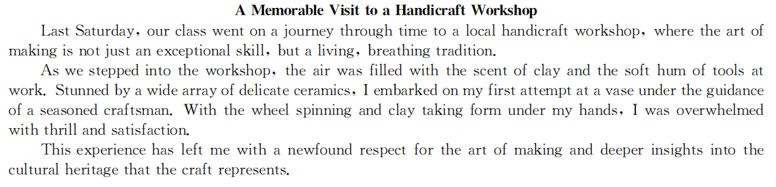

官方范文

Slide 12
下水作文
Last Saturday witnessed our journey to a local handicraft workshp, a cradle of artisan spirit, living fossils of heritage, and birthplace of unique handicrafts, which turned out to be a hit.
As I stepped into the workshop, what greeted me was a wide array of exquisite handicrafts, a showcase of artisans’ skills.As scheduled, what followed was a presentation given by a craftsman about the history of this time-honored local handicraft. One of the highlights was that,under the guidance of a craftsmen, I attempted to try my hand at wood carving. With the patterns taking shapes beneath my hand, a surge of unparalleled exhilaration welled up within me.
Overall, the visit to the local handicraft workshop was literally a rewarding and educational experience. Not only did I savor the charm of traditional skills but also I fostered a deeper understanding and appreciation for the artistry. As a student, I will carry forward this knowledge, hoping to contribute in my own small ways to the preservation and celebration of our cultural treasures.
A Memorable Visit to a Handicraft Workshop

Slide 13
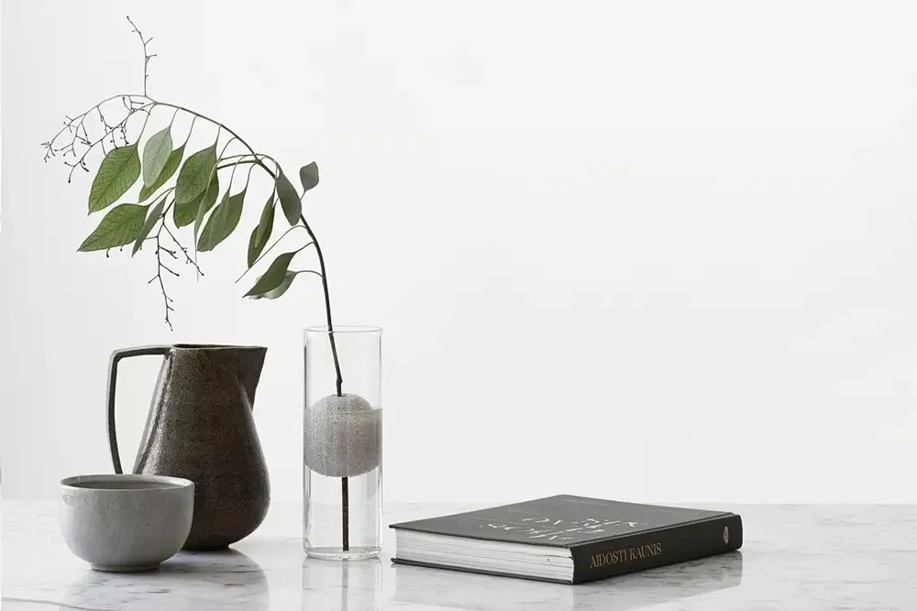
Thank you!

