Slide 1


感恩遇见，相互成就，本课件资料仅供您个人参考、教学使用，严禁自行在网络传播，违者依知识产权法追究法律责任。
更多教学资源请关注
公众号：溯恩英语
知识产权声明

Slide 2
2024年10月天域全国名校协作体
高三英语联考客观题讲评
海亮实验中学 陈虹

Slide 3
目录
壹
贰
叁
肆
题型概况
阅读理解
完形填空
语法填空

Slide 4
题型概况
一

Slide 5
单击此处添加标题
题型 | 话题 | 体裁 | 词数
阅读A | 人与社会:Three books of unconventional travels | 应用文 | 324
阅读B | 人与自我:Self-help obsession led to realization of self-acceptance. | 记叙文 | 354
阅读C | 人与自然：Ocean's vital role overshadowed by human abuse and neglect. | 说明文 | 389
阅读D | 人与社会 Alphabetical order affects student grades inversely. | 说明文 | 346
七选五 | 人与自我 Overcome setbacks and create a better life chapter. | 说明文 | 312
完型填空 | 人与自我 Embrace my body and defeat the insecurity | 记叙文 | 294
语法填空 | 人与社会 Beijing's hutongs: historic neighborhoods under threat. | 说明文 | 221
单击此处添加文本

Slide 6
阅读理解
二

Slide 7
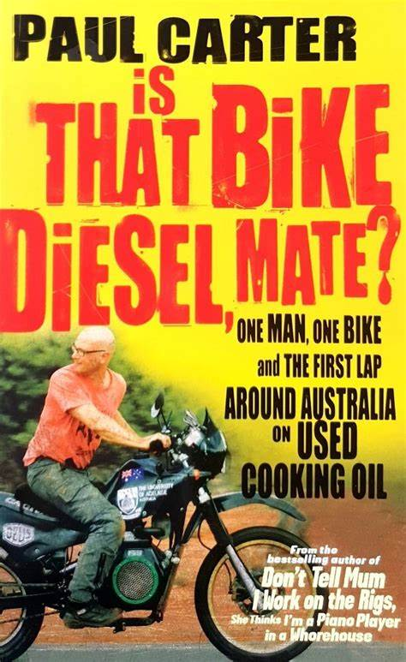

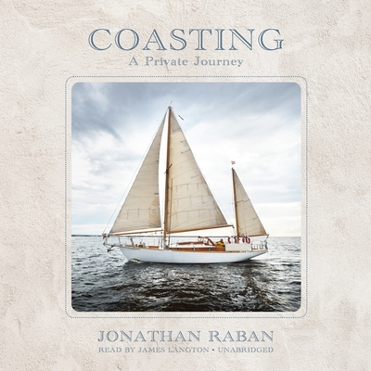
A 篇
Three books of unconventional travels
本文介绍了三本关于不同寻常旅行经历的书籍。

Slide 8
A 篇
21. What is special of Paul Carter’s travel?
A. He breaks the land speed record.
B. He uses an unconventional fuel.
C. His aging parents accompanies him.
D. His motorcycle almost dies in a crash.
细节理解题
知识补充:
convention和tradition的区别
"convention" 可以用来形容更现代、更具体的习俗
“tradition" 则更多用于描述具有历史意义的习俗。
定位第二段：But author Paul Carter decided to .... on a homemade motorcycle that runs on cooking oil.... keen to explore alternative fuels

Slide 9
22. What challenge does Tim Moore face while traveling in the UK?
A. Searching for alternative fuels.
B. Surviving heavy storms at sea.
C. Enduring the freezing cold in winter.
D. Enjoying himself in unattractive places.
细节理解题
定位第三段：...“My primary challenge was to have a good time in places that everyone had said I wouldn’t,”...

Slide 10
细节理解题
23. What do the three books have in common?
A. They share practical travel advice for tourists.
B. They compare different modes of transportation.
C. They explore unique and challenging travel experiences.
D. They offer alternative fuel sources and their applications.
第二段：There are lots of ways ...But author Paul Carter decided to...
第三段：Travel writers usually go to... But not Tim Moore...
第四段：...And this is the book about his adventure...

Slide 11
语料积累
词汇
Unconventional（非传统的） Homemade motorcycle（自制摩托车）
Alternative fuels（替代燃料） Land speed record（陆地速度记录）
Quirky characters（古怪的角色）Nautical adventure（航海冒险）
Philosophical（哲学的）
短语
Run on biofuel（使用生物燃料运行） Head to（前往）
Attempt to break（尝试打破） Navigate Britain（航行英国）
Get caught in storms（遭遇风暴）Take part of the journey（参与旅程）

Slide 12
好句欣赏
Follow him as he heads to “the bleakest towns, the worst hotels and the scariest pubs”.
跟着他前往“最凄凉的城镇，最糟糕的酒店和最恐怖的酒吧”。
用排比的方法，“bleakest”（最凄凉的）、“worst”（最差的）、“scariest”（最可怕的），形成了强烈的视觉和情感冲击，用简洁的语言创造出丰富的内容和情感。

Slide 13
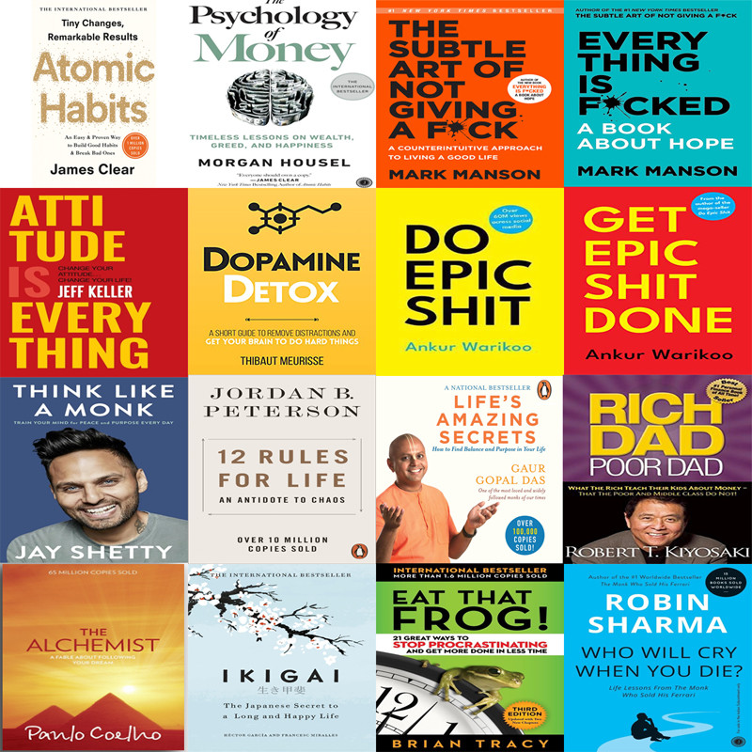
B 篇
Self-help obsession led to realization of
self-acceptance
本文讲述了作者长达15年的自我提升之旅。最终，她开始接受自己的不完美，认识到自己或许根本不需要修复。

Slide 14
24. Why did the author become obsessed with self- help materials?
A. To escape from her family. B. To overcome personal failures.
C. To look for a way to kill time. D. To find guides to better herself.
细节理解题
第一段：For 15years I read the books, took the courses and downloaded the apps to try to become a better person.

Slide 15
25. What can we learn about the author from Para. 4?
A. She often quarreled with her siblings in childhood.
B. She became stronger after her father passed away.
C. Her upbringing environment greatly influenced her.
D. Her long time of reading helped her out of feeling bad.
推理判断题
第四段：Growing up in an environment of addiction and domestic conflict made me vulnerable to the industry’s promises of self-improvement.

Slide 16
推理判断题
26. What caused the author to quit her obsession?
A. The death of her father. B. A conversation with a loved one.
C. The suggestion from an instructor. D. An app on self- improvement.
第六段：I talked with a loved one and recognized that in trying to change my life, I was trying to change things that were out of my control.

Slide 17
主旨大意题
27. What does the author want to convey in the text?
A. Embracing the true self. B. Focusing on the strengths.
C. Seeking professional advice. D. Cultivating the positive thinking.
最后一段：...that focusing all my energy on improving myself...
最后一段：It can also stop me from unconditionally accepting my imperfectly perfect self.

Slide 18
语料积累
心理活动相关的词汇
hook v 勾住，吸引 vulnerable adj 脆弱的，易受伤害的
dawn on me 我开始明白 suck the joy 享受快乐
be obsessed with 痴迷于
"come round to" 意味着逐渐接受或同意某个观点、建议或计划，尤其是经过一段时间的思考或讨论后。它也可以表示改变态度或看法，最终同意或支持某事。
其他词汇
toxic adj 有毒的 devour vt 狼吞虎咽地阅读
domestic conflict 家庭冲突 cane n 藤条；拐杖
conditional adj 有前提的 come round to 逐渐接受或同意

Slide 19
长句分析
Over the next 15years, I bought hundreds of self- help books, courses and apps, and tracked down every self- styled personal improvement expert in the hope that they could teach me how to become happier, more confident and more lovable.
状语
主语
谓语
宾语
（
谓语
定语
）
（
宾语
同位语从句
）
宾语从句
状语
在接下来的15年里，我买了数百本自助书籍、课程和应用程序，并找到了每一位有自我风格的个人改进专家，希望他们能教我如何变得更快乐、更自信、更可爱。

Slide 20
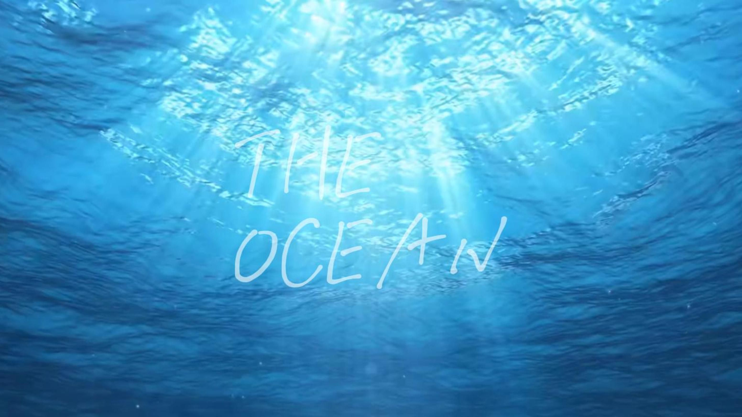
C 篇
Ocean's vital role overshadowed by human abuse and neglect.
这篇文章主要探讨了气候变化对海洋的影响，尤其是海洋酸化和海洋温度升高的问题。

Slide 21
①The ocean covers almost three- quarters of the planet. Were all the planet’s water placed over the United States, it would form a column of liquid 132km tall. The ocean provides 3bn people with almost a fifth of their protein (making fish a bigger source of the stuff than beef). Climate and weather systems depend on the temperature patterns of the ocean and its interactions with the atmosphere. If anything ought to be too big to fail, it is the ocean.
②Humans have long assumed that the ocean’s size allowed them to put anything they wanted into it and to take anything they wanted out. However, changing temperatures and chemistry, overfishing and pollution have stressed its ecosystems for decades.
③The ocean stores more than nine- tenths of the heat trapped on Earth by greenhouse-gas emissions. Consequently, coral reefs are suffering. Scientists expect almost all corals to be gone by2050．By the middle of the century the ocean could contain more plastic than fish by weight. Ground down into tiny pieces, it is eaten by fish and then by people, with uncertain effects on human health. Nevertheless, appetite for fish grows: almost 90% of stocks are fished either at or beyond their sustainable limits. The ocean nurtures humanity. Humanity treats it with contempt.
④Such self-destructive behavior demands explanation. Unarguably, the ocean being subject to a series of laws and agreements, enforcement is hard. Apart from this, two reasons stand out. One is geography. The bulk of the ocean is beyond the horizon and below the waterline. The damage being done to its health is visible in a few liminal places. But for the most part, the sea is out of sight and out of mind. It is telling that there is only a single fleeting reference to the ocean in the Paris agreement on climate change.
⑤Second, the ocean is a victim of other bigger processes. The emission of greenhouse gases into the atmosphere is changing the marine environment along with the rest of the planet. The ocean has warmed by 0.7℃ since the 19th century, damaging corals and encouraging organisms to migrate towards the poles for cooler waters. Greater concentrations of carbon dioxide in the water are making it more acidic, harming creatures such as crabs and oysters, whose calcium carbonate shells suffer as marine chemistry alters. What if we all turned off the air conditioning for a bit , opened our windows , and truly experienced life as it was happening , not what we manufactured it to be? we might be a little less comfortable , but maybe a little more connected.
Introduction
Problem Statement
Detailed Problems
Cause Analysis
Environmental Impacts
&
Suggestions

Slide 22
主旨大意题
28. What is paragraph 1 mainly about?
A. The vastness of the ocean. B. The significance of the ocean.
C. The ecosystem of the ocean. D. The climate of the ocean.
第一段：The ocean covers... , it would form... The ocean provides .... Climate and weather systems depend on ... the ocean and its interactions with the atmosphere. If anything ..., it is the ocean.

Slide 23
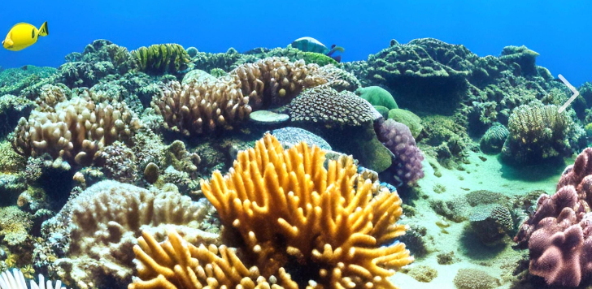
29. How does the author convey his message in paragraph 3?
A. By listing current problems. B. By providing research data.
C. By citing expert opinions. D. By comparing different ecosystems.
推理判断题
第三段：...Consequently, coral reefs are suffering. ...all corals to be gone by2050．By the middle of the century the ocean ....

Slide 24
30. Why does the author mention “the Paris agreement on climate change” in paragraph 4?
A. To show people often disobey it.
B. To tell us people seldom refer to it.
C. To remind us the ocean is vital to man.
D. To prove ocean protection is overlooked.
推理判断题
从分析文章结构可知，本段是关于出现这个问题的原因，所以该段中的例子是为了说明其中的一个原因The bulk of the ocean is beyond the horizon and below the waterline.... But for the most part, the sea is out of sight and out of mind.

Slide 25
推理判断题
31. What will the author probably write next?
A. How to tap into the ocean.
B. How to research into the ocean.
C. How to rise to the challenges of the ocean.
D. How to raise people’s environmental awareness.
知识补充：
rise vi 上升
raise vt 提起；举起
arise vi 出现
arouse vt 唤醒
rise to 应对；迎接
前文在分析海洋所面临的问题，按照说明文的基本结构，接下去应该是关于该如何应对这个问题。

Slide 26
语料积累
词汇
vastness n 广阔 protein n 蛋白质 overfishing n 过度捕捞
coral reefs 珊瑚礁 acidity n 酸性 calcium carbonate 碳酸钙
nurture vt 滋养 self-destructive adj 自毁性的 contempt n 轻视
enforcement n. 实施 alter v. 改变
短语
track down 追踪 in the hope that... 希望
out of sight and out of mind 眼不见心不烦
a series of 一系列 be subject to 受...影响
apart from 除了

Slide 27
长难句分析
Were all the planet’s water placed over the United States, it would form a column of liquid 132km tall.
如果地球上所有的水都放在美国上空，它就会形成一个132公里高的液体柱。
整个句子是一个复合句，包含一个条件状语从句和一个主句。条件状语从句是用虚拟语气来表达一个假设的情况，该从句省略了“if”,从句发生部分倒装，助动词“were”提前。这种表达方式通常用于强调某个概念或数据的惊人之处，在这里是为了强调地球上水资源的总量。

Slide 28
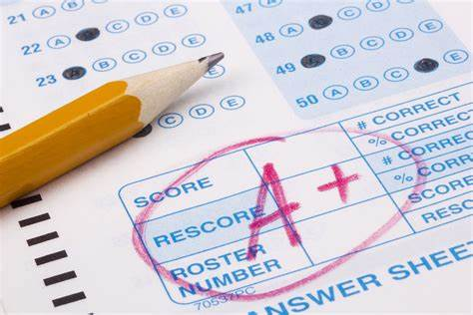
D 篇
Alphabetical order affects student grades inversely.
本文主要探讨了高等教育领域中，学生姓氏的字母顺序可能对其学术成绩产生的影响。

Slide 29
①In higher education, where meritocracy (任人唯贤) and objectivity are highly valued, one might assume that the alphabetical order of students’ surnames plays no role in determining their academic success. However, recent research suggests otherwise.
②A study conducted by researchers at the University of Michigan, analyzing over 30 million grading records, reveals a surprising finding: students with surnames that appear earlier in the alphabet tend to receive higher grades compared to their counterparts with later alphabetical placements. This bias is particularly striking in large classes or courses where assignments are submitted digitally through platforms like Canvas, a widely used online learning management system. Systems like this typically arrange student submissions alphabetically by default (系统默认). As a result, students with surnames towards the end of the alphabet, such as those starting with Y or Z, tend to receive lower grades on average compared to their peers with surnames from the beginning of the alphabet.
③This phenomenon is attributed to an effect known as “sequential grading bias”, which refers to an unintentional advantage or disadvantage that students may face due to the order in which their work is evaluated. For example, job interview candidates who are interviewed later in the day may be rated more harshly compared to those who went earlier. In the context of alphabetical ordering, instructors often begin grading from the top of the list, where surnames starting with letters like A or B appear. This initial advantage can unintentionally influence grading patterns, where early papers might receive more favorable assessments compared to those evaluated later. However, the exams that are graded in the reverse order in which they are submitted may show an opposite trend.
④Educational institutions and policymakers are encouraged to explore alternative grading strategies that mitigate alphabetical biases. Suggestions include randomized grading orders, nameless submissions, or deliberate efforts to counteract first impressions through diverse evaluation criteria. By addressing these biases proactively, institutions can foster fairer and more inclusive learning environments where student performance is evaluated impartially based on merit rather than surname placement.
Introduction
Problem Statement
Explanation of the Phenomenon
Recommendations

Slide 30
32. Why does the author mention Canvas in the context of the study?
A. To promote the use of digital platforms for academic purposes.
B. To highlight the popularity of online learning management systems.
C. To emphasize the impact of digital learning platforms on grading biases.
D. To demonstrate the diverse grading standards of digital learning platforms.
细节理解题
知识补充：context的用法
n 背景，环境；上下文，语境
相关词组：in the context of 在...的背景下
within the context of 在...的范围内
historical context 历史背景
Canvas是在第二段中提到的。从文章结构可知本段在说明文的篇章结构中是“提出问题”。本文的问题就是“按字母顺序排列的学生姓氏可能影响他们的学业成绩”。从前文This bias is particularly striking in large classes or courses where assignments are submitted digitally through platforms like Canvas, a widely used online learning management system. 可知Canvas这个例子就是为了说明这个问题。

Slide 31
33. In the last paragraph, what does the underlined word “mitigate” mean?
A. Complicate. B. Simplify. C. Fuel. D. Reduce.
词义猜测题
从文章结构可知，最后一段是提出建议：鼓励教育机构和政策制定者探索替代的评分策略，以减少字母顺序偏见。因此划线单词应该是“减少”的意思
知识补充：sequence的用法
n 一系列，连续；顺序
相关词汇：加前缀con- consequence n 结果
加前缀sub- subsequence n. 后继，随后
34. According to the text, one suggested alternative grading strategy should be based on _______.
A. the student’s surname B. random grading sequence
C. random first impression D. the student’s submission time
该题问的是建议的内容。根据文章结构，答案在最后一段， Suggestions include randomized grading orders, nameless submissions, or deliberate efforts to counteract first impressions through diverse evaluation criteria.

Slide 32
35. Which of the following may be the best title for this passage?
A. Inequality Issues via Digital Learning Systems
B. Strategies for Overcoming Bias in Grading Systems
C. Unintended Consequences of Alphabetical Grading
D. The Cause of Sequential Grading on Student Performancerning platforms.
主旨大意题
说明文的标题抓住两个点，一是“文章结构”，二是“关键词”。从文章结构可知，文章的主题是第二段中说明的，“关键词”是alphabet和grading。故C项正确。

Slide 33
语料积累
与学习相关的词汇
objectivity n 客观性 alphabetical adj. 按字母顺序的
counterpart n. 职能（或地位）相当的人
submission n 投降；屈服；提交，呈递
is attributed to 归因于 effect n 效应
rate v 评价 harshly adv 严厉地
counteract v 抵消 foster v 促进
inclusive learning environment 包容的学习环境
merit n 成绩

Slide 34
长句分析
By addressing these biases proactively, institutions can foster fairer and more inclusive learning environments where student performance is evaluated impartially based on merit rather than surname placement.
状语
主语
谓语
定语
宾语
（
主语
谓语
状语
）
定语从句
通过主动解决这些偏见，教育机构可以促进更公平、更包容的学习环境，在这种环境中是根据成绩而不是姓氏的位置来公正地评估学生的表现。

Slide 35

七选五
Overcome setbacks and create a better life chapter.

Slide 36
Life is filled with numerous victories and downfalls; what matters is how you tackle each situation. Whether it is your schooling or a serious life struggle, we must learn to turn the page and change our life for the better. 36_____
A. Now it’s your turn to think outside the box.
B. We must forgive ourselves to begin the next chapter.
C. Here’s how you can create a new chapter in your life.
D. What you can do in this situation is draw a mental line.
E. However, giving up and being stuck in pain will be even harder.
F. Let your tears and sweat water the seeds of your future happiness.
G. Besides, you will obtain the motivation you can’t find in yourself.
解析：该句的位置在说明文的第一段，是在引出话题，上文在陈述人生中遇到问题后该怎么做，后文是具体的方法，所以C项中“create a new chapter”承上“turn a page ”; “Here’s how you can”启下具体方法

Slide 37
You might find yourself in a dead end. 37 This will help you mark your future decisions. Everything that you faced until now was just a part of the problem and everything that comes after the line will be part of the solution. Don’t take the whole thing as suffering; instead, it is a learning experience. Make sure that you won’t let anything hold you back and will try to be better each day.
A. Now it’s your turn to think outside the box.
B. We must forgive ourselves to begin the next chapter.
C. Here’s how you can create a new chapter in your life.
D. What you can do in this situation is draw a mental line.
E. However, giving up and being stuck in pain will be even harder.
F. Let your tears and sweat water the seeds of your future happiness.
G. Besides, you will obtain the motivation you can’t find in yourself.
解析：该句的位置在段落中的第二句，上文是一种状况，下文中的“This”指代本句中提到的应对措施，故D项中“in this situation”承上，“draw a mental line”是应对措施。

Slide 38
When handling a tough situation, you may need some extra help. Connect with people that have gone through the same trials as you have. During the interactions, you will notice the different patterns which made them successful. 38 Their experiences are beneficial to uplifting your spirit and truly help you out.
解析：该段提供的方法是“与那些经历过同样考验的人建立联系。”该句前是这种方法的一个好处，后文是进行总结。故G项---这种方法的另一个好处，是能承上启下的。
A. Now it’s your turn to think outside the box.
B. We must forgive ourselves to begin the next chapter.
C. Here’s how you can create a new chapter in your life.
D. What you can do in this situation is draw a mental line.
E. However, giving up and being stuck in pain will be even harder.
F. Let your tears and sweat water the seeds of your future happiness.
G. Besides, you will obtain the motivation you can’t find in yourself.

Slide 39
Another amazing approach is to make sensible and favorable choices for yourself. Engaging in battles and struggles is going to be very hard. 39 Picture your goals in your mind and make sensible steps towards them with each passing day. Remember to do what actually works and make sure that nothing stands in your way.
解析：该句前文是面对的困难，后文是具体解决方式，故该句也应该是“困难”之一。E项中“even harder”与前文中的“very hard”是递进关系。
A. Now it’s your turn to think outside the box.
B. We must forgive ourselves to begin the next chapter.
C. Here’s how you can create a new chapter in your life.
D. What you can do in this situation is draw a mental line.
E. However, giving up and being stuck in pain will be even harder.
F. Let your tears and sweat water the seeds of your future happiness.
G. Besides, you will obtain the motivation you can’t find in yourself.

Slide 40
The past is a part of your history, but not a part of your destiny. Life moves on and so should we. 40 The new chapter of your life is coming for you.
A. Now it’s your turn to think outside the box.
B. We must forgive ourselves to begin the next chapter.
C. Here’s how you can create a new chapter in your life.
D. What you can do in this situation is draw a mental line.
E. However, giving up and being stuck in pain will be even harder.
F. Let your tears and sweat water the seeds of your future happiness.
G. Besides, you will obtain the motivation you can’t find in yourself.
解析：本段是末段，是对前文的总结和对未来的畅想。故F项既是承上，对前文的总结，也是启下，对将来的畅想。

Slide 41
语料积累
与个人发展相关的词汇
downfall n 没落 tackle vt 解决
hold back 阻止；抑制
uplift your spirit 提升你的精神
sensible and favorable choices 明智和有利的选择
be stuck in pain 困在痛苦中
destiny n 命运
知识补充：sensible
意思：理智的
词根：sense
相关形容词：senseless无意义的
sensitive 敏感的
sensational 轰动的

Slide 42
完型填空
三

Slide 43

Embrace my body and defeat the insecurity
这篇文章讲述了作者为参加高中毕业30年同学会而选购服装的经历。这个经历让她意识到，真正的问题不在于衣服，而在于她对自己身体的不自信。

Slide 44
Dress shopping for my thirty- year high school reunion had become very frustrating because I’d gained weight over the years.
How could I attend the reunion looking like this? I felt embarrassed and ashamed. I finally 41 on a simple black dress, one size bigger, so it would be 42 and cover my body.
That evening I tried on the dress again in front of the mirror at home. The dress looked 43 ! Just then, my husband and son walked in. “Mom, what are you wearing?” My son giggled. “That dress is too big!” My husband 44 .
I looked at my 45 once more; I looked like I was wearing a sack. I don’t know what came over me, but I started to laugh 46 happy tears fell. It must have been 47 , because we all stood there roaring with 48 .
settle on 决定 work on 从事
insist on 坚持 take on 承担
41. A. settled B. worked C. insisted D. took
42. A. straight B. shabby C. loose D. delicate
43. A. amazing B. strange C. elegant D. horrible
44. A. agreed B. argued C. answered D. expected
45. A. mirror B. reflection C. shadow D. size
46. A. when B. unless C. until D. though
47. A. worthwhile B. ambitious C. infectious D. familiar
48. A. anger B. approval C. surprise D. laughter

Slide 45
I 49 the dress the next day and I bought a red, 50 dress! This time when I stood in front of the mirror, I couldn’t believe it—I loved what I saw. “Wow, you’re beautiful!” my husband said, when I 51 around to show him.
On the day of the reunion I was 52 . I timidly walked into the venue. Just then, one of my friends ran over to hug me. “You look amazing with that cute dress!” she said, excited. That evening I talked, laughed and danced the night away.
That was a turning point for me. Since then, I have learned to embrace my body 53 hiding it. I realized later that those dresses I 54 didn’t look bad on my body; it was my lack of 55 that made them look bad. My reflection in the mirror was the reflection of my lack of security.
spin的用法：
v. 1.纺纱
例：She spun the wool into yarn for knitting.
2. 旋转
例：The dancer spun gracefully on her toes.
3.编织故事
例：He spun a tale of his adventures.
4. 急转弯
例：The car spun off the road in the snow.
49. A. returned B. withdrew C. ordered D. delivered
50. A. bright-looking B. long-lasting C. fast-updating D. well-fitting
51. A. wandered B. spun C. looked D. sat
52. A. pleased B. nervous C. upset D. frustrated
53. A. instead of B. apart from C. regardless of D. other than
54. A. tried on B. came across C. give away D. turned down
55. A. discipline B. determination C. attention D. confidence

Slide 46
长难句分析
Dress shopping for my thirty- year high school reunion had become very frustrating because I’d gained weight over the years.
主语
定语
谓语
表语
原因状语从句
为我30年的高中聚会买衣服非常令人沮丧，因为这么多年来我的体重增加了。

Slide 47
语料积累
词汇
giggle vi. 咯咯地笑 delicate adj. 脆弱的；精致的；微妙的
elegant adj 优美的 sack n 麻袋
timidly adv 羞怯地 venue n 举办地点
withdraw v （使）撤退；提；收回
frustrated adj 挫败的 discipline n 纪律
词组
apart from 除了 other than 除了
give away 泄露；赠送 turn down 拒绝

Slide 48
语法填空
四

Slide 49
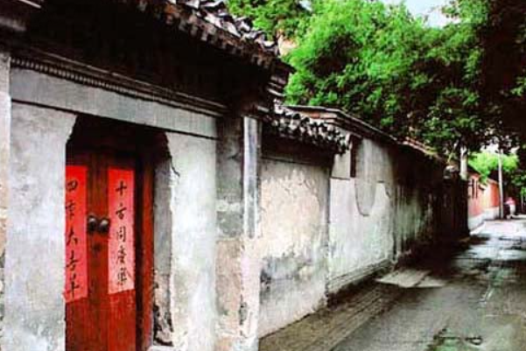
Beijing's hutongs: historic neighborhoods under threat.
这篇文章介绍了北京胡同的文化和特色，以及它们面临的挑战。

Slide 50
distinction n 差别；特点；卓越
distinct adj 不同的；明显的
distinctive adj 独特的；与众不同的
Hutongs are narrow alleys or lanes that are characteristic of Beijing, representing a unique aspect of Chinese culture. 56 (date) back to the Yuan Dynasty, these traditional neighborhoods are known for their 57 (distinction) architectural style and communal living. Walking through a hutong, one can see ancient courtyard houses, 58 provide a glimpse into the daily lives of the residents.
The atmosphere in hutongs is lively and vibrant. Local shops and street vendors often line the streets, offering everything from traditional snacks to handmade crafts. This creates 59 strong sense of community, as neighbors often gather to chat and share stories. The cultural significance of hutongs 60 (extend) beyond just architecture; they are also places where traditions are preserved.
Dating
56. 非谓语动词
distinctive
追溯到：date back to/date from没有被动语态
57. 词性转换
wihch
58. 非限定性定语从句
a
59. 冠词
extends
60. 谓语动词

Slide 51
However, hutongs face challenges due to urbanization. Many have been demolished to make way for modern buildings, threatening the 61 (preserve) of this cultural heritage. Efforts 62 (make) to protect these historic areas recently, as they are of vital importance for understanding Beijing’s history and culture.
In conclusion, hutong culture offers a fascinating insight 63 the past and present of Beijing. It is essential 64 (cherish) these unique neighborhoods, as they represent a way of life that is rich in history and community spirit. By doing so, we ensure that future 65 (generation) can appreciate the beauty and significance of hutong culture.
语法填空的考查重点：动词
1.考查谓语动词
2. 考查非谓语动词
3. 词性转换
做题方法：
1. 判断一句话中是否缺谓语动词（60题、62题），谓语动词要注意时态和语态。常考时态是一般过去时或现在完成时。
2. 如果已经有了谓语动词，考虑非谓语动词（56题、64题）。
3. 还有可能考到的是词性转换，常考的词性转换是动词和名词的词性转换。
61. 词性转换
preservation
have been made
62. 谓语动词
into
63.介词
to cherish
64. 非谓语
generations
65. 名词的单复数

Slide 52
长难句分析
Efforts have been made to protect these historic areas recently, as they are of vital importance for understanding Beijing’s history and culture.
主语
谓语
目的状语
主语
谓语
表语
状语
原因状语
最近已经做出了努力来保护这些历史区域，因为它们对于理解北京的历史和文化具有至关重要的重要性。

Slide 53
语料积累
与建筑相关的语料
distinctive architectural style 独特的建筑风格
ancient courtyard houses 古代的院子
line the streets 排列在街道两边
urbanization n 都市化 demolish vt 拆除
与观点看法相关的语料
provide a glimpse into 一窥
vibrant adj. 充满生机的
a strong sense of community 强烈的社区意识
offer an insight into 提供对...的深入了解
cherish the unique neighborhoods 珍惜这一独特的社区

Slide 54
感谢观看

