Slide 1


感恩遇见，相互成就，本课件资料仅供您个人参考、教学使用，严禁自行在网络传播，违者依知识产权法追究法律责任。
更多教学资源请关注
公众号：溯恩英语
知识产权声明

Slide 2
M2U1 Cultural Heritage
Reading and Thinking

Slide 3
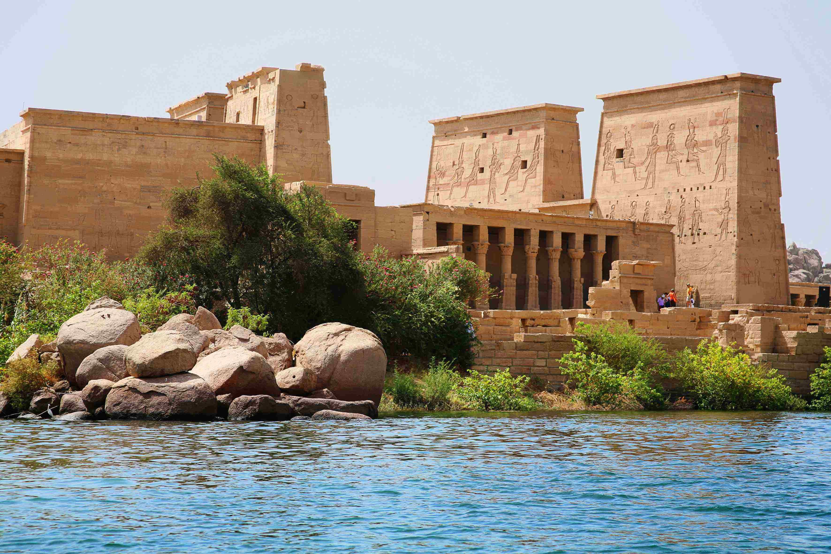
Language study

Slide 4
CHUNKS
Para 1
经济发展
一个时期到来了
让步于
做某事不可能
保持平衡
取得进步
文化遗址的保护
一个大的挑战
economic development
There comes a time when…
give way to
it is not possible to do sth
keep the right balance between…
make progress
the protection of cultural sites
a big challenge
challenging adj.

Slide 5
Para 2-3
1.但是，大的挑战有时候会有好的解决办法。
2.在尼罗河上建一个大坝
3. 控制洪水，发电，供水
4.建议遭到了抗议
5.向某人求助
6.建立一个委员会
7.限制对…的损害
8.防止… 的损失
9.筹集基金 10.调查问题
11.组织几次测试
12.提出建议
13.签署文件/颁布文件
1. Big challenges, however, can sometimes lead to great solutions.
2.build a dame across…
3. control floods, produce electricity, supply water
4. The proposal led to protests.
5. turn to sb (for help)
6. establish a committee
7. limit the damage to...
8. prevent the loss of sth
9. raise funds… 10. investigate the issue
11. conduct several tests
12.make a proposal for how to do sth
13. sign/ issue a document

Slide 6
1. 政府和环境学家
2. 一片片地拆掉
3. 营救不计其数的文化遗址
4. 捐赠
5. 它被认为是一个巨大的成功。
6. 找到通往…的路径
7.撞到，碾压过去的遗迹
8.不但…而且…
9. 经营一个项目
10. 阻止世界文化遗产消失
11. 单个的国家
12. 全球社区
Para 4-6:
1.govenrnments and environmentalists
2.take down sth piece by peice
3. rescue countless cultural relics
4. donate…to
5. It was considered (to be/ as) a great success.
6. find a path to…
7. run over the relics of the past
8. not only… but also
9. run a programme
10. prevent world cultural heritage sites from disappearing
11. a single nation
12. the global community

Slide 7
a period of time 后接 when 引导的定语从句
Para 1
when
1. There comes a time _________ the old must give way to the new
There comes a time when….
Eventually, / It‘s inevitable( 不可避免的). / It has to happen.
总有一天…
一个你需要作出选择的时间 / 时刻 / 时代到了.
There comes a time when you have to make a choice.
It was a time _______ people were divided geographically, leading to many varieties of dialects and characters. (B1U5 P62)
when
There comes a time when..
It was a time when…
There was a time when…

Slide 8
give way to .. to be replaced by something 被…代替
1) 暴风雨过后阳光灿烂。
The storm gave way to bright sunshine.
2) As he drew nearer, his anxiety gave way to relief.
当他走近时，他的焦虑减轻了。

Slide 9
2. … ___________ (keep) the right balance between progress and the protection of cultural sites can be a big challenge.
keeping
保持…之间的平衡
失去平衡
良好的平衡感
keep the right balance between…and…
lose one’s balance
a good sense of balance
3. Water from the dam would likely damage a number of temples and…
= 1) probably adv.
likely adj.=2) probable
be likely to do sth.
It is/was likely that…
Tickets are likely to be expensive.
It is likely that tickets are expensive.
It is likely to remain cold the whole week.

Slide 10
Para 2
但是该提案引发了抗议。
But the proposal led to protests.
proposal: n. a formal suggestion/plan; the act of making a suggestion
提议；建议
提出建议
同意提议
接受提议
否决提议
make/put forward a proposal=propose (v.)
approve a proposal
accept a proposal
reject a proposal

Slide 11
to
for
2…. the government turned _________ the United Nations __________ help in 1959.
turn to sb for help/advice…
to whom
Is there anyone _________ ___________ we can turn for help?

Slide 12
Para 3
to
1. A committee was established to limit damage ________ the Egyptian buildings and prevent the ________ (lose) of cultural relics.
loss
prevent …from doing
stop…from doing
Scientists are taking action to prevent the disease from spreading.
No one can prevent you from attending this meeting.
loss n.
失落感
体重减轻
感到迷茫，不知所措
a sense of loss
weight loss
(be) at a loss
我对下一步做什么心里没谱。
I'm at a loss what to do next.

Slide 13
2. The group asked for contributions from different departments and raised funds within the international community.
raise funds . collect money 筹募资金
我们在进行慈善募捐。
We are raising money for charity.
3. Experts investigated the issues, conducted several tests, and then made a proposal for how the buildings could be saved.
A, B and C 连动式结构，表示动作先后
Early the next morning, Jane got out of bed, dressed herself, and rushed to the railway station.

Slide 14
3. conduct vt.
to organize and/or do a particular activity组织；安排；实施；执行
conduct an experiment/investigation/interview
conduct a survey/study/research
conduct a test/trial
2) conduct oneself: to behave in a particular way举止；表现
He conducted himself far better than expected.
他表现得比预料的要好得多。

Slide 15
Para 4—6
by
1. Temples and other cultural sites were taken down piece _______ piece, and then moved and put back together again in a place ___________ they were safe from the water.
where
in which
2. 1) The countries not only had found a path to the future that did not run over the relics of the past, but also they had learnt that it was possible for countries to work together to build a better tomorrow.
2) Not only had the countries found a path to the future that did not run over the relics of the past, but they had also learnt that it was possible for countries to work together to build a better tomorrow.
not only…but also …= not just…., but (sb) also并列连词，连接连个对等的成分，如果连接句子，not only 放在句首，这句子要部分倒装。
Not only is she thoughtful, but (also) she is broad-minded.

Slide 16
3. Perhaps the best example is shown by UNESCO, __________ runs a programme __________ prevent world cultural heritage sites around the world ________ disappearing.
which
which
that
from
run vt. to be in charge of a business, campaign, etc.管理；经营

Slide 17
B2U1 教材答案

Slide 18
P3 Pronunciation
1. 1. present 2. grew 3. scream 4. exists 5. twelfth
6. confused
2. 1. Yuanmingyuan? Just cross the street.
2. Bruce preferred the guidebook.
3. The dragon followed its trail.
4. It is a different context.
5. The trains were dark green.

Slide 19
P 5 Activity 5
proposal progress, development, heritage, temple, damage, establish, preserve, prevent
Title: Scientist Says Progress Shouldn’t Damage Cultural Heritage

Slide 20
P10
Activity 1
be proud to keep a balance prevent from
donate sth to lead to take part in
make sure turn to
take part in, be proud to, keep a balance, lead to, prevent …from,
make sure, donate….to, turn to
Activity 2
(that/which), that/which, where/whose, who, where/on which, whose, when

Slide 21
Workbook
Using words and Expressions on P 61
Activity 1
1 protection 2 preserve 3 proposal 4 promote 5 prevent
6 partner 7 protest
Activity 2
1 make 2 investigate 3 run 4 conduct/run 5 raise 6 sign
7 keep 8 establish
1. raise funds 2. Keeping a balance 3 signs a/the document
4. ran/conducted hundreds of tests
5. is running a programme
6. established a committee
7. made a proposal
8. Investigate the issue
Activity 3 on P 62
protection; proposal; protests; damaging; turned; established; loss
funds; global

Slide 22
Activity 4 on P 62
1. Every year Mount Tai attracts visitors from all over the world who admire its beautiful views.
2. It is worthwhile to spend money on goods of high quality
3. Many countries took part in the project and donated money to protect the cultural heritage of areas along the Nile River.
4. The father was proud to introduce his son to a professional athlete.
5. Make sure you understand these numbers in context, or they will make no sense at all.
6. Do you know how far it is from the entrance of the Forbidden City to the Nine Dragon Wall?
7. Judy is quite familiar with the application process for overseas study programme.
8 South Africa, officially the Republic of South Africa, is a the southern tip of Africa.

Slide 23
Activity 5 on P 62
1. Some people believe cultural heritage protection should give way to economic development.
2. His proposal at the meeting led to a lot of different responses.
3. A lot of supplies provided by the global community has not prevented people there from suffering.
4. I trust him a lot and always turn to him for help when I am in trouble.
5. Volunteers contributed a lot to raising funds to help the children go back to school.

Slide 24
Using structures on P 62
Activity 1
1 where 2 why 3 whom 4 where 5 who 6 whose
7 (that/which) 8 when 9 which
Activity 4
1. they were 改为 which were
2. that is改为which is
3. that is改为that/which were
4. it did not改为which did not
5. they are改为which were
6. those had改为those who had
7. delete “then”
8. in 1722 the time the society改为in 1722 when the society
9. delete “on it”

