Slide 1


感恩遇见，相互成就，本课件资料仅供您个人参考、教学使用，严禁自行在网络传播，违者依知识产权法追究法律责任。
更多教学资源请关注
公众号：溯恩英语
知识产权声明

Slide 2

高三一轮复课教材拓展
---Food and Culture
陕西省礼泉第一中学 陈瑞

Slide 3
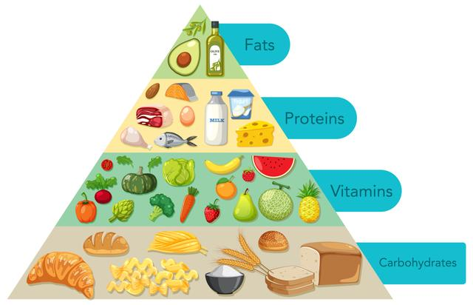
According to our second passage, what should we pay attention to if we want to be healthy?
√ consume different categories of fresh foods
√ cut down on desserts
√ eat slowly

Slide 4
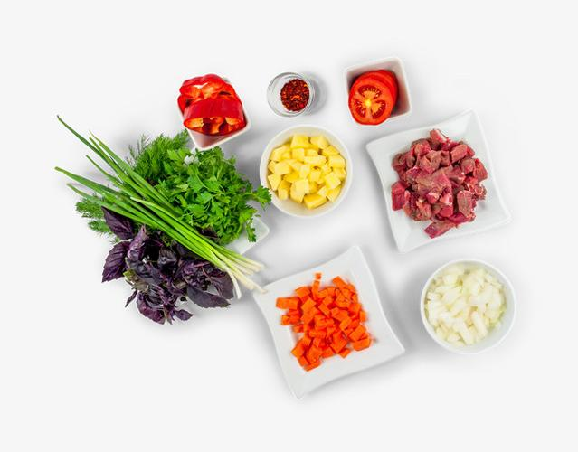

Can you say some words about meat, fruits , vegetables, seasonings, and cooking methods?

Slide 5
meat | fruits | vegetables | seasonings 调味料 | cooking methods
beef mutton pork chicken fish shrimp 虾 ground pork 肉皮 aspic[ˈæspɪk] 肉冻 ... | strawberry lemon durian 榴莲 watermelon grape mango pineapple kiwi fruit 猕猴桃 cherry 樱桃 ... | pumpkin mushroom pepper 辣椒 cabbage cucumber eggplant spinach菠菜 [ˈspɪnɪtʃ] onion broccoli 西兰花 [ˈbrɒkəli] ... | green onion 葱ginger 姜 garlic salt vinegar Sichuan pepper 花椒 cooking wine 料酒 soy sauce 酱油 [ˌsɔɪ ˈsɔːs] sesame oil 香油 [ˈsesəmi] ... | fry 炒煎炸 cut chop 剁碎 roll 擀 wrap 包 boil 煮 steam 蒸 stew 炖 [stjuː] ..

Slide 6
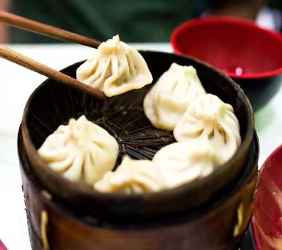
delicious
tasty
yummy
juicy
delicate（精致/巧的）
difficult
terrible
horrible
(Xiao long bao)
soup dumplings

Slide 7
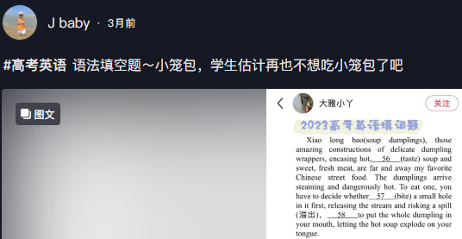


Slide 8
2023年全国新高考英语Ⅰ卷
Xiao long bao (soup dumplings), those amazing constructions of delicate dumpling wrappers, encasing hot, tasty soup and sweet, fresh meat, are far and away my favorite Chinese street food.The dumplings arrive steaming and dangerously hot.To eat one,you have to decide whether to bite a small hole in it first, releasing the stream and risking a spill(溢出) or to put the whole dumpling in your mouth,letting the hot soup explode on your tongue......

Slide 9
① What are the two ways to eat soup dumplings ?
② Where were soup dumplings born?

Slide 10
2023年全国新高考英语Ⅰ卷
①Xiao long bao (soup dumplings), those amazing constructions of delicate dumpling wrappers, encasing hot, tasty soup and sweet, fresh meat, are far and away my favorite Chinese street food.②The dumplings arrive steaming and dangerously hot.③To eat one,you have to decide whether to bite a small hole in it first, releasing the stream and risking a spill(溢出) or to put the whole dumpling in your mouth,letting the hot soup explode on your tongue......

Slide 11
What should we attach more importance
to when we are preparing for our college entrance examination?
accumulate more words
Xi’an ancient wall
(2021.全国甲卷.语填)
Beijing hutong
(2023.浙江卷.语填)
The first international tea
（2022.全国乙卷.语填）
practise analyzing complex
sentences more
focus more on Chinese culture

Slide 12

https://www.seriouseats.com/best-bites-in-china-chinese-food-drink
PERSONAL ESSAYS CHINESE CUISINE What to Eat in China: A Traveler's Guide by Fiona Reilly Updated October 30, 2019
Spare more effort to read the original foreign magazines !
Xiao long bao, those miraculous constructions of delicate dumpling wrappers encasing a big slurp of hot, savory soup and sweet, fragrant ground pork, are far and away my favorite Chinese street food. The pocket of soupy stock is the dumpling's essential element: a flavored pork aspic, typically made with pork skin, chicken bones, ginger, scallions, and Shaoxing wine, simmered for hours until the collagen-heavy ingredients have turned to gelatin, and then cooled until it sets. The dumplings arrive steaming and dangerously hot—to eat one, you have to decide whether to nibble a hole in it first, releasing the steam and risking a spill, or throw caution to the wind and pop the whole dumpling in your mouth, a burst of near-scalding broth exploding on your tongue.

Slide 13
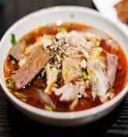
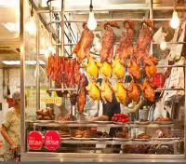
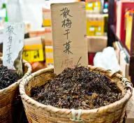
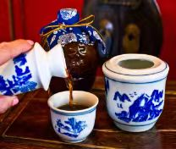
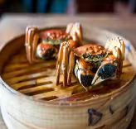
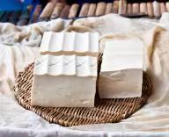
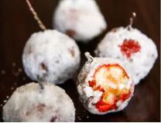
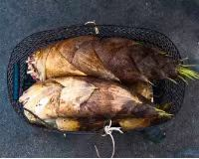
Fuqi Feipian
Meigancai
Shaoxing Wine
Siu Mei
Crystal Sugar Hawthorns
Hairy Crab
Fresh Tofu
Bamboo Shoots

Slide 14
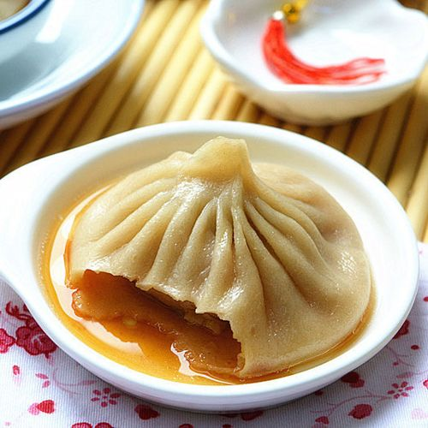
Viewing
How does the soup get in there ?
Tips:
1 Listen to the key words
2 Take notes if necessary

Slide 15
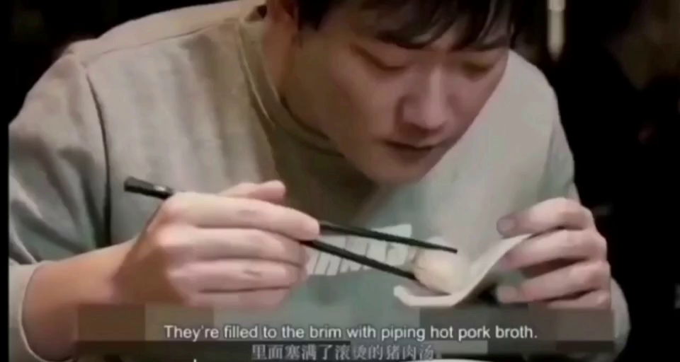

Slide 16
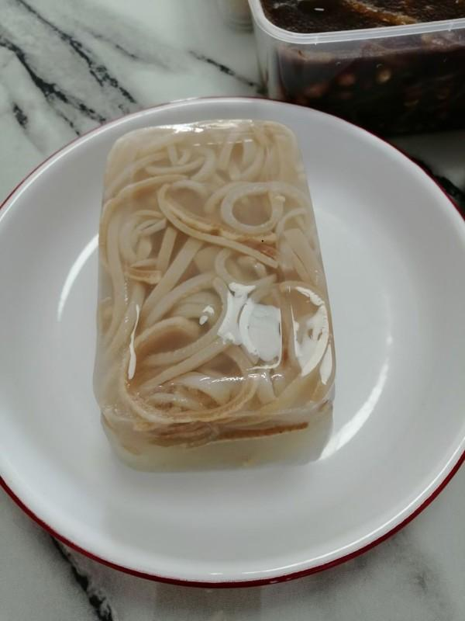
Viewing
How does the soup get in there?
It is aspic actually [ˈæspɪk]（肉冻).
When it’s steamed, it turns back
to liquid again.

Slide 17
View the latter part again and figure out the missing words.
Do you know how to make the soup dumplings?

Slide 18
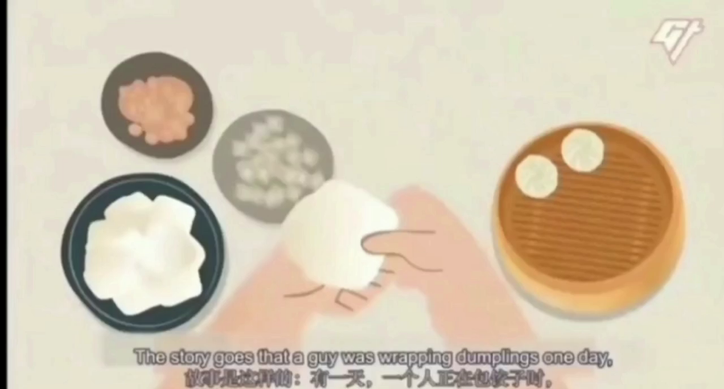

Slide 19
Figure out the missing words.
1 Aspic 2 flour 3 filling
4 wrapped 5 steamed

Slide 20
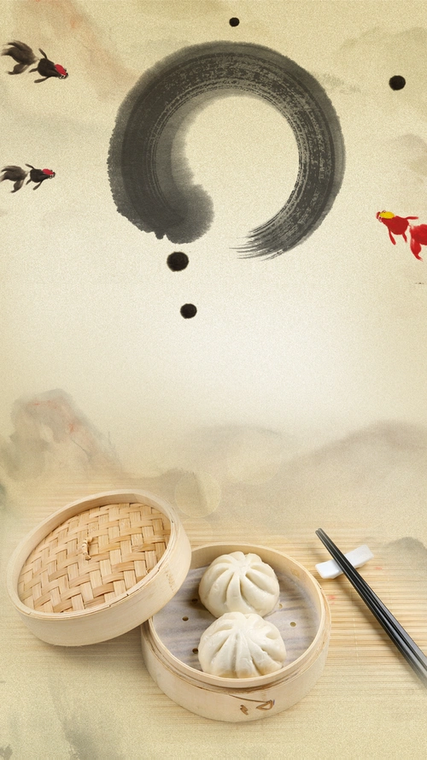
What culture does Xiao Longbao carry?
★ intangible cutural heritage
★ reflect the spirit of craftmanship
★ historic and cultural symbol of Shanghai
★carry the legacy of culture and customs and traditions to mordern times
...

Slide 21
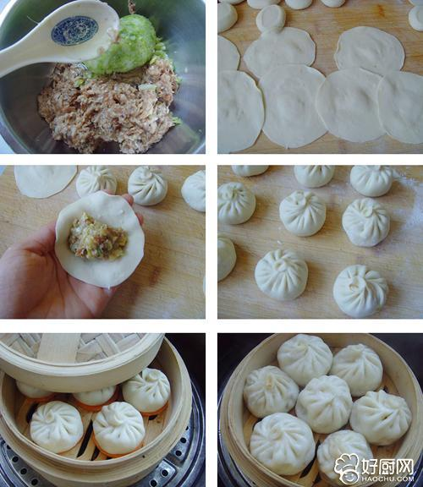
Speaking in groups:
How to make the soup dumplings?
suggested expressions:
prepare the filling ,meat, aspic, seasonings, flour, dough, rest for 20 mins, roll the wrappers, wrap/encase, put the filling inside , pleats, folds, place them in the steamer , steam 8-15 mins,enjoy, tasty
S1: How to make the filling?
S2: How to make the wrappers?
S3: How to encase/wrap the soup dumplings?
S4: How to steam them?
Hello,everyone！Our group are glad to tell you how to make soup dumplings ....

Slide 22
writing
Learning A New Skill
It is important for us to master some basic living skills to prepare us for our future life.That is why I learned how to cook soup dumplings during the National Day holiday.
Early in the morning, I bought some ingredients, including some fresh vegetables, meat and seasonings in the local market. Once I got back home, I began to make them. To begin with, ______________________________ ____________________________________________________________ Then,_______________________________________________________________________________________ After that, ____________________ ____________________________________________________________
The moment I put the dishes on the table，my parents gave me a thumbs-up. I felt so proud that I shared housework with my parents, which also showed I had grown up.

Slide 23
Writing Criteria
Content | Do you express yourself clearly and logically?
Language | Do you have any grammatical and spelling mistakes?
Handwriting | Is your handwriting easy to read ?
Struture | Do you use three paragraphs,topic sentences and linking words properly?

Slide 24
writing
Learning A New Skill
It is important for us to master some basic living skills to prepare us for our future life.That is why I learned how to cook soup dumplings during the National Day holiday.
Early in the morning, I bought some ingredients, including some vegetables, meat and seasonings in the local market. Once I got back home, I began to make them. To begin with, I made the fillings with meat, aspic, chopped cabbage and seasonings mixed together. Then, I put the flour and water to make the dough and let it rest for 20 minutes before rolling it into skins. After that, I placed the wrapped dumplings into the steamer basket and steamed for 15 minutes.
The moment I put the dishes on the table，my parents gave me a thumbs-up. I felt so proud that I shared housework with my parents, which also showed I had grown up.

Slide 25
（2023全国乙卷）学校英文报组织同学们分享自己在假期中学到的新技能，请你以此为主题写一篇短文投稿。
内容包括: 1.简要描述; 2.体验和感受
注 意：1.词数100左右； 2.题目已为你写好。
Learning A New Skill

Slide 26
Q: Why are there an increasing number of passages related to Chinese traditional culture in CEE ?
Chinese nation has a civilization history of more than 5,000 year and we should admire the excellent Chinese culture, strengthen cultural confidence and acquire great wisdom from it.
√ Growing national power
√ Increasing cultural confidence

Slide 27
Self-assessment
Items | Yes | Not exactly | No
1.Can you output some words and expressions about meat, vegetables, seasonings and cooking methods ?
2.Can you describe the process of making soup dumplings in English clearly and logically?
3.Do you realize that you should attach more importance to the accumulation of the words and the Chinese culture while preparing for the CEE?
4.Do you want to read other passages on the suggested website and want to make the soup dumplings by yourself ?

Slide 28
Assignments
Compulsory:
1. Polish your writing.
2. Spare time to do soup dumplings for your family.
Optional :
Read and have a try in continuous writing. (2021新高考Ⅰ&Ⅱ卷) 读后续写——A Mother’s Day Surprise

Slide 29
Thanks for your time
and attention!

