Slide 1


感恩遇见，相互成就，本课件资料仅供您个人参考、教学使用，严禁自行在网络传播，违者依知识产权法追究法律责任。
更多教学资源请关注
公众号：溯恩英语
知识产权声明

Slide 2

Exploring Poetry in China
人教版选择性必三
Unit5 Workbook
Reading and Writing

Slide 3

Teaching Objectives
At the end of the class, students are able to:
state the core features of Chinese poetry at different stages
know how to appreciate a poem
be aware of the differences between Chinese and Western poetry
think about the translation of a poem critically
have a better understanding about the culture exchange through poems

Slide 4

Free talk
Would you like to share the poem you like best and explain why you like it ?
Oh, sure! I really like this poem titled "The Road Not Taken" by Robert Frost. It's about choosing your own path in life, and how even though we can't go back and change our choices, they make us who we are. I like it because it reminds me that every decision we make, even the small ones, shape our lives in a unique way. What do you think about that? Do you have a favorite poem or quote that you like?

Slide 5

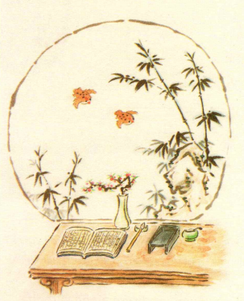
Lead in
According to the title and illustrations, what do you expect to read from the passage?
the development of poetry in China
the features of Chinese classical/modern poetry
how to appreciate Chinese poetry
the differences between Chinese and Western poetry
...

Slide 6

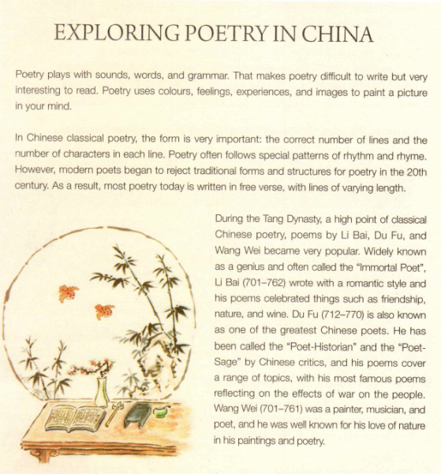
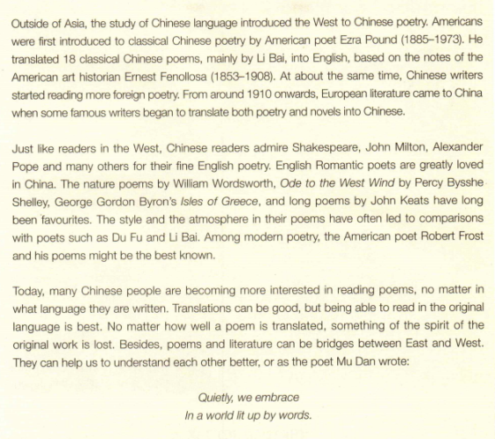
Read for main idea
P1 introduce poetry generally
P2 traditional poetry vs. modern poetry
P3 the distinguished poets and their works in Tang Dynasty
P4 the exchange of poetry between Asia and Europe
P5 the western poets Chinese readers admire
P6 Translations are not good enough to appreciate a foreign poem and literature.

Slide 7
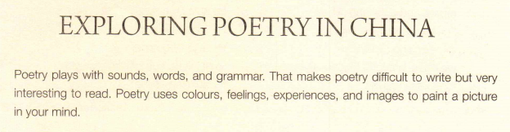
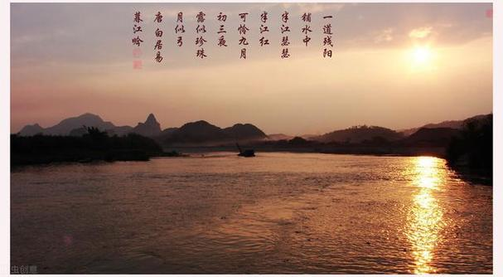
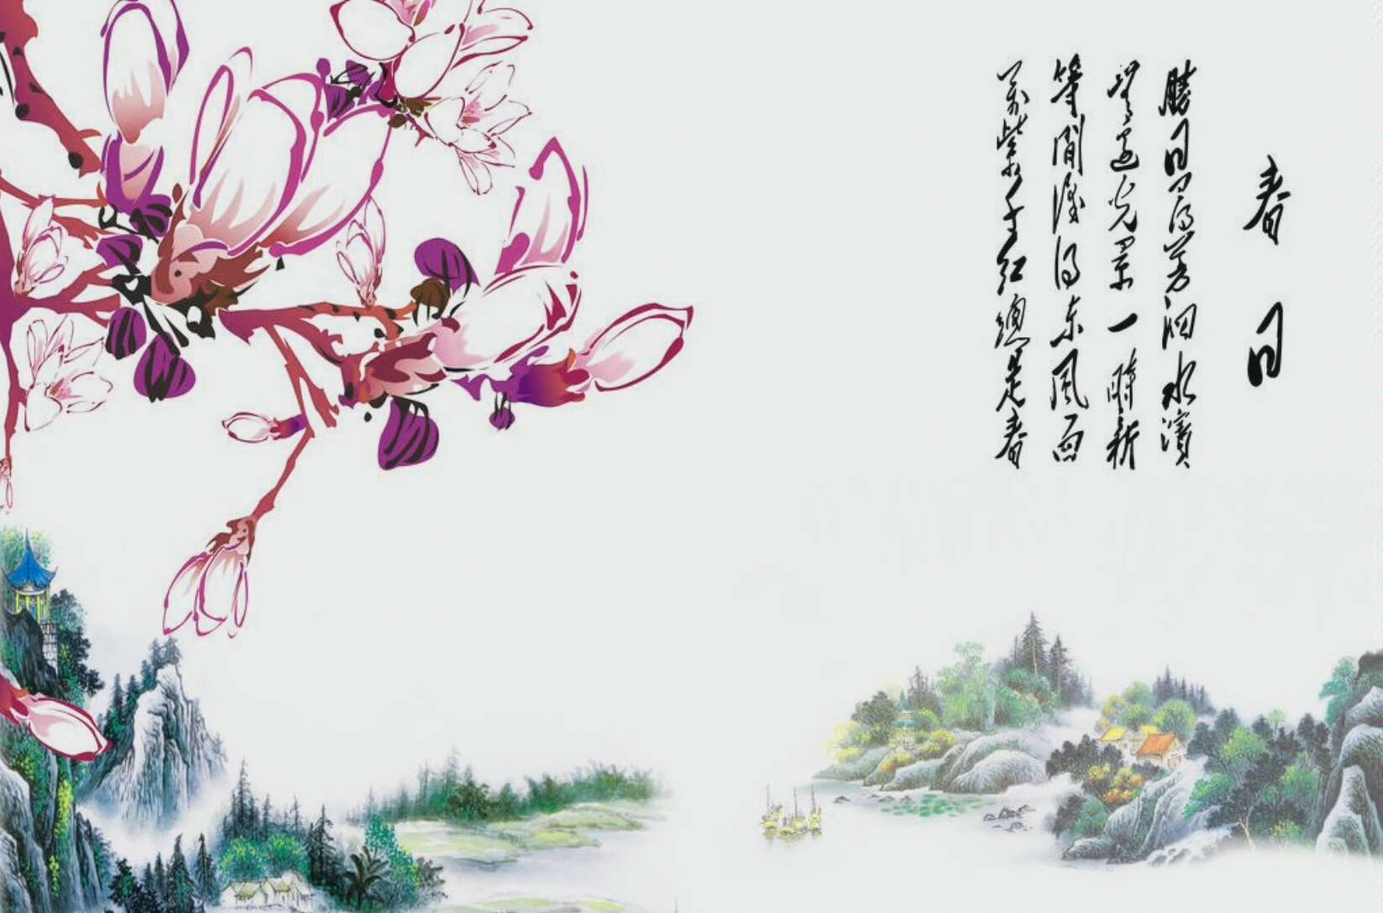
What’s your understanding about “plays with”?
Which poem does the underlined sentence remind you of?
It means the clever use of something.

Slide 8
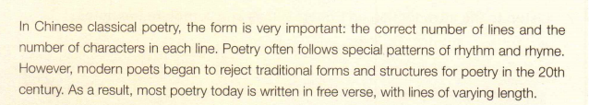
1.What are the typical features of classical Chinese poetry?
The typical features of classical Chinese poetry are form, which has a correct number of lines and characters in each line, and following special patterns of rhythm and rhyme.
2.How is modern poetry written?
Modern poetry rejects traditional forms and structures and is written in free verse, with lines of varying length.
?

Slide 9
Critical Thinking
Why do modern poetry reject traditional forms and structures ?
Innovation & Rebellion‌:
Desire for novelty and breaking conventional norms.
Rebellion against strict rules to seek new artistic avenues
03
Expression Freedom‌:
Traditional constraints limit expression.
Free verse offers flexibility for deeper emotions and thoughts.
01
02
Individuality & Authenticity‌:
Emphasis on personal voice and unique expression.
Varying line lengths reflect individual rhythms and emotions.

Slide 10
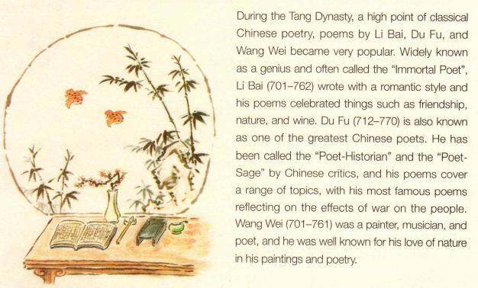
Topic sentence
According to the passage,how can we introduce a poet?
What themes did the three Tang Dynasty poets like to write about?
Li Bai liked to write in a romantic style about friendship, nature, and wine. Du Fu liked to write about a range of topics such as history and the effects of war. Wang Wei liked to write about nature.

Slide 11
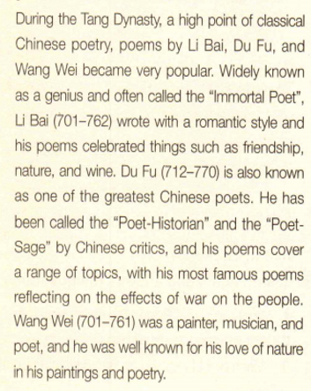

Learn from the language
According to the passage,how can we introduce a poet?
aspects | advanced expressions
status 地位身份 | widely known as;often called;非谓语 be known as/for;has been called...by be谓语
writing style 写作风格 | write with a romantic style;
themes 诗歌主题 | celebrated things such as; cover a range of topics； with poems reflecting on...

Slide 12
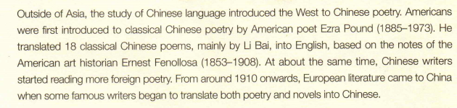
Who first introduced Americans to Chinese poetry?
American poet Ezra Pound first introduced Americans to Chinese poetry.
When did European literature come to China?
European literature came to China from around 1910 onwards.

Slide 13
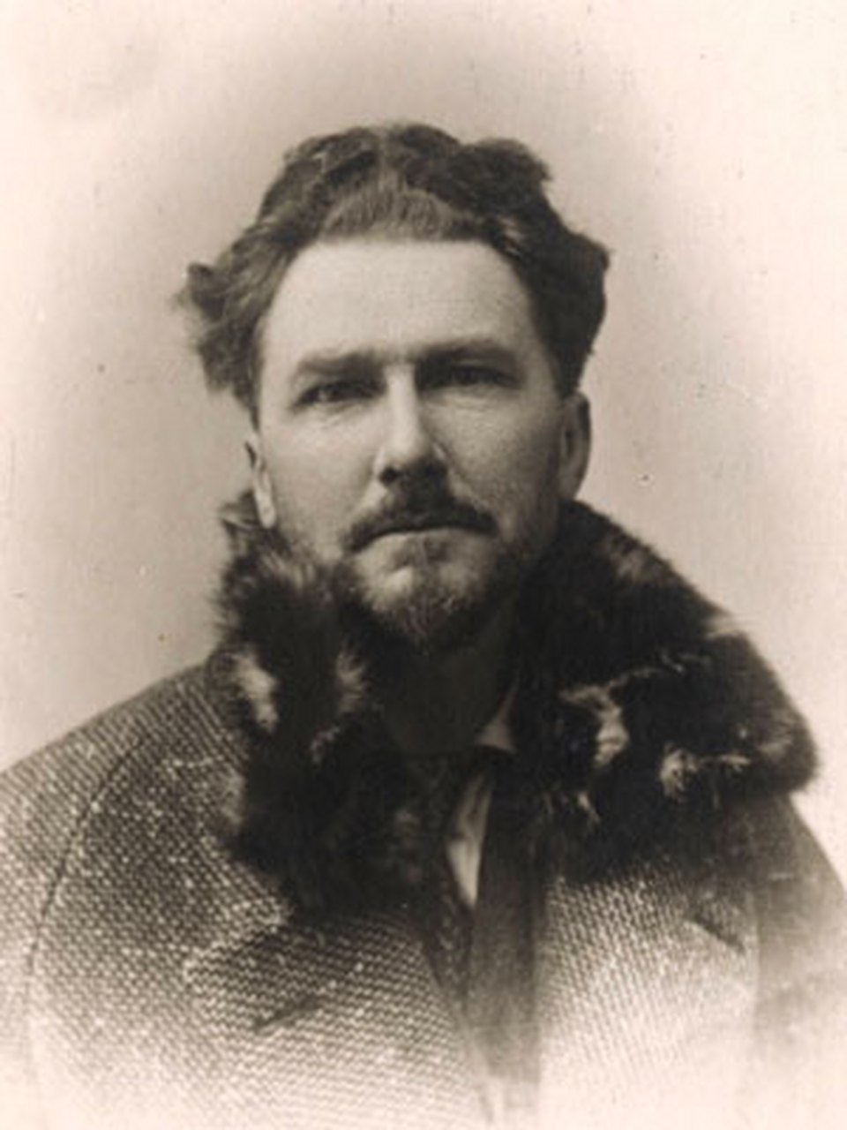
Ezra Pound（埃兹拉·庞德）是20世纪美国诗坛的巨匠，也是意象派诗歌运动的重要代表人物
‌。他出生于爱达荷州小城海莱市，在费城长大，主要著作包括《诗章》、《华夏集》、《阅读ABC》等。庞德早年以意象派诗歌著名，其中《诗章》被视为英美现代诗歌的登峰造极之作。他致力于将中国文学带入西方世界，对中国古诗赞赏有加，并根据东方学者芬诺洛萨的遗稿翻译出了中国古诗的英译本《国泰集》。庞德还译过《大学》、《中庸》、《论语》等国学名著，中国的儒家哲学和古典文学给他提供了丰厚的创作灵感。他的诗歌和翻译作品对东西方诗歌的互相借鉴做出了卓越贡献‌

Slide 14
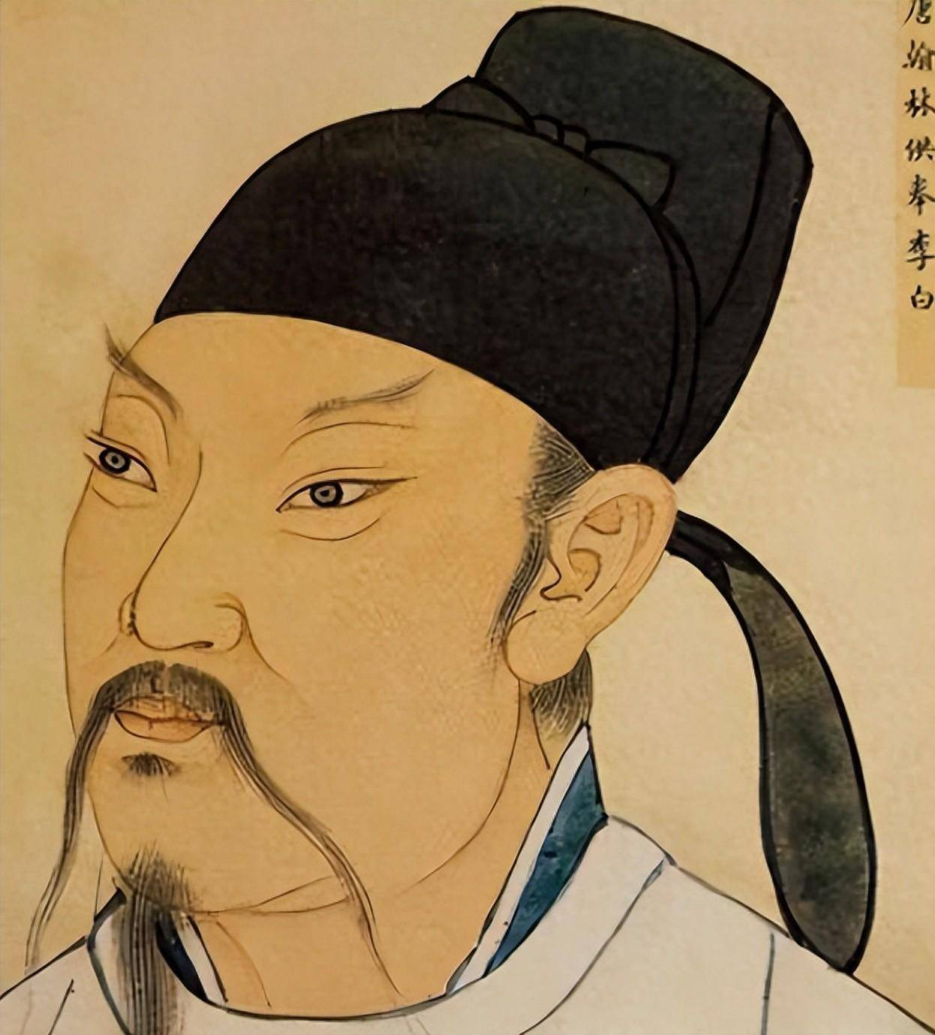
Critical Thinking
What do you think of the following translation?
You came by on bamboo stilts(高跷), playing horse,
You walked about my seat, playing with blue plums（梅子）.
郎骑竹马来，绕床弄青梅。
相迎不道远，直至长风沙。
And I will come out to meet you.As far as Cho-fu-Sa.
—李白《长干行》

Slide 15
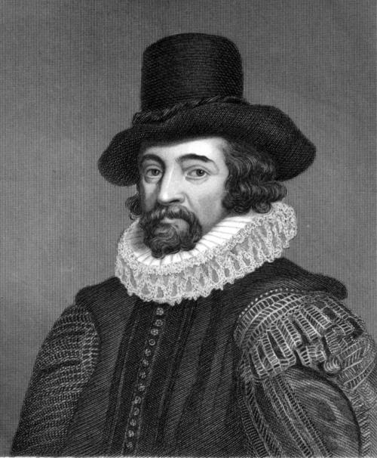
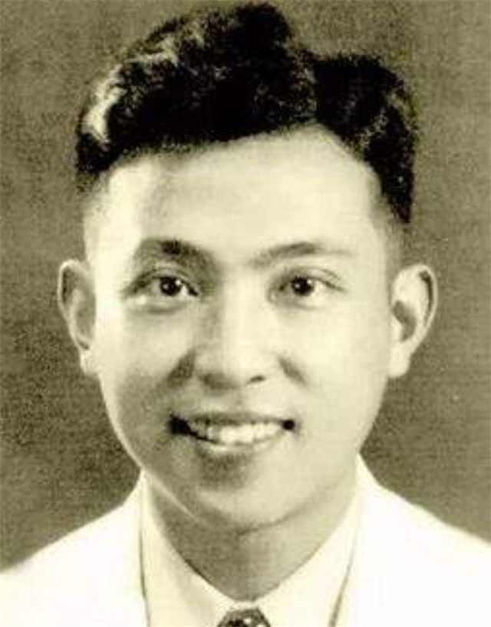
Critical Thinking
Of Studies
Francis Bason
Studies serve for delight,for ornament,and for ability.Their chief use for delight, is in privateness and retiring;for ornament, is in discourse; and for ability, is in the judgment and disposition of business.
论学习
王佐良 译
读书足矣怡情，足以博彩，足以长才。其怡情也，最见于独处幽居之时；其博彩也，最见于高谈阔论之中；其长才也，最见于处世判事之际。

Slide 16
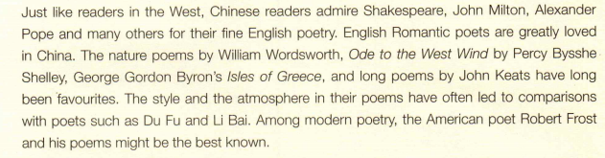
Who are the most popular English Romantic poets?
The most popular English Romantic poets are William Wordsworth, Percy Bysshe Shelley, George Gordon Byron, and John Keats.
Why do Chinese readers admire the same western poets as readers in the West?

Slide 17
Deep Thinking
Why do Chinese readers admire the same western poets as readers in the West?
Western poets often explore universal themes such as love, nature, freedom, and human emotions, which resonate with readers worldwide, including Chinese audiences.
The artistic quality of these poets' works transcends cultural boundaries, appealing to readers through their use of language, imagery, and literary techniques.
These poets have become part of global cultural exchange, allowing Chinese readers to appreciate diverse literary styles and ideas.
Chinese readers may find emotional connections in the works of Western poets, relating to personal experiences and shared human values.
1
2
3
4
Universal Themes
‌Artistic Merit
Cultural Exchange
Emotional Connection

Slide 18
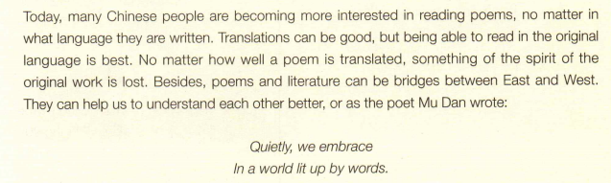
What does the writer think about translations of poems?
The writer thinks that translations of poems can be good but reading them in their original language is best.

Slide 19
Discussion
Discuss the questions with your partner.
1 . How has foreign poetry influenced Chinese poetry? Find the clues from the text to support your opinion.
Chinese poetry has been influenced by foreign poetry such as the works of the English Romantic poets, like Wordsworth.
2. Do you think translating poems from one language to another is a good thing? Why?
I think translating poems from one language to another is a good thing because it promotes cultural exchange between the people of the world.

Slide 20

Assignment
Read the poems in Expanding Your World and choose the poem you like best. Write an essay about your understanding of the poem, and explain why you like it. The following expressions may help you.
Tips for you
The poem is written from a parent's/... perspective.
The poet describes the scene ...
The poet compares ... with ...
... reminded me of ...
The poet was filled with ... as he/she wrote ...
The image of ... brings a feeling of...
The reason why I love this poem is that ...

Slide 21

Sample writing
The poem On Children describes parents’ relationship to their children. The poet is saying that your children are not your property, and that they are individual people with their own thoughts and souls that should be respected. Parents should not try and make their children exactly like themselves. The poet compares a parent and child to a bow and arrow to describe this relationship. The parent is the bow, which should remain stable and reliable, and the child is the arrow, which one should make sure is fired straight and true.
I think the poet was filled with love for his children when he wrote this, and also knowledge that he had come to understand himself. The reason why I love this poem is that I think it will help people become better parents by showing them that it is better not to control their children too much. They should be thereto look after them when they need it and guide them on their way.

Slide 22
Thank you！

