Slide 1


感恩遇见，相互成就，本课件资料仅供您个人参考、教学使用，严禁自行在网络传播，违者依知识产权法追究法律责任。
更多教学资源请关注
公众号：溯恩英语
知识产权声明

Slide 2
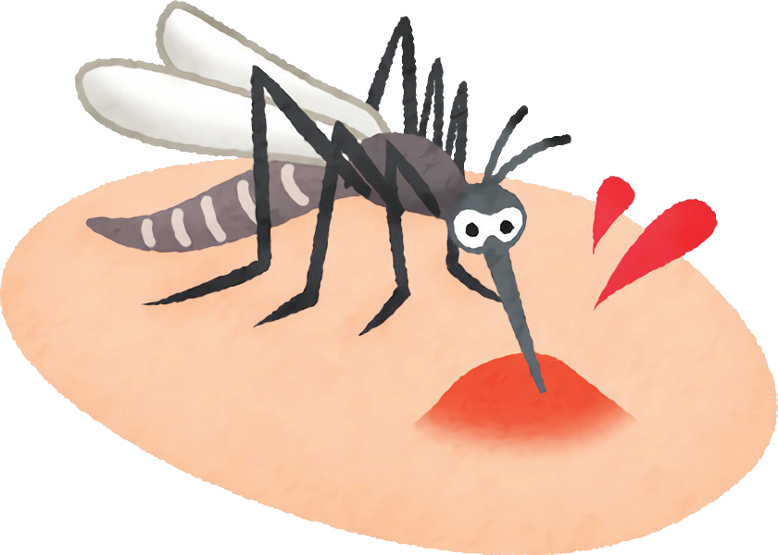
Mosquito Bites
——语篇知识在科普说明文阅读中的应用
黄新 云南民大附中

Slide 3
Word bank
itch | v. to have an uncomfortable feeling on your skin that makes you want to scratch
bite | vt. (bite - bit - bitten) to wound sb by making a small hole or mark in their skin n. a wound made by an animal or insect
swell | v. (swell-swelled-swollen) to become bigger or rounder
avoid | vt. to prevent sth bad from happening
in theory | according to the assumed facts
measure | n. an official way that is done in order to achieve a particular aim
mosquito | n. a flying insect that bites humans and animals and sucks their blood
relief | n. the feeling that comes when something burdensome is removed
additionally | adv. more than was first mentioned

Slide 4

Activity 1: Prediction
What can we do to avoid mosquito bites?
What should we do if we were bitten?
a mosquito
The mosquito is biting the skin.
What kind of skin does the mosquito prefer?
The skin is red and swollen.

Slide 5
Learning Objectives (学习目标)
——语篇知识在科普说明文阅读中的应用
By the end of this class, you will be able to:
predict the main parts of an expository writing by focusing on the
title and the picture;
analyze an expository writing from both macroscopic宏观的 and
microscopic微观的 view, including the writing type文体, the structure结构,
the explanation methods说明方法, some signposts语言标志词, the word
meaning guessing词义猜测 and cultural meaning文化意义.

Slide 6
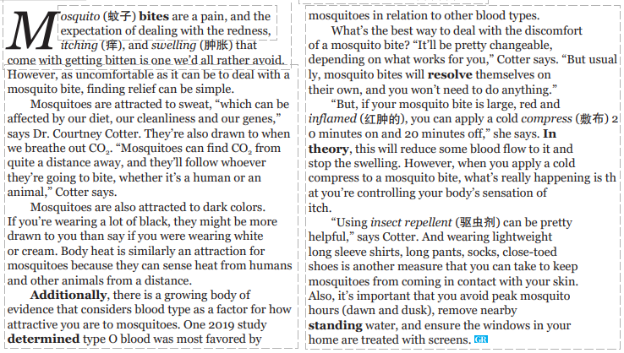
Activity 2: Discourse structure analysis (文本分析)——from macroscopic (宏观的) and microscopic (微观的) view
What’s the theme context (主题语境)?
People and self
Human and society
Human and nature
How is the passage organized?

Slide 7

Activity 2: Discourse structure analysis (文本分析)——from macroscopic (宏观的) and microscopic (微观的) view
How is the passage organized?
Can you find some nouns in Para.1?
Can you find some verbs or v-ings in Para.1?
The main idea of Para.1:
Getting bitten and dealing with mosquito bites can be uncomfortable, but finding relief can be simple. Luckily, mosquito bites can be avoided.
For what factors will a human or an animal get bitten?
What can we do to deal with mosquito bites?
What can we do to avoid mosquito bites?

Slide 8
Activity 2: Discourse structure analysis (文本分析)——from macroscopic (宏观的) and microscopic (微观的) view
Read Para. 2 to Para. 7
and underline the beginnings；
Circle some signposts (语言标志词) that imply the discourse logic(语篇逻辑).
Para. 5-Para. 6 (Part 2)
Parallel relationship
Ways to deal with MB
Para. 2-Para. 4 (Part 1)
Parallel relationship平行关系
Factors behind MB
Para. 7 (Part 3)
Ways to avoid MB

Slide 9
Activity 2: Discourse structure analysis (文本分析)——from macroscopic (宏观的) and microscopic (微观的) view
Go through each part, circle more signposts.
Part 2: Ways to deal with MB （locate verbs）
Part 1: Factors behind MB (locate nouns)
Part 3: Ways to avoid MB （locate verbs）

Slide 10
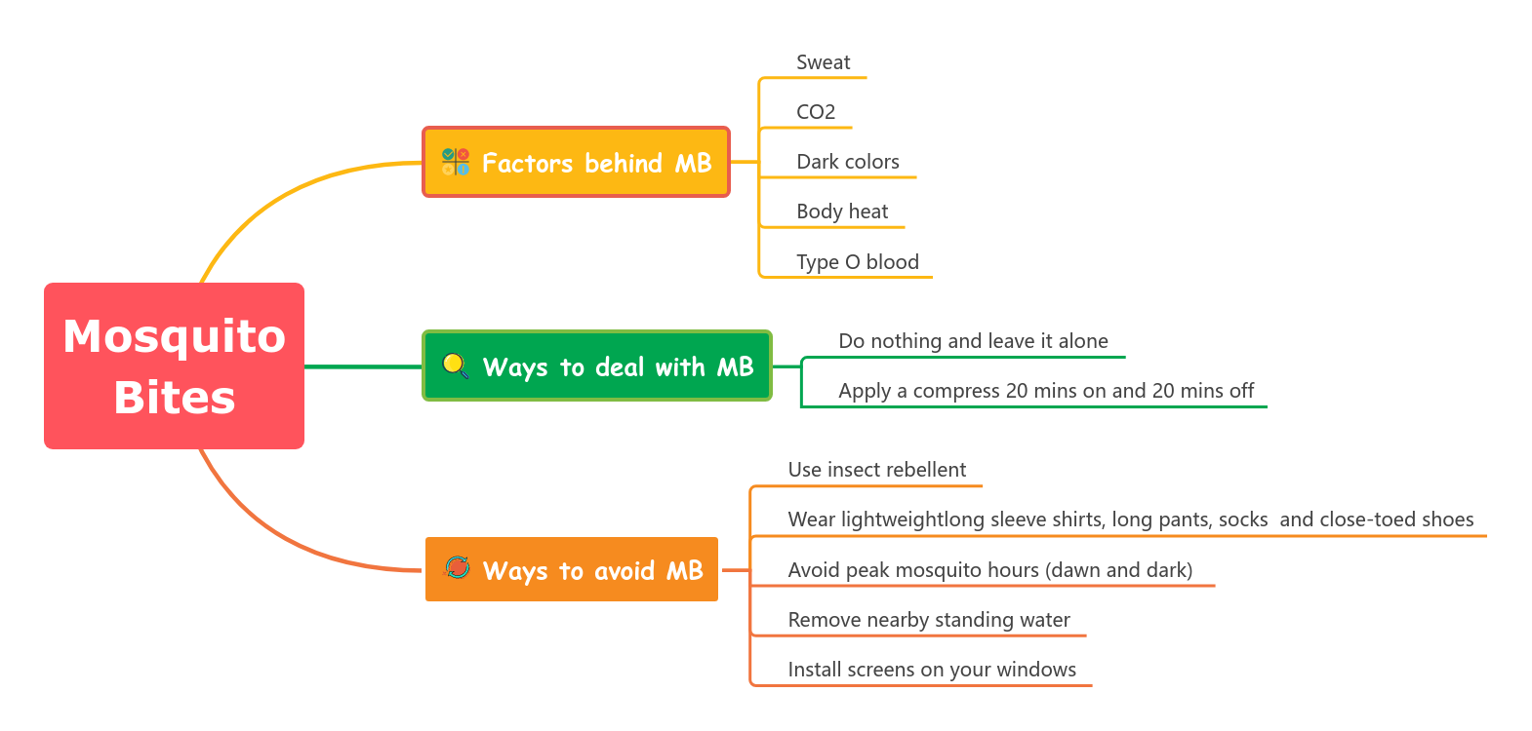

Activity 2: Discourse structure analysis (文本分析)
The Mind map of Mosquito Bites
The Mind map of Mosquito Bites
How is the discourse (语篇) organized?
What’s the writing type (体裁)?
Narration (记叙文)
Argumentative essay (议论文)
Expository writing (说明文)
Practical writing (应用文)
This discourse explains and provides so much information.
The passage is organized from the general to details.

Slide 11
Activity 3: Discourse language analysis(文本分析)—from microscopic view(微观)
How does the author make such information persuasive(有说服力的)?
Comparison and Contrast (比较说明法)
Quotation (引用说明法)
Common methods of explanation (说明方法)：
Definition (定义法)
Example (举例说明法)
Comparison and Contrast (比较说明法)
Cause and Effect (因果说明法)
Quotation (引用说明法)
Cause and Effect (因果说明法)

Slide 12
Activity 3: Discourse language analysis(文本分析)—from microscopic view(微观)
What are the meanings of the circled words?
Guess by word root (借助词根猜词义)
Guess by signposts (借助语言标志词猜词义)
定义性标志词：如“is called”、“means”、“refers to”等，这些词后面通常会直接给出生词的定义或解释。
解释性标志词：如“similarly”、“that is”、“in other words”、“i.e.”、“or”等，这些词用于进一步阐述或复述前面的内容，从而帮助理解生词的含义。
对比性标志词：如“but”、“however”、“on the other hand”等，这些词表示前后内容的对比或转折，有时可以通过对比来推测生词的反义词或不同含义。
举例性标志词：如“for example”、“such as”等，后面通常会给出具体的例子来说明前面的概念或生词，从而帮助理解其含义。

Slide 13

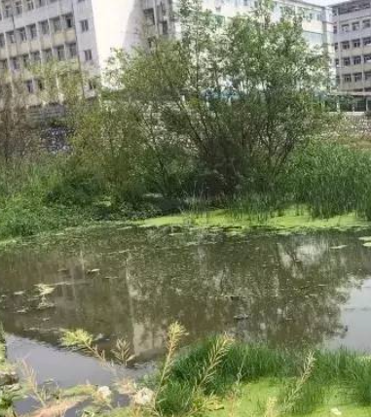


Activity 3: Discourse language analysis(文本分析)—from microscopic view(微观)
What are the meanings of the circled words?
Guess by word root (借助词根猜词义)
Guess by signposts (借助语言标志词猜词义)
Guess by common knowledge (借助常识猜词义)

Slide 14

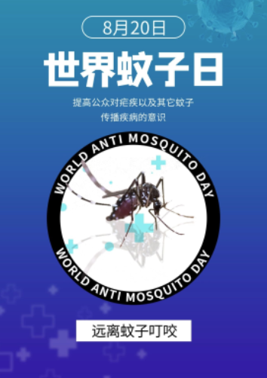

Activity 4: Cultural meaning
What can you learn from this word map(词图)?
Aug. 20th
World Anti-mosquito Day
世界反蚊子日
large in quantity
The ecology should be kept in balance.
We should protect ourselves from mosquitoes!
suck blood
annoying
If there were no mosquitoes, it could be a disaster too.
Mosquitoes are so dangerous！

Slide 15
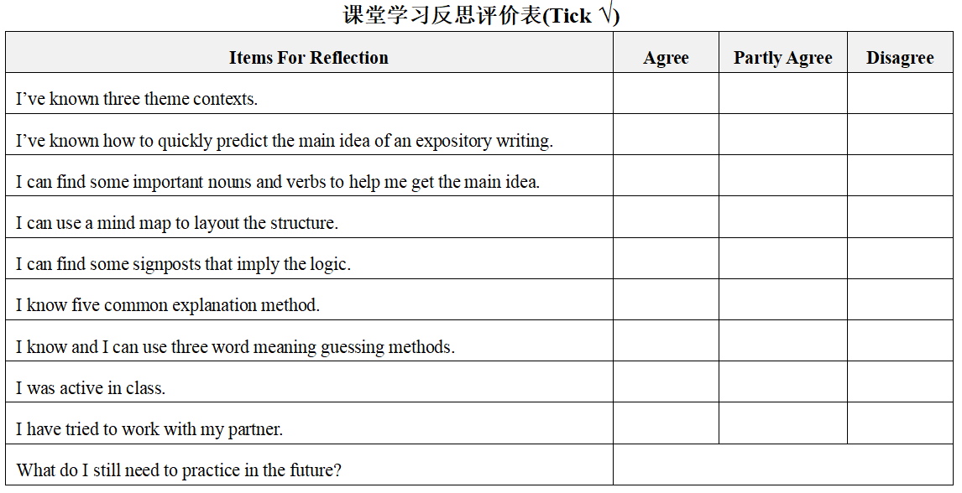
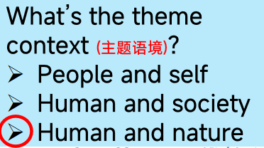
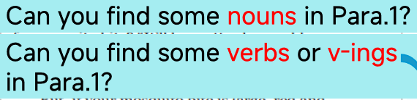
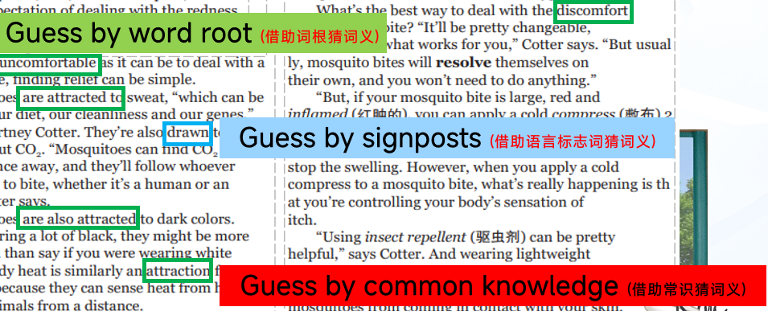
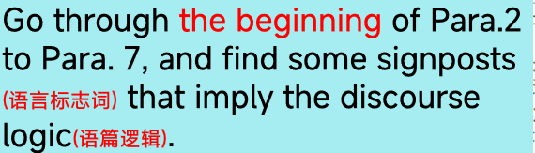
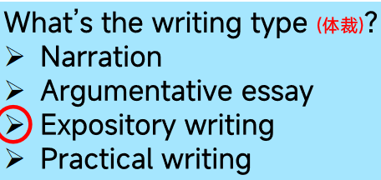
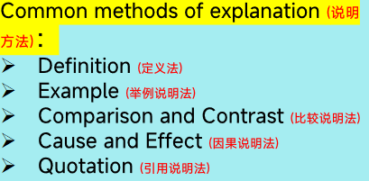
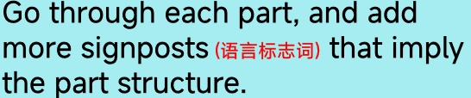
What have you learned in this class?
microscopic view
微观语篇知识
句子内部的语法结构、
词语搭配、指代关系、
句子的信息展开方式等
discourse knowledge
语篇知识
macroscopic view
宏观语篇知识
段与段的关系
以及语篇各部分与语篇主题之间的关系，
语篇类型、语篇格式等
Predict the main idea
with the help of T and P.
Nouns, verbs and v-ings in the first paragraph tells the topic.
The theme context matters.
discourse
analysis
语篇分析
Signposts
imply the logic.
Each writing type has its own features.
Explanation methods makes explanation persuasive.

Slide 16
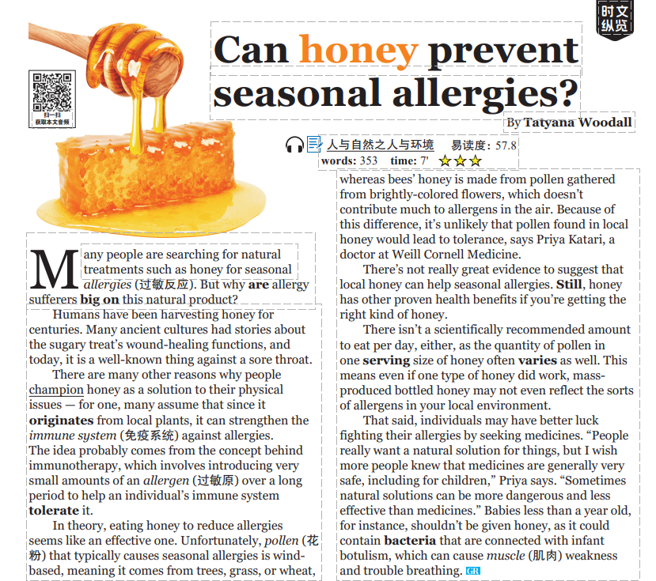
It is an expository writing.
Theme context is human and nature.
We can predict that the discourse is about whether honey can prevent seasonal allergies.
But why are allergy sufferers big on this natural product?
At least Para. 2&3 are about the reasons.
Explanation method: Quotation
Comparison and Contrast
(比较说明法)

Slide 17
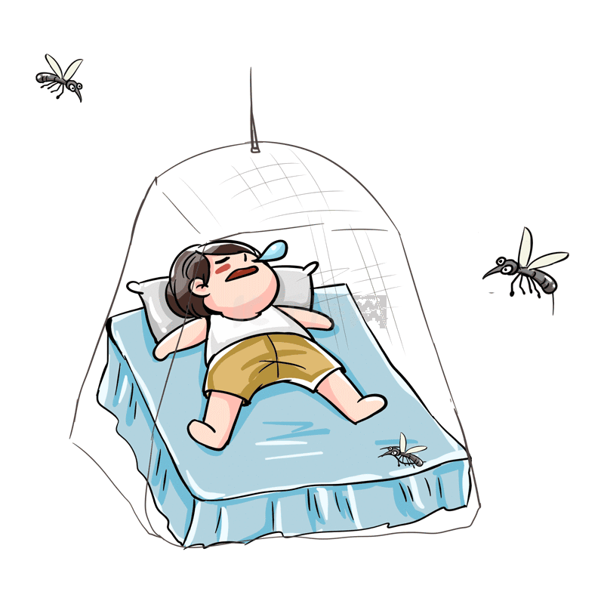
Homework
Option 1: Design a mind map for the given passage.
Option 2: Raise 2-4 questions for the given passage.
Questions | Question types
1. Which of the following is most attractive for a mosquito? | 理解性问题
2. What does Cotter think of dealing with mosquito bites? | 分析性问题
3. What is the authors purpose of writing the text? | 评价性问题
4. Which statement can be the ending of the passage? | 创作性问题
Thank you!

