Slide 1


感恩遇见，相互成就，本课件资料仅供您个人参考、教学使用，严禁自行在网络传播，违者依知识产权法追究法律责任。
更多教学资源请关注
公众号：溯恩英语
知识产权声明

Slide 2
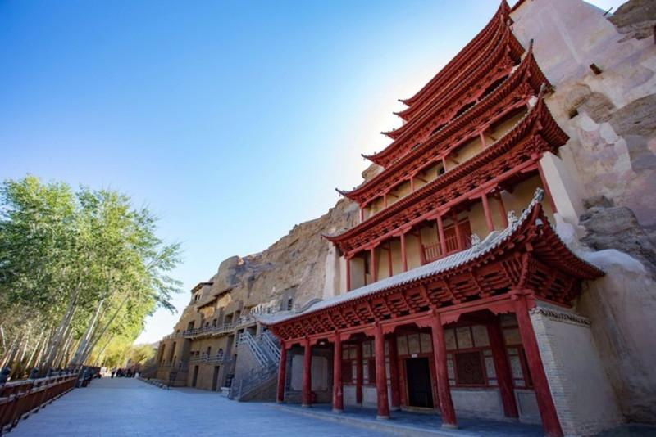
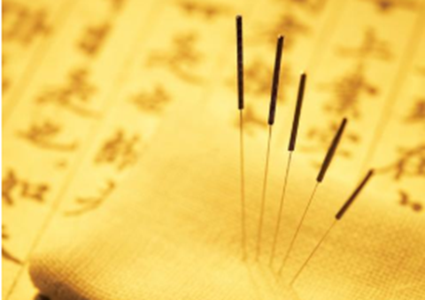
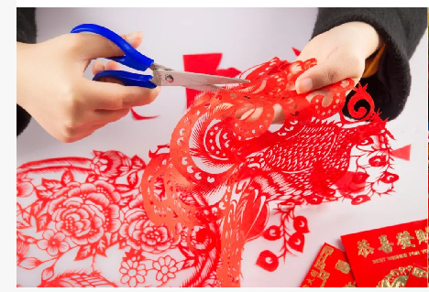
Mogao Caves
Chinese Acupuncture(针灸)
Paper cutting
Practical Writing Themed on
Cultural Heritage

Slide 3
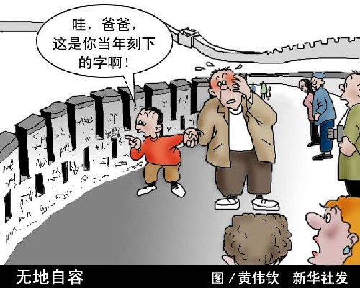
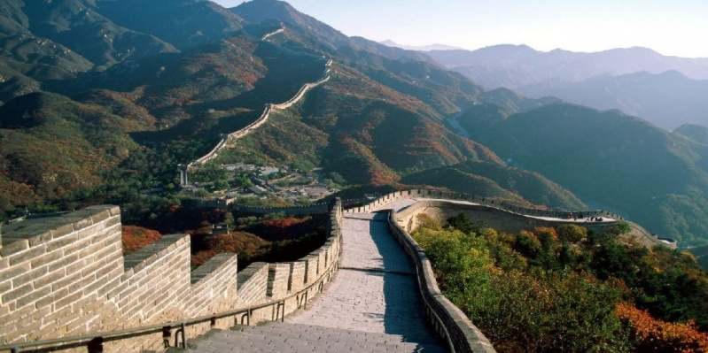
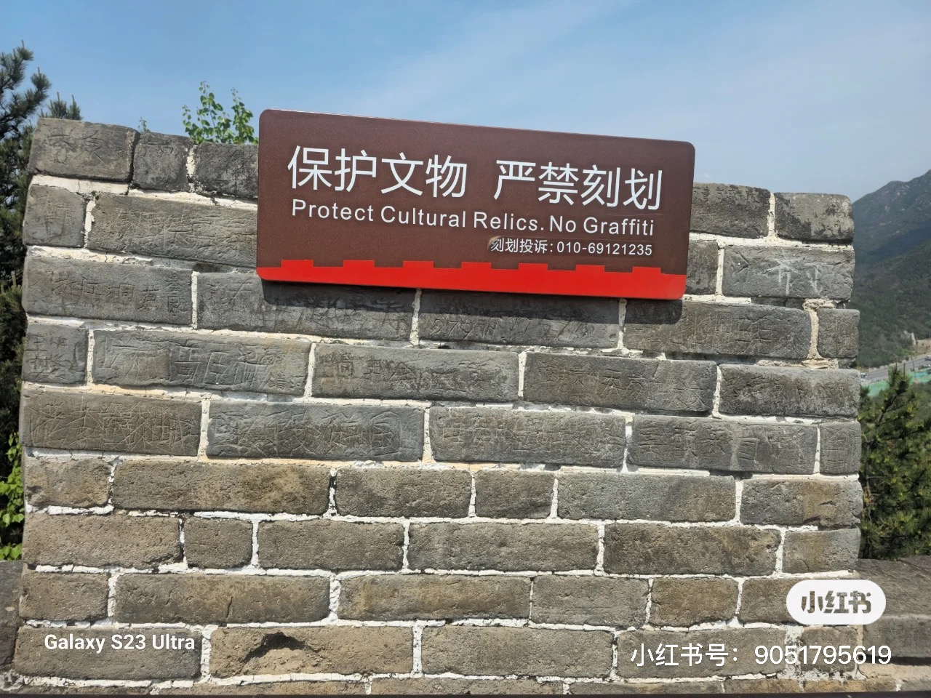
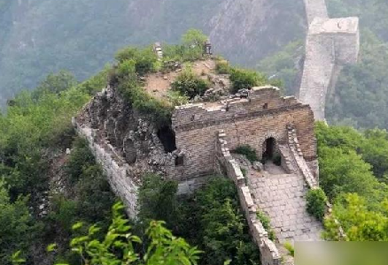
What happened to the Great Wall ?

Slide 4
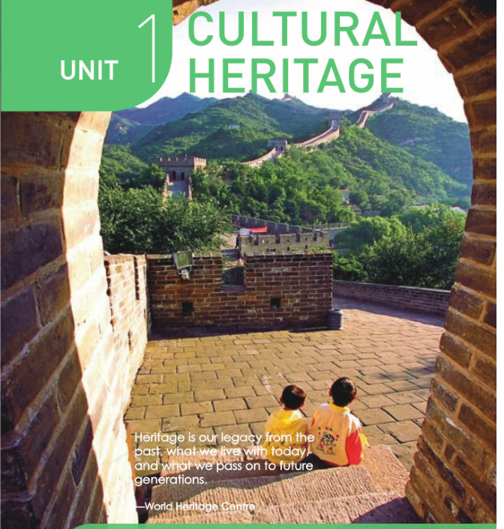
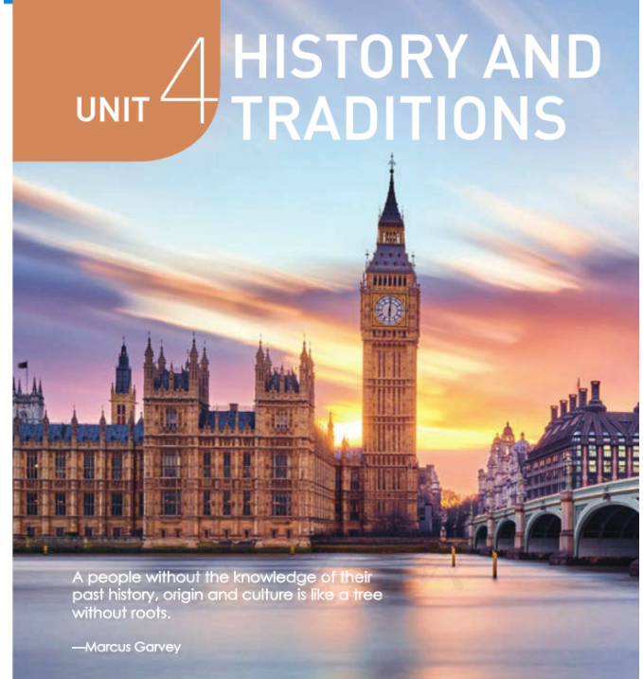
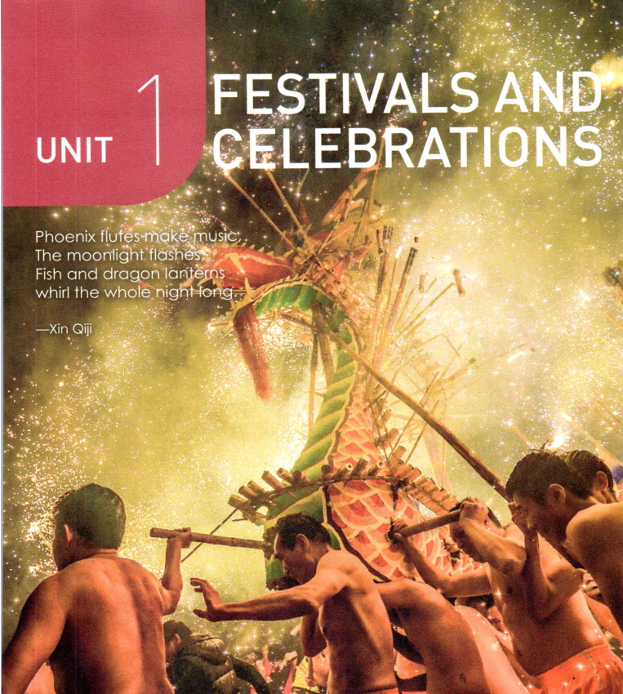
必修2 Unit 1
Cultural Heritage
必修2 Unit 4
History and traditions
必修3 Unit 1
Festivals and celebration

Slide 5

Do you remember....
Q1: What is heritage ?
Heritage is our legacy from the past, what we live with today, and what we pass on to future generations.
today
past
future

Slide 6
Do you know....
Q2: What are the types and forms of cultural heritage ?
temples
TangibleCultural
Heritage
castles/statues/murals
(壁画)/ caves/ruins/ pyramids/ monuments/tombs/cultural relics/architectures/palaces/
historical sites/stone inscriptions...
Cultural
Heritage
calligraphy
Intangible
Cultural heritage
traditions/customs/
festivals/ arts/ symbols/ cuisines/ folk/ operas/paper-cutting
crafts/embroidery(刺绣) /Chinese acupuncture(针灸) / etc...

Slide 7
Do you know....
Q3: Why does UNESCO establish a world heritage list ?
1.Promote better protection of heritage sites
2.Raise global awareness about the importance of preserving heritage
3.Encourage International Cooperation for heritage conservation.
4.Balance economic progress with heritage preservation.
.....

Slide 8
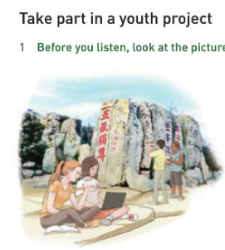
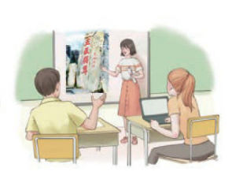
1
Problems and Dangers
Problems:
☑ The flood of tourists cause damage to Mount Tai;
☑ The monument suffers wear and tear from natural forces such as wind, water, temperature
Mount Tai

Slide 9
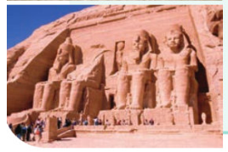
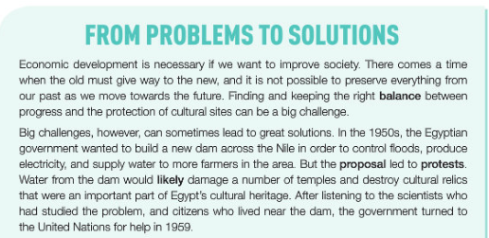
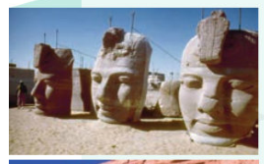
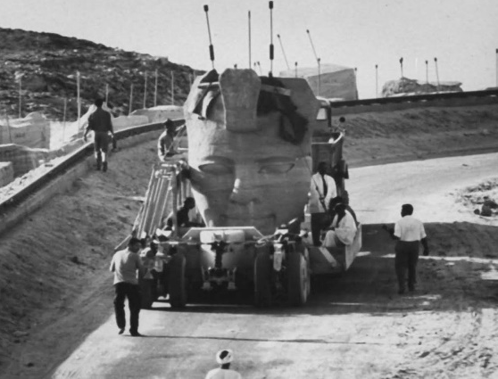
1
Problems and Dangers
Balance?
Progress of society
Protection of cultural sites
Egyptian temples
build a new dam
damage cultural heritage

Slide 10
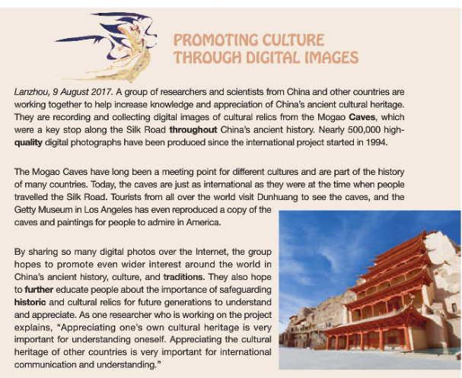
1
Problems and dangers
Problems:
☑ How to preserve the priceless murals and caves from being damaged and keep them to the future generations.
Mogao Caves

Slide 11
2
Protection and inheritance
Problems:
☑ The flood of tourists cause damage to Mount Tai;
☑ The monument suffers wear and tear from natural forces such as wind, water, temperature
A picture is worth a thousand words.
take part in
1._______________an international youth project;
2.search for clues to creatively _________ the old stele on Mount Tai from being damaged;
3.________an app about Mount Tai;
4.take _________ of the temples and stones.
preserve
create
Mount Tai
photos

Slide 12
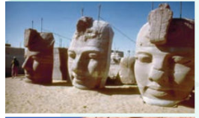

2
Protection and inheritance
Problems:
☑ strike a balance between economic progress and heritage preservation
☑ build a new dam vs damage cultural heritage
Heritage protection needs joint effort of the global community .
turn to
1. ___________UN for help
2. ____________ with other countries
3. ___________ piece by piece
4. move and put back together
cooperate
take down
Egyptian temples

Slide 13
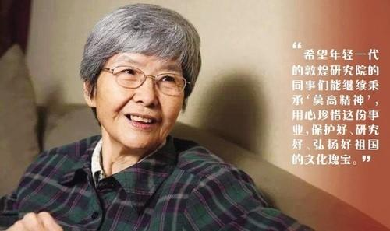
2
Protection and inheritance
Problems:
☑ How to preserve the priceless murals and caves from being damaged and keep them to the future generations.
It was Fan Jinshi that created digital Dunhuang, recording and collecting digital images of cultural relics from the Mogao Caves.
promote the Mogao Caves through _________ techniques: digital images, virtual tour,...
digital

Slide 14
Conclusion
Problems and Dangers | Protections and Inheritance
natural factors
→ long-term natural forces such as wind, water and temperature
natural disasters such as earthquake, fire etc...
human activities
→ economic development
→ the flood of tourists
→ wars, conflicts
......
take part in relevant organisation that protects heritage;
→ raise or donate money to an organization or group that protects our cultural heritage;
→ set up a fund
turn to local museums or historical societies for help
→ promote virtual tour
limit the tourist numbers;
→ take photos of relics
→ enhance International cooperation with other countries
......

Slide 15
Social values and Attitude
3
1. 文化遗产是每一个国家的宝贵财富。它们代表了老百姓的智慧并在维持文化多样性和认同扮演着重要的角色。
The cultural heritage is _____________________ of every nation. They_______________________________ and play a vital role in ____________________________________.
2. 文化遗产充当了我们和过去历史的纽带/桥梁,方便我们了解我们的 “根”和欣赏由祖先传承下来的遗产。
Cultural heritage ____________ a bridge/bond to our past and history, allowing us to_____________________ and appreciate the legacy ______________________________. (done做定语)
the priceless treasure
represent the wisdom of people
maintaining cultural diversity and identity
serves as
understand our roots
passed down by our ancestors

Slide 16
3. 我们越明白遗产突出的普遍价值，就越可能会尊重它们。
____________we acknowledge the ______________________ of our heritage site, _______________ we are to treat them ____________.
4. 人人都有责任尊重，保护文化遗产，不仅仅是为了自己，更是为了我们的子孙后代。
We all share a _____ responsibility to __________________them, not just for ourselves ,but ____________________.
The more
outstanding universal value
the more likely
with respect
joint
respect and preserve
for generations to come

Slide 17
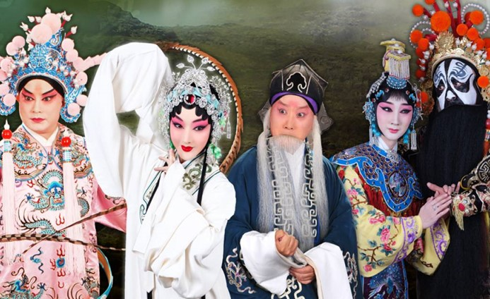
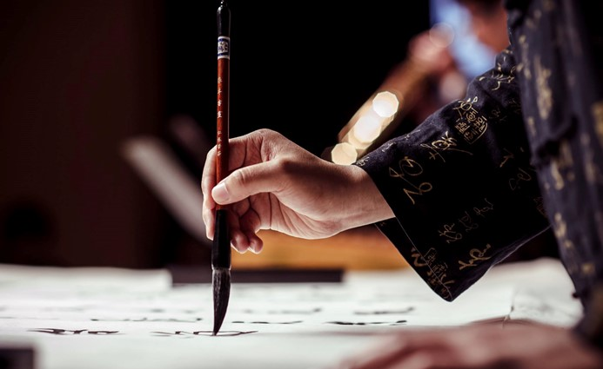
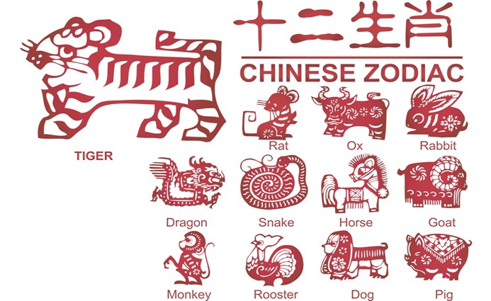
Cultural heritage is more than cultural relics, but also
traditions, customs, and knowledge etc....
Peking Opera
Chinese Calligraphy
Chinese Paper-cutting

Slide 18
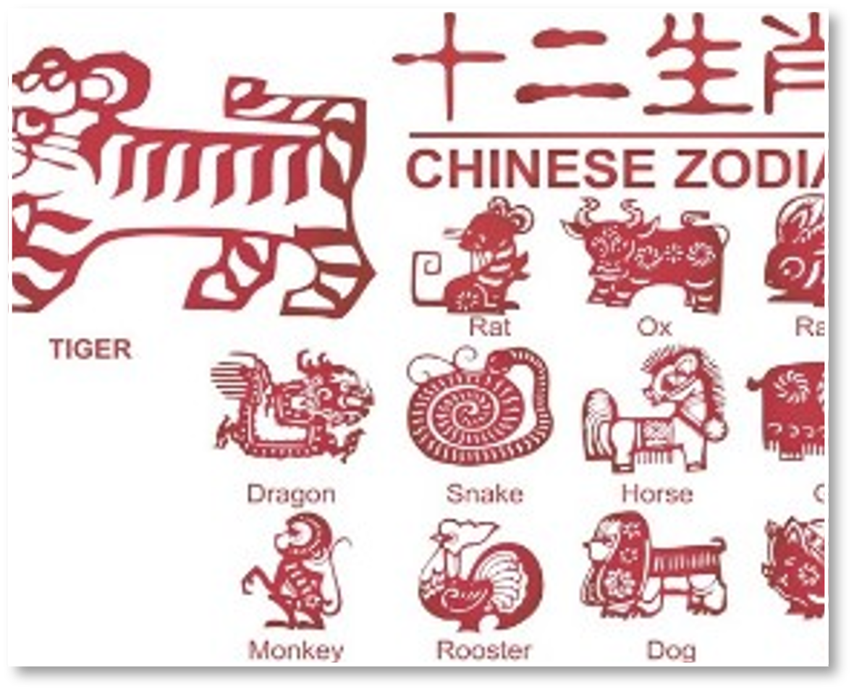
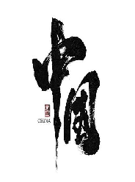
intangible cultural heritage （descriptive words+ functions）
  Although paper cutting is popular around the globe, only Chinese paper cutting was on the UNESCO Intangible Cultural Heritage (ICH) lists, because it has a history of more than 1,500 years and it represents cultural values of the people throughout China.
It is an ______________ part of our culture that dates back to thousands of years. __________(feature) diverse and distinctive styles, Chinese calligraphy ________ tools and materials are well-known _____________________________(文房四宝), conveys the writer’s unique characters, rich thoughts and emotions.
Not only does it _________________________________
but also _______________________________.
integral/inseparable
Featuring
whose
“the Four Treasures of the Chinese Study”
reflect the beauty and elegance of the Chinese language
Paper- Cutting
embodies the spirit and philosophy of our people
calligraphy

Slide 19
4
Practice
你班英语课上将举行主题为“Let’s protect cultural heritage around us”的英语演讲比赛，请你写一篇演讲稿参赛,内容包括：
1．说明保护文化遗产的重要性；
2．推荐具体措施。
注意：1．词数80左右；
2．增加适当细节，以使行文连贯。
________________________________________________________________________________________________ __________________________________________________________________________________________________________________________________________________________________________________________________________________________________________________________________________________________________________________________________________________________________________________________________________________________________________________________________

Slide 20

Writing structure
Good morning, everyone!
Dear fellow students,
Ladies and gentlemen,
Salutation
①It is a great honor/privilege for me to stand here and make/deliver a speech entitled/with the title of...
②I am privileged/honored to have the opportunity to share my ideas on...
Beginning
Body
......
Ending
That’s all. Thanks for your listening/attention!

Slide 21
Write and share: words and expressions for reference
Aspects
Expressions and sentence patterns
problems
cause damage to; preserve...from being damaged
serve as a bridge to our past and history
allow us to understand our roots priceless treasure of every country
represent the wisdom of Chinese people
maintain cultural diversity and identity.
share a joint responsibility to respect, protect and preserve cultural heritage, not just for ourselves ,but for generations to come.
The more…the more….
values and attitude
take part in relevant organization that protects heritage;
raise or donate money to an organization or group
set up a fund
turn to local museums or historical societies for help
promote virtual tour
limit the tourist numbers;
take photos of relics
Enhance International cooperation with other countries....
protection

Slide 22
Checklist
5 C criteria for a good piece of writing!
Coherent ideas
Complete content
Correct grammar, spelling
Clear structure
Clean handwriting

Slide 23
Hello, everyone，
I’m honored to stand here and the topic of my speech is “Let’s protect cultural heritage around us”．
It is widely recognized that cultural heritage, including both tangible and intangible forms, is the priceless treasure of every nation and the accumulated wisdom of our ancestors．They serve as a bridge to our past and history, allowing us to understand our roots and appreciate the legacy passed down by our ancestors. Hence, it is vital for each of us to share a joint responsibility to respect and preserve them, not just for ourselves ,but for generations to come.
As for the specific measures, first, when visiting the historic sites, we should follow the established guidelines．Second, we should strive to incorporate intangible cultural heritage into our daily lives．
That’s all. Thank you for your attention.

Slide 24
Searching for more different applications
你校英文报打算出一期文化遗产保护的专刊。请你用英语写一篇短文投稿，内容包括：
1．文化遗产面临的问题 2.你的建议
注意：1．词数80左右；
2．增加适当细节，以使行文连贯。
随着经济的发展,越来越多的文化遗产(cultural relics)遭到破坏。假设你是红星中学高中生李华,请你向同学们发出倡议。
内容包括：
1.文化遗迹的重要性 2.呼吁人们保护文化遗产
注意：1．词数80左右；
2．增加适当细节，以使行文连贯。

Slide 25
Sharing
A concerted effort to preserve our heritage is a vital link to our cultural, educational, aesthetic, inspirational, and economic legacies.
— Steve Berry
Shared Heritage, shared future.

Slide 26
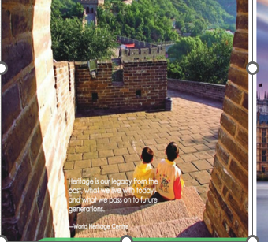
5
Homework---peer editing
Surf the Internet for more information about cultural heritage.
Exchange your speech draft with your deskmate and comment on it based on the checklist .

Slide 27

Thank you!

