Slide 1


感恩遇见，相互成就，本课件资料仅供您个人参考、教学使用，严禁自行在网络传播，违者依知识产权法追究法律责任。
更多教学资源请关注
公众号：溯恩英语
知识产权声明

Slide 2




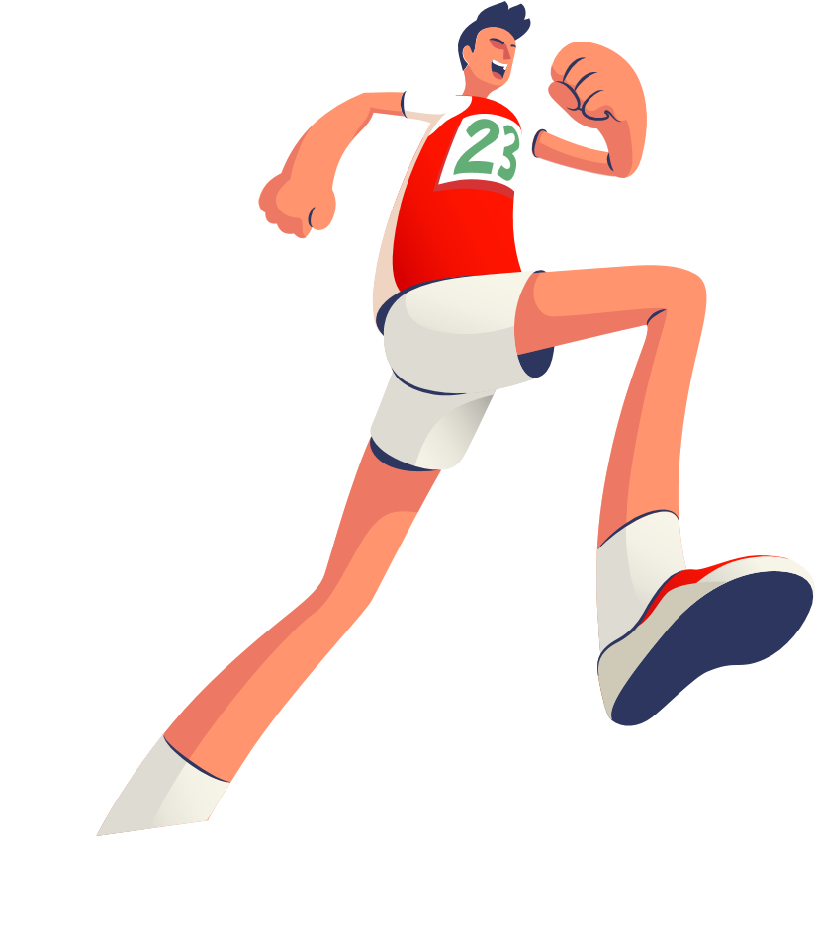


The Ultimate Trainers
Good English
Notes:
VCG41N1226331540 VCG211253393377

Slide 3

Teaching Objectives:
1. familiarize yourself with the main idea of these chapters
2. grasp the key words and expressions related to running/competitions.

Slide 4


Chapter 6: Jake makes up his mind
Chapter 7: Where are the trainers?
Chapter 8: The big race
Chapter 2: Kevin Beadle
Chapter 3: Jake Tries them out
Chapter 4: Anna works it out
Chapter 5: It won't prove anything
Chapter 9: The trainers get their own back
Chapter I: The Perfect Trainers
Chapter 10: Back to whenever

Slide 5
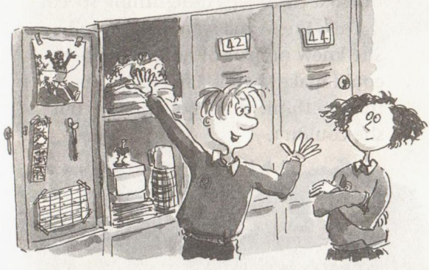
Chapter 4 Anna works it out
What does it refer to?
How does Anna work it out?
What are they quarreling for? Who are you for?

Slide 6
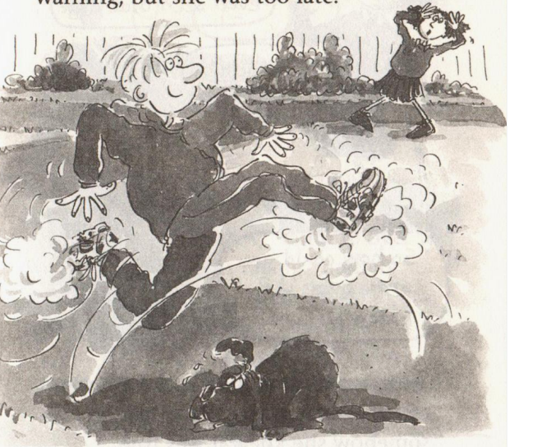
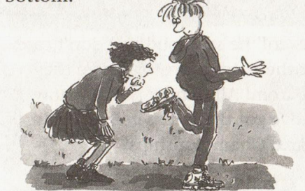
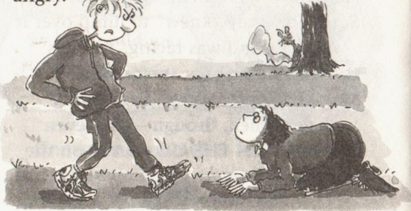
What does it refer to?
How does Anna work it out?
'It's the trainers! 'she burst out.' It's like they have a life of their own! I mean, no one could run so fast. The trainers were doing it. You were just a passenger. '
It was the trainers that ran so fast
observing and pondering
witnessed him leaping into the air
observed words on the bottom
knelt and stared straight at

Slide 7
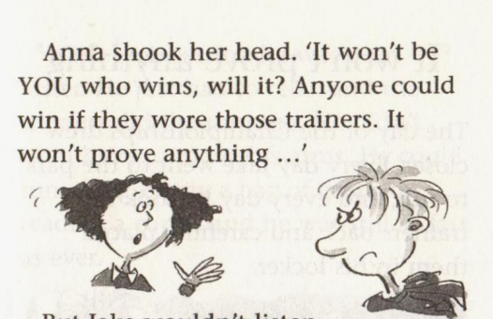

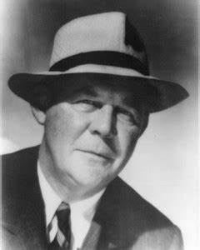
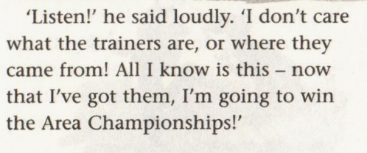
What are they quarreling for? Who are you for?
“It’s not whether you win or lose, but how you play the game. Winning is not everything!”
---Grantland Rice
(a legendary sportswriter)
Winning is all that counts!
Honesty is the best policy!
You won’t really win with that.

Slide 8
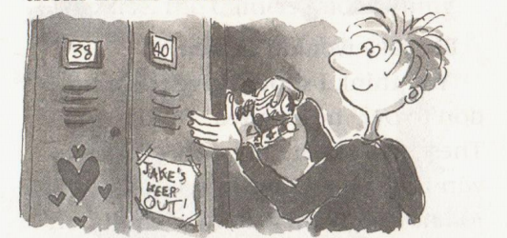
Chapter 5 It won't prove anything
Who says it? Why does she say it?
Does it work?

Slide 9
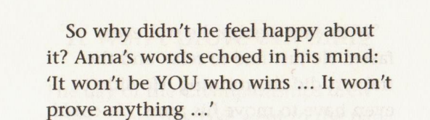
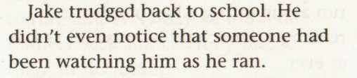
Who says it? Why does she say it?
Does Jake agree with her?

Slide 10
Which words in chapter 4 indicating the fast speed.
Jake set off at an amazing pace.以惊人的速度
His feet flew over the ground and he finished the first three laps in lightning speed以闪电般的速度
He ran off like a speeding train. 就像一列飞驰的火车
Understanding hit her like a bucket of cold water. 她就像被泼了一桶冷水，一下子就明白了。
Anna’s mind was racing. 安娜的大脑在飞速地运转

Slide 11
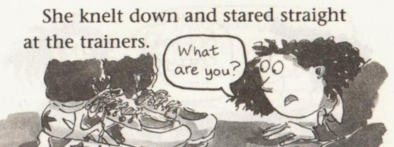
She knelt and stared straight at the trainers.
kneel v. /niːl/ (knelt knelt )
[ V]~ (down) to be in or move into a position where your body is supported on your knee or knees跪；跪着；跪下
•We knelt (down) on the ground to examine the tracks.我们跪在地上察看足迹。

Slide 12
The day of the Championships drew closer.
锦标赛的日子越来越近了
have a row with sb 与某人争吵或发生争执
Anna's words echoed in his mind. 在他的脑海回想
He trudged back to school.拖着沉重的脚步走到学校
trudge vt. to walk slowly with heavy steps because you are tired or carrying sth heavy 缓慢地走
He trudged the last two miles to the town.他步履艰难地走完最后两英里到了城里。

Slide 13
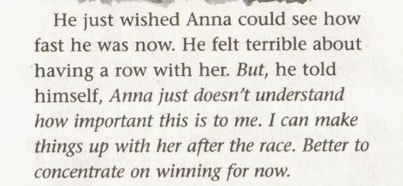
Write an email to Anna for Jake, including the following content:
1. show apology
2. express your new reflection
(about 120words)

Slide 14
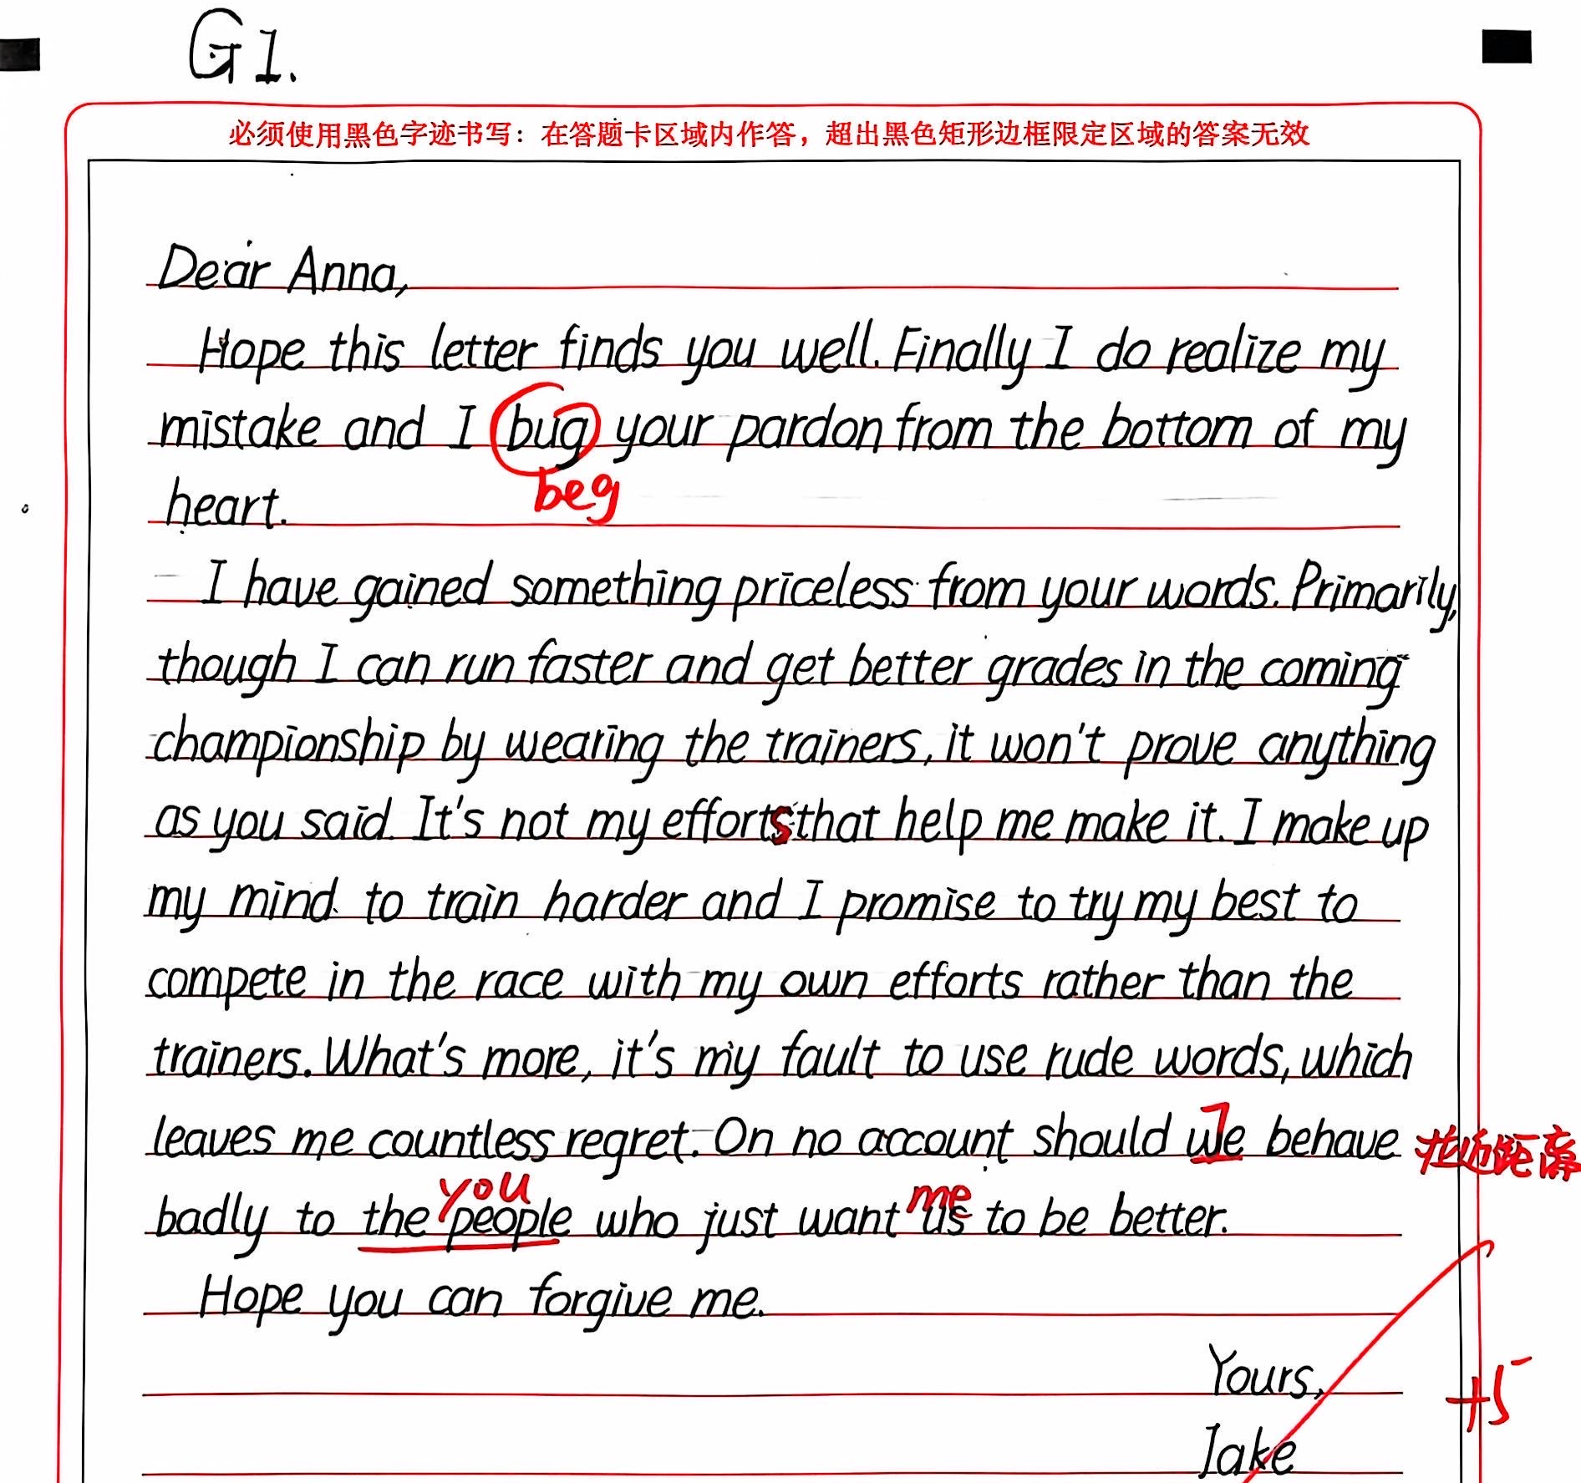

Slide 15
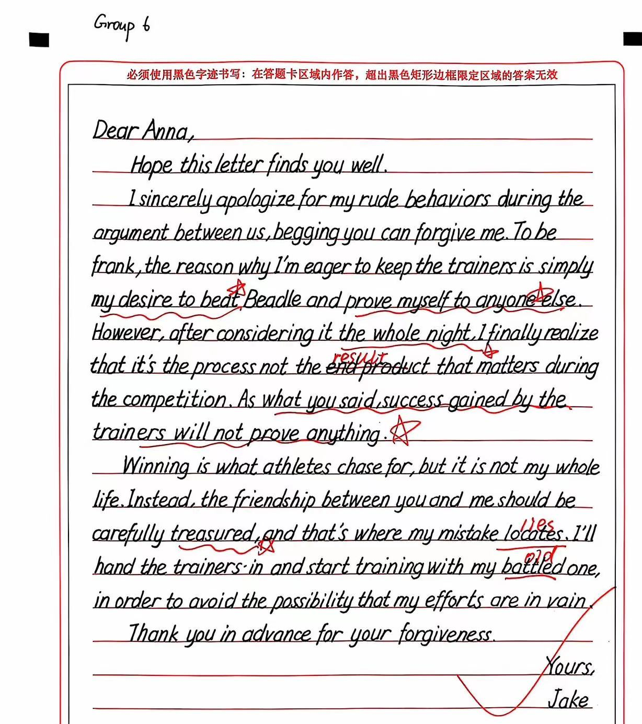

Slide 16
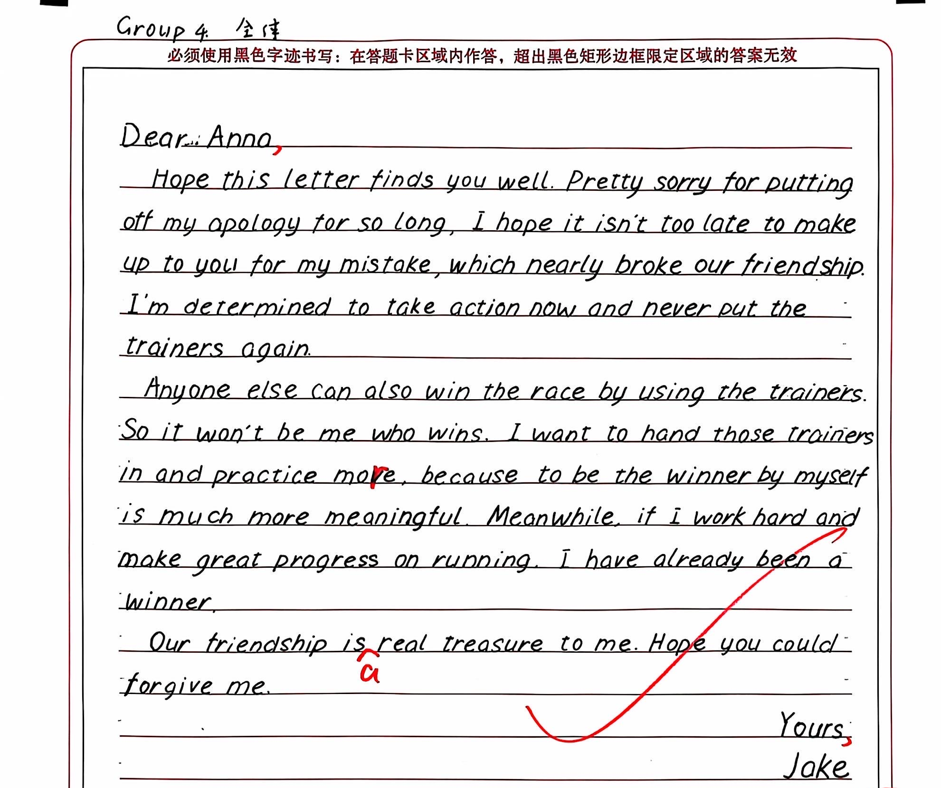

Slide 17
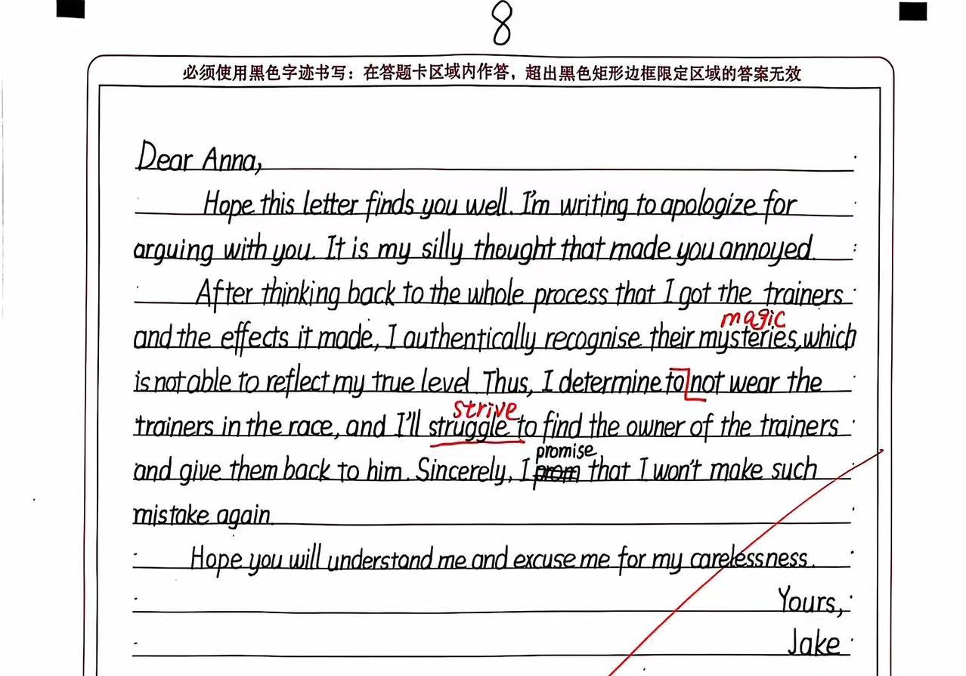

Slide 18
Dear Anna,
Hope this email finds you well. I’m writing to express my heartfelt apology for our recent quarrel and share with you my new reflection.
Reflecting on the situation, I recognize that my impolite words and actions have caused you pain, and for that, I am deeply sorry. So occupied with my own goals that I was blind to see your care to me. But now I’ve fully realized that you are right; winning shouldn’t be achieved at the expense of dishonesty and it is the spirit of sportsmanship that truly matters.
Moreover, after having a second thought, I’ve determined that honesty is the best policy, regardless of the circumstances and will put it into practice. I appreciate your patience and the lessons you’ve taught me. I have decided not to use the magic trainers and to complete the race on my own.
Once again, I apologize and extend my gratitude for your understanding. Look forward to making it up to you.
Yours,
Jake

