Slide 1


感恩遇见，相互成就，本课件资料仅供您个人参考、教学使用，严禁自行在网络传播，违者依知识产权法追究法律责任。
更多教学资源请关注
公众号：溯恩英语
知识产权声明

Slide 2


阅读客观题分析
北师大嘉兴附中 吴晨华

Slide 3
题型 | 话题 | 体裁 | 词数
阅读A | 人与社会：A guide of the 4 Best Movies of 2024 | 应用文 | 259
阅读B | 人与社会：An introduction on a book and various attitudes towards tree-planting | 说明文 | 350
阅读C | 人与社会：Apple’s new design to deal with motion sickness | 说明文 | 331
阅读D | 人与社会：AI’s limitation of not helping language understanding and cultural competency fostering | 说明文 | 365
七选五 | 人与自我：An introduction on loneliness and the ways to overcome it | 说明文 | 264
完型填空 | 人与社会：Call on people to be a corner person and be connected in the community | 记叙文 | 254
语法填空 | 人与社会：the deep bond between Nice, France and Hangzhou, China as sister cities | 说明文 | 254

Slide 4

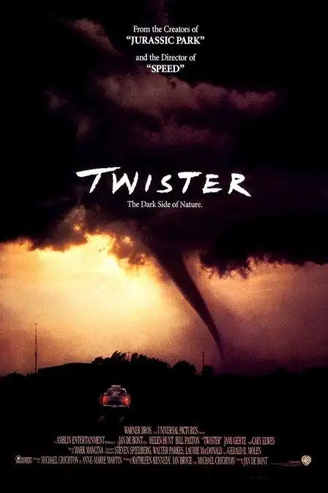
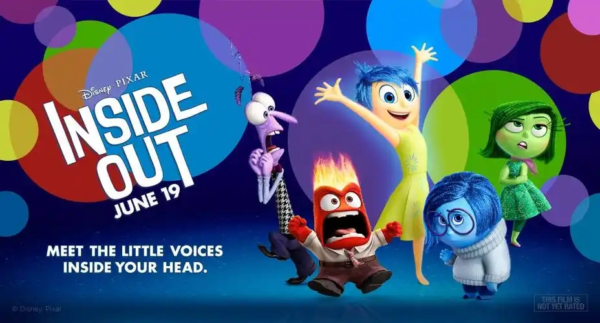

A
人与社会：
A guide of the 4 Best Movies of 2024

Slide 5

A
Welcome to our guide of the Best Movies of 2024, featuring every Certified Fresh movie as they come in week by week!
Joker: Folie à Deux (Oct. 4)
The first Joker stunned Hollywood by becoming a $1 billion hit despite being R-rated and having a modest budget for a comic book movie. The sequel（续作）comes at a challenging time for the comic book genre, but can Joker 2 have the last laugh? Joaquin Phoenix reprises his Oscar-winning role as Arthur Fleck, with Lady Gaga joining as co-lead in this musical in filmmaker Todd Phillips' feature.
Twisters (July 19)
The new version of the '90s movie Twister stars Daisy Edgar-Jones, Glen Powell and Anthony Ramos. Minari's Lee Isaac Chung directs. The original followed storm-chasers in Oklahoma and was known for its inventive special effects that brought tornadoes to the big screen.
Inside Out 2(June 14)
The gang is back together in this animated follow-up to the beloved Pixar movie that follows the anthropomorphized（人格化）emotions of a young girl led by Amy Poehler's Joy. Joining for this round is Anxiety, voiced by Maya Hawke.
Mufasa: The Lion King (Dec.20)
After Jon Favreau's The Lion King remake made more than $ 1 billion at the box office in 2019，Disney was keen to return to the world with a prequel（前传）focusing on Mufasa. This time, Barry Jenkins directs the cartoon with Aaron Pierre voicing Mufasa, a role made famous by James Earl Jones in the 1994 animated feature.
2024年4部最新创作的4部电影以及它们的特色
21. Which movie is a remake? A. Joker: Folie à Deux.
B. Twisters. C. Inside Out 2. D. Mufasa: The Lion King. 22. What do Inside Out 2 and Mufasa: The Lion King have in common? A. Both are animated films. B. Both introduce new characters. C. Both are made by new directors. D. Both are financially successful. 23. Where is the text probably from? A. A journal on film studies. B. An entertainment website. C. A textbook on movie history. D. A daily newspaper on global news.

Slide 6
文本再现
featuring
1. Welcome to our guide of the Best Movies of 2024, _____________(feature) every _________(certify) Fresh movie as they come in week by week!
in filmmaker Todd Phillips' feature
in the 1994 animated feature
The software has no particular distinguishing features.
Her eyes are her most striking feature.
The film features Cary Grant as a professor.
Jon featured in one of the show's most thrilling episodes.
2. The first Joker ___________(同义词：shock) Hollywood by becoming a $1 billion hit despite being R-rated and ___________________________(预算低) a comic book movie.
3. __________(join) for this round is Anxiety, ________(voice) by Maya Hawke.
Certified
（电影的）正片，故事片
（电影的）正片，故事片
特色；特征；特点
面容的一部分（如鼻、口、眼）
以…为特色；由…主演
担任主演
stunned
having a modest budget for
Joining
voiced

Slide 7
B
人与社会：
An introduction on a book and various attitudes towards tree-planting

Slide 8
B
“Growing fruit trees is a very simple way to stay in love with our world,” says Vivian Keh, playwright and daughter of immigrants, holding a basket of persimmons（柿子）she’s cultivated to feel connected to her Korean ancestors. Keh is just one of the 50 remarkable subjects in naturalist writer Amy Stewart's The Tree Collectors: Tales of Arboreal Obsession, a collection of portraits of people transformed by their love of trees.
Initially, trees struck Stewart as an odd thing to collect. Intrigued by this community of enthusiasts, she discovered educators, preservationists and visionaries, all draw to a kind of curation, motivated by reasons as diverse as their projects. They plant trees in public and private spaces both modest and expansive, nurturing（培育）their collections to honor beloved dead, attract wildlife, preserve rare species, connect to history, invest in the future, grow food and create beauty.
Steward categorizes these tree collectors according to their sense of purpose. Kenneth Hoegh, one of the book's “ecologists”, tests which cold-loving species might grow in a warming and historically treeless Greenland. “Healer” Joe Hamilton plants loblolly pines on a parcel of land he got from his enslaved ancestors with an eye toward long-term sustainable forestry which he hopes will establish a source of generational wealth for his family. Reagan Wytsalucy has a plan to restore traditional peach orchards on Navajo land as one of the "community builders” who seek to bring people together.
Adding to the book's charm are Stewart's watercolor illustrations-she gives us a look at each of her human subjects while also cataloging the most wonderful qualities of featured trees, such as Seussian eucalyptus seed pods and delicate camellia blossoms.
After spending time in this varied commonwealth, you'll undoubtedly experience an intense desire to rest under the shade of a leafy oak. But something even deeper is happening here: by creating a space for people to talk about something they love. "How often do any of us get a chance to pour our hearts out to a stranger?” she writes. “Somehow, talking about trees made it possible.”
Amy Stewart 的新书The Tree Collectors : Tales of Arboreal Obsession, 这本书通过讲述不同人对于树的热爱来说明一个共同的话题，即树能链接人和人，包括人和祖先，家人，甚至是陌生人。
24. What does the underlined word "curation" in paragraph 2 mean? A. Connection. B. Collection. C. Treatment. D. Transformation. 25. What purpose of planting trees is mentioned in paragraph 3? A. To preserve rare species. B. To honor beloved dead. C. To develop new varieties. D. To strengthen social bonds. 26. What does the quote in the last paragraph suggest about discussing trees? A. It inspires new ideas. B. It rarely happens in public. C. It allows deep emotional sharing. D. It helps resolve environmental issues. 27. What does the writer think of the book? A. Complicated. B. Conventional. C. Inspiring. D. Intense.

Slide 9
文本再现
are
1. Adding to the book's charm ____ Stewart's watercolor illustrations -she gives us a look at each of her human subjects while also __________(catalog) the most wonderful qualities of ________(feature) trees.
2. _________(initial), trees struck Stewart as an odd thing to collect.
3. After spending time in this varied commonwealth, you’ll ___________(not doubt) experience an intense desire to rest under the shade of a leafy oak.
What does the writer think of the book? A. Complicated. B. Conventional. C. Inspiring. D. Intense.
I felt so self-conscious under Luke's mother's intense gaze.
His intensity alarmed me.
cataloging
featured
Initially
adj. initial
v. initiate
n. initiative
undoubtedly

Slide 10
4. …, says Vivian Keh, playwright and daughter of immigrants, ________(hold) a basket of persimmons（柿子）she’s cultivated to feel _________(connect) to her Korean ancestors.
5. Keh is just one of the 50 remarkable subjects in naturalist writer Amy Stewart's The Tree Collectors: Tales of Arboreal Obsession, a collection of portraits of people ___________ (transform) by their love of trees.
6. Intrigued by this community of ___________(爱好者), she discovered educators, preservationists and visionaries, all draw to a kind of curation, ___________(motive) by reasons as diverse as their projects.
7. Healer” Joe Hamilton plants loblolly pines on a parcel of land he got from his enslaved ancestors with an eye toward long-term sustainable forestry _______ he hopes will establish a source of generational wealth for his family.
8. He has a plan to _______(恢复) traditional peach orchards on Navajo land as one of the “community builders” who ______(试图) bring people together.
holding
connected
transformed
enthusiasts
motivated
which
restore
seek to

Slide 11
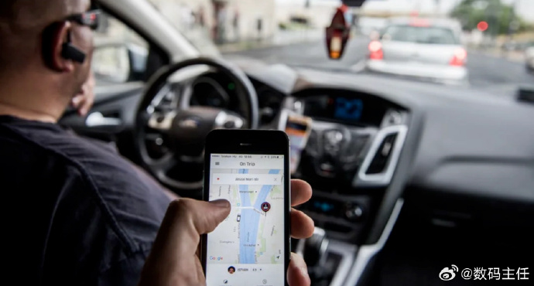
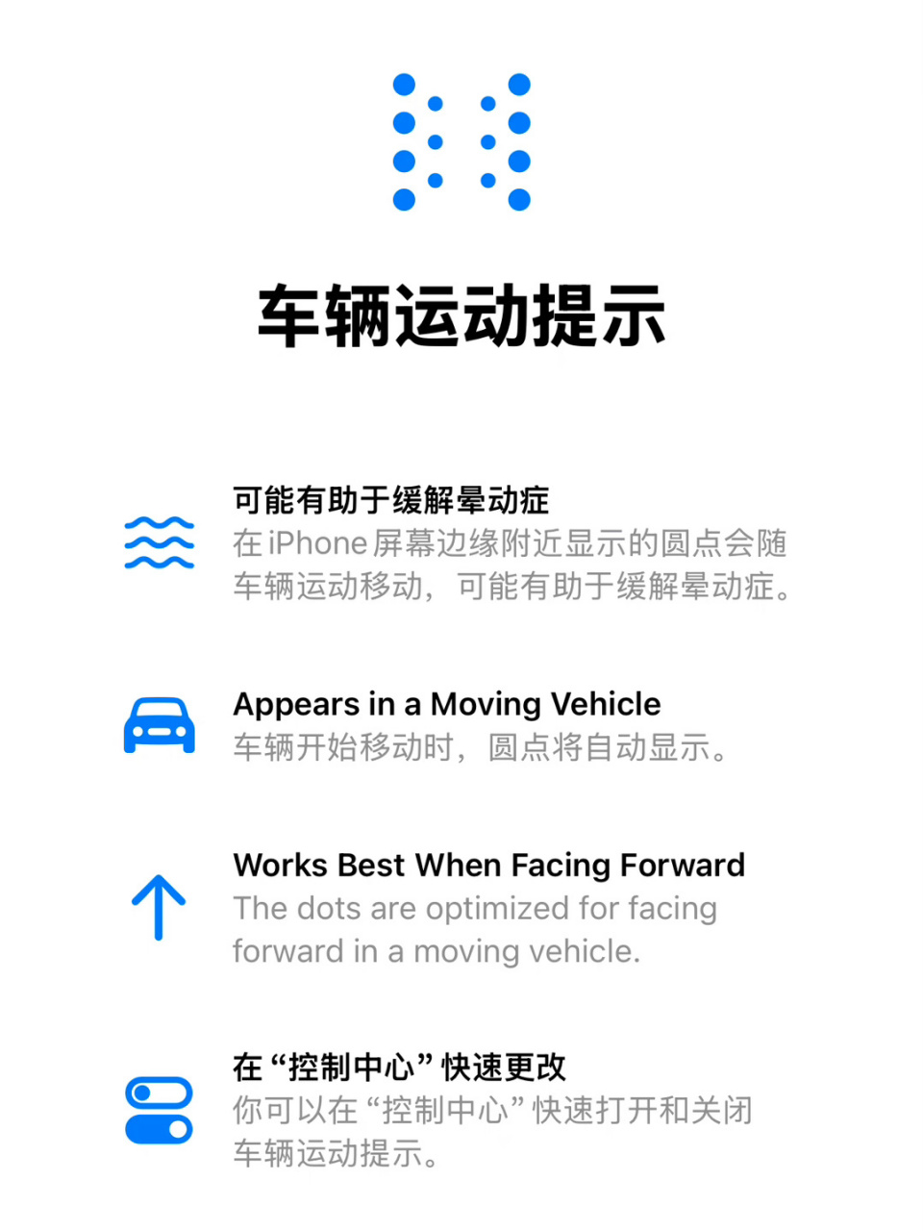
C
人与社会：
Apple’s new design to deal with motion sickness

Slide 12
Introduce the topic
28. Which type of people can be interested in Vehicle Motion Cues? A. Frequent travelers. B. Book lovers. C. Vehicle operators. D. Sport scientists. 29. What is paragraph 2 mainly about? A. The principle of Apple's new design. B. The cause of motion sickness. C. The functions of Apple's new design. D. The symptoms of motion sickness.
30. By displaying animated dots around the screen, Apple's Vehicle Motion Cues is able to A. ease sensory conflicts in the brain B. tell the mismatched physical sensations C. balance the movement of our eyes and body D. increase the effectiveness of vehicle motion 31. Which can be the best title of the passage? A. Make the Most of Your Journey: Apple Bridges the Gap B. Find the Magic of a Moving Vehicle: Apple's Got Your Back C. Enjoy Your Reading: Apple Offers a Revolutionary Solution D. Say Goodbye to Motion Sickness: Apple Introduces Its New Design
For many, travel isn't just about the destination-it's about making the most of the journey. However, for a lot of people, the journey is often ruined by an uncomfortable experience often accompanied by vomiting, known as motion sickness. If you've ever felt the unwelcome urge to vomit while reading or using your device in a moving vehicle, you're not alone. Recognizing this common issue, Apple has stepped up to offer a revolutionary solution: the Vehicle Motion Cues feature for iPhones and iPads.
Motion sickness occurs when there is a disconnect between what your eyes see and what your body feels. When you're in a moving vehicle, your body senses motion through its vestibular system(the inner ear),but if your eyes are focused on a still screen that doesn't reflect this movement, the brain receives mixed signals. This sensory conflict can lead to dizziness, nausea, and overall discomfort-symptoms all too familiar to motion sickness sufferers.
Apple's new Vehicle Motion Cues feature is designed to bridge this gap and bring relief to those likely to experience motion sickness. This revolutionary feature works by displaying animated dots, around the edges of your screen, which move at the same time and speed as the motion of your vehicle. These moving cues help keep the motion your body feels in line with what your eyes see, effectively reducing the sensory mismatch that causes motion sickness.
The magic lies in the simplicity and effectiveness. The animated dots move inconsistency with the vehicle's motion, providing a visual representation of the movement your body is experiencing. By matching the visual input with the physical sensations of motion, your brain is less likely to experience the confusion that leads to sickness.
Early reports and user feedback indicate that Vehicle Motion Cues is receiving high praise for its effectiveness. So next time you embark on a journey, whether short or long, remember that Apple's got your back -or rather, your brain-helping you make the most of every mile with ease and comfort.
C
The cause of motion sickness
The principle of Apple's new design
The functions of Apple's new design.
The influence/ conclusion
介绍了苹果针对晕车推出的新功能

Slide 13
文本再现
1. If you‘ve ever felt__________________(令人讨厌的冲动) to vomit while reading or using your device in a moving vehicle, you're not alone. _____________(recognize) this common issue, Apple has stepped up to offer a revolutionary solution.
2. Apple’s new Vehicle Motion Cues feature is designed to __________(缩小) this gap and bring relief to (=________) those likely to experience motion sickness.
-This revolutionary feature ______(work) by displaying animated dots
3. These moving cues help keep the motion your body feels in line with _______your eyes see, effectively __________(reduce) the sensory mismatch _______ causes motion sickness.
4. The magic lies in the __________(simple) and ____________(effective). The animated dots move in consistency with the vehicle's motion, ___________(provide) a visual _____________(represent) of the movement your body is experiencing.
5. So next time you _____________(开始) a journey, whether short or long, remember that Apple‘s got your back - __________(更确切地说), your brain-helping you _______________ (充分利用) every mile with ease and comfort.
the unwelcome urge
Recognizing
realizing/ Aware of
站出来，挺身而出
功能
bridge
relieve
works
what
reducing
that
simplicity
effectiveness
providing
representation
She stepped back from the door expectantly.
I'll be back as soon as I can.
It expected services to get slowly back to normal.
They wrote back to me and told me I didn't have to do it.
Her son was lying peacefully on his back.
He opened the back door.
He backed his car out of the drive(车道).
It has found a new witness to back his claim that he is a victim
embark on
or rather
make the most of
=back up

Slide 14


D
人与社会：
AI’s limitation of not helping language understanding and cultural competency fostering

Slide 15
P1：lead in ：作者用AI制作中文视频引入
表达了对AI在语言翻译中的角色的思考
A few days ago, I watched a video of myself talking in perfect Chinese. I've been studying the language on and off for only a few years, and I'm far from fluent. But there I was, pronouncing each character just as a native speaker would. “My favorite food issushi,” I said-wo zui xihuan de shiwu shi shousi.
I'd created the video using software from a Los Angeles-based artificial-intelligence start-up called HeyGen. The technology, which only needs a single selfie and a script to generate deepfake videos of real people ＂saying” almost anything， is a testament（证明）to the advancements in AI language tools. This got me thinking about the declining interest in language learning with fewer students enrolling in foreign language courses and the decrease of English proficiency among young people in some places.
AI translation, integrated into social media and messaging platforms, seems to be everywhere. Even language-learning apps are using AI-generated content in their marketing. However, language translation is an art rather than a science. Something enormous will be lost in exchange for that convenience. As Anne, a Chinese translator said, “Building a ladder between widely different languages, such as Chinese and English, is sometimes as difficult as a doctor building a bridge in a patient‘s heart.”
Language learning fosters cultural competency, a skill that AI cannot simply copy. Learning a different way to speak, read, and write helps people discover new ways to see the world. No machine can replace such a profoundly human experience. Deborah Cohn, a language professor, emphasizes that language learning is actually about understanding and connecting with different cultures. Instead of abandoning language courses in favor of AI, some educators advocate for emphasizing the intercultural aspects of language learning. Paula Krebs of the MLA points out that even with a “universal translator”, sometimes, the greater meaning of people’s utterance（言辞）remains a mystery.
In essence, while AI language tools offer convenience, they lack the depth and cultural insight that comes from human language learning. The challenge and beauty of learning a language are in understanding the cultural tapestry（织锦）that weaves through words, something AI has yet to achieve.
D
32.Why does the author give the example in paragraph 1? A. To promote the language software. B. To show off his Chinese language skills. C. To prove learning a language is a wasted effort. D. To encourage critical thinking about AI language tools. 33. What can we learn from paragraph 3? A. AI translation deserves more attention. B. Language apps play a key role in marketing. C. Language translation is far beyond technology. D. Learning a different language is an uphill battle. 34. What is the key benefit of learning a language according to the passage? A. Better digital literacy. B. Improved translation skills. C. Deeper cultural confidence. D. Effective intercultural interaction. 35.What does the author imply in the last paragraph? A.AI language tools offer convenience. B.AI facilitates language learning in terms of culture. C. AI is far from perfect in helping language understanding. D. AI has achieved success in the development of language learning tools.
p1导入话题+ p2 总起句引发思考
P3：语言翻译不是技术
P4：语言学习培养文化素养
P5：结论：AI提供了便利，但无法替代。

Slide 16
文本再现
have been studying
1. I __________________(study) the language on and off for only a few years.
2.The technology, which only needs a single selfie and a script ____________( generate) deepfake videos of real people “saying” almost anything, ______(be) a testament(证明)
to the _______________(advance) in AI language tools.
3. This got me thinking about the declining interest in language learning with fewer students _________ (enroll) in foreign language' courses and the decrease of English proficiency among young people in some places.
4. AI translation,_________(integrate) into social media and messaging platforms, seems to be everywhere.
5.Language learning fosters cultural competency, ___ skill that AI cannot simply copy.
6. In essence, ______AI language tools offer convenience, they lack the ______(deep) and cultural insight that comes from human language learning .
to generate
is
advancements
enrolling
sign up for/ register for
integrated
a
while
depth
depth height width length

Slide 17
文本词汇拓展
from
beyond
far _____ fluent/ perfect → far _______ technology
the ________ interest → the _________ of English proficiency
English _________(熟练/能力) → cultural ___________(能力)
______(培养)cultural competency→ __________(促进)language learning
in ________of → ________ for
in ________ of
in _________
in ________ of
inter-前缀
远非
远超
decrease
declining
下降
不断下降的
proficiency
competency
foster
facilitate
favor
支持
advocate
倡导
exchange
交换
essence
事实上
skin care essence; essential/ crucial
terms
就…而言
intercultural
interaction
interview/ intermedia/ international/ interchange/ interconnection/ interdependence/ intercompany/ interdisciplinary/ interpersonal

Slide 18
阅读总结：如何快速定位主旨题？
Step1关键词锁定；Step2 文本大意概括
 | main content | 主旨题
A | 2024年4部最新创作的4部电影以及它们的特色。
B | 介绍Amy Stewart 的新书The Tree Collectors : Tales of Arboreal Obsession, 通过讲述不同人对于树的热爱来说明一个共同的话题，即树能链接人和人，包括人和祖先，家人，甚至是陌生人。 | 27. What does the writer think of the book? | A. Complicated B. Conventional. C. Inspiring D. Intense.
C | 介绍苹果针对晕车推出的新功能。该功能通过在手机屏幕侧边加入与车辆震动频率相似的 动画点，有效减缓因为眼视与体感不统一导致的晕车。该功能推出后，大受好评。 | 31. Which can be the best title of the passage? | A. Make the Most of Your Journey: Apple Bridges the Gap B. Find the Magic of a Moving Vehicle: Apple's Got Your Back C. Enjoy Your Reading: Apple Offers a Revolutionary Solution D. Say Goodbye to Motion Sickness: Apple Introduces Its New Design
D | 以作者用AI制作中文视频引入，表达作者对AI在语言翻译中的角色的思考——虽然AI为翻译提供了便利，但无法替代语言学习中文化素养的培养。 | 32.Why does the author give the example in Para.1? | A. To promote the language software. B. To show off his Chinese language skills. C. To prove learning a language is a wasted effort. D. To encourage critical thinking about AI language tools.

Slide 19
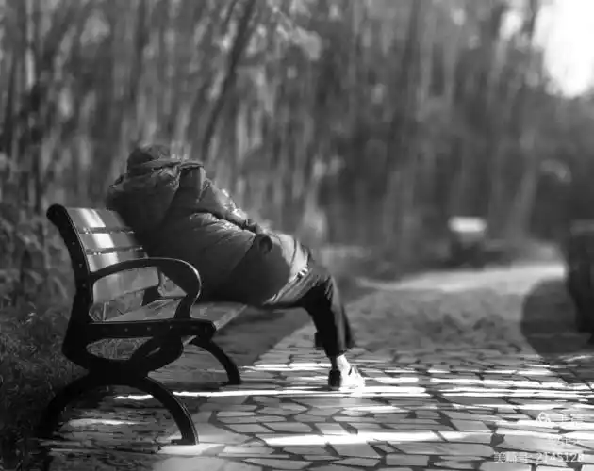
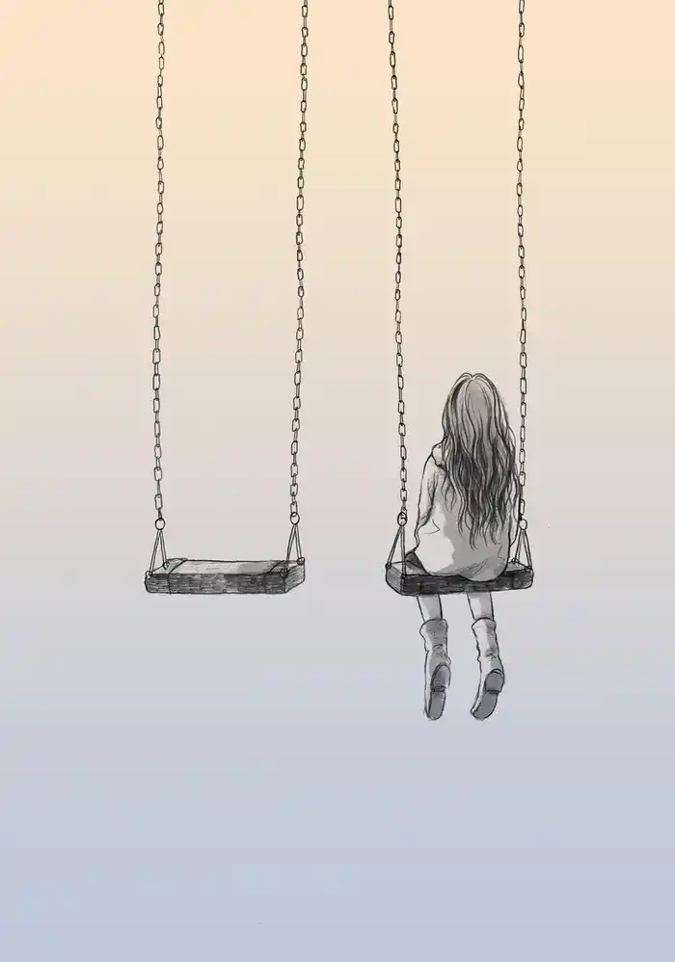
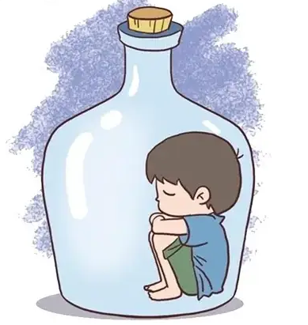
七选五
人与自我：
An introduction on loneliness and the ways to overcome it

Slide 20
How Loneliness Is Killing Us
Loneliness is absolutely an epidemic(流行病) in our society, but it's been growing for decades. Loneliness is the sense that “I am less connected to other people than I want to be.” 36______. And that makes it different from isolation( 独处). I can deliberately isolate myself and feel great about that, but only you can tell if you’re lonely.
37_______. In some studies, as many as 60% of people will say that they feel lonely much of the time. Young adults aged 16 to 24 are the loneliest age group.
There are many factors that are responsible for that. Loneliness was on the rise from the 1950s in part because of the rise of private cars. We’ve become a much more mobile society where the networks of family and friends get loose as people move for jobs and other kinds of opportunities like education.
38_______. But then it tears us away from the communities we are bom into and spend much of our lives creating. When television came into the American home, there was more of a decline in investing in our communities. And that was made worse as the digital revolution gave us more and more screens to look at.
Research finds loneliness is dangerous to our health. 39 ____________. In addition, people who are lonely in late life have more rapid brain decline.
The choice we can make to keep us on a good path of well-being is to invest in our relationships with other people. 40___________You belong. You matter. You're connected.
7选5
definition
situation
causes
effect
advice

Slide 21
A. It’s a very subjective experience.
B. All of that is good on the one hand.
C. You may feel lost and may have low confidence..
D. Stress coming from loneliness causes physical breakdown.
E. Since the 1950s, people have been less and less invested in other people.
F. People go to faraway colleges and only get in touch with families on screen.
G. A good way is to find an activity around other people where you are comfortable.

Slide 22
How Loneliness Is Killing Us
Loneliness is absolutely an epidemic(流行病) in our society, but it's been growing for decades. Loneliness is the sense that “I am less connected to other people than I want to be.” 36______. And that makes it different from isolation( 独处). I can deliberately isolate myself and feel great about that, but only you can tell if you’re lonely.
代词 36A 词汇主题 subjective experience主观经验
A. It’s a very subjective experience.
B. All of that is good on the one hand.
C. You may feel lost and may have low confidence.
D. Stress coming from loneliness causes physical breakdown.
E. Since the 1950s, people have been less and less invested in other people.
F. People go to faraway colleges and only get in touch with families on screen.
G. A good way is to find an activity around other people where you are comfortable.

Slide 23
主旨（观点） 37E 例证
37_______. In some studies, as many as 60% of people will say that they feel lonely much of the time. Young adults aged 16 to 24 are the loneliest age group.
There are many factors that are responsible for that. Loneliness was on the rise from the 1950s in part because of the rise of private cars. We’ve become a much more mobile society where the networks of family and friends get loose as people move for jobs and other kinds of opportunities like education.
A. It’s a very subjective experience.
B. All of that is good on the one hand.
C. You may feel lost and may have low confidence.
D. Stress coming from loneliness causes physical breakdown.
E. Since the 1950s, people have been less and less invested in other people.
F. People go to faraway colleges and only get in touch with families on screen.
G. A good way is to find an activity around other people where you are comfortable.

Slide 24
advantages
承上 代词 38B 转折
disadvantages
38_______. But then it tears us away from the communities we are born into and spend much of our lives creating. When television came into the American home, there was more of a decline in investing in our communities. And that was made worse as the digital revolution gave us more and more screens to look at.
A. It’s a very subjective experience.
B. All of that is good on the one hand.
C. You may feel lost and may have low confidence.
D. Stress coming from loneliness causes physical breakdown.
E. Since the 1950s, people have been less and less invested in other people.
F. People go to faraway colleges and only get in touch with families on screen.
G. A good way is to find an activity around other people where you are comfortable.

Slide 25
总分（论点1） 39 D 并列 +词汇转换
Research finds loneliness is dangerous to our health. 39 ____________. In addition, people who are lonely in late life have more rapid brain decline.
The choice we can make to keep us on a good path of well-being is to invest in our relationships with other people. 40___________You belong. You matter. You're connected.
并列 40 G 词汇主题语境
A. It’s a very subjective experience.
B. All of that is good on the one hand.
C. You may feel lost and may have low confidence.
D. Stress coming from loneliness causes physical breakdown.
E. Since the 1950s, people have been less and less invested in other people.
F. People go to faraway colleges and only get in touch with families on screen.
G. A good way is to find an activity around other people where you are comfortable.

Slide 26
好词好句整理
呈上升趋势
部分地
关系疏远
使…远离
出生于…
更多的是下降
除了
大脑快速衰退
主观体验
一方面……另一方面
缺乏自信
身体崩溃
与…取得联系
你有归属,你很重要,你是与他人相联的。
on the rise = growing
in part
get loose
tear away from
be born into
more of a decline in
in addition
rapid brain decline
subjective experience
on the one hand…on the other hand
have low confidence
physical breakdown
get in touch with
You belong. You matter. You’re connected.

Slide 27
完型填空
人与社会：
Call on people to be a corner person and be connected in the community

Slide 28
完型
扫清选项词汇障碍
41. A. turned off B. pulled into C. checked out D. zoomed past
42. A. welcome B. doubt C. review D. invent
43. A. imaginations B. sales C. connections D. responsibilities
44. A. Friends B. Hosts C. Relatives D. Neighbors
45. A. even B. never C. always D. sometimes
46. A. labeled B. delivered C. finished D. diversified
47. A. acts B. jokes C. pictures D. conversations
48. A. job B. story C. project D. experiment
49. A. warming B. sign C. suggestion D. poster
50. A. laugh B. estimate C. quarrel D. complain
51. A. shop B. holiday C. car D. back
52. A. morning B. afternoon C. darkness D. daylight
53. A. joy B. generosity C. colors D. decorations
54. A. paints B. remembers C. considers D. illustrates
55. A. desire B. vote C. need D. volunteer
到达，驶入
飞驰而过
贴标签
使……多样化
估计；判断，评价
抱怨
慷慨，大方
阐明；举例说明；给……加插图
投票

Slide 29
完型
利用词汇衔接（复现、同现）助力解题
“You’re a corner person? I’m a corner person, too!” My friend said with a grin as he 41 pulled into my corner-house driveway. While many people avoid corner lots, I actually 42 welcome the idea of a corner house.
You can enrich the lives of neighbors and passers-by by creating 43 connections. Over the years, I've grown many different herbs (香草), in pots and containers at the edge of my driveway. 44 Neighbors walk by and stop to take a few for their dinner plans, and later they may 45 even give me a serving of the 46 finished product. The herb idea has led to many 47coversations as well as Christmas gifts.
I also began a newspaper 48 project out the front years ago. After reading the papers myself, I put them out on a little table with a(n) 49 sign, “Help yourself to a newspaper.” Many come for the papers. I've even heard people 50 estimate at what time my papers will be out on the table.
Every Christmas evening, my “corner person” friend would create a magical 51 holiday
window in his neighborhood, which includes a slide show of the season’s favorite music videos. As people walk by his corner in the 52 darkness, their lives are brightened by this creative display of 53 joy.
Cities can bring people together, and the corner lot person 54 illustrates this beautifully. Do you now 55 desire to be a corner person? Let's meet at my corner to discuss further!
avoid – while转折– welcome
and – even 递进
Christmas Evening – holiday window – in the darkness – lives are brightened by joy

Slide 30
文本词汇整理
“pull in/into”
If a vehicle pulls in or pulls into somewhere, it moves in that direction and stops there. （车辆）驶进，驶向
“pull up”
When a car or sb driving a car pulls up, the driver stops the car, often for a short time. （车）停下；（某人）把车停下
“zoom past”
To zoom means to move very quickly
“check in /check out ”
登记入住/退房
Practice:
1. I pulled ______the empty parking space. 我把车开进了空车位。
2. A car pulled ____ outside my house. 一辆轿车在我家门外停了下来。
3. They got into the car and zoomed off.
4. In the last few meters of the race, she suddenly zoomed ahead.
5. They said the operation had been successful and they expected his wife to pull through.
6. He'd never have managed on his own, but his colleagues have pulled him through.
into
up
飞驰而去
飞速前进
渡过困境
帮助某人度过难关

Slide 31
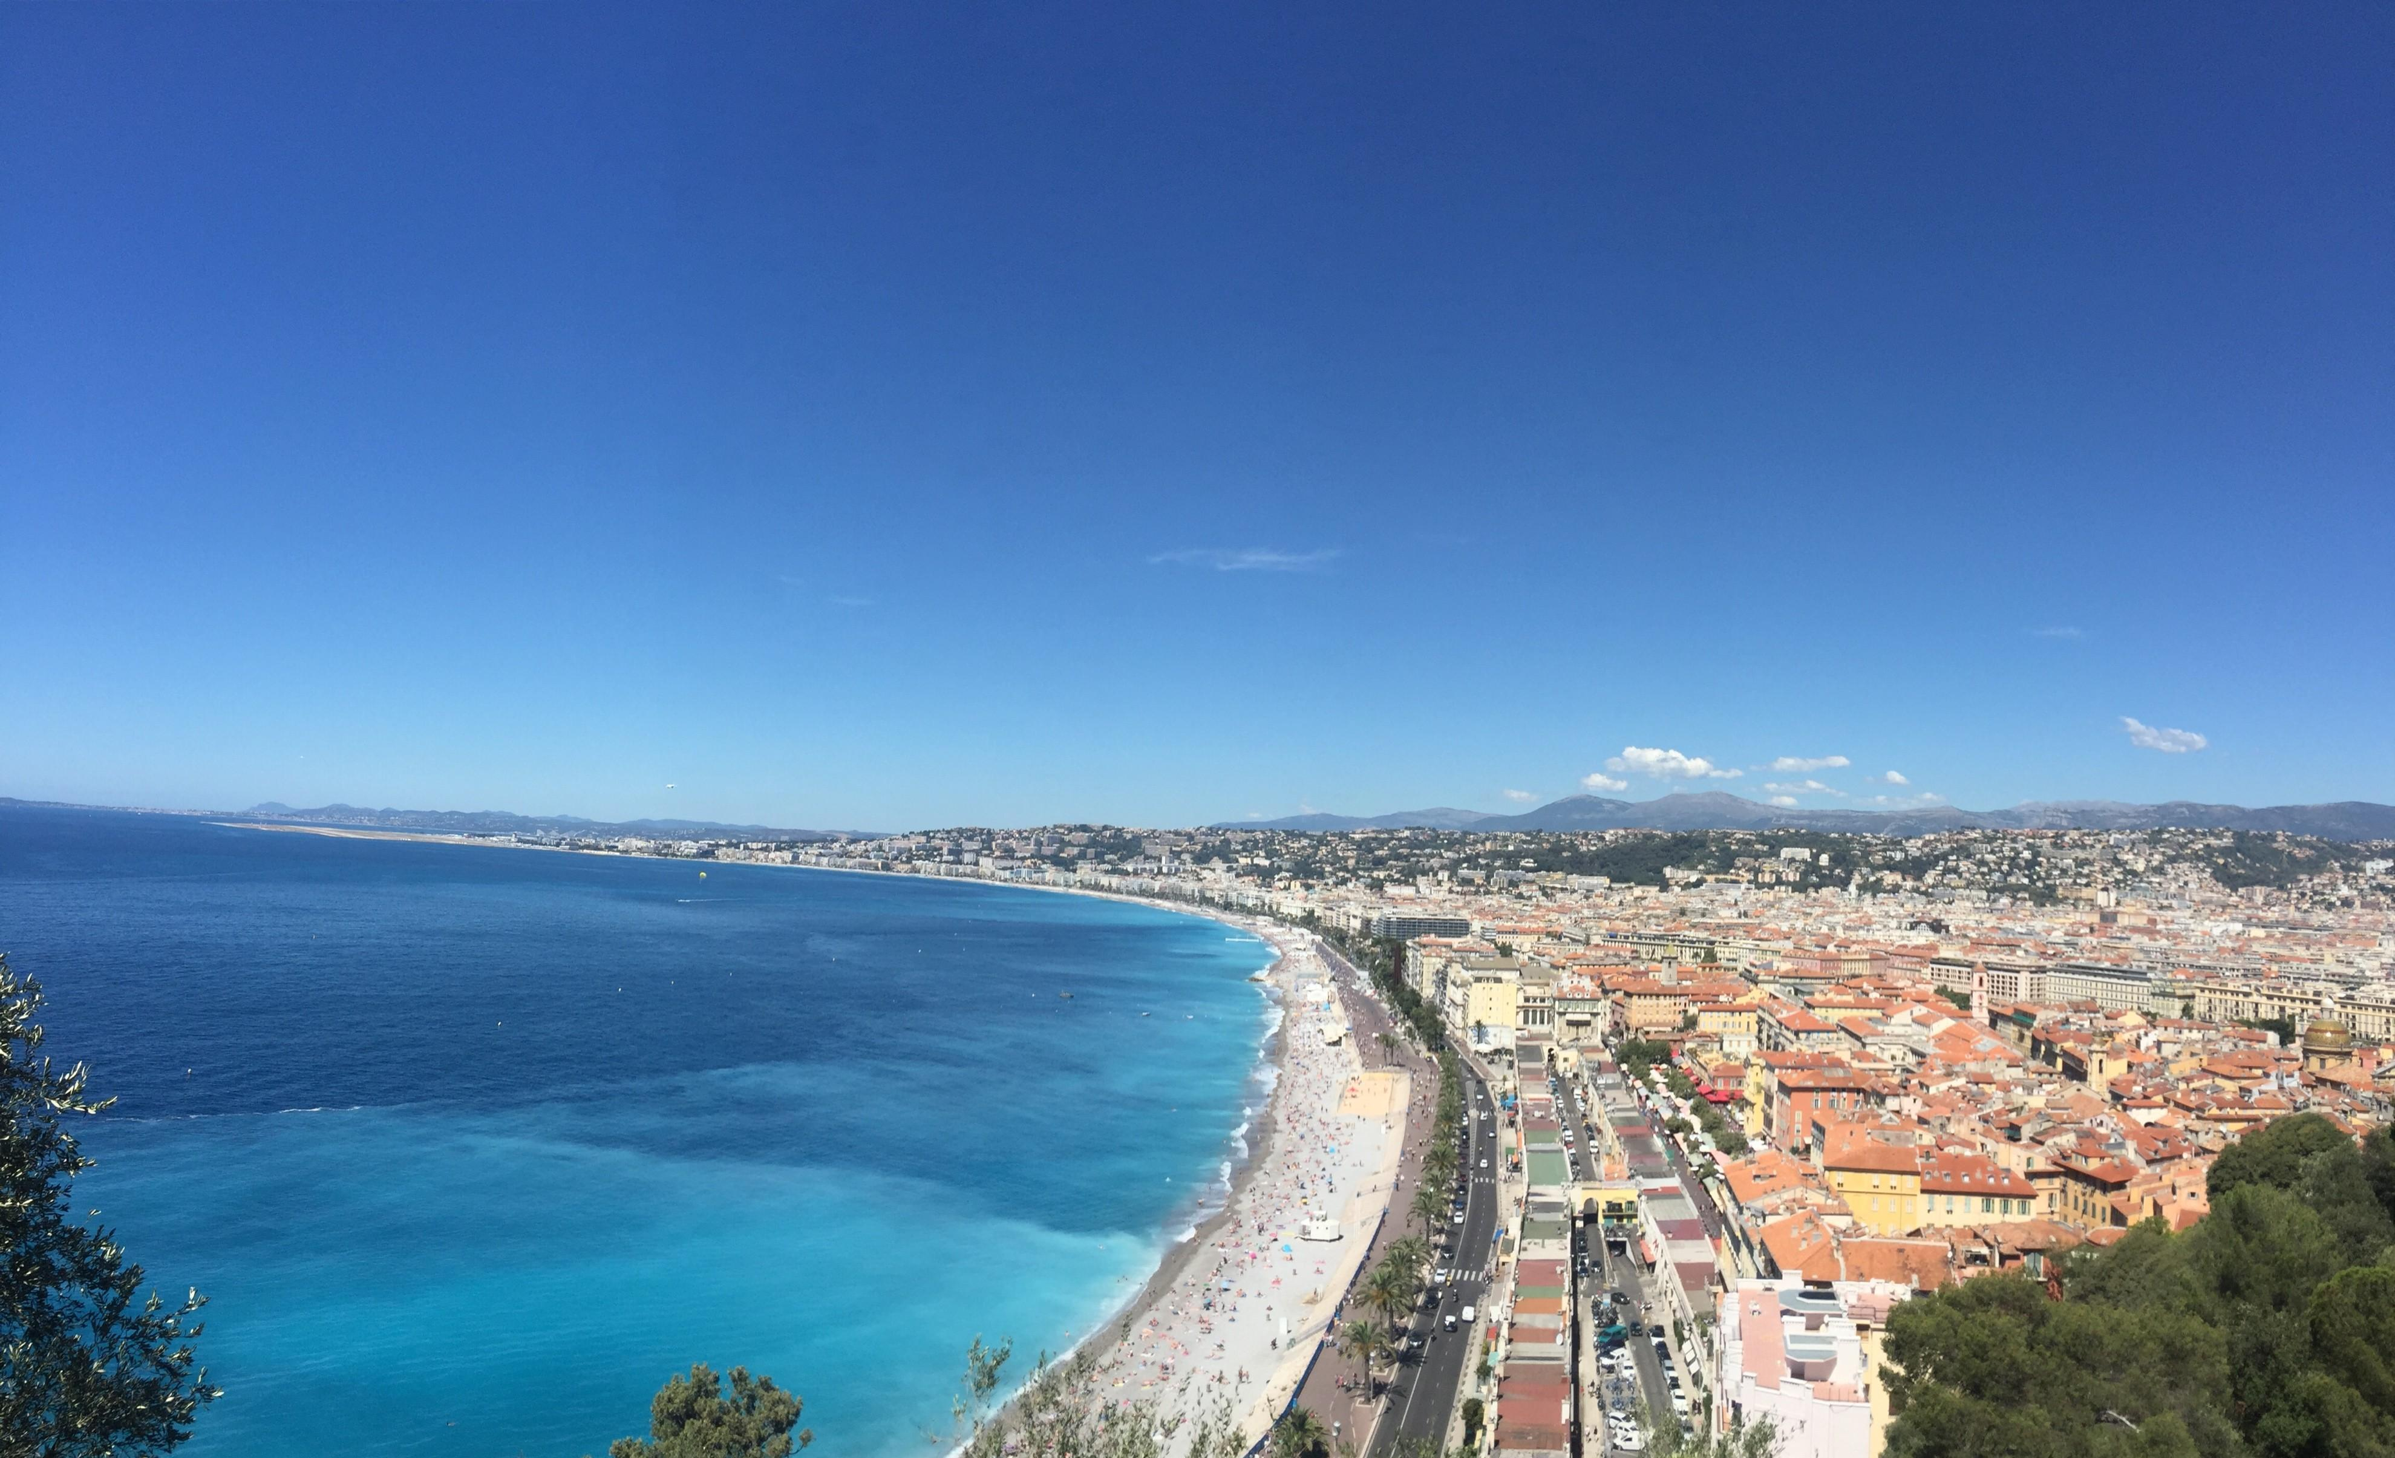
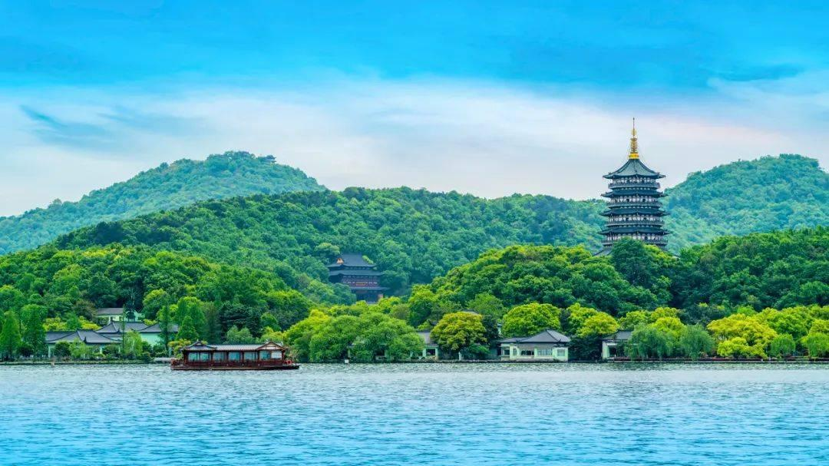
语法填空
人与社会：
the deep bond between Nice, France and Hangzhou, China as sister cities

Slide 32
“Nice” to Meet You, Hangzhou
Nice, France and Hangzhou, China have been developing a unique bond since their official declaration 56________sister cities in 1998, connecting the two vibrant cultures separated by 9,300 kilometers through numerous 57___________ ( initiative) . To Rudy Salles, deputy chairman of the Nice Tourist Office, the sister-city relationship between the two is a perfect match.
Having visited Hangzhou several times, Salles describes it as “a very well- organized and 58___________ ( welcome) city”. He recalls a Nice food festival at the Dragon Hotel Hangzhou, where traditional food, such as salade nicoise 一59____________ ( make) from tomatoes, hard-boiled eggs and olives and dressed with olive oil, and pan Bagnet, 60_________ sandwich made from whole wheat bread enclosing the classic salade nicoise, was served.
The cultural exchange between the two cities reached a new 61 ________( high) in 2017 when Hangzhou Opera and Dance Drama Theater 62 _________( stage) the show To Meet the Grand Canal in Nice, at the invitation of the Nice government. In addition to the formal show, Chinese performers organized flash events on the streets of Nice 63_________ ( engage) more people.
In 2014 the Grand Canal was listed as a UNESCO World Heritage Site. At the news, the Nice government approached Hangzhou, keen to learn from its experience, as Nice was seeking a similar status. In 2021, UNESCO added the city of Nice to its World Heritage List. '“Our candidacy for UNESCO 64 ________( support) by China, for 65 ________we are so grateful, ”says Salles. .
语法
as
介词
initiatives
可数名词复数
缺形容词，区分welcome词义
welcoming
=(which is) made
made
a
同位语；可数名词单数
缺名词，注意错误书写hight
height
staged
谓语动词：时态、语态、主谓一致
to engage
表示目的
谓语动词：时态、语态、主谓一致
was supported
定语从句，be grateful for…/ 易错答案：what
which

Slide 33
文本词汇细查
“engage”
to engage more people
A. engage sth: to succeed in attracting and keeping sb's attention and interest
B. engage sb (as sth/ to do sth): to employ sb to do a partioular job
C. engage with sth/sb: to become involved with and try to understand sth/sb
B
1. She has the ability to engage with young minds. ______
2. He is currently engaged as a consultant. ______
3. It is a movie that engages both the mind and the eye. ______
4. get engaged in = get involved in = participate in
C
A
“welcome” vs “welcoming”
welcoming
1. She gave everyone a _____________(welcome) smile.
2. The holiday was a__________( welcome) change/break/relief.
welcome
“candidate” → n. candidacy: refers to the fact of being a candidate in an election
Candidates
1. ___________ must write their names on the top page of the exam paper.
2. She is expected to announce officially her __________for president early next week.
candidacy

Slide 34
文本词汇整理
建立独特的联系
正式宣布为姊妹城市
众多倡议
完美匹配
这是一个组织良好、热情好客的城市
达到新的高度
应政府的邀请
寻求类似的地位
把这个城市列入世界遗产名录
策划/组织/启动演出
我们的联合国教科文组织候选资格
develop a unique bond
official declaration as sister cities
numerous initiatives
a perfect match
a very well-organized and welcoming city
reach a new height
at the invitation of government
seek a similar status
add the city to its World Heritage List
stage/organize/launch the show
our candidacy for UNESCO
courage – encourage
danger – endanger
rich – enrich
able – enable
sure – ensure
short – shorten
strength – strengthen
broad – broaden
wide – widen
light – ?
en-前缀、-en后缀
文中enclose/ enslave
enlighten

Slide 35
“Nice” to Meet You, Hangzhou
Nice, France and Hangzhou, China have been developing 1. ______ unique bond since their official 2. ___________(declare) as sister cities in 1998, 3. ___________(connect) the two vibrant cultures separated by 9,300 kilometers through numerous initiatives. To Rudy Salles, deputy chairman of the Nice Tourist Office, the sister-city relationship between the two is a perfect match.
4. ____________(visit) Hangzhou several times, Salles describes it as “a very well-organized and welcoming city”. He recalls a Nice food festival at the Dragon Hotel Hangzhou, 5.______ traditional food, such as salade nicoise –made from tomatoes, hard-boiled eggs and olives and dressed with olive oil, and pan Bagnet, a sandwich made from whole wheat bread enclosing the classic salade nicoise, 6.______________(serve).
The cultural exchange between the two cities reached a new height in 2017 when Hangzhou Opera and Dance Drama Theater staged the show To Meet the Grand Canal in Nice, at the invitation of the Nice government. In addition to the formal show, Chinese 7. __________(perform) organized flash events on the streets of Nice to engage more people.
In 2014 the Grand Canal was listed as a UNESCO World Heritage Site. At the news, the Nice government approached Hangzhou, keen to learn from its experience, as Nice was seeking a similar status. In 2021, UNESCO added the city of Nice 8.____ its World Heritage List. “Our candidacy for UNESCO was supported by China, for which we are so grateful, ”says Salles. .
文本再填空
a
declaration
connecting
Having visited
where
was served
performers
to

Slide 36
文本再填空
“Nice” to Meet You, Hangzhou
Nice, France and Hangzhou, China 1. _______________________(develop) a unique bond since their official declaration as sister cities in 1998, connecting the two vibrant cultures 2.________ (separate) by 9,300 kilometers through numerous initiatives. To Rudy Salles, deputy chairman of the Nice Tourist Office, the sister-city relationship between the two is a perfect match.
Having visited Hangzhou several times, Salles describes it 3. ______“a very well-organized and welcoming city”. He recalls a Nice food festival at the Dragon Hotel Hangzhou, where traditional food, such as salade nicoise –made from tomatoes, hard-boiled eggs and olives and dressed with olive oil, 4._______ pan Bagnet, a sandwich made from whole wheat bread enclosing the classic salade nicoise, was served.
The cultural exchange between the two cities reached a new height in 2017 5. ______ Hangzhou Opera and Dance Drama Theater staged the show To Meet the Grand Canal in Nice, at the invitation of the Nice government. In addition to the formal show, Chinese performers organized flash events on the streets of Nice to engage more people.
In 2014 the Grand Canal 6.____________(list) as a UNESCO World Heritage Site. 7.______ the news, the Nice government approached Hangzhou, keen to learn from its experience, 8._________________ Nice was seeking a similar status. In 2021, UNESCO added the city of Nice to its World Heritage List. “Our candidacy for UNESCO was supported by China, 9._____ which we are so grateful, ”says Salles.
have been developing/ have developed
separated
as
and
when
was listed
At
as/ since/ because
for

