Slide 1


感恩遇见，相互成就，本课件资料仅供您个人参考、教学使用，严禁自行在网络传播，违者依知识产权法追究法律责任。
更多教学资源请关注
公众号：溯恩英语
知识产权声明

Slide 2
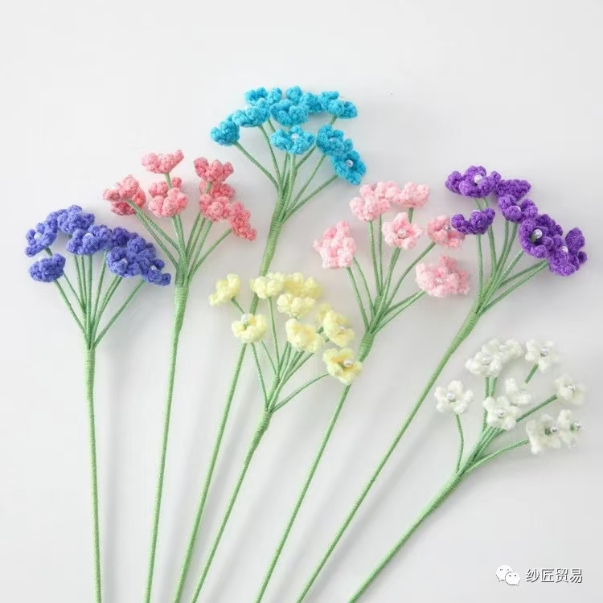
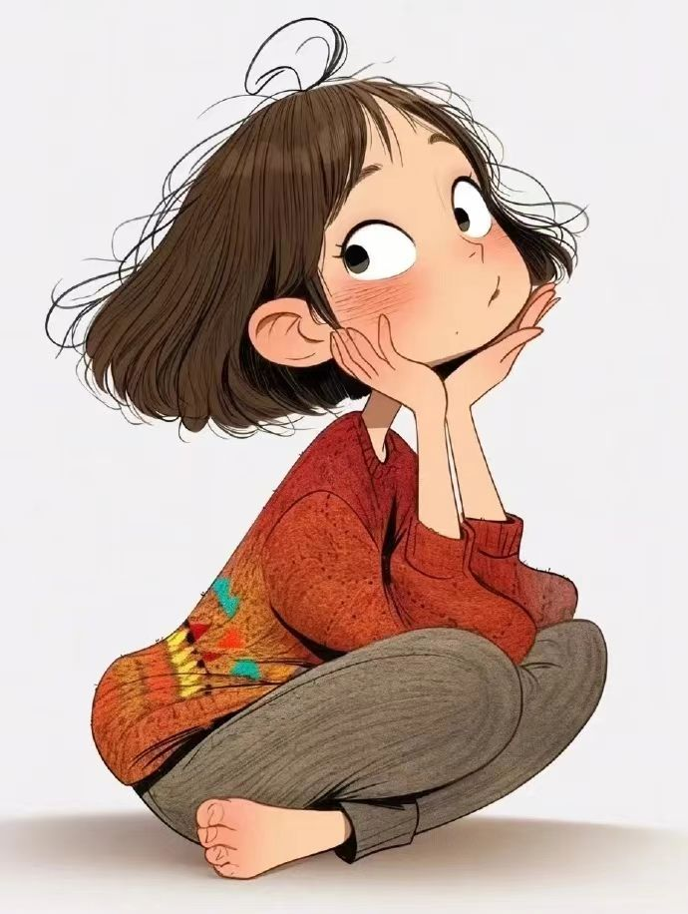
九省联考2025
届高三10月联
考读后续写
Continuation Writing
小围巾，大之爱
文本解构与写作训练
礼泉教育局教研室 高小聪

Slide 3
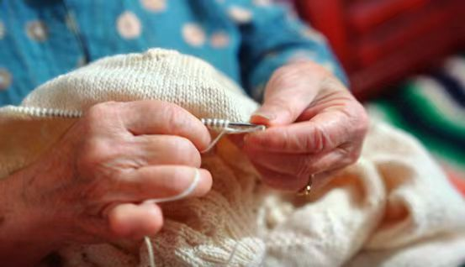
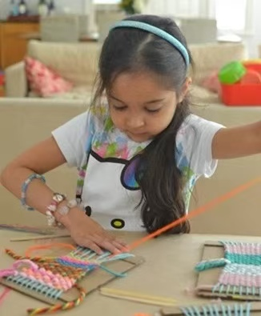
Lead-in
1. What do you often
do in your spare time?
2. What are they doing
in the pictures?
3. How do you find the items knitted with love by your mother?

Slide 4
Present the writing task
第二节（满分25分）
阅读下面材料，根据其内容和所给段落开头语续写两段，使之构成一篇完整的短文。
P1. Emma comes from a remote village surrounded by mountains. Unlike her trendy classmates in New York who are addicted to such high- tech things as smartphones and social media, she prefers knitting(编织).
P2. Emma's love for the traditional skill is deeply influenced by her mother, who can create all kinds of beautiful things with a pair of simple needles. Whenever she is free, she will sit down and start knitting all kinds of things for her children and neighbors. Whether it is a mini bag or a scarf, each item is a unique gift full of love and warmth. And they are deeply loved by the receivers.
P3. Her mother's passion for knitting and generous spirit of helping others have inspired Emma to follow in her footsteps and she has taken up knitting as a hobby, too. By the age of 14, Emma has become especially good at making scarves and gloves. With beauty and practicality, Emma's hand- made gifts never fail to impress her friends as well as her relatives.

Slide 5
Present the writing task
P4. Last week, the city was hit by a heavy snowstorm, which left many, particularly the homeless, in a desperate situation. As Emma made her way to school, she noticed a man shaking under the bridge near her school. It was a homeless man she often saw on the route. But today he looked particularly miserable. His face was half -hidden under a piece of worn cloth that hardly served as protection against the cold. Touched by the sight, Emma approached the man and presented her scarf to the homeless man.
P5. "For me, Miss?" asked the man in surprise. "It is too expensive!"
P6. "Please don't mind it. I have made it for myself and I can make another one in a few days!" Emma replied while she was wrapping the scarf around the poor man's neck. "I hope it might keep you away from the terrible cold."
注意：1．续写词数应为150个左右；
2．请按如下格式在答题卡的相应位置作答。
P1. Instantly, the man's eyes brightened and a big smile appeared on his face.
___________________________________________________________________
P2. Emma shared the idea of setting up a knitting club with some of her "high- tech" classmates.___________________________________________________________________________________________________________________________

Slide 6
Analyse the three elements of the story
Emma: simple, traditional, unique
Her classmates: trendy
Emma’s mother: kind, helpful, skillful in knitting
Her neighbors, her friends and relatives: grateful，appreciative
A homeless man: desperate, miserable
Characters
Social setting
Her mother's passion for knitting and generous spirit of helping others have inspired Emma to follow in her footsteps...
Settings
（P1-P3）
Small scarf
Great Love
Natural
setting
Last week, the city was hit by a heavy snowstorm, which left many, particularly the homeless, in a desperate situation.
Beginning（P4）
... on the way to school, Emma saw a homeless man trembling with cold under the bridge near the school.
Middle（P5+P6）
She wrapped the scarf around the poor man's neck.
Plot
Instantly, the man's eyes brightened and a big smile appeared on his face.
Climax
(续写第一段）
Ending
（续写第二段）
Emma shared the idea of setting up a knitting club with some of her "high- tech" classmates.

Slide 7
Predict the continuation writing
What details must be mentioned in the 1st paragraph of the continuation writing?
Para1. Instantly, the man's eyes brightened and a big smile appeared on his face.
情节协同与情感协同
Problems
Hints
Action
1. How would Emma respond to the homeless man’s emoji changes?
particularly miserable; brightened eyes; a big smile;
She prefers knitting. By the age of 14, Emma has become especially good at making scarves and gloves. With beauty and practicality, Emma's hand- made gifts never fail to impress her friends as well as her relatives.
Response
2. What would Emma do to help the homeless?
Emotion
Family spirit is passed from generation to generation: kindness, generosity, selflessness...
3. Why would she do so?

Slide 8
Predict the continuation writing
What details must be mentioned in the 2nd paragraph of the continuation writing?
Para2. Emma shared the idea of setting up a knitting club with some of her "high- tech" classmates.
情节协同与情感协同
Hints
Problems
1.Whether it is a mini bag or a scarf, each item is a unique gift full of love and warmth. And they are deeply loved by the receivers.
2. With beauty and practicality, Emma's hand- made gifts never fail to impress her friends as well as her relatives.
3.I hope it might keep you away from the terrible cold.
Action
1.How did her high-tech classmates react to Emma’s idea?
Family spirit
and skillful skills are passed from Mother to Emma.
Response
2.What did the members in the club do?
Emotion
3. What difference did they make to the homeless?

Slide 9
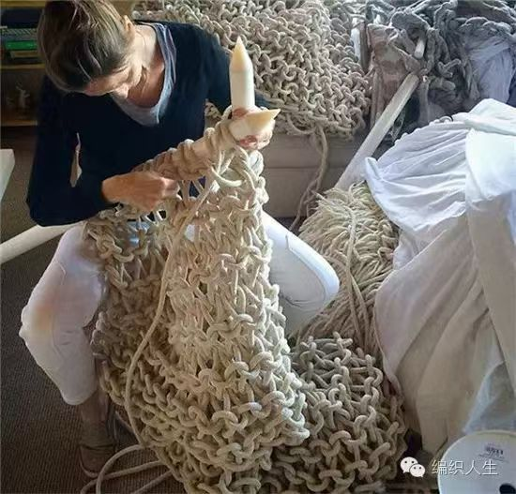
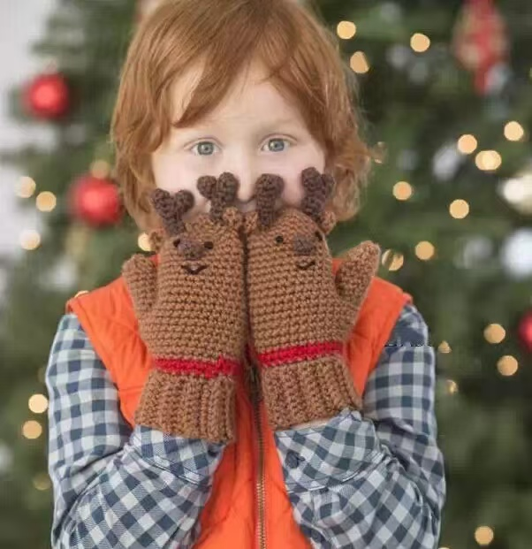
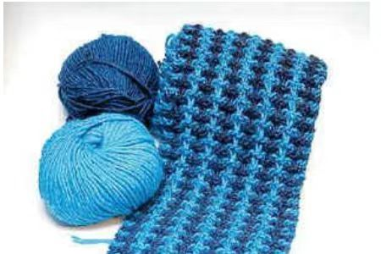
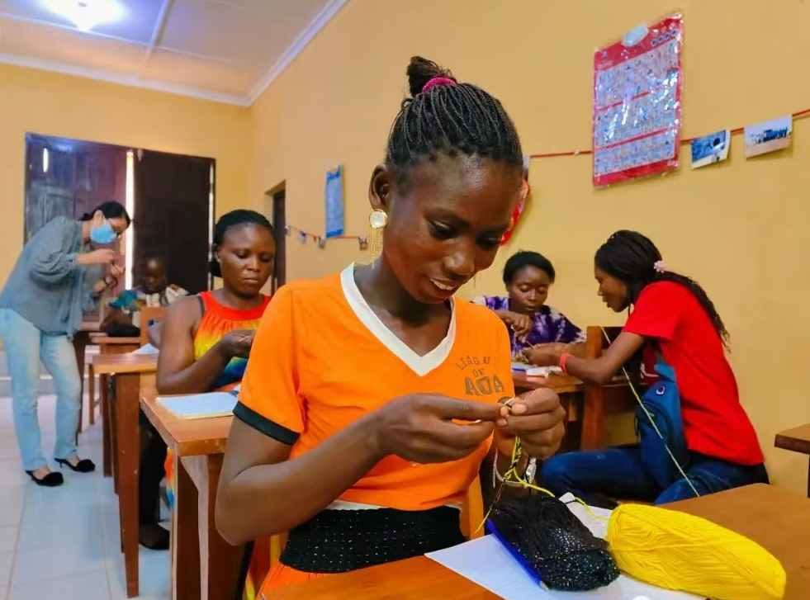
Think about the theme
Man and Self;
Man and Society
Love Loves to Love Love.
因为爱所以爱。
--- James Joyce
主题协同
Her mother’s love for knitting and generous spirit of helping others have inspired Emma to follow in her footsteps.
Small scarves and gloves made with love warm the whole winter.
Love is like a ripple, spreading from a home to those in need.

Slide 10
Appreciate the language:
情节协同；情感协同
主题协同；语言协同
✮Her mother: can create all kinds of beautiful things with a pair of simple needles.
✮Emma: a remote village
prefers knitting
Her classmates:
New York
are addicted to
high- tech things
Contrast
traditinal- man-made
trendy- high-tech
simple- beautiful
Love warmth
Emma ：approached the man and presented her scarf to the homeless man, following in her mother’s footsteps
The man:
in surprise
A homeless man：
looked particularly miserable.
Emma shared the idea of setting up a knitting club with some of her "high- tech" classmates.
(expectant, eager)
The man: his eyes brightened and a big smile appeared on his face. (excited, grateful, hopeful)
Emma: was wrapping the scarf around the poor man's neck. (generous)

Slide 11
Extend the language:
表示同情的块词：
表示爱的传递的词块：
表示感动的词块：
1.can't help crying
2.Can’t contain oneself
3.be touched to the core
4. have a lump in one's throat
5.be moved to tears
6.weep for joy
7.shed tears of gratitude
8.throw one's arms around Sb.
9.Tears welled up in his eyes.
10.A lump came to his throat.
11.His eyes moistened with tears of gratitude.
12. A warmth filled his heart.
13. He felt a deep sense of appreciation and humility（潮湿）.
1. be/feel sorry to hear/ see that...
2. have /show pity on...
3. be sympathetic to Sb.
4. sympathize with Sb.
5. She pressed my hand in sympathy.
6. His painful eyes seem to beg me to spare.
7. He stood silently, torn by sorrow and compassion, weighing what to say.
8. Seeing his condition, she immediately felt a huge sympathy for him. It was coming deep from within my heart.
1. Sometimes, a small act of kindness may be
powerful enough to make a great difference. We should pass on the kindiness.
2. It occurred to me that
a simple act could make the world so much better.
3.Although the snowstorm
still was going on outside, a warm current rose in my heart.
4. Knitting scarves and gloves is knitting love and warmth.
5. It occurred to me that a simple act could make the world so much better.

Slide 12
表示希望的语块：
表示惊讶的词块：
表示喜悦的语块：
1.A spark of hope kindled in their hearts.
2. Life bloomed with happiness and hope.
3. Hope was the star that guided them through the darkest night, a beacon that promised a brighter tomorrow.
4.In the face of despair, hope flickered like a candle, its gentle light refusing to be extinguished.
1.It gave sb. a shock/surprise when...
2. He froze, with his mouth hanging open.
3. ... jumped to one’s feet and stepped back in no time, completely at a loss.
4.Sb. gasped in astonishment as...
1. His smile bloomed like a flower.
2. A bright smile spread across one's face.
3. He was in high spirits, and felt like being on top of the world.
4. He laughed, his eyes shining / twinkling with excitement.

Slide 13
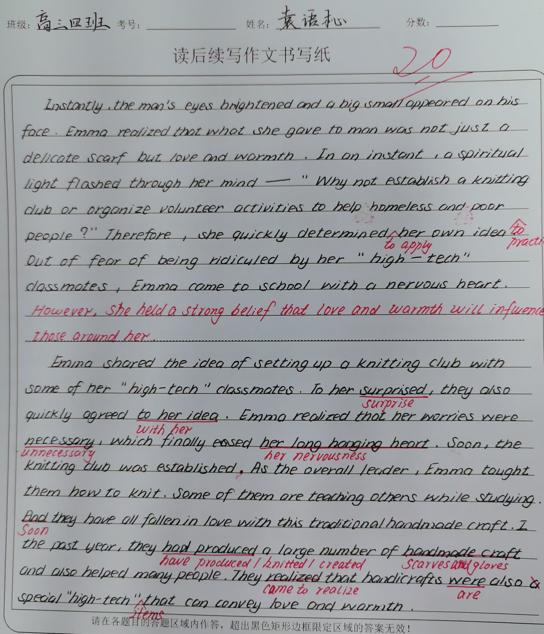
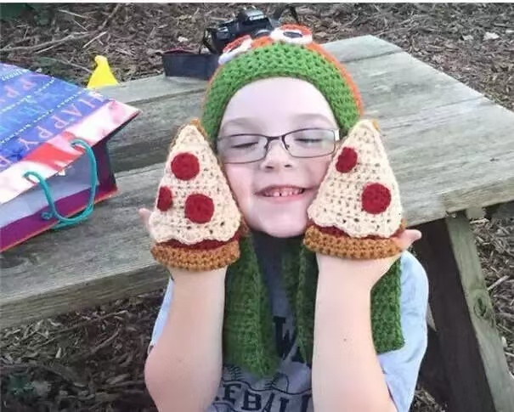
Analyze the
Ss’ writing
学生作品1：
第四档 （20分）
续写与所给短文融合度较高，与所提供段落的段首句衔接较为合理；
语言表达较丰富，能够使用过渡词使文章连贯，情节发展合理；
句型多样，有些许错误，但不影响理解。

Slide 14
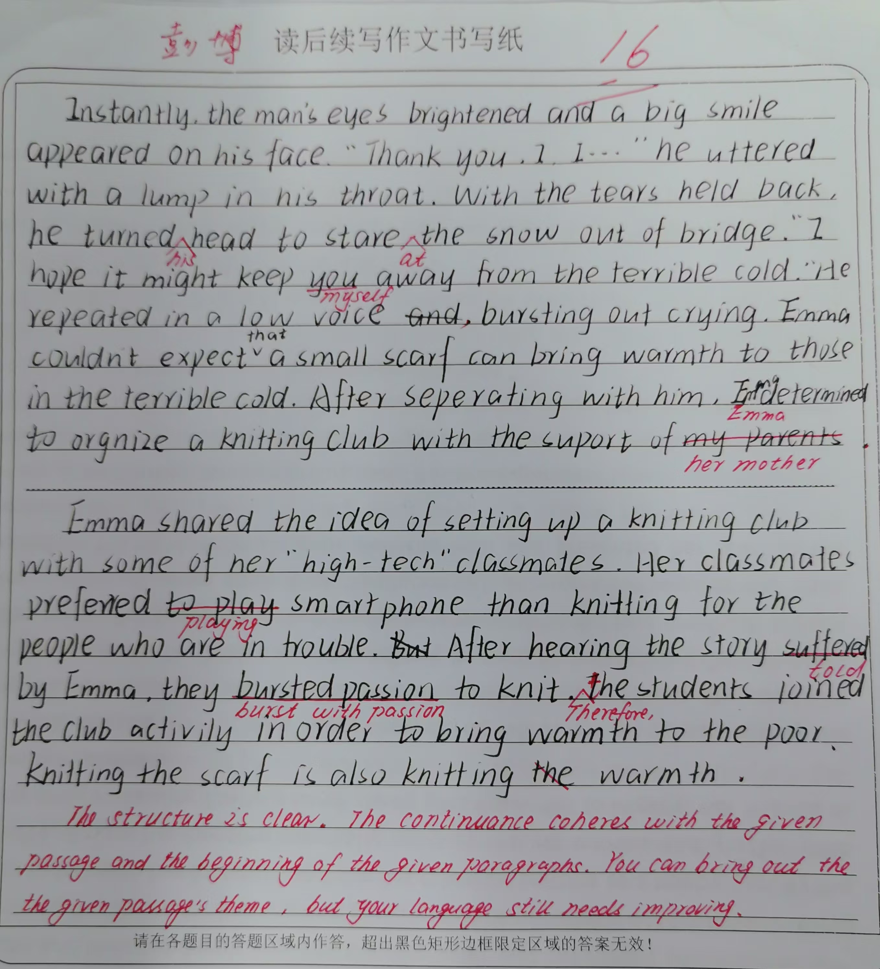

Analyze the
Ss’ writing
学生作品2：
第四档（16分）
续写部分与原文语境融合度较高。故事发展比较合理，但续写内容不够饱满，句型结构不够丰富，有些词汇运用不准确，须在词汇识记、语法运用、句型转换方面多下功夫。

Slide 15
教师下水作文:
Instantly, the man's eyes brightened and a big smile appeared on his face. Watching such a warm scene, a flood of 1__________(happy) filled her mind. 2________ heavy snowstorm, 3____________(encourage) by her mother’s generous spirit, Emma didn’t feel cold without a scarf. She suddenly realized how 4____________ (significance) knitting is for those in need as well as herself. Therefore, it 5__________ (occur) to her that a knitting club would be set up in the school, 6_______ the classmates fond of knitting could create scarves and gloves.
Emma shared the idea of setting up a knitting club with some of her "high- tech" classmates. 7________(hear) her words, the classmates were both 8____________ (enthusiasm) and hesitant because the idea was novel and needed skills. 9_____________ (immediate) Emma promised to teach them knitting, the classmates were active 10_______ (join) the club. Their spare time for High-tech things 11___________ (make) full use of to make scarves and gloves. Winter 12_____________ (approach), scarves and gloves were distributed to the homeless. Love is like a ripple, spreading from a home to those in need.
happiness
Despite
encouraged
significant
occurred
where
Hearing
enthusiastic
Immediately
to join
was made
approaching

Slide 16
Instantly, the man's eyes brightened and a big smile appeared on his face. At that moment, Emma realized that what she presented was not just a scarf 1_____ a sign of love and hope. 2________ (inspire), she determined to bring that spark of hope to more 3_________ (home) people. On her 4_______ (arrive) at the school, an idea 5_________ (occur) to her. "Why not set up a knitting club to bring more warmth and hope to 6_______(that) in need?" she wondered.
Emma shared the idea of setting up a knitting club with some ofher "high- tech" classmates. At first, she 7_____________(worry) that they might laugh at her "low- tech" idea. To her 8 ____________ (amaze) , they responded to her proposal 9_______________(enthusiasm) . In a few days, the club 10______________(found) and more and more students joined them. Some of them started learning the traditional skill and others used social media 11_________ (seek) help online. By the end of winter, the club distributed more than two thousand hand- knitted items. Never did the kids 12_________ (realize)the marriage of high- tech and low- tech could be so magic!
官方范文：
but
Inspired
homeless
arrival
occurred
those
was worried
amazement
enthusiastically
was founded
to seek
realize

Slide 17
网络范文：
Instantly, the man’s eyes brightened and a big smile appeared on his face. His hands trembled slightly as he 1_____ (hold) the scarf, clutching it as if it were a treasure. “Thank you, miss. This means 2_______(much) than you can imagine,” he said, his voice choked with 3__________ (grateful) . Emma felt a warm bloom in her chest, a feeling deeper than simple 4__________(kind) . It was at this moment 5_______she realized her knitting could serve a greater purpose. She thought of her mother, who had always knitted for neighbors and family, 6________ (give) love through every creation. If only more people7____________ (feel) the warmth of a simple scarf, she thought, a newfound determination growing within her. Inspired, she decided to turn her passion 8_______ something larger, something that could bring comfort to others in need.
Emma shared the idea of setting up a knitting club with some of her “high-tech” classmates. At first, they were 9__________(hesitate), casting doubtful looks as if knitting couldn’t 10______________ (compare) be compared to the thrill of their gadgets. Little did they expect that knitting could make such 11___ impact. Emma passionately shared her experience with the homeless man, 12___________ (explain) how a single scarf had brought him comfort. Her story painted a vivid image, and one by one, her classmates’ skepticism faded, 13__________ (replace) by genuine interest. Soon, a few classmates volunteered to give it a try, excited by the thought of creating something meaningful. With each new member joining, the club's influence grew 14_________ (steady) . As students gathered after school to knit scarves, gloves, and hats, Emma watched with pride as her simple idea 15____________(blossom) into a shared mission to spread warmth and compassion.
held
more
gratitude
kindness
that
giving
could feel
into
hesitant
be compared
an
explaining
replaced
steadily
blossomed

Slide 18
Homework
Edit and polish your writing.
家风是一种无
言的教育，润
物无声地影响
孩子的心灵。

