Slide 1


感恩遇见，相互成就，本课件资料仅供您个人参考、教学使用，严禁自行在网络传播，违者依知识产权法追究法律责任。
更多教学资源请关注
公众号：溯恩英语
知识产权声明

Slide 2

The World
October 16th-31st, 2024

Slide 3

1. World Watch 世界观察

Slide 4
Text Completion
The Wall Street Journal (October 18, 2024 A8)
IMF: Soft Landing Seen, But Tepid Growth
Inflation rates are falling and the ______ (globe) economy is on track for a soft landing, but the outlook for growth is tepid and rising trade barriers are a headwind, the head of the International Monetary Fund said on Thursday. In a speech ahead of the fund’s annual meetings in Washington, D.C., next week, IMF Managing Director Kristalina Georgieva said governments should act quickly ______ (halt) a sharp rise in their debts, and work together to resolve ________ (grow) trade tensions. Figures ________ (release) by the European Union’s statistics agency on Thursday showed the annual rate of inflation fell to 1.7% in September, below the European Central Bank’s 2% target for the first time since June 2021. In the U.K., inflation also fell to 1.7%, ______ in the U.S. prices rose by 2.4%.
BANGLADESH: Court Seeks Arrest Of Former Premier
A special court in Bangladesh issued arrest warrants on Thursday for former Prime Minister Sheikh Hasina and 45 others, including her close aides, on charges of crimes ______ humanity during a student-led uprising in July and August that forced her to flee the country, ___ prosecutor said. Prosecutor B.M. Sultan Mahmud said the Dhaka-based International Crimes Tribunal under Nobel laureate Muhammad Yunus, the country’s interim leader, issued the warrants in response to two petitions by the prosecution. There was no _______ (react) from Hasina’s Bangladesh Awami League party. Hasina ____ (flee) to India on Aug. 5 after weeks of protests over government job quotas in ______ hundreds of people died. Prosecutors said Hasina, her close aides and security agencies were responsible for killing the protesters and others.
global
to halt
growing
released
while
against
a
reaction
fled
which

Slide 5
Reading Comprehension
Which of the following statements is correct according to the text?
A. The global economy is recovering swiftly according to the IMF head.
B. Inflation rate in the U.K. was below the 2% target for the first time in three years.
C. Former Bangladesh Prime Minister were arrested for her crimes against humanity.
D. Protesters were killed during the student-led uprising in July and August in Bangladesh.

Slide 6
Vocabulary
1. tepid: slightly warm, sometimes in a way that is not pleasant 不冷不热的
not enthusiastic 不热情的；不热烈的
She bent her mouth to the tap and drank the tepid water.
她把嘴伸到水龙头底下去喝那微温的水。
2. aide: a person who helps another person, especially a politician, in their job
（尤指从政者的）助手
He is a close aide to the Prime Minister.
他是首相的亲密助手。
Translation
这台戏只得到了零落的掌声。
The play was greeted with tepid applause.
Translation
总统拿起电话，给一个助手发话。
The President picked up his phone and spoke to an aide.

Slide 7
Translation
Figures released by the European Union’s statistics agency on Thursday showed the annual rate of inflation fell to 1.7% in September, below the European Central Bank’s 2% target for the first time since June 2021. In the U.K., inflation also fell to 1.7%, while in the U.S. prices rose by 2.4%.
欧盟统计机构周四发布的数据显示，9月份的年通胀率降至1.7%，自2021年6月以来首次低于欧洲央行2%的目标。英国的通货膨胀率也降至1.7%，而美国的物价上涨了2.4%。
A special court in Bangladesh issued arrest warrants on Thursday for former Prime Minister Sheikh Hasina and 45 others, including her close aides, on charges of crimes against humanity during a student-led uprising in July and August that forced her to flee the country, a prosecutor said.
孟加拉国一名检察官说，周四，孟加拉国一个特别法庭对前总理谢赫·哈西娜和其他45人发出逮捕令，其中包括她的亲密助手。他们被控在7月和8月学生领导的起义中犯下反人类罪，这场起义迫使哈西娜逃离该国。

Slide 8
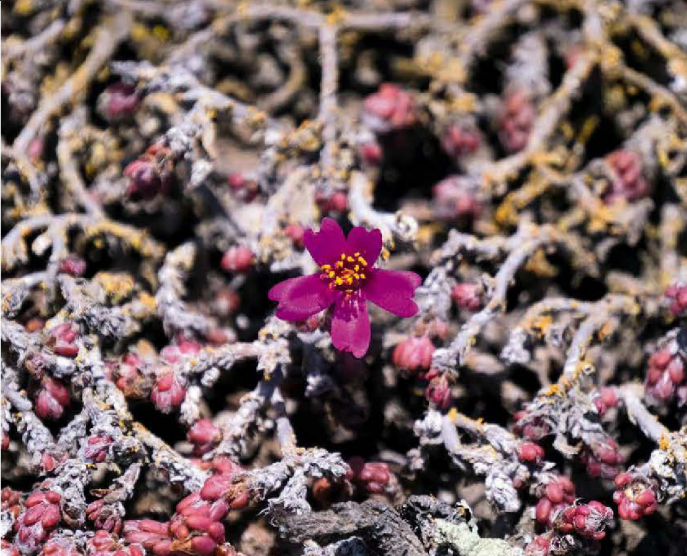
2. The botanists studying plants from the sky
植物学家从空中研究植物

Slide 9
Text Completion
BBC Science Focus（October, 2024 P25)
easier
Finding tiny flowers in the middle of the desert is hard but its far ______ (easy) if you can search from above. Desert ecosystems are generally delicate and __________ (access) and off-road vehicles can damage the fragile habitats. That’s _____ scientists from the Royal Botanic Gardens, Kew, turned to para-motorists (paragliders powered by motors) to help in their conservation efforts in the deserts of Peru.
Scientists from Kew have been studying plants in parts of the desert _______ (know) as lomases [oases fed not by rain, but by fog) for almost a century. There ____ (be) over 1,700 plant species in the lomases, but they remain incredibly hard to map - some only flower once a decade and the areas are _________ (extreme) vulnerable to climate change and human activity. with Peruvian scientists from Huarango Nature, RBG Kew helped train paramotorists to identify, collect, geo-reference and preserve plants for taxonomic study.
“Our study shows that through ____ exciting collaboration, today’s extreme sports enthusiasts can work alongside scientists to help monitor ecosystems _____ gather crucial environmental data, protect species and aid conservation efforts,” said Oliver Whaley., Honorary Research Associate at RBG Kew.
The collaboration has led the Peruvian Government _________ (protect) a 63km² (15,689 acre) area of desert on the coast of Peru and designate ___ a conservation reserve.
inaccessible
why
known
are
extremely
an
and
to protect
it

Slide 10
Vocabulary
1. vulnerable: weak and easily hurt physically or emotionally （身体上或感情上）脆弱的，易受…伤害的
She looked very vulnerable standing there on her own. 她独自站在那里，看上去弱不禁风。
2. collaboration: the act of working with another person or group of people to create or produce sth 合作；协作
She wrote the book in collaboration with one of her students. 她和她的一个学生合写了这本书。
Translation
老人是我们社会中特别容易受到伤害的成员。
Old people are particularly vulnerable members of our society.
Translation
这是一次带来极其有益的成果的合作。
It was a collaboration that produced extremely useful results.

Slide 11
Translation
Finding tiny flowers in the middle of the desert is hard but its far easier if you can search from above. Desert ecosystems are generally delicate and inaccessible and off-road vehicles can damage the fragile habitats.
在沙漠中寻找微小的花朵很难，但如果你能从上面搜索，就容易多了。沙漠生态系统通常是脆弱的，难以进入，越野车辆会破坏脆弱的栖息地。
Our study shows that through an exciting collaboration, today’s extreme sports enthusiasts can work alongside scientists to help monitor ecosystems and gather crucial environmental data, protect species and aid conservation efforts.
我们的研究表明，通过令人兴奋的合作，今天的极限运动爱好者可以与科学家一起帮助监测生态系统，收集重要的环境数据，保护物种并帮助保护工作。

Slide 12
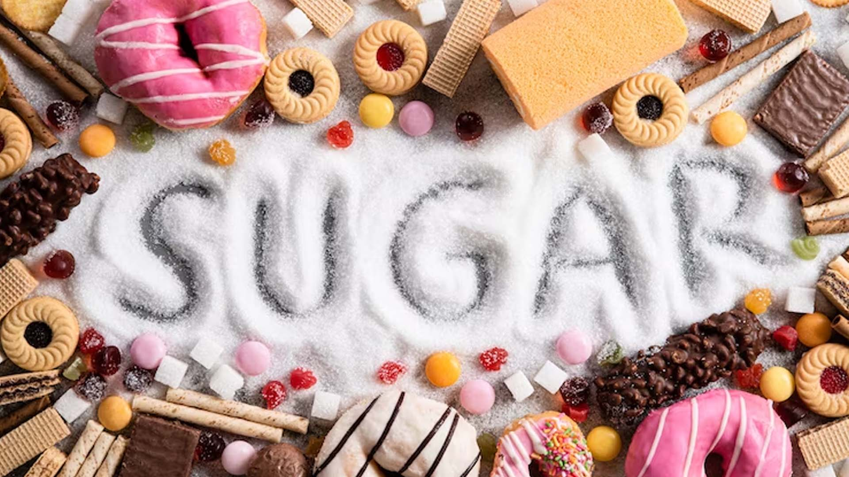
3. HOW MUCH SUGAR IS TOO MUCH?
摄入多少糖算多？

Slide 13
Text Completion
Unprocess Your Diet（ October 9, 2024 P39)
Sugar ______ (occur) naturally in small quantities in foods like fruits, vegetables and milk, along with other useful nutrients. Our bodies break down this sugar ____ energy and food with natural sugar doesn’t seem to do much damage. It’s when we consume diets full “free” of sugars and take in more than we can use ____ we begin to see the negative health effects. Free sugars are sugars ______ (add) to food to enhance their taste or extend their shelf life, as well as those found in syrups, honey and fruit juice - in short, sugars that have been in any way refined or freed from the cells of the organism they were created in.
Foods that naturally contain unrefined sugars, also provide important vitamins and minerals, but added sugar offers nothing ___ extra energy. It’s currently recommended that added sugar should make up no more than five per cent of an adult’s daily calorie intake ___________ is approximately around 30 grams a day, _______ (rough) equivalent to seven sugar cubes. However, studies show the average adult in the UK consumes double that amount every day. The guidelines for children between the _____ (age) of four and six suggest they should consume no more than 19 grams of added sugar a day, which is equivalent to five sugar cubes.
Many people believe that brown sugars, syrups and nectars are ______ (good) for the body than white sugar, but experts suggest there’s no such thing ___ “good” or “bad” when it comes to added sugar. Some forms of sugar or natural sweetener may be less processed or contain small quantities of vitamins and minerals, but ultimately they still have the potential to cause the same amount of harm.
occurs
for
that
added
but
which / that
roughly
ages
better
as

Slide 14
Vocabulary
1. equivalent: equal in value, amount, meaning, importance, etc. （价值、数量、意义、重要性等）相等的，相同的
Eight kilometres is roughly equivalent to five miles. 八公里约等于五英里。
2. ultimately: in the end; finally 最终；最后；终归
Ultimately, you'll have to make the decision yourself. 最终你还是得自己拿主意。
Translation
她在那家新公司做同样的工作，但薪水更高。
She’s doing the equivalent job in the new company but for more money.
Translation
糟糕的饮食终将导致疾病。
A poor diet will ultimately lead to illness.

Slide 15
Translation
Sugar occurs naturally in small quantities in foods like fruits, vegetables and milk, along with other useful nutrients. Our bodies break down this sugar for energy and food with natural sugar doesn’t seem to do much damage.
糖自然存在于水果、蔬菜和牛奶等食物中，含量很少，还有其他有用的营养物质。我们的身体会将这种糖分解为能量，而含有天然糖的食物似乎不会造成太大的损害。
It’s currently recommended that added sugar should make up no more than five per cent of an adult’s daily calorie intake which is approximately around 30 grams a day, roughly equivalent to seven sugar cubes.
目前建议，添加糖不应超过成年人每日卡路里摄入量的5%，即每天约30克，大致相当于7块方糖。

Slide 16
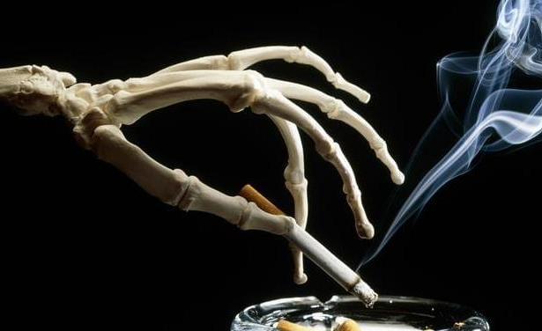
4. Smoking leaves a trace in bones for centuries 吸烟在骨头上留下的痕迹会持续几个世纪

Slide 17
Text Completion
The Times (October 16, 2024 P14)
Tobacco leaves traces in smokers’bones for the rest of their lives and for centuries after their deaths, archaeologists have found, providing a way to reveal the smoking habits of skeletons___ the first time.
The research from the University of Leicester, based on human remains buried in Britain between the 12th and19th centuries, _______ (show) the long-lasting impact of tobacco on a smoker’s bones and helps to illustrate the link between smoking and bone-related conditions, such as ____ increased risk of fractures.
The University of Leicester team examined the cortical bone — the dense tissue ___________ makes up the outer layer of bones and provides strength — in human skeletons. They examined 323 sets of remains, some of them from known tobacco users _____ others with unknown smoking statuses.
The researchers used mass spectroscopy to analyse the molecular make-up of the bones, and found 45 molecular _______ (feature) that differed between the bones of smokers and non smokers. The study, published in the journal Science Advances, concluded:“Tobacco consumption leaves a metabolic record in human bone distinctive enough __________ (identify) its use in individuals of unknown tobacco consumption.”
The study noted that the physical harm _______ (cause) by smoking is well documented but that its impact has ________ (main) been seen in soft tissue and organs in the increased risks of lung, bladder, and throat cancers as well as stroke and coronary artery disease.
It added that smoking had also been linked with bone-related conditions such as low bone density, an increased risk of fractures and periodontitis, ________ (note): “Archaeological human skeletal remains … have the potential to provide direct evidence that can be used to study past pathological and health conditions, including diseases associated with tobacco use.”
for
shows
an
that\ which
and
features
to identify
caused
mainly
noting

Slide 18
Vocabulary
1. dense : containing a lot of people, things, plants, etc. with little space between them 密集的；稠密的
Where Bucharest now stands, there once was a large, dense forest. 现在的布加勒斯特所在地曾经是一片茂密的大森林。
2.distinctive: having a quality or characteristic that makes sth different and easily noticed 独特的；特别的；有特色的
When Miles Davis died jazz was robbed of its most distinctive voice.
当迈尔斯•戴维斯去世时，爵士乐里最具特色的声音也被夺走了。
Translation
我们在茂密的植被中开出一条通路。
We fought our way through the dense vegetation.
Translation
雄鸟的头上有明显的白色斑纹。
The male bird has distinctive white markings on its head.

Slide 19
Translation
The research from the University of Leicester, based on human remains buried in Britain between the 12th and19th centuries, shows the long-lasting impact of tobacco on a smoker’s bones and helps to illustrate the link between smoking and bone-related conditions, such as an increased risk of fractures.
莱斯特大学的这项研究基于12世纪至19世纪埋在英国的人类遗骸，显示了烟草对吸烟者骨骼的长期影响，并有助于说明吸烟与骨骼相关疾病（如骨折风险增加）之间的联系。
It added that smoking had also been linked with bone-related conditions such as low bone density, an increased risk of fractures and periodontitis, noting: “Archaeological human skeletal remains … have the potential to provide direct evidence that can be used to study past pathological and health conditions, including diseases associated with tobacco use.”
研究补充说，吸烟也与骨骼相关的疾病有关，如骨密度低、骨折和牙周炎的风险增加，并指出：“考古人类骨骼遗骸……有可能提供直接证据，用于研究过去的病理和健康状况，包括与吸烟有关的疾病。”

Slide 20

5. BBC News 10/21/2024

Slide 21

Dictation
There have been multiple _________ across the southern suburbs of the Lebanese capital Beirut, where the Israeli military has targeted branches of a bank it accuses of helping to finance Hezbollah. Those living near the bank’s offices have been told to leave and streets were soon filled with people seeking __________________. There’s been similar strikes in Hezbollah’s strongholds in the south and east of Lebanon. Our correspondent Jonathan Head is in Beirut.
“The warnings issued to people in Lebanon by the Israeli military were unusually blunt and _________. We will strike several targets in the coming hours, it read, and additional targets through the night. People in 25 locations were warned to leave. Shortly after that, loud explosions were heard in southern Beirut one after the other. The main focus of these attacks appears to be the Hezbollah bank called Al-Qard al-Hassan, which Israel accuses of funneling Iranian money to the group to fund buying and storing weapons and to _____________ of its members.”
The UN peacekeeping mission in southern Lebanon says an Israeli bulldozer has destroyed a watchtower and the perimeter fence of one of its positions. It’s the latest in a series of incidents that have followed Israel’s call for UNIFIL troops to ________. Blue helmets in another southern village have not received any food or water _______ in 3 weeks.
The Moldovan president says an unprecedented assault on democracy is to ______ for the poor showing of her camp in Sunday’s presidential election and referendum on ties with Europe. Maia Sandu topped the poll, but by a much lower margin than ________ and will face a second round next month. There have been multiple allegations that Russia has tried to buy votes and of mounting a campaign of disinformation. Ms. Sandu also said criminal gangs had undermined the democratic process.
“Criminal groups working together with foreign forces hostile to our national interests have attacked our country with tens of millions of Euros, lies and propaganda, using their most __________ means to keep our citizens and our nation trapped in uncertainty and _________.”
air strikes
safer neighborhoods
sweeping
pay the salaries
withdraw
supplies
blame
expected
disgraceful
instability

Slide 22
Vocabulary
1. funnel: to move or make sth move through a narrow space, or as if through a funel （使）流经狭窄空间，经过漏斗形口子
High tides in the North Sea were funnelled down into the English Channel by a storm. 北海高涨的潮水被一场风暴推涌进英吉利海峡。
2. hostile: very unfriendly or aggressive and ready to argue or fight
敌对的；敌意的
The West has gradually relaxed its hostile attitude to this influential state. 西方对这个颇具影响力的国家的敌视态度已逐渐缓和。
Translation
巨大的管道把水沿山坡输送下山。
Huge pipes funnel water down the mountainside.
Translation
她公然对抗她的父母。
She was openly hostile towards her parents.

Slide 23
Translation
There have been multiple air strikes across the southern suburbs of the Lebanese capital Beirut, where the Israeli military has targeted branches of a bank it accuses of helping to finance Hezbollah. Those living near the bank’s offices have been told to leave and streets were soon filled with people seeking safer neighborhoods.
黎巴嫩首都贝鲁特南郊发生多起空袭，以色列军方袭击了一家银行的分支机构，并指责该银行为真主党提供资金。住在银行办公室附近的人被告知要离开，街道上很快就挤满了寻求更安全社区的人。
The Moldovan president says an unprecedented assault on democracy is to blame for the poor showing of her camp in Sunday’s presidential election and referendum on ties with Europe. Maia Sandu topped the poll, but by a much lower margin than expected and will face a second round next month.
摩尔多瓦总统说，她的阵营在星期天的总统选举和与欧洲关系的全民公决中表现不佳，这要归咎于对民主前所未有的攻击。Maia Sandu在民意调查中名列前茅，但领先优势远低于预期，下个月将面临第二轮选举。

