Slide 1


感恩遇见，相互成就，本课件资料仅供您个人参考、教学使用，严禁自行在网络传播，违者依知识产权法追究法律责任。
更多教学资源请关注
公众号：溯恩英语
知识产权声明

Slide 2
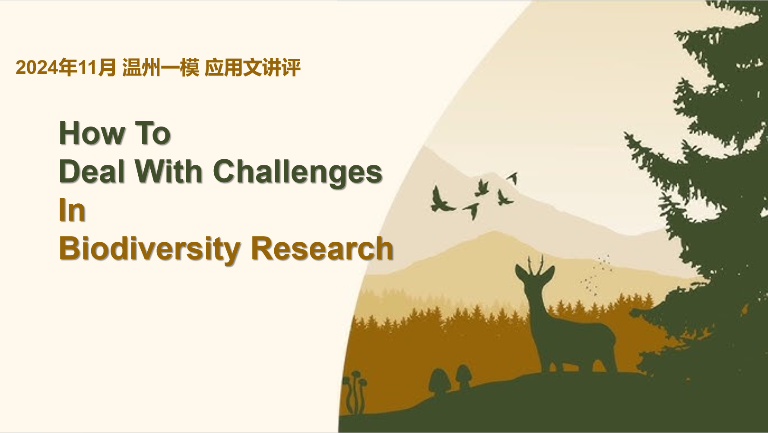

Slide 3

假定你是李华，你的英国朋友Jasper对你在“科学三分钟”(3-minute Science Speech Activity)中介绍的生物多样性研究很感兴趣，想了解你如何应对研究中的挑战。请你写一封邮件回复，内容包括：
1．研究困难；2．解决方法。
注意：
1．写作词数应为80左右；
2．请按如下格式在答题纸的相应位置作答。
I. Analyze the requirements
Genre:
Person:
Voice:
Tense:
Contents:
Structure:
a letter of reply
mainly first person
friendly& sincere
present& past tense
challenges in the research
solutions
- Para.1: greeting& writing purpose
to reply and share...
- Para.2: challenges& solutions
- Para.3: close

Slide 4
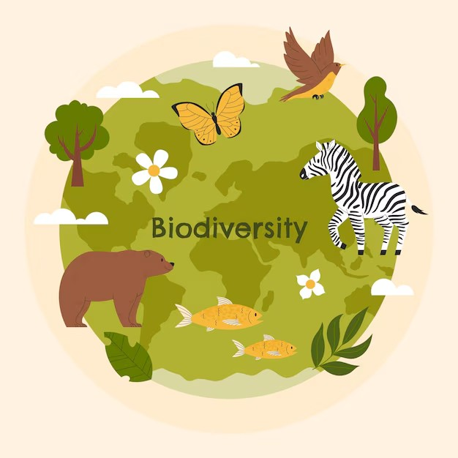
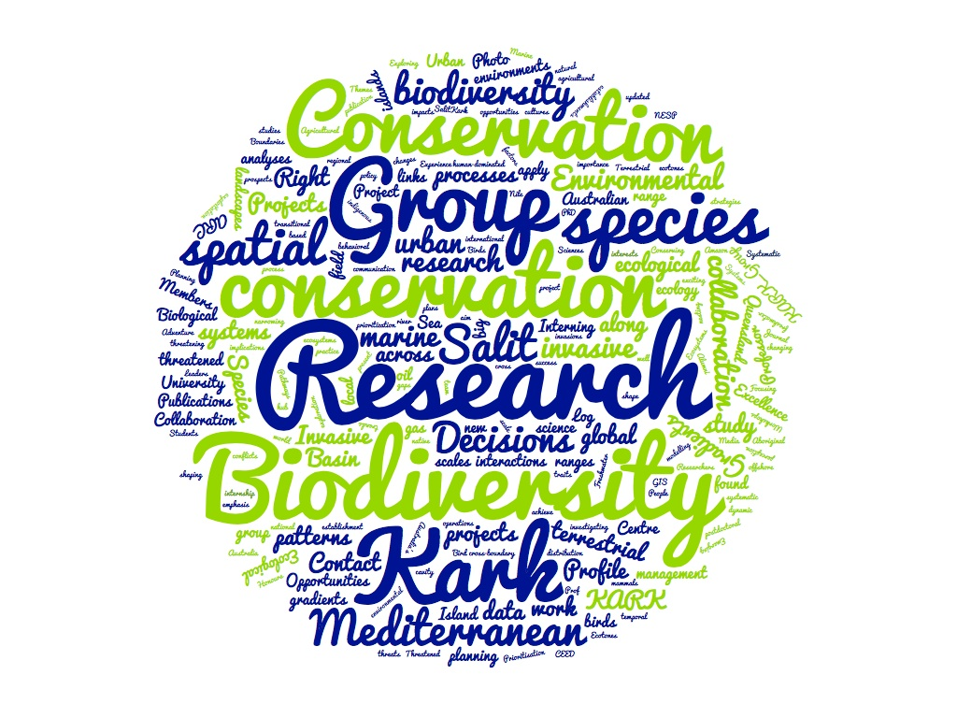
假定你是李华，你的英国朋友Jasper对你在“科学三分钟”(3-minute Science Speech Activity)中介绍的生物多样性研究很感兴趣，想了解你如何应对研究中的挑战。请你写一封邮件回复，内容包括：
1．研究困难；2．解决方法。
注意：
1．写作词数应为80左右；
2．请按如下格式在答题纸的相应位置作答。
II. Brainstorm
What’s biodiversity research like in you mind?
What could be the challenges?
How to deal with them?
Is the background setting familiar to you?

Slide 5
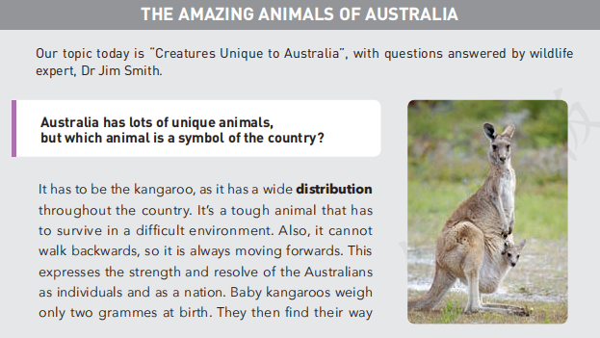
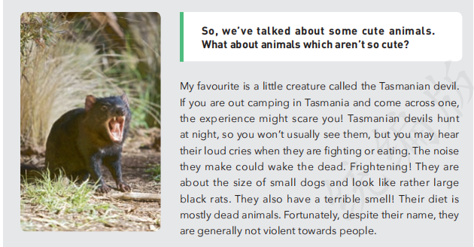
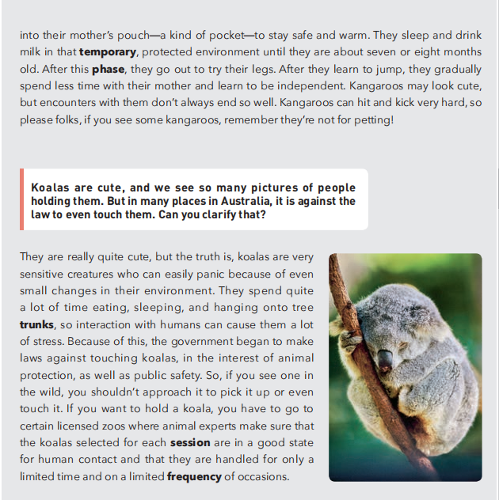
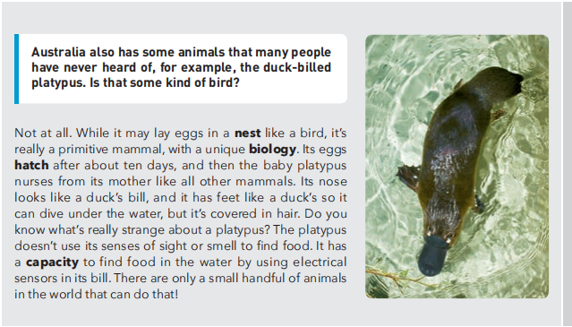
- Is there any reference in our textbooks?
XB4U2
The Amazing Animals In Australia
Biodiversity:
distributions
habitats
habits
behavior
characteristics
diets
types
...

Slide 6
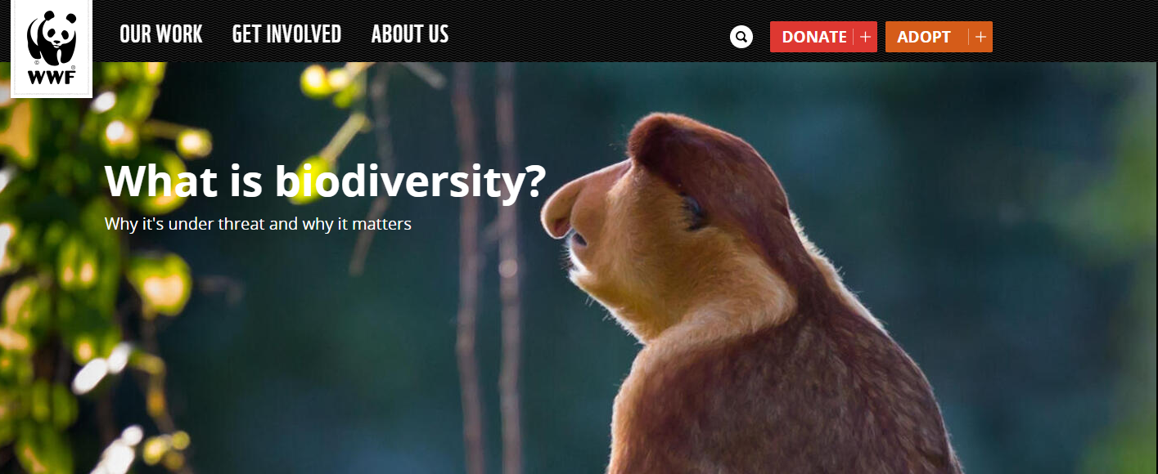
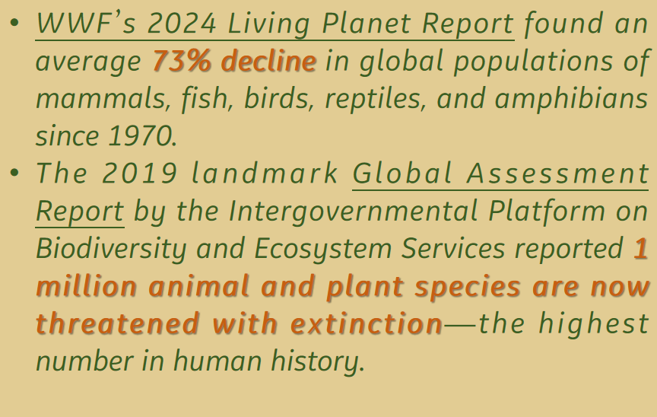
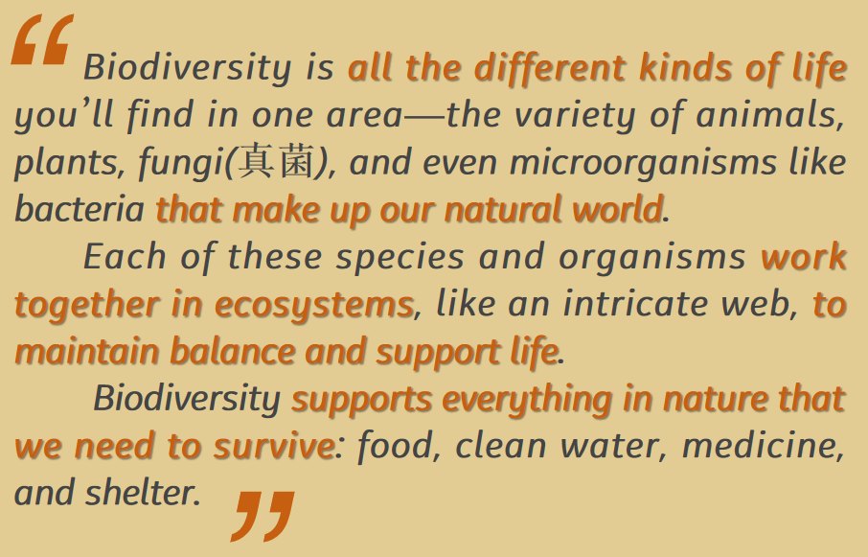

Slide 7
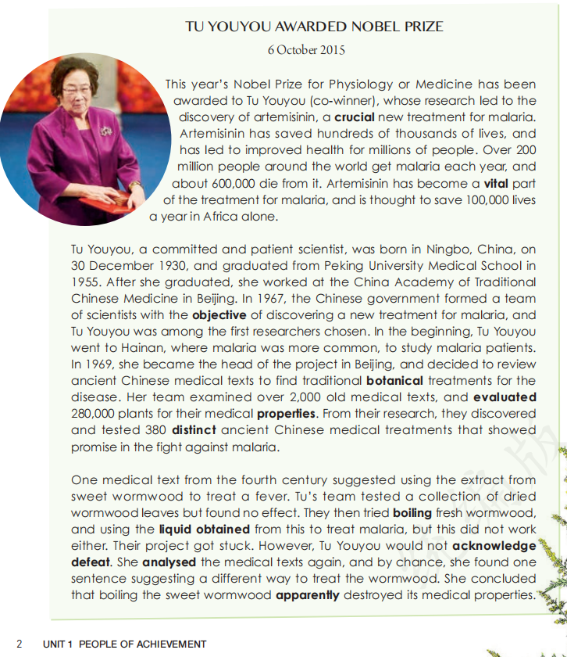
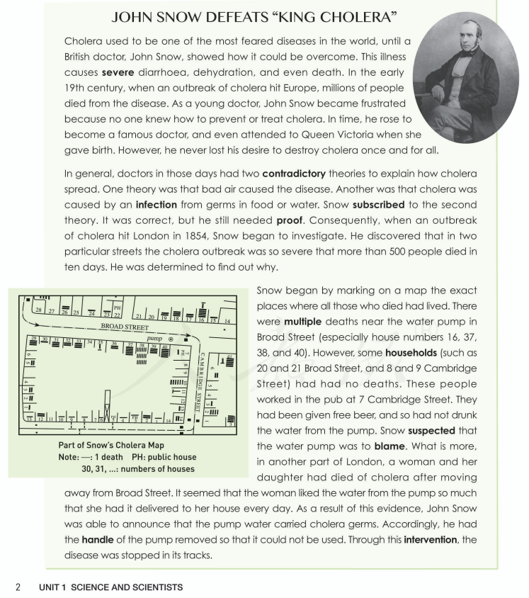
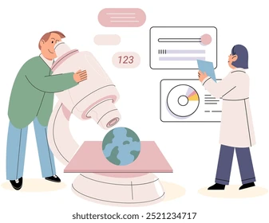
- How about the research?
- Is there any reference in our textbooks?
XB1U1
People Of Achievements
XB2U1
Science& Scientists
search existing reports
keep track of the subjects
analyse the materials
do experiments
...
analyse the existing theories
collect research information
mark on a map
carry out investigations
...

Slide 8

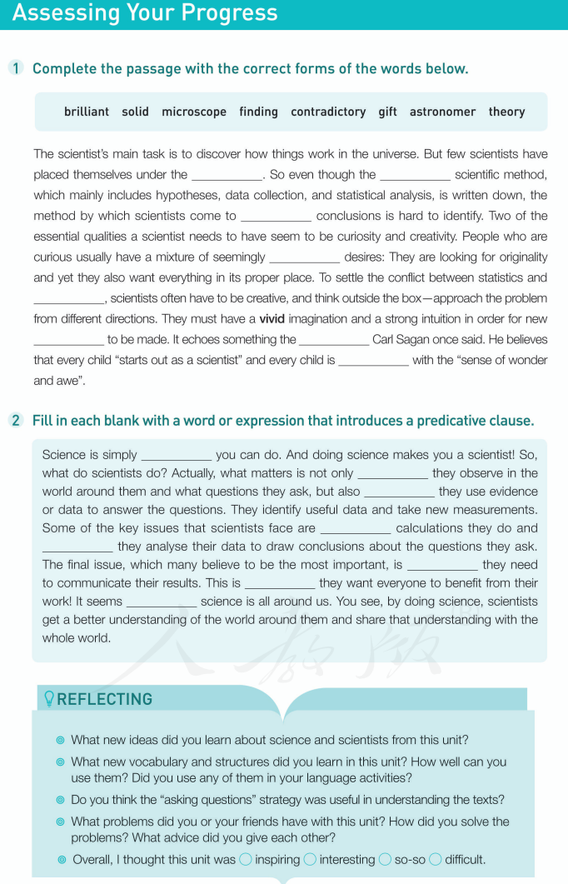

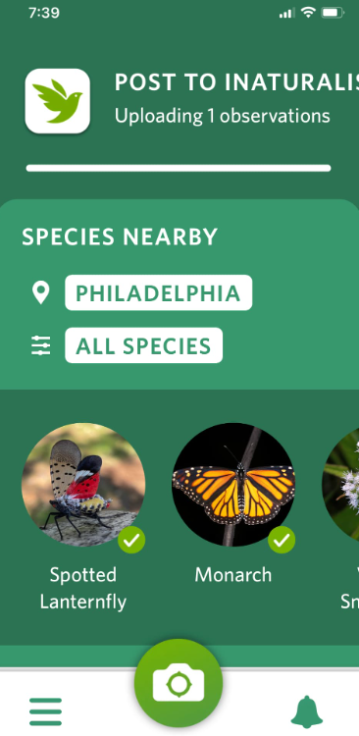


- Is there any reference in our textbooks?
XB2U1
Science& Scientists
Scientific Methods:
establish hypotheses
collect data
statistical analysis
identify useful data
think outside the box
take new measurements
draw conclusions
Essential qualities:
curiosity nad creativity
Benefits:
the sense of wonder and awe
everyone to benefit from their work
get a better understanding of the world around them and share the understanding with the whole world

Slide 9

slides
mindmap
images
video clip
...
Effective methods to transform a science report to a speech
- Is a science report the same as a speech narrative?
- May there be anything more to be included other than the required points?
rewarding
fulfilling
insightful
inspiring
...
Feelings towards the research or speech
on research
on knowledge
on qualities
on influences
....
Potential gains in the process

Slide 10

III. Organize and polish the language
THE OPENING
THE BODY
THE CLOSE
Great to hear from you! Regarding my 3-minute science speech on Biodiversity Research, I'd love to tell you about the challenges and solutions I encountered.
Thank you for your interest in my biodiversity research for the Science Speech Activity. let me share the challenges and how I handled them.
Hope this mail finds you well, too! As you mentioned, my biodiversity research experience was both challenging and rewarding.
One of the initial challenges in my research was....
....was a major challenge due to the uncertain experimental conditions.
Additionally, .... was pretty time-consuming.
I encountered several unexpected technical issues like.... that delayed the progress.
To deal with..., I adopted...
Furthermore, my biology teacher’s kind guidance helped broaden my perspectives and enhance the effectiveness of my finding.
By the way, I also drafted a well-organized outline to keep my presentation on the track.
It’s indeed a great learning experience, and I'm proud of how it turned out. Looking forward to catching up soon!
If you'd like to know more about my research or tips for giving a great science speech, I'd be happy to share!
How about the school project you work on? Look forward to your further information!
Be logical
Be coherent
Be specific
Be communicative
To the point

Slide 11
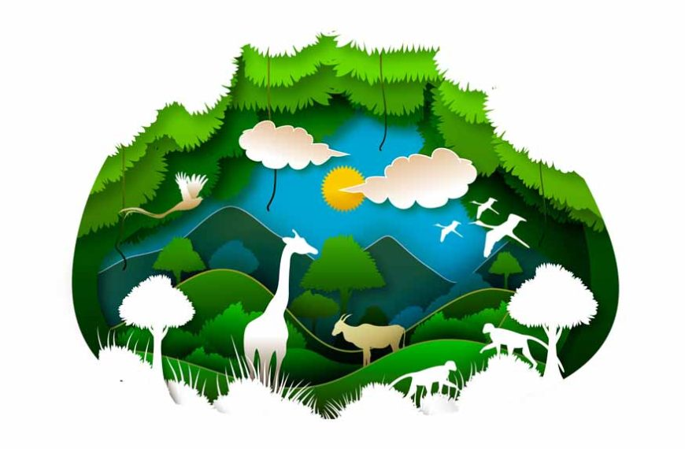
IV. Sample Writing
Dear Jasper,
Glad to catch up! I’m thrilled to hear you're interested in my recent 3-minute science speech on biodiversity research, The Plants Around Us. Preparing for it was quite an adventure!
One of the initial challenges was collecting accurate data in the diverse ecosystems. Therefore, I sourced the existing reports and adopted some technical assistance like Baidu Map and Xingse, a plant-identifying app. Additionally, transforming complex scientific materials into a clear and captivating speech is also demanding. Fortunately, my biology teacher gave me detailed guidance in how to conduct statistical analysis, display findings and draw conclusions. By the way, the clip video I edited successfully engaged my audience!
Overall, the experience was incredibly rewarding. How’s your school project going?
Cheers,
Li Hua
Be communicative
To the point
Be logical
Be coherent
Be specific
Complete contents

