Slide 1


感恩遇见，相互成就，本课件资料仅供您个人参考、教学使用，严禁自行在网络传播，违者依知识产权法追究法律责任。
更多教学资源请关注
公众号：溯恩英语
知识产权声明

Slide 2
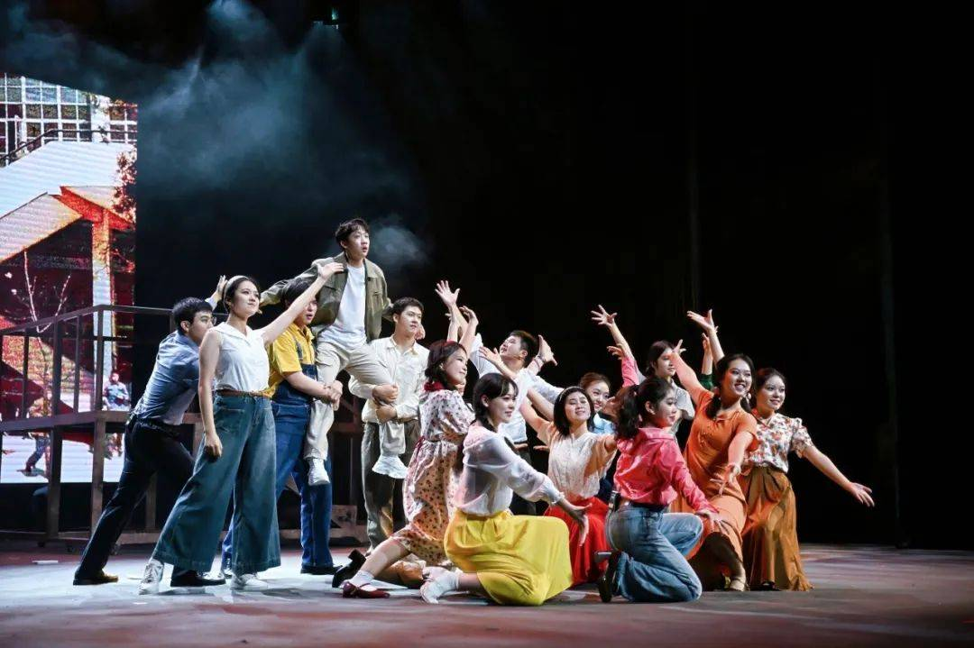
—2024湖衢丽11月高三联考应用文写作分析
A Letter of Invitation
to Drama Night

Slide 3
Lead in
art and culture
假定你是李华，你校将举办英语节“戏剧之夜”（Drama Night）活动，并进行网络直播（live-stream）,请你给英国好友David 写一封电子邮件，邀请他观看，内容如下：
（1）活动介绍；
（2）观看时间和方式。
注意：
（1）写作词数应为80左右；
（2）请按如下格式在答题纸的相应位置作答。
What’s the writing purpose of this E-mail?
How can we achieve this purpose by our writing?

Slide 4
Think
event——Drama Night
How can we achieve this purpose by our writing?
give a background information of this writing (the event)
P1
state a clear writing purpose
（1）活动介绍
（2）观看时间和方式
introduce the event in a more attractive way
P2
give a clear information about watching details,such as Date & Time, Viewing Platform...
P3
repeat invitation and look forward to his participation/watch

Slide 5
Beginning
Hope this letter finds you well.
How’s everything going?
Greetings:
Version 1
Thrilled to share with you an exciting event that our school is hosting a "Drama Night," I cordially invite you to watch the live-stream of this spectacular occasion.
Version 2
Given that a live-stream “Drama Night” is scheduled to be held by our school this weekend, I can’t wait but invite you to join us and enjoy this thrilling and impressive event.
give background information of this writing ( the event)
P1
state a clear writing purpose

Slide 6
Ending
P3
repeat invitation and look forward to his participation/watch
Repeat invitation :
Your presence, even if virtual, would mean the world to us, and I'm sure the performers would be thrilled to know they have an international audience cheering them on.
Look forward to your paticipation:
Hope you can join us online!
I'm eagerly looking forward to 'seeing' you there and sharing this special moment together.
Looking forward to sharing this special evening with you!
Other things:
Please do let me know if you plan to join us, and feel free to spread the word to any of your friends who might be interested as well.
Please do let me know if you'll be able to join us, and feel free to invite any of your friends who might be interested as well.

Slide 7
event——Drama Night
Think
How to introduce the event in a more attractive way?
concrete
abstract
1.attractive performance
2.attractive
participation
3.attractive
harvest

Slide 8
event——Drama Night
Brainstorm
1.1 well-prepared performance
1.attractive performance
1.2talented performers
1.3profound Chinese culture and art
1.4different Interpretation of foreign culture and art
2.1means of viewing
2.attractive
participation
2.2means of interaction

Slide 9
Brainstorm
3.1 a feast of Chinese culture
event——Drama Night
3.2 perceive diverse cultures/cultural differences/cultural exchange
enjoy culture
3.attractive
harvest
3.3 artistic and cultural perception ability
enhance ability
3.4 cultural literacy and aesthetic ability

Slide 10
Accumulation
1.1 well-prepared performance
参与者精心制作了他们的作品，融合了西方和东方戏剧的元素，保证了一个充满故事，情感和创造力的夜晚。
Participants have meticulously crafted their productions, blending elements of both Western and Eastern theatre, promising an evening rich in storytelling, emotion, and creativity.

Slide 11
Accumulation
1.2talented performers
见证与他同龄的中国学生的非凡表演热情与天赋
experience creativity and witness the incredible talent of Chinese peers
1.3profound Chinese culture and art
观看到精彩的戏剧表演体现中国艺术与文化的（他感兴趣的）
watch captivating/engaging/appealing plays/performances about Chinese traditional culture and art that you are keen on.

Slide 12
Accumulation
1.4different Interpretation of foreign culture and art
体验学生的创造力，看看他们如何从不同的角度/重新解读英语戏剧
enjoy experience students’ creativity and seeing how they interpret English drama from a different perspective/anew

Slide 13
Accumulation
2.1 means of viewing
今年的活动与众不同/亮点之一是它将在全球直播，让像你这样的国际朋友无论距离多远都能收看并亲身体验这一神奇的时刻。
What sets this year's event apart/One of the highlights is that it will be live-streamed globally, allowing international friends like you to tune in and experience the magic firsthand, no matter the distance.

Slide 14
Accumulation
2.2means of interaction
我们还在直播期间设置了互动聊天部分，观众可以实时分享他们的想法和反应，使其成为真正的全球和引人入胜的体验。
We've also set up an interactive chat section during the live-stream where viewers can share their thoughts and reactions in real-time, making it a truly global and engaging experience.
我们还在直播期间安排了一个互动聊天部分，观众可以实时分享他们的想法、反应和对表演的欣赏。
We have also arranged for an interactive chat section during the live-stream, where viewers can share their thoughts, reactions, and appreciation for the performances in real-time.

Slide 15
Accumulation
3.1 a feast of Chinese culture
享受到中国艺术与文化的视觉盛宴
glimpse into the vibrant Chinese traditional cultural and art; be a feast of extensive and profound Chinese traditional cultural and art
接触到/沉浸于丰富的文化
be exposed to/immersed in rich and diverse cultural knowledge
感受中国戏剧的魅力
feel/experience the charm of Chinese drama

Slide 16
Accumulation
3.2 perceive diverse cultures/cultural differences/cultural exchange
深入了解/感受中西戏剧文化差异
gain a deep insight into cultural differences between Chinese and Western drama
感受文化交流之美，多元和谐之美
experience the beauty of cultural exchange and harmony among diversity

Slide 17
Accumulation
3.3 artistic and cultural perception ability
提升艺术文化感知能力
enhance artistic and cultural perception ability
3.4 cultural literacy and aesthetic ability
提升文化素养和审美能力
improve cultural literacy and aesthetic ability

Slide 18
Accumulation
sentence pattern:
By participating in this live-stream, you can...
It's a unique and fantastic opportunity for you to ...
Not only can you, but also you can...
Examples:
By participating in this live-stream, you can be exposed to rich cultural knowledge and improve your cultural literacy and aesthetic ability.
It's a unique and fantastic opportunity for you to glimpse into the vibrant cultural life of our school and witness the incredible talent of your Chinese peers.

Slide 19
Accumulation
‌Watching Details‌
How to make yourself more thoughtful and considerate?
‌Date & Time‌:
The Drama Night will take place on Saturday night, starting at 7:00 PM (China Standard Time, which is GMT+8).
Please adjust your schedule accordingly to ensure you don't miss any of the excitement.
Mark your calendar and set a reminder so you don't miss a single moment of the excitement!

Slide 20
Accumulation
‌Watching Details‌
How to make yourself more thoughtful and considerate?
‌Viewing Platform‌:
The event will be streamed live on our school's official Weibo account and YouTube channel. Simply search for “Drama Night Live" on either platform closer to the event date, and you'll find the live-stream link easily accessible.
You can watch it on the school’s official website. I’ll send you the link as soon as it’s available.

Slide 21
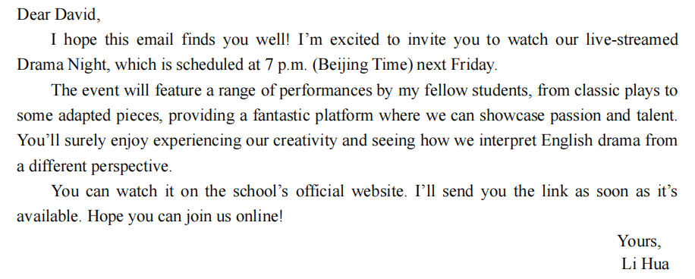

Sample writing one

Slide 22
Sample writing two
Dear Chris,
Given that a live-stream “Drama Night” is scheduled to be held by our school at 7 p.m. (Beijing Time) this Saturday, I can’t wait but invite you to join us and enjoy this thrilling and impressive event.
There will be a variety of dramas, ranging from engaging plays about Chinese traditional culture and art that you are keen on to creative and different interpretation of English literature. Through this event, not only will you gain a deep insight into cultural differences between Chinese and Western drama, but also it will enhance your artistic and cultural perception ability.
You can watch it on the school’s official website. I‘ll send you the link as soon as it’s available.Looking forward to sharing this special evening with you and I’m confident that it is bound to be a pleasant, fulfilling and unforgettable memory for both of us!
Yours,
Li Hua

Slide 23
Sample writing three
Dear Chris,
Thrilled to share with you an exciting event that our school is hosting a "Drama Night," I cordially invite you to watch the live-stream of this spectacular occasion.
Participants have meticulously crafted their productions, blending elements of both Western and Eastern theatre, promising an evening rich in storytelling, emotion, and creativity.That night, not only can you experience creativity and witness the incredible talent of Chinese peers, but also you can glimpse into the vibrant Chinese traditional cultural and art.
The Drama Night will take place on Saturday night, starting at 7:00 PM (China Standard Time, which is GMT+8). Please adjust your schedule accordingly to ensure you don't miss any of the excitement.The event will be streamed live on our school's official Weibo account. Simply search for “Drama Night Live" on either platform closer to the event date, and you'll find the live-stream link easily accessible.I'm eagerly looking forward to 'seeing' you there and sharing this special moment together.
Yours,
Li Hua

Slide 24

Thank you!

