Slide 1


感恩遇见，相互成就，本课件资料仅供您个人参考、教学使用，严禁自行在网络传播，违者依知识产权法追究法律责任。
更多教学资源请关注
公众号：溯恩英语
知识产权声明

Slide 2

回忆 难忘的瞬间
2024.10 九省联考

Slide 3
when
where
what
假定你是李华，假期你去留学生Tom的家乡游玩时受到了他的热情款待。请你给他写一封电子邮件，内容包括：
1. 表示谢意；
2. 回忆难忘的瞬间。
Dear Tom,
_____________________________________________________
_____________________________________________________
_____________________________________________________
Thanks again and I’m looking forward to seeing you in China soon!
Yours,
Li Hua
how
Thank you so much for your hospitable reception during my visit to your hometown last holiday.
What things can be unforgettable during a visit?

Slide 4
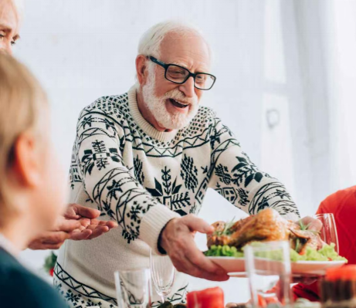
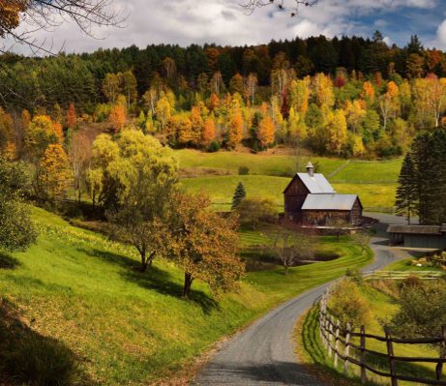


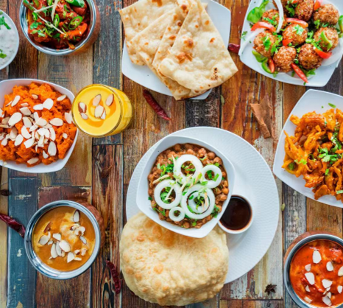
something unforgettable?
breathtaking natural sights/ beauty
warm, kind, hospitable family & locals
long and profound history
splendid and distinctive culture
palatable delicacies

Slide 5
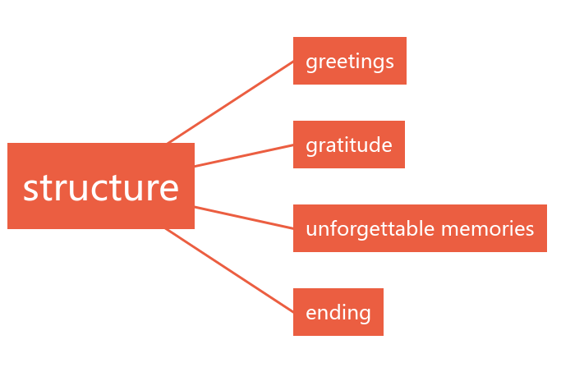
I’ve just arrived home.
I hope this email finds you in good spirits/ finds you well.
Thank you so much for your hospitable reception during my visit to your hometown last holiday.
warm, kind, hospitable family & locals
splendid and distinctive culture
breathtaking natural sights/ beauty
long and profound history
palatable delicacies
Thanks again and I’m looking forward to seeing you in China soon!

Slide 6
general
Your warmth, kindness, and the rich cultural experiences you provided made my stay exceptionally memorable.
It is your warmth and the once-in-a-lifetime experiences that made my trip such a blast.
I can well recall/ remember the wonderful moments we shared.
The time we spent together still play vividly in my mind.
specific
... was particularly special.
Additionally, ... were highlights that I will cherish forever.
Besides, I am deeply fascinated with...
Above all, ... made me linger.

Slide 7

...Your warmth, kindness, and the rich cultural experiences you provided made my stay exceptionally memorable.
I still well recall the wonderful moments we shared. Our hike up the beautiful hill, where you shared fascinating stories about your local heritage while we enjoyed the breathtaking view of the countryside, was particularly special. Additionally, experiencing traditional cuisine and participating in the lively ball were cultural highlights that I will cherish forever. Above all, your family’s welcoming spirit and delicious homemade meals truly made me feel like part of the family.

Slide 8

...It is your warmth and the once-in-a-lifetime experiences that made my trip such a blast.
The time we spent together still play vividly in my mind. I particularly cherish the day when we visited the charming countryside, where you introduced me to the beauty of your homeland. The traditional music session at the local pub was another highlight – the lively tunes and friendly atmosphere were simply magical. And of course, I can’t forget the palatable delicacies your family curated (精心准备). What a feast!

Slide 9
A possible version:
Dear Tom,
I have just arrived home. Thank you very much for the hospitality I have received during my stay at your home! I’ll remember forever the time we spent together.
I’m particularly impressed by the local dishes you prepared for me. Their flavors are still lingering in my mouth! I’m also grateful for your showing me around the town, which has given me a deeper insight into the local culture and history. It is your warmth and thoughtfulness that has made my travel such an unforgettable experience!
Thanks again and I’m looking forward to seeing you in China soon!
Yours,
Li Hua
A possible version:
Dear Tom,
I have just arrived home. Thank you very much for the hospitality I have received during my stay at your home! I’ll remember forever the time we spent together.
I’m particularly impressed by the local dishes you prepared for me. Their flavors are still lingering in my mouth! I’m also grateful for your showing me around the town, which has given me a deeper insight into the local culture and history. It is your warmth and thoughtfulness that has made my travel such an unforgettable experience!
Thanks again and I’m looking forward to seeing you in China soon!
Yours,
Li Hua
点评：
(1)内容：
覆盖所有内容要点，表达清楚、合理；
(2)语言：
应用了较多复杂、高级的语法结构和词汇，如be particularly impressed by, linger, give sb. a deeper insight into, 强调句等；
(3)逻辑：
自然流畅地使用了语句间的连接成分，使全文结构紧凑，如also, which等。
Para. 1 Greeting + Gratitude
Para. 2 Memories
Para. 3 Ending

