Slide 1


感恩遇见，相互成就，本课件资料仅供您个人参考、教学使用，严禁自行在网络传播，违者依知识产权法追究法律责任。
更多教学资源请关注
公众号：溯恩英语
知识产权声明

Slide 2

A Speech of Influential Technological Item
—2024宁波一模应用文写作分析

Slide 3
Analyze
theme/topic of the speech: influential technological product/item/device
Organizer:English Club
学校英语俱乐部将组织关于“生活中具有重大影响的科技产品”的讨论，请你作为代表发言，内容包括：
（1）介绍一项产品及其影响；
（2）对该产品的展望。
注意：
（1）写作词数应为80左右；
（2）请按如下格式在答题纸的相应位置作答。
Good morning,everyone.
a speech演说发言谈话
introduce the item, its impact and the prospect
What’s the genre/writing purpose of this writing?
In this speech, what should be included in each part ?

Slide 4
Think
influential technological production/item
In a speech, what should be included in each part ?
Greetings to the audience
P1
Opening
（1）介绍一项产品及其影响
（2）对该产品的展望
the theme/topic and purpose of the speech
introduce the item, its impact and the prospect in a logical way
P2
Body
P3
appreciation/summary
/anticipation/wish
Closing

Slide 5
Accumulation
Greetings to the audience
P1
Opening
the theme and purpose of the speech
Version 1
Today,I’m so honored/privileged to deliver a speech with the theme of ‘the influential technological item in our daily life’, which is ...
Version 2
Today, I am thrilled to share with you an influential technological item in our life:...

Slide 6
Accumulation
the theme/topic and purpose of the speech
Version 3
It is an honor to stand here today, representing/on behalf of our vibrant English Club, to delve into the fascinating realm of technology and its profound impact on our lives. The topic that I have chosen to discuss is "A Technology Product That Has Significantly Influenced Our Lives," and for this purpose, I would like to highlight the ...

Slide 7

Brainstorm
What is the influential technological item you are going to introduce?
ChatGPT
Smartphone
Smartwatches
VR
3D Printers

Slide 8
Brainstorm
P2
introduce the item, its impact and the prospect in a logical way
general
How to introduce that technological item in a logical way?
specific
positive impacts
negtive impacts
prospect/outlook

Slide 9
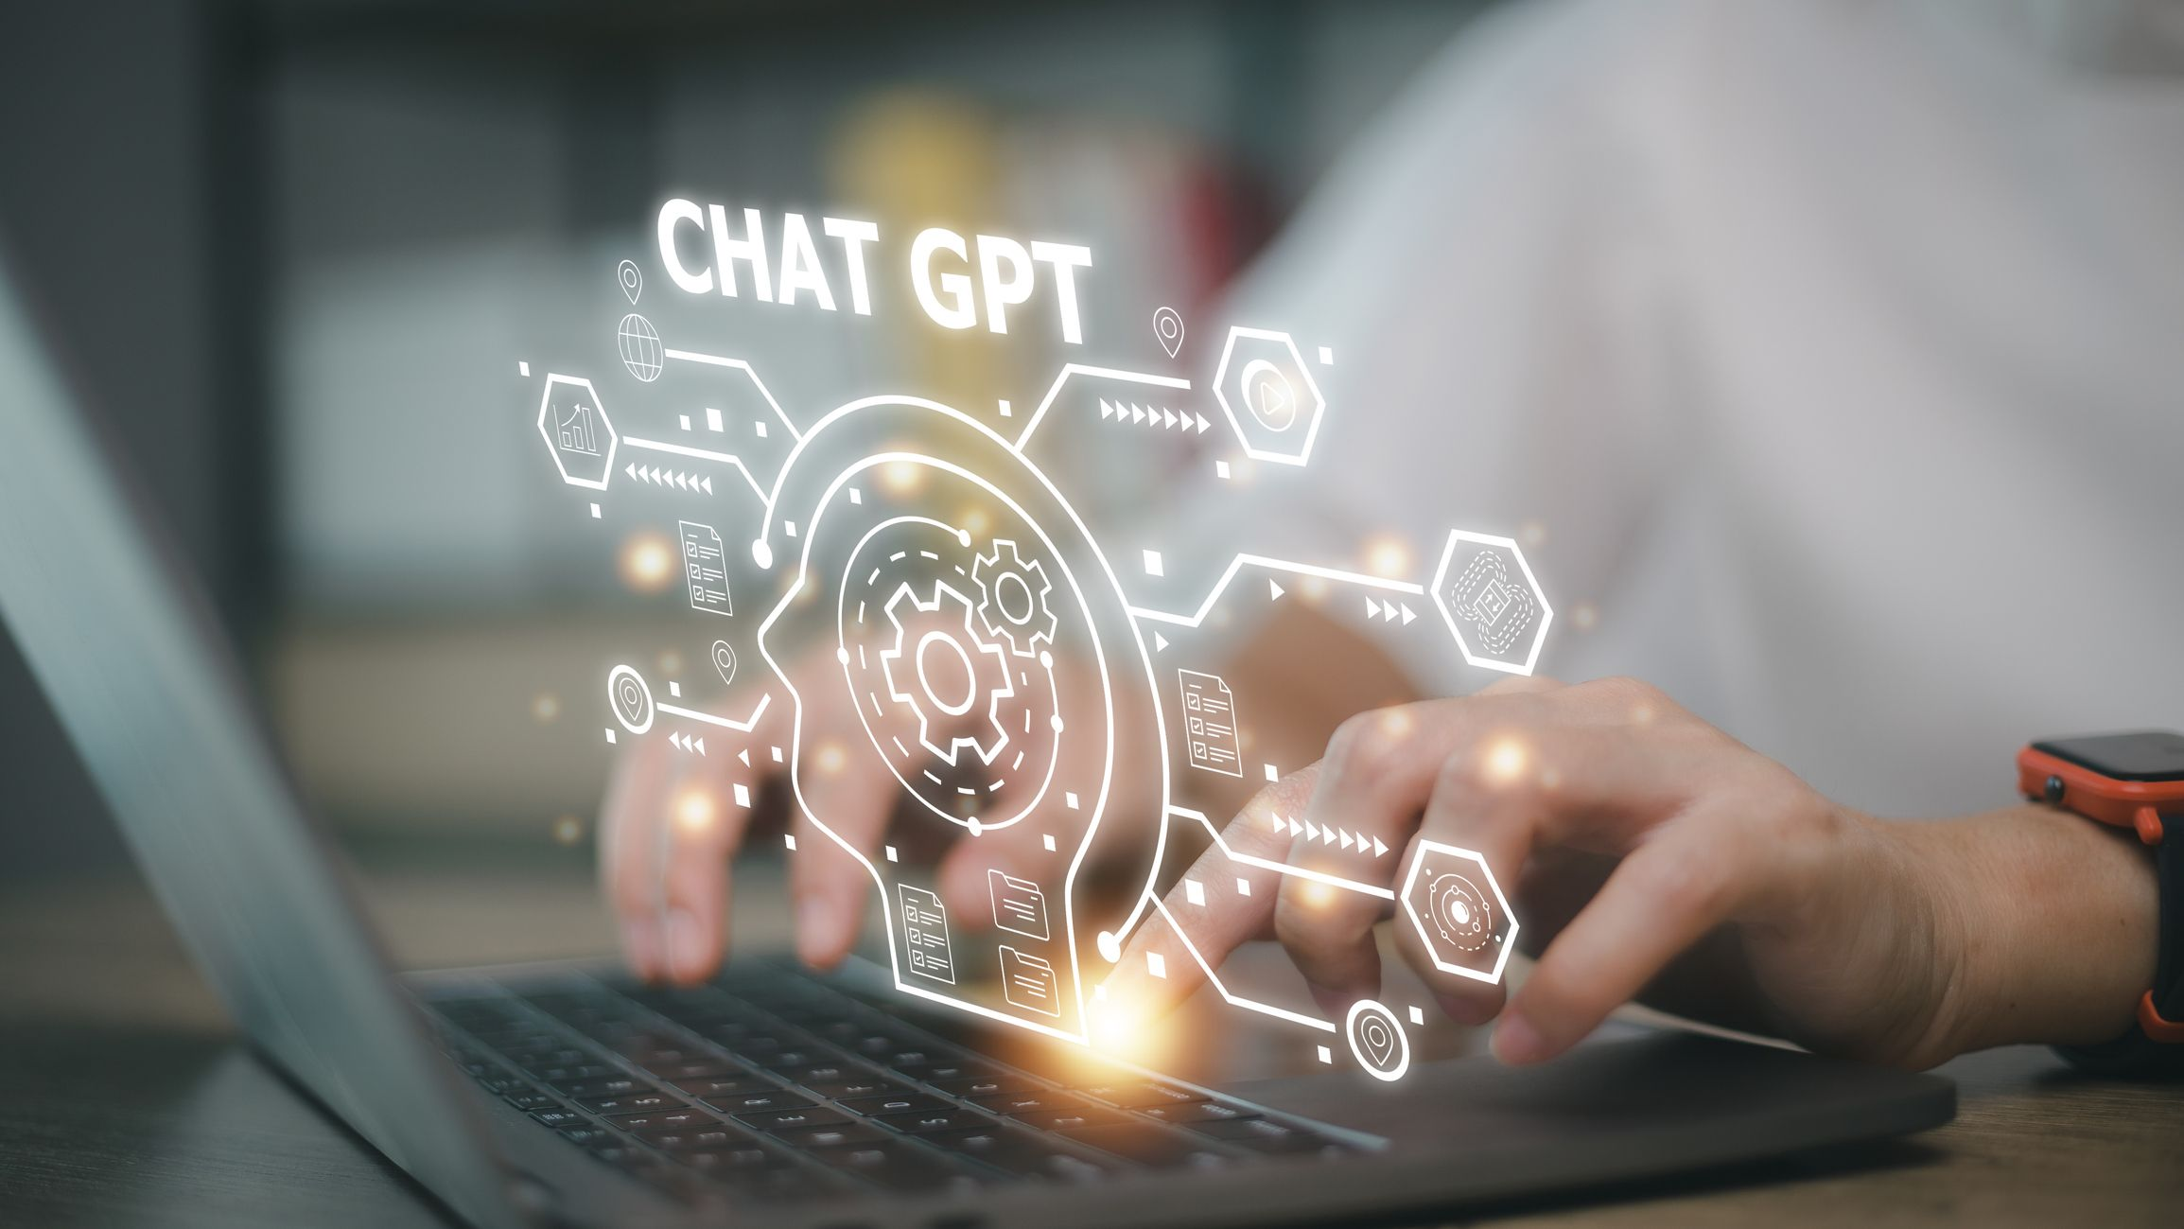
Accumulation
general
ChatGPT, an advanced artificial intelligence language model, has profoundly influenced various aspects of people's lives since its emergence.
positive impacts
Not only has it reshaped the way we interact with machines but has also opened up new possibilities for communication, productivity, and innovation.

Slide 10
Accumulation
negative impacts
Despite its convenience, it may provide incorrect information if not properly trained or updated.
Prospects/Outlook
With continuous progress and updates, ChatGPT is likely/bound/expected to become even more accurate and reliable.

Slide 11
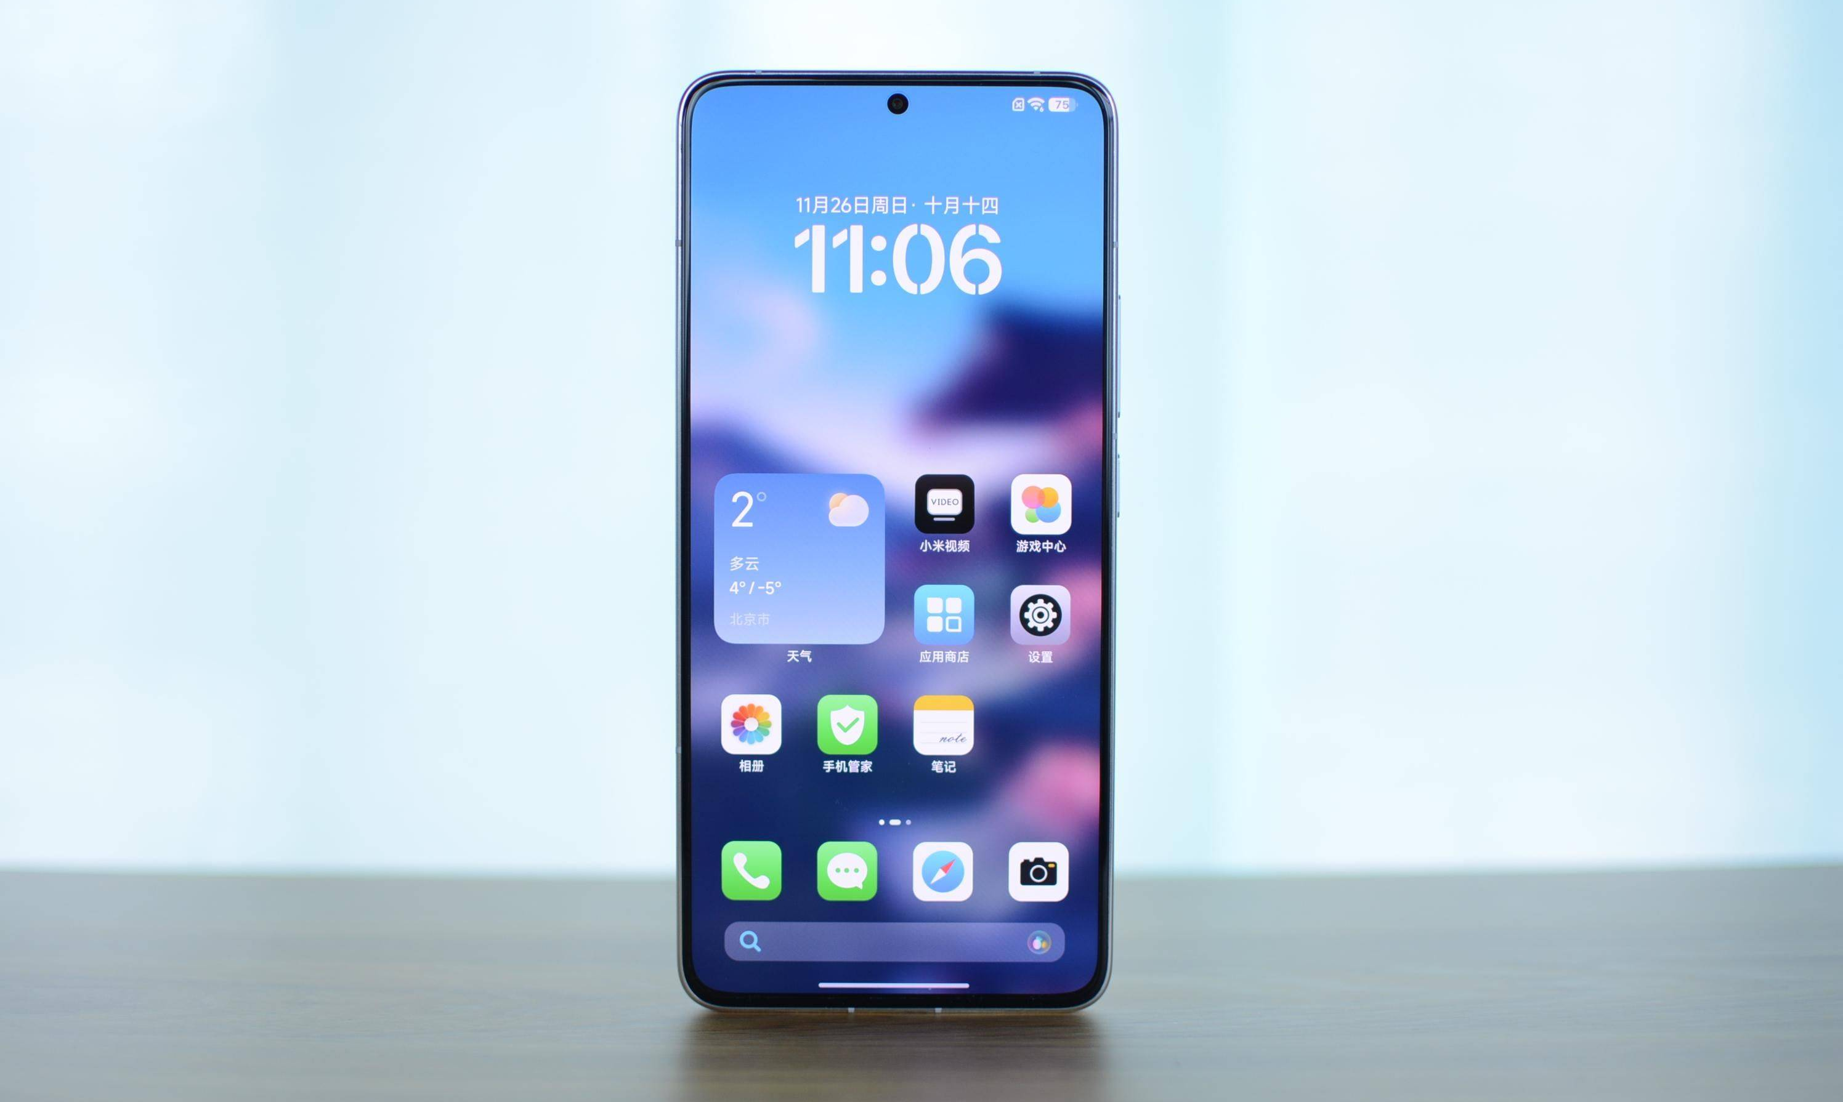
Accumulation
general
Smartphones have revolutionized the way we live, work, and communicate.
positive impacts
These pocket-sized devices have become an integral part of our daily lives, offering unparalleled convenience, connectivity, and access to information.

Slide 12
Accumulation
negative impacts
Despite its convenience,it can also be a major source of distraction, affecting productivity and personal relationships.
Prospects/Outlook
As technology continues to evolve, smartphones are expected to integrate even more advanced features. This includes enhanced AI capabilities, improved camera technology, and more sophisticated security measures.

Slide 13
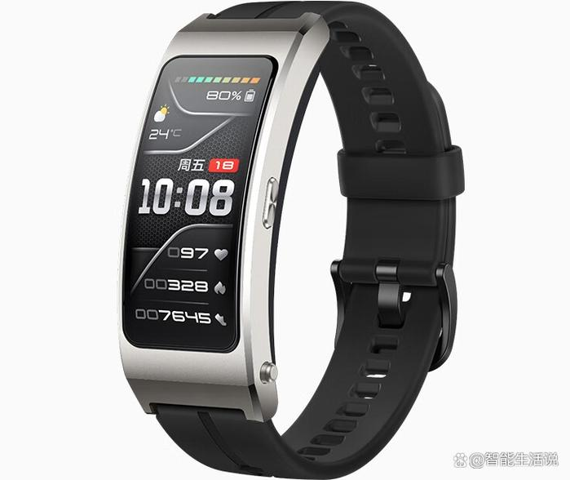
Accumulation
general
Smartwatches have emerged as a popular wearable technology,which have significantly impacted people's lives.
positive impacts
Not only can they help track heart rate, sleep patterns, steps taken and calories burned, but they can also help users maintain a healthier lifestyle.

Slide 14
Accumulation
negative impacts
Despite the advantages, their limited battery life requires frequent charging and it can also be a source of distraction, similar to smartphones.
Prospects/Outlook
As technology evolves, smartwatches are expected to offer even more advanced health monitoring features. This includes blood pressure monitoring, blood oxygen level tracking, and early detection of health issues.

Slide 15
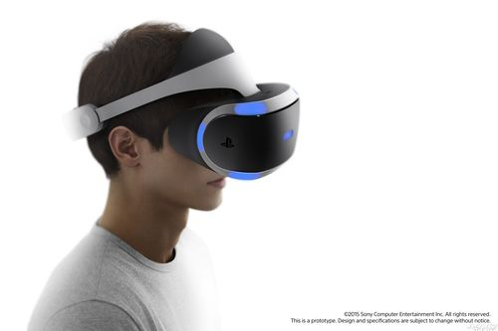
Accumulation
general
Virtual Reality (VR) has emerged as a transformative technology, significantly impacting various aspects of people's lives.
positive impacts
By creating immersive, computer-generated environments, VR has opened up new possibilities for entertainment, education, healthcare, and more.Not only do they offer a highly immersive and engaging experience for gaming, education, and training, but they also enhance learning by allowing users to interact with virtual environments.

Slide 16
Accumulation
negative impacts
Despite the advantages, they usually have high initial cost for VR hardware and accessories and some users may experience motion sickness or discomfort.
Prospects/Outlook
As technology advances, VR is expected to offer even more immersive and realistic experiences.
VR technology is becoming more accessible and affordable, leading to its widespread adoption in various industries. This will enable more people to experience the benefits of VR and drive further innovation and development.

Slide 17
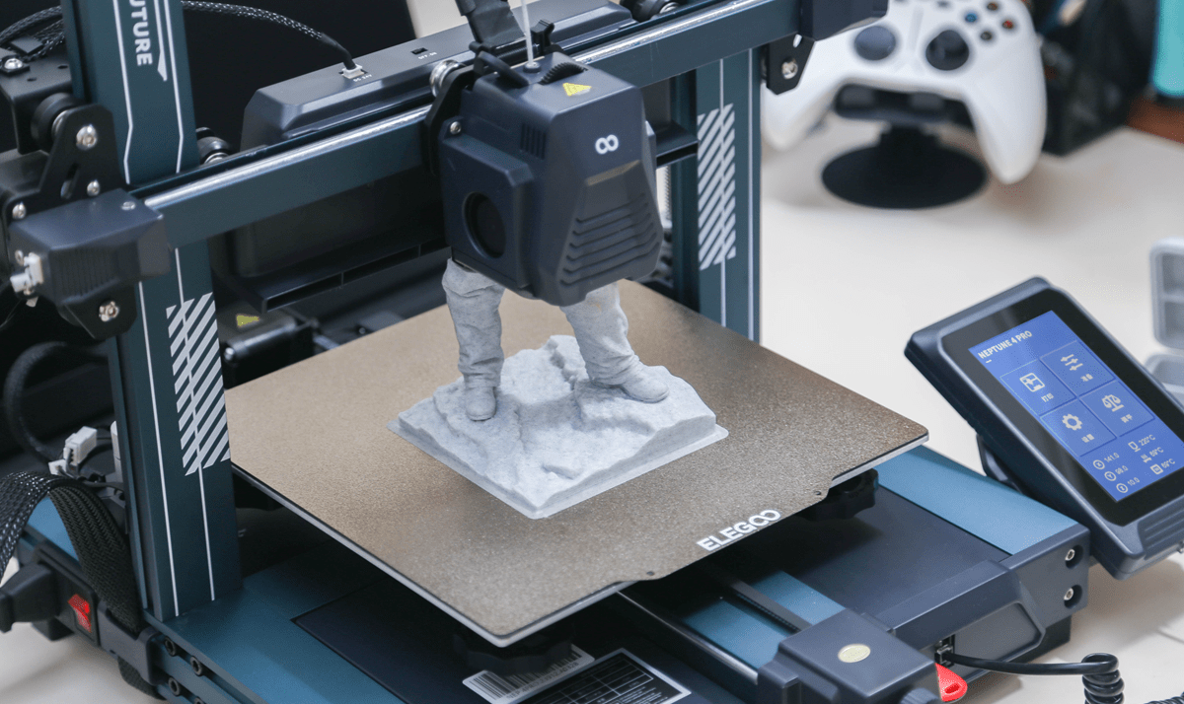
Accumulation
general
3D printing has emerged as a revolutionary technology that has significantly impacted various aspects of people's lives.
positive impacts
By creating three-dimensional objects from digital designs, 3D printers have opened up new possibilities for innovation, customization, and efficiency.
Not only does it encourage innovation and creativity in design and manufacturing, but it also allows for the creation of customized and unique objects, tailored to individual preferences and needs.

Slide 18
Accumulation
negative impacts
Despite the advantages, it is expensive to purchase and maintain. It is restricted to specific materials that can be 3D printed.
It may produce objects with lower quality or durability compared to traditional manufacturing methods.
Prospects/Outlook
As technology advances,3D printing technology is becoming more accessible and affordable, making it possible for more people and businesses to adopt and benefit from this innovative technology. This will drive further innovation and development, as well as create new opportunities for entrepreneurship and economic growth.

Slide 19
Accumulation
appreciation/summary
/anticipation/wish
P3
Closing
Version1 :
Thank you for your attention, and I look forward to the following extensive, in-depth and inspiring discussions.Have a wonderful day, and thank you once again.
Version2 :
Thank you for your attention and engagement today. It has been a pleasure sharing these thoughts with you, and I am grateful for the opportunity to learn and grow together through this discussion. Let's continue to explore and embrace the wonders of technology, shaping a brighter future for all. Have a wonderful day, and thank you once again.

Slide 20

Sample writing one
Good morning, everyone.
Today, I am thrilled to share with you a technological item in our life: Artificial Intelligence (AI). AI involves the development of computer systems designed to perform tasks that normally require human intelligence.
By automating routine tasks and providing innovative solutions to complex problems, AI has already made waves in various aspects. It is transforming healthcare with personalized treatments, enhancing security with facial recognition, and even teaching languages with unmatched efficiency.
Looking ahead, AI is bound to become an indispensable part of our lives. I anticipate significant advancements in AI’s ability to interact with the world, leading to breakthroughs in robotics, autonomous transportation, and even creative fields like art and music. While the future with AI holds immense promise, it’s also crucial to address ethical issues to make sure it benefits humanity.
Thank you.

Slide 21
Sample writing two
Good morning, everyone.
Today,I’m so honored to be here to deliver a speech with the theme of ‘the influential technological item in our daily life’, which is ChatGPT.
As we all know, ChatGPT, an advanced artificial intelligence language model, has profoundly influenced various aspects of people's lives since its emergence. Not only has it reshaped the way we interact with machines but has also opened up new possibilities for communication, productivity, and innovation.Despite these advantages, it may provide incorrect information if not properly trained or updated, which lowers our working efficiency. However,with continuous progress and updates, ChatGPT is bound to become even more accurate and reliable.
Thank you for your attention, and I look forward to the following extensive, in-depth and inspiring discussions.Have a wonderful day and thank you once again.

Slide 22
Sample writing three
Good morning, everyone.
It is an honor to stand here today, on behalf of our vibrant English Club, to delve into the technology and its profound impact on our lives. The topic that I have chosen to discuss is "A Technology Product That Has Significantly Influenced Our Lives," and for this purpose, I would like to highlight the Smartphones.
It is widely acknowledged that Smartphones have revolutionized the way we live, work, and communicate. These pocket-sized devices have become an integral part of our daily lives, offering unparalleled convenience, connectivity, and access to information that was inaccessible previously.Despite these advantages,they can also be a major source of distraction, affecting productivity and personal relationships. However,as technology continues to evolve, smartphones are expected to integrate even more advanced features,enabling more people to experience their benefits.
Thank you for your attention and engagement today. It has been a pleasure sharing these thoughts with you, and I am grateful for the opportunity to learn and grow together through this discussion. Let's continue to explore and embrace the wonders of technology, shaping a brighter future for all. Have a wonderful day, and thank you once again.

Slide 23

Thank you!

