Slide 1


感恩遇见，相互成就，本课件资料仅供您个人参考、教学使用，严禁自行在网络传播，违者依知识产权法追究法律责任。
更多教学资源请关注
公众号：溯恩英语
知识产权声明

Slide 2
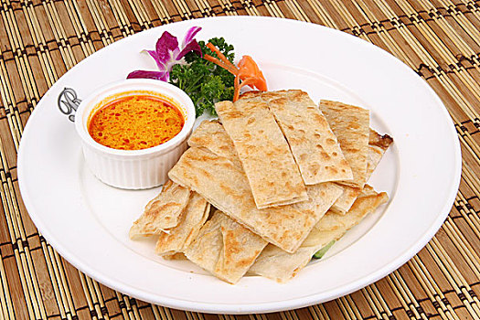


---2024-11 湖丽衢三地市联考
人与社会之友谊篇
郑素红

Slide 3
读原文:
When Devon's sister, Lil, went off to college, Devon's stomach felt all twisty. Then Mom said that Kapil, a high-school student from India, would be staying in their house and living in Lil's room, for they were the host family. The piece of news made Devon's stomach feel worse, as he missed his sister so much. "What if I can't understand him?" Devon asked. "He speaks English well," Mom said.
On Kapil's first day, he exchanged some small talk with Devon before disappearing into his new room. Lil's room, Devon reminded himself. As days went on, Kapil started spending more time in the rest of the house. He was in the kitchen a lot, whose cooking always filled the air with steam and spice that made Devon's eyes water. "Smells wonderful!" Mom exclaimed. When Lil called a few days later, Devon told her about Kapil's cooking, "Lucky! I love Indian food!" Lil said. "But it seems too spicy for me," replied Devon.
One day, Mom had to work late. "Kapil will stay with you until I get home," she explained.Devon's stomach twisted. Lil had always stayed with him when Mom had to work late.

Slide 4
When Devon got home from school, Kapil greeted him at the door. "Would you like à snack?" Kapil asked. Devon shrugged. Lil and he used to cook together after school, which they called "making messes." Kapil opened the refrigerator. "How about a yogurt?" "I had one at breakfast," responded Devon in a cold voice. Kapil opened a cupboard and smiled. "Wait here." He returned with a package. "I 'lI cook an Indian snack," he announced. Kapil pulled out a round, thin cracker the size of a small Frisbee, poured oil into a pan and fried the cracker. Then the kitchen was filled with spicy smells. After a while, Kapil handed Devon a plate with the sizzling pancake on it. “Papadum(印度薄饼),” he said. “Made from bean flour.”
Para1: Devon's stomach twisted again.
Para2: Looking at the empty plate, Devon said to Kapil, "Let's make messes!"

Slide 5
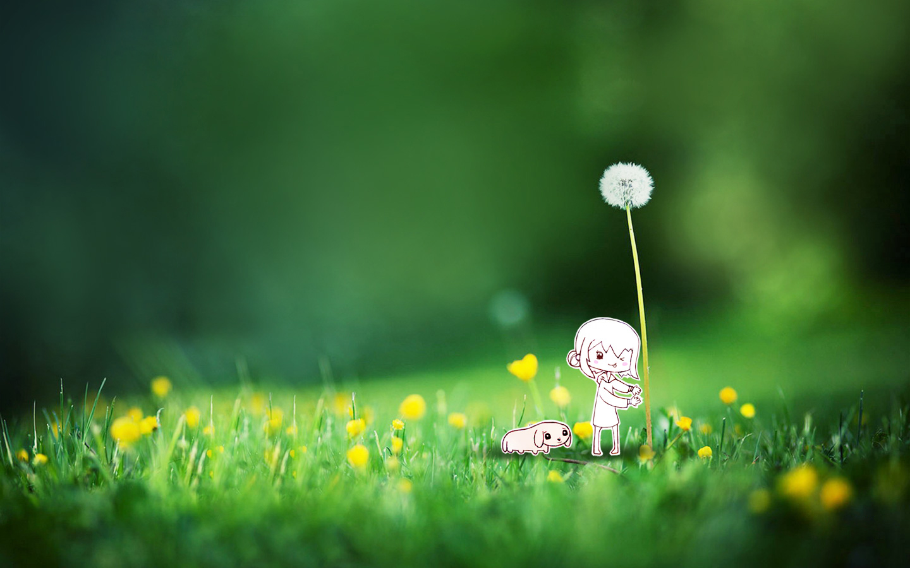
Read for elements
characters：Major roles Devon Kapil
Minor roles: Devon’s sister Lil & their mother
2. narrative perspective: third-person ( Devon Kapil )
time： before / during / after the cooking competition
place： in the kitchen at Devon’s house;
Event : An Indian high-school student “occupied”
Devon’s sister Lil’s room.

Slide 6
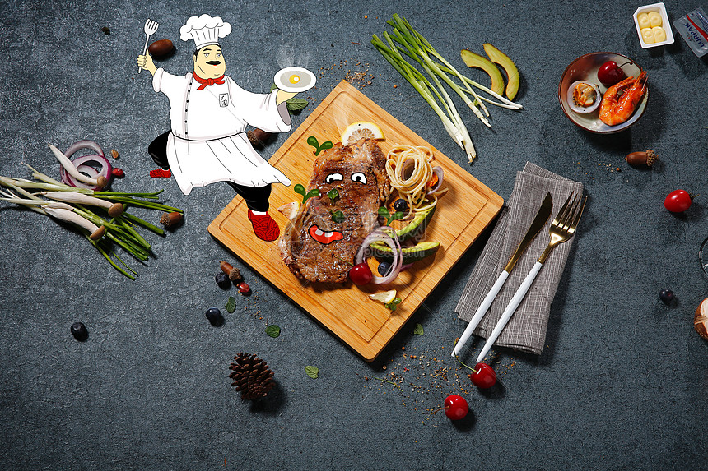
Conflict 1: Devon’s sister Lil went to college and Devon missed her .
Analyze conflicts
Conflict 2: Lil’s room was occupied by Kapil, an Indian high-school student.
solution : Devon befriended Kapil by making messes in the kitchen just as Devon and Lil did before.

Slide 7

5.story line
Climax
One day, Mom had to work late and Kapil would stay with Devon until she got home. Kapil cooked papadum for Devon.
Para1: Devon's stomach twisted again.
Time going by, Kapil was in the kitchen a lot, whose cooking always filled the air with steam and spice that made Devon's eyes water.
Para2: Looking at the empty plate, Devon said to Kapil, "Let's make messes!"
Deven felt even sadder when told Kapil would live in his sister’s room.
Devon’s sister Lil went to college and Devon felt sad.
background
Ending
Beginning

Slide 8
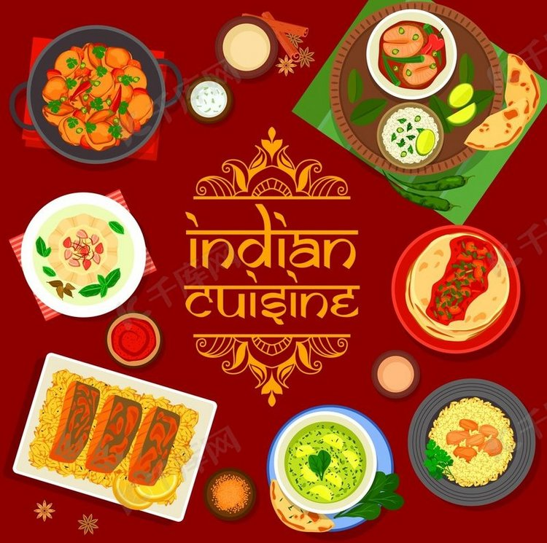
Read for clues and echoes
hidden clues | echoes
When Devon's sister, Lil, went off to college, Devon's stomach felt all twisty. Then Mom said that Kapil, a high-school student from India, would be staying in their house and living in Lil's room, for they were the host family. The piece of news made Devon's stomach feel worse, as he missed his sister so much. "What if I can't understand him?" Devon asked. "He speaks English well," Mom said. | 1. When Devon was enjoying every bite of those traditional dishes from a faraway land, Devon’s stomach felt untwisted. 2. Devon asked with curiosity, “ Do you miss your family?” Casting an understanding look at Devon, Kapil said he missed his family as much as Devon missed his sister.

Slide 9
Read for clues and echoes
hidden clues | echoes
On Kapil's first day, he exchanged some small talk with Devon before disappearing into his new room. Lil's room, Devon reminded himself. As days went on, Kapil started spending more time in the rest of the house. He was in the kitchen a lot, whose cooking always filled the air with steam and spice that made Devon's eyes water. "Smells wonderful!" Mom exclaimed. When Lil called a few days later, Devon told her about Kapil's cooking, "Lucky! I love Indian food!" Lil said. "But it seems too spicy for me," replied Devon. | 3. The overwhelmingly spicy smell of the papadum went straight into his nostrils, making Devon’s eyes water. 4. All of a sudden, “ Lucky! I love Indian food” echoed in his ears.

Slide 10
Read for clues and echoes
hidden clues | echoes
…Lil and he used to cook together after school, which they called "making messes." Kapil opened the refrigerator. "How about a yogurt?" "I had one at breakfast," responded Devon in a cold voice. Kapil opened a cupboard and smiled. "Wait here." He returned with a package. "I 'lI cook an Indian snack," he announced. ………. After a while, Kapil handed Devon a plate with the sizzling pancake on it. “Papadum(印度薄饼),” he said. “Made from bean flour.” | 5. Ice between Devon and Kapil melting, Devon embarked on a new journey of making messes with Kapil and a “spicy” friendship began to bloom. 6. Noticing confusion etched on Kapil’s face, Devon grinned from ear to ear, explaining briefly that his sister Lil and he used to cook together after school and how much he missed her.

Slide 11
心理描写
神态描写
动作描写
外貌描写
环境描写
对话描写
语言
无灵主语
动作链
分词作状语
With 复合结构
独立主格
从句
倒装句
虚拟语气
强调句
长短句结合
考生构思情节的同时，要考虑合适的语言句式以及修辞

Slide 12
Plot the continuation story
Para1: Devon's stomach twisted again.
Para2: Looking at the empty plate, Devon said to Kapil, "Let's make messes!"
Link1: How did the papadum smell? What did Devon do with it?
Body: What did Kapil do? Then what did Devon do?
Link2: What happened to the papadum ?
Link3: How did Devon explain “make messes”?
Body: What did Devon say to Kapil to invite him to make messes?
How did Kapil feel? What did Kapil do together with Devon?
Theme: How did the relationship change between Devon and Kapil?

Slide 13
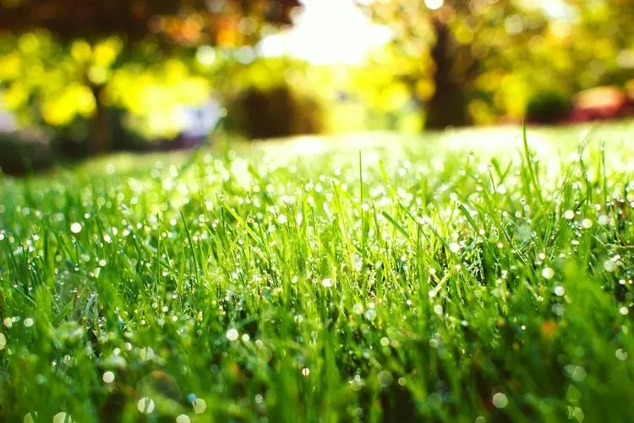
Design link1
Para1: Devon's stomach twisted again.
Link1A: (呼应原文最后一句：） The overwhelmingly spicy smell of the papadum went straight into his nostrils, making Devon’s eyes water.
Link1B: （呼应原文Devon 对姐姐做的东西更怀念）Eyes fixed on the spicy-smelling papadum, how Devon missed Lil and those delicious dishes cooked by Lil！
Link1 C: (对比Kapil 与姐姐做的吃的完全不一样） Lil had never cooked such spicy snack of bean flour before! “ It must taste horrible! ” Devon thought to himself， frowning.

Slide 14
Design link2
Para1: Devon's stomach twisted again.
Para2： Looking at the empty plate, Devon said to Kapil, "Let's make messes!"
Link2 A: (呼应第二段所给句首句，暗示“我吃完了盘子里的飞饼”) Every taste bud on his tongue awakened, Devon wolfed it down, exclaiming, “ I love Indian food just as my sister does!”
Link2 B: (呼应第二段所给句首句，暗示“我吃完了盘子里的飞饼”,并回扣 Devon’s stomach ) When Devon was enjoying every bite of those traditional dishes from a faraway land, Devon’s stomach gradually felt untwisted, his initial unease giving way to gratitude.

Slide 15
Design link3
Para2: Looking at the empty plate, Devon said to Kapil, "Let's make messes!"
Link3A: ( make messes 是Devon and Lil 特有的暗号，Kapil 对于make messes 的理解是有偏差的。） “What?” Kapil asked in puzzlement, eyes wide open.
Link3B: ( make messes 是Devon and Lil 特有的暗号，Kapil 对于make messes 的理解是有偏差的。） “ Are you kidding me? ” Kapil cast a suspicious glance at Devon, confusion etched on face.

Slide 16
Design ending
Para2: Looking at the empty plate, Devon said to Kapil, "Let's make messes!"
Ending A: (Devon 一开始对于Kapil 是有抵触情绪的) Ice between Devon and Kapil melting, Devon embarked on a new journey of making messes with Kapil and a “spicy” friendship began to bloom.
Ending B: (时间线延长一下，展现一下友谊从开始到亲密)
It dawned on Devon that he could create new memories with Kapil in the kitchen. With each attempt at Indian cuisine, their friendship bonded by a papadum grew increasingly strong and close/ intimate.

Slide 17
Para1: Devon's stomach twisted again.
The overwhelmingly spicy smell of the papadum went straight into his nostrils, making Devon’s eyes water. His mind filled with doubts and unease, he was not sure if he could handle the hot papadum. But all of a sudden, “ Lucky! I love Indian food” echoed in his ears. Staring at the still-sizzling pancake, Devon summoned up all his courage to pick it up, took a deep breath and had a tiny bite. What stunned him was that Kapil’s thin pancake didn’t taste like cardboard. Instead, it exploded in his mouth like numerous little flavor bombs. Every taste bud on his tongue awakened, Devon wolfed it down, exclaiming, “ I love Indian food just as my sister does!” (117)

Slide 18
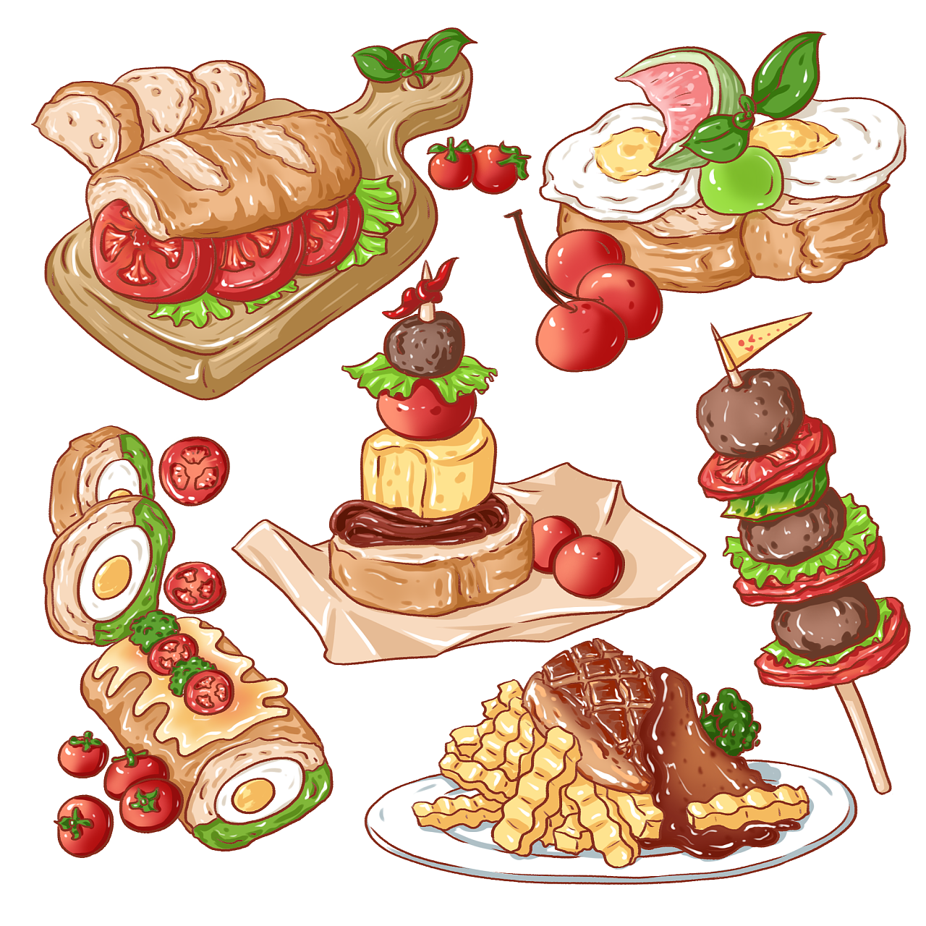
Para2: Looking at the empty plate, Devon said to Kapil, "Let's make messes!"
“What?” Kapil asked in puzzlement, eyes wide open. Noticing confusion etched on Kapil’s face, Devon grinned from ear to ear, explaining briefly that his sister Lil and he used to cook together after school and how much he missed her. Vivid memories of cooking with Lil crowding in, Devon begged Kapil with watery eyes, “Can we make food together?” Moved and determined to act as a big brother, Kapil nodded, eyes sparkling with joy and anticipation. Smiling at each other, they charged into the kitchen, rummaged through the cupboard，searched for the ingredients and cooked
Devon and Lil’s dishes and spicy Indian food together. Ice between Devon and Kapil melting, Devon embarked on a new journey of making messes with Kapil and a “spicy” friendship began to bloom. (116)

Slide 19
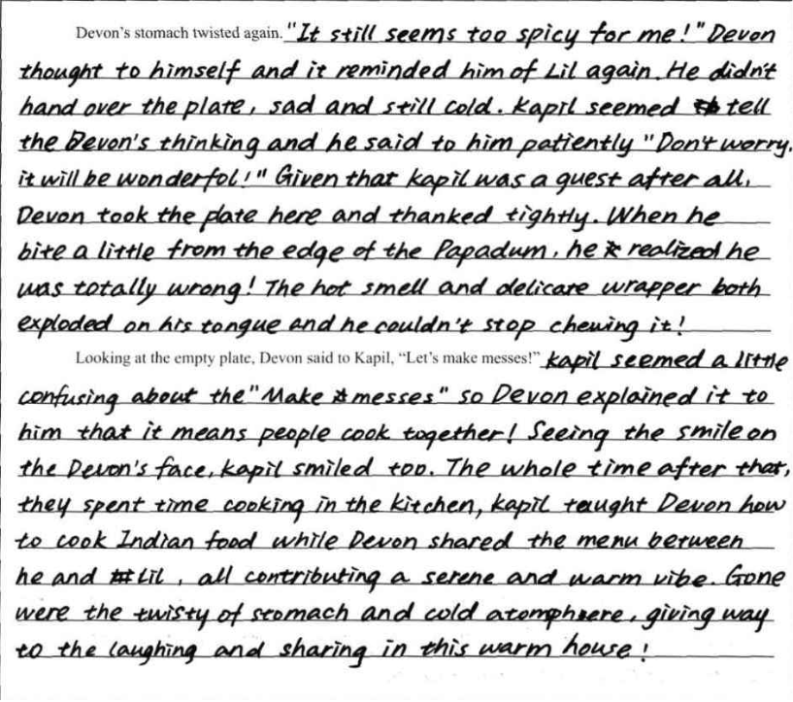
考生习作点评：
三处衔接紧凑，符合故事发展逻辑；尤其是第二段的衔接，非常自然，考生抓住了“ make messes ”这个字眼，也从开始尝试吃印度飞饼到喜欢印度食物到两个人有了语言的初次交流，自然而然地为接下来的友谊做好了铺垫；
句式多样丰富，情感表达自然，
不足：个别表达出现语法错误如： seemed tell; contributing to 介词to 漏掉； 以及中式英语： The whole time after they spent time cooking in the kitchen,

Slide 20
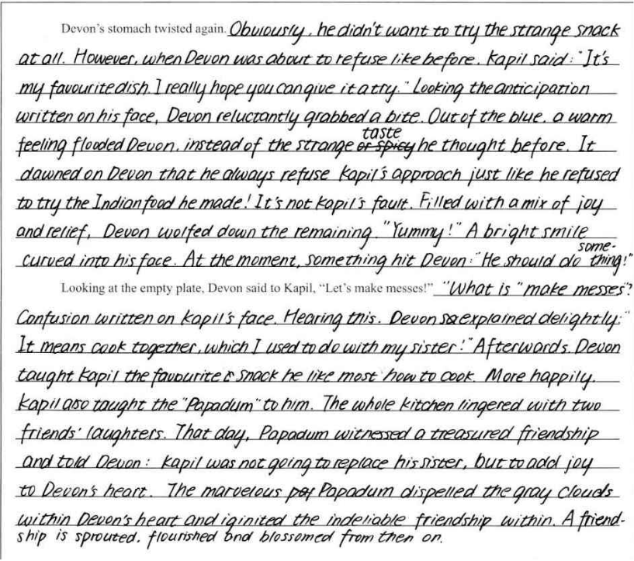
考生习作点评：
两段均与段首句的衔接非常自然贴切
语言非常老练，词汇储备以及语料储备充足
文笔优美；充分考虑到跨文化的文本背景，并在续写中有很好的体现，并与原文进行呼应回扣。

Slide 21
动作描写之所说 （ “口” 发出的动作）：
Every taste bud on his tongue awakened, Devon wolfed it down, exclaiming, “ I love Indian food just as my sister does!” （ 惊叹）
Looking into her tearful eyes, Mom comforted her in a soft voice/ tone, “ Don’t worry! Let’s go back to the cinema to find your phone. ( 柔声安慰）
“What?” Kapil asked in confusion, eyes wide open. ( 问）
Trapped in the lift car and feeling extremely desperate, I screamed for help at the top of my lungs, hoping someone could hear me and send rescue to us. ( 高声呼救）
Seeing David cross the finish line, all the audience cheered up and applauded enthusiastically , moved by David unique perseverance and courage. ( 喝彩）

Slide 22
友谊素材
Ice between Devon and Kapil melting, Devon embarked on a new journey of making messes with Kapil and a “spicy” friendship began to bloom.
With each attempt at Indian cuisine, their friendship bonded by a papadum grew increasingly strong and close/ intimate.
A seed of a beautiful friendship was sown unknowingly in our hearts despite our distinct differences in hobbies.
In the kitchen filled with steam and spice, the aroma of Indian food cooked by Kapil was like an invisible hand, slowly beginning to knock on the door of friendship in Devon’s heart.

