Slide 1


感恩遇见，相互成就，本课件资料仅供您个人参考、教学使用，严禁自行在网络传播，违者依知识产权法追究法律责任。
更多教学资源请关注
公众号：溯恩英语
知识产权声明

Slide 2

温州市普通高中2025届
高三第一次适应性考试
北师大嘉兴附中 吴晨华

Slide 3

题型 | 话题 | 体裁 | 词数
阅读A | 人与社会：An introduction on High School Program –Science Alliance | 应用文 | 293
阅读B | 人与社会：An Indian, Rathee made fact-checking videos. | 记叙文 | 265
阅读C | 人与社会：An introduction on Skeuomorphs | 说明文 | 368
阅读D | 人与社会：An introduction on the PhD job shadow program | 说明文 | 360
七选五 | 人与社会：How to overcome the harmful habit of JUDGING | 说明文 | 304
完型填空 | 人与社会：A couple who was helped by a housing program | 记叙文 | 207
语法填空 | 人与社会：The history and popularity of Malatang | 说明文 | 213

Slide 4
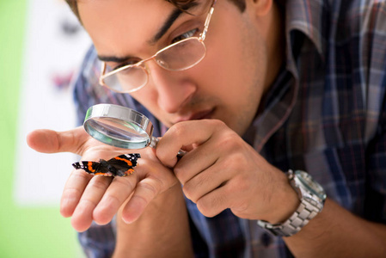
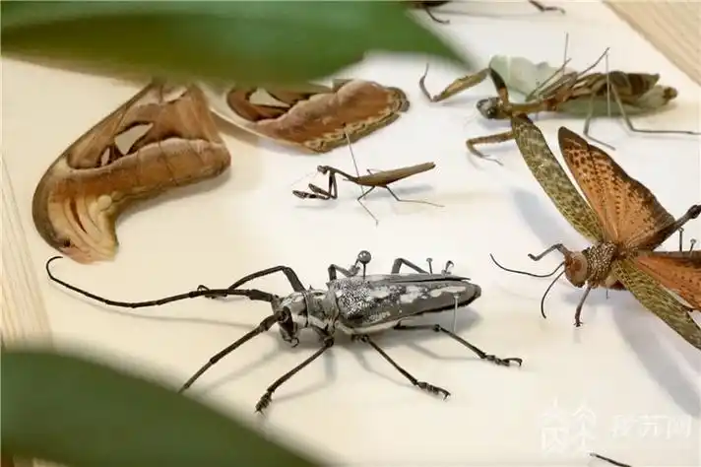
A
An introduction on High School Program –Science Alliance
人与社会：应用文

Slide 5
Science Alliance: High School Program
We are excited to announce the expansion of the Science Alliance Program to students in grades 9-12. Students can choose the topics they want to explore: anthropology, astrophysics, conservation science, Earth science, and evolutionary biology.
During the school year, Science Alliance High School runs three sessions: Fall, Winter, and Spring. Courses will meet once or twice a week on Tuesdays and/ or Thursdays from 4:30-6:30 pm.
Should you have any trouble registering using the program links, please call Central Reservations at 212-769-5200 to purchase or be added to the waitlist.
You will obtain a full refund if you cancel at least 30 days before the start of the program. A half refund if you cancel at least 15 days ahead, a quarter refund if you cancel at least a week ahead. Any cancellations less than a week before the start of the program are not eligible to receive a refund.
21. What is known about the program?
A. It runs on a monthly basis.
B. It is tailored for freshmen.
C. It consists of four sessions.
D. It covers a variety of topics.
22. What can students do at Insectarium?
A. Raise insects in the lab.
B. Create tools with museum scientists.
C. Go on an insect field trip.
D. Contribute specimens to the museum.
23. If a student cancels registration 20 days ahead, how much will he receive?
A. None. B.$500. C.$1,000. D.$750.
Fall 2024 Sessions
CLASS | AGE GROUP | DATES & TIMES
Insectarium Insects play a vital role in our New York City community by decomposing the city’s organic matter and pollinating (授粉) the vast majority of our food-bearing plants. In this course, students will explore insect biodiversity, human health, and the Museum scientists that have contributed research and specimens (标 本 ) to the Insectarium. They will practice various insect collection methods in the field and preparation techniques back in the lab. Using the Museum’s insect collections and new technologies, students will explore a variety of digital tools that allow the m to study these tiny creatures in new, more visible ways. Click Here to Register Cost: $1,000 | Grade 9 Grade 10 Grade 11 Grade 12 | Tuesdays & Thursdays, 4:30-6:30 pm 10/10,10/15,10/17, 10/22,10/24,10/29, 11/7,11/12,11/14, 11/19,11/21,12/3, 12/5,12/10,12/12

Slide 6
文本词汇学习
认识生词
insectarium aquarium oceanarium planetarium
food-bearing plants
decompose the city’s organic matter
decode deforest decolonize devaluation decolor defog delist
4. explore insect biodiversity
5. Any cancellations are not eligible to receive a refund.
活动主题词汇
这次采访活动为新生量身定制 ，并按月进行，涵盖多个话题。如果你感兴趣，请点击链接（这里）并注册报名。如果你足够幸运，你将被加入到候补名单中。如果报名取消你将获得全额退款 。
_________freshmen, the interview runs______________, _________________________.
If interested , please__________________________ . If you are lucky enough , you will __________________. And you will ___________________if you ____________________ /withdraw your enrollment.
昆虫展览室
水族馆
海洋水族馆
天文馆
产食用作物的植物
分解
解码
砍伐树林
去殖民化
贬值
使脱色
除雾，使清晰
从单子上划去
生物多样性
取消，撤销
=qualified
Tailored for
on a monthly basis
covering a variety of topics
click the link (here) to register
be added to the waitlist
obtain a full refund
cancel your registration

Slide 7
文本词汇学习
一词多译
During the school year, Science Alliance High School runs three sessions.
He has no idea how to run a business.
Stop trying to run my life for me.
Her life had always run smoothly before.
Shall I run you home?
She ran her fingers nervously through her hair.
I ran my eyes over the page.
Her last musical ran for six months on Broadway.
His face was running with sweat.
The trail ran through the woods.
2. Scientists have contributed research and specimens to the Insectarium.
Would you like to contribute to our fund-raising event?
I can do some work that will contribute to international cooperation and understanding.
We hope everyone will contribute to the discussion.
I believe that each of us can contribute to the future of the world.
提供，开设
管理，经营
操纵、控制
运转，运行
开车送某人
用手指摩挲着
匆匆看一眼
持续
流动
延伸
捐赠
有助于
参与
做贡献

Slide 8
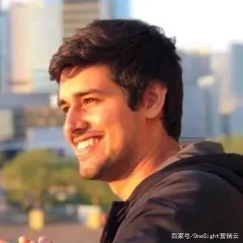
B
人与社会：记叙文
An Indian, Rathee
made fact-checking videos.

Slide 9
Rathee discovered YouTube in 2014, a time when cheap smartphones and cellular(蜂窝) data led to a boom in internet access in India. Inspired by videos he watched online, Rathee, now 28, started a travel vlog. But he soon noticed a problem. “People in India weren’t trained on how to use the internet and blindly trusted whatever they saw on YouTube or WhatsApp,” he says. So Rathee, who grew up in a small northern Indian town in the state of Haryana and later studied mechanical engineering in Germany, became what he calls a “YouTube educator”, making videos in Hindi that fact-check topics that are trending on Indian social media. “My aim is to present things as simply as possible and break down complex issues in simple words,” he says.
Rathee’s work is incredibly popular— he’s accumulated nearly 13 million subscribers, making his YouTube channel one of the most-viewed in the country. It has also led to conflicts. When a film called The Kerala Story began making waves in May, Rathee made a 23-minute video in which he argued that the film promoted a false theory. Though Rathee used the government’s data and international sources to make his counterclaim, his fact-checking led to consequences, including threats sent to his family.
Despite the risks, Rathee remains calm. He makes videos for one reason. “I hope they teach people tolerance, coexistence, and accepting each other’s opinions, values that I myself really value,” he says. “I’m surprised doing such a simple thing can bring so much attention,” he adds, “maybe because no one tries to dare to do that.”
24. What problem did Rathee notice with Indians?
A. They blindly subscribed to vlogs.
B. They were addicted to online videos.
C. They had limited access to the Internet. D. They were easily misled by online information.
25. Why did Rathee make his video about the film?
A. To attract views and attention.
B. To correct government data.
C. To stop the spread of a false theory.
D. To support his previous argument.
26. Which word could best describe Rathee’s work?
A. Confusing. B. Enlightening.
C. Disappointing. D. Entertaining.
27. What does the underlined word “that” in the last paragraph refer to?
A. Raising various opinions.
B. Challenging the authority.
C. Making fact-checking videos.
D. Critisizing traditional values.
why
what
why
how

Slide 10
文本词汇学习
Inspired
_________(inspire) by videos he watched online, Rathee, now 28, started a travel vlog.
Rathee, ______ grew up in a small northern Indian town, became ____he calls a “YouTube educator”, ________(make) videos in Hindi that fact-check topics that are trending on Indian social media.
Rathee’s work is __________(incredible) popular— he’s accumulated nearly 13 million__________ (subscribe), making his YouTube channel one of the most-viewed in the country.
When a film called The Kerala Story began making waves in May, Rathee made a 23-minute video _________ he argued that the film promoted a false theory.
Though Rathee used the government’s data and international sources to make his counterclaim, his fact-checking led to consequences, including threats _______(send) to his family.
_________ the risks, Rathee remains calm.
I hope they teach people ___________(tolerate), coexistence, and accepting each other’s opinions, values that I myself really value.
They blindly subscribed ____ vlogs.
They were addicted ____ online videos.
They had limited access ____ the Internet.
subscribe to
I've personally never subscribed to the view.
He subscribes regularly to the charity.
who
what
making
incredibly
subscribers
in which
引起骚动、激起争议或产生重大影响
sent
反诉；反对要求
Despite
tolerance
lead to a boom
lead to conflicts
lead to consequences
to
to
to
access
Students must have access to good resources.
= _______________
be accessible to

Slide 11
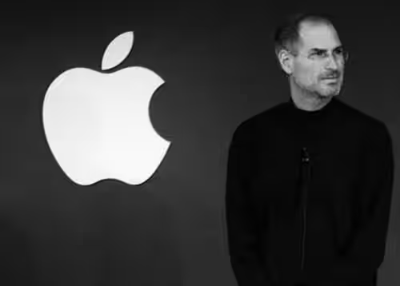
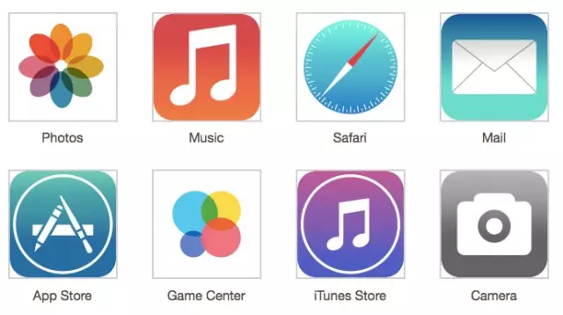
C
An introduction on Skeuomorphs
人与社会：说明文

Slide 12

The concept of skeuomorphs
Have you ever noticed how the email icon(图标) on many computers and smartphones is of an envelope? Or how camera phones make the sound of a real camera clicking when you take a photo, even though there’s no shutter to open or close? These are examples of skeuomorphs, which is when new things take on the appearance or sound of the object they’ve replaced.
Why would new things want to look like something old? It’s all to do with human psychology. Psychologist James Gibson says one of the ways people understand the world is through affordances — objects whose shape tells you how to use them. When creating new digital technologies, inventors like Steve Jobs of Apple used skeuomorphs so people would know how to use their products. By showing people an image of something they already knew how to use, it made using a computer or smartphone easier.
However, as people became more familiar with modern technology, some designers argued that skeuomorphs were no longer necessary. Indeed, the younger generation don’t need visual references to older items they’ve never used. This led to something called flat design, where computer desktops and smartphone home screens started to do away with skeuomorphism.
Skeuomorphs made a comeback, though, with smart watches. Many smart watches took on the appearance of an old fashioned watch, with a clock face. This was to encourage people who didn’t like digital watches to consider buying a smart watch.
While these are the ways skeuomorphs are used today, that doesn’t mean it’s only a modern phenomenon. In fact, the word was first used in 1899 by the archaeologist Henry Colley March, who realized that some ancient artefacts(人工制品) kept the appearance of older objects, even though there was no practical reason for them to do so. When ancient Greek builders moved from using wood to stone, they recreated some of the characteristics of wooden buildings. From ancient Greek architecture to 21ª century technology, skeuomorphs have been a key feature of scientific progress. So, when you wonder about the objects of the future, take a look around. Chances are that they will look a lot like the objects of the past.
28. Which of the following is an example of skeuomorphs?
29. How would people feel about skeuomorphs?
User-friendly. B. Safety-centered.
C. Energy-saving. D. Cost-effective.
30. Why did some designers think skeuomorphs unnecessary?
A. Users became accustomed to technology.
B. These products were expensive to design.
C. Young people rejected traditional designs.
D. The existing standards had been updated.
31. What is the last paragraph mainly about?
A. The prediction about future objects.
B. The key feature of scientific progress.
C. The design philosophies of skeuomorphism.
D. The ever-lasting presence of skeuomorphs.
The psychological reasons of using skeuomorphs
Being unnecessary among the young
The comeback of skeuomorphs
Earlier cases of using skeuomorphs

Slide 13
文本词汇学习
New things take on the appearance or sound of the object they’ve replaced.
Many smart watches took on the appearance of an old fashioned watch, with a clock face.
No other organization was able or willing to take on the job.
They are not always willing to take on untrained workers.
It’s all to do with human psychology.
This led to something called flat design, where computer desktops and smartphone home screens started to do away with skeuomorphism.
3. One of the ways people understand the world is through affordances –objects whose shape tells you how to use them.
The ever-lasting presence of skeuomorphs
4. Chances are that they will look a lot like the objects of the past.
5. Users became familiar with (=_______________) technology.
呈现
承担
雇佣
与…相关
废除、消除或摆脱
功能可见性
永远存在
很有可能
accustomed to

Slide 14
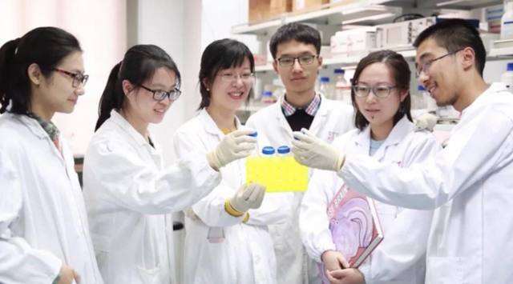
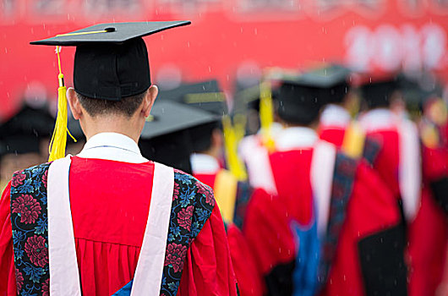
D
An introduction on the PhD job shadow program
人与社会：说明文

Slide 15
In 2017, the University of Waterloo created the PhD job shadow program to help PhDs explore their career options beyond a tenure-track faculty position(终身教职). The program achieved this by having PhD students shadow non-faculty (非教师) staff or hosts who work in departments such as graduate studies and postdoctoral affairs and the centre for teaching excellence. The students would write up a case study relevant to the staff members’ department, including projects like designing a survey or creating a report based on document review.
In 2023, the program was improved to give students greater agency when choosing a host based on student, host and program staff feedback who all found that student-host matching didn’t always meet student needs or expectations. Students were asked to create a list containing up to five staff of their choice and then paired with the staff chosen from their submitted lists. This active effort to find common ground with their hosts created a more meaningful relationship and allowed for higher satisfaction with the interactions during the program.
Choosing their host and doing research around their role allowed students to be better prepared to contribute to a specific department through the case study. One student claimed:“So I found that in general it was a direct match... There are parts that I would have to learn, but the background structure of what I’ve been doing directly translates.” This is particularly relevant since PhD students may finish their program feeling prepared for academia, but most PhD programs do not provide support or training for jobs outside of tenure-track positions.
Mistakenly, the tenure-track is considered by many as the only way to successfully conclude a path in academia and any other paths are“plan B”, which can give feelings of being a “failure”. When students get the opportunity of experiencing what they enjoy about their research in other non-academic or research-related role, finding an equally meaningful career outside of faculty roles becomes clearer and more possible. As one student commented:“It made me realize that the administrative aspect of academia is deeper, richer and more meaningful than what a lot of people assume.”
更大的能动性
The origin
32. What did the PhD Students do in the job shadow program?
A. They experienced non-faculty jobs.
B. They interviewed tenure-track faculty.
C. They worked as teaching assistants.
D. They helped students with career choices.
33. How did the program change in 2023?
A. It limited the number of hosts.
B. It narrowed down its subjects.
C. It raised its standards for hosts.
D. It increased the PhDs’autonomy.
34. What benefit did the program bring to PhDs?
A. Expansion of career exploration.
B. Preparation for future research.
C. Familiarity with academic settings.
D. Satisfaction with the chosen careers.
35. What may the PhDs agree with according to the last paragraph?
A. Plan B leaves much to be desired.
B. Non-academic positions are also valuable.
C. The administrative positions are better choices.
D. Explorations beyond their capabilities are meaningful.
The improvement
The benefits
The influence

Slide 16
文本词汇学习
职业选择
生涯探索
教学卓越
与…相关
满足某人的需要或期望
与…配对
找到共同点
为特定的部门做出贡献
担任助教
缩小
career options/ choices
career exploration
teaching excellence
be relevant to
meet one’s needs or expectations
be paired with
find common ground with
contribute to a specific department
work as teaching assistants
narrow down
allow:
This active effort to find common ground with their hosts allowed for higher satisfaction with the interactions during the program.
Choosing their host and doing research around their role allowed students to be better prepared to contribute to a specific department through the case study.
A housing program called Vila Reencontro allowed them to look through a list of potential homes available to rent.
使有可能
准许，允许

Slide 17
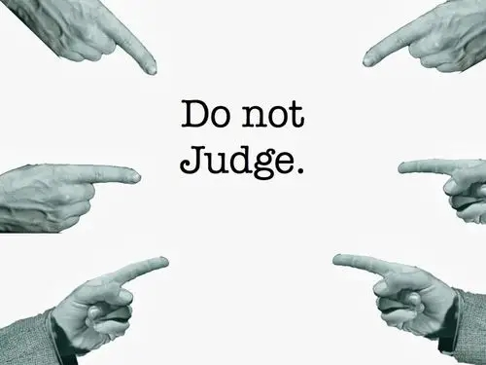
七选五
How to overcome the harmful habit of JUDGING
人与自我：说明文

Slide 18
How to Overcome the Harmful Habit of Judging
You’ve done it. I’ve done it. We all do it— we all sometimes pass judgment on others when their behavior doesn’t meet our standards. Clothing choices, how people spend their free time, job skills— the list of possible things to judge is endless.
36 While you may not consciously label them as such, you are familiar with nonverbals that convey judgment: pursed lips, raised eyebrows, crossed arms, tipping head to literally look down upon another.
We judge others to protect our own self-images. But that protection comes at a price. 37 And with it comes defensiveness, prejudice, and hostility(敌意). Judgment is just a dressed-up version of shame. We put the shame on to someone else so that we don’t have to feel our own.
To overcome judgment, you should shore up your self-worth. If you are grounded in confidence and value yourself, you are less likely to be judgmental. Remind yourself when you feel judged by others, it’s a reflection of their own battle with shame, not who or what you are. Yes, you make mistakes and sometimes behave badly. 38 You grow, learn, and improve. You accomplish and achieve and win. You are valuable and worthy even when you fall short.
When you accept your flaws(缺陷) and mistakes and still see yourself as a worthwhile human being in spite of them, you can in turn accept other flawed human beings, too. 39
Judging others creates a false sense of self-worth. If you find yourself doing it, stop. 40 But do take a look in the mirror. Where do you need shoring up? It takes some thoughtfulness and work, but you’ll have better relationships, improved trust, more creativity, and greater influence when you stop judging others and start valuing yourself.
What: the phenomenon of judging
Why: the bad influence of judging
How: the way to overcome judgment
How: the effect of stopping judging

Slide 19
A. Don’t beat yourself up for it.
B. Shame hits you from many angles.
C. But you are more than your mistakes.
D. You’ve been on the receiving end, too.
E. Judgment costs creativity, curiosity, and trust.
F. At the core is the feeling of not being good enough.
G. The more you like and accept yourself, the less you have to put others down.
不要为此自责。

Slide 20
How to Overcome the Harmful Habit of Judging
You’ve done it. I’ve done it. We all do it— we all sometimes pass judgment on others when their behavior doesn’t meet our standards. Clothing choices, how people spend their free time, job skills— the list of possible things to judge is endless.
36 While you may not consciously label them as such, you are familiar with nonverbals that convey judgment: pursed lips, raised eyebrows, crossed arms, tipping head to literally look down upon another.
36. D 与para.1 对比
A. Don’t beat yourself up for it.
B. Shame hits you from many angles.
C. But you are more than your mistakes.
D. You’ve been on the receiving end, too.
E. Judgment costs creativity, curiosity, and trust.
F. At the core is the feeling of not being good enough.
G. The more you like and accept yourself, the less you have to put others down.

Slide 21
How to Overcome the Harmful Habit of Judging
We judge others to protect our own self-images. But that protection comes at a price. 37 And with it comes defensiveness, prejudice, and hostility(敌意). Judgment is just a dressed-up version of shame. We put the shame on to someone else so that we don’t have to feel our own.
37. E 同义、并列
A. Don’t beat yourself up for it.
B. Shame hits you from many angles.
C. But you are more than your mistakes.
D. You’ve been on the receiving end, too.
E. Judgment costs creativity, curiosity, and trust.
F. At the core is the feeling of not being good enough.
G. The more you like and accept yourself, the less you have to put others down.

Slide 22
How to Overcome the Harmful Habit of Judging
To overcome judgment, you should shore up your self-worth. If you are grounded in confidence and value yourself, you are less likely to be judgmental. Remind yourself when you feel judged by others, it’s a reflection of their own battle with shame, not who or what you are. Yes, you make mistakes and sometimes behave badly. 38 You grow, learn, and improve. You accomplish and achieve and win. You are valuable and worthy even when you fall short.
When you accept your flaws(缺陷) and mistakes and still see yourself as a worthwhile human being in spite of them, you can in turn accept other flawed human beings, too. 39
38. 转折
39. 总结 词的对应
A. Don’t beat yourself up for it.
B. Shame hits you from many angles.
C. But you are more than your mistakes.
D. You’ve been on the receiving end, too.
E. Judgment costs creativity, curiosity, and trust.
F. At the core is the feeling of not being good enough.
G. The more you like and accept yourself, the less you have to put others down.

Slide 23
How to Overcome the Harmful Habit of Judging
Judging others creates a false sense of self-worth. If you find yourself doing it, stop. 40 But do take a look in the mirror. Where do you need shoring up? It takes some thoughtfulness and work, but you’ll have better relationships, improved trust, more creativity, and greater influence when you stop judging others and start valuing yourself.
40. 承上启下，指代
A. Don’t beat yourself up for it.
B. Shame hits you from many angles.
C. But you are more than your mistakes.
D. You’ve been on the receiving end, too.
E. Judgment costs creativity, curiosity, and trust.
F. At the core is the feeling of not being good enough.
G. The more you like and accept yourself, the less you have to put others down.

Slide 24
文本词汇学习
符合我们的标准
将它们标记为
要付出代价
支撑你的自我价值
保持自信
珍视自己
与羞耻作斗争
表现不好
达不到
有缺陷的人类
提升的信任
自责
贬低别人
克服评判
不要妄加评判
感到被评判
噘起嘴唇，扬起眉毛，交叉双臂，低下头来看不起别人
meet our standards
label them as
come at a price
shore up your self-worth
be grounded in confidence
value yourself
battle with shame
behave badly
fall short
flawed human beings
improved trust
beat yourself up
put others down
overcome judgment
be less likely to be judgmental
feel judged
pursed lips, raised eyebrows, crossed arms, tipping head to literally look down upon another

Slide 25

A couple who was helped by
a housing program
完型填空
人与社会：记叙文

Slide 26
41. A. lost B. desired C. pursued D. discussed
42. A. parked B. teamed C. placed D. connected
43. A. parted B. managed C. struggled D. promised
44. A. occasionally B. unexpectedly C. purposefully故意地 D. suddenly
45. A. persuaded B. required C. reminded D. allowed
46. A. available B. expensive C. convenient D. comfortable
47. A. with B. for C. in D. from
48. A. clients顾客；客户 B. applicants C. programs D. options
49. A. reforming B. accessing接近,进入,获取 C. performing D. offering
50. A. gift B. contract合同，契约 C. spot位置，职位 D. bonus奖金，红利
51. A. keep B. increase C. collect D. pay
52. A. miss B. celebrate C. spend D. save
53. A. observing B. cutting C. coloring D. doing
54. A. once B. while C. before D. since
55. A. privacy隐私，秘密 B. space C. time D. business

Slide 27
When the couple had to close their business, they 41 almost everything. With no work, home, car or food, and their young son, Henrique, 42 with his grandmother, they 43 to survive. They spent nights on the floor at the railway station and 44 found beds in a shelter.
A housing program called Vila Reencontro 45 them to look through a list of potential homes 46 to rent, so they could choose what would be the best fit 47 their family. After seeing several 48 , they decided to go with what they are now in.
And they were provided with other opportunities, including 49 medical care and finding jobs. Lee Sousa was offered a(n) 50 in the city’s sanitation department(卫生部门)— which he still has today. The housing program will 51 their rent for the next two years.
Their son is able to live with them again. And he has been doing exceptionally well at school, never wanting to 52 a day. Every morning he takes his time 53 his hair, making sure the curls(卷发) are just right, 54 his mom walks him to school.
Having their own 55 , the family is getting their life back on track.
lost
placed
struggled
occasionally
Para.1 difficulties met
allowed
available
for
options
be fit for固定搭配
accessing
spot
pay
Para. 2-4 helps offered
miss
doing
before
整理发型
space
Para. 5 result

Slide 28
文本词汇学习
难点突破：allow
(请用allow改写一下句子)
a. With the door, light could enter.
The door allows the light to enter.
b. With the compromise, he could continue his free market reform.
The compromise allowed him to continue his free market reform.
c. With the program, he could have more options available to choose from.
The program allowed him to have more options available to choose from.
d. With the housing program, he could look through a list of potential homes available to rent.
The housing program allowed them to look through a list of potential homes available to rent.

Slide 29
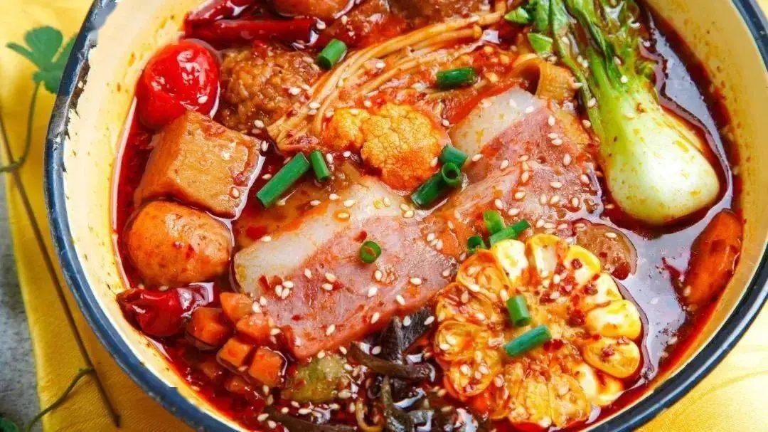
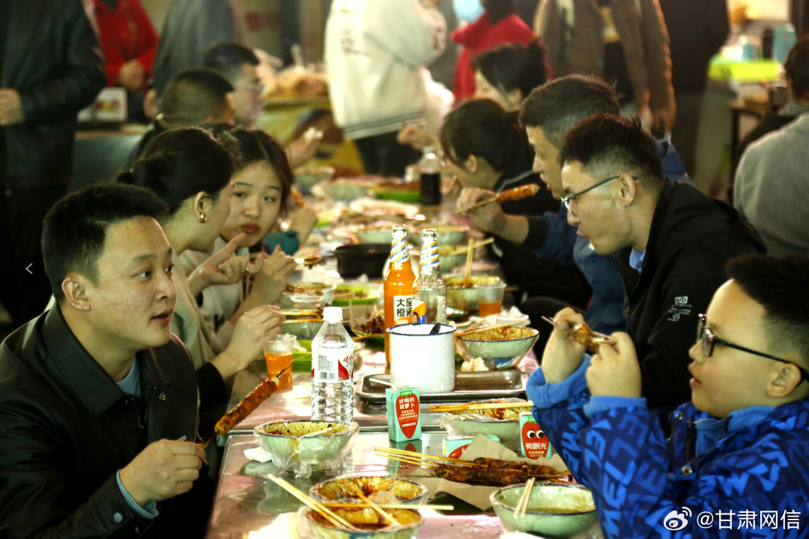
语法填空
The history and popularity of Malatang
人与社会：说明文

Slide 30
56. 1）缺谓语 2）since: 从句一般过去时、主句现在完成时
Since March, the hashtag #TianshuiMalatang, referring to a popular type of street food, 56 (receive) more than 140m views on Weibo, a social-media platform.
Look back a few hundred years, though, and chillies(辣椒) were nowhere 57 (find). Unlike ginger and Sichuan peppers, which are native to the region and widely used, chilli peppers were brought to China 58 America by Portuguese and Dutch explorers only in the 16th century.
At first, nobody ate them. For at least 50 years, they were grown as decorative plants, 59 (prize) for their cheerfully bright colour and tiny white flowers, and occasionally used as medicinal herbs. During China’s last imperial(皇朝) period, a system 60 taxed salt forced farmers in Guizhou province to look for 61 alternative. They chose chillies, which produce several crops a year and take up little land. From there, a new flavour 62 (unlock).
The pepper steadily spread to other rural areas of China, 63 its overpowering flavour barred it from getting near the tables of urban families. With the industrialisation, hundreds of millions of people poured into big cities, 64 (bring) with them the spicy flavours of home. Chillies are now used in street food, fine dining and snacks in 65 (region) with little tradition of heat.
has received
57. 不定式的被动语态；句式：祈使句+and+陈述句=if条件句
to be found
from
58. 介词
59. 非谓语：被动完成
prized
that/ which
60. 定语从句
an
61. 可数名词单数
was unlocked
62. 谓语动词：时态、语态、主谓一致
but
63.转折
64. 非谓语：主动进行，表结果
bringing
65. 可数名词复数
regions

Slide 31
文本你挖空
Since March, the hashtag #TianshuiMalatang, referring to a popular type of street food, has received more than 140m views on Weibo, a social-media platform.
Look back a few hundred years, though, and chillies(辣椒) were nowhere to be found. Unlike ginger and Sichuan peppers, which are native to the region and widely used, chilli peppers was brought to China from America by Portuguese and Dutch explorers only in the 16th century.
At first, nobody ate them. For at least 50 years, they were grown as decorative plants, prized for their cheerfully bright colour and tiny white flowers, and occasionally used as medicinal herbs. During China’s last imperial(皇朝) period, a system that taxed salt forced farmers in Guizhou province to look for an alternative. They chose chillies, which produce several crops a year and take up little land. From there, a new flavour was unlocked.
The pepper steadily spread to other rural areas of China, but its overpowering flavour barred it from getting near the tables of urban families. With the industrialisation, hundreds of millions of people poured into big cities, bringing with them the spicy flavours of home. Chillies are now used in street food, fine dining and snacks in regions with little tradition of heat.

Slide 32
文本再填空
Since March, the hashtag #TianshuiMalatang, 1. ___________(refer) to a popular type of street food, has received more than 140m views on Weibo, 2.______ social-media platform.
Look back a few hundred years, though, and chillies(辣椒) were nowhere to be found. Unlike ginger and Sichuan peppers, which are native 3.____ the region and widely used, chilli peppers 4. ____________(bring) to China from America by Portuguese and Dutch explorers only in the 16th century.
At first, nobody ate them. For at least 50 years, they were grown 5. _____ decorative plants, prized for their cheerfully bright colour and tiny white flowers, 6. _______ occasionally used as medicinal herbs. During China’s last imperial(皇朝) period, a system that 7. _______ (tax) salt forced farmers in Guizhou province to look for an alternative. They chose chillies, 8._______ produce several crops a year and take up little land. From there, a new flavour was unlocked.
The pepper 9. _________(steady) spread to other rural areas of China, but its overpowering flavour barred it from getting near the tables of urban families. With the 10.______________(industrial), hundreds of millions of people poured into big cities, bringing with them the spicy flavours of home. Chillies are now used in street food, fine dining and snacks in regions with little tradition of heat.
referring
a
to
were brought
as
and
taxed
which
steadily
industrialisation

Slide 33
文本词汇整理
be native to
be prized for
cheerfully bright color
decorative plants
medicinal herbs
taxed salt
look for an alternative
take up
unlock a new flavor
overpowering flavor
bar … from
pour into
原产于
因…而受到赞扬
欢快明亮的颜色
观赏性植物
草药
盐征税
寻找替代方案
占据
解锁新口味
压倒性的味道
阻止、禁止
倾倒

Slide 34

Thanks for your attention

