Slide 1


感恩遇见，相互成就，本课件资料仅供您个人参考、教学使用，严禁自行在网络传播，违者依知识产权法追究法律责任。
更多教学资源请关注
公众号：溯恩英语
知识产权声明

Slide 2
2024年11月绍兴市高三模考英语
客观题讲评
海亮实验中学 陈虹

Slide 3
题型概况
一

Slide 4
单击此处添加标题
题型 | 话题 | 体裁 | 词数
阅读A | 人与自然:A project for researching the elephant | 应用文 | 284
阅读B | 人与自然:A working experience with David Liittschwager | 记叙文 | 302
阅读C | 人与社会：Cooperation is important. | 议论文 | 307
阅读D | 人与自然 A special type of paint | 说明文 | 313
七选五 | 人与社会 Strategies to have great conversations | 说明文 | 285
完型填空 | 人与自我 Atransformative college philosophy class | 记叙文 | 284
语法填空 | 人与社会 An introduction of the Zenghouyi Chimes | 说明文 | 203
单击此处添加文本

Slide 5
阅读理解
二

Slide 6
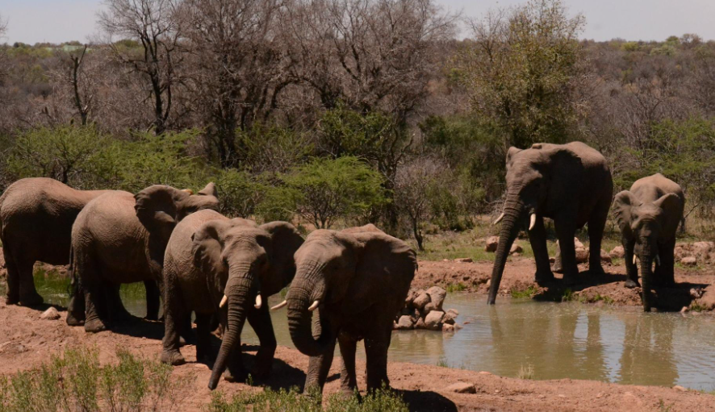
Bring the Elephant Home Project:Research South Africa
A篇
本文是一篇招募南非大象的研究项目参与者的应用文。从项目内容、有利之处、要求、选拔过程和花费五个方面进行了介绍说明。

Slide 7
A 篇
21.What is the main value of joining the project?
A.Enjoying emerged cultural experiences.
B.Doing fieldwork regularly with experts.
C.Helping promote elephants'well-being.
D.Acquiring reliable elephant behaviour data.
细节理解题
well-being
"well-being" 是高考英语中相对常见的词汇,在近五年的高考试卷中出现了53次之多。
通常表达的是“健康”、“幸福”或“福祉”的状态，它涉及到个人或群体的生活质量和心理健康状况。
高考例句：
Many of our problems—class attendance, educational success, student happiness and well-being—might be improved by cutting down the bureaucratic mechanisms and meetings and instead hiring an army of good teachers.
Researchers from the University of Connecticut Health Center asked the residents a large number of questions about their quality of life, emotional well-being and social interaction, as well as about the quality of the facilities.
第一段：....thereby making a valuable contribution to elephant conservation and management.

Slide 8
22.What counts most in being an expedition participant?
A.The age of the applicants.
B.The quality of being independent.
C.The language proficiency in writing.
D.The passion for elephant conservation.
counts
推理判断题
count的用法
计算：v 表示数数或计算数量。 例如："Please count the number of books on the shelf."
总计：n 指总数或总计。 例如："The count of votes is still underway."
重要性：n 表示某事物的重要性或价值。 例如："Every vote counts in an election."
依赖：v 表示依赖或依靠。 例如："You can count on me to help you."
考虑： v 表示将某事物视为重要的或有价值的。 例如："I don't count money as the most important thing in life."
指控：n 法律上指对某人的正式指控或起诉。例如："The defendant faced multiple counts of fraud."
计数单位：n 指一个计数单位，如“一次”或“一个”。例如："Give me three counts before you jump."
● Elephant conservation expedition participant qualifications
The most important requirements are that you are enthusiastic about elephants,and motivated to make a real change.

Slide 9
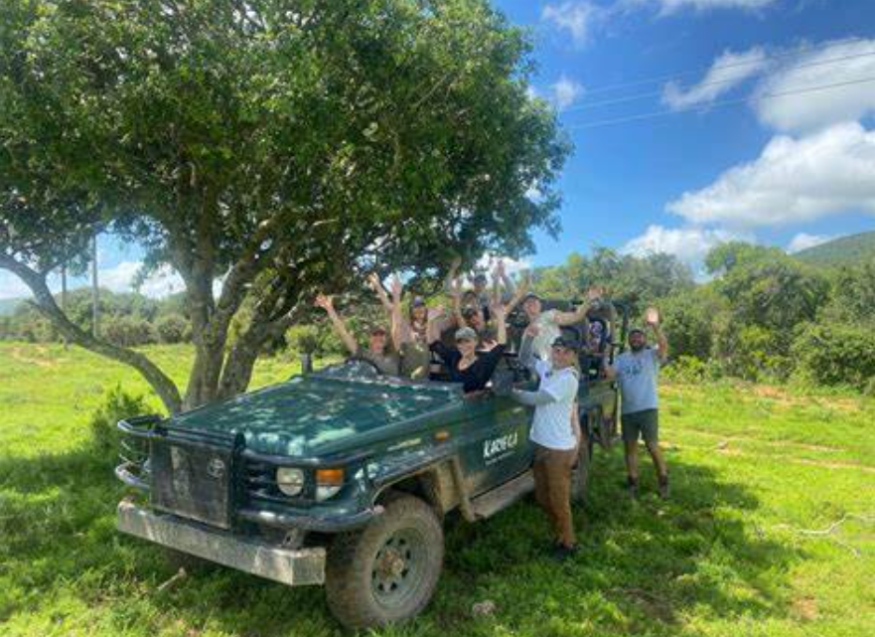
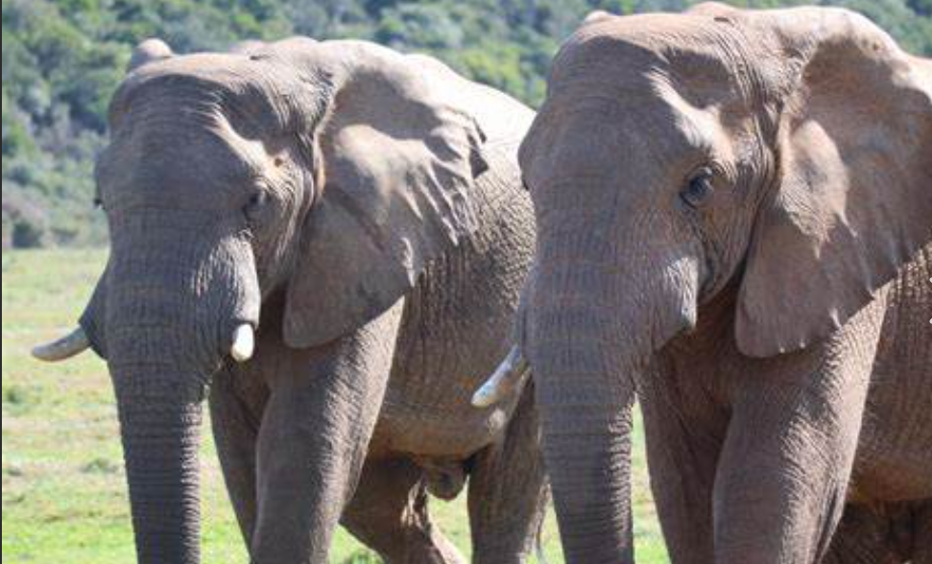
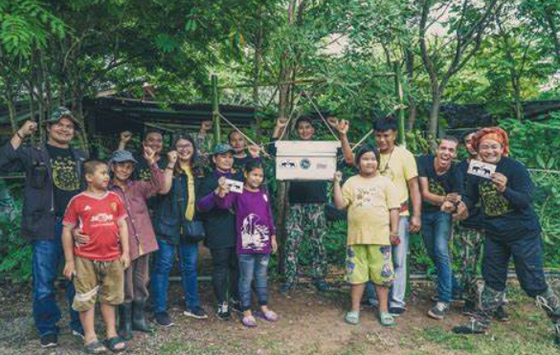
23.What can be learned from the passage?
A.Funds from the expedition are used to help elephants.
B.Participants have single rooms for accommodation,
C.Travel expenses are excluded in program costs.
D.Participants have full access to the internet.
exclude:不包含在内
细节理解题
最后一段：All funds raised from participating in this unique experience will contribute to elephant research and conservation projects.

Slide 10
语料积累
与自然保护相关的语料
Elephant conservation - 大象保护 Elephant research assistants - 大象研究助理
Elephant behaviour data - 大象行为数据 Elephant dung - 大象粪便
Identify individual elephants - 识别个别大象 Sustainable solutions - 可持续解决方案
Tracking technology - 追踪技术 Elephant conservation and management - 大象保护和管理
Game drives - 野生动物观察驾车 Expert guides - 专家导游
Natural animal behaviour - 自然动物行为 Cultural experience - 文化体验
Emerged cultural experience - 出现的文化体验

Slide 11
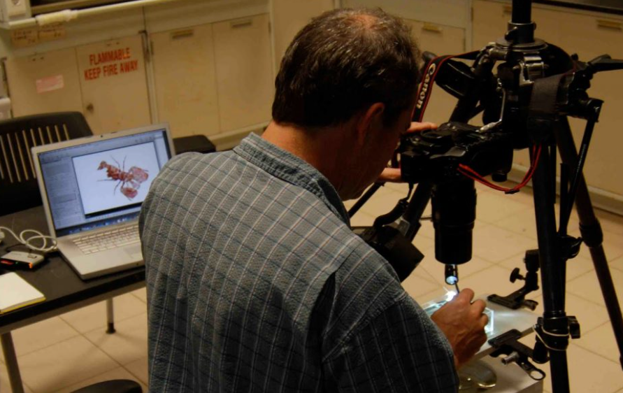
A working experience with David Liittschwager
B篇
本文讲述了作者在和摄影师David Liittschwager 一起工作的一段经历让他感受到了海洋生物的奇妙，尤其是通过David拍摄的照片，作者意识到了摄影的魔力，以及它如何扩展我们的视觉感知，让我们从新的角度看待世界。

Slide 12
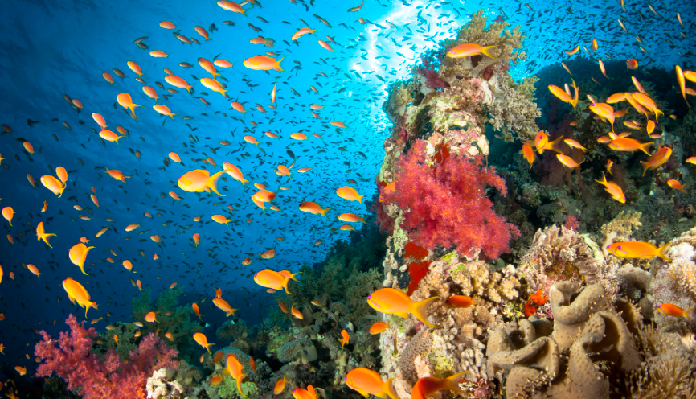
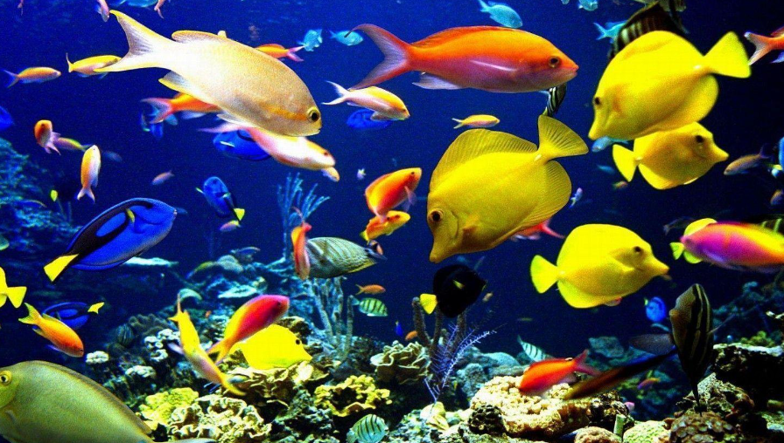
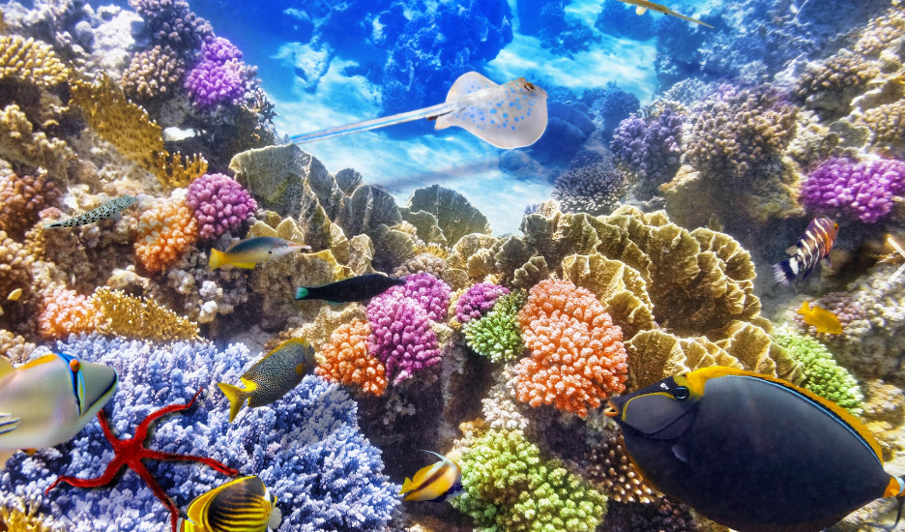
B 篇
24.What was the author's role in the magazine assignment?
A.Photographing the marine life.
B.Documenting the amazing biodiversity.
C.Building an aquarium for marine research.
D.Attracting and gathering species of marine life.
细节理解题
第二段：Every night, I would cast a floating lamp... I'd then set up aquariums to house them as they waited for David to take their shot.即吸引并收集海洋生物

Slide 13
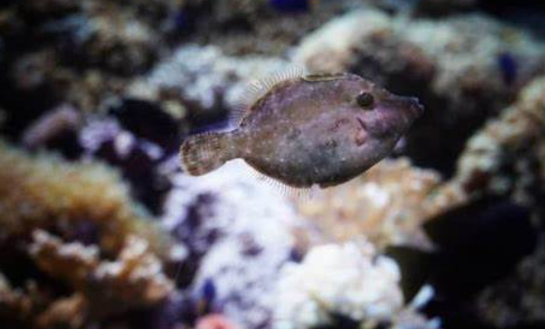
25.What surprised the author about the image of a baby flounder?
A.The advanced techniques of lighting.
B.The strange appearance of the small fish.
C.The accurate display of its comprehensive details.
D.The unexpected effect of background processing.
细节理解题
第四段： But David's photograph of this flounder revealed a universe of detail that even my eager eyes had missed.His macro lens magnified ... The lightning-fast exposure froze... A precisely aimed light released ....
小比目鱼

Slide 14
26.What can we infer about the author from the text?
A.He launched a local snorkeling project.
B.He achieved his dream by taking up photography.
C.The project motivated him to start ocean research.
D.The experience changed his view of photography.
推理判断题
最后一段：Before working for David, I had assumed the goal of photography was simply to reproduce an observation so that others could share the same experience. It had never occurred to me ...
“某人突然想起某事”： It occures to sb that...
It hits sb that...
It strikes sb that...

Slide 15
27.What is the true magic of photography?
A.To record an observation result.
B.To help people see the world anew.
C.To share one's specific experience.
D.To reveal visible wonders of the world.
推理判断题
anew
"anew" 是一个副词，它是由前缀 "a-" 和形容词 "new" 结合而成的。在这个组合中，"a-" 作为一个强调前缀，用来加强 "new" 的含义，使得 "anew" 表达的是“再次”或“重新”的概念，强调某事以新的方式或新的开始发生或进行。
例如：
"Start anew" 意味着“重新开始”。
"Rewrite the essay from scratch and approach it anew" 意味着“从头开始重写文章，并以新的方式处理它”
最后一段：... photography could expand our visual perception and therefore teach us to look at the world from new perspectives.

Slide 16
语料积累
与摄影相关的语料
Assignment：任务或任务分配 Document：记录或记录下
Biodiversity：生物多样性 Specimens：标本
Aquariums：水族馆或鱼缸 Shot：拍摄
Macro lens：微距镜头 Magnify：放大
Exposure：曝光 Distraction：干扰物。
其他语料
Visual perception：视觉感知 New perspectives：新视角

Slide 17

Cooperation is important
C篇
本文探讨了合作的重要性。强调了合作在人类进化过程中的基本作用，以及它在现代社交互动和关系中的核心地位。

Slide 18
C 篇
It would be difficult to overemphasize the importance of cooperation,not only because it was fundamental to the success of our species through evolution,but because it is fundamental to the success of almost all modern social interactions and relationships.
Let's start by defining what cooperation actually means.Although definitions vary,cooperation has been defined as working or acting together for mutual benefit.It requires two or more people to act in the best interest of their collective rather than acting for selfish benefit.During task-related communication,cooperation can be expressed in terms of proposing a fair distribution of resources or equal outcomes.
If weconsider the dangerous environments that our ancestors grew up in,where around every corner was a potential predator(捕食者),it's no surprise that cooperation was encouraged.Having strong social relationships provided a helping hand when sick or injured,and helped gather food as well as warnings about what to avoid eating.As a result,modern humans are hard-wired to find cooperation rewarding.Researchers have demonstrated that cooperating with others is associated with increased reward-related activity in the brain compared to engaging in non-cooperative exchanges,even when the physical rewards obtained from such exchange remain the same. Evidently,itis in our nature to want to cooperate,and this is why our relationships thrive when we do.
When we consider the needs of others and put the goals of the collective above the desire for selfish gain duringdecision making,we lay the groundwork for a strong trusting relationship to be built.But it's not just in ourpersonal lives that cooperation allows us to thrive,the same goes for our professional lives.In business,when we work collaboratively with others,be it at an individual level (between employees)or an industry level (between organizations),the shared resources and shared ideas enable innovation to flourish.It is exactly this cooperative approach of “two heads are better than one”that is at the heart of project success throughout academia and the private sector.
Introduction
Definition
Necessity
Meaning

Slide 19
28.Which statement best defines cooperation according to paragraph 2?
A.Acting together for common interests
B.Working individually for personal gains.
C.Building strongrelationships within a team.
D.Associating with each other in an equal way.
细节理解题
第二段：Although definitions vary,cooperation has been defined as working or acting together for mutual benefit.
29.Why does the author mention dangerous environments in human history?
A.To show the cooperative ability of our ancestors.
B.To explain the link between cooperation and reward.
C.To highlight the role of cooperation in human survival.
D.To illustrate the research of reward-related brain activity.
推理判断题
第三段：If we consider the dangerous environments that our ancestors grew up in,where around every corner was a potential predator(捕食者),it's no surprise that cooperation was encouraged.强调合作的重要作用。

Slide 20
30.How does cooperation contribute to success in profesional settings?
A.It promotes innovations by sharing ideas and resources.
B.It creates profit opportunities for organizations.
C.It ensures fair competition among employees.
D.It enables individualsto satisfy their desire.
推理判断题
第四段：...the same goes for our professional lives....be it at an individual level (between employees)or an industry level (between organizations),the shared resources and shared ideas enable innovation to flourish.
be it
"be it" 是英语中的一种表达方式，通常用于正式或文学语境中，用来引入一个条件、假设或情况。这种结构可以看作是 "let it be" 的缩写形式，其中 "let" 被省略了。"be it" 通常用于强调或突出随后提到的条件或可能性。
例：Be it rain or shine, the game will go on.（无论是下雨还是晴天，比赛都会继续。）
Be it man or woman, young or old, everyone is welcome."（无论是男性还是女性，年轻人还是老年人，每个人都受欢迎。）
You can choose any subject; be it history, science, or literature."（你可以选择任何科目；无论是历史、科学还是文学。）

Slide 21
31.What is the main idea of the passage?
A.Cooperation leads to theboost of business.
B.Cooperation strengthens personal relationships
C.Cooperation is a key driver of human development.
D.Cooperation is a vital factor for professional success
主旨大意题
第一段：...but because it is fundamental to the success of almost all modern social interactions and relationships
第三段：... this is why our relationships thrive when we do.
第四段：... is at the heart of project success throughout academia and the private sector.
Tips:说明文和议论文的主旨大意题切忌“以偏盖全”，要从文章的主旨和每一段的main idea入手。 sector.

Slide 22

语料积累
与合作互动相关的语料
mutual benefit 共同的利益 collective n 集体
social interactions 社会交流 individual level 个人层面
与大脑和奖励机制相关的语料
reward-related activity 与奖励相关的活动
non-cooperative exchanges 非合作交流

Slide 23

A special type of paint
D篇
本文是关于一种新型油漆的研发，这种油漆能够自我清洁并且可能从空气中去除污染物。但这只是一个初步的研究步骤，并不声称能够从空气中去除所有污染，但整体来看，这项研究看起来很有前景。

Slide 24
D 篇
Background
The pollutants jamming our skies aren't just a health risk;they also cause ugly stains on buildings and other structures.To combat this,chemists have been working for years on a special type of paint that not only can clean itself but also may remove pollutants from the air.
In a recent study,researchers have developed a new paint that works using UV rays from ordinary sunlight,making its self-cleaning properties easier to activate.They've also shown they can effectively produce this paint from recycled materials.“We do this by using waste materialfrom industry and also using fallen leaves,which are organic waste,”says Qaisar Maqbool,a chemist at the Vienna University of Tcchnology.
In the working process,UV light stimulates the electrons in the titaníum oxide nanoparticles (二氧化钛纳米颗粒),which interact with airborne water molecules to produce highly reactive hydroxyl radicals(烃基自由基).These unstable chemicals attack pollutants that come in contact with the paint,converting them into less harmful substances such as carbon dioxide and water.The research team added some necessary elements to the nanoparticles'structure,which reduced the amount of energy needed to spark the reaction and let it work via ordinary sunlight.In laboratory tests,these modified nanoparticles removed up to 96 percent of tested pollutants added to the paint's surface.
“It's better to be able to use solar light to activate,as the paint can work passively,by itself,” says Antonio Nieto-Márquez Ballesteros,a chemist at the Technical University of Madrid.But a real-world setting would probably reduce its effectiveness,he adds.“Under laboratory conditions, it's a very small scale,and everything is very well controlled,such as temperature,humidity or the concentration of pollutants,but you will never get those results at a real scale.”
The study authors stress that this work is just an initial step in their research.“I think it's a very fundamental study,”says co-author Günther Rupprechter.“We don't claim that we can remove all contamination from air,”he says,“but overall,it looks promising.”
Topic
Working principle
Challenge
Prospect

Slide 25
32.What is the purpose of working on the new paint?
A.To clean up pollutants from the air.
B.To reuse waste materials from industry.
C.To reduce the health risk from sunlight.
D.To increase the amount of nanoparticles.
细节理解题
第一段：...To combat this,chemists have been working for years on a special type of paint that not only can clean itself but also may remove pollutants from the air.
细节理解题
33.What is essential in the working process of the paint?
A.Recycled water. B.UV light. C.Stable chemicals. D.Carbon dioxide.
第三段：In the working process,UV light stimulates the electrons ...which interact with ... to produce ....
电子

Slide 26
34.What do the researchers think of the paint?
A.It holds an uncertain marketing prospect.
B.Its effectiveness may fall short in real world.
C.Its working conditions remain to be confirmed.
D.It deserves immediate application on a large scale.
推理判断题
研究者的看法，定位第四段：...But a real-world setting would probably reduce its effectiveness,he adds.
35.Which of the following is the best title for the text?
A.This Paint Can Clean Both Itself and the Air
B.New Paint Is Being Applied to Real-world Setting
C.Recycled Materials Contribute to a Promising Paint
D.Laboratory Research Unveils Ground-breaking Innovation
主旨大意题
说明文的标题满足两个条件：1. key words 2.main idea
全文的key words是“paint”,main idea看第一段“paint that not only can clean itself but also may remove pollutants from the air.”

Slide 27
语料积累
与研究相关的语料
self-cleaning properties - 自我清洁的特性 recycled materials - 回收材料
airborne water molecules - 空气中的水分子 highly reactive - 高反应性
laboratory tests - 实验室测试 initial step - 初步步骤
fundamental study - 基础研究
其他语料
jam v 堵塞 stain n 污点
combat v 对抗 activate v 激活
convert v 使...转变 passively adv 被动地

Slide 28

Strategies to have great conversations
七选五
文章提供了一些实用的建议，帮助读者在与陌生人交流时能够更自然、更有效地进行对话。

Slide 29
七选五
How can you make sure to have great conversations,cspecially wíth people you don't know well?How do you keep a conversation flowing,cspecially with someone you've just met?Your first and most important step is to make that person feel listened to. 36
解析：该句的位置在说明文的第一段，是在引出话题，上文陈述了解决方式--“让对方感觉被倾听”。这也是整篇文章的主题。所以本句不需要对话题再深入或继续延申，只需要对上句进行再强调。故A项“那正是大部分人需要的”符合题意。
A.That's something most of us desire.
B.However,I'll add a word of warning.
C.Make eye contact much but not all of the time.
D.It is a great way to learn how to keep the volley going.
E.Being good at starting conversations is an essential skill.
F.You might start thinking about whether you're wasting time.
G.Then,pay attention to the rhythm and flow of the conversation.

Slide 30
The No.1 way to make someone feel listened to is to actually listen to them.That may sound stupidly obvious,but it can be hard to actually do,When someone is talking to you about something,especially if what they're saying doesn't directly relate to your interests,your mind may want to busy itself with other things. 37 The key to better engagement is to push distractions aside and concentrate.The more you can actually focus on what the person is saying, the betteryou'll be able to engage with them.
解析：承上启下。根据第一句主题句可知本段的方法是“actually listen to them”。上文在陈述交谈时思想会抛锚，再联系下文 ，直接陈述关键的办法。所以本句是对上文的进一步解释，思想抛锚的具体表现。故F项正确
A.That's something most of us desire.
B.However,I'll add a word of warning.
C.Make eye contact much but not all of the time.
D.It is a great way to learn how to keep the volley going.
E.Being good at starting conversations is an essential skill.
F.You might start thinking about whether you're wasting time.
G.Then,pay attention to the rhythm and flow of the conversation.

Slide 31
Beyond that,using body language can be very useful. 38 Smile at the other person and nod to let them know you understand the points they're making.You can take it a step further and mirror them,reflecting back their body positioning and posture. 39 If focusing on body language distracts you from listening,then it isn't worth it,in my opinion.In that case,I believe it's better to just focus on what they're saying.Chances are,your body language will naturally reflect you really are paying attention.
解析：根据主题句可知本段的方法是“using body language”。38题和下文的另外两句属于同一个句群，是对首句的举例。故C项“make eye contact”符合题意。
A.That's something most of us desire.
B.However,I'll add a word of warning.
C.Make eye contact much but not all of the time.
D.It is a great way to learn how to keep the volley going.
E.Being good at starting conversations is an essential skill.
F.You might start thinking about whether you're wasting time.
G.Then,pay attention to the rhythm and flow of the conversation.

Slide 32
Beyond that,using body language can be very useful. 38 Smile at the other person and nod to let them know you understand the points they're making.You can take it a step further and mirror them,reflecting back their body positioning and posture. 39 If focusing on body language distracts you from listening,then it isn't worth it,in my opinion.In that case,I believe it's better to just focus on what they're saying.Chances are,your body language will naturally reflect you really are paying attention.
A.That's something most of us desire.
B.However,I'll add a word of warning.
C.Make eye contact much but not all of the time.
D.It is a great way to learn how to keep the volley going.
E.Being good at starting conversations is an essential skill.
F.You might start thinking about whether you're wasting time.
G.Then,pay attention to the rhythm and flow of the conversation.
解析：上文在陈述不同的“body language”,下文是“如果身体语言干扰你倾听，那就不值得了”，所以39题应是转折关系。故B项“however”符合题意

Slide 33
40 It's a bit like playing tennis,where the objective is to keep the volley going as long as possible.If you always respond to what the other person says with just a word or two,you're putting too much pressure on them to keep the conversation going.Conversely,if you take a conversational opening and run with it,launching into a detailed explanation of how your company works or a lengthy anecdote,you're likely to lose their interest.You effectively shut the other person out of the conversation.
解析：本题考查主题句。从下文可知，本段在陈述另一种方法，故要与前面的文段相衔接，所以选择支必须要有衔接词；再从后文将聊天比作“tennis”要“keep the volley going”，符合G项中的“rhythm and flow”
A.That's something most of us desire.
B.However,I'll add a word of warning.
C.Make eye contact much but not all of the time.
D.It is a great way to learn how to keep the volley going.
E.Being good at starting conversations is an essential skill.
F.You might start thinking about whether you're wasting time.
G.Then,pay attention to the rhythm and flow of the conversation.

Slide 34

语料积累
人际交往相关的语料
push distractions aside - 抛开分心的事物 engage with - 与...互动
smile at - 向...微笑 mirror - 镜像模仿
keep the volley going - 保持对话的连续性
putting too much pressure on - 施加太多压力
lengthy anecdote - 长篇轶事
shut the other person out - 排除他人

Slide 35
完形填空
三
本文是作者在大学期间的一次转变经历。在经历了焦虑和挣扎后，作者最终完成了一篇哲学论文，并意外地得到了教授的好评。这次经历让作者意识到教育不仅仅是职业道路，更是个人成长和自我发现的机会。

Slide 36
The first class I went to in college was philosophy,and it changed my life.Our first assignment was to write a response paper to an essay by Albert Camus.
I entered college 41 to get a degree in engineering.I always liked the way mathematics had clear answers and was good at it.So when I reccived this,I was instantly nervous,Even more troubling was that the professor 42 to givc any guidelincs; he gave us total 43 ,Full of anxiety,I read Camus' essay multiple times but still felt unsurc.Unlike math,there were no set answers here,and I was forced to 44 my own interpretation.
When I sat down to write,my notes and ideas were all 45 ,but the words were lost,I tried various strategies but nothing seemed to work. 46 ,after a lot of stress,my ideas became more organized and the words fell on the page.Still I wondered if what I was saying made sense, Through all the 47 ,I continued writing the best I could and turned it in,simply hopíng for the best.
appeal to 吸引；上诉；呼吁
present: n 礼物；现在
adj 出席的；现在的
v 送礼物给；呈现
reflect on: 回忆；反省；思考
account for:为...做出解释；占据
submit to:屈服于；提交
figure out:弄清楚；计算出
41.A.intending B.assuming C.appealing D.promising
42.A.agreed B.volunteered C.refused D.hesitated
43.A.imagination B.freedom C.vision D.assessment
44.A.reflect on B.account for C.submit to D.figure out
45.A.present B.familiar C.unique D.practical
46.A.Apparently B.Eventually C.Occasionally D.Absolutely
47.A.delight B.passion C.uncertainty D.disappointment

Slide 37
Then came judgment day.The professor returned our papers with grades and 48 ,He gave me an A,suggesting that my essay was 49 overall and my reading of the essay was original. My relief and newfound 50 upon reading his comments could not be overstated.
What I learned through this process 51 well beyond a college paper.I learned to be 52 to new challenges.I left engineering and became a lawyer.Philosophy helped me 53 courage to try a new career path.More importantly,I learned that education is not just a path to a career but a chance to 54 .Philosophy taught me the value of learning for its own sake,and this lesson continues to 55 my life every day.
48.A.recognition B.persuasion C.notes D.comments
49.A.brief B.effective C.abstract D.critical
50.A.confidence B.gratitude C.energy D.credit
51.A.anticipated B.connected C.extended D.revealed
52.A.open B.sensitive C.loyal D.subject
53.A.admire B.seek C.show D.develop
54.A.adapt B.grow C.understand D.succeed
55.A.transfer B.appreciate C.impact D.determine
extend:延伸；表示；使竭尽全力
be open to:对...持开放态度
be sensitive to :对...很敏感
be loyal to:忠于
be subject to:服从；经受
for its own sake:为了某事物本身的目的或价值去做某事，强调行为的内在动机，即行为本身是目的，而不是作为达到其他目的的手段。
例：He paints for the love of art, for its own sake, not to make money.
他绘画是出于对艺术的热爱，而不是为了赚钱。

Slide 38
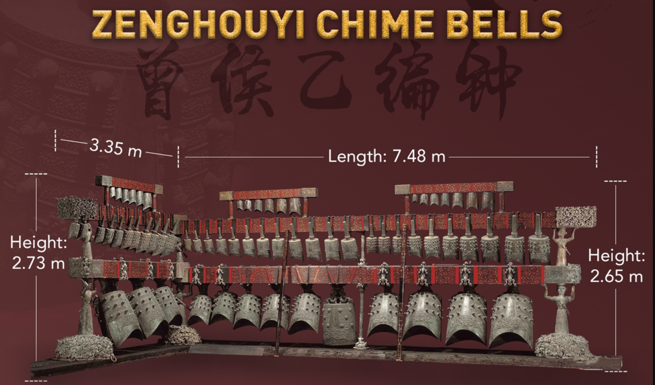
语法填空
四
这篇文章介绍了一套来自中国战国时期的大型古代乐器---曾侯乙编钟（Zenghouyi Chimes）。

Slide 39
The Zenghouyi Chimes are an enormous musical instrument dating from China's Warring States Period.This set of chimes is 56 (particular)large.Its frame is 7.48 metres long and 2.65 metres high with 65 bells 57 (suspend)from it.
One characteristic that sets these chimes apart from others is that they can play not only the five-tone scale,but also the seven-tone scale.Their unique oval design 58 (mean)that each bell can produce two different tones 59 (depend)on where it is struck,This was a groundbreaking 60 (discover) for the study of ancient Chinese music because before the appearance of this instrument,people thought that Greece was 61 the seven-tone scale first appeared.
suspend:悬挂；暂停
particularly
56. 词性转换
suspended
57. 非谓语动词
means
58. 谓语动词
depending
59. 非谓语动词
discovery
60. 词性转换
where
61. 名词性从句

Slide 40
The Zenghouyi Chimes have been played three times 62 the set was unearthed.The first time was in Wuhan,the year it was discovered.The second was at the National Museum of China in Beijing in 1979 to commemorate the 30th anniversary of the founding of our country. The third 63 (record)in 1997, which was then edited into a performance of symphonic music 64 (mark) the return of Hong Kong to China.
The Zenghouyi Chimes are 65 genuine miracle not only because they inform us about the rituals and music of ancient China,but also because they demonstrate the highest level of bronze casting techniques.
since
62. 时间状语从句
since引导时间状语从句，主句通常使用现在完成时
after引导时间状语从句，主句可以使用过去时、现在时或将来时
befor引导时间状语从句，主句可以使用过去时、现在时或将来时
was recorded
63. 谓语动词
to mark
64. 非谓语动词
a
65. 冠词
语法填空中a和the的常考点：
a 用于指代任何一个属于某类事物的成员，但不特指哪一个。它通常用于第一次提到某个事物时，表示非特定性。
the 用于指代特定的、已知的或独一无二的事物.

Slide 41
感谢您的观看
THANK YOU

