Slide 1


感恩遇见，相互成就，本课件资料仅供您个人参考、教学使用，严禁自行在网络传播，违者依知识产权法追究法律责任。
更多教学资源请关注
公众号：溯恩英语
知识产权声明

Slide 2





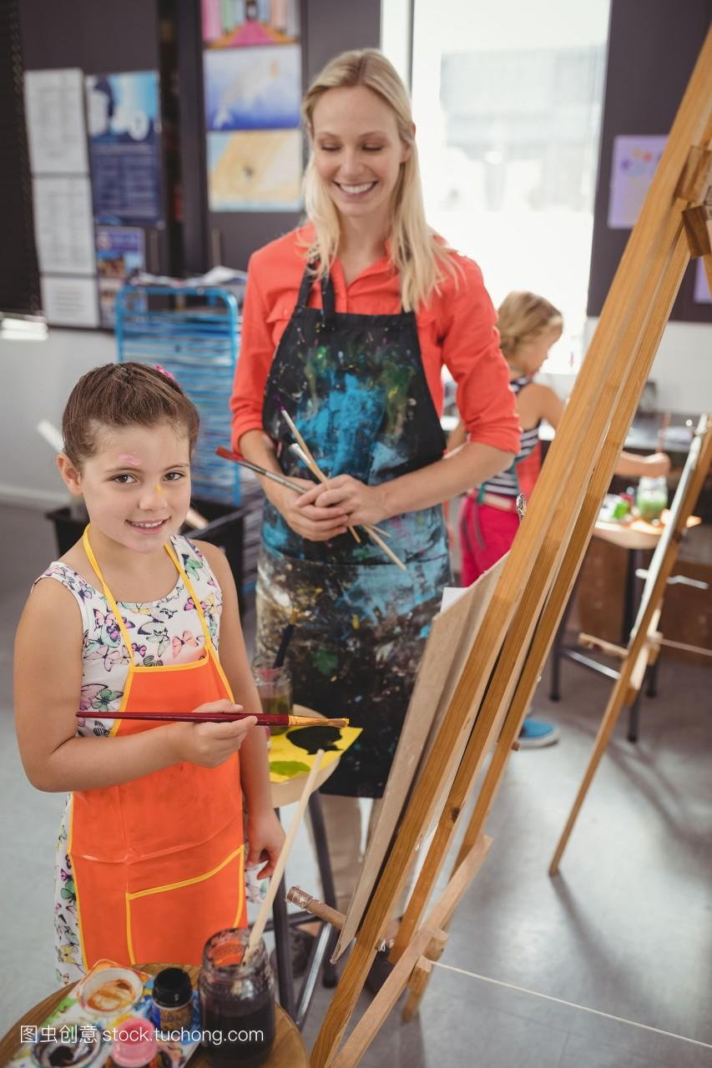
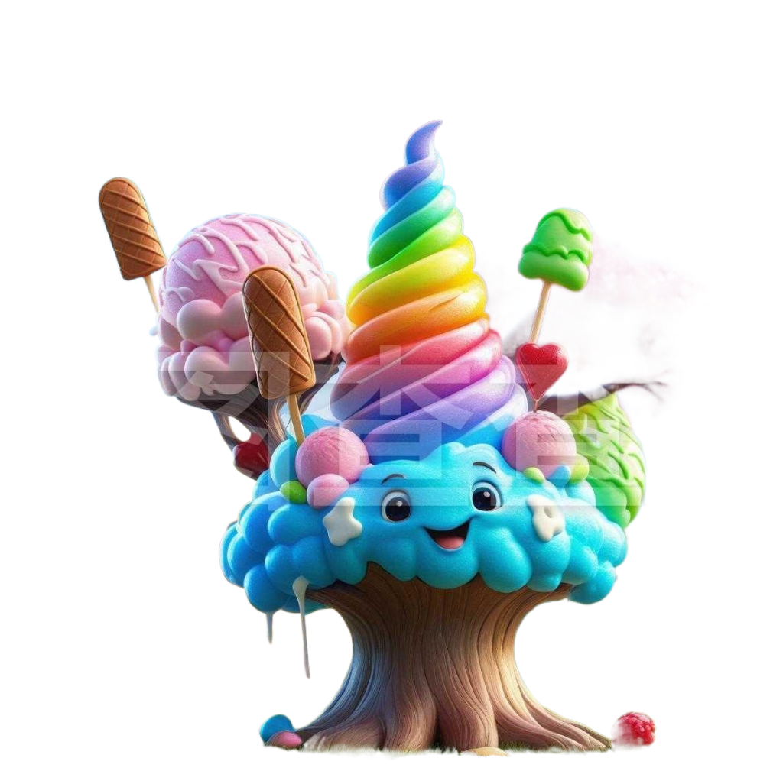
细节袅袅绕文中 情节盎然伴主题
2024年杭州一模读后续写: 蹲下来看孩子
杭州二中树兰高级中学 郭合英

Slide 3




Lead in
1. Where do we get the ice cream cones?
2. Have you seen a tree with
ice cream cones?
Let’s begin the class!

Slide 4
Text analysis
Detailed analysis
Learning objectives
Language accumulation
Works appreciation

Slide 5

1
Text analysis
掌握词汇 了解梗概

Slide 6
读后续写（满分25分）
be one’s thing
是某人喜欢的事情
be topped with
被......覆盖
Mary was the art teacher for primary school students. On this particular day, she was guiding them through the process of drawing a scenic landscape. Akila yawned(打哈欠), clearly disinterested － drawing wasn’t her thing. A small group of students gathered around Tina, laughing at her unusual drawing: a sun sporting sunglasses and trees topped with ice cream cones.
Mary instructed Tina firmly but with unease, “Draw it the way I showed you.” As the lesson continued, doubt crept into Mary's mind. Had the joy of creativity been overshadowed by the pressure to fit in? She scanned the room, observing her students’ face － some concentrated, others uncertain. Akila’s disinterest was clear, and Tina’s imaginative drawing had been met with ridicule instead of praise.
After class, Mary sat down with Tina, her tone softening.“Why did you draw the sun with sunglasses and the trees with ice creams?” she asked gently.
Tina’s eyes sparkled with a touch of rebellion(叛逆). “I love ice cream, and I thought the sun would look cool with sunglasses. Why do we always have to draw like everyone else?”
with unease
不安
fit in
适合，适应
融入（群体）
be overshadowed by
被蒙上阴影
scan the room
环顾房间
meet with
遭遇到
a touch of
一丝丝

Slide 7
Mary paused, her thoughts racing. Tina’s drawings weren’t just curious － they were a window into a world where imagination ruled, where rules could be bent into delightful chaos. Was she, by enforcing a rigid style, killing that very creativity?
The next morning, Mary walked into the classroom with a renewed sense of purpose. She placed a large sheet of paper in front of the class and announced a new project: they would create a collective(集体的) artwork titled “Our Dream World”with no rules. They were free to use colors, shapes, and patterns however they wished.
At first, the students hesitated, unsure of this newfound freedom. Akila leaned back, skeptical of what seemed like another pointless exercise. But Tina, her creativity no longer restricted, eagerly grabbed her crayons and began to draw with abandon.
Then, Maya joined in. And then Michael...
Para1: As the students worked, Mary observed them with curiosity.
Para2: Mary stood back and surveyed the creation.
thought race
思绪万千
bend the rules
放松规定; 通融
a renewed sense of purpose
一种新的使命感
be free to do sth.
自由地做某事
be skeptical of
对......怀疑
lean back
向后靠
with abandon
尽情地…
with curiosity
好奇地
survey the creation
审视作品

Slide 8
Language accumulation
English
Chinese
be one’s thing
是某人喜欢的事情
be topped with
被......覆盖
with unease
不安
fit in
适应，融入(群体)
be overshadowed by
被蒙上阴影
scan the room
环顾房间
a renewed sense of purpose
一种新的使命感

Slide 9
Language accumulation
English
Chinese
a touch of
一丝丝
thought race
思绪万千
be free to do sth.
自由地做某事
be skeptical of
对......怀疑
with abandon
尽情地…
with curiosity
好奇地
survey the creation
审视作品

Slide 10
who
Mary，Tina，Akila
what
Tina’s unusual drawings
basic elements
where
in the art class
why
Tina was laughed at.
Mary made an adjustment
to her teaching style.
how

Slide 11
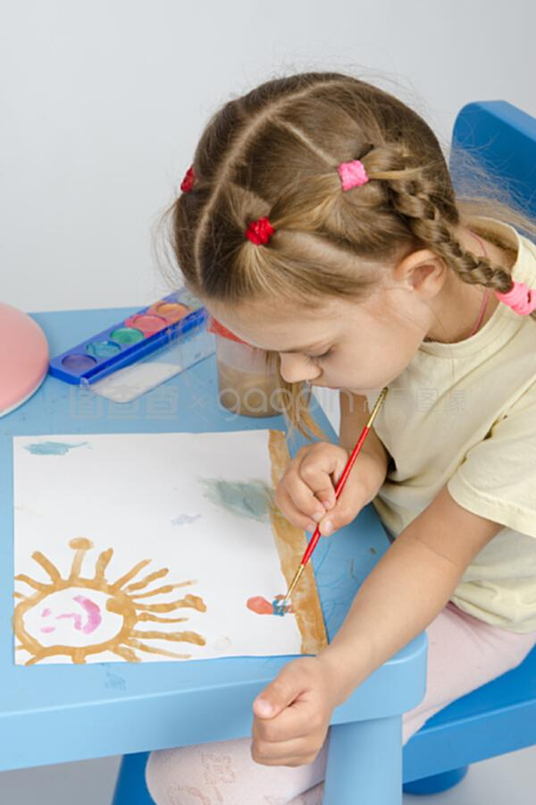

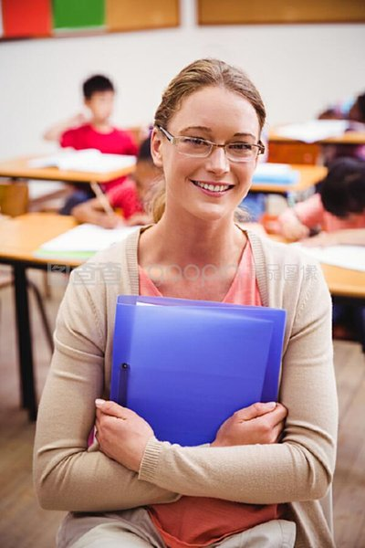

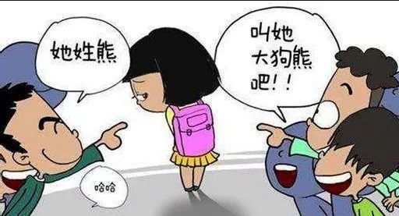
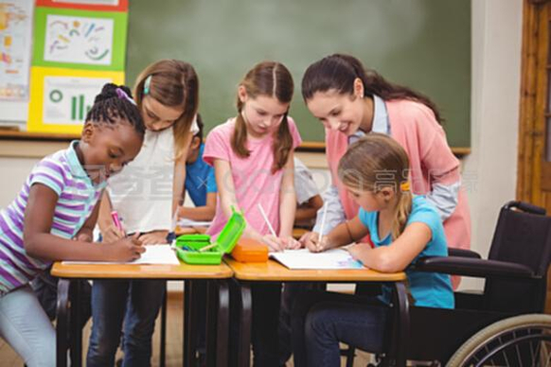
mind-map
an unusual drawing
3. Tina:________
no interest
2. Akila:________
1. The art teacher:
__________
Mary
6. Finally, the teacher
asked the students to
________
draw freely
being laughted at
4. Tina:________

Slide 12
2
Detailed analysis
利用契诃夫之枪，找出隐含的细节，
凭借情感的转变，凝练蕴含的主题。

Slide 13
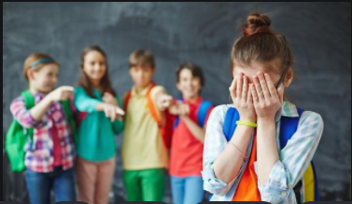
1.Why did Akila lose interest in the art class?
Can you find the reason in this paragraph?
Mary was the art teacher for primary school students. On this particular day, she was guiding them through the process of drawing a scenic landscape. Akila yawned(打哈欠), clearly disinterested － drawing wasn’t her thing. A small group of students gathered around Tina, laughing at her unusual drawing: a sun sporting sunglasses and trees topped with ice cream cones.
主人公
The author gave no answer to the reason, which gave reader with a suspense(悬念).
2.Why did a group of students laugh at Tina?
Because of her unusual drawings.

Slide 14

利用契科夫法则，以读促思
Mary was the art teacher for primary school students. On this particular day, she was guiding them through the process of drawing a scenic landscape. Akila yawned, clearly disinterested － drawing wasn’t her thing. A small group of students gathered around Tina, laughing at her unusual drawing: a sun sporting sunglasses and trees topped with ice cream cones.
disinterested
interested
being laughed at
（the reason）
being respected/admired

Slide 15
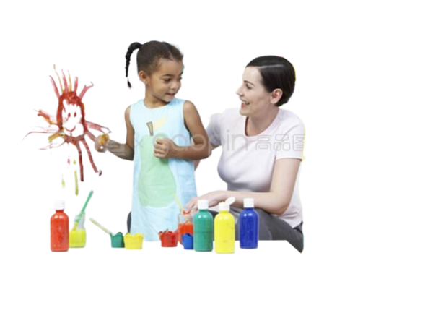
利用契科夫法则，以读促思
Mary instructed Tina firmly but with unease, “Draw it the way I showed you.” As the lesson continued, doubt crept into Mary’s mind. Had the joy of creativity been overshadowed by the pressure to fit in? She scanned the room, observing her students’ face － some concentrated, others uncertain. Akila’s disinterest was clear, and Tina’s imaginative drawing had been met with ridicule instead of praise.
1. What made Mary unease?
Tina with imagination and creativity
2. What does the sentence
show?
4. What does this sentence mean?
It shows that Mary always goes by the book.(循规蹈矩)
It shows Mary has already started self-reflection.
3. What do the sentences mean?
They show Mary has realized her teaching style is not perfect.

Slide 16



利用契科夫法则，以读促思
After class, Mary sat down with Tina, her tone softening.“Why did you draw the sun with sunglasses and the trees with ice creams?” she asked gently.
In the opinion of the adults, it’s abnormal and ridiculous to draw the picture.
Tina’s eyes sparkled with a touch of rebellion(叛逆). “I love ice cream, and I thought the sun would look cool with sunglasses. Why do we always have to draw like everyone else?”
In the opinion of the children, it’s fanstatic and reasonable.

Slide 17


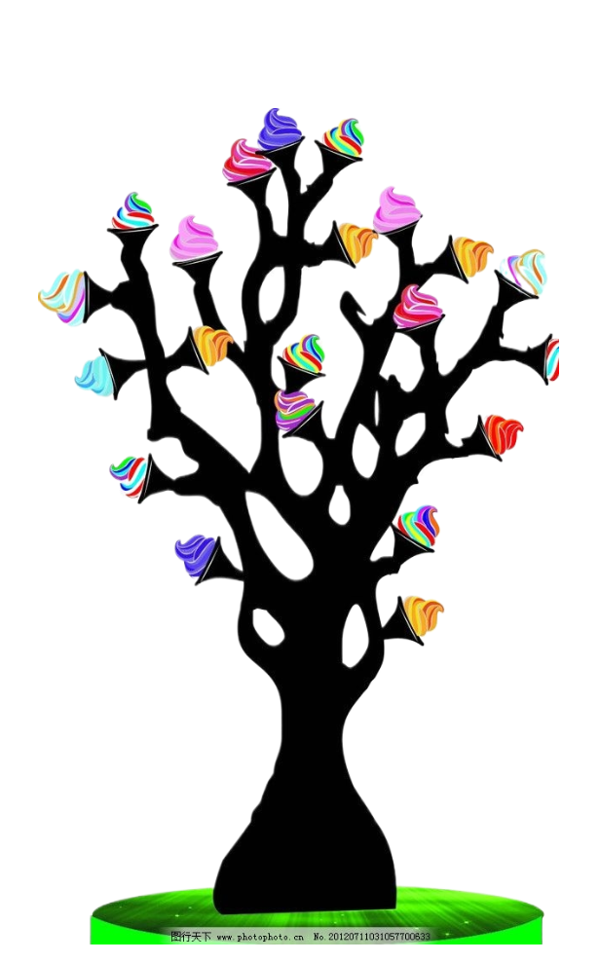
利用契科夫法则，以读促思
凝炼主旨
This lays a foundation for the teacher’s change.
（这为教师的转变奠定了基础）
After class, Mary sat down with Tina, her tone softening.“Why did you draw the sun with sunglasses and the trees with ice creams?” she asked gently.
成人有自己固定的思维，有自己已经形成的人生观和价值观。在对待孩子的问题上，习惯从自己的角度出发。如果这样，就永远不知道孩子在想什么。因此，成人只有蹲下来，才能从同一水平线上和孩子对视，才能站在孩子的高度去看问题，才能真正地走进孩子的世界，才能给孩子正确的引导，才能让孩子的发展更为顺利。
This shows Tina is different from other students, and She has a rich imagination and creativity. It is her unconstrained creativity that sparkes her interest in painting.
Tina’s eyes sparkled with a touch of rebellion(叛逆). “I love ice cream, and I thought the sun would look cool with sunglasses. Why do we always have to draw like everyone else?”

Slide 18
利用契科夫法则，以读促思
Mary began to wonder if her own teaching method was too dogmatic (教条的).
（Mary开始思考自己的教学是否太教条了）
Mary paused, her thoughts racing. Tina’s drawings weren’t just curious － they were a window into a world where imagination ruled, where rules could be bent into delightful chaos. Was she, by enforcing a rigid style, killing that very creativity?
Children’s creativity is supposed to be encouraged rather than discouraged.
（孩子们的创造力是用来被鼓励而不是被抹杀的）
Reflection: Shall I become the killer to strangle (扼杀) the children’s imagination?
（难道我要成为扼杀孩子们创造力的刽子手?）（“思”中有“变”）

Slide 19
利用契科夫法则，以读促思
A new day, a new beginning，
Mary made a stunning change.
The next morning, Mary walked into the classroom with a renewed sense of purpose. She placed a large sheet of paper in front of the class and announced a new project: they would create a collective(集体的) artwork titled “Our Dream World”with no rules. They were free to use colors, shapes, and patterns however they wished.
Problem
(dogmatic(教条的))
Mary’ change: Respect individuality and fully release the students’ imagination and creativity.
Mary的变化：尊重个性, 释放学生的想象力和创造力
solution
(no rules / draw freely)

Slide 20

利用契科夫法则，以读促思
At first, the students hesitated, unsure of this newfound freedom. Akila leaned back, skeptical of what seemed like another pointless exercise. But Tina, her creativity no longer restricted, eagerly grabbed her crayons and began to draw with abandon.
Then, Maya joined in. And then Michael...
What did Akila and other studnets’ reaction show?
They showed no interest in
painting with restrict.
What did Tina, Maya and Michael’s reaction show?
Imagination with no rules in painting made them interested.

Slide 21


利用契科夫法则，逆推故事情节
Para1
As the students worked, Mary observed them with curiosity.
start to draw the artwork with abandon
学生的心情？
回应原文：She placed a large sheet of paper in front of the class
and announced a new project: they would create a collective artwork titled “Our Dream World”with no rules.
the students’ specific behaviour in the painting ?
the collective artwork: Our Dream World
Para2
Mary stood back and surveyed the creation.
What were Mary’s feelings?
What did Mary deal with the creation?
What was the main idea ?

Slide 22
3
Language accumulation
关注语言特色 奏响情感之弦
(采用协同和show, don’t tell技巧让语言生动活泼)

Slide 23

她那双眼睛闪烁着好奇的光芒，驱使她去探索学生丰富的想象力，就像一位宇航员探索未知的宇宙一样。
Her eyes sparkled with curiosity, driving her to explore the rich imagination of her students, just like an astronaut sticking his neck out for the unknown universe.
写作特点：修辞+俚语+非谓语+原文语言

Slide 24
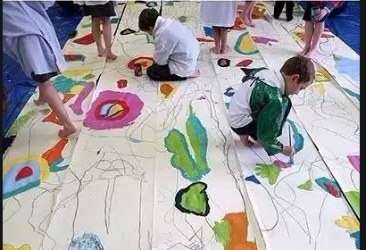
学生们兴奋地像刚刚从笼中释放的小鸟，他们欢呼着、雀跃着，舞动着手中的画笔就好像孙悟空拎起了金箍棒。画笔在他们手中魔法般地开始了“72变”。
The students were as excited as birds newly freed from their cages. They cheered and jumped, waving their paintbrushes with joy, just like Sun Wukong waving his Monkey King Bar(金箍棒). In their hands, the brushes seemed to perform magical “72 transformations.”
写作特点：修辞+非谓语

Slide 25
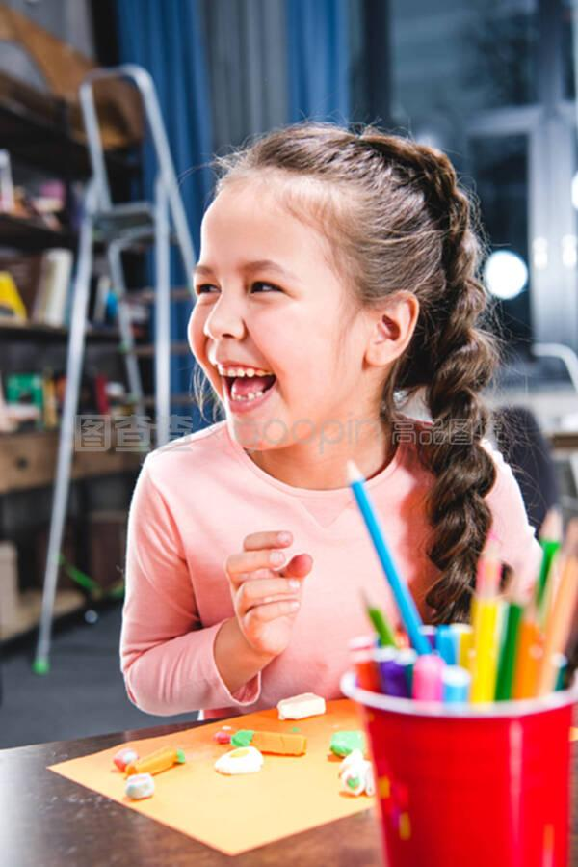
对画画不感兴趣的Akila高兴得花枝乱颤，嘴就像皮鞋裂了线一样。她手拿画笔尽情地让自己的思绪在画纸上驰骋。
Akila, who thought drawing wasn’t her thing, was full of the joys of spring as if her mouth were a leather shoe that had cracked a line. She grabbed her crayons cheerfully, letting her thoughts run wild on the paper with abandon.
写作特点：修辞+俚语+定语+非谓语+原文语言

Slide 26

Tina尽情地发挥自己的想象。蜡笔所到之处宛如五线谱上的音符，谱写着心中最美的梦幻世界。显然，Tina富有想象力的画得了同学们的表扬而不是嘲笑。
Tina gave play to her imagination with no rules. The places where the crayons reached were like notes on the staff, composing the most beautiful dream world in her heart. Obviously, Tina’s imaginative painting met with the classmates’ praise rather than ridicule.
写作特点：修辞+定语+非谓语+原文语言

Slide 27
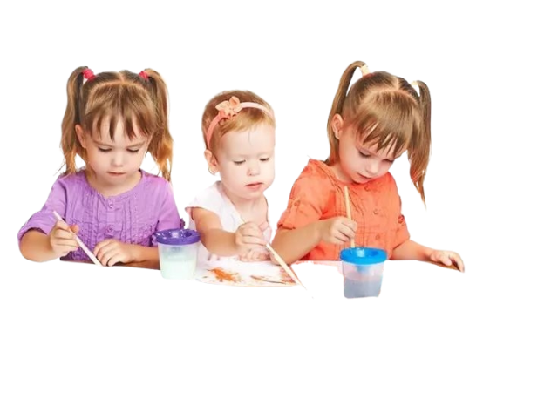
Maya和Michael犹如快乐的小松鼠蹦跳着加入了Tina。蜡笔滴答滴答地落在画纸上，犹如一个个跳舞的精灵在狂欢。很快，在他们的共同努力下，一副最富有想象力和创造力的 画---“Our Dream World” 被勾勒出来。
Maya and Michael, like cheerful little squirrels, skipped over to join Tina. The crayons fell on the paper with the sound of tick, like dancing fairies. In next to no time, through their combined efforts, the most imaginative and creative drawing titled “ Our Dream World ” came to life.
写作特点：修辞+原文语言

Slide 28
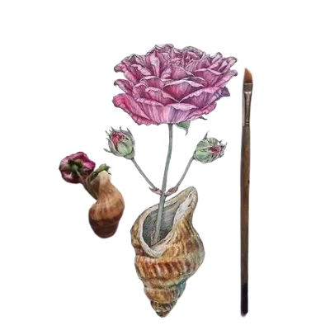
展现在她眼前的画是一副充满幻想的“Our dream world”，虽有些浮夸但却着墨巧妙，惟妙惟肖，犹如马良的神笔, 所画之物呼之欲出。
A fantasy-filled painting titled “Our Dream World”, somewhat overstated but skillfully described, came across her eyes. Like the magical brush of Ma Liang, the drawn things came alive.
写作特点：修辞+无灵主语+形容词做状语

Slide 29
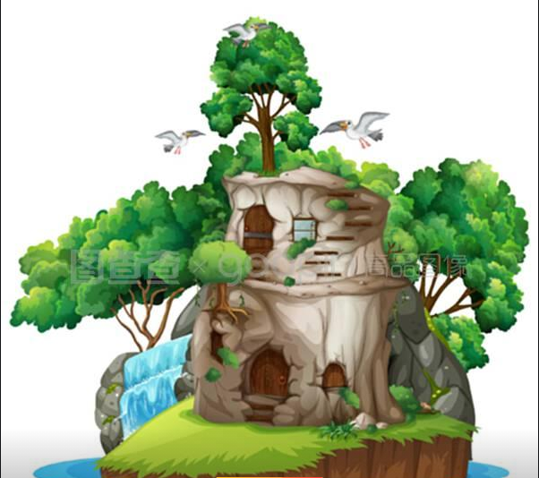

这幅既是个人能力的展示，也是共同智慧的结晶, 这让她心里情不自禁地涌起一种自豪感。
Not only was the creation a showcase of individual talent, but also a reflection of collective wisdom, which filled her with a surge of pride.
写作特点：倒装+定语

Slide 30


这不仅仅是一幅画，更是孩子们富有想象力的有力证明。Mary很庆幸自己及时调整了教条的教学方式。
Not just was it a painting, but a powerful proof to the children’s imagination. Mary considered herself lucky enough to have made timely adjustments to
the previous teaching method.
写作特点：倒装

Slide 31
Mary 突然有一个想法，她决定把这副画挂在教室最显眼的位置，这不仅是对学生的鼓励，也是对自己的鞭策。仿佛漆黑夜里的一束光，既照亮了她前行的道路，又温暖了学生，确保他们的想象力不被黑暗吞噬。
A fanstatic idea suggested itself to Mary. She determined to hang the painting in the most eye-catching place in the classroom, which was not only an encouragement for her students, but a reminder for herself. It was like a beam of light in the dark night, lighting her path forward and warming her students to ensure that their imagination would not be devoured by the darkness.
写作特点：无灵主语+定语从句+修辞

Slide 32
4
Works appreciation

Slide 33
Original works
As the students worked, Mary observed them with curiosity. The students were as excited as birds newly freed from their cages. They cheered and jumped, waving their paintbrushes with joy, just like Sun Wukong waving his Monkey King Bar. In their hands, the brushes seemed to perform magical “72 transformations.” Akila, who had thought drawing wasn’t her thing, was over the moon as if her mouth were a leather shoe that had cracked a line. Tina gave play to her imagination with no rules, composing the most beautiful dream world in her heart. Maya and Michael, like cheerful little squirrels, skipped over to join Tina. The crayons fell on the paper with the sound of tick, like dancing fairies. Obviously, Tina met with the classmates’ praise rather than ridicule. Through their combined efforts, the most imaginative and creative drawing titled “ Our Dream World ” came to life.
Mary stood back and surveyed the creation. Overstated but skillfully described, A fantasy-filled painting came across her eyes. Like the magical brush of Ma Liang, the drawn things came alive. Not only was the creation a showcase of individual talent, but also a reflection of collective wisdom, which filled her with a surge of pride. In reality, not just was it a painting, but a powerful proof to the children’s imagination. Mary considered herself lucky enough to have made timely adjustments to the previous teaching method. Suddenly, a fanstatic idea suggested itself to Mary. She determined to hang the creation in the most eye-catching place in the classroom, which was not only an encouragement for her students, but a reminder for herself. It was like a beam of light in the dark night, lighting her path forward and warming her students to ensure that their imagination would not be devoured(吞噬) by the darkness.
I

Slide 34
A possible answer
As the students worked, Mary observed them with curiosity. She noticed how Akila, initially disinterested, had quietly chosen vibrant colors and was now blending them together to create a swirling sky filled with fantastical creatures that flew over a stone castle. Meanwhile, Tina was enthusiastically adding playful details to her section of the paper—a whimsical garden where flowers wore hats and creatures rested on the ice cream-topped trees. Mary felt a wave of relief wash over her. The room was alive with chatter and laughter, as Akila and Tina frequently exchanged ideas and inspired one another. Akila even leaned over to admire Tina's ice cream trees and said, "That is mind-blowing!" It was wonderful to see them cooperate, their initial differences melting away in the warmth of shared creativity.
Mary stood back and surveyed the creation. The enormous canvas had transformed into a magnificent portrayal of each student's imagination, forming a breathtaking landscape that reflected their individuality yet spoke to their collective spirit. Mary felt a sense of pride swell within her, she realized that in letting go of rigid structures, her students gave their painting an unrealistic but dream-like quality. Akila, Tina, and the rest of the class had not only embraced their own creative paths but had also nurtured each other's ideas. They were thrilled, “It was the best painting ever! We should definitely hang it on the wall!” Inspired by the moment, Mary decided to host an exhibition of their dream world, inviting parents and other classes to admire the beauty of imagination unleashed in her classroom.

Slide 35

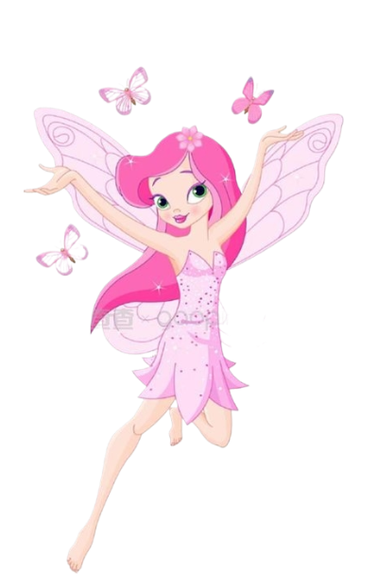
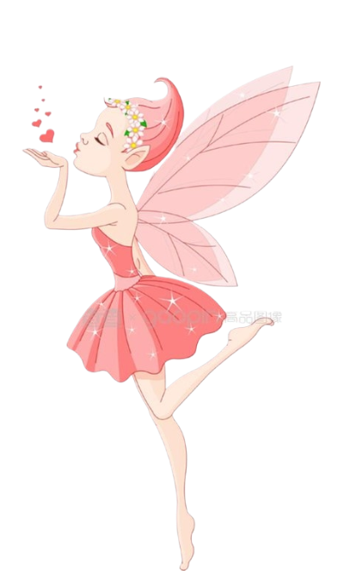
风带来了故事的种子，
时间使它发芽！
我们应该尊重孩子的个性，
使他们自由地成长！

