Slide 1


感恩遇见，相互成就，本课件资料仅供您个人参考、教学使用，严禁自行在网络传播，违者依知识产权法追究法律责任。
更多教学资源请关注
公众号：溯恩英语
知识产权声明

Slide 2

The World
November 1st-15th, 2024

Slide 3
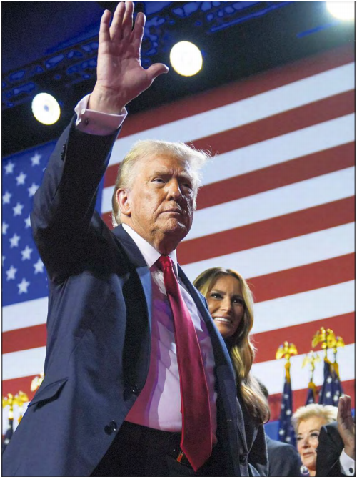
1. TRUMP WINS 45TH PRESIDENT WILL BECOME THE 47TH
特朗普赢得2024年美国总统大选,将成为美国第47任总统

Slide 4
Text Completion
Los Angeles Times（November, 2024 A1)
Donald Trump was elected the 47th president of the United States on Wednesday, fulfilling his promise ________ (shatter) America’s political status quo after he refused to accept his loss to Joe Biden four years ago and inspired a mob of supporters to ________ (violence) storm the U.S. Capitol.
The Republican president-elect’s victory over Democratic Vice President Kamala Harris — after an extraordinary campaign in which he was convicted of felony charges and survived two assassination _______ (attempt) — was decisive: Trump trounced Harris in all the key “blue wall” and Southern battleground states and maintained leads in Arizona and Nevada, _________ (prompt) a torrent of anguish among Democrats.
As Trump _______ (secure) 295 electoral votes to Harris’ 226, Democrats could not take comfort in winning the popular vote, as they did when Trump defeated Hillary Clinton in 2016. With more than 139 million ballots counted, Trump had 4.8 million more votes than Harris.
“This will forever _____________ (remember) as the day the American people regained control of their country,”Trump told a crowd at around 2:30 a.m. Wednesday from a stage adorned with star-spangled banners at his campaign headquarters in West Palm Beach, Fla.
Trump, ____ won by appealing to Americans’ anxieties about the economy and immigration and slamming Democrats as excessively“woke” and out of touch, said the election represented ___ “massive victory for democracy and for freedom.”
Harris conceded to Trump on Wednesday in a phone call ______ she addressed the American people. A senior Harris aide said the vice president congratulated Trump ____ his victory. A Trump official said Trump, in turn, acknowledged Harris’ “strength, professionalism, and tenacity.”
to shatter
violently
attempts
prompting
secured
be remembered
who
a
before
on

Slide 5
Vocabulary
1. felony: the act of committing a serious crime such as murder or rape ; a crime of this type 重罪；重刑罪
Generally an intent to kill is not necessary for felony-murder. 一般来说，谋杀企图在重罪谋杀规则中不是必须的。
2. concede: to admit that sth is true, logical, etc 承认（某事属实、合乎逻辑等）
He was forced to concede (that) there might be difficulties. 他被迫承认可能有困难。
Translation
这样的行为实际上等于犯了重罪。
Such action constitutes a felony.
Translation
他不情愿地向我承认了这一点。
He reluctantly conceded the point to me.

Slide 6
Translation
Donald Trump was elected the 47th president of the United States on Wednesday, fulfilling his promise to shatter America’s political status quo after he refused to accept his loss to Joe Biden four years ago and inspired a mob of supporters to violently storm the U.S. Capitol.
唐纳德·特朗普周三当选为美国第47任总统，兑现了他要打破美国政治现状的承诺。四年前，他拒绝接受输给乔·拜登的事实，并激发了一群支持者暴力冲击美国国会大厦。
Trump, who won by appealing to Americans’ anxieties about the economy and immigration and slamming Democrats as excessively“woke” and out of touch, said the election represented a “massive victory for democracy and for freedom.”
特朗普利用美国人对经济和移民的焦虑，抨击民主党人过于“清醒”和脱离现实，赢得了选举。他说，这次选举代表了“民主和自由的巨大胜利”。

Slide 7
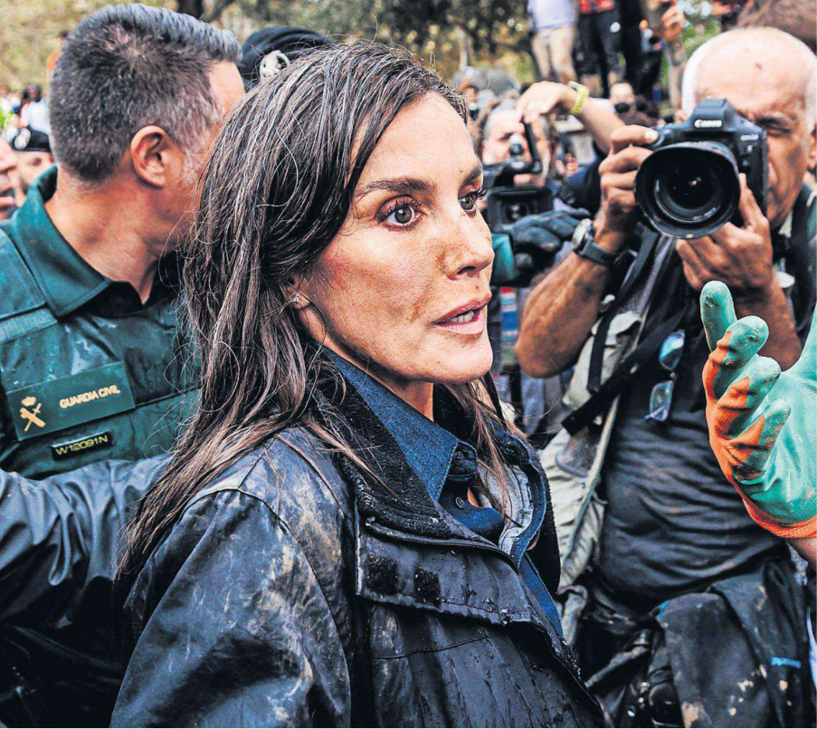
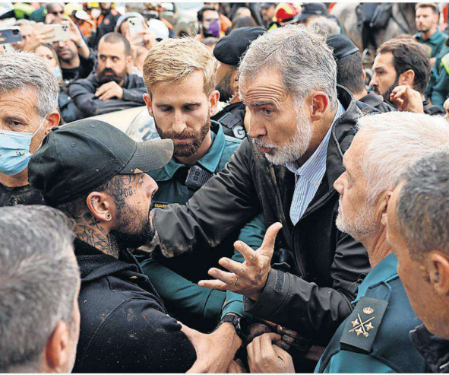
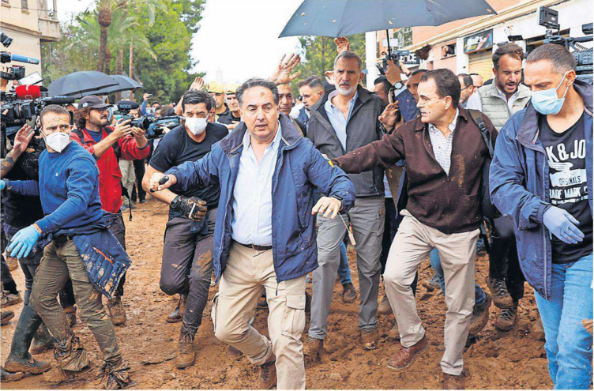
2. Spain’s royals pelted with mud as flood anger erupts
西班牙国王亲临灾区遭愤怒民众围攻

Slide 8
Text Completion
The Times (November 4 2024 P5)
After five days of shovelling mud amid the devastation _______ (cause) by Spain’s floods José Ribelles picked up handfuls of it and threw it at King Felipe. “What do you expect — for us to tell him sweet nothings?” said Ribelles, 23, a supermarket worker from Paiporta, in the southeast Valencia region, ______ an angry crowd threw stones, sticks and insults at the king and Queen Letizia when they visited the area. ______ (shout) of “Murderers” and “Get out of here” accompanied the tirade of projectiles in Paiporta, the town worst-hit by the disaster, where at least 70 people died. Police had to step in, some on horseback, _______ (keep) back the crowd of several dozen, some wielding shovels and poles. Two of the king’s bodyguards ___________ (treat) for injuries. One could be seen with a bloody wound on his forehead.
The attack was unprecedented — the first on the monarchy since its restoration after the _____ (dead) of the dictator Franco in 1975. The queen burst into tears after speaking to several people, ________ (include) one woman who wept in her arms. The king’s security team put up umbrellas to protect the royal couple, who emerged stained with mud from the assault.
Pedro Sánchez, ____ prime minister, was ushered back to his vehicles but the king held his ground, trying to pacify people with words of sympathy. The rear window of one of Sánchez’s cars was broken before he and local politicians quickly left.
In a video ___ social media yesterday Felipe told the country to “understand the anger and frustration” of people in the Valencia region. Residents, ________, remained hostile towards the king, saying the state had failed them. “They wanted to kill us. The first thing you have to do is to warn people when a dam is about to be overwhelmed and broken,” Ribelles said. “You can’t warn people when they are already drowning.
caused
where
Shouts
to keep
were treated
death
including
the
on
however

Slide 9

Reading Comprehension
Which of the following statements is correct according to the text?
A. Residents in Paiporta were so angry that they attacked the King and Queen.
B. There has been another attack on the monarchy since its restoration in Spain.
C. The prime minister did not leave the crowds after he had been pelted with mud.
D. Valencia residents forgave King Felipe after his sympathetic speech on social media.

Slide 10
Vocabulary
1. devastation: great destruction or damage, especially over a wide area （尤指大面积的）毁灭，破坏，蹂躏
A huge bomb blast brought chaos and devastation to the city centre.
一颗威力巨大的炸弹在市中心爆炸，引起一片混乱并造成严重破坏。
2. tirade: a long angry speech criticizing sb/sth or accusing sb of sth
（批评或指责性的）长篇激烈讲话
She launched into a tirade of abuse against politicians.
她发表了长篇演说，愤怒地谴责政客。
Translation
炸弹造成大面积破坏。
The bomb caused widespread devastation.
Translation
她就造成自己企业破产的政策发表了激愤的长篇演说。
She launched into a tirade against the policies that ruined her business.

Slide 11
Translation
The attack was unprecedented — the first on the monarchy since its restoration after the death of the dictator Franco in 1975. The queen burst into tears after speaking to several people, including one woman who wept in her arms. The king’s security team put up umbrellas to protect the royal couple, who emerged stained with mud from the assault.
这次袭击是史无前例的，是1975年独裁者佛朗哥去世后君主制复辟以来的第一次。王后在对几个人发表讲话后泪流满面，其中一名女子在她怀里哭泣。国王的安全团队撑起雨伞保护这对皇室夫妇，他们在袭击中满身是泥。
Pedro Sánchez, the prime minister, was ushered back to his vehicles but the king held his ground, trying to pacify people with words of sympathy. The rear window of one of Sánchez’s cars was broken before he and local politicians quickly left.
首相佩德罗·桑切斯被护送回他的车里，但国王没有离场，试图用同情的话语安抚人们。桑切斯的一辆车的后窗被打碎，随后他和当地政客迅速离开。

Slide 12
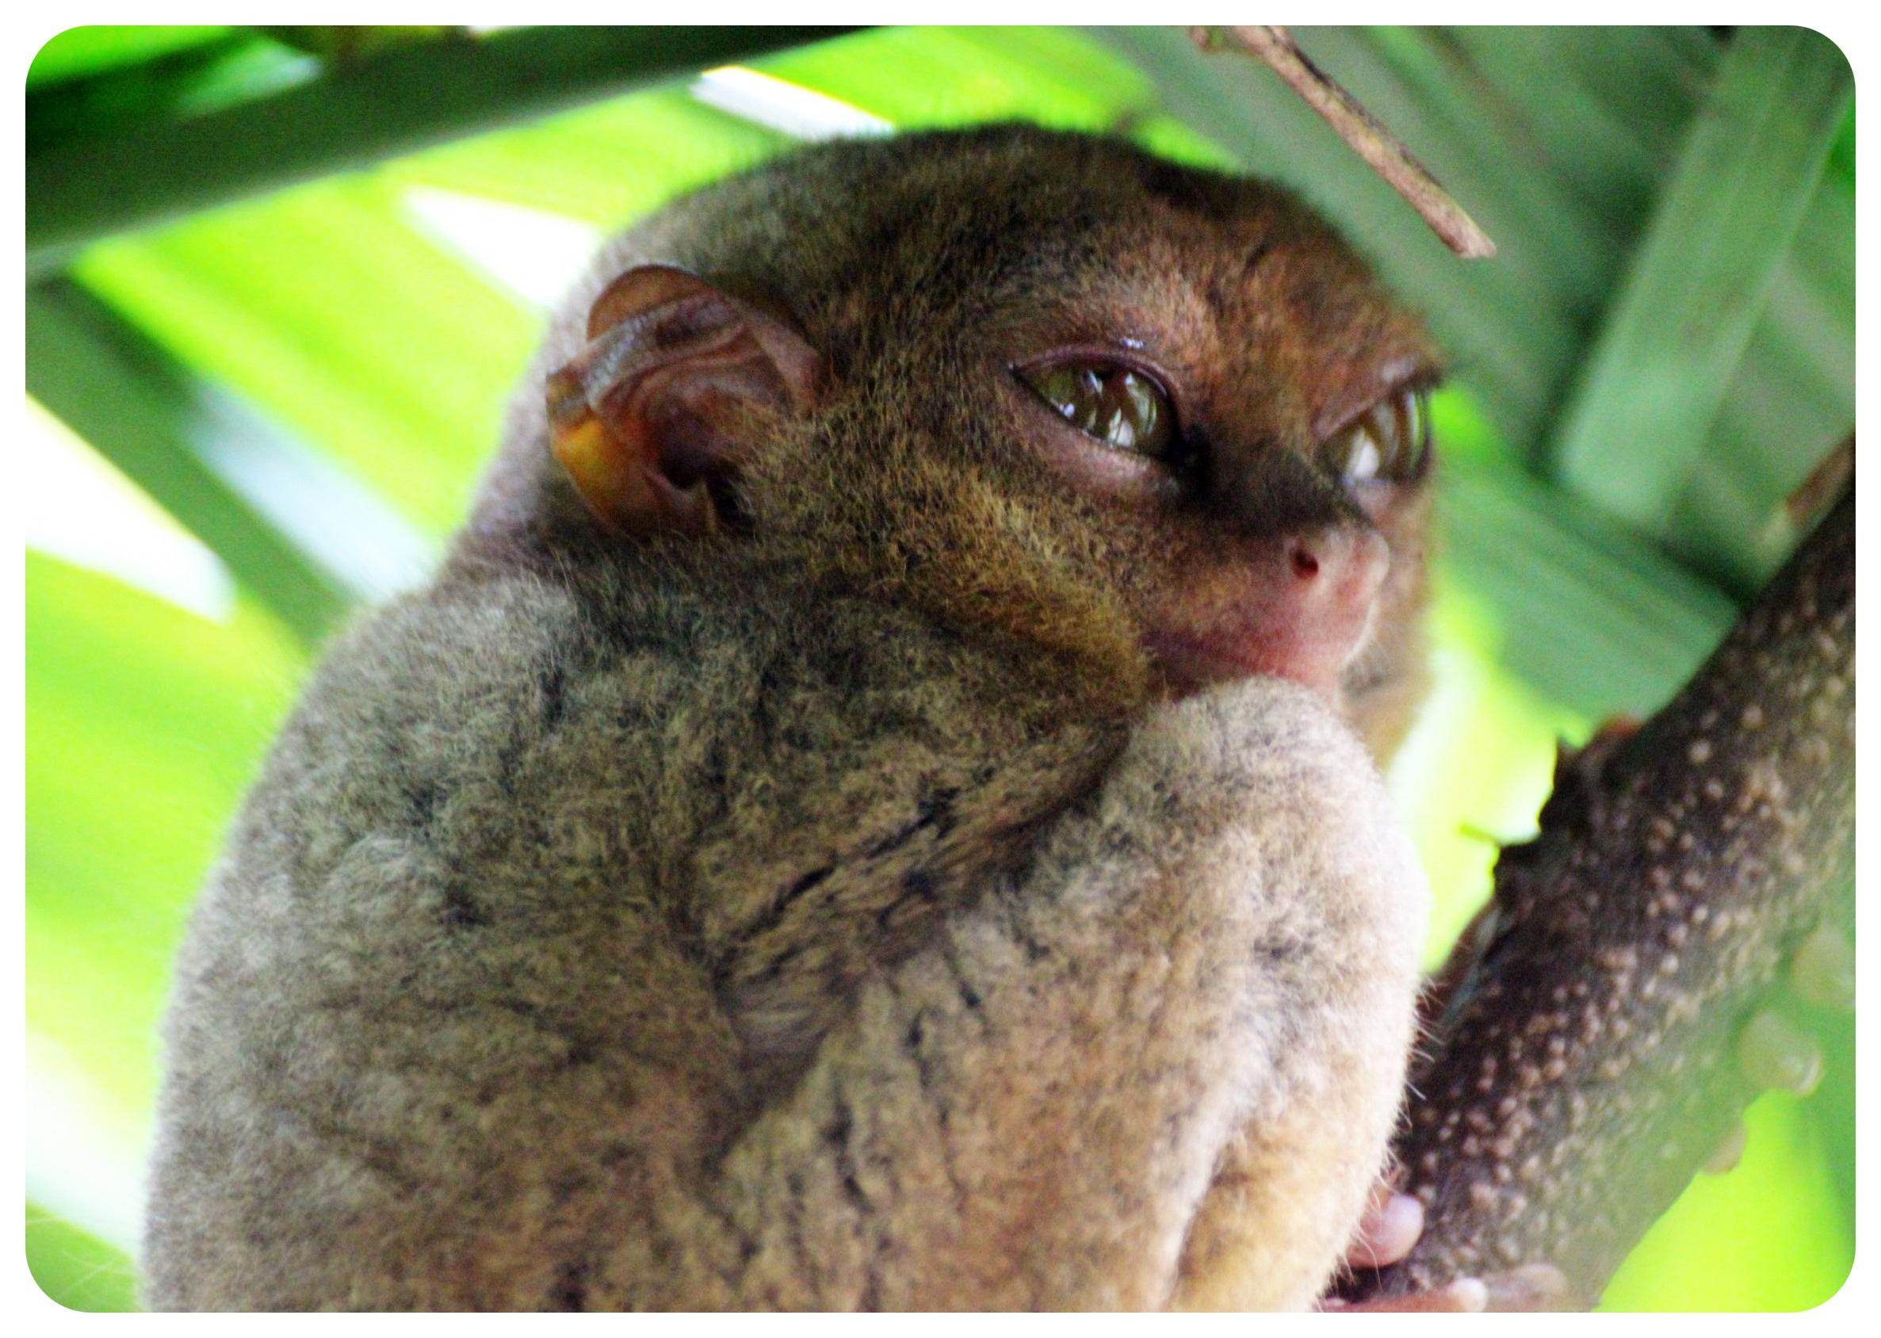
3. Tarsiers in Trouble
眼镜猴处于困境

Slide 13
Text Completion
BBC Science Focus（October, 2024 P25)
smallest
Tarsiers are among the world’s ________ (small) primates, with large bulging eyes, tiny bodies and ET-like fingers. ____ their cute appearance has counted against them - they are poached for the pet trade and made to pose for selfies with paying tourists. Habitat loss and sound and light pollution are other key _______ (threat).
One species ______ (face) a particularly severe decline is the Philippine tarsier. “The situation is worrying, as we know of few strongholds for the Philippine tarsier,” says Pierre Fidenci, president of ESI. According to Fidenci, the decline could be ______ (part) attributed to lifestyle changes in the local communities in and around the sanctuary, particularly Purok Bagong Silang, which _____________ (connect) to the electricity grid in 2016. The indigenous B’laan people have since been able to use lamps during the evening and radios and televisions during the day. Being nocturnal, tarsiers are very sensitive ___ light, and the increased daytime noise may be disturbing their sleep patterns. Habitat has also been lost due to human encroachment and farming.
“The implementation of immediate conservation measures is required __________ (ensure) the recovery and ________ (survive) of the tarsier,” says Fidenci. “Measures should include habitat restoration (such as tree planting), the removal and stopping of new illegal encroachments within the protected area, noise reduction and fostering organic _________ (ecology) agriculture in the area.”
But
threats
facing
partly
was connected
to
to ensure
survival
ecological

Slide 14
Vocabulary
1. sanctuary: an area where wild birds or animals are protected and encouraged to breed 鸟兽保护区；禁猎区
It is used by fishermen and is designated a bird sanctuary. 它被渔民使用，并被指定为鸟类保护区。
2. indigenous: belonging to a particular place rather than coming to it from somewhere else 本地的；当地的；土生土长的
The lake is surrounded by indigenous plants and trees. 这个湖被当地的植物和树木所环绕。
Translation
该公园是美国最大的野生动物保护区。
The park is the largest wildlife sanctuary in the US.
Translation
袋鼠原产于澳大利亚。
The kangaroo is indigenous to Australia.

Slide 15
Translation
But their cute appearance has counted against them - they are poached for the pet trade and made to pose for selfies with paying tourists. Habitat loss and sound and light pollution are other key threats.
但它们可爱的外表却对它们不利——它们被偷猎用于宠物交易，并被迫与付费游客自拍。栖息地丧失、声音和光污染是其他主要威胁。
Being nocturnal, tarsiers are very sensitive to light, and the increased daytime noise may be disturbing their sleep patterns. Habitat has also been lost due to human encroachment and farming.
眼镜猴是夜行动物，对光线非常敏感，白天噪音的增加可能会扰乱它们的睡眠模式。由于人类的入侵和农耕，栖息地也在丧失。

Slide 16
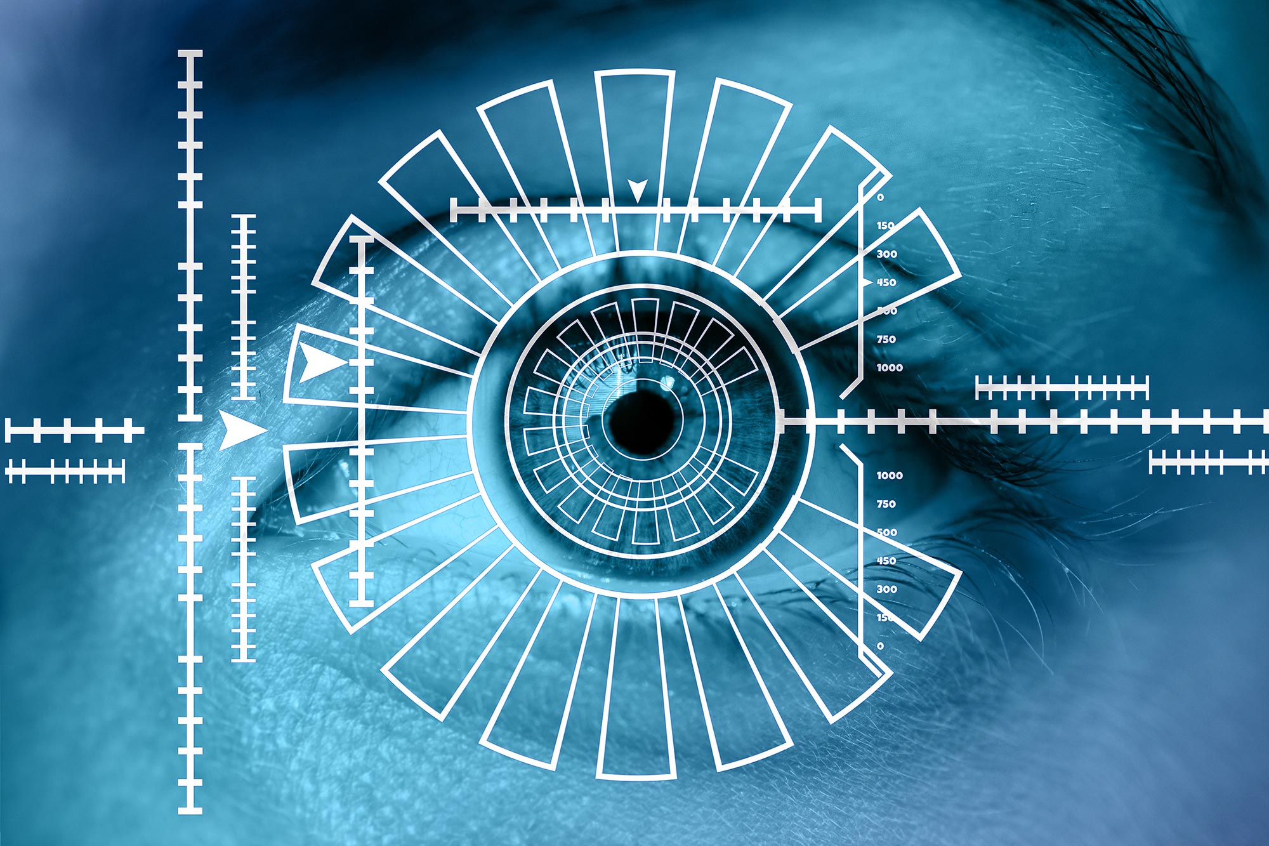
4. Eye scans will help prevent blindness from diabetes
眼部扫描有助于预防糖尿病导致的失明

Slide 17
Text Completion
The Times (November 18, 2024 P4)
and
A new eye screening scheme could free up 120,000 hospital appointments a year ____ help prevent sight loss, the NHS has said.
The initiative will provide advanced eye scans to people with diabetes outside __________ (tradition) hospitals, in larger GP practices, community hospitals and mobile vans. The introduction across the country of OCT scans will save ___ estimated 120,000 hospital ophthalmology appointments, NHS England said. Ophthalmology treatments make up almost a _____ (ten) of the NHS waiting list Steve Russell, NHS England director for screening, said: “It’s fantastic news ____ these advanced eye scans will be available closer to home for thousands of people with diabetes across the country. This technology will help us find and treat diabetic eye conditions early, ________ (helping) minimise and prevent sight loss, and it also means that thousands of appointments in traditional hospital settings could _________ (save), which is great news for the NHS.”
People with diabetes can develop a condition ______ (call) diabetic retinopathy, in which high blood sugar levels damage the back of the eye. It can cause blindness if left untreated, _____ regular screening can catch problems early.
It is expected that 60,000 people with _____ (sign) of eye disease will take part in OCT screening. The scans create a 3D image giving more accurate results. All eye care services are expected to be using the technology by next October.
traditional
an
tenth
that
helping
be saved
called
but
signs

Slide 18
Vocabulary
1. initiative: a new plan for dealing with a particular problem or for achieving a particular purpose 倡议；新方案
Local initiatives to help young people have been inadequate. 当地对年轻人的扶助法案一直不够完善。
2. minimise: to reduce sth, especially sth bad, to the lowest possible level 使减少到最低限度
Good hygiene helps to minimize the risk of infection. 保持清洁有助于最大限度地减少感染的危险。
Translation
和平倡议受到了双方的欢迎。
The peace initiative was welcomed by both sides.
Translation
忧心忡忡的人们想把患上癌症的风险降到最低。
Concerned people want to minimize the risk of developing cancer.

Slide 19
Translation
This technology will help us find and treat diabetic eye conditions early, helping minimise and prevent sight loss, and it also means that thousands of appointments in traditional hospital settings could be saved, which is great news for the NHS.
这项技术将帮助我们及早发现和治疗糖尿病性眼病，帮助最大限度地减少和预防视力丧失，这也意味着可以节省成千上万的传统医院预约，这对NHS来说是个好消息。
It is expected that 60,000 people with signs of eye disease will take part in OCT screening. The scans create a 3D image giving more accurate results. All eye care services are expected to be using the technology by next October.
预计将有6万名有眼疾症状的人参加OCT筛查。扫描产生的3D图像提供了更准确的结果。预计到明年10月，所有的眼科护理服务都将使用这项技术。

Slide 20

5. BBC News 11/05/2024

Slide 21

Dictation
Moldova’s President Maia Sandu has claimed ______ over her pro-Moscow challenger, Alexandr Stoianoglo. Official figures from the runoff election show her establishing a clear lead with 98% of the votes counted.
In the final 48 hours of the US presidential election campaign, the _________ have been concentrating on the seven swing states, most likely to decide the outcome. Polls suggest the eventual result could be extremely ____.
More rain is falling in the Spanish region of Valencia, where irate residents earlier pelted King Felipe, Queen Letizia, and the prime minister with mud, calling them murderers. More than two hundred people lost their lives across the region, and others _____________.
The British Foreign Secretary, David Lammy, has said the concept of reparations for former colonial nations affected by ______ is not about money. Mister Lammy told the BBC that this was not the debate people want. He’s visiting two African economic powerhouses, Nigeria and South Africa.
An Israeli court has said a leak of __________________ involving a close aide to the prime minister may have compromised efforts to secure the release of Israeli hostages held by Hamas. The prime Minister, Benjamin Netanyahu, has denied __________.
The jailed Vietnamese property tycoon Truong My Lan will appear in court on Monday to ______ against her death penalty. She was sentenced in April for embezzling more than 12 billion dollars.
Bolivia’s former president, Evo Morales, says the government is refusing to have a dialogue with him or his supporters to avoid bloodshed. On the second day of a ____________, Mister Morales accused the government of responding by arresting his supporters.
The _________ Formula One champion Max Verstappen has won a crash-strewn Sao Paulo Grand Prix, despite starting in 17th position on the grid, bad weather stopped the race after 33 laps.
victory
candidates
tight
remain missing
slavery
classified intelligence
wrongdoing
appeal
hunger strike
defending

Slide 22
Vocabulary
1. irate: very angry 极其愤怒的；暴怒的
She then wrote an extremely irate letter about me.
她接着写了一封关于我的信，言辞极其激烈。
2. pelt: to attack sb by throwing things at them
投物攻击；向…投掷
Some of the younger men began to pelt one another with snowballs.
一些年轻人开始相互投掷雪球。
Translation
店主非常恼火,差点把我从那个地方扔出去。
The owner was so irate that he almost threw me out of the place.
Translation
人群开始向警车扔石块。
Crowds started to pelt police cars with stones.

Slide 23
Translation
More rain is falling in the Spanish region of Valencia, where irate residents earlier pelted King Felipe, Queen Letizia, and the prime minister with mud, calling them murderers. More than two hundred people lost their lives across the region, and others remain missing.
西班牙巴伦西亚地区下了更多的雨。早些时候，愤怒的居民向国王费利佩、王后莱蒂齐亚和首相扔泥巴，称他们是杀人犯。整个地区有200多人丧生，还有人失踪。
An Israeli court has said a leak of classified intelligence involving a close aide to the prime minister may have compromised efforts to secure the release of Israeli hostages held by Hamas. The prime Minister, Benjamin Netanyahu, has denied wrongdoing.
以色列一家法院称，涉及总理一名亲密助手的机密情报泄露，可能影响了确保释放被哈马斯扣押的以色列人质的努力。以色列总理本雅明·内塔尼亚胡否认有不当行为。

