Slide 1


感恩遇见，相互成就，本课件资料仅供您个人参考、教学使用，严禁自行在网络传播，违者依知识产权法追究法律责任。
更多教学资源请关注
公众号：溯恩英语
知识产权声明

Slide 2

活用教材词汇，靶向高考写作
BX3U3单词拓展

Slide 3

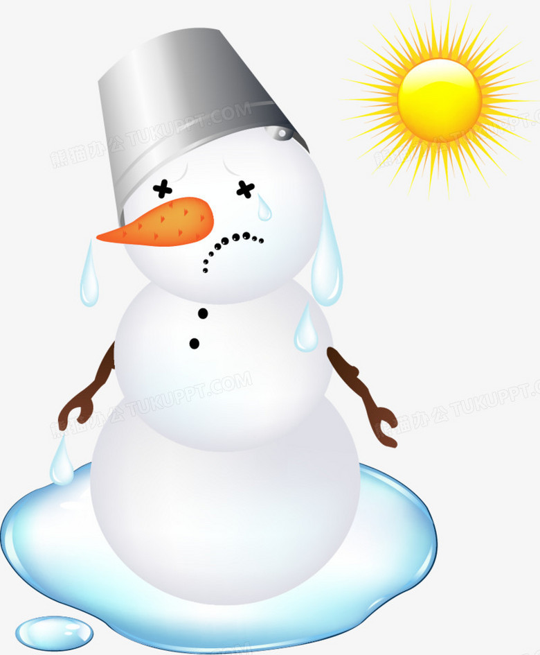
melt /melt/ vt. & vi. （使）融化；熔化；软化
1. 他们的食物快用完了，他们每天共用一瓶融雪。然后一个冰瀑把他们的帐篷平台埋了，把他们挤在了一起。爬下来是不可能的。
Their food was running out and they shared a single bottle of snow melt each day. Then an ice fall buried their tent platform and squeezed them together. It was impossible to climb down.
2. 昏暗的灯光亮着;整个房间充满了温暖和爱。那时我们知道，
爱可以融化他的孤独。
The dim light was on; the whole room was filled with
warmth and love. We knew then that love can melt his loneliness.
3. 他们的脸上洋溢着驱散寒冷的微笑。
Their faces were illuminated by smiles that melt away the cold.

Slide 4
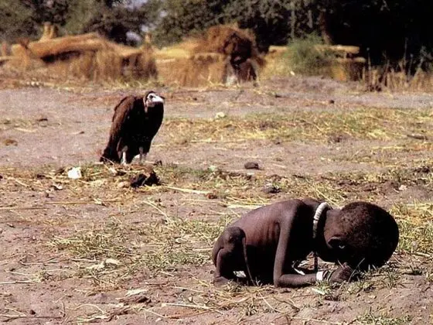
starve /stɑːv/ vt. & vi. （使） 挨饿；饿死
starvation /stɑːˈveɪʃ(ə)n/ n. 饿死
1. 饿死
2. 到目前为止，他的一生都很不幸，小时候患有严重的、危及生命的疾病，这使他的精神和身体都陷入困境，家里也缺钱。
starve to death / die of starvation
He’d been unlucky so far in life, suffering severe, life-threatening illnesses as a child, leaving him mentally and physically stuck and the family starved of cash.
3. 听到父亲死于饥饿的消息，爱德蒙心如刀绞，但是他暂时需要保持冷静。
Edmond felt such pain at the news of his father's death by starvation that he had to remain quiet for a few moments.

Slide 5




release /rɪˈliːs/ vt. & n. 排放；释放；发布
1. 为了释放学习压力，得到放松，今天下午我们班和高三一班打了一场足球比赛。
In order to release pressure from study and get some relaxation, our class played a basketball match with Class 1, Senior 3 this afternoon.
2. 我如释重负地感觉到头上的压力稍稍减轻了一些。
My heart soared with relief as I felt a slight release of pressure on my head.
3. 她感到自己的眼泪突然而甜蜜地流出来。
She felt the sudden sweet release of her own tears.

Slide 6


sustainable /səˈsteɪnəb(ə)l/ adj. 可持续的，合理利用的
1. 至于活动内容，可以考虑设立摊位，推广环保知识，鼓励可持续发展。
As for the content of the activity, you could consider setting up booths to promote environmental knowledge and encourage sustainable practices.（2023年北京卷 “绿色北京”）
2. “减少塑料，收集塑料，创造美丽家园”的口号强调了减少使用塑料的重要性，在我们的学校和社区积极捡起塑料废物，为更清洁和更可持续的生活环境做出贡献。
The slogan "Reduce Plastic，Collect Plastic，Create a Beautiful Home" emphasizes the importance of using less plastic，actively picking up plastic waste in our school and community，and contributing to a cleaner and more sustainable living environment.

Slide 7

comprehensive /kɒmprɪˈhensɪv/ adj. 全部的；所有的；详尽的
1.这并不奇怪，因为你对中国文化非常感兴趣，并且一直在探索中国文化。你不仅查阅了丰富的资源，还咨询了许多当地人和专业人士，这使你对中国文化有了全面的了解和良好的掌握。
It came as no surprise, for you are keenly interested in Chinese culture and have been continuously exploring it. Not only did you refer to abundant resources, but also you consulted many locals and professionals, which equips you with a comprehensive knowledge and good command of Chinese culture.
2. 总之，篮球不仅可以提高身体素质，而且有助于全面发展。
In short, basketball can not only improve physical fitness but also contribute to comprehensive development.

Slide 8

comprehensive /kɒmprɪˈhensɪv/ adj. 全部的；所有的；详尽的
3. 您的名著《本草纲目》是您耗费多年心血写成的，被认为是中国医学史上最完整、最全面的医学著作。
Your famous book, Compendium of Materia Medica, which cost you years of effort, has been regarded as the most complete and comprehensive medical work in the history of Chinese medicine.
4. 我们的汉语日庆祝活动取得了巨大的成功。与会嘉宾纷纷表示，此次活动让他们对汉语有了更全面、更深入的认识。
Our Chinese Language Day Celebrations proved to be a huge success. Participants thought highly of it, saying that the celebrations have helped them see into our language in a more comprehensive and deeper angle.

Slide 9

worldwide /ˌwɜːldˈwaɪd/ adv. 遍及全球地 adj. 世界各地的；影响全世界的
1. 全世界成千上万的动物爱好者纷纷点赞，称赞保罗是一个勇敢的英雄，因为他的努力和敏捷的思维。
Giving a lot of likes, thousands of animal lovers worldwide praised Paul as a hero for his brave efforts and quick-thinking.
2. 他是2003年抗击非典和2019年抗击新冠肺炎的领军人物，赢得了全世界的尊敬。
He is a leading figure in the battles against SARS in 2003 and COVID in 2019, winning him the worldwide respect.

Slide 10


trend /trend/ n. 趋势；趋向；动向
1. 我个人坚信，随着这一趋势的发展，它不仅加强了文化交流，也为国际合作带来了新的机遇。
Personally, I firmly believe that as this trend continues, it not only strengthens cultural exchange but also brings new opportunities for international cooperation.
2. 我写信来分享一个有趣的趋势，即越来越多的外国人热衷于学习汉语。
I am writing to share an interesting trend that an increasing number of foreigners are keen on learning the Chinese language.

Slide 11

frequently /ˈfriːkwəntli/ adv. 频繁地；经常
frequent adj. 频繁的；经常的
1. 可以肯定，新的一年充满了困难和挑战。总共有6个主要的主题要处理，我们很可能会经常感到时间短缺。
It is certain that the coming year is laden with difficulties and challenges. With in total six major subjects to work on, chances are that we will frequently feel a shortage of time.
2. 有这么多的家长来接送他们的孩子，我们学校门口附近经常发生交通堵塞，给我们学生和老师带来了很多不便。
With so many parents coming to send and pick up their children, traffic jams are frequent near our school gate, causing much inconvenience to us students as well as our teachers.
3. 在过去的几年里，极端天气和自然灾害频繁发生，如洪水、地震等，
造成数百万人死亡，无数房屋被毁。
Over the past years, there has been frequent extreme weather and natural disasters, such as floods, earthquakes and so on, killing millions of people and destroying countless homes.

Slide 12



policy /ˈpɒləsi/ n. 政策；方针；原则
1. 如你所知，我们学生应该不遗余力地实施垃圾分类政策。所以，我毫不犹豫地抓住了这个机会。
As you know, we students should spare no efforts in implementing the policy of garbage classification. So, I seized this opportunity without hesitation.
2. 最近我们班就退耕还林政策进行了一次讨论，我们的意见出现了分歧。
Recently our class had a discussion about the policy of returning farmland to forests and our opinions were divided.
3. 一些学生支持这一政策，认为随着植被的增加，水土流失将变得不那么严重。
Some students support this policy, saying that with the increase of vegetation, water loss and soil erosion will become less severe.

Slide 13


policy /ˈpɒləsi/ n. 政策；方针；原则
4. 第二天，当校长把我叫到他的办公室时。“玛莎，”他说，“今年关于奖学金夹克的政策发生了变化。今年董事会决定收取15美元，这仍然不够买这件夹克的全部费用。所以如果你付不起买夹克的钱，它会给下一个排队的人。
The next day when the principal called me into his office. “Martha,” he said, “There’s been a change in policy this year regarding the scholarship jacket. This year the Board has decided to charge fifteen dollars, which still won’t cover the complete cost of the jacket. So if you are unable to pay the money for the jacket, it will be given to the next one in line.”

Slide 14

footprint /ˈfʊtprɪnt/ n. 足迹；（某物所占的）空间量；面积
1. 一天，当邮递员离开她家时，湿土上留下了他的脚印。莎莉挣扎着拿出一张纸，打印出来，把他脚上的照片取了下来。
One day when the postman left her home, his footprints were left on wet soil. Sally struggled out with a paper and put it on print and took down the picture of his feet.
2. 我们离开房子，穿过白雪覆盖的田野。我们的脚印在雪地里走得很深，但随着雪的继续下，脚印也消失了。我们穿过田野，目标是吉米的房子。
We left the house and walked across the snow-covered fields. Our footprints went deep in the snow, only to disappear as the snow continued to fall. We headed across the field, aiming for Jimmy’s house.

Slide 15

seize /siːz/ vt. 抓住；夺取；控制
1.我们面前有很多机会。你能否抓住机遇取决于你所做的选择。
There are lots of chances in front of us. Whether you can seize them or not depends on the choices you make.
2. 在课堂上，我尽力抓住每一个机会来提高自己。渐渐地，我开始和我的同学正常交谈，并与他们相处得很好。
In class, I tried my best to seize every opportunity to improve myself. Gradually, I began to have normal conversations with my classmates and got along well with them.
3. 当我最终到达一楼时，我感到头晕，沮丧似乎又一次抓住了我。但这一次，我设法使自己镇定下来。
As I eventually approached the first floor, I felt dizzy and frustration seemed to seize me again. But this time, I managed to compose myself.

Slide 16

refer to 参考，查阅; 指的是; 提及，谈到
1. 此外，你推荐的书很有帮助，我仍然经常参考它们。
Besides, the books you recommended were very helpful and I still refer to them often.
2. 你不仅查阅了丰富的资源，还咨询了许多当地人和专业人士，这使你对中国文化有了全面的了解和良好的掌握。
Not only did you refer to abundant resources, but also you consulted many locals and professionals, which equips you with a comprehensive knowledge and good command of Chinese culture.
3. 简最终接受了她将不得不坐在轮椅上走动的事实。她再也没有提起唱歌的事。我知道她是一个善良、善解人意的女孩，她害怕谈论她最初的梦想会让我们俩感到不安。
Jane eventually accepted the fact that she would have to get around in a wheelchair. Never did she refer to the subject of singing again. I knew she was a nice and understanding girl, who was afraid that talking about her original dream would upset the two of us.

Slide 17



be trapped in 被困在某处：无法离开某个地方或处境
1. 在他后悔之前，我们的车已经陷在沙子里了。父亲试图掉头或后退，但车没有移动。我们很担心，被困在荒无人烟的地方。更糟糕的是，天开始下雨，天气很冷。
Before he regretted it, our car had got stuck in the sand. My dad tried to turn around or move back, but the car didn’t move. We were worried, trapped in the middle of nowhere. Even worse, it began raining and was cold.

Slide 18


be trapped in 被困在某处：无法离开某个地方或处境
2. 所有奇妙的记忆涌上心头，她忍不住哭了起来。如果我不是和汤姆吵了一架，走开，爬到高处，我就不会被困在这个可怕的地方，面临死亡的危险。她带着无尽的焦虑后悔着，然后带着闪烁的泪光睡着了。
All the fantastic memory crowded in and she couldn’t help crying, “Hadn’t I quarreled with Tom, walked away and climbed to the high place, I wouldn’t be trapped in this awful place, confronted with the danger of dying.” She regretted with endless anxiety, and then became asleep with shining tears in her eyes. 2016年10月浙江卷“夫妻遇险”
3. 当她走近一座高耸的悬崖时，阿米莉亚惊恐地倒吸了一口气。在汹涌的海浪之上，一个狭窄的礁石上，有一只小海豚被困在一张厚厚的渔网里。
As she approached a towering cliff, Amelia gasped in horror. On a narrow ledge (岩架), high above the violent waves, was a young dolphin trapped in a thick fishing net.

Slide 19


be responsible for 对...负责
1. 所需要的志愿者将负责接待、咨询和翻译。展会相关资料将提前提供。
The volunteers needed will be responsible for reception, consultation and translation. Exhibition-related materials will be provided in advance.
2. 在我看来，虽然人工智能有它的好处，但我们也必须谨慎并考虑潜在的后果。以负责任和道德的方式继续研究和开发人工智能是很重要的。
In my opinion, while AI has its benefits, we must also be cautious and consider the potential consequences. It is important to continue researching and developing AI in a responsible and ethical manner.
3. 通过这次经历，我学会了欣赏无条件的爱的力量，以及做一个负责任和关心宠物的主人的重要性。
Through this experience, I learned to appreciate the power of unconditional love and the importance of being a responsible and caring pet owner.

Slide 20

bring ... out 使显现，使表现出；阐明；生产，出版
1. 正是B老师的洞察力、远见和体贴，激发了4名学生的潜能。她才是真正配得上A的人。
It is Mrs B’s insight, vision and thoughtfulness that bring out the potential in four of her students. She is the one who truly deserves the grade A.
2. 如今，许多父母尽他们最大的努力给他们的孩子一个快乐和有意义的生活。然而，过多的关心和爱可能会宠坏孩子，甚至带来问题。
Nowadays, many parents try their best to give their children a happy and meaningful life. However, too much care and love may spoil a child and even bring about problems.
3. 首先，将有一个不同朝代的中国传统服装展览，这将带来一场视觉盛宴。
To start with, there will be an exhibition of traditional Chinese costumes of different dynasties, which will bring about a visual feast.
辨析： bring about
只有行动能够带来改变。
Only actions can bring about changes.

Slide 21

harmonious /hɑːˈməʊniəs/ adj. 和谐的
常用搭配： 与大自然和谐共处
live in harmony with nature
1. 用善行充实每一天，生活才会更加美好和谐。我们所做的每一件好事都是迈向幸福的一步，我们所做的每一件好事都有助于我们成为我们应该成为的人。
Enriching every day with good deeds and life will be more beautiful and harmonious. Every act of kindness we do is a step toward happiness and every act of kindness we do helps us become the person we are meant to be.
2. 双胞胎把早餐端上楼，叫醒了母亲。睁开眼睛，她听到双胞胎孩子说“母亲节快乐”，面前摆着热乎乎的早餐。2021年新高考I&II卷“母亲节礼物”
The twins carried the breakfast upstairs and woke their mother up. Eyes opened, the woman heard a harmonious “Happy Mother’s Day” from her twin kids with hot, sweet breakfast before her.

Slide 22


harmonious /hɑːˈməʊniəs/ adj. 和谐的
3. 为了使附近的社区更加和谐，我们学习小组在暑假期间举办了一个以社区服务周为主题的活动。
To help make the nearby community a more harmonious one, our learning group held an activity, whose theme was Community Service Week, during the summer vacation.
4. 孔子的重要性怎么强调也不为过。他的教诲塑造了中国文化的道德和伦理基础，培养了对权威的尊重、和谐的人际关系和对知识的追求。
The significance of Confucius cannot be overstated. His teachings shaped the moral and ethical foundation of Chinese culture, fostering respect for authority, harmonious relationships, and the pursuit of knowledge.
harmonious family

Slide 23



submit /səbˈmɪt/ vt. & vi. 提交；呈递；屈服
1. 如果你想申请成为会员，你必须填写申请表，并在本周五之前提交给学校体育办公室。
If you want to apply for the membership, you are required to fill in the application form and submit it to school sports office by this Friday.
2. 他不情愿的屈服于他母亲。
He submitted unwillingly to his mother.
3. 每位学生只需要提交一份作品，并附上标题和个人信息，包括姓名、班级和电子邮件地址。请在11月底前将您的文件包发送至photoexhi@qq.com。
Each student is supposed to submit only one entry with a title and personal information including name, class and email address. Please send your file package to photoexhi@qq.com by the end of November.

Slide 24



annual /ˈænjuəl/ adj. 每年的；一年的 n. 年刊；年鉴
1. 也许今年我会到处种上鲜艳的一年生植物。
Maybe this year I’ll sow brilliant annuals everywhere.
2. 鉴于你对体育的浓厚兴趣，我写信邀请你参加定于12月1日在我们学校体育场举行的一年一度的体育节，你一定不能错过。
Given your keen interest in sports, I’m writing to invite you to participate in our annual Sports Festival scheduled to be held on December 1st in our school stadium, which you shouldn’t miss.
3. 我们所有人都在厨房的餐桌上努力工作，我妈妈在拍摄一年一度的活动。
All of us were hard at work at the kitchen table, with my mom filming the annual event. （with复合结构）2021浙江1月高考“南瓜”

Slide 25


on behalf of 代表（代替）某人
1. 我代表我们学生会写信邀请你参加下周六举行的“体验你未来的工作”活动。
On behalf of our Students’ Union, I’m writing to invite you to participate in an activity called “Experience Your Future Job” to be held next Saturday.
2. 我谨代表学校和社区，热烈欢迎来自伦敦姐妹学校的交流团。我们很高兴你能来我们的家乡。
On behalf of our school and community, I warmly welcome the exchange group from London Sister School. We’re thrilled to have you visiting our hometown.
3. 我谨代表我们学校，向您在今年的英语文化节上所做的演讲表达我们诚挚的感谢。
On behalf of our school, I'm writing to convey our sincere appreciation to you for the lecture you gave during this year's English Culture Festival.
in order to help sb 为了帮助某人
as the representative of sb or instead of them 代表（代替）某人

Slide 26

sensitive /ˈsensətɪv/ adj. 敏感的；善解人意的；灵敏的
1. 又走了半个街区，他找到了答案，一辆移动的垃圾车。它的声音一定触动了我的狗灵敏的耳朵，所以当我们靠近它时，它叫得更响了，还用爪子抓着我的背。
Another half-block of carrying him brought the answer — a moving garbage truck. Its sound must have hit my dog’s sensitive ears, so he cried louder and clawed at my back as we drew closer to it.
2. 为了改善这种情况，我建议博物馆聘请专业的中文翻译来修改所有的中文标识，确保翻译准确，文化敏感，语法正确。
To improve the situation, I suggest the museum hire a professional Chinese translator to revise all the Chinese signage, ensuring that the translations are accurate, culturally sensitive, and grammatically correct.

Slide 27

sensitive /ˈsensətɪv/ adj. 敏感的；善解人意的；灵敏的
3. 在他的盘子旁边，安德鲁发现了一张漂亮的字母卡片。是他妻子寄来的。上面写着:祝贺你，我的爱人! 我就知道你会加薪的!我准备这顿晚餐是为了表达我对你的爱。我为你的成就感到骄傲! 他读了这封信，停下来思考蒂娜是多么善解人意和体贴。
Next to his plate Andrew found a beautiful lettered card. It was from his wife. It read: “Congratulations, my love! I knew you’d get the raise! I prepared this dinner to show just how much I love you. I am so proud of your accomplishments!” He read it and stopped to reflect on how sensitive and caring Tina was.

Slide 28


restore /rɪˈstɔː(r)/ vt. 恢复；使复原；修复
1.出乎我意料的是，她给了我一个拥抱，表示原谅，说我的忏悔对她意义重大。清除了耻辱，恢复了信心，这是多么令人宽慰啊。
To my great surprise, she gave me a hug as a token of forgiveness, saying my confession (坦白) meant a lot to her. What a relief it was to clear the shame and restore the faith.
2. 此外，我们可以呼吁我们周围的人采取行动。通过共同努力，我们可以保护和恢复我们宝贵的海洋。
Besides, we can call on people around us to take action. By working together, we can protect and restore our precious oceans.

Slide 29


conservation /ˌkɒnsəˈveɪʃ(ə)n/ n. 对（环境、文物等）保护；保持
1. 海洋被生态学家称为地球的肺，在生物圈中起着至关重要的作用。随着6月8日世界海洋日的临近，应高度重视海洋养护。
The oceans, which are referred to by ecologists as the lungs of our planet, have played a crucial role in the biosphere. With the World Oceans Day falling on 8 June approaching, great importance should be attached to ocean conservation. 2022全国甲卷“海洋保护投稿”
2. 展览定于本周日上午9点在学校美术馆开始，持续3个小时。它旨在提高学生的环保意识，鼓励环保行为。
The exhibition is scheduled to start at 9 a.m.this Sunday in the school art gallery，lasting for 3 hours. It is aimed at raising students' awareness of environmental conservation and encouraging eco-friendly behavior.

Slide 30

dozen /ˈdʌz(ə)n/ n. （一）打；十二个
dozens of 许多；很多
1. 我们住在一个农场里，养了十几只小鸡。这些小鸡还太小，不能出门，它们被放在洗衣房里的一个塑料箱里，在加热灯的照射下。
We lived on a farm and raised a dozen baby chicks. Too young to be outside, the chicks were in a plastic bin in our laundry room, under the warmth of a heat lamp.2023全国卷“爸爸的歌声”
2. 我工作很努力。我检查了我的拼写。我请姐姐纠正我的语法。我从图书馆借了六本关于保罗·里维尔的书。我甚至读了一些。
I worked hard. I cheeked my spelling. I asked my older sister to correct my grammar. I checked out a half-dozen books on paul Revere from the library. I even read a few of them. 2023年新课标Ⅰ &Ⅱ卷 “写作竞赛”
3. 在等待枪响的时候，我的喉咙感觉就像一块棉花田，在夏天的炎热中裂开了。我凝视着外面的人群;几十张来自教堂和学校的熟悉面孔在我的视野中闪现。他们是为我来的。
My throat felt like a field of cotton, cracked with the summer heat, as I waited for the gun to fire. I gazed out at the crowd; dozens of familiar faces from church and school flickered across my view. They had come for me.

Slide 31


regulation /ˌreɡjuˈleɪʃ(ə)n/ n. 章程；规章制度
1. 我呼吁我们学校所有使用电动自行车的学生遵守规定，戴上头盔，尽一切努力把安全放在第一位。
I’m appealing to all the students of our school who use electric bicycles to obey the regulation and make every effort to put safety in the first place by wearing helmets.
2. 到目前为止，快餐公司已经巧妙地避开了政府的管理。
So far, fast-food firms have cleverly avoided government regulation.

Slide 32

contribute /kənˈtrɪbjuːt/ vi. &vt. 捐献，捐赠；是......的原因；投稿
contribute to 有助于，促成
1. 我现在是贵校的交换生，我相信这次活动对我来说是一个很好的贡献和学习的机会。
I am currently an exchange student at your school and I believe this activity would be a great opportunity for me to contribute and learn.2023年天津卷“申请参加中英文化交流活动”
2. 我很高兴有机会为校报撰稿，并帮助促进其向学生提供高质量新闻的使命。
make contributions to
I am excited about the opportunity to contribute to the school newspaper and help promote its mission of providing quality journalism to the student body.
4. 我希望你们的会议能够提高人们的网络文明意识，为我国建立一个更安全、更清洁的网络环境做出贡献。
I hope your conference will raise people's awareness of Internet civilization, and contribute to a safer and cleaner online environment in our country.

Slide 33


end up 最终到达/陷入
1.不一会儿，他就生气了，冲进我们的房间，怒目张视地问我们是谁把他的花弄得一团糟。勇敢的玛丽亚没有哭，而是把花递过来，解释我们的初衷，以及结果如何。
In no time, he got annoyed and stormed into our room, questioning us in glare who it was that made such a mess of his flowers. Instead of crying, brave Maria held out the flowers and explained what we meant to do and how it ended up this way.
2. 站在窗边的人试图打开窗户让新鲜空气进来，但以失败告终。
Those standing by the windows attempted to open them to let in fresh air but ended up in failure.

Slide 34


concern /kənˈsɜːn/ n. 担心，忧虑；使人担忧的事物 vt. 使担忧
concerned adj. 相关的；担心的，焦急的
concerning prep. 关于，涉及
1. 你好吗？您一直很关心我们的英语学习。我代表我的同学向你表示感谢。
How are you? You have always been concerned about our English learning. On behalf of my classmates, I would like to thank you. 2.然而，我们关心的是如何说服别人，尤其是妈妈，接受皮埃尔。
However, what concerned us was how we could persuade others, especially Mom, to accept Pierre.
3. 夜幕降临时，天冷得刺骨。由于担心大雁的安全，我们恳求爸爸保护这个小家伙。
It was freezing cold when night fell. Concerned about the wild goose’s safety, we begged dad to protect the little guy.

Slide 35


concern /kənˈsɜːn/ n. 担心，忧虑；使人担忧的事物 vt. 使担忧
concerned adj. 相关的；担心的，焦急的
concerning prep. 关于，涉及
4. 《功夫熊猫》讲述了一个关于一只会表演武术的又大又胖的熊猫的故事。
Kung Fu Panda tells a story concerned with a big, fat panda that can perform martial arts.
5. 这些书按其内容主要可分为三类。首先是关于中国文化的，里面有插图和生动的传说故事。
The books can be divided mainly into three types according to their contents. First come those concerning Chinese culture, in which there are illustrations and vivid legend stories.

Slide 36


address /əˈdres/ n. 地址，住址 v. 演说，演讲；处理，设法解决；致函
1. “谢谢你，”乔说着，迅速抄下了地址。他立即向电话簿上的地址走去。
“Thank you,” Joe said, quickly copying down the address. He immediately headed for the address from the phone book.
2.大家早上好。我很荣幸能发表题为“我的梦想工作”的演讲。
Good morning, everyone. I feel it an honor to address a speech titled "My dream job".
3. 随着时间的推移，我发现自己在舒适区之外做的事情越来越多，对生活的态度也越来越积极。我开始解决超重的问题。我经常跑步，这帮助我减掉了80磅。
As time went on, I found myself doing more things out of my comfort zone and feeling more positive about life. I started to address being overweight. I ran regularly, which helped me lose eighty pounds.

Slide 37


http://www.sunedu.com
Thank You!

