Slide 1



感恩遇见，相互成就，本课件资料仅供您个人参考、教学使用，严禁自行在网络传播，违者依知识产权法追究法律责任。
更多教学资源请关注
公众号：溯恩英语
知识产权声明

Slide 2

应用文评析---演讲稿
（读后续写写作比赛）
24年11月浙江省9+1联盟高三联考

Slide 3
题目呈现
假定你是李华，在上周的英语读后续写作文大赛中获得了第一名。为此，学校英语沙龙邀请你作相关写作分享，请写一篇发言稿，内容包括：
1. 获奖感受；
2. 写作建议。
参考词汇：读后续写continuation writing
(1)写作词数应为80左右； (2)请按如下格式在答题纸的相应位置作答。
Dear fellow students,
________________________________________________________________________________________________________________________________________________________________________________________________________________________________________________________________________________________________________________________________________________
Thank you! _________________________________________________________________________________________________

Slide 4

目录
1
SDL应用文写作模式介绍
2
基于SDL模式的写作步骤
3
4
范文及下水作文分享
同话题相关写作拓展

Slide 5
1
SDL应用文写作模式介绍

Slide 6
基于SDL模式的应用文写作步骤
仔细审题拟定结构(Structure)
研读要点
拓展细节 (Details)
02
01
依据话题
整合语料
(Language)
巧用策略
润色表达(Language)
04
03

Slide 7
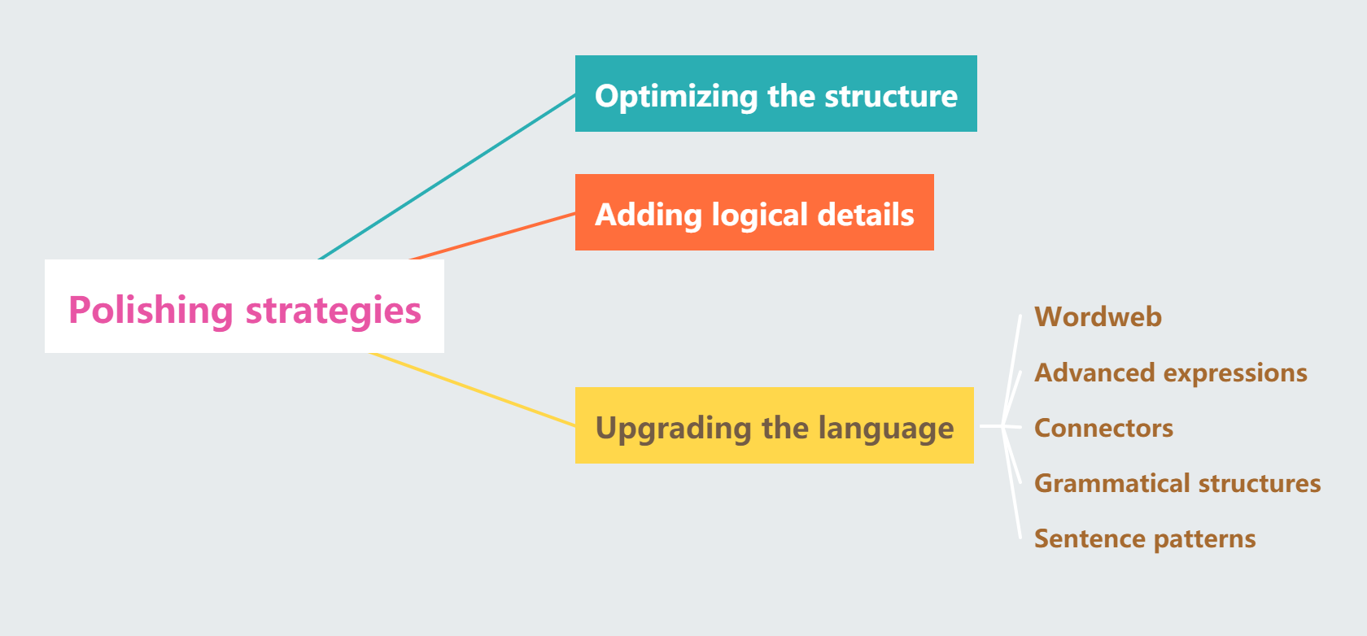
SDL模式在应用文写作修改过程的策略运用

Slide 8
2
基于SDL模式的写作步骤

Slide 9
Step 1:仔细审题，拟定结构(structure)
体裁 | 发言稿
人称 | 第一人称，第二人称
时态 | 一般现在时，一般过去时
结构 | Para 1: (自我介绍)+演讲背景+演讲目的(background information+speech purpose) Para 2: 获奖感受+写作建议(personal feelings&reflections+suggestions on writing) Para 3: 致谢+表达期望(acknowledgement+hope)

Slide 10


Step 2: 研读要点，拓展细节(details)
获奖的喜悦
I can hardly contain my excitement and pleasure at being awarded the first prize.
倍感荣幸与自豪
It is my honor to receive the first prize in the English contiuation writing competition.
对自己创作的激励与鼓舞
This honour is a milestone in my writing journey, which will spur me to make big strides in the future.
个人努力的回报
It is a recognition of the countless hours I’ve spent in polishing my craft.
对老师和团队的感谢
This glory is not just mine alone; it also belongs to my supportive teacher, who offered professional guidance in the whole process.
要点1：
获奖感受
意识与行动
自我及他人
成长与反思

Slide 11

Step 2: 研读要点，拓展细节(details)
扩展阅读量
You’re supposed to expose yourself to more authentic reading materials penned by native speakers.
写作技巧的建议
What serves as the most important portion of our writing style is the vivid description and innovative use of words.
You should ensure you maintain the original story’s tone and voice, which is the key to a successful continuation writing.
加强日常练习
You’re recommended to make it a rule to write a short story on a regular basis.
树立自信心
A thousand-mile journey begins with the first step. As long as you keep practising, you’ll definitely boost self-confidence and promote your writing skills.
要点2：
写作建议
意识与行动
理论与实践
动态与静态

Slide 12
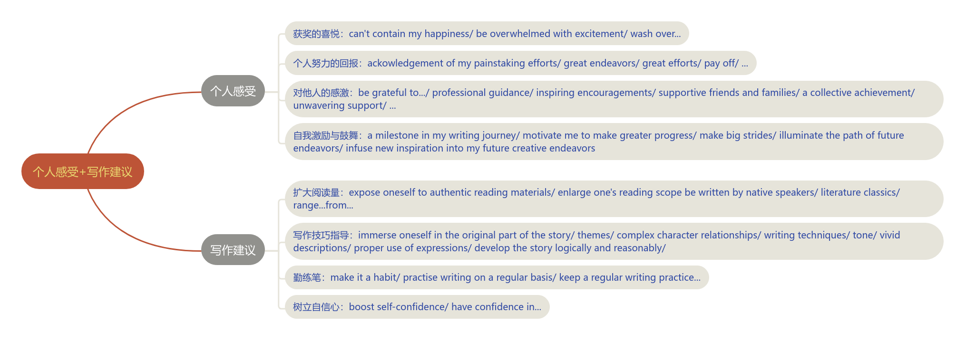
Step 3: 依据话题，整合语料(language)
3

Slide 13



Step 3: 依据话题，整合语料(language)
表示建议的句子：
I suggest/recommend that you (should)...
You’re strongly suggested doing sth.
You’re supposed to do...
You’d better do...
You’re recommended to do...
It is a wise/good choice to do...
It never fails to be a good idea to do...
My first piece of advice is that you (should) do...
Why not do...?
If I were you, I would do...
表示过渡的句子：
When it comes to continuation writing, I have some suggestions for you.
As to how to improve the continuation writing, here are some practical advice for you.
表示递进的连词：
what’s more, besieds, in addition, apart from that,furthermore,...

Slide 14
Step 4:巧用策略，润色表达(language)
Para 1: 演讲背景+演讲目的
3
I’m Li Hua. Exceedingly delighted to be awarded the first prize in the continuation writing last week, I’m honored to share with you my experience and offer some suggestions. ---非谓语动词
I’m Li Hua, the winner of last week’s continuation writing contest. It is a great privilege for me to be invited here and share my notions and insights into English writing with you. ---it作形式主语
I’m Li Hua. It is with immense joy that I share with you the feeling of being recognized as the champion in the continuation writing competition. I feel greatly honored to have the chance delve into the world of writing and offer some practical suggestions. ---强调句；高阶词组

Slide 15
Step 4:巧用策略，润色表达(language)
Para 2: 获奖感受+写作建议
The moment my name was announced as the winner, a mixture of feelings washed over me, astonishment, disbelief, and gratitude. I felt as if all the late nights and the moments of self-doubt had taken shape in this single, shining moment. All my efforts and hard work have paid off. ---the moment引导时间状语从句；高阶词组；as if句型
This achievement has been both rewarding and motivating, constantly reminding me of the painstaking efforts and great endeavors I’ve made in this process. I’m deeply grateful to my English teacher, whose professional guidance and inspiring encouragements played a crucial role in my preparations. ---词汇网；非谓语动词; 定语从句

Slide 16
Step 4:巧用策略，润色表达(language)
Para 2: 获奖感受+写作建议
This honor marks a significant milestone in my writing journey, which will definitely motivate me to make greater efforts and illuminate the path of future endeavors. ---定语从句；高阶词组
Upon hearing the good news that I was recognized as the first-place winner in the continuation writing contest, I was overwhelmed with happiness and joy. This victory can serve as a powerful motivator, encouraging me to continue pursuing writing and honing my craft further. ---同位语从句；非谓语动词；被动语态；高阶词组
This prize is a witness to my hard work, creativity and persistence during the preparation process, which has infused new inspiration into my future creative endeavors. ---定语从句；高阶词组

Slide 17
Step 4:巧用策略，润色表达(language)
Para 2: 获奖感受+写作建议
This victory is not just mine alone; it also belongs to my supportive teachers, my families, and most importantly, to the power of perseverance and passion for the English language. ---高阶词组
This award is not just a personal triumph but a collective achievement. It is an acknowledgement to the unwavering support of my teacher, the friendship of my fellow writers, and the silent hours spent in crafting sentences over and over again. ---高阶词组；排比句式

Slide 18
Step 4:巧用策略，润色表达(language)
Para 2: 获奖感受+写作建议
When tackling continuation writing, you’re supposed to immerse yourself fully in the original part of the story—its themes, complex character relationships, conflicts and narrative techniques. ---省略句；高阶词组
What’s more, you’re recommended to apply vivid descriptive expressions and various sentence patterns to make your writing attractive and compelling. ---连词；被动语态；高阶词组
When it comes to improving your continuation writing, my first piece of advice is to expose yourself to a wide range of authentic literature classics written by native speakers, be it classic novels or poems. ---高阶词组；be it...or...引导的让步状语从句

Slide 19
Step 4:巧用策略，润色表达(language)
Para 2: 获奖感受+写作建议
When embarking on writing a continuation part, you should ensure you maintain the original story’s language features and develop the plot logically and reasonably. ---省略句
Besides, you’d better make it a habit to practise free writing on a regular basis, as it not only boosts your creativity but also enhances your ability to choose words and construct sentences.---连词；it作形式宾语；高阶词组
What serves as the most significant part of our continuation writing is the vivid descriptons and appropriate applications of expressions in line with the original part. ---主语从句；高阶词组

Slide 20
Step 4:巧用策略，润色表达(language)
Para 2: 获奖感受+写作建议
A thousand mile journey begins with the first step. As long as you keep practising, you’ll definitely boost self-confidence and promote your writing skills. ---引用；让步状语从句
No one is born to be a Shakespeare, but if you keep practising with the suggstions offered, you’re bound to make great progress in continuation writing. ---条件状语从句

Slide 21
Step 4:巧用策略，润色表达(language)
Para 3: 致谢+期望
Thank you agin for this honor, and I hope you can get find my suggestions helpful and beneficial.
Hopefully, you can gain enlightenment from my suggestions and evetually develop your own unique style one day.
I hope you can gain something can gain something and embark on the journey of writing from a different perspective.
Practice makes perfect! I hope my insights can spark your writing passion and help you get the hang of it.

Slide 22
3
范文及下水作文分享

Slide 23

范文分享
Dear fellow students,
I’m honored to stand here today afer winning first place in last week’s continuation writing contest. This achievement means a lot to me, which not only boost my confidece but motivates me to eplore more in creative writing.
As for writing tips, I believe there are a few key aspects to focus on. Always read original works to enrich your vocabulary and enhance the authenticity of your language. Practice writing regularly, paying close attention to possible plot twists, character development and themes. Don’t forget to revise your drafts thoroughly, checking grammar, detailed description and the overall flow of the narrative.
Remember, writing is a journey. Enjoy the process and let your imaginatio flow!
Thank you!

Slide 24
教师下水作文
Dear fellow students,
I’m Li Hua. Exceedingly delighted to be awarded the first prize in the continuation writing last week, I’m honored to share with you my experience and offer some suggestions.
This achievement has been both rewarding and motivating, constantly reminding me of the painstaking efforts and great endeavors I’ve made in this process. I’m deeply grateful to my English teacher, whose professional guidance and inspiring encouragements played a crucial role in my preparations. When it comes to continuation writing, you’re supposed to immerse yourself fully in the original part of the story—its themes, complex character relationships, conflicts and narrative techniques. What’s more, you’re recommended to apply vivid descriptive expressions and various sentence patterns to make your writing attractive and compelling.
Thank you again for this honor! I hope you can find my suggestions helpful.

Slide 25
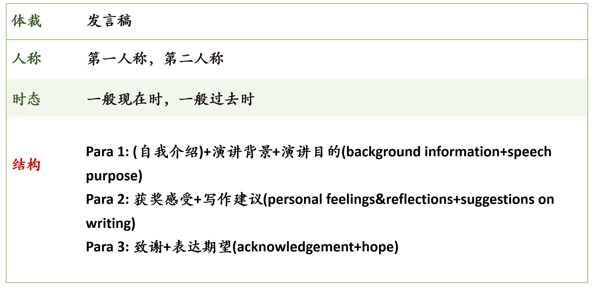
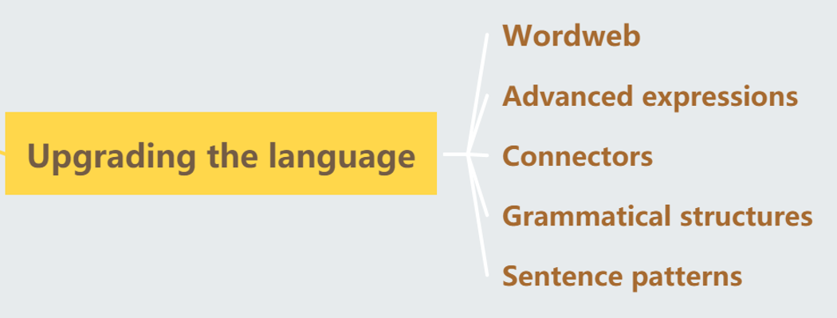
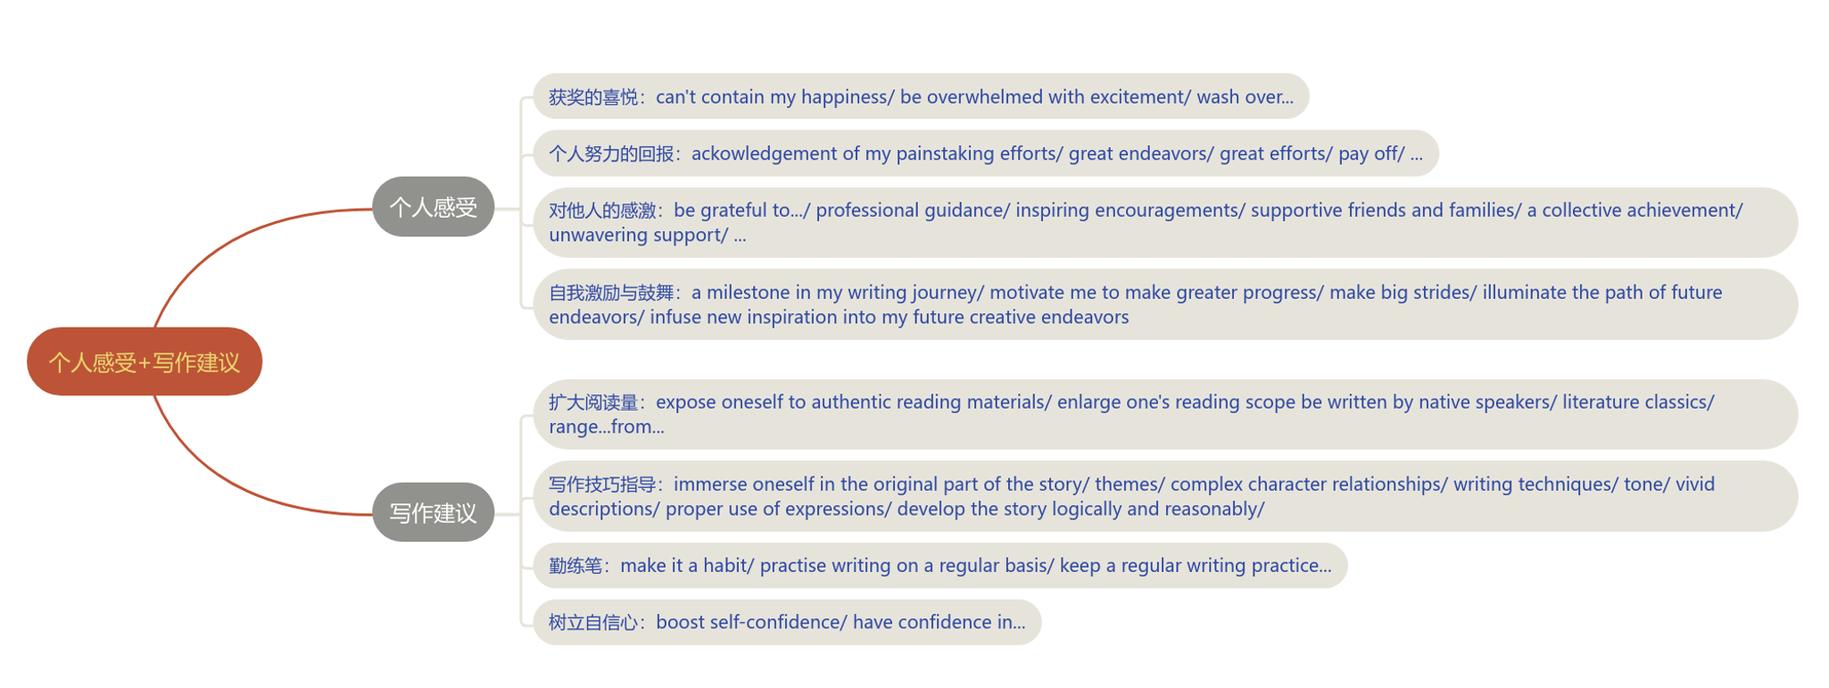
意识与行动
自我及他人
成长与反思
理论与实践
静态与动态
内容+语言+思维
仔细审题，
拟定结构
研读要点，
拓展细节
思维
巧用策略，
润色表达
依据话题，
整合语料

Slide 26
4
同类话题写作拓展

Slide 27
拓展1：告知信（改编自24.11温州一模）
Dear Jasper,
Learning your keen interest in my experience of taking part in this continuation writing contest, I’m wrting to share with you how I overcame the difficulties in the preparation process.
The biggest obstacle for me was how to organize the contiuation part of the story logically and reasonably. To tackle this problem, I turned to my English teacher for help, who guided me to read the original part thoroughly to better understand the background information, character relationships and the theme, thus laying a good foundation for my writing. Another big headache was my limited vocabulary and writing skills, which made it challenging for me to express my ideas clearly. Therefore, I exposed myself to a wide range of literature classics, thus greatly promoting my ability to choose words and construct sentences.
Despite the painstaking efforts I’ve made in this process, it was quite a rewarding experience in that it not only helped me appreciated the beauty of language but also illuminated the path for my future endeavors. I hope you’ll find these information useful. Lookong forward to your reply.
Yours,
Li Hua
假定你是李华，在上周举办的校读后续写写作比赛中获得了一等奖。你的英国朋友Jasper对你的参赛经历非常感兴趣，想了解你如何应对备赛中的挑战。请你写一封邮件回复，内容包括：
1. 写作中遇到的困难
2. 困难的解决方法

Slide 28
拓展2：投稿（24.11金华一模结合24.11福建省名校联盟）
Embrace English, Show Ourselves
Last week witnessed the huge success of our school’s English Week themed “Embrace English, Show Ourselves”.
There were a wide range of fascinating activities, among which the English writing competition left me a deep impression. The title of the competition was “Beautiful China in My Eyes”. Almost all the students got involved in this activity, where they were expected to write a passage related to the given topic within 300 words in any form. Their sentences they crafted immered us in the appealing langdcape and profound history of our motherland. At hthe end of this competition, the top three students were awarded the prizes and their works would be displayed in the school’s publicity window.
This activity was quite rewarding and inspiring, as it not only provided a platform for students to showcase their talents but it also provoked their creativity and critical thinking.
你校上周举办了主题为“Embrace English, Show Ourselves”的英语周系列活动，请你写一篇短文向校英文报投稿，内容包括：
1.你印象最深的一个活动
2. 你的感想。

Slide 29
Thank you

