Slide 1


感恩遇见，相互成就，本课件资料仅供您个人参考、教学使用，严禁自行在网络传播，违者依知识产权法追究法律责任。
更多教学资源请关注
公众号：溯恩英语
知识产权声明

Slide 2
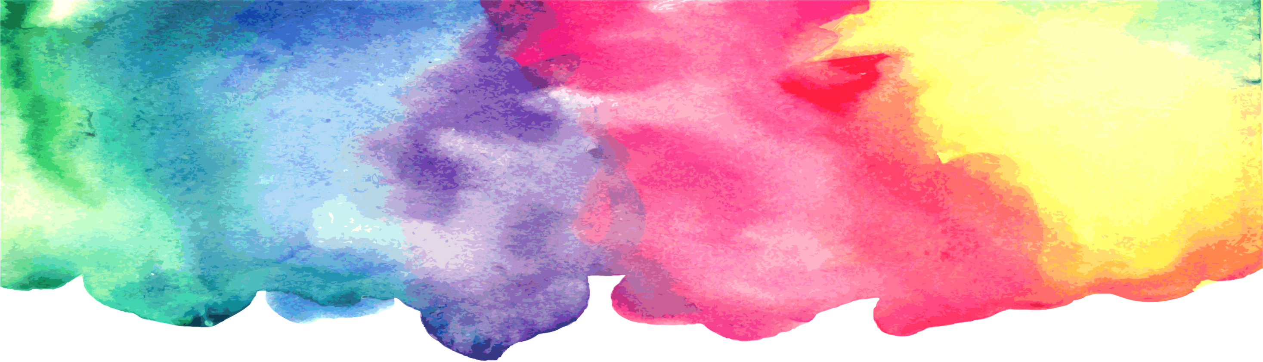

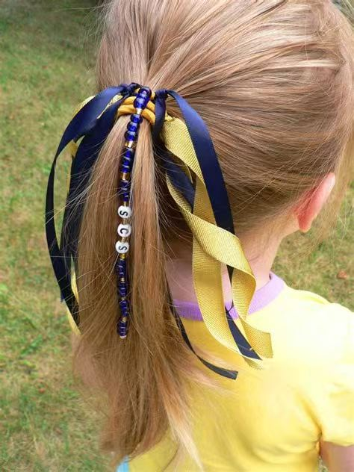
Continuation writing
2024年11月稽阳联考
A Shoplifting Tale
浙江省衢州第一中学 徐荣仙

Slide 3
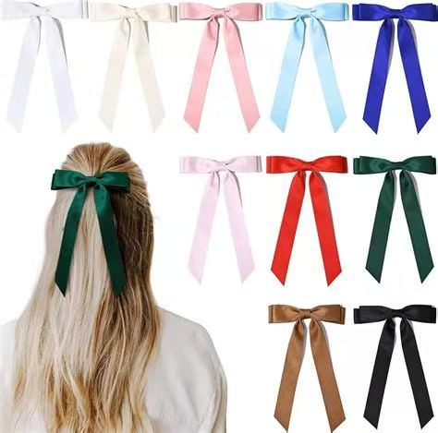
Lead in
Caught in the Act: A Shoplifting Tale
Q: Have you ever felt an overwhelming desire to possess something you really like but don’t belong to you?
Q: If you encounter such a situation, how do you usually handle it?
Q: Would you resort to stealing to take possession of things that do not belong to you? Why?

Slide 4
一、读后续写文本
The cat was out of the bag. I was caught on the spot. The security guard grabbed my arm. “Come with me," he barked, leading me back inside the discount store and into the office. Then he pointed to a lime-green chair. "Sit down!”
I sat. He glared at me. “You can give it to me or I can take it, your choice. What will it be?" I pulled the package of hair ribbons out of the pocket of my jeans, handed it to him and begged, “You're not going to call my dad, are you?"
"I'm calling the police. They will call your father."
My head dropped onto my hands and I sobbed, “No, please! Can't you just let me go? I can pay you. I have money in my pocket. I'm only fourteen years old. Please, I won't ever shoplift again!"
"Save your tears. They won't work on me. I'm sick of you bad kids stealing, just for the thrill of it.” I sat there, trembling uncontrollably. The previous excitement brought by stealing lipstick, teen magazine and all that stuff... now gave way to immense fear and shame.
The police arrived, and the policemen walked me to their black-and-white car and opened the backdoor. I got in, and they drove me through the middle of our small town. I slouched down into the seat so no one could see me as I looked out the window at the evening sky. Then I saw the steeple(尖塔) of my family's church, and the guilt

Slide 5
pierced me like a dagger. “How could I have been so stupid? I've broken my father's heart...and God's," thought I.
We arrived at the station, and a round woman with a square face asked me questions until I ran out of answers. She pointed to the door of a large open cell and said, “Sit. Wait." I walked in, and my footsteps made an echo that bounced off the bars. The tears started again as I sat down on a hard bench and heard her dial the telephone and say, "I have your daughter in a cell at the police station. No, she's not hurt. She was caught shoplifting. Can you come and get her? Okay. You're welcome, good-bye." She yelled, "Hey kid, your father's on his way.”
注意:
1.续写词数应为150左右;
2.请按如下格式在答题卡的相应位置作答。
About one hundred years later, I heard his voice say my name. ____________________
After we arrived home, Dad finally asked me, "Why_______________________________

Slide 6
Read for vocabulary
on the spot
security guard
grab
bark
the discount store
a lime-green chair
shoplift
be sick of
give way to
walk me to...
slouch down to
pierce me like a dagger
当场
保安
抓住
大叫
折扣店
一个浅绿色椅子
在商店里行窃
厌倦...
让路给
陪...走到...
无精打采地低头坐着
像匕首一样刺痛我

Slide 7
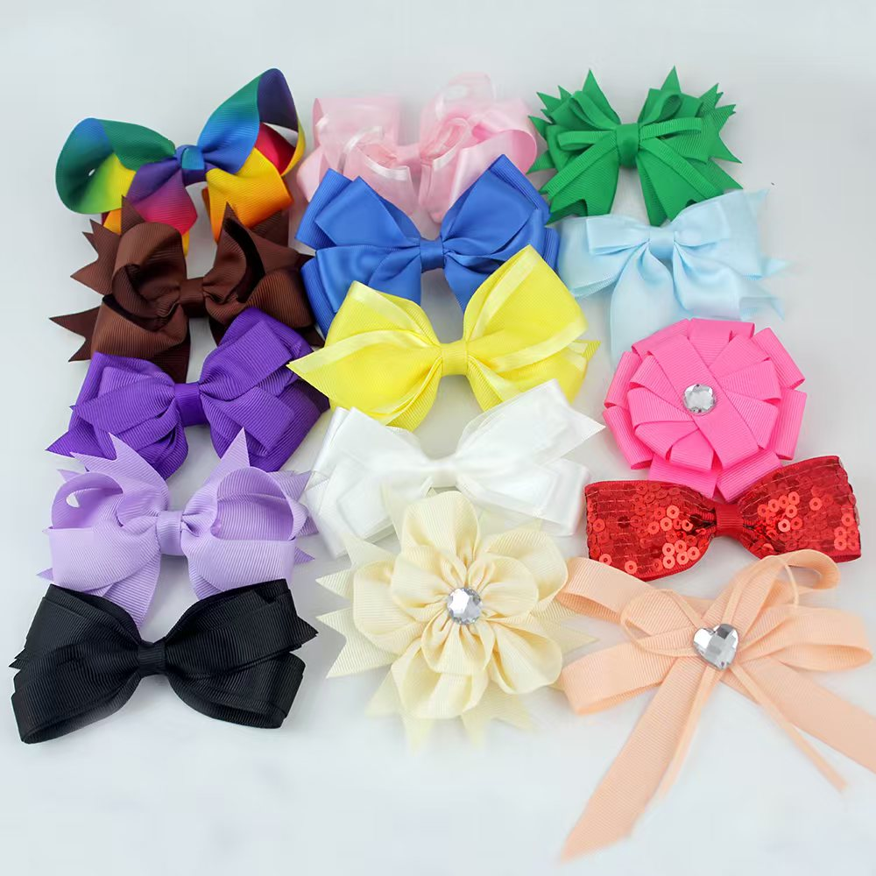

01
01
Read for main idea
Read for main idea
The main idea of the passage is about a young girl's experience with the consequences of shoplifting. She was caught by a security guard, who took her into custody and eventually handed her over to the police. The narrative described her feelings of fear, shame, and guilt as she was processed at the police station and awaited her father's arrival. The passage emphasizes the emotional turmoil and regret that follow her initial excitement of stealing, serving as a cautionary tale about the serious repercussions of such actions.

Slide 8
02
Read for plot
(1)The cat was out of the bag. I was caught on the spot.
(2)The security guard grabbed my arm. “Come with me," he barked, leading me back inside the discount store and into the office. Then he pointed to a lime-green chair. "Sit down!”
(3)I sat. He glared at me. “You can give it to me or I can take it, your choice. What will it be?" I pulled the package of hair ribbons out of the pocket of my jeans, handed it to him and begged,“You're not going to call my dad, are you?"
(4)"I'm calling the police. They will call your father."
(5)My head dropped onto my hands and I sobbed, “No, please! Can't you just let me go? I can pay you. I have money in my pocket. I'm only fourteen years old. Please, I won't ever shoplift again!"
(6) "Save your tears. They won't work on me. I'm sick of you bad kids stealing, just for the thrill of it.” I sat there, trembling uncontrollably. The previous excitement brought by stealing lipstick, teen magazine and all that stuff... now gave way to immense fear and shame.
(7)The police arrived, and the policemen walked me to their black-and-white car and opened the backdoor. I got in, and they drove me through the middle of our small town. I slouched down into the seat so no one could see me as I looked out the window at the evening sky. Then I saw the steeple(尖塔) of my family's church, and the guilt pierced me like a dagger.
Para. 1 ---The introduction of shoplifting
Para. 2-6 --- I pleaded with the security guard for forgiveness
and not to inform her parents.
Para. 7&8 --- Her father was called to the police station to pick her up.

Slide 9
“How could I have been so stupid? I've broken my father's heart...and God's," thought I.
(8) We arrived at the station, and a round woman with a square face asked me questions until I ran out of answers. She pointed to the door of a large open cell and said, “Sit. Wait." I walked in, and my footsteps made an echo that bounced off the bars. The tears started again as I sat down on a hard bench and heard her dial the telephone and say, "I have your daughter in a cell at the police station. No, she's not hurt. She was caught shoplifting. Can you come and get her? Okay. You're welcome, good-bye." She yelled, "Hey kid, your father's on his way.”
注意:
1.续写词数应为150左右;
2.请按如下格式在答题卡的相应位置作答。
About one hundred years later, I heard his voice say my name. _______________________
After we arrived home, Dad finally asked me, "Why_______________________________

Slide 10
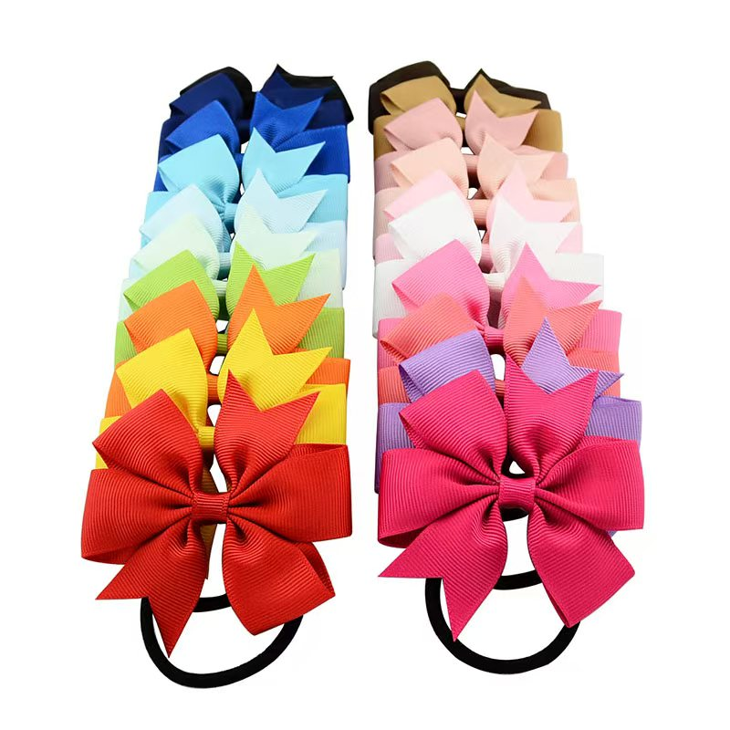
Development of the plot
Para.1
Para.2-6
Para.7-8
Para.9-10
The introduction of a shoplifting —— a young girl caught
stealing hair ribbons
Beginning(Setting)
I pleaded with the security guard for forgiveness and not to inform her parents, but in vain.
Development
Conflict
Her father was called to the police station to pick her up
Ending?
Develop the plot logically and rationally!

Slide 11
03
Read for characters
the security guard
Authoritative
He barked orders at the author, such as "Come with me" and "Sit down!", indicating a commanding presence.
Unyielding
He was not swayed by the author's pleas or tears, showing a strict adherence to the rules and consequences of shoplifting.
Impatient
His response "Save your tears. They won't work on me" suggests he was tired of dealing with such situations and was not interested in the author's excuses or emotional appeals.
the author
The author shoplifted out of excitement and thrill, which is indicative of impulsive behavior.
Impulsive
Regretful
After being caught, the author felt immense fear, shame, and guilt, showing a deep sense of regret for their actions.
Young and Naive
The author's plea to the security guard,"I'm only fourteen years old" suggest a lack of maturity and understanding of the gravity of their actions.
frightened
trembling uncontrolablly...I slouched down into the seat so no one could see me ...,

Slide 12
04
Read the given hints
"Save your tears. They won't work on me. I'm sick of you bad kids stealing, just for the thrill of it.” I sat there, trembling uncontrollably. The previous excitement brought by stealing lipstick, teen magazine and all that stuff... now gave way to immense fear and shame.
The police arrived, and the policemen walked me to their black-and-white car and opened the backdoor. I got in, and they drove me through the middle of our small town. I slouched down into the seat so no one could see me as I looked out the window at the evening sky. Then I saw the steeple(尖塔) of my family's church, and the guilt pierced me like a dagger. “How could I have been so stupid? I've broken my father's heart...and God's," thought I.
We arrived at the station, and a round woman with a square face asked me questions until I ran out of answers. She pointed to the door of a large open cell and said, “Sit. Wait." I walked in, and my footsteps made an echo that bounced off the bars. The tears started again as I sat down on a hard bench and heard her dial the telephone and say, "I have your daughter in a cell at the police station. No, she's not hurt. She was caught shoplifting. Can you come and get her? Okay. You're welcome, good-bye." She yelled, "Hey kid, your father's on his way.”
scared, regretful, annoyed, ashamed, grief-stricken
Paragraph 1:
About one hundred years later, I heard his voice say my name._________________________.
What happened?
Paragraph 2:
After we arrived home, Dad finally asked me, "Why?" ________________________

Slide 13

Prediction
写作难点：
一段首句 “his voice”指的是父亲的声音，学生需考虑与此衔接。根据二段首句 “finally”的提示，第一段中不能出现父亲问其偷窃的原因。原文第五、六两段已对偷窃的原因作出提示，可作续写协同点。
Paragraph 1:
About one hundred years later, I heard his voice say my name.___
Paragraph1:
Q1: What kind of emotion did the father's voice convey?
Q2: How did I feel when I saw my father?
Q3: What was my father’s reaction to me when he saw me?
Q4: What procedures would my father have to go through before picking me up from the police station?
Paragraph 2:
After we arrived home, Dad finally asked me, "Why?" ___________
心理描写
神态描写
动作描写
Q1:What’s my reason for my theft?
Q2: How did I feel about my theft?
Q3: What lesson did I learn from the accident?
Q4: the theme?

Slide 14
05
Read for theme
The Consequences of Impulsive Actions:
The story illustrates the immediate and severe consequences of a momentary lapse in judgment, emphasizing the importance of considering the outcomes before engaging in impulsive behavior.
The Power of Guilt and Remorse:
The experience serves as a reminder of the emotional turmoil that often accompanies wrongdoing, especially when it betrays the trust of loved ones and one's own moral compass.
The Impact of Actions on Family and Personal Values:
The story highlights how one's actions can affect not just themselves but also their family, and how breaking the law can lead to a crisis of faith and a betrayal of personal values, as evidenced by the protagonist's reflection on their church and the disappointment they feel towards their father and God.

Slide 15
One possible version :
About one hundred years later, I heard his voice say my name. It was soft, yet filled with a mix of disappointment and concern. Then the woman called me up to the desk at three times the necessary volume. I kept my eyes on the floor as I walked toward them. I saw my dad’s shoes, but I didn’t speak to him or look at him. He signed some papers and we were allowed to leave. The air was dark and cold as we walked to the car in heavy silence. Then he whispered in a sad and faraway voice, “My daughter... a thief...” I melted into regretful tears. The miles home felt like forever.
After we arrived home, Dad finally asked me, “Why?” I told him about the first time I stole a tube of lipstick and how I felt equal amounts of thrill and guilt. Then, gradually, the guilt faded as the thrill grew. Hot tears bit my face as I said, “Please forgive me. I’ll never do it again.” Dad required me to make a list of all the places I stole from and go to repay the owners. The next morning, I did exactly as he asked. It was impossibly hard, but I did it. Thanks to his courage, I never stole again.

Slide 16
优秀习作 1
About one hundred years later,I heard his voice say my name. It was a mix of disappointment and concern that I had never heard before. I looked up to see my father‘s tired eyes, filled with a sadness that mirrored my own. He didn’t say anything else, just held out his hand for me to take, and I did, feeling the warmth and comfort of his touch amidst the cold, sterile environment of the police station. The walk to the car was silent, the weight of my actions pressing down on both of us.
After we arrived home,Dad finally asked me, “Why?” His voice was quiet, but the question hung heavy in the air. I hesitated, the words catching in my throat.“ I don‘t know, Dad,” I finally admitted, the truth of my confusion and regret mixing with the tears that streamed down my face. “I just...I just wanted to fit in, I guess.” His face softened, and he pulled me into a hug, the kind that only a father can give, one that says he’s disappointed but still loves you unconditionally. “We'll get through this,” he whispered, and I believed him. It was the start of a long journey to make things right, but I knew I wouldn’t have to walk it alone.

Slide 17
优秀习作 2
About one hundred years later, I heard his voice say my name. It was as if time had slowed to a crawl, and every step he took echoed the weight of disappointment. I looked up to see my father's face, a mixture of sadness and anger that I would never forget. His eyes, usually so warm and full of life, were now clouded with a pain I had caused. I wanted to disappear, to take back the moment I had made that fateful decision, but there was no escape from the reality I had created. The car ride home was a journey not just through the familiar streets but through the unfamiliar territory of my own conscience, where every turn led to the same truth: I had made a terrible mistake.
After we arrived home, Dad finally asked me, "Why?" His voice was barely above a whisper, but it resonated with a depth of hurt that I had never heard before. I hesitated, searching for the words that could explain the inexplicable. "I don't know, Dad, I thought it was a thrill, but I realize now how wrong I was. I'm so sorry.” I replied, my voice trembling with a mix of fear and regret. The silence that followed was deafening. As I looked into his eyes, I saw a reflection of my own remorse, a mirror to the pain I had caused, and it was a sight that cut deeper than any physical pain could. Father held me tightly in his broad embrace, without uttering a single word.

Slide 18
An appealing ending?
首尾呼应型
I hesitated, then the words tumbled out, echoing the fear and confusion that had led me to that store. "I just wanted to feel...something, Dad. I didn't think it would lead to this. "He sighed, the weight of my actions settling over us both. "We'll fix this,” he promised, and I knew we would, together, just like we always had.
情景交融型
The question hung in the air, as heavy as the silence that followed. The night had turned cool, the breeze whispering through the open window, a gentle reminder of the freedom I'd so carelessly thrown away. "I was lost,” I admitted, my voice barely a whisper. "But I'm found now, Dad. I swear I'll never lose my way again."

Slide 19
自然结尾型
The question was simple, yet it held the weight of a thousand unspoken words. I looked at him, my father, my rock, and I knew that no matter what, he would help me navigate through this storm. "I don't know, Dad, "I replied honestly. "But I promise you, I'll find out, and I'll make it right."
个人感悟型
The question was a mirror, reflecting back the image of a girl I barely recognized.” I thought I could take what I wanted without consequences, "I confessed, my voice shaking with the realization of my own naivety.” But I learned today that every action casts a long shadow.” Dad nodded, his eyes filled with a sadness that matched my own. “Yes, it does,” he agreed, “but it's never too late to step into the light.” And with that, we began the long journey of healing, one step at a time.

Slide 20
Here are some sentences that capture the feelings of guilt,regret,sadness,and the desire for redemption that fit the story's ending:
• The echo of my father's footsteps seemed to resonate with the pounding of my guilty heart, each step a reminder of the trust I had betrayed.
• As I looked into his eyes, I saw a reflection of my own remorse, a mirror to the pain I had caused, and it was a sight that cut deeper than any physical pain could.
• The silence in the car was a heavy blanket of disappointment, and I felt every thread of it wrapping around me, a tangible weight of my actions.
• My chest ached with the realization that my impulsive thrill had turned into a lifetime of lessons learned the hard way.

Slide 21
The taste of fear in my mouth had turned into the bitter tang of regret, a flavor I knew I would never forget.
• Each tear that fell was a drop of the sorrow I felt, not for myself, but for the father who had taught me to be better, and the daughter I had disappointed.
• The hardness of the bench was nothing compared to the hardness I felt in my heart, a heart that was now breaking with the knowledge of my wrongdoing.
• The car ride home was a journey not just through the familiar streets but through the unfamiliar territory of my own conscience, where every turn led to the same truth: I had made a terrible mistake.

Slide 22
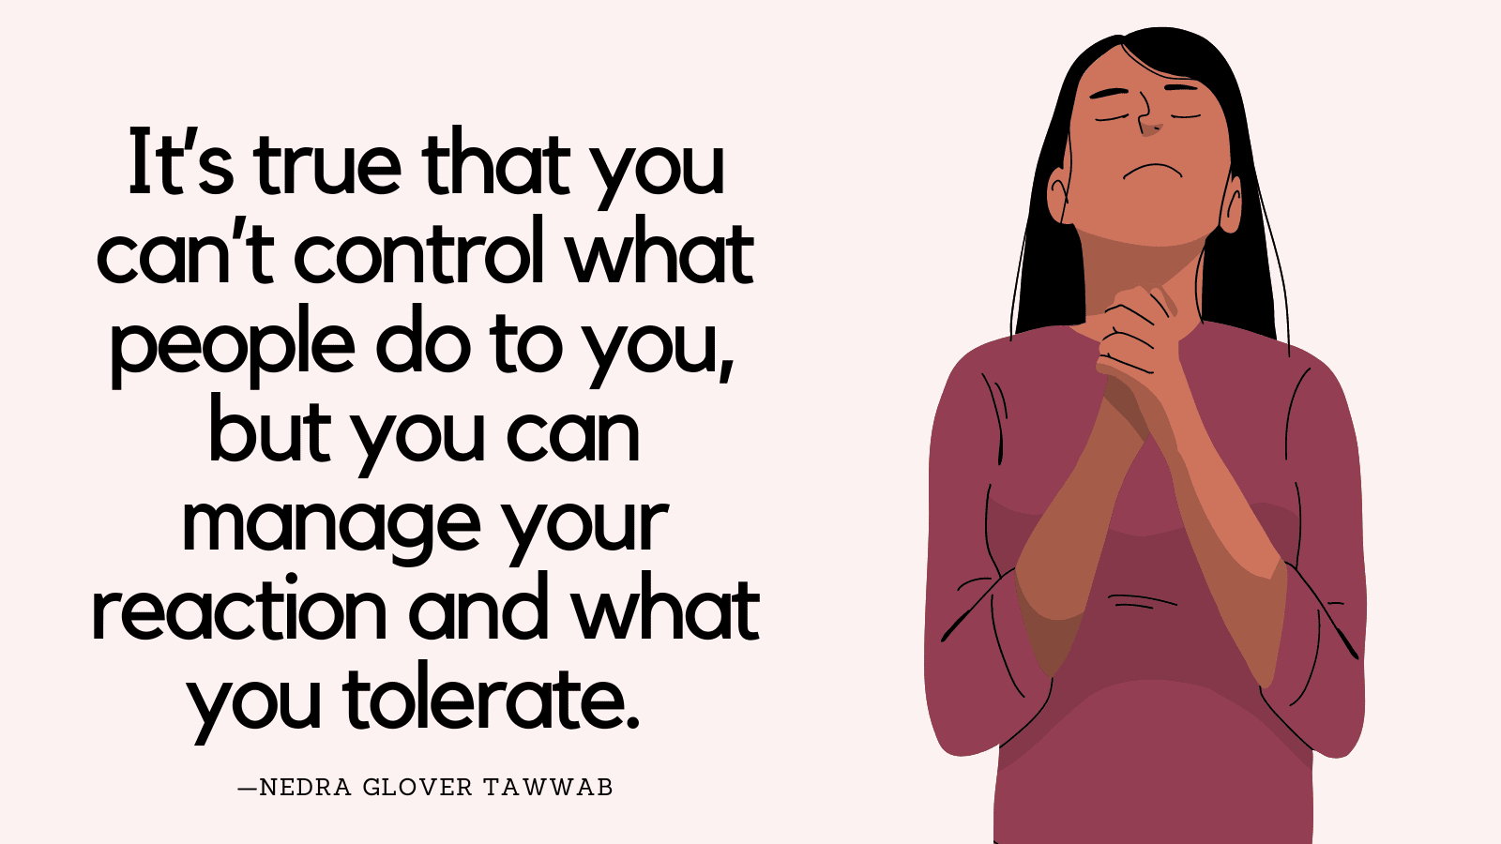
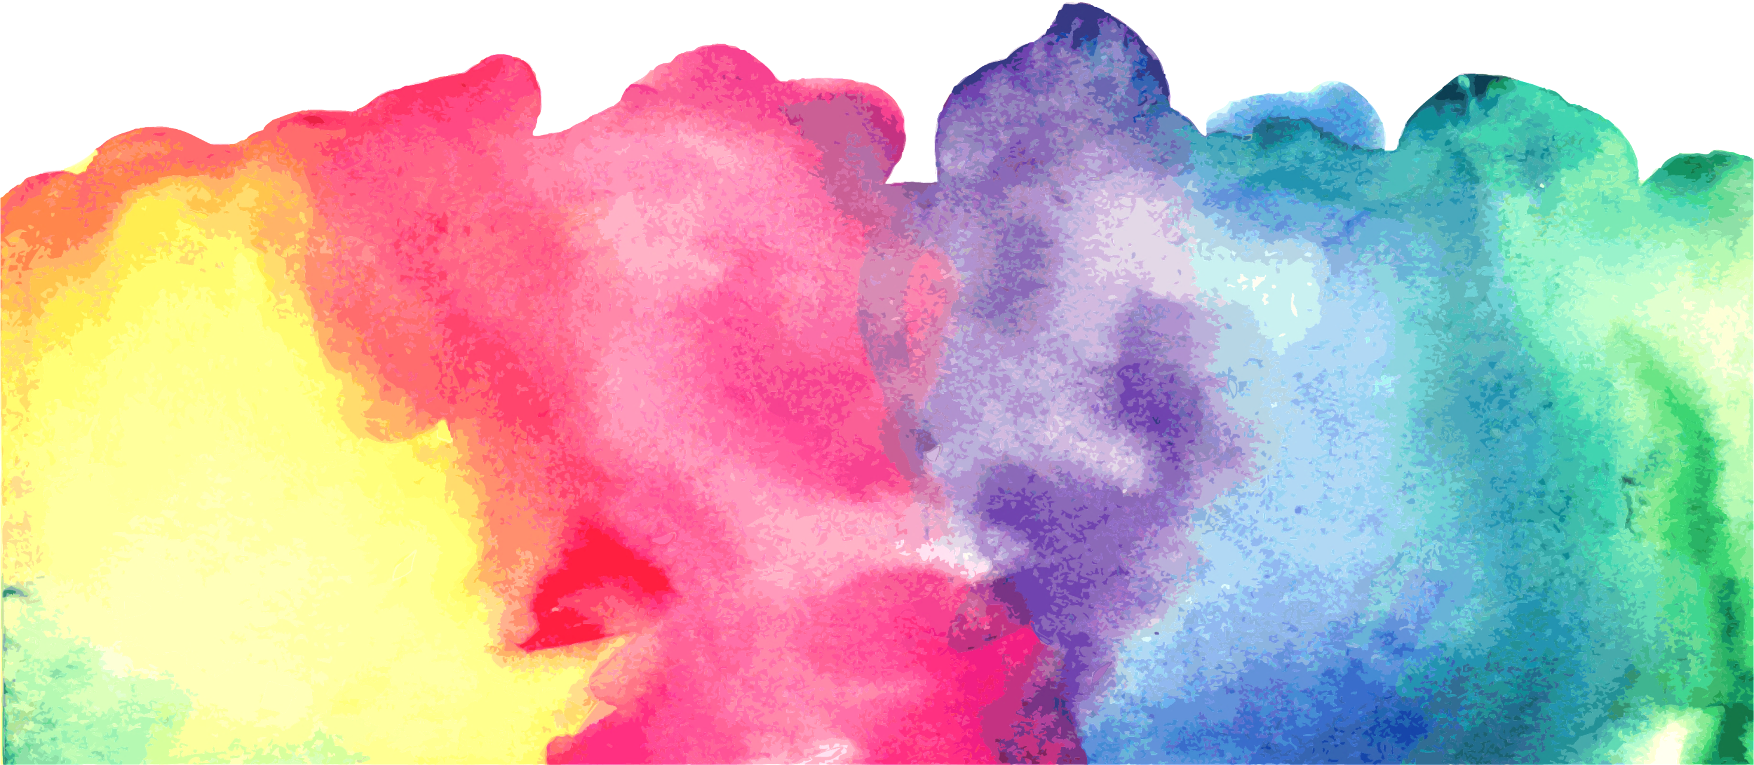
Thanks！

