Slide 1



感恩遇见，相互成就，本课件资料仅供您个人参考、教学使用，严禁自行在网络传播，违者依知识产权法追究法律责任。
更多教学资源请关注
公众号：溯恩英语
知识产权声明

Slide 2
读后续写之结构搭建
ContinuationWriting
-Building structure
By Scarlett Liu

Slide 3


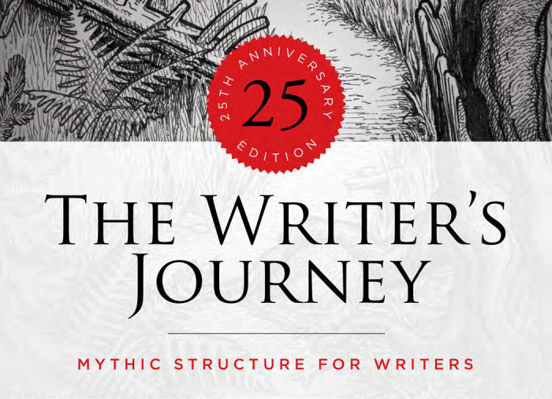
Structure Building
问题导学How to write a good story?
Christopher vogler

Slide 4

Stucture Building
Before writing :冲突和主角
主角通过自身努力或借助环境和他人，结果是问题暂缓或失败。
尝试
冲突
解决！
主角灵机一动或者关键人/物的出现 解决
反应
转折
主角（配角）感受/语言/动作的描写

Slide 5
2016浙江·吵架出走迷路
One weekend in July, Jane and her husband, Tom, had driven three hours to camp overnight by a lake in the forest.Unfortunately, on the way, an unpleasant subject came up and they started to quarrel. By the time they reached the lake, Jane was so angry that she said to Tom, " I'm going to find a better spot for us to camp" and walked away.With no path to follow, Jane just walked on for quite a long time. After she had climbed to a high place, she turned around, hoping to see the lake. To her surprise, she saw nothing but forest and, far beyond, a snow-capped mountain top. She suddenly realized that she was lost.
"Tom!" she cried. "Help!No reply. If only she had not left her mobile phone in that bag with Tom. Jane kept moving, but the farther she walked, the more confused she became. As night was beginning to fall, Jane was so tired that she had to stop for the night. Lying awake in the dark, Jane wanted very much to be with Tom and her family. She wanted to hold him and tell him how much she loved him. Jane rose at the break of day, hungry and thirsty. She could hear water trickling somewhere at a distance. Quickly shefollowed the sound to a stream. To her great joy, she also saw some berry bushes. She drank and ate a few berries.
Never in her life had she tasted anything better. Feeling stronger now, Jane began to walk along the stream and hope it would lead her to the lakeAs she picked her way carefully along the stream, Jane heard a helicopter. Is that for me? Unfortunately, the trees made it impossible for people to see her from above. A few minutes later, another helicopter flew overhead. Jane took off her yellow blouse, thinking that she should go to an open area and flag them if they came back again.
Para1: But no more helicopters came and it was getting dark again
Para2:It was daybreak when Jane woke up.
主角：Jane
冲突：Jane got lost in forest

Slide 6
2016浙江·吵架出走迷路
Para 1反应-尝试-衔接
扫过
But no more helicopters came and it was getting dark again
1.A wave of terror swept over her.
2.Her heart pounding fiercely and her palm sweating, an inner voice
told her that she had to find a safe place.Tired and terrified as she was,
Jane plucked her courage to feel the way.
3.Luckily, it didn't take long before she found a cave.
4.Sighing with relief, she felt a glimmer of hope, saying to herself.
"Tomorrow is another day."
5.With that, she went to sleep, in whose dream her husband kept her company.
砰砰的跳
反应
感受
尝试：危机暂缓
鼓起勇气
一丝希望
反应 ：感受
衔接
It was daybreak when Jane woke up.

Slide 7
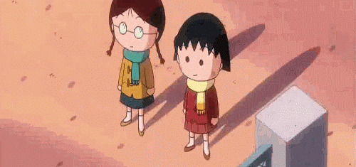
Building Structure
好故事来源于好结构
反应：感受/动作/语言
尝试：自身/外在 暂缓矛盾/失败
Para 1
反应：感受/动作/语言
衔接：依照第二段首句

Slide 8
2016浙江·吵架出走迷路
Para2 反应-转折-解决（点睛之笔）
It was daybreak when Jane woke up.
1.Hungry and disappointed, she found no helicopter overhead,
and at a loss .
2.It suddenly dawned on her that she should find a big open area first.
3.Having gobbling down some blackberries, she can't wait to set off.
After what seemed a century, such an area did come into sight.
4. Her face brightened up.
5. Meanwhile, a helicopter was flying towards her
6 .Upon its landing, out dashed her husband who hugged Jane tightly,
tears welling up in their heart.
7. It was at the moment that they decided not to quarrel any more but learned to compromise
反应：感受
不知所措
狼吞虎咽
转折：关键事物
反应：情感线
解决！
V冲向
V争吵
点睛收尾
V 妥协

Slide 9
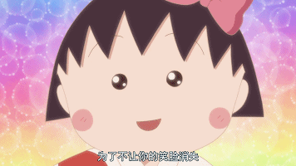
Building Structure
好故事来源于好结构
反应：心理，动作，语言
转折：主角灵机一动或者关键 人/物的出现
Para 2
反应：心理，动作，语言
解决+点睛之笔

Slide 10
Read before write
who is the main characher?
Basic information
When did the story happen?: | It was a day in the middle of
Where did the story happen? | The neighborhood store where sold
Who appeared in the story? | Me and my friend. A about 70 years old.
What did the writer do? | To buy an ice cream
Why did the writer do so? | Because the weather is too
How did the story goes? | They met an old lady whose shopping cart had been by something on the ground and things like soap all dropped on the ground.
hot
July
ice cream
lady
hot
knocked
over

Slide 11
结构训练-43期
It was a hot day in the middle of July. I decided to walk to the neighborhood store where it sold my favorite thing , ice cream. I pulled a friend towards the ice cream store, almost passing out from the burning sun on the way.
As we walked on, my friend kept saying that it was too hot.She thought that she was stupid to decide to come with me to buy ice cream.I felt sorry and tried to encourage her.“We're almost there.Just think of the cool and sweet taste of ice cream in your mouth. It'll be worth the walk,”I told her. But I had to admit that the store was quite a distance from our houses. During the journey,my mouth began to become dry and I wanted to drink.
When we were about a block away from the store, I noticed an old lady who was walking in our direction. She was about 70 years old.She had a big back problem, so she was unable to keep her back straight. She was struggling, pushing a shopping cart（购物推车）full of things like the soap,bread and water. With each step toward her,we began to see her appearance more clearly. It appeared that she was often unhappy and easy to get angry.

Slide 12
结构训练-43期
I looked at my friend to see if she had noticed her.I could see that she had and that she disliked the old lady due to the lady's appearance. As we approached the lady pushing the shopping cart, my friend directed me away from the old lady and the cart.
I began to observe other passers-by.They were also trying to avoid her. Suddenly I heard a terrible sound behind me. I quickly turned around to see what it was. I found the lady's cart had been knocked over by something on the ground.
Paragraph 1:
Things in the shopping cart like the soap all dropped on the ground.
Paragraph 2:
Then my friend continued walking on while I went to the lady.
冲突：help her or not?

Slide 13
Building Structure
主角：“ I”
冲突：help her or not?
好故事来源于好结构
反应：情感线/动作线
尝试：自身/外在 暂缓矛盾/失败
Para 1
反应：情感线/动作线
衔接：依照第二段首句
Then my friend continued walking on while I went to the lady.

Slide 14
Write by yourself
Para1:Things in the shopping cart like the soap all dropped on the ground
(反应) My heart pounding fiercely and my palm sweating, an inner voice told me that
(尝试)Fortunately, it didn’t take long before I asked
（尝试失败/暂缓）But
(衔接)With a feeling of ，I

Slide 15
拆解结构-反应（动作+心理描写）
1反应(动作)： adj. and adj. as sb was, sb did sth/doing sth(非谓语）
尽管又...又...,sb依然做sth......
尽管又热又累，我决定帮助她把东西捡起来。
2 反应（心理+动作）： one’s heart pounding fiercely and one’s palm sweating, an inner voice told sb that......(独立主格）
Sb.心脏狂（fiercely)跳,手掌出汗，内心有一个声音告诉自己要....
我的心脏狂跳，手掌出汗，内心有一个声音告诉自己一定要坚持自己的信念。

Slide 16
Para 1反应-尝试-衔接
1.尝试（动作）：luckily/Fortunately, it didn’t take long before sb did.....
幸运的是，这没有花费某人多长时间
2.衔接： With...+一种状态，sb 做了..., 非限定从
With a feeling of +（情绪）伴随着+一种情绪
With sb doing sth伴随着+一种状态，sb 做了...
幸运的是，和他商量这件事没花多少时间。
感觉很失落，我还是选择去帮助她。

Slide 17
Write by yourself
好故事来源于好结构
反应：心理，动作，语言
转折：主角灵机一动或者关键 人/物的出现
Para 2
反应：心理，动作，语言
解决+点睛之笔

Slide 18
Write by yourself
Para1:Things in the shopping cart like the soap all dropped on the ground
(反应) My heart pounding fiercely and my palm sweating, an inner voice told me that
(尝试)Fortunately, it didn’t take long before I asked
（尝试失败/暂缓）But
(衔接)With a feeling of ，I

Slide 19
Para 2反应-转折-解决-点睛之笔
1.转折（关键人)： It suddenly dawned on sb that sb should do...
某人突然意识到她、他应该做什么。
2.反应（情感）：Seeing/ Hearing sth, sb felt a great sense of +情绪welling up in sb’s heart and surging through sb.
看到、听到sth/sb. 感到一种强烈的情绪涌上心头，并且涌遍全身。
3.解决（动作）luckily/Fortunately, it didn’t take long before sb did.....
幸运的是，这没有花费某人多长时间
4.点睛之笔： It is the kindness of +sb that brings sunshine and warmth to us.

Slide 20
Write by yourself
Paragraph 2:
Then my friend continued walking on while I went to the lady.
(反应 ) and as I was, I
(转折）It suddenly dawned on （sb) that (sb) should do
(反应) Seeing this, (sb )felt a great sense of welling up in (sb’s) heart and surging through (sb)
(解决) Eventually,

Slide 21
Stucture Building-Brainstorming
灵机一动
关键人、物
自身/外在（他人或者环境）危机暂缓或尝试失败
转折
尝试
解决！
冲突
反应
心理/动作/语言
反应
心理/动作/语言

