Slide 1


感恩遇见，相互成就，本课件资料仅供您个人参考、教学使用，严禁自行在网络传播，违者依知识产权法追究法律责任。
更多教学资源请关注
公众号：溯恩英语
知识产权声明

Slide 2
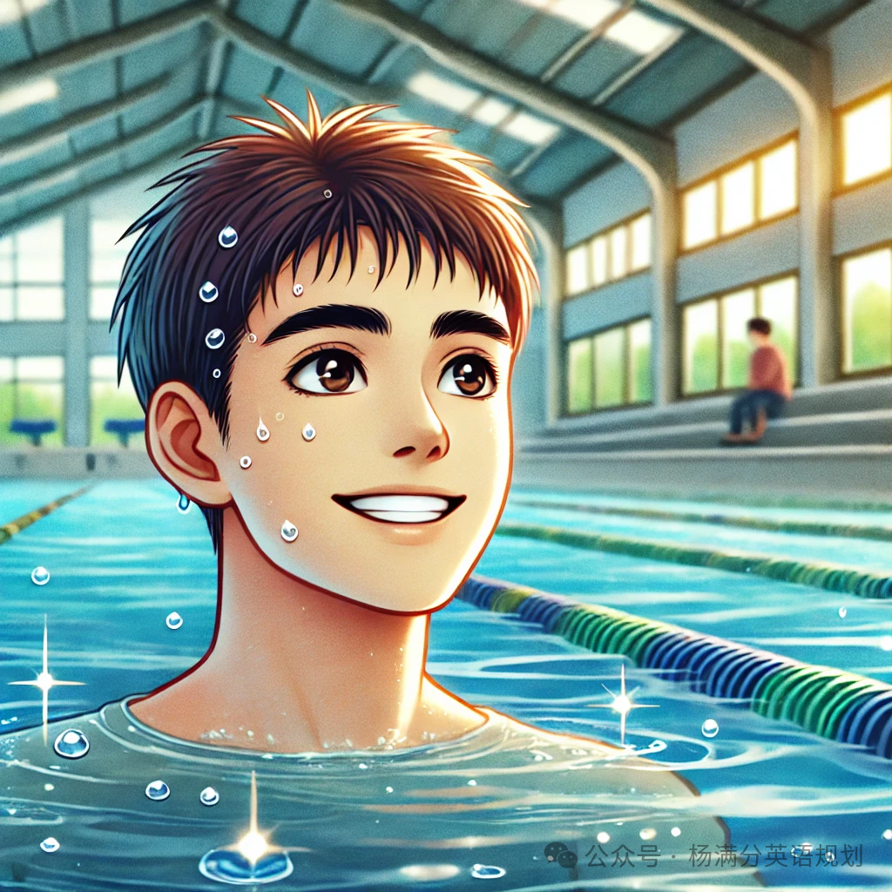
2025届11月绍兴市高考诊断性考试
读后续写讲评

Slide 3
故事背景与主题分析
故事主要讲述了主人公从害怕游泳到敢于面对挑战的心理转变过程。通过学习游泳、适应水中环境，再到最终勇敢参赛，主人公一步步克服了自我怀疑和内心的障碍。这个故事不仅展示了如何在恐惧中找到力量，更体现了成长的主题，非常适合考生在续写中使用感官描写和细腻的动作链来塑造角色的心理变化。

Slide 4
Read for the basic elements
who
“I”, instructor, co-workers, participants
what
I was not good at swimming.
basic
elements
how
I participated in a swimming lesson and in a swimrun.
why
I wanted to break through my comfort zone.
where
In a swimming pool, in a swimrun.

Slide 5
Read for the key plots
For years, swimming was one of those things where I thought, “I’m not good at it, and I never will be.” That thought lingered there most of my childhood.
This all changed last year when the company I worked for announced that they were going to arrange a swimrun, a race where you partially swim and partially run to finish the race. Of course, it was a voluntary activity and I was not going to participate.
However, as the weeks progressed, I started thinking to myself. “What would it feel like to break through my comfort zone and finally face my insecurity?” To help the swimrun participants prepare for the race, the company arranged an opportunity to learn how to swim freestyle with a swim instructor. I ultimately decided to at least participate in the first swimming lesson.
I was mentally prepared to be the worst student during the lesson. However, as it turned out, I had plenty of co-workers that were equally bad at swimming. After a few swimming lessons, I even got compliments for how quickly I managed to improve. Not only had I shattered my old belief about my disability in water, but something else had started to stir. I had gotten a taste for swimming and was curious to see where it could lead me. “How would it feel like to be completely comfortable in the water?” I wondered.
I started going to the public bathhouse to practice the few tips I had gotten from the swimming instructor. I’d watch YouTube videos and try and mimic the movements by myself in the water to the best of my abilities.
Without a doubt — in the beginning, I looked like a drowning monkey. I would swim; I would sink, coughing up water, and repeat it all over again. I’d get yelled at for swimming too slow at the freestyle range. However, I focused on the process and the soon-to-be new skillset that I did not get discouraged by the slow progress nor the occasional scolding.
My thought in my…
The turning point
My decision
?
My first swimming lesson
?
My practice after …
My struggle in…
…

Slide 6
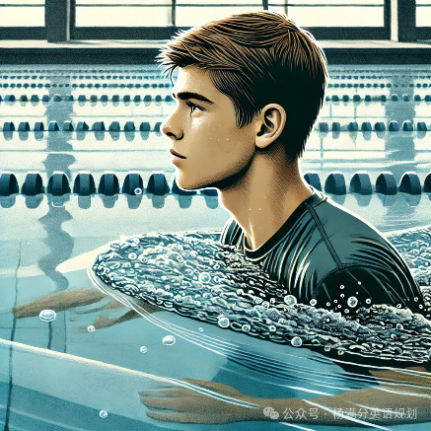
Predict for the key plots
三个阶段：
自我怀疑 尝试突破 克服挑战
Paragraph 1:
The thoughts of gliding through water effortlessly was what kept me going.
从自我怀疑到逐步适应
◉Did I make progress immediately?
◉ What did I do to improve myself in swimming?
◉ What changes happened then?
Feel unsettled/worried
hit a plateau 处于停滞期/到达瓶颈
practice by myself or turn to my swimming instructor ?
Feel confident
break the bottleneck and feel at ease
Paragraph 2:
Regarding the swimrun, I eventually decided to participate.

Slide 7
Discuss for the details
聚焦游泳技能突破瓶颈
exhausted/ depressed
in low spirits情绪低落
on the verge of collapse
Paragraph 1:
◉ What was my plateau? How did I feel?
» I was not able to ____________________________（在水中长时间屏住呼吸）.
» My obstacle was that I often _______________________（无法保持平衡）.
» The waving of my hands didn’t match my ____________________（蹬腿）.
» What troubled me was that I always _____________________ (划水节奏不对).
hold a breath for long under water
failed to keep my balance
kicking/paddling legs
lost rhythm on my strokes
◉ How did I practice under the guidance of my instructor ?
» repeating thousands and thousands of _______________
» practice swimming and sinking
» interact with co-workers in effective skills
教练教的内容要跟我前面提到的“短板”或问题一致。
After having experienced countless failures, __________________ lingered in my ears
/ an old saying stirred up my courage.
That is __________________________.
◉ What changes happened then?
» my swimming skills improved bit by bit
» I was expert at / grasped the trick of ______________________.
» I felt a wave/sense/surge of ____________________________ welled up in my body.
My body grew attuned to the water, and I began to feel a newfound grace, something I had never associated with myself before. For the first time, I wasn’t just swimming. I was embracing the water, and with it, the challenge I once feared.
我的身体逐渐适应了水，我开始感到一种新发现的优雅，这是我以前从未与自己联系过的。我第一次不仅仅是在游泳，而是在拥抱水，以及与之相伴的曾经令我恐惧的挑战。
achievements / confidence/energy

Slide 8
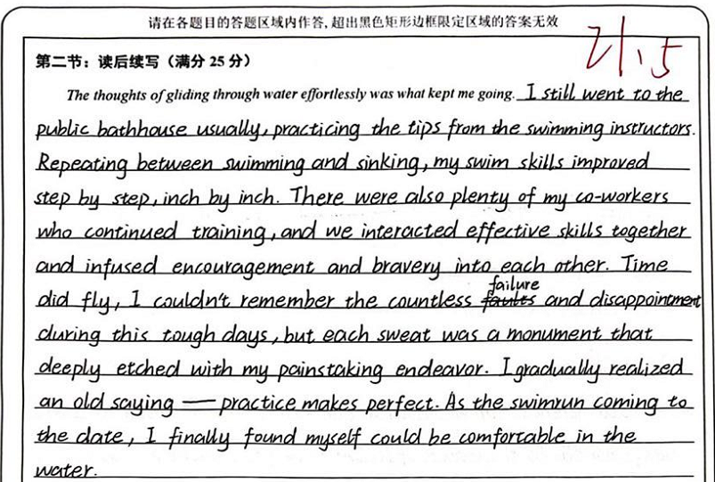
Appreciate a fine piece of writing
高分1
» infuse …into注入
» etch 铭刻
» endeavor努力

Slide 9
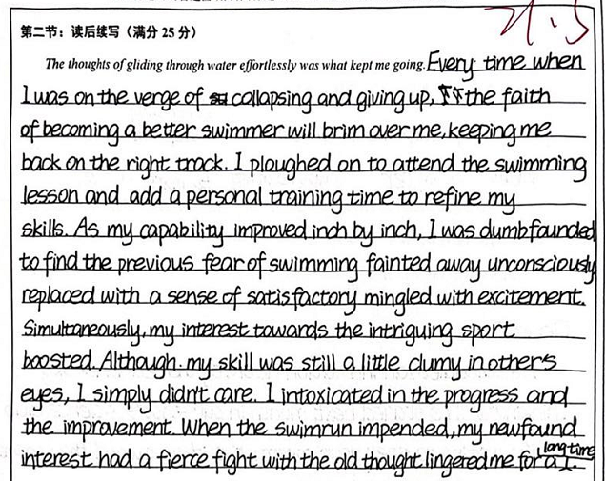
Appreciate a fine piece of writing
高分2
» collapse崩溃
» brim with充满
Her eyes brimmed
with tears.她热泪盈眶。
» plough on坚持不懈
»refine改进
»be mingled with混合
»dummy 笨蛋
»intoxicate陶醉
»impend逼近

Slide 10

Predict for the key plots
游跑赛表现：
比赛开始 比赛过程 比赛结果（感悟）
Paragraph 2:
Regarding the swimrun, I eventually decided to participate.
◉What was it like at the beginning of the race?
◉ What was it like during the race?
◉ What was the result of the race? What did “I” learn from the race?

Slide 11
Discuss for the details
领先___________________
落后___________________
齐头并_________________________
take the lead
Paragraph 2:
Then came the big day. （过渡句）
fall behind
keep pace with/draw level with
◉ What was it like at the beginning of the race?
◉ What was it like during the race?
1._______________________________________________（随着发令枪的声音穿透空气）, the race began as expected.
2.I could feel that all the eyes were fixed on us. ________________________________
___________(一种强烈的紧张感涌上我的全身).
With the sound of the starting gun piercing through the air
A strong sense of nervousness surged
through me
propelling myself
1. I found myself flexible like a dolphin in the water, _____________________
_________________ (快速向前推进自己）. （比喻）
2.Striking water and adjusting breath constantly, I _______________________. （我拼命地奋力向前游）。
3.____________and ____________, I was racing neck and neck.
手臂划水，腿脚踢水，Mike飞快地超过一个又一个人。
4.Swiftly adjusting my breath, I swam forward __________________________.(像离弦的箭）
forward swiftly
strove forward desperately
Arms pulling
legs paddling
like an arrow off the bowstring

Slide 12
Discuss for the details
Paragraph 2:
◉ What was it like during the race?
◉ What was the result of the race?
1.150 meters covered, I was left behind by two competitors. In the last 50 meters, I
______________________________________（我竭尽所能游向终点线）, arms pushing forward fast and legs hitting the water hard.
2.Thunderous shouts of my name from the audience ___________________________
________（注入了活力和自信）. I sped up, like an energetic dolphin chasing after his prey ______________________________（用我最后一点力气）.
swam to the finish line with all my strength
游泳的过程
injected energy and confidence
into me
with my last ounce of strength
1.When the result was announced that I won first place, other players rushed to me and congratulated me, _________________________________________________（场馆里的观众爆发出雷鸣般的掌声）.
2. when the race finished, _______________________（做梦也没有想到） had I expected that I would win the first prize.
the audience in the stadium bursting into thunderous applause
获奖+祝贺
never in my wildest dream
获得名次

Slide 13
Discuss for the details
Paragraph 2:
◉ What did “I” learn from the race?（观众的反应）
◈As the final whistle blew, the cheers from the crowd echoed/lingered in the stadium, and I couldn’t help but feel a rush of excitement as I ___________________ the glory of our victory.
人群的欢呼声回荡在体育场内，当我沉浸在胜利的荣耀中时，我不禁感到一阵兴奋。
◈ Despite the physical and mental exhaustion, I couldn’t wipe the smile off my face as I reflected on _____________________________________________________.
◈ It is my ______________________ that won me ___________________________.
basked/was immersed in
the incredible memories and lessons learned from the competition
hard work and persistence
recognition
honor
champion trophy
success
结尾强调句
回扣主题

Slide 14
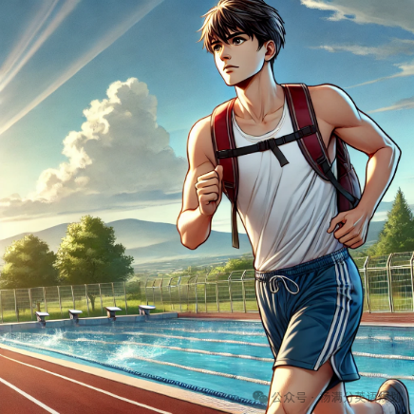
下水作文：
Regarding the swimrun, I eventually decided to participate. Stepping up to the starting line, I took a deep breath, letting the anticipation settle in my chest. The whistle blew, and I dove in with confidence I hadn’t known I possessed. The water no longer felt foreign; it was an ally（盟友）, guiding me forward. As I emerged from the swim portion（部分）, adrenaline fueled my steps, carrying me to the finish line. Crossing that line, I realized that the race wasn’t just against time; it was against my own insecurities. And this time, I had won.
视觉：终点线的标志、其他参赛者的身影，增强紧张的气氛。
触觉：水的支撑力、跑步时地面的反弹力，增强人物在运动过程中的感受。
听觉：参赛者的呼吸声、脚步声，增添现场的紧迫感。
动作链：主人公从水中跃起、奔向终点，展现了最后的冲刺和胜利的瞬间。
adrenaline[əˈdrenəlɪn]肾上腺素

Slide 15
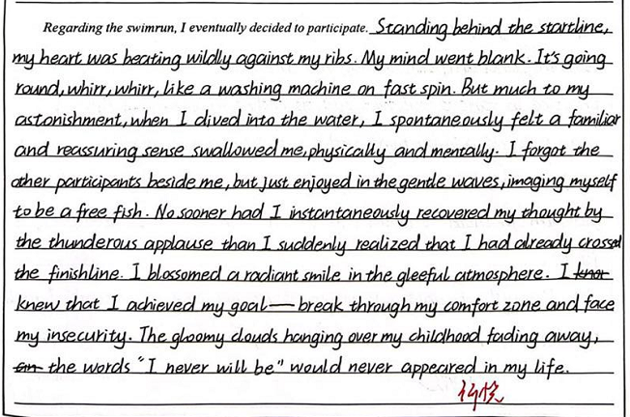
Appreciate a fine piece of writing
高分1
»go blank
» dive into
» No sooner had I ...than...
»instantaneously
»thunderous applause
»fade away
首尾呼应

Slide 16
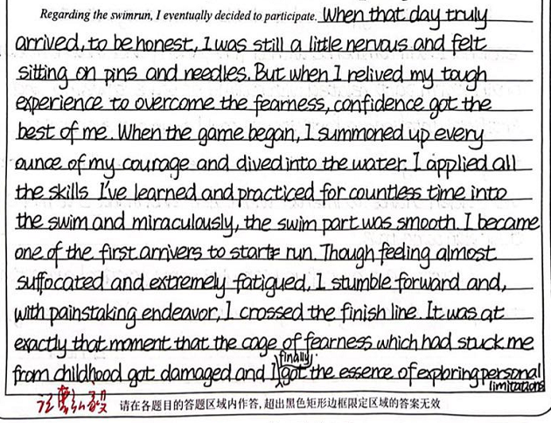
Appreciate a fine piece of writing
高分2
»summon up every ounce
of my courage
» miraculously
» feel suffocated
»with painstaking endeavor

Slide 17
范文
The thought of gliding through water effortlessly was what kept me going. At a certain point, I hit a plateau, So, I decided to contact my swimming instructor for more swimming lessons. Under his guidance, I started to practice more by myself. Some days, I would come back seriously wondering if my body constitution was meant for swimming at all. On other days, I would feel fantastic while completing my laps. Still, there was one single thing that stood out during my practice sessions: while repeating thousands and thousands of crawling strokes(爬泳, 捷泳), I slowly but surely started to enjoy the process of swimming thoroughly.

Slide 18
范文
Regarding the swimrun, I eventually decided to participate. For me, this challenge was pushing me to my limits, as I had been utterly scared to confront this weakness of mine. The race began, and soon I was completely breathless from the physical exertion. However, I solely focused on all the movements I had been practicing repetitively throughout the summer. Before I knew it, I had finished. The swimrun had been my end goal but I already knew by then that I was going to continue swimming. I wished my childhood self could meet my present-day self to see that I was not naturally bad at swimming. It was possible to change and surpass the boundaries of my comfort zone.

Slide 19

"The biggest challenge you can take on is challenging yourself."

