Slide 1


感恩遇见，相互成就，本课件资料仅供您个人参考、教学使用，严禁自行在网络传播，违者依知识产权法追究法律责任。
更多教学资源请关注
公众号：溯恩英语
知识产权声明

Slide 2

活用教材词汇，靶向高考写作
BX3U4单词拓展

Slide 3

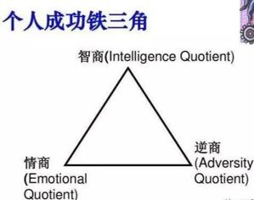
adversity /ədˈvɜ:səti/ n.困境; 逆境
1. 这真是一场精彩的势均力敌的比赛，它不仅加强了两校之间的友谊，而且鼓励我们在逆境中不放弃。
It was really a fantastic close game, which has not only strengthened the friendship between the two schools but encouraged us not to give up in face of adversity.
2. 得知你最近因为考试不及格而心情不好，我写信是想邀请你参加一个由著名心理学家史密斯先生举办的主题为“如何积极应对逆境”的讲座。
Knowing that you are in a bad mood these days because of your failure in the exams，I am writing to invite you to attend a lecture with the theme of "How to deal with adversity positively" given by the famous psychologist Mr. Smith.

Slide 4


adversity /ədˈvɜ:səti/ n.困境;逆境
3. 爸爸轻轻地拍着我的肩膀安慰我说:“你从来没有让我失望过，以后也不会。”他还解释说:“虽然没有进入前15名，但在逆境中尽了最大的努力，已经是胜利者了。”
Patting my shoulder gently, dad comforted me, “You never disappointed me, and you will never.” He further explained that though I didn’t make it into the top 15, I was already a winner as I had done my utmost when adversity struck.

Slide 5
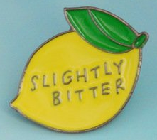

bitter /ˈbɪtə(r)/ a.严寒的;激烈而不愉快的
1. 事实上，我们如何道歉以弥补过错的过程只是一个模糊的过程，但作为一个沉默的帮犯的痛苦教训却铭刻在我的记忆中。
In fact, the process of how we apologized to make amends was just a blur, but the bitter lesson of being a silent accomplice was branded on my memory.
2. 刺骨的寒冷立刻攫住了他，穿透了他厚重的羊毛外套，咬着任何露出来的皮肤。
The bitter cold seized him instantly, piercing through his heavy wool coat and biting any exposed skin.

Slide 6


bitter /ˈbɪtə(r)/ a.严寒的;激烈而不愉快的
3. 时间一分一秒地过去，他长长地叹了口气:“孩子，买来的奖品不能叫奖品。”我理解地点点头。但谁知道我是多么的不情愿和痛苦?
Time ticking by, he heaved a long sigh, “My child, an award bought can’t be called an award.” I nodded understandingly. But who knew how reluctant and bitter I was?
4. 在遭受了一连串的打击之后，她病倒了，患了严重的流感。她不得不在家里呆了整整一个星期，感到极其难受和绝望。
Suffering a series of bitter blows, she fell ill, a severe case of flu. She had to stay at home for the whole week, feeling extremely bad and hopeless.

Slide 7

endurance /ɪnˈdjʊərəns/ n.忍耐力;耐久力
endure /ɪnˈdjʊə(r)/ v. 持续存在，持久；忍受，忍耐
1. 他们不仅勇敢地面对生活的挑战，忍受失去亲人的痛苦，而且还致力于帮助他人，激励他人，甚至挽救他人的生命。
They were not only brave enough to face the challenges of life, to endure the loss of loved ones, but also devoted themselves to helping others, to inspiring others and even to saving their lives.
2. 就像在我所有的比赛中一样，我没有成为最前面的明星。当我的耐力超过了他们之前的速度时，我喜欢这种超车的感觉。
As in all of my races, I didn’t star out in the front. I loved the feeling of passing people as my endurance overtook their premature speed.

Slide 8

endurance /ɪnˈdjʊərəns/ n.忍耐力;耐久力
endure /ɪnˈdjʊə(r)/ v. 持续存在，持久；忍受，忍耐
3. 虽然她在这些项目中排名最后，但她的坚持，耐力以及对童年梦想的热情使她的名字出现在新公布的消防员名单上。
Though she ranked the last among such items, her persistence, endurance as well as the passion for a childhood dream made her name appear on the list of newly-announced firefighters.
4. 首先，打篮球需要不断的体能训练，可以锻炼全身肌肉，改善心肺功能，增强耐力和爆发力。
Firstly, basketball requires constant physical training, which can exercise the muscles of the whole body, improve cardiopulmonary function, enhance endurance and explosive force.

Slide 9

qualified /ˈkwɒlɪfaɪd/ a.符合资格;具…知识/技能
1. 我写这封信是想申请成为将在贵画廊举办的中国画展的志愿者。我认为我能胜任这份工作，因为我从小就学习中国画。
I’m writing to apply to be a volunteer for the Chinese Painting Exhibition which will be held in your art gallery. I think I am qualified for this job, because I have learned Chinese painting since childhood.
2. 为了成为一名合格的志愿者，我做了一些准备。我采访了很多来自各行各业的人，提高和加深了我对天津的了解。
To be a qualified volunteer, I made some preparations. I interviewed many people from all walks of life, which improved and deepened my understanding of Tianjin.
3. 首先，作为一个土生土长的中国人，我对中国传统文化有很好的了解，我有信心我有资格向游客介绍我们的宝藏。
Firstly, as a native Chinese equipped with a good knowledge traditional Chinese culture, I’m confident that I’m qualified to introduce our treasures to visitors.

Slide 10
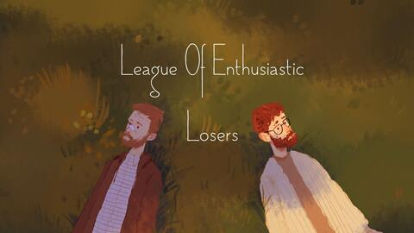
enthusiastic /ɪnˌθju:ziˈæstɪk/ a.热情的;热心的
enthusiasm /ɪnˈθjuːziæzəm/ n. 热情，热忱
1. 最初，在观看北京冬奥会时，我对滑冰产生了热情。从那时起，我就下定决心要掌握这项迷人的运动。
Initially, on watching the Winter Olympics Games in Beijing, I became enthusiastic about skating. From then on, I was determined to master this fascinating sport.
2. 她知道她必须找到一种方法来引导他们积极的能量，把他们的热情转化为学习的动力。
She knew she had to find a way to channel their energy positively, turning their enthusiasm into a driving force for learning.
3. 回顾在舞台上唱歌的这些年，我意识到这是我一生都在等待的机会。在舞台上唱歌时，我保持着饱满的热情，把最好的一面展现给观众。
Looking back the years I had experienced as I sang on the stage, I realized that it is the opportunity that I had been waiting for the whole life. I kept myself full of enthusiasm as I was singing on the stage, showing the best to the audience.

Slide 11
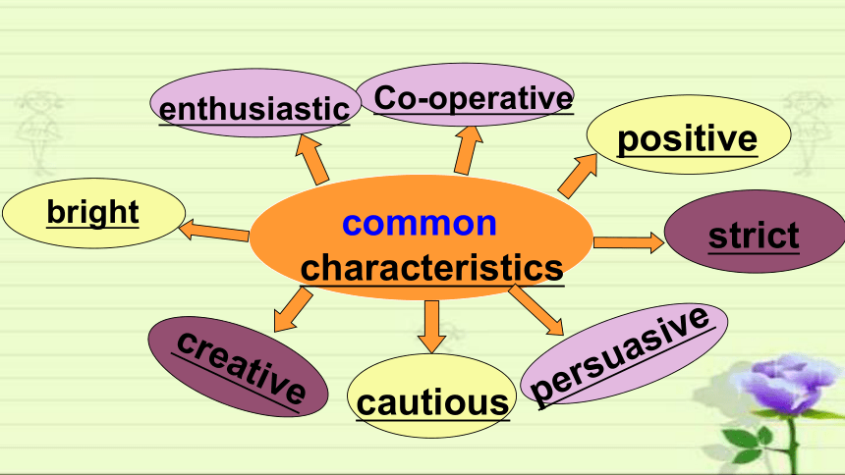
enthusiastic /ɪnˌθju:ziˈæstɪk/ a.热情的;热心的
enthusiasm /ɪnˈθjuːziæzəm/ n. 热情，热忱
4. 在我看来，这张照片不仅反映了我们学生的活泼和热情，也能让爱尔兰学生有宾至如归的感觉。
As far as I am concerned, this photo not only reflects the liveliness and enthusiasm of our students, but also can make Irish students feel at home.
5. 因为我知道你对中国茶文化有强烈的热情，所以我写信给你是想和你分享一个茶文化展览的相关消息。
Because I know that you have strong enthusiasm for Chinese tea culture, I’m writing to share with you the related news about a tea culture exhibition.

Slide 12
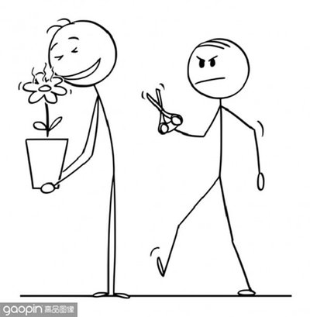
envy /ˈenvi/ n.&vt.羡慕;妒忌
1. “我记得当你妈妈还是个婴儿的时候，我不得不像一只疲惫的老鼠一样蹑手蹑脚地走。刚开始的几个月我非常讨厌她。” “但你和妈妈似乎很亲密，” 我说，内疚地掩饰着我对罗莎的嫉妒。
“I remember having to creep around like a worn-out mouse when your mum was a baby. I spent the first months hating her so much.” “But you and Mum seem so close,” I said, guiltily hiding away my envy of Rosa.
2. 我立刻动手把它擦干净，把它擦得像糖果苹果一样鲜红。它变成了一件美丽的东西，我为拥有它而欣喜若狂。我的姐姐惊讶地看着新擦亮的、清新的玩具车，眼里带着一丝遗憾和嫉妒。
I immediately set down to wiping it clean and polishing it to a bright candy-apple red. It turned to be a thing of beauty, and I became overjoyed at possessing it. My elder sister was amazed at the newly-polished, refreshing toy car, with a hint of regret and envy in her eyes.

Slide 13

envy /ˈenvi/ n.&vt.羡慕;妒忌
3. 嗯，我妈妈说。亚利桑那，你不觉得这是个机会让你成为一个特别好的朋友吗?有时，当我们的朋友做得很好，我们感到嫉妒，不知道该怎么做。试着给她一点时间和理解。我打赌她不久就会回心转意的。
“Hmm,” said my mum. “Arizona, don’t you think this might be an opportunity for you to be an extra-good friend?” “Sometimes when our friends do well, we feel envious and don’t know how to act. Try giving her a little time and understanding. I bet she’ll come around before too long.”

Slide 14

crush /krʌʃ/ vt.毁坏;压坏 n.拥挤的人群
1. 她终于脱离了危险，但是因为她的腿被压碎了，她是否还能走路还是个疑问。
She was finally out of danger but, because her legs had been crushed, there was doubt whether she would be able to walk again.
2. 在离别的那一刻，我的模型车跟着亚历克斯走了。虽然看着它离开我很伤心，但当我看到他紧紧抓住它的笑容时，我的心在歌唱。
In the moment of parting, my model car went with Alex. Though I was crushed to see it go, my heart sang when I saw his beaming face as he tightly clutched it.
3. 我坐在那里，惊恐万分，动弹不得。压力压在我身上。如果我不能上高中怎么办?爸爸妈妈会把我赶出他们的房子吗?
I sat there, panic stricken, unable to move. Pressure crushed in on me. What if I could not go to high school? Would Dad and Mum kick me out of their house?

Slide 15
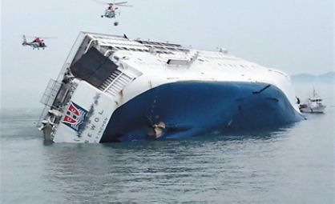
sink /sɪŋk/ vi.沉没;下沉 vt.使下沉
1. 听到你家乡发生地震的消息，我很震惊。你陷入悲伤是可以理解的。
I was shocked at the news about the earthquake in your hometown. It's understandable that you sink into sadness.
2. 没过多久，风就把它们冻住了。那是最可怕的时刻。他们的情绪开始低落，开始怀疑自己是否能继续下去。
It didn’t take long until the wind froze them in place.That was the scariest moment. Their spirits began to sink and they started to doubt if they could continue.

Slide 16
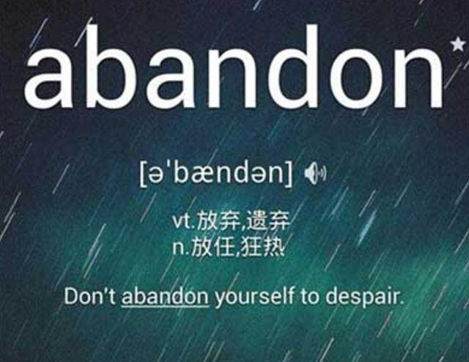

abandon /əˈbændən/ vt.舍弃;抛弃;放弃
1. 当他看着婴儿美丽的脸庞幸福地笑着时，温柔的浪潮席卷了他。多漂亮的孩子啊!他不知道谁会忍心放弃这样的快乐。
As he laughed with happiness at the beautiful face of the baby, waves of being gentle washed over him. What a beautiful baby! He wondered who could have the heart to abandon such a joy.
2. 秋收时节，大多数的村民在天黑以后都会开怀畅饮、大吃大喝，甚至还唱起山村民歌。
At the harvesting time, most of the villagers would abandon themselves to wining, eating and even singing folk songs after dark.

Slide 17

blanket /ˈblæŋkɪt/ n.毯子
1. 这里是那么宁静，褐色的岩石、深绿色的松树和傍晚的阳光混合在一起，形成了一幅神奇的景象。它看起来就像一条美丽的编织毯子，只为我们铺在地上。
It was so peaceful and quiet and the colors of the brown rocks, the deep green pine trees, and the late afternoon sun mixed to create a magic scene. It looked like a beautiful woven blanket spread out upon the ground just for us. 2018年浙江卷6月“美国西部农场旅行”
2. 厚厚的雪花从灰色的天空飘落下来，很快就在地面上盖上了一层厚厚的、整齐的白色毯子。阵阵寒风把飘落的雪搅成滚滚的波浪，挡住了他在结冰的街道上的视线。
Fat snowflakes drifted down from the grey sky, soon covering the ground in a thick , neat blanket of white. Icy gusts of wind swirled the falling snow into rolling waves that clouded his view down the frozen street.

Slide 18
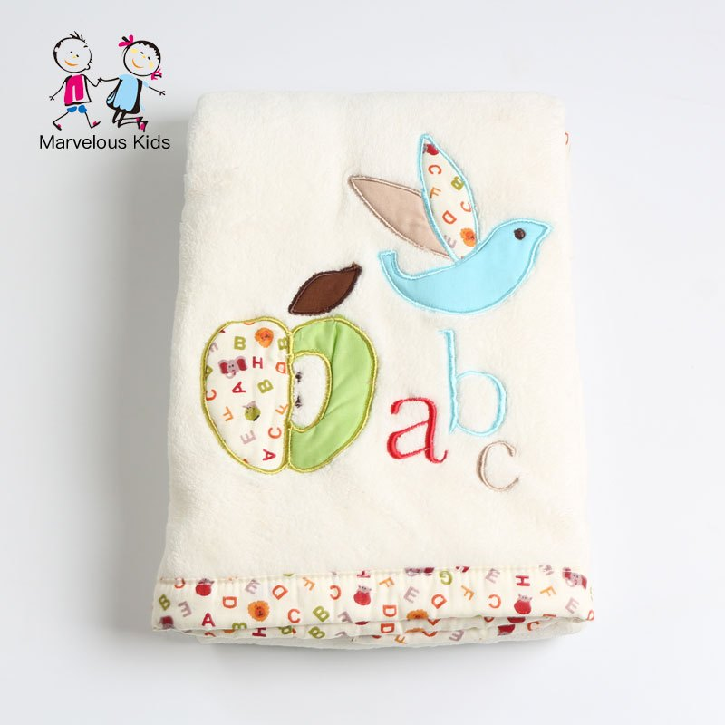
blanket /ˈblæŋkɪt/ n.毯子
3. 他看着儿子托德在地板上铺了一条毯子。他看着托德把沙发枕头放在毯子上，靠在沙发上。艾希礼坐在毯子上，抱着她最喜欢的泰迪熊。
He watched as his son, Todd, put a blanket on the floor. He watched as Todd arranged the couch pillows on the blanket, against the couch. Ashley sat on the blanket and held her favorite teddy bear.

Slide 19

belongings /bɪˈlɒŋɪŋz/ n.[pl.]财物;动产
belong to
1. 为了增进我们之间的相互了解，我们为你选购了大约300本书。主要分三种类型。
In order to promote our mutual understanding, we’ve chosen and bought about 300 books for you. The mainly belong to three types. 2015年全国高考天津卷“图书捐赠”
2. 突然我注意到人行道上躺着什么东西。我停下来，把它捡起来，发现这是一个书包。幸运的是，从里面的书我了解到它属于李华，一个高二的学生从3班。
Suddenly I noticed something lying on the pavement. I stopped, picked it up and found it was a schoolbag. Luckily from the books inside I learned it belongs to Li Hua, a Senior Two student from Class 3. 2013年浙江卷“我骄傲的事”

Slide 20

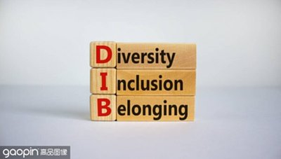
belongings /bɪˈlɒŋɪŋz/ n.[pl.]财物;动产
belong to
3. 他目不转睛地盯着盒子，里面装满了他心爱的妻子的珍贵物品。当他小心翼翼地揭开每一件物品时，悲伤的浪潮向他袭来，毫不屈服，毫不留情。
His gaze was fixed upon the box, overflowing with the treasured belongings of his beloved wife. As he delicately unveiled each item, waves of sorrow crashed upon him, unyielding and unmercifully.
4. 他不得不忍受没有朋友的孤独，难以适应新的文化，努力寻找归属感。
He had to suffer from loneliness of having no friends, the difficulty in fitting into a new culture and the struggle hard to find a sense of belonging.

Slide 21


miserable /ˈmɪzrəbl/ adj. 痛苦的;令人难受的
1. 约翰坐在沙发上，悲伤得僵住了，他的身体因几个小时的痛苦哭泣而疲惫不堪。
Seated on the couch, John was frozen with sorrow, his body drained and depleted from hours of miserable weeping.
2. 从前，一个女儿向父亲抱怨说，她的生活很悲惨，她不知道该怎么活下去。她厌倦了一直奋斗和挣扎。
Once upon a time a daughter complained to her father that her life was miserable and that she didn’t know how she was going to make it.She was tired of fighting and struggling all the time.

Slide 22

miserable /ˈmɪzrəbl/ adj. 痛苦的;令人难受的
3. 爸爸，求你了，求你了……弗恩不停地乞求。看着她痛苦的脸，阿拉贝尔先生陷入了沉思。
“Dad, please, please...” Fern kept begging. Looking at her miserable face, Mr Arable was lost in deep thought.
4. 我知道这可怕的一天迟早会到来。它来的太快了，我在牙科诊所的候诊室里，心情很不好，忐忑不安。
I knew this dreaded day would come sooner or later. It came too fast and there I was, in the waiting room of the dental clinic, miserable with butterflies in my stomach.

Slide 23
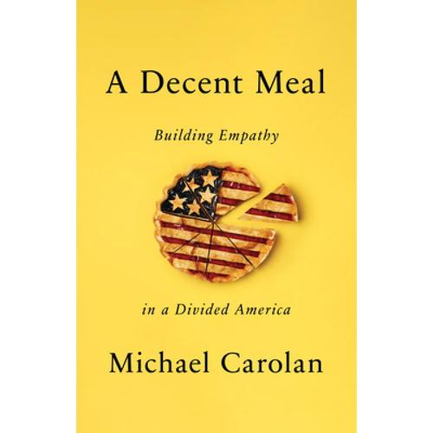
decent /ˈdi:snt/ adj. 相当不错的;正派的
1. 大日子终于来了。他穿着整洁，灰色领带和得体的西装很相配。血液涌向他的脸上，心脏剧烈跳动，他试图冷静下来，然后深呼吸了几下。轮到他了。
The big day finally came. He dressed neatly, the grey tie matching perfectly the decent suit. Blood rushing to his face and heart pounding heavily, he tried to calm down, and then took a few deep breaths. It was his turn.
2. 我的心怦怦直跳，站在她的桌子旁，漫不经心地问她，我是否可以把剧中无礼的台词改得更得体一些。
With my heart racing, I stood near her desk and casually asked if I might possibly change the disrespectful line in the play to a more decent one.
3. 一个独奏?我都不记得上次把小号从箱子里拿出来是什么时候了。我甚至怀疑我是否能从它那里得到一个像样的音符。
A solo? I couldn’t remember the last time I’d taken my trumpet out of its case. I doubted I’d even be able to get a decent note out of it.

Slide 24


perseverance /ˌpɜ:sɪˈvɪərəns/ n.毅力;韧性;不屈不挠精神
1. 这个活动的目的是向人们传播坚持不懈的精神。此外，最重要的是提交的工作应该包括科学家。
The purpose of this activity is to spread the spirit of perseverance to people. In addition, the most important thing is that the submitted work should include a scientist.
2. 比赛开始的那一刻，所有的球员都全身心地追逐足球，竭尽全力地进球，这生动地展示了他们的毅力和耐力。
The moment the game started, all the players committed themselves to chasing the football and went to great lengths to score a goal, which vividly demonstrated their perseverance and endurance.

Slide 25
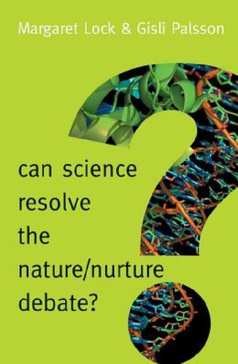
resolve /rɪˈzɒlv/ v.决定;决心 n.决心
1. 我很高兴许多家长对咨询项目表示赞赏，因为他们得到了解决问题的有用建议。通过这次活动，我也积累了一些人生经验。
I’m very glad that many parents have applauded the counseling project because they get useful suggestions to resolve problems. I have also accumulated life experience through this activity.
2. 挣扎了很长一段时间后，我最初想保留这条项链的愿望被我要归还它的决心所取代。
After struggling for a long time, my initial desire to keep the necklace gave way to my resolve to return it.

Slide 26
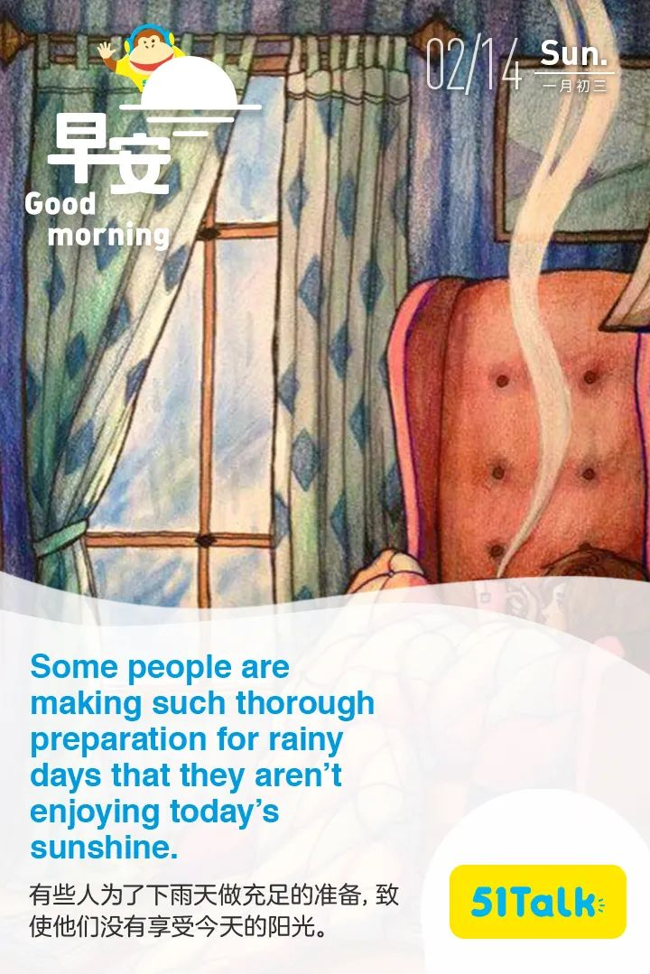
thorough /ˈθʌrə/ adj. 深入的;彻底的;细致的
1. 上周日，当我的父母出去购物时，我突然有了一个主意:为什么不把房间彻底打扫一下呢?
Last Sunday, when my parents went out shopping, I suddenly got an idea: why not give the rooms a thorough cleaning.
2. 晚饭后，我把所有的东西都放在托盘里，并比平时更彻底地擦了擦桌子。
After dinner, I placed everything in my tray and wiped the table more thoroughly than usual.

Slide 27
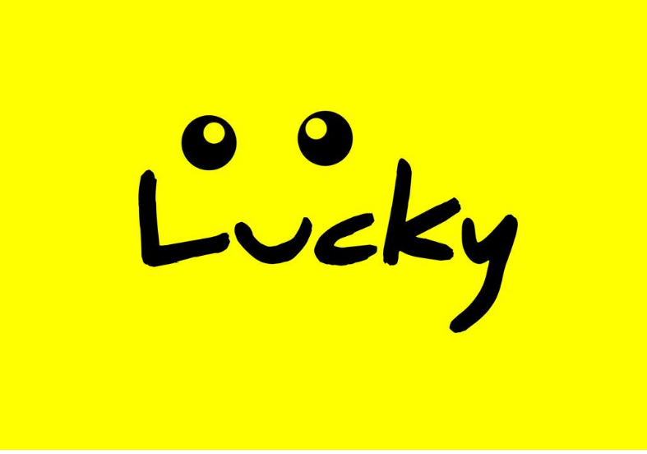
1. 今年，很难说是我的奖品还是我14岁的弟弟杰森(Jason)选出的奖品获奖。不幸的是，在取出它们的内脏之前，我们忘了称它们的重量，但我决心要证明我的观点。
This year, it was hard to tell whether my prize or the one chosen by my 14-year-old brother, Jason, was the winner. Unfortunately we forgot to weigh them before taking out their insides, but I was determined to prove my point. 2021年浙江卷1月“南瓜”
2. 突然，他有了一个主意。他在抽屉里翻来翻去，幸运地找到了一张精致而芬芳的纸。他笔直地坐在椅子上，开始用他最好的笔迹写一封信，作为母亲节的礼物。
Suddenly he had an idea. He fumbled in his drawers and fortunately found a piece of delicate and fragrant paper. He sat down straight on his chair, and began to write a letter in his best handwriting as a Mother’s Day present.

Slide 28

bark /bɑ:k/ vi.&n.(狗)吠叫;吠叫声
1. 这只该死的狗对着埃文下巴前的一只大蝎子直叫。埃文趴在地上，头高高举起，吓得呆住了，贝利继续在几英寸远的地方大声吠叫。
The damn dog was barking directly at a huge scorpion in front of Evan’s chin. Evan lay on his belly, his head held high, frozen in fright as Bailey continued to bark at full volume mere inches away.
2. 看着凹痕上还残留着一些残破的树叶和树皮，我试图打消她的念头。
Looking at the dent with some crashed leaves and bark still sticking there, I attempted to perish (打消) her thought.
3. 她会大声喊出简单数学题的正确答案，这对我来说是一种独特的互动方式，可以评估我的进步。
She would bark out the correct answers to simple math problems — it was a unique, interactive way for me to assess my progress.

Slide 29


guidance /ˈgaɪdns/ n.指导;引导;导航
1.我迫切需要您在英语口语方面的专业指导，因为语言能力对这样的面试是至关重要的。
I’m in urgent need of your professional guidance in my oral English because language proficiency is of vital importance for such an interview.
2. 我们在工作人员的指导下穿过灌木丛，寻找水果和蔬菜。我和我的朋友愉快地摘了它们。
We walked through the bushes and looked for fruits and vegetables with the guidance of the workers. I picked them happily with my friends. 2020全国II“采摘活动”

Slide 30

guidance /ˈgaɪdns/ n.指导;引导;导航
3. 在父亲的指导下，他们采取了积极的行动，重新开始。他们做了面包，然后继续煮粥。2021全国新高考“母亲节礼物”
Under the guidance of their father, they took positive actions and started all over again. They made the bread and then went on cooking porridge.
4. 我写信是想寻求您对我在阅读国外杂志时遇到的一个问题的指导。尽管尝试了各种方法，我还是不能像我希望的那样有效地理解这些文章。
I am writing to seek your guidance on a problem I have been facing while reading foreign magazines. Despite trying various methods, I am unable to comprehend the articles as effectively as I would like to.

Slide 31
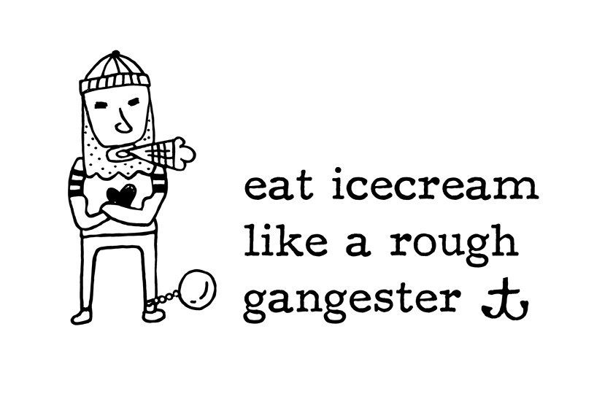
rough /rʌf/ a.汹涌的;粗糙的;粗略的
1. 我哥哥给了他一把扳手，然后开始帮他换轮胎。我们开始了解这个年轻人，他来自附近一个贫困的社区。
My brother gave him a wrench, then proceed to help him change the flat. We started getting to know the young man who was from a rough neighborhood nearby.
2. 收到你的来信我非常高兴。你在上次来信中问我关于我们学校体育锻炼的情况，下面的信息可以给你一个大致的了解。
I am more than delighted to hear from you. You asked me in your last letter about the physical exercise in our school and the following information may give you a rough sketch.
3. 我在学校里表演了几年。当我在一个戏剧中得到一个粗糙的角色时，我很兴奋，因为我那鼓舞人心的戏剧老师和导演信任我，把这个角色交给了我。
I had been acting in school for a few years. When I got a rough role in a play, I, only a junior in my high school, was excited that my inspiring drama teacher and director had trusted me with the part.

Slide 32


rough /rʌf/ a.汹涌的;粗糙的;粗略的
4. 他们还没来得及抛下鱼线，风就突然起了。巨浪开始冲击小船。
They hadn’t even cast their lines when the wind picked up suddenly. Rough waves began battling against the little boat.
5. 在蓝天的映衬下，一条崎岖不平的小路蜿蜒穿过湖面，通向山顶，两边长满了野花和野草。阳光照在晶莹剔透的湖面上，显得格外明亮。
Against the blue skies, a rough path wound to the top of the mountain across the lake with wild flowers and grass on both sides. The sunlight brightened on the glassy surface of the lake.

Slide 33

loyal /ˈlɔɪəl/ adj. 忠诚的;忠实的
1. 今年是《青年》十周年。作为一个忠实的粉丝，我真诚地希望《芳华》在未来的岁月里越来越有吸引力，让更多的学生受益。2021年新高考I卷“投稿”
This year marks the tenth anniversary of Youth. As a loyal fan, I sincerely hope that Youth will be increasingly appealing and benefit more students in the years to come.
2. 马克斯不再只是一只宠物，他成了莎拉忠实的朋友和快乐的源泉，莎拉在事业和个人生活之间找到了新的平衡。
Max became more than just a pet; he became a loyal friend and a source of happiness for Sarah,who had discovered a newfound balance between her career and personal life.
3. 约翰跑回屋里说:“妈妈，你不能把爷爷的椅子扔了。”它已经陪伴了他几十年，就像一个忠实的朋友，见证了他生命中最重要的时刻!
John then ran back inside and said, “Mom, you can’t throw out grandpa’s chair. It has been with him for decades and is like a loyal friend that has witnessed the most important moments in his life!”

Slide 34

candidate /ˈkændɪdət/ n.候选人;应试者
1. 因此，我毫不犹豫地推荐她作为您广告中职位的理想人选。
Therefore, I do not hesitate to recommend her as an ideal candidate for the post you advertised.
2. 此时此刻,他盯着试卷上的题目, 附近考生偶尔的咳嗽声开始让他更加慌张。他知道这次考试将决定他的未来,压力山大。
Then and there, he was staring at the questions on the page when the occasional cough from a nearby candidate started to get on his nerves. He knew that this exam would determine her future, and the pressure was overwhelming.
3. 希望我能成为贵公司的合适人选。如果您能认真考虑我的申请，我将不胜感激。期待您的回复。
Hope I can be a suitable candidate of your company. I would appreciate it if you could take my application into serious consideration. Looking forward to your kind reply!

Slide 35


commitment /kəˈmɪtmənt/ n.承诺;保证;奉献
committed
1. 在我看来，钟南山的非凡之处不仅在于他对医学事业的巨大贡献，更在于他对自己热爱的事业的执着。
In my opinion, what makes Zhong Nanshan so extraordinary is not only his great contributions to medical work but also his commitment to what he loves.
2. 在我们周围广泛的工作中，我会选择成为一名教师。我母亲首先解释了我的选择。她对教学的执着和当老师的快乐激励着我。
Of the wide range of jobs around us, I will choose to be a teacher. My mother accounts for my choice first. Her commitment to teaching and happiness of being a teacher motivate me.

Slide 36

commitment /kəˈmɪtmənt/ n.承诺;保证;奉献
committed
3. 我钦佩袁博士不仅因为他为人类谋福利的伟大决心，而且因为他不断地设定更高的目标，而不是停止尝试。正是他的奉献、无私和奉献激励着我走得更远。
I admire Dr Yuan not only for his great determination to seek welfare for mankind but for his continuously setting higher goals instead of stopping trying. It is his commitment, selflessness and devotion that inspire me to go further.
4. 业务员们听了我开玩笑的询问，咯咯地笑了起来，并向我保证，“友好的福特”确实致力于自己的品牌和声誉。
The salesmen chuckled heartily at my playful inquiry and assured me that Friendly Ford was indeed committed to its name and reputation.

Slide 37

hold on (to) 坚持某种状态或位置; 抓住某物不放
1. 然而，老师和导游鼓励我们紧紧抓住我们的信仰。最后，我们到达了山顶，从山顶往下看。
However, the teachers and the tour guides encouraged us to hold on to our faith tightly. Eventually, we reached the top and looked down from the peak. 2013年江西省高考英语 “登山”
2. 那就是爬到书架的顶端，直到他能拿起那本书。他只需要把两边抓得更紧一点，这样他就不会掉下来。
It was to climb to the top of the shelf until he could just take the book. He’d just have to hold on to the sides a little tighter so that he wouldn’t fall off.

Slide 38

a rush of 一股......
rush v. 冲，奔；把......迅速送往
1. 楼梯被水淹了。要到一楼的卧室去是不可能的。房间的门是关着的，但没有闩上。水随时都可能涌进来。女人们惊慌失措。
The staircases were flooded. It was impossible to get to the bedroom on the first floor. The door to the room was closed but not bolted. Any moment the water could rush in. The women panicked.
2. 令我吃惊的是，她抓住了我的小手指。一阵感情的冲动席卷了我，我轻轻地把她从篮子里抱起来。
To my amazement, she grabbed onto my little finger. A rush of affection sweeping over me, I gently lifted her up from the basket.
3. 看到他们一起沐浴在春日的阳光下，脸上写着微笑，我感到被冷落了，一阵刺痛涌上我的身体。
Seeing them together bathed in the spring sun and smiles written on their faces, I felt left out, a rush of piercing pain run through my body.

Slide 39
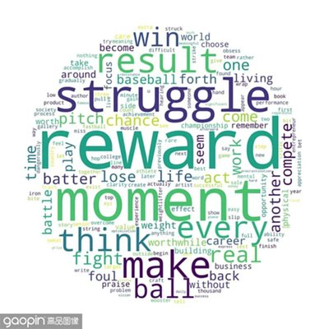
reward /rɪˈwɔːd/ n. 奖励，回报 v. 酬谢，奖赏；奖励
rewarding adj. 值得的，有意义的；赚钱的
1. 她立刻对经常帮助她和其他邻居的艾利森感到同情。她决定给艾莉森更多的糖果作为奖励，并给安娜和她的朋友们一个教训。
She immediately felt pity for Allison, who often helped her and other neighbors. She decided to give Allison much more candy as a reward and teach Anna and her friends a lesson.
2. 事实上，阅读经典是有益的。它有利于性格发展和个人成长。
In fact, reading classics is rewarding. It is beneficial to character development and personal growth.
3. 然后，母亲平静地鼓励本用更多的巧克力奖励自己，因为他在这次活动中表现出了其他的优点。他照吩咐做了，承认面对事故时他很镇静。
The mother then calmly encouraged Ben to reward himself with more chocolates for other merits he had displayed in this event. He did as he was told to, confessing that he was calm when facing the accident.

Slide 40

desperate /ˈdespərət/ adj. 不顾一切的，拼命的; 绝望的，无望的
1. 我想知道他们正在经历什么，我非常想知道我能为他们做些什么。当我把勺子推到锅里，拿了一大勺倒进他们的碗里时，他们感激地点头。
I wanted to know what they were going through and I was desperate to know what I could do for them. They nodded gratefully as I pushed my spoon into the pot and took a large spoonful and poured it into their bowls. 2022年浙江卷6月 “社区帮忙”
2. 由于孩子即将出生，她急需经济上的帮助。有了陌生人的好意，她很感动，知道一切都会好起来的。同时，她决心把善良传递给其他需要帮助的人。
She was in desperate need of financial help with the baby coming soon. With the kindness from a stranger, she felt moved and knew everything would be fine. Also, she was determined to pass on the kindness to another in need.

Slide 41

desperate /ˈdespərət/ adj. 不顾一切的，拼命的; 绝望的，无望的
3. 他绝望的眼神拉着肖恩的心弦。先生，我只有2美元，但你可以拿走!肖恩说着，把手伸进口袋，拿出了钞票。谢谢你！谢谢你！我可以加满油，及时赶到医院。那人感激地接过钞票。
Finally, John collapsed onto their bed, burying his face in her pillow. "Return to me," he wept, though he knew his desperate cries were in vain.
His desperate eyes pulled at Sean’s heartstrings. “Well, sir. I only have $2, but you can have it!” Sean said, reaching into his pocket and taking out the bills. “Thank you! Thank you! I can fill up and reach the hospital in time.” The man took the bills gratefully.
4. 最后，约翰瘫倒在床上，把脸埋在她的枕头里。“回到我身边来，”他哭着说，虽然他知道他绝望的呼喊是徒劳的。

Slide 42

motive /ˈməʊtɪv/ n.动机;原因;目的
motivated /ˈməʊtɪveɪtɪd/ adj. 积极的，主动的；有……动机的
motivation /ˌməʊtɪˈveɪʃ(ə)n/ n. 动力，诱因；积极性，干劲
1. 此外，如果与他们相处不融洽或沟通有困难的人配对，学生可能会感到不舒服或缺乏动力。
Besides, students may feel uncomfortable or less motivated if paired with someone who they don’t get along with or have difficulty communicating with. 2023年新高考II卷 “分组建议”
2. 当被问到为什么那一年球队表现这么好时，一名球员谈到了珍妮。他提到了她在场边的存在如何给球队带来了新的动力和灵感。
When asked why the team did so well that year, a player spoke of Jenny. He mentioned how her presence on the sidelines brought a new level of motivation and inspiration to the team.

Slide 43

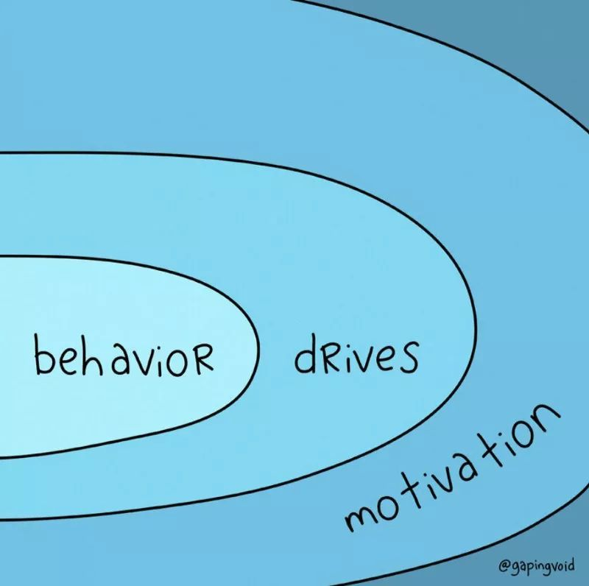
motive /ˈməʊtɪv/ n.动机;原因;目的
motivated /ˈməʊtɪveɪtɪd/ adj. 积极的，主动的；有……动机的
motivation /ˌməʊtɪˈveɪʃ(ə)n/ n. 动力，诱因；积极性，干劲
3. 这将使每个学生都能与水平相似、兴趣相似的同学一起练习英语口语，这将有助于增强学生的动力和信心。
This would allow each student to practice their spoken English with peers who are of a similar proficiency level, and ones with similar interests, which would serve to enhance student motivation and confidence. 2023年新高考II卷 “分组建议”

Slide 44


http://www.sunedu.com
Thank You!

