Slide 1


感恩遇见，相互成就，本课件资料仅供您个人参考、教学使用，严禁自行在网络传播，违者依知识产权法追究法律责任。
更多教学资源请关注
公众号：溯恩英语
知识产权声明

Slide 2

Propose a Debate Topic on Future job
2024.12县域联盟高三联考应用文分析

Slide 3

Lead-in
Have you ever participated in a debate as a participant or audience?
Do you think its debate topic is a good one? And why?
So what characteristics should a good debate topic possess?

Slide 4

What characteristics should a good debate topic possess?
‌Controversial: allow both sides to present opposing viewpoints
‌Debatable:ensure both sides to have ample room to argue their points effectively
‌Timely:be relevant to current events, societal trends,capturing the interest of participants and audiences.
‌Balanced:provide equal opportunities for both sides
‌Thought-provoking:stimulate critical thinking and encourage participants to delve deeper into the issues
‌Clearly defined:be stated in a clear and unambiguous manner

Slide 5
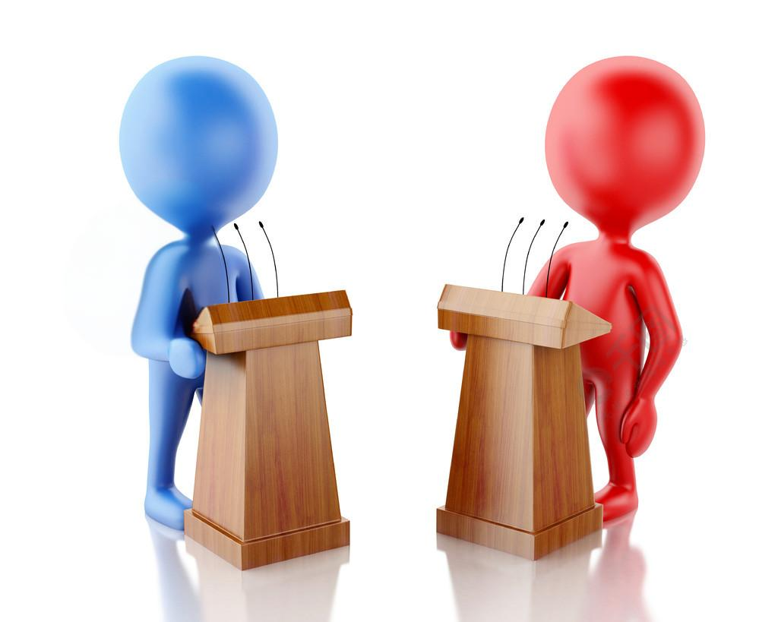
Brainstorm
Debate topics on future job
preference
content
model
location
subject
Should we pursue careers based on passion or financial stability?
Should we value technology or interpersonal communicatio-n?
Will remote work become the mainstream working model in the future?
Should graduates stay in big cities or go back to their hometown?
Will artificial intelligence replace human jobs in the future?

Slide 6
Before writing
假定你是李华，校英文报“Big Debate”栏目正面向全校学生征集关于未来职业的辩论话题，请你给栏目编辑写一封邮件，内容包括：
1.推荐辩题；
2.说明理由。
注意：
1.写作词数应为80左右；
2.请按如下格式在答题纸的相应位置作答。
proposal/recomendation letter
What’s the writing purpose of this E-mail?
Who is the receiver ?
What should we write ?

Slide 7
What should we write and how to arrange them in a logical way?
self-introduction
P1
writing purpose,debate topic
general
P2
content
reasons of
the proposal?
specific
significance
effect
P3
appreciation/anticipation/wish

Slide 8
During writing
Write and Appreciate
P1
self-introduction +writing purpose,debate topic
I’m Li Hua, an enthusiastic reader of your column. Thrilled to learn that the "Big Debate" section is seeking suggestions/proposals for debate topics concerning future careers, I would like to take this opportunity to propose a timely and thought-provoking topic:Will artificial intelligence replace human jobs in the future?

Slide 9
During writing
Write and Appreciate
P1
self-introduction +writing purpose,debate topic
I'm Li Hua, a passionate reader of our school's English newspaper, especially of your column "Big Debate" .I can’t wait but propose a timely and thought-provoking debate topic: Will artificial intelligence replace human jobs in the future?

Slide 10
During writing
Write and Appreciate
P1
self-introduction +writing purpose,debate topic
I’m Li Hua, an enthusiastic reader of your column. I’d like to propose a thought-provoking debate topic:Should we pursue careers based on passion or financial stability?

Slide 11
During writing
general
content
reasons of
the proposal
P2
significance
specific
effect
The reasons are as follows.To begin with, this debate topic is so controversial that it allows both sides to present opposing viewpoints about the future professions. Also, as artificial intelligence has profoundly influenced various aspects of our lives, a topic revolving around it is bound to arouse interests and stimulate critical thinking among participants and audience. Plus, not only is it highly relevant, engaging, and inspiring, but it can also foster a meaningful exchange of ideas and perspectives.

Slide 12
During writing
P3
appreciation/anticipation/wish
I would appreciate it if you could take my proposal into your consideration.Looking forward to a vibrant and lively discussion that this topic could spark within our school community. All the best!
I believe this topic is highly relevant and engaging and will spark meaningful discussions among students. Looking forward to hearing your thoughts. Best wishes.

Slide 13
Sample writing one
Dear Editor,
I’m Li Hua, an enthusiastic reader of your column. I’d like to propose a thought-provoking debate topic:Should we pursue careers based on passion or financial stability?
In an era marked by competitive environment, the choice between following one’s passion or securing financial stability impacts not only one’s individual fulfillment but also overall well-being.For us young students, a debate on topic will encourage us to reflect on our own values and long-term goals, preparing us to make informed decisions when planning our future career paths.
I believe this topic is highly relevant and engaging and will spark meaningful discussions among students. Looking forward to hearing your thoughts. Best wishes.
Yours,
Li Hua

Slide 14
Sample writing two
Dear Editor,
I’m Li Hua, an enthusiastic reader of your column. Thrilled to learn that the "Big Debate" section is seeking suggestions/proposals for debate topics concerning future careers,I can’t wait but propose a timely and thought-provoking debate topic: Will artificial intelligence replace human jobs in the future?
The reasons are as follows.To begin with, this debate topic is so controversial that it allows both sides to present opposing viewpoints about the future professions. Also, as artificial intelligence has profoundly influenced various aspects of our lives, a topic revolving around it is bound to arouse interests and stimulate critical thinking among participants and audience. Plus, not only is it highly relevant, engaging, and inspiring, but it can also foster a meaningful exchange of ideas and perspectives.
I would appreciate it if you could take my proposal into your consideration.Looking forward to a vibrant and lively discussion that this topic could spark within our school community. All the best!
Yours,
Li Hua

Slide 15

After writing
Reflection
Have we achieved our writing purpose ?
If you are the editor, will you adopt it or forget it?

