Slide 1


感恩遇见，相互成就，本课件资料仅供您个人参考、教学使用，严禁自行在网络传播，违者依知识产权法追究法律责任。
更多教学资源请关注
公众号：溯恩英语
知识产权声明

Slide 2
2025届高三部分重点中学12月联合测评
英语试题 客观题分析
北师大嘉兴附中 吴晨华

Slide 3
题型 | 话题 | 体裁 | 提问类型 | 词数
阅读A | 人与社会：Affordable big cities for travelers | 应用文 | 细节理解2 主旨总结1 | 261
阅读B | 人与自然：Adams Cassinga’s various identities and his story of protecting wild life | 记叙文 | 细节理解3 人物总结1 | 367
阅读C | 人与社会：Understanding of mental fatigue and the advice to overcome it | 说明文 | 词义推测1 细节理解3 | 330
阅读D | 人与社会：Understanding of confirmation bias and strategies to overcome it | 说明文 | 细节理解3 主旨总结1 | 350
七选五 | 人与自我：Introduction to the significance and benefits of hobbies | 说明文 |  | 333
完型填空 | 人与自我：A mail carrier’s experience of meeting a vicious dog | 记叙文 |  | 281
语法填空 | 人与社会：Introduction to the Sifang Art Museum, Nanjing | 说明文 |  | 255

Slide 4
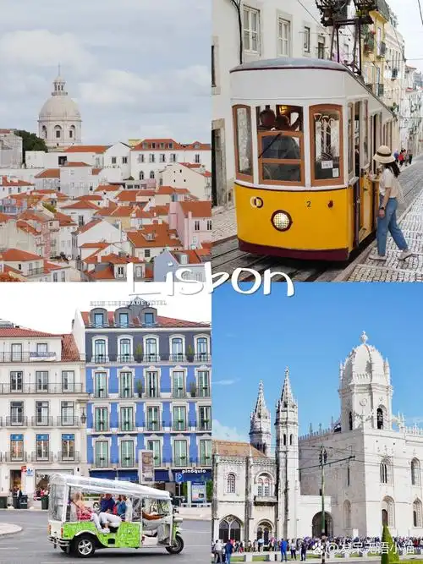
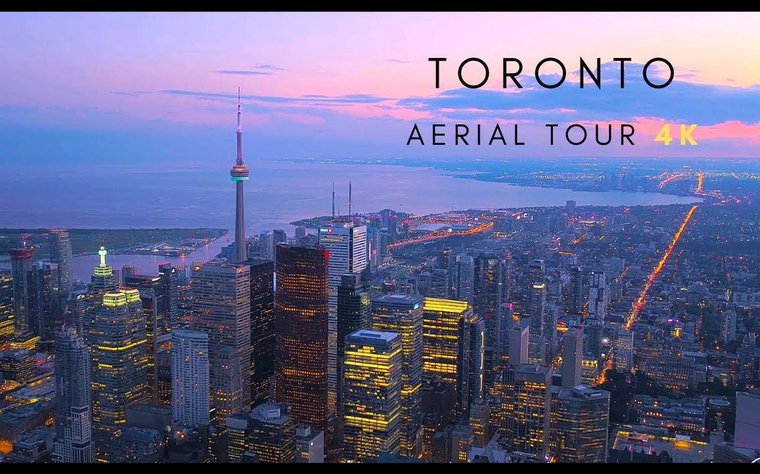

A篇
人与社会：Affordable big cities for travelers

Slide 5
Prices have been rising rapidly in cities across the world, driving the cost of living higher than ever before. But not everywhere has been impacted equally. For travelers, these places can offer the same big-city convenient facilities at a much lower cost of living.
Lisbon, Portugal
As the least-expensive city in Western Europe, according to the EIU rankings, Lisbon has been a hot spot for travelers in recent years. Mercedes Zach recommends exploring the bohemian（波西米亚式的）Bairro Alto neighbourhood to uncover street art, city views and sunset gatherings with locals. The Roman Theatre Museum gives a glimpse into the city’s Roman past, with preserved theatre ruins.
Toronto, Canada
Canadian cities to the north continue to remain lower in the cost-of-living rankings. Of all the Canadian cities ranked, Toronto ranks the most affordable. Toronto resident Stephanie Ciccarelli recommends city sightseeing via boat cruise on Lake Ontario, or visiting the Hockey Hall of Fame.
Tokyo, Japan
Moving three down the index（指标）this year and ranking 60 overall, Tokyo continues to be Japan’s most expensive city yet is now more affordable than, fellow Asian cities like Singapore and Hong Kong. Tokyo resident Masa Yamamoto encourages tourists to wander around the urban garden and pubic art displays at the newly developed Azabudai Hills neighbourhood for free. For a new perspective on the city, he recommends the contemporary art Mori Art Museum and its connected Tokyo City View, which offers a view of the city from 250 m above sea level for just 2,000 yen.
重视首段的内容，涉及主旨大意和写作目的。
21. Which attraction can give you brief insights into the city’s history?
A. The Hockey Hall of Fame.
B. The Mori Art Museum.
C. The Roman Theatre Museum.
D. The Bairro Alto neighbourhood.
22. What tourist highlights are shared by Lisbon and Tokyo?
A. City views and artistic appeal.
B. Street markets and urban parks.
C. Historical ruins and museums.
D. Local customs and landmarks.
23. What is the primary focus of this passage?
A. Affordable big cities for travelers.
B. EIU ranking of cost-effective cites.
C. The rapid rise in global living expenses.
D. Cities known for their high cost of living.

Slide 6
语言知识梳理
1.在文本中学习词汇
生活成本
Prices have been rising rapidly in cities across the world, driving the cost of living higher than ever before. But not everywhere has been impacted equally. For travelers, these places can offer the same big-city convenient facilities at a much lower cost of living.
Lisbon, Portugal
As the least-expensive city in Western Europe, according to the EIU rankings, Lisbon has been a hot spot for travelers in recent years. Mercedes Zach recommends exploring the bohemian（波西米亚式的）Bairro Alto neighbourhood to uncover street art, city views and sunset gatherings with locals. The Roman Theatre Museum gives a glimpse into the city’s Roman past, with preserved theatre ruins.
Toronto, Canada
Canadian cities to the north continue to remain lower in the cost-of-living rankings. Of all the Canadian cities ranked, Toronto ranks the most affordable. Toronto resident Stephanie Ciccarelli recommends city sightseeing via boat cruise on Lake Ontario, or visiting the Hockey Hall of Fame.
Tokyo, Japan
Moving three down the index（指标）this year and ranking 60 overall, Tokyo continues to be Japan’s most expensive city yet is now more affordable than, fellow Asian cities like Singapore and Hong Kong. Tokyo resident Masa Yamamoto encourages tourists to wander around the urban garden and pubic art displays at the newly developed Azabudai Hills neighbourhood for free. For a new perspective on the city, he recommends the contemporary art Mori Art Museum and its connected Tokyo City View, which offers a view of the city from 250 m above sea level for just 2,000 yen.
提供同样的城市便利设施
排名 n.
非谓语动词
排名 n.
谓语动词
非谓语动词
提供城市景观
推荐，鼓动做某事

Slide 7
语言知识梳理
2.介绍城市相关表达
生活成本
便利的设施
游客喜欢的热门地方
初步感受…
乘船游览
漫步城市花园和公共艺术展览
以全新的视角看待这座城市
城市景观
使某人了解…
旅游亮点
cost of living
convenient facilities
a hot spot for travelers
gives a glimpse into …
boat cruise
wander around the urban garden and pubic art displays
for a new perspective on the city
a view of the city
give sb. insights into …
tourist highlights

Slide 8
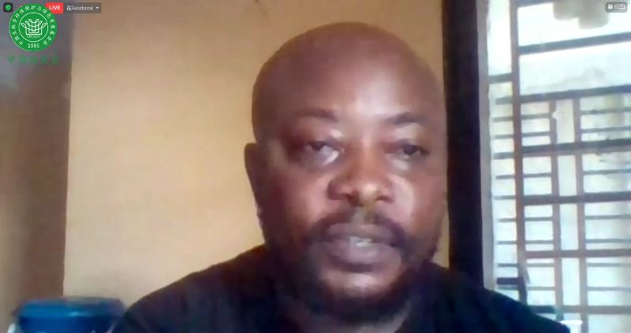
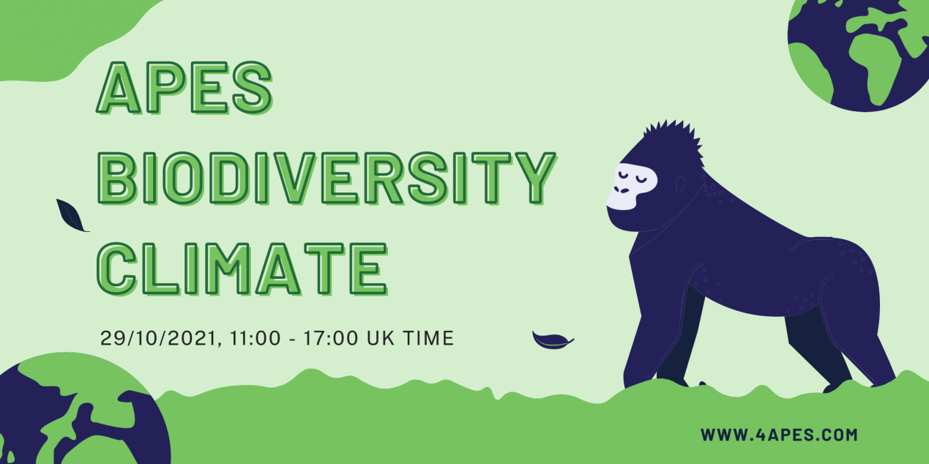
B篇
人与自然：Adams Cassinga’s various identities and his story of protecting wild life

Slide 9
Adams Cassinga has had many identities: refugee (难民); journalist, mining consultant. And now, defender of wildlife.
As a child, he was fascinated by animals gorillas living in the forests outside his hometown of Bukavu in the Democratic Republic of the Congo (DRC)—but his path to conservation was winding. His father, who feared Adams would be taken as a child soldier, sent him to South Africa. In Johannesburg, Adams learnt to survive on the streets while teaching himself English in public libraries. After he was granted official refugee status, he studied journalism and landed his first job working for a local newspaper. While working as an investigative reporter in 2006, Adams was shot three times! Adams changed career paths again, this time to work in the profitable mining industry in South Africa. In this role, he returned years later to the DRC to visit gold mines.
One day, while flying to a gold mine in northeastern Congo, Adams saw the wounds of mining operations on the lush forest landscape. He began to think about the beauty of his country’s wild places and the struggle to protect them. After volunteering as an honorary ranger（护林人）, Adams took his wildlife mission one big step further, founding Conserv Congo in 2017. Conserv Congo fights-illegal hunting-and -trafficking（非法交易） through undercover investigations in pursuit of criminals in the illegal wildlife trade. With a team of volunteers including police officers, politicians and students, Adams steals into trafficking networks and conducts organized traps with the authorities.
Adams places great value in winning over the hearts and minds of the police officers he works with. “They need to understand the reason behind what we do. We have to transform them into nature lovers. They can only protect what they know and love,” he says: It also partners with multiple national parks, helping to prevent illegal hunting, training volunteers to patrol the parks with rangers, and buying uniforms and other supplies for rangers. To date, the non-profit has worked on more than 6,000 criminal cases, rescued hundreds of trafficked animals from chimps to parrots, and seized tons of ivory and pangolin scales.
24. What did Adams go through when he arrived in South Africa?
A. Civil war. B. Culture shock.
C. Language barrier.
D. Regional discrimination.
25. What motivated Adams to start out on the path of conservation?
A. The beautiful scenery of the forest.
B. The deep affection for wild animals.
C. The gold mine in northeastern Congo.
D. The forest destruction caused by mining.
26. What is Adams trying to achieve in partnership with the police officers?
A. A uniform rule for, national parks.
B. A comprehensive supply for rangers.
C. A scientific system of training volunteers.
D. A transformation in attitude towards nature.
27. Which words can best describe Adams?
A. Rigid and reserved.
B. Active and committed.
C. Adaptable and humorous
D. Humble and diligent.
Para 1: general introduction
Para 2: early experience
Para 3: he founded Conserv Congo to protect the wildlife
Para 4: His contribution to wildlife protection
刻板僵硬和
寡言少语的

Slide 10
语言知识梳理
consultation
consultant
1. journal n. _______________ n. consult v. ________________ n. ______________ n.
defend v. _____________ n. _____________ n. honor v./n. ___________ adj. ____________ adj.
pursue v. ______________ n. _____________ n.
2. 为…着迷 ________________________ 通过暗中调查 ____________________________
潜入；偷偷进入 _______________ 设下圈套 _________________
非常重视 _____________________ 赢得人心 _________________________________
和…结伴 ___________________ patrol ___________ petrol ____________
3. His path to conservation was winding. ____________
尤指正式地或法律上）同意，准予，允许
4. After he was granted official refugee status, he studied journalism and landed his first job working for a local newspaper.
5. To date (= ____________), the non-profit has worked on more than 6,000 criminal cases, rescued hundreds of trafficked animals from chimps to parrots, and seized tons of ivory and pangolin scales.
journalist
defence
defender
honorable
honorary
pursuit
pursuer
be fascinated by
through undercover investigations
steal into
conduct organized trap
place great value in …
win over the hearts and minds of sb.
partner with …
巡逻
汽油
曲折的
succeed in getting a job
So far

Slide 11

C篇
人与社会：Understanding of mental fatigue and the advice to overcome it

Slide 12
tip: 根据句意，gratifying应与fatigue相反
It goes without saying that hard physical labor wears you out, but what about hard mental labor? “Influential theories suggested that fatigue(疲惫) is a sort of illusion cooked up by the brain to make us stop whatever we are doing and turn to a more gratifying activity,” says Mathias Pessiglione of Pitie-Salpetriere University in Paris, France. “But our findings show that cognitive work results in a true functional transformation -accumulation of toxic substances- so fatigue would indeed be a signal that makes us stop working but for a different purpose: to preserve the integrity of brain functioning.”
Pessiglione and colleagues wanted to understand what mental fatigue really is. They used magnetic resonance spectroscopy (MRS) to monitor brain chemistry over the course of a workday. They studied two groups of people; those who needed to think hard and those who had relatively simple cognitive tasks.
They saw signs of fatigue, only in the group doing hard mental work. Those in that group also exhibited in their choices a change toward options proposing rewards at short delay with minimal effort. Critically, they also had higher levels of glutamate(谷氨酸) in the brain’s prefrontal cortex（前额皮质）. Together with earlier evidence, the scientists say it supports the hypothesis that glutamate accumulation makes further activation of the prefrontal cortex more costly, such that cognitive control is more difficult after a mentally tough workday.
So, is there some way to overcome this limitation of our brain’s ability to think hard? “Not really, I’m afraid,” Pessiglione said. “I would employ good old recipes: rest and sleep! There is good evidence that glutamate is removed from the brain during sleep.”
There may be other practical implications of the findings. For example, the researchers say, monitoring of prefrontal cortex could help to detect severe mental fatigue. Such an ability may help adjust work agendas to avoid burnout. Pessiglione also advises people to avoid making important decisions when they’re tired.
28. What does the underlined word “gratifying” in Paragraph 1 mean?
A. Relaxing. B. Complex.
C. Temporary. D. Rewarding.
29. What does the group performing hard mental work exhibit in the study?
A. Fewer signs of mental fatigue.
B. Greater motivation and effort.
C. Higher efficiency in complex tasks.
D. Stronger preference for immediate rewards.
30. What do we know about glutamate accumulation?
A. It causes a sense of peaceful mind.
B. It enhances brain function in a limited way.
C. It signals the brain is emptying its mental energy.
D. It decreases the cost of prefrontal cortex activation.
31. What is Pessiglione’s advice for those overwhelmed by mentally demanding tasks?
A. Remove them from the work agenda.
B. Reduce the complexity of all cognitive tasks.
C. Schedule strategic breaks to allow for-recovery.
D. Apply technology to monitoring the brain activity.
Topic: mental fatigue
Study: what is mental fatigue
findings
advice

Slide 13
语言知识梳理
1. 语法填空
____________(influence) theories suggested that fatigue(疲惫) is a sort of illusion _________(cook) up by the brain to make us stop whatever we are doing ______ turn to a more gratifying activity.
They studied two groups of people; those who needed to think hard and those who had ___________ (relative) simple cognitive tasks.
Those in that group also ___________(exhibit) in their choices a change toward options __________ (propose) rewards at short delay with minimal effort.
___________(critical), they also had higher levels of glutamate in the brain’s prefrontal cortex.
Together with earlier evidence, the scientists say it supports the hypothesis _______ glutamate accumulation makes further activation of the prefrontal cortex more_______(cost), such that cognitive control is more difficult after ____ mentally tough workday.
So, is there some way to overcome this __________(limit) of our brain’s ability to think hard?
It enhances brain function in a ________(limit) way. The future holds _________(limit) promise.
There may be other __________(practice) implications of the findings.
Stronger ____________(prefer) for immediate rewards.
Reduce the ____________(complex) of all cognitive tasks.
Apply technology ____monitoring the brain activity.
Influential
cooked
and
relatively
exhibited
proposing
Critically
that
costly
a
limitation
limited
limitless
practical
preference
complexity
to

Slide 14
语言知识梳理
2. 一词多义
1) function
But our findings show that cognitive work results in a true functional transformation -accumulation of toxic substances- so fatigue would indeed be a signal that makes us stop working but for a different purpose: to preserve the integrity of brain functioning.”
It enhances brain function in a limited way.
The authorities say the prison is now functioning normally.
On weekdays, one third of the room functions as workspace.
2) n.→v.
a) It signals the brain is emptying its mental energy.
Chest pains can be a warning signal of heart problems.
She signalled (that) it was time to leave.
This announcement signalled a clear change of policy.
The house had been standing empty.
She emptied the water out of the vase.
b) Schedule strategic breaks to allow for recovery
We‘re working to a tight schedule.
The meeting is scheduled for Friday afternoon.
adj.实用的；功能的
n.运行，运作
n.作用；功能
v.运转
v.起作用
n.信号
v.示意
v.表明
adj.空的
v.清空
n.日程安排
v.安排

Slide 15
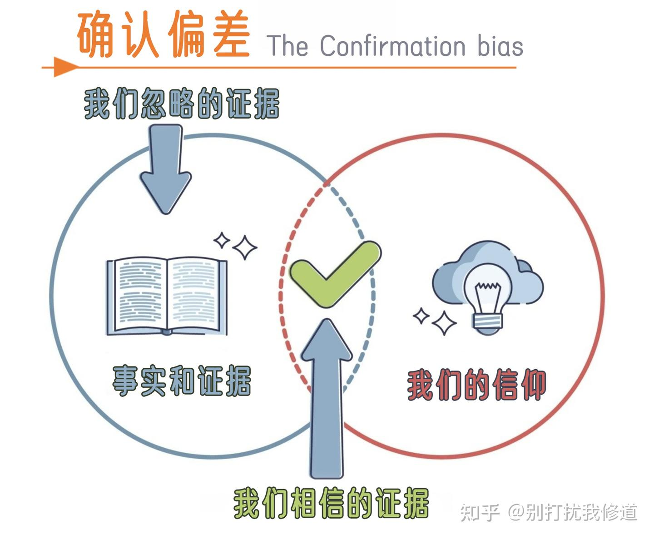
D篇
人与社会：Understanding of confirmation bias and strategies to overcome it

Slide 16
Confirmation bias refers to people’s tendency to seek out information that supports their existing beliefs. While it’s usually subconscious, its impacts are significant. It can cloud people's judgement and decision-making processes.
One explanation for confirmation bias is that it is an efficient way to process information. Humans are constantly fed with information and cannot possibly take the time to carefully process each piece. It is adaptive for humans to rely on subconscious, automatic judgements that contribute to the efficiency. Another reason why people show confirmation bias is to protect their self-worth. People like to feel good about themselves, and discovering a belief they highly value is incorrect makes them feel bad about themselves. Therefore, confirmation bias will encourage them to disregard the information contrary to their belief.
Researches show that confirmation bias is strong and widespread. In studies examining my-side bias, people were able to generate and remember more reasons supporting their side of a controversial issue than the opposing side. Only when a researcher directly asked people to generate arguments against their own beliefs were they able to do so. It is not that people are incapable of generating arguments that are contrary to their beliefs, but, rather, people are not motivated to do so.
Confirmation bias also surfaces in interpersonal communication. When interacting with people who perceivers think have certain personalities, the perceivers will ask questions that are biased toward supporting the perceivers’ beliefs. If a new roommate is expected to be friendly and outgoing, Maria may ask her if she likes to go to parties rather than asking if she often studies in the library.
Confirmation bias may lead to incomplete and misinterpreted understanding of an issue or topic, as crucial information may.be overlooked or dismissed. Thus, to avoid it, people are supposed to diversify the sources of information accessed as seeking multiple perspectives brings a broader understanding of the subject matter and allows for well-rounded decision-making. Another way is to actively challenge the bias by questioning assumptions and relying on evidence rather than personal opinions, which helps us consciously recognize informational biases and minimize their impact.
32. Why do people show confirmation bias?
A. To help maintain their dignity.
B. To prevent shallow judgements.
C. To handle complex information.
D. To develop their logical reasoning.
33. What did the studies in Paragraph 3 find?
A. People couldn’t produce arguments against their belief.
B. Information supporting people’s belief often won preference,
C. It took considerable motivation to face controversial issues.
D. People focused on information concerning the opposing side.
34. How does the writer illustrate confirmation bias in communication?
A. By making comparison. B. By giving an example.
C. By introducing a study. D. By defining a concept.
35. What is the passage mainly about?
A. The role of my-side bias in enhancing people’s own beliefs.
B. The effects of information overload on decision-making process.
C. The impact of confirmation bias on interpersonal communication.
D. Understanding of confirmation bias and strategies to overcome it.
What
Why
How

Slide 17
语言知识梳理
1. 词的前缀
conscious 意识的 → 潜意识的
correct 正确的 → 不正确的
regard 注意,留心 →忽视,轻视,不尊重
capable有能力的 →无能力的；不能胜任的
complete全部的,完整的→不完整的
interpret解释 →曲解
look看 →忽视
miss错过 →让……离开,解散 →轻蔑的
load负载，重荷 →超载
subconscious
incorrect
disregard
incapable
incomplete
misinterpret
overlook
dismiss
dismissive
overload
impolite
polite →
legal →
regular →
responsible →
reasonable →
honest →
accurate →
active →
illegal
irregular
irresponsible
unreasonable
dishonest
inaccurate
inactive

Slide 18
2. 一词多义
bias
confirmation bias/ the questions are biased towards supporting the perceivers’ beliefs
The newspapers have biased people against her.
2) cloud
It can cloud people’s judgement and decision-making processes.
Her eyes were clouded with tears.
Suspicion clouded her face.
Her father's illness cast a cloud over her wedding day.
3) process
It can cloud people’s judgement and decision-making processes.
It is an efficient way to process information.
It will take a week for your application to be processed.
processed cheese
4) surface
Confirmation bias also surfaces in interpersonal communication.
He surfaced, gasping for air.
the earth's surface
n.偏见
adj.有偏见的
v.使有偏见
v.使模糊，使迷惑
v. 变模糊
v.(忧虑、悲伤、愤怒)显现于面部
n.阴影；忧郁；焦虑；令人忧虑的事
n.过程
v. 加工，处理
v. 加工，处理
adj.经过加工的
v.重新出现，显露
v.浮出水面
n. 表面

Slide 19
3. 词汇整理
有…的倾向
寻找信息
现有的观点
影响人们的判断
处理信息
被喂养/厌烦
适应
导致
保护自我价值/维护尊严
肤浅的判断
合乎逻辑的理由
与…相反
不能做某事
使信息来源多样化
带来更广泛的理解
全面的决策
have a tendency to
seek out information
existing beliefs
cloud people’s judgment
process information
be fed with/ be fed up with
be adaptive for
contribute to
protect one’s self-worth/ maintain one’s dignity
shallow judgments
logical reason
be contrary to
be incapable of
diversify the sources of information
bring a broader understanding of
well-rounded decision-making

Slide 20
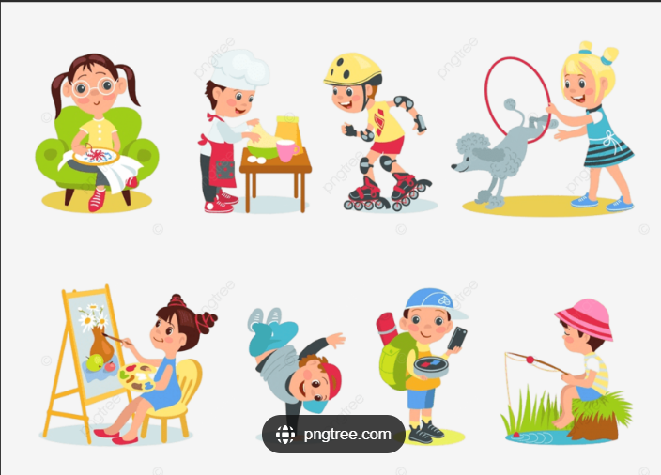
七选五
人与自我：Introduction to the significance and benefits of hobbies

Slide 21

Step1: 读大意、定结构
Hobbies are more than just a fun way to kill the time. A widespread and harmful misunderstanding is that engaging in hobbies mirrors a lack of self-discipline. 36 In fact, hobbies can provide essential balance in our lives and enhance overall well-being. The benefits you obtain will depend on your hobby-taking up jogging, for instance, will benefit your cardiovascular（心血管的）health more than, say, crossword puzzles, which may improve your cognitive health. The point is that nearly all hobbies can provide measurable positive health benefits.
If we regularly spend time on hobbies, we usually enjoy a higher level of fitness. 37 A 2023 comprehensive analysis of multiple studies found strong evidence that engaging in leisure activities can improve health by protecting against heart disease and age-related physical decline. The report, published in the journal Lancet Psychiatry, found that for people who were suffering from a chronic（慢性的）illness, doing a hobby helped them manage their symptoms and even slowed the progression of their illness. But another of the researchers’ findings is perhaps the most striking: the strong relationship between doing leisure activities and increased longevity（长寿）. 38 It found that older adults have a 19% lower risk of disease-related death when they engage in regular leisure activities.
39 . They are vital to sustaining our mental health. People who made a conscious effort each day to spend time doing hobbies (no matter what they were) showed an average boost of 8% in well-being and a 10% drop in stress and anxiety, according to a 2023 study published in the Journal of Personality. “On a fundamental level, humans need meaning, something that gives them a sense of purpose. 40 ” says Dr. Hafeez, who has led several massive studies on hobbies. “Engaging in what you enjoy greatly enhances your well-being.”
With all these visible benefits of hobbies, why not just make time for activities that bring you joy and fulfillment every day?
theme
benefits to
physical
health
benefits to
mental
Health 39?
appeal

Slide 22
Step2: 看选项、找关键
A. The science backs this up.
B. Hobbies make us happier.
C. You gain a lot from hobbies.
D. Nothing could be further from the truth.
E. The more you engage in hobbies, the longer you will live.
F. A different study conducted last year confirmed the impact.
G. And being able to pursue your passion really contributes to that.
支持
与事实大相径庭
句间衔接
指代、人称
词的对应

Slide 23
Step3: 看语篇、选项逐个击破
Hobbies are more than just a fun way to kill the time. A widespread and harmful misunderstanding is that engaging in hobbies mirrors a lack of self-discipline. 36 In fact, hobbies can provide essential balance in our lives and enhance overall well-being. The benefits you obtain will depend on your hobby-taking up jogging, for instance, will benefit your cardiovascular（心血管的）health more than, say, crossword puzzles, which may improve your cognitive health. The point is that nearly all hobbies can provide measurable positive health benefits.
同义复现 misunderstanding D 同义复现 truth
A. The science backs this up.
B. Hobbies make us happier.
C. You gain a lot from hobbies.
D. Nothing could be further from the truth.
E. The more you engage in hobbies, the longer you will live.
F. A different study conducted last year confirmed the impact.
G. And being able to pursue your passion really contributes to that.
支持

Slide 24
Step3: 看语篇、选项逐个击破
代词this A 例证
If we regularly spend time on hobbies, we usually enjoy a higher level of fitness. 37 A 2023 comprehensive analysis of multiple studies found strong evidence that engaging in leisure activities can improve health by protecting against heart disease and age-related physical decline. The report, published in the journal Lancet Psychiatry, found that for people who were suffering from a chronic（慢性的）illness, doing a hobby helped them manage their symptoms and even slowed the progression of their illness. But another of the researchers’ findings is perhaps the most striking: the strong relationship between doing leisure activities and increased longevity（长寿）. 38 .It found that older adults have a 19% lower risk of disease-related death when they engage in regular leisure activities.
例证 F 代词 意义一致
A. The science backs this up.
B. Hobbies make us happier.
C. You gain a lot from hobbies.
D. Nothing could be further from the truth.
E. The more you engage in hobbies, the longer you will live.
F. A different study conducted last year confirmed the impact.
G. And being able to pursue your passion really contributes to that.

Slide 25
Step3: 看语篇、选项逐个击破
主旨 B 同义替换 代词
39 .They are vital to sustaining our mental health. People who made a conscious effort each day to spend time doing hobbies (no matter what they were) showed an average boost of 8% in well-being and a 10% drop in stress and anxiety, according to a 2023 study published in the Journal of Personality. “On a fundamental level, humans need meaning, something that gives them a sense of purpose. 40 ” says Dr. Hafeez, who has led several massive studies on hobbies. “Engaging in what you enjoy greatly enhances your well-being.”
With all these visible benefits of hobbies, why not just make time for activities that bring you joy and fulfillment every day?
40 代词 G 同义替换
A. The science backs this up.
B. Hobbies make us happier.
C. You gain a lot from hobbies.
D. Nothing could be further from the truth.
E. The more you engage in hobbies, the longer you will live.
F. A different study conducted last year confirmed the impact.
G. And being able to pursue your passion really contributes to that.

Slide 26
语言知识梳理
同义词
1.important ____________________________________________
2.improve ____________________________________________________
3. health ____________________________________
4. striking _____________________________________
词形转换
5. measure v ______________adj
6. analyze v ______________ n
7. comprehend v _______________ n ________________ adj
一词多义
8. The clear water mirrors the blue sky.
The novel mirrors our life in varied angels .
This is almost the mirror image of the situation there .
9. drop the key /The book dropped off the shelf drop dead Water dropped
a drop of water eye/nose drops chocolate drops drop in magazine subscriptions
significant , essential , vital , crucial , critical
enhance , boost , promote , advance , facilitate , increase
wellness , fitness , hygiene
outstanding ， noticeable ， remarkable
measurable
analysis
comprehension
comprehensive
v.清澈的水映着蓝蓝的天
v. 小说从不同角度反映了我们的生活
n.这几乎是那里形势的翻版
巧克力糖

Slide 27
语言知识梳理
词汇翻译
enhance overall well-being
improve your cognitive health
an average boost of 8%
increase longevity
crossword puzzles
back sth up
kill the time
comprehensive analysis of multiple studies
age-related physical decline
a high/ fundamental level
make a conscious effort
engage in
The point/essence is that....
mirror a lack of self-discipline
pursue your passion
Nothing could be further from the truth
10.提升整体福祉
11.改善认知健康
12.平均8%的提升
13.延长寿命
14.填字游戏
15.支持某事(备份)
16.打发时间
17.对多项研究的综合分析
18.与身体相关的身体机能衰退
19.高水平/基础水平
20.刻意努力
21参与
22.重点是
23.反映自制力的缺乏
24.追求热情.
25与事实大相径庭

Slide 28
语法填空及长难句理解
（1）The benefits you obtain will depend on your hobby---________(take）up jogging, for instance, will benefit your cardiovascular health more than, say, crossword puzzles, _______may improve your cognitive health.
（2）A 2023 comprehensive __________（analyze） of multiple studies found strong evidence _______ engaging in leisure activities can improve health by protecting ________ heart disease and age-related physical decline.
（3）The report, ____________(publish) in the journal Lancet Psychiatry, found that for people who were suffering from a chronic illness, ________(do) a hobby helped them manage their symptoms ______even slowed the progression of their illness.
（4） People who made a conscious effort each day _________( spend) time doing hobbies (no matter what they were) ________ (show) an average boost of 8% in well-being and ____ 10% drop in stress and anxiety, according to a 2023 study published in the Journal of Personality.
（5） “On a fundamental level, humans need meaning, something________ gives them a sense of purpose” says Dr. Hafeez, who has led several massive studies on hobbies. “Engaging in ______you enjoy greatly enhances your well-being.”
（6）______all these visible benefits of hobbies, why not just ______ (make) time for activities that bring you joy and fulfillment every day?
taking
which
analysis
that
against
published
doing
and
to spend
showed
a
that
what
With
make

Slide 29

完型填空
人与自我： A mail carrier’s experience of meeting a vicious dog

Slide 30
Step1: 选项全击破
接受培训生
41. A. employer B. customer C. trainee D. neighbour
42. A. experience B. capability C. knowledge D. profession
43. A. kicked B. opened C. blocked D. approached
44. A. Until B. Before C. Since D. Immediately
45. A. failed B. managed C. attempted D. resolved
46. A. pushed B. tore C. threw D. speared
47. A. bond B. encounter C. disagreement D. competition
48. A. cornered B. discouraged C. squeezed D. accompanied
49. A. urged B. empowered C. directed D. persuaded
50. A. turn B. energy C. measure D. course
51. A. unique B. simple C. common D. frequent
52. A. plain B. sketched C. faded D. colored
53. A. hides B. signals C. flashes D. introduce
54. A. prospect B. occupation C. expectation D. intention
55. A. especially B. reasonably C. occasionally D. constantly
能力
靠近
决心
撕开
刺，戳
遭遇，邂逅
将…逼入死角
授权
课程，过程，路线，一道菜
素描，速写
前景，展望

Slide 31
Step2: 首尾定主题
If there’s one crucial lesson that Tara Snyder, a seasoned(有经验的) mail carrier for the U.S. Postal Service, reveals to every new ____41 , it’s this: “Even if a dog seems friendly for 364 days of the year, they can still have a bad day-and bite.”
Snyder speaks from 42 . In April 2024, while completing her usual route in Pennsylvania, she 43 a resident’s door to obtain a signature for a piece of mail. 44 she had time to react, a 70-pound dog charged out of the house and attacked her hand. She 45 to protect herself with her mailbag, but it was too late. “It 46 my hand open pretty severely,” she recalls. The injury required 17 stitches, a round of antibiotics, and three weeks off work to recover.
This wasn’t the first or last 47 between Snyder and aggressive dogs at tat residence. On a separate occasion, another dog 48 her on the porch, though fortunately, she wasn’t bitten that time. The incident has 49 Animal Control to investigate the owners, and the Postal Service is taking every 50 to protect its mail carriers. Sadly, Snyder’s story is far from 51 : according to Postal Service data, there were 5,800 reported dog-related incidents involving postal workers in 2023.
This brings us to the 52 paw-print stickers you may have noticed on mailboxes. An orange sticker 53 a dog resides at that address, while a yellow sticker shows that a dog lives nearby. The 54 _______was to warn Postal Service employees and other delivery workers to remain alert(警惕的), 55 around dogs with a known history of negative reactions to mail carriers.
trainee
a shared lesson
experience
approached
Before
attempted
tore
experiences
encounter
cornered
urged
measure
unique
colored
signals
intention
especially
solution

Slide 32
Step3: 主体找线索
If there’s one crucial lesson that Tara Snyder, a seasoned(有经验的) mail carrier for the U.S. Postal Service, reveals to every new ____41 , it’s this: “Even if a dog seems friendly for 364 days of the year, they can still have a bad day-and bite.”
Snyder speaks from 42 . In April 2024, while completing her usual route in Pennsylvania, she 43 a resident’s door to obtain a signature for a piece of mail. 44 she had time to react, a 70-pound dog charged out of the house and attacked her hand. She 45 to protect herself with her mailbag, but it was too late. “It 46 my hand open pretty severely,” she recalls. The injury required 17 stitches, a round of antibiotics, and three weeks off work to recover.
This wasn’t the first or last 47 between Snyder and aggressive dogs at tat residence. On a separate occasion, another dog 48 her on the porch, though fortunately, she wasn’t bitten that time. The incident has 49 Animal Control to investigate the owners, and the Postal Service is taking every 50 to protect its mail carriers. Sadly, Snyder’s story is far from 51 : according to Postal Service data, there were 5,800 reported dog-related incidents involving postal workers in 2023.
This brings us to the 52 paw-print stickers you may have noticed on mailboxes. An orange sticker 53 a dog resides at that address, while a yellow sticker shows that a dog lives nearby. The 54 _______was to warn Postal Service employees and other delivery workers to remain alert(警惕的), 55 around dogs with a known history of negative reactions to mail carriers.
trainee
experience
approached
Before
attempted
tore
encounter
cornered
urged
measure
unique
colored
signals
intention
especially

Slide 33
Step4 逻辑关系
If there’s one crucial lesson that Tara Snyder, a seasoned(有经验的) mail carrier for the U.S. Postal Service, reveals to every new ____41 , it’s this: “Even if a dog seems friendly for 364 days of the year, they can still have a bad day-and bite.”
Snyder speaks from 42 . In April 2024, while completing her usual route in Pennsylvania, she 43 a resident’s door to obtain a signature for a piece of mail. 44 she had time to react, a 70-pound dog charged out of the house and attacked her hand. She 45 to protect herself with her mailbag, but it was too late. “It 46 my hand open pretty severely,” she recalls. The injury required 17 stitches, a round of antibiotics, and three weeks off work to recover.
This wasn’t the first or last 47 between Snyder and aggressive dogs at tat residence. On a separate occasion, another dog 48 her on the porch, though fortunately, she wasn’t bitten that time. The incident has 49 Animal Control to investigate the owners, and the Postal Service is taking every 50 to protect its mail carriers. Sadly, Snyder’s story is far from 51 : according to Postal Service data, there were 5,800 reported dog-related incidents involving postal workers in 2023.
This brings us to the 52 paw-print stickers you may have noticed on mailboxes. An orange sticker 53 a dog resides at that address, while a yellow sticker shows that a dog lives nearby. The 54 _______was to warn Postal Service employees and other delivery workers to remain alert(警惕的), 55 around dogs with a known history of negative reactions to mail carriers.
trainee
experience
approached
Before
attempted
tore
转折关系
encounter
cornered
urged
measure
unique
colored
signals
并列关系
intention
especially
递进关系

Slide 34
语言知识梳理
1. 词汇积累
an experienced employee
既不独特也不完美 (far from)
The police cornered the suspect in a dark alley.
The company tried to corner the market
for a certain product
He cornered every street and alley of the
old town during his exploration.
a seasoned trainee
be far from unique or perfect
警察在一条黑暗的小巷里将嫌疑人逼入死角
这家公司试图垄断某种产品的市场.
在探索过程中，他已经熟悉了老城区的每一条街道和小巷。
2. 翻译 approach , fix , charge , tear
小狗缓缓走近，双眼紧盯着眼前的零食。毫无预兆地，它猛地向前冲去，动作迅速地将包装撕开，露出了它的奖赏。
inched close
As the dog slowly approached, its eyes fixed on the treat before it. Without warning, it charged forward and,
tore open the package swiftly , revealing its prize.
,prize exposed

Slide 35
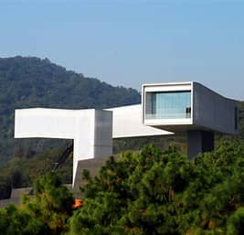
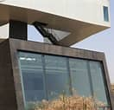
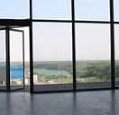
语法填空
人与社会：Introduction to the Sifang Art Museum, Nanjing

Slide 36
同位语
developer
In a forest on the outskirts of Nanjing, China, 58-year-old real-estate 56 (develop) Lu Jun, has his pride and joy the Sifang Art Museum, a 21,528-square-foot art space comprised of numerous 57 ________________(function) spaces, as well as permanent and temporary exhibition venues.
The museum 58 (form) by a field of parallel(平行的) perspective spaces and garden walls in black bamboo-formed concrete over which a light “figure” hovers. The straight passages on the ground level gradually turn into the 59 (wind) passage of the figure above. The upper gallery, 60 (suspend) high in the air, unwraps in a clockwise turning order and ends at “in-position” viewing of the city of Nanjing in the distance.
The courtyard is paved with Old Hutong bricks recycled 61 the destroyed courtyards in the center of Nanjing. Limiting the colors of the museum to black and white matches it to the ancient buildings in the city, and 62 (give) a background to the artwork to be exhibited within.
The Sifang Parkland is about the experience. The site is a living, ever-evolving project that waits ______63 (experience) personally, as each visit will give a different, individual journey. Art and architecture exist harmoniously with nature here, and visitors can not only experience contemporary architectural spaces and art works, 64 seek spiritual satisfaction away from the maddening noise of urban centers.
China’s wealthy people like Mr. Lu are underwriting 65 major cultural boom, spending billions of yuan on grand buildings to showcase impressive collections of art, antiques and other cultural rarities.
形容词修饰名词
functional
is formed
谓语动词
winding
suspended
形容词修饰名词
非谓语，过去分词做定语
介词搭配
from
gives
谓语并列
to be experienced
非谓语 不定式被动
but
Not only …but (also )并列
a
不定冠词

Slide 37
1.形容词学习
numerous functional spaces
permanent and temporary exhibition venues
the straight /winding passages
a clockwise turning order
a living, ever-evolving project
a different, individual journey
spiritual satisfaction
the maddening noise
in- position viewing
2. 非谓语做定语
art space ___________(comprise) of numerous functional spaces,
the upper gallery _________(suspend) high in the air
give a background to the artwork________________ (exhibit)next week .
bricks ________(recycle) from the destroyed courtyards
a project ________(wait) to be experienced
a courtyard ________(pave) with red bricks
语言知识梳理
很多的功能性空间
永久和暂时展览场馆
笔直的/蜿蜒的通道
顺时针转动的顺序
一个具有生命力，不断发展的项目
一段不同的个人旅程
精神上的满足
让人发狂的噪音
静观
comprised
suspended
to be exhibited
recycled
waiting
paved

Slide 38
语言知识梳理
3.词组翻译
一位房地产开发商
展览场馆
平行透视空间场
黑竹形成的混泥土花园墙
一个轻盈的身影在花园墙上盘旋.
铺满
将… 限制在
与自然和谐共存
一个有生命力，不断进化/发展的项目
寻求远离让人发狂的噪音的精神上的满足
为文化繁荣提供财力支持
展示文化珍品.
a real-estate developer
exhibition venues
a field of parallel perspective spaces
garden walls in black bamboo-formed concrete
A light "figure" hovers over the garden walls.
be paved with
limit ...to...
exist harmoniously with nature
a living, ever-evolving project
seek spiritual satisfaction away from the maddening noise
underwrite a cultural boom
showcase cultural rarities

Slide 39
文本再填空
In a forest on the outskirts of Nanjing, China, 58-year-old real-estate developer Lu Jun, has his pride and joy the Sifang Art Museum, a 21,528-square-foot art space ___________（comprise） of numerous functional spaces, as well as permanent and temporary exhibition ______(venue).
The museum is formed by a field of parallel(平行的) perspective spaces and garden walls in black bamboo-formed concrete over _____a light “figure” hovers. The straight passages on the ground level gradually turn into the winding passage of the figure above. The upper gallery, suspended high in the air, unwraps in a clockwise turning order and _____(end) at “in-position” viewing of the city of Nanjing in the distance.
The courtyard is paved with Old Hutong bricks recycled from the _______(destroy)courtyards in the center of Nanjing. Limiting the colors of the museum ___black and white matches it to the ancient buildings in the city, and gives a background to the artwork____________（exhibit） within.
The Sifang Parkland is about the experience. The site is a living, ever-evolving project that waits to be experienced personally, _____each visit will give a different, individual journey. Art and architecture exist harmoniously with nature here, and visitors can not only experience contemporary architectural spaces and art works, but seek ________(spirit) satisfaction away from the maddening noise of urban centers.
China’s wealthy people like Mr. Lu are underwriting a major cultural boom, spending billions of yuan on grand buildings to showcase impressive collections of art, antiques and other cultural _______(rare).
comprised
venues
which
ends
destroyed
to
to be exhibited
as
spiritual
rarities

Slide 40
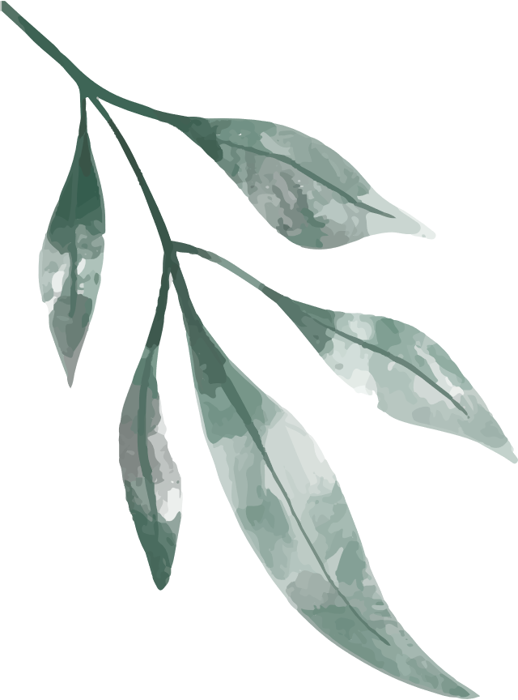
Thanks
for your attention

