Slide 1


感恩遇见，相互成就，本课件资料仅供您个人参考、教学使用，严禁自行在网络传播，违者依知识产权法追究法律责任。
更多教学资源请关注
公众号：溯恩英语
知识产权声明

Slide 2

Suggestion on Volunteer Work
——2024.12 Z20高三联考应用文

Slide 3

Lead-in
Have you ever participated in volunteer work?
Why do you choose to take part in it?
What key factors should be considered when choosing volunteer work?

Slide 4

When choosing volunteer work, several key factors should be considered:
‌Clear Motivation and Purpose‌: Understand why you want to volunteer and ensure your motivation aligns with the work.
‌Personal Conditions‌: Assess your physical health, family support, and availability to commit time to volunteering.
‌Required Skills and Abilities‌: Ensure you have the necessary qualities and skills for the volunteer role.
‌Volunteer Support‌: Check for provided support such as insurance, logistics, and training.
‌Time and Location‌: Consider the scheduling and location of the volunteer work to ensure compatibility with your personal arrangements.

Slide 5

Before writing
假设你是李华，你校下周日有两个志愿者活动同时举行，一个在火车站，另一个在市文化博物馆。你的交换生朋友Peter不知道选择哪一个参加，写信向你寻求建议。请你写一封回信，内容包括：
1.给出建议；
2.说明理由。
注意：
1.写作词数应为80左右；
2.请按如下格式在答题纸的相应位置作答。
suggestion/recomendation letter
What’s the writing purpose of this E-mail?
Who is the receiver ?
What should we write ?

Slide 6
What should we write and how to arrange them in a logical way?
Greeting
P1
backgound information
writing purpose:recommendation/suggestion
general
positive:
negative
person →activity
P2
reasons of
the suggestion?
personality interest
chance
benefit
specific
P3
hope/promise/anticipation/wish

Slide 7
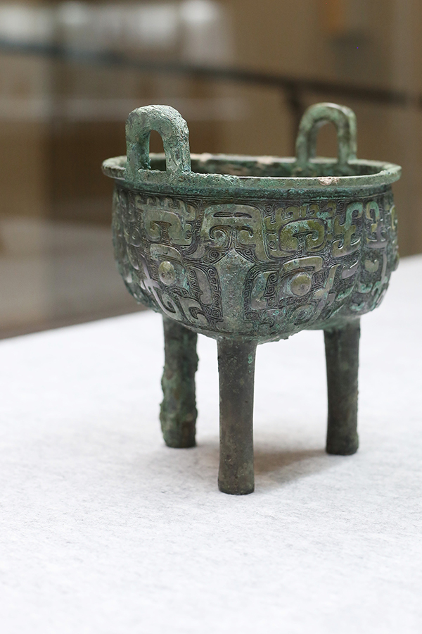
Brainstorm
the benefits of volunteer work at local cultural museum
Knowledge
Capability
expand your horizons beyond textbooks
deepen your understanding of local culture
fit for someone with your curiosity and passion for learning
hone your communication skills ；improve the comprehensive capability/literacy
enhance problem-solving skills
foster patience and a sense of service

Slide 8

Brainstorm
the benefits of volunteer work at the railway station
Chance
Capability
provide an excellent opportunity to serve the community and assist travelers
be a great way to meet new people from all walks of life
build valuable connections and even potential job opportunities in the future
foster a sense of belonging and social responsibility
effectively interact with diverse individuals
manage unexpected situations,
navigate busy environments,
enhance personal and professional capabilities.

Slide 9
During writing
Write and Appreciate
P1
Greeting +backgound information,writing purpose
I hope this letter finds you well. Given that you are bothered by how to choose between the two volunteer activities, I’d like to recommend the activity at the city cultural museum.
I hope this letter finds you well. I was delighted to receive your letter seeking advice on which volunteer activity to participate in next Sunday.Thinking twice, I would like to recommend the volunteer opportunity at the city cultural museum.

Slide 10
During writing
positive:
negative
person →activity
general
P2
personality interest
chance
benefit
reasons of
the suggestion
specific
The reasons are as follows.To begin with,since you’re enthusiastic about Chinese local traditional culture, volunteering in the cultural museum is bound to offer you a fabulous and immersive experience during your exchange programme. Plus,through interacting with museum visitors, ranging from children to seniors, not only will you hone your communication skills, but you can also improve the comprehensive capability. Compared with the volunteer work at the railway station,guiding passengers, assisting with ticket purchases, maintaining order, and other repetitive duties, volunteer work at the museum is a choice second to none.

Slide 11
During writing
P3
hope/promise/anticipation/wish
I sincerely hope that my above suggestion can be beneficial to you. Feel free to reach out if you have any questions.Eager for your sharing about the approaching volunteer experience. All the best!
Should you have any further questions or need additional guidance, please don't hesitate to reach out.Eager to hear your decision and wish you a rewarding volunteer experience next Sunday!

Slide 12
Sample writing one
Dear Peter,
Thanks for reaching out! If I were in your shoes, I’d recommend the activity at the train station.
It offers a fantastic opportunity to interact with travelers, assisting them with directions, tickets, and luggage. The bustling atmosphere is not only engaging but also enriching, offering a chance to enhance both communication and problem-solving skills.
While the museum activity is also meaningful, it focuses more on quieter tasks like organizing exhibits or guiding visitors. At the train station, you’ll enjoy a more dynamic and hands-on experience, where your outgoing personality can truly shine as you connect with people from all walks of life.
Let me know if you need any more information.
Yours,
Li Hua

Slide 13
Sample writing two
Dear Peter,
I hope you’re doing well! I’d recommend joining in the volunteer activity at the city’s cultural museum.
With your interest in history and art, I think you’d find this setting more rewarding and better suited to your personality. At the museum, you’ll have the chance to guide visitors, share fascinating stories, and deepen your understanding of local culture — a perfect fit for someone with your curiosity and passion for learning.
While the train station activity offers a lively, fast-paced environment, it focuses more on logistics and quick interactions. In contrast, the museum allows for in-depth conversations and meaningful connections, giving you a chance to really engage with visitors and make an impact.
Feel free to reach out if you have any questions.
Yours,
Li Hua

Slide 14
Sample writing three
Dear Peter,
I hope this letter finds you well. Given that you are bothered by how to choose between the two volunteer activities, I’d like to recommend the activity at the city cultural museum.The reasons are as follows.
To begin with,since you’re enthusiastic about Chinese local traditional culture, volunteering in the cultural museum is bound to offer you a fabulous and immersive experience during your exchange programme. Plus,through interacting with museum visitors, ranging from children to seniors, not only will you hone your communication skills, but you can also improve the comprehensive capability.
Compared with the volunteer work at the railway station,guiding passengers, assisting with ticket purchases, maintaining order, and other repetitive duties, volunteer work at the museum is a choice second to none.
I sincerely hope that my above suggestion can be beneficial to you. Feel free to reach out if you have any questions.Eager for your sharing about the approaching volunteer experience. All the best!
Yours,
Li Hua

Slide 15
After writing
Reflection
Have we achieved our writing purpose ?
If you were Peter, would you find it beneficial and persuasive?

