Slide 1


感恩遇见，相互成就，本课件资料仅供您个人参考、教学使用，严禁自行在网络传播，违者依知识产权法追究法律责任。
更多教学资源请关注
公众号：溯恩英语
知识产权声明

Slide 2

T8
读后续写
讲评
What information can you get from the picture?
How will you feel if there’s someone like him in your class?
How about in your family?
Do you want to be a straight-A student like him? Why (not)?
What should you do to make it?

Slide 3

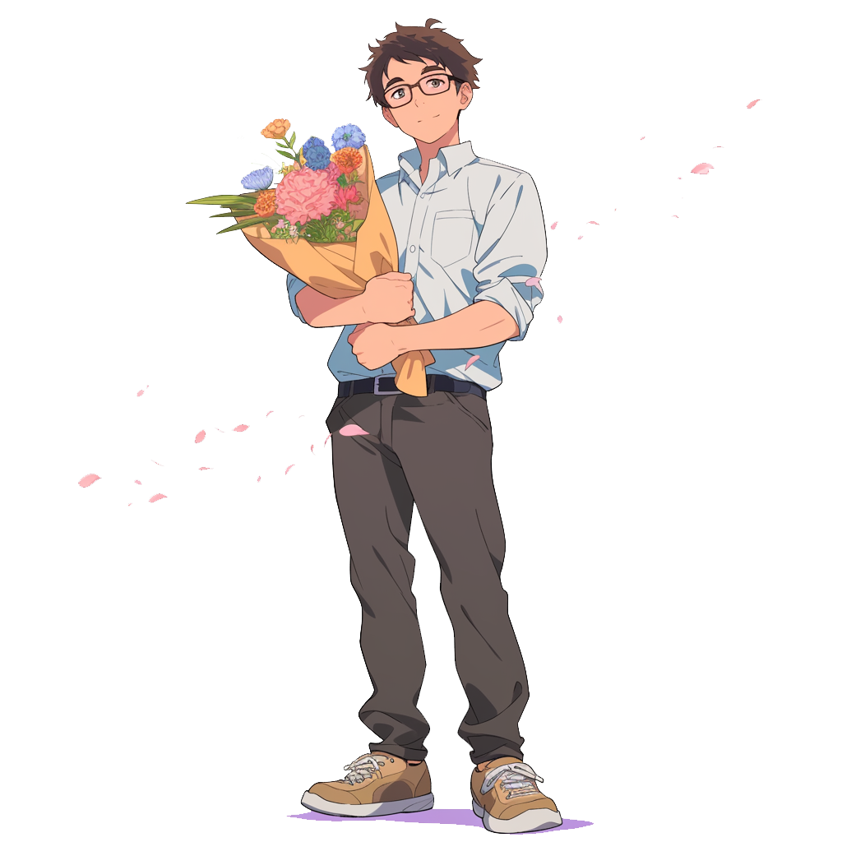
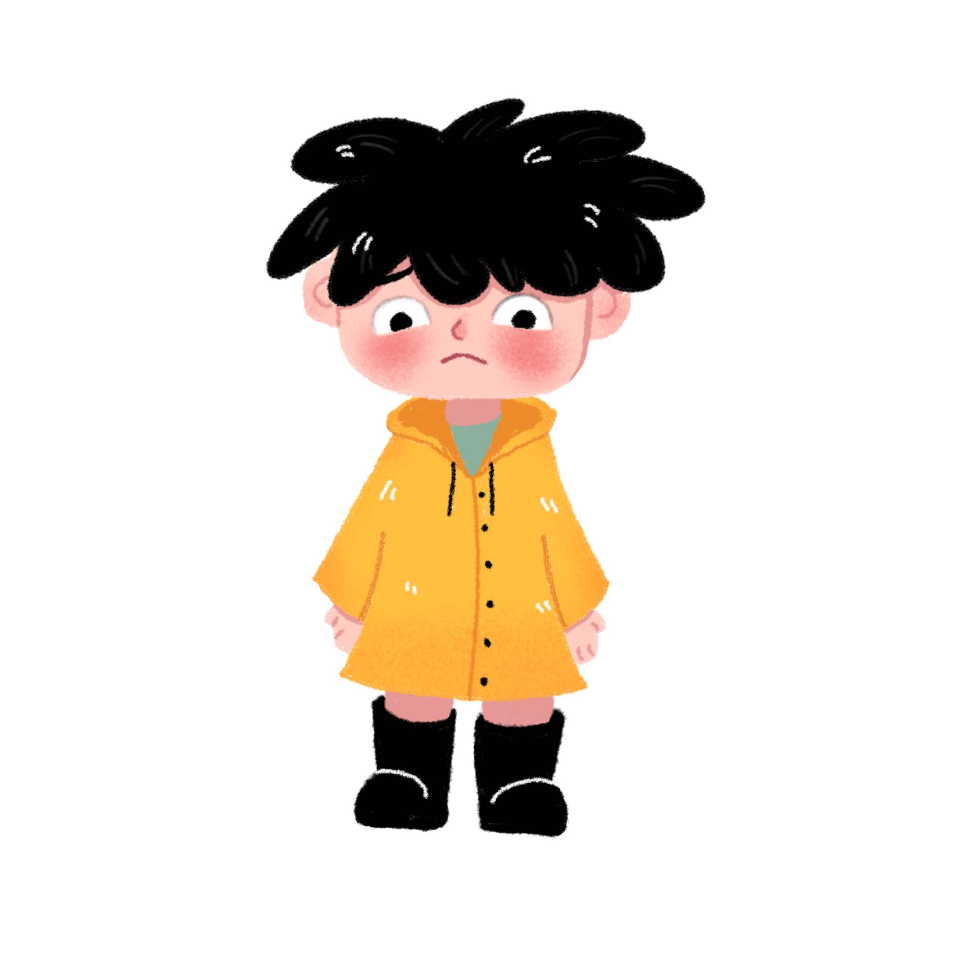

原题呈现：
My brother Jack was so smart that he earned a full scholarship to Harvard. I often wished he wasn’t so perfect because it made me feel like I had to work twice as hard just to prove myself to others. On one hand, his success was a challenge that I enjoyed, but on the other hand, it was an immense pressure that I struggled to cope with.
To balance his record in high school, I felt like I was constantly running on a treadmill (跑步机), dedicating every moment to a non-stop race. There was no room for relaxation as I pursued that perfect record. My life seemed to be compressed, into a series of endless tasks and deadlines.
“I needed an A,” I repeated to myself before the biology test, so that I would maintain my perfect record and secure a place on the honor roll. I studied till the last minute of lunch and rushed to class. I felt a sense of confidence as I glanced over the first page of the test, quickly filling in the answers with a smile. However, as I turned to the last page, my mind went blank. Time ticked by, and soon, the classroom began to empty as students finished their tests and left, except me. “Lara, class ended. I need you to hand in your test,” Mrs. Phloem said, stretching out her hand. Reluctantly, I handed her the test paper.
The next day, I received my test back. I stared dumbfounded at the red mark: 76. Not even a B minus, my mind screamed. Just average. It’s over. No perfect record. I felt an unprecedented (前所未有的) sense of frustration and disappointment. After school, I dragged my heavy feet back home. When I pushed open the door, Jack was sitting on the couch, reading. Seeing his leisurely state, I cried, hard to contain the jealousy and sadness in my heart. Jack immediately noticed the depression on my face. He asked with concern, “What’s wrong, Lara?” Blinded by frustration mixed with a touch of jealousy, I shouted at him “How I wish you were not so perfect!”
Paragraph 1. With a hint of hurt and surprise in his eyes, Jack gently approached me.
Paragraph 2. His words were like a warm breeze, blowing my depression away and changing my mindset.
原题呈现：
My brother Jack was so smart that he earned a full scholarship to Harvard. I often wished he wasn’t so perfect because it made me feel like I had to work twice as hard just to prove myself to others. On one hand, his success was a challenge that I enjoyed, but on the other hand, it was an immense pressure that I struggled to cope with.
To balance his record in high school, I felt like I was constantly running on a treadmill (跑步机), dedicating every moment to a non-stop race. There was no room for relaxation as I pursued that perfect record. My life seemed to be compressed, into a series of endless tasks and deadlines.
“I needed an A,” I repeated to myself before the biology test, so that I would maintain my perfect record and secure a place on the honor roll. I studied till the last minute of lunch and rushed to class. I felt a sense of confidence as I glanced over the first page of the test, quickly filling in the answers with a smile. However, as I turned to the last page, my mind went blank. Time ticked by, and soon, the classroom began to empty as students finished their tests and left, except me. “Lara, class ended. I need you to hand in your test,” Mrs. Phloem said, stretching out her hand. Reluctantly, I handed her the test paper.
The next day, I received my test back. I stared dumbfounded at the red mark: 76. Not even a B minus, my mind screamed. Just average. It’s over. No perfect record. I felt an unprecedented (前所未有的) sense of frustration and disappointment. After school, I dragged my heavy feet back home. When I pushed open the door, Jack was sitting on the couch, reading. Seeing his leisurely state, I cried, hard to contain the jealousy and sadness in my heart. Jack immediately noticed the depression on my face. He asked with concern, “What’s wrong, Lara?” Blinded by frustration mixed with a touch of jealousy, I shouted at him “How I wish you were not so perfect!”
Paragraph 1. With a hint of hurt and surprise in his eyes, Jack gently approached me.
Paragraph 2. His words were like a warm breeze, blowing my depression away and changing my mindset.
原题呈现：
My brother Jack was so smart that he earned a full scholarship to Harvard. I often wished he wasn’t so perfect because it made me feel like I had to work twice as hard just to prove myself to others. On one hand, his success was a challenge that I enjoyed, but on the other hand, it was an immense pressure that I struggled to cope with.
To balance his record in high school, I felt like I was constantly running on a treadmill (跑步机), dedicating every moment to a non-stop race. There was no room for relaxation as I pursued that perfect record. My life seemed to be compressed, into a series of endless tasks and deadlines.
“I needed an A,” I repeated to myself before the biology test, so that I would maintain my perfect record and secure a place on the honor roll. I studied till the last minute of lunch and rushed to class. I felt a sense of confidence as I glanced over the first page of the test, quickly filling in the answers with a smile. However, as I turned to the last page, my mind went blank. Time ticked by, and soon, the classroom began to empty as students finished their tests and left, except me. “Lara, class ended. I need you to hand in your test,” Mrs. Phloem said, stretching out her hand. Reluctantly, I handed her the test paper.
The next day, I received my test back. I stared dumbfounded at the red mark: 76. Not even a B minus, my mind screamed. Just average. It’s over. No perfect record. I felt an unprecedented (前所未有的) sense of frustration and disappointment. After school, I dragged my heavy feet back home. When I pushed open the door, Jack was sitting on the couch, reading. Seeing his leisurely state, I cried, hard to contain the jealousy and sadness in my heart. Jack immediately noticed the depression on my face. He asked with concern, “What’s wrong, Lara?” Blinded by frustration mixed with a touch of jealousy, I shouted at him “How I wish you were not so perfect!”
Paragraph 1. With a hint of hurt and surprise in his eyes, Jack gently approached me.
Paragraph 2. His words were like a warm breeze, blowing my depression away and changing my mindset.
原题呈现：
My brother Jack was so smart that he earned a full scholarship to Harvard. I often wished he wasn’t so perfect because it made me feel like I had to work twice as hard just to prove myself to others. On one hand, his success was a challenge that I enjoyed, but on the other hand, it was an immense pressure that I struggled to cope with.
To balance his record in high school, I felt like I was constantly running on a treadmill (跑步机), dedicating every moment to a non-stop race. There was no room for relaxation as I pursued that perfect record. My life seemed to be compressed, into a series of endless tasks and deadlines.
“I needed an A,” I repeated to myself before the biology test, so that I would maintain my perfect record and secure a place on the honor roll. I studied till the last minute of lunch and rushed to class. I felt a sense of confidence as I glanced over the first page of the test, quickly filling in the answers with a smile. However, as I turned to the last page, my mind went blank. Time ticked by, and soon, the classroom began to empty as students finished their tests and left, except me. “Lara, class ended. I need you to hand in your test,” Mrs. Phloem said, stretching out her hand. Reluctantly, I handed her the test paper.
The next day, I received my test back. I stared dumbfounded at the red mark: 76. Not even a B minus, my mind screamed. Just average. It’s over. No perfect record. I felt an unprecedented (前所未有的) sense of frustration and disappointment. After school, I dragged my heavy feet back home. When I pushed open the door, Jack was sitting on the couch, reading. Seeing his leisurely state, I cried, hard to contain the jealousy and sadness in my heart. Jack immediately noticed the depression on my face. He asked with concern, “What’s wrong, Lara?” Blinded by frustration mixed with a touch of jealousy, I shouted at him “How I wish you were not so perfect!”
Paragraph 1. With a hint of hurt and surprise in his eyes, Jack gently approached me.
Paragraph 2. His words were like a warm breeze, blowing my depression away and changing my mindset.
How would you describe Jack?
Any supporting details?
How did “I” feel about him?
If you were him, will you feel the same?
What did “I” do ?
How would you describe “I” ?
Did it work out well?
How did “my” feeling change?
How did Jack react to “my”
burst of emotions?
What kind of person is Jack?
enjoy the challenge but feel stressed
Stage 1:
Analyze the original article for:
the characters’ personality
change of feelings
actions and reactions
linguistic features like contrast (show development of story and personality) and short sentences (create rhythm and show a particular emotional burst)
be narrowed down in size
confident at first
nervous and stressed out
dumbfounded
frustrated and disappointed
jealous, sad and depressed

Slide 4
Stage 2:
Brainstorm the possible development of the story
feelings
actions and reactions
contrasts show development of story and personality
imitation of the language
Paragraph 1. With a hint of hurt and surprise in his eyes, Jack gently approached me.
Paragraph 2. His words were like a warm breeze, blowing my depression away and changing my mindset.
Paragraph 1. With a hint of hurt and surprise in his eyes, Jack gently approached me.
Paragraph 2. His words were like a warm breeze, blowing my depression away and changing my mindset.
1. Jack asked me about what had happened.
2. I told Jack about my failure in the test.
3. Jack comforted me.
actions:
patted me on the shouder, held me by the hand...
words:
I didn't mean to make you feel this way. We're siblings. We're supposed to support each other, not compete.
You have your own strengths and abilities, and you don't need to prove anything to anyone. Just focus on being the best version of yourself, and everything else will fall into place.

Slide 5
Stage 2:
Brainstorm the possible development of the story
feelings
actions and reactions
contrasts show development of story and personality
imitation of the language
Paragraph 1. With a hint of hurt and surprise in his eyes, Jack gently approached me.
Paragraph 2. His words were like a warm breeze, blowing my depression away and changing my mindset.
1. Jack asked me about what had happened.
2. I told Jack about my failure in the test.
3. Jack comforted me.
1. I began change myself in reality.
2. Jack supported me to become a better self.
3. I reflected on this experience and learnt a life lesson.
learn to embrace his own strengths and weaknesses, recognizing that true success is not about being perfect but about growing and improving in his own unique way.

Slide 6
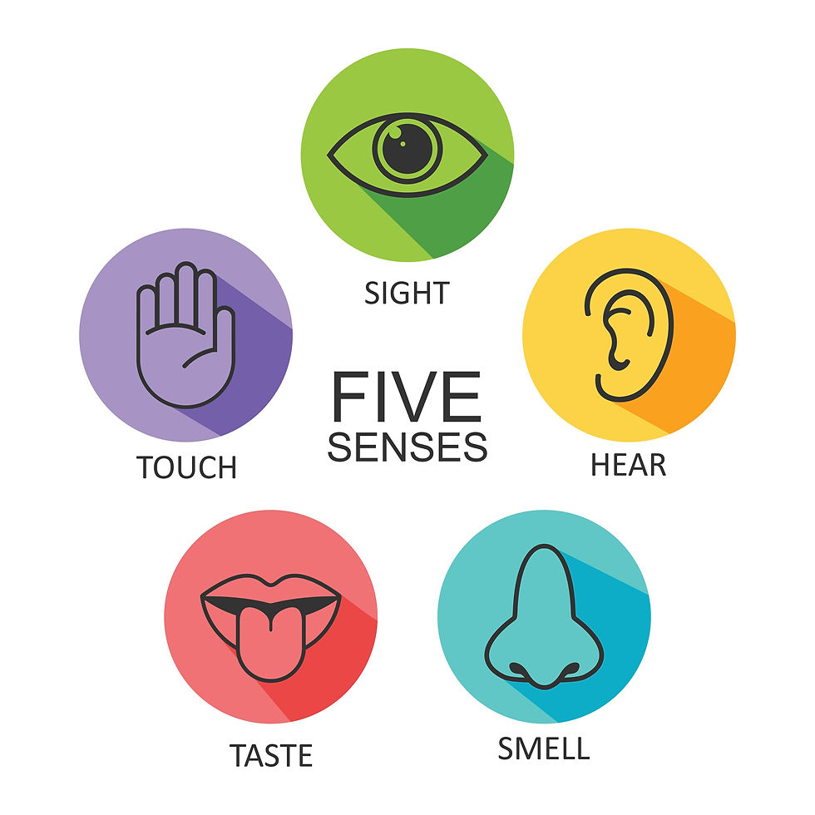
Use five senses to describe how Jack comforted “me”
He stood before me, his expression a mix of concern and empathy, his brow furrowed (皱眉) in genuine worry.
Jack approached me with comforting eyes, gently placing a hand on my shoulder.
Jack’s voice was soft as he asked, “What’s wrong?” with concern in his tone.
Jack’s hand lightly held mine, sending a comforting warmth through my body.
His soothing voice broke the silence, “You’re not alone. I’m here for you.”
He wrapped an arm around my shoulders, pulling me into a comforting embrace.
Jack’s presence and words were like a sweet balm (香油；镇痛剂), healing my wounded heart/ weaving my shattered heart.
Jack’s familiar scent approached as he came closer, soothing my tense nerves.

Slide 7
Use contrast to show the difference and development
In contrast to my constant striving for perfection, Jack’s calm manner and acceptance of his own successes seemed to come effortlessly. It was just a reminder of how differently we approached life’s challenges.
My brother’s ease in his accomplishments was a contrast to my own internal struggle, making me realize that I needed to find a balance between striving and acceptance.
Jack’s gentle words sparked a flicker of hope that perhaps I didn’t have to be perfect to be loved and accepted.
As Jack spoke softly, his words seemed to penetrate the armor (盔甲) of my frustration, revealing a vulnerability I hadn’t acknowledged before. It was a turning point in my journey of self-discovery.

Slide 8
With a hint of hurt and surprise in his eyes, Jack gently approached me. He placed his book aside as he sat beside me on the couch. “What’s going on?” he asked softly, his voice tinged with concern. My tears welled up as I looked at him, all the frustration and jealousy I had been holding in spilling out in an instant. “How could you be so perfect?” I cried, feeling a mix of anger and sorrow. Jack’s face fell, and he looked at me with a puzzled expression. “I didn’t mean to make you feel this way,” he said, his voice trembling slightly. “We’re siblings. We’re supposed to support each other, not compete. My achievements are not a threat to yours; they’re just a part of my journey. You have your own path to follow, and I believe in you.”
His words were like a warm breeze, blowing my depression away and changing my mindset. Instead of focusing on his successes and feeling inferior, I decided to channel my energy into pursuing my own goals and dreams. Jack was always there to support me, offering encouragement and advice whenever I needed it. With his support, I started to believe in myself more, and I began to see progress in my own endeavors. Through this experience, I learned that true success isn’t about competing with others or achieving perfection; it’s about being the best version of yourself and finding happiness and fulfillment in your own unique path. It was also due to Jack’s unwavering support and kindness that taught me true sibling bonds are built on mutual respect and encouragement, not on comparisons or jealousy.
With a hint of hurt and surprise in his eyes, Jack gently approached me. He placed his book aside as he sat beside me on the couch. “What’s going on?” he asked softly, his voice tinged with concern. My tears welled up as I looked at him, all the frustration and jealousy I had been holding in spilling out in an instant. “How could you be so perfect?” I cried, feeling a mix of anger and sorrow. Jack’s face fell, and he looked at me with a puzzled expression. “I didn’t mean to make you feel this way,” he said, his voice trembling slightly. “We’re siblings. We’re supposed to support each other, not compete. My achievements are not a threat to yours; they’re just a part of my journey. You have your own path to follow, and I believe in you.”
His words were like a warm breeze, blowing my depression away and changing my mindset. Instead of focusing on his successes and feeling inferior, I decided to channel my energy into pursuing my own goals and dreams. Jack was always there to support me, offering encouragement and advice whenever I needed it. With his support, I started to believe in myself more, and I began to see progress in my own endeavors. Through this experience, I learned that true success isn’t about competing with others or achieving perfection; it’s about being the best version of yourself and finding happiness and fulfillment in your own unique path. It was also due to Jack’s unwavering support and kindness that taught me true sibling bonds are built on mutual respect and encouragement, not on comparisons or jealousy.
With a hint of hurt and surprise in his eyes, Jack gently approached me. He placed his book aside as he sat beside me on the couch. “What’s going on?” he asked softly, his voice tinged with concern. My tears welled up as I looked at him, all the frustration and jealousy I had been holding in spilling out in an instant. “How could you be so perfect?” I cried, feeling a mix of anger and sorrow. Jack’s face fell, and he looked at me with a puzzled expression. “I didn’t mean to make you feel this way,” he said, his voice trembling slightly. “We’re siblings. We’re supposed to support each other, not compete. My achievements are not a threat to yours; they’re just a part of my journey. You have your own path to follow, and I believe in you.”
His words were like a warm breeze, blowing my depression away and changing my mindset. Instead of focusing on his successes and feeling inferior, I decided to channel my energy into pursuing my own goals and dreams. Jack was always there to support me, offering encouragement and advice whenever I needed it. With his support, I started to believe in myself more, and I began to see progress in my own endeavors. Through this experience, I learned that true success isn’t about competing with others or achieving perfection; it’s about being the best version of yourself and finding happiness and fulfillment in your own unique path. It was also due to Jack’s unwavering support and kindness that taught me true sibling bonds are built on mutual respect and encouragement, not on comparisons or jealousy.
With a hint of hurt and surprise in his eyes, Jack gently approached me. He placed his book aside as he sat beside me on the couch. “What’s going on?” he asked softly, his voice tinged with concern. My tears welled up as I looked at him, all the frustration and jealousy I had been holding in spilling out in an instant. “How could you be so perfect?” I cried, feeling a mix of anger and sorrow. Jack’s face fell, and he looked at me with a puzzled expression. “I didn’t mean to make you feel this way,” he said, his voice trembling slightly. “We’re siblings. We’re supposed to support each other, not compete. My achievements are not a threat to yours; they’re just a part of my journey. You have your own path to follow, and I believe in you.”
His words were like a warm breeze, blowing my depression away and changing my mindset. Instead of focusing on his successes and feeling inferior, I decided to channel my energy into pursuing my own goals and dreams. Jack was always there to support me, offering encouragement and advice whenever I needed it. With his support, I started to believe in myself more, and I began to see progress in my own endeavors. Through this experience, I learned that true success isn’t about competing with others or achieving perfection; it’s about being the best version of yourself and finding happiness and fulfillment in your own unique path. It was also due to Jack’s unwavering support and kindness that taught me true sibling bonds are built on mutual respect and encouragement, not on comparisons or jealousy.
Stage 3:
对标阅卷标准，查漏补缺
内容；词汇、语法；语篇
(1)续写内容的质量、完整性以及与原文情境的融洽度。
(2)所使用词汇和语法结构的准确性，恰当性和多样性。
(3)上下文的衔接和全文的连贯性。

Slide 9
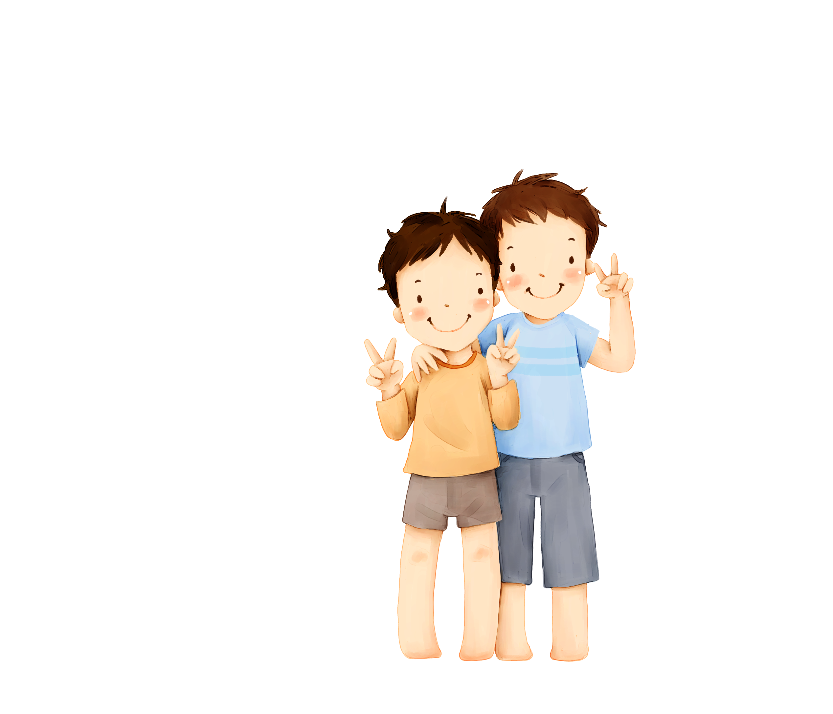
A possible version:
With a hint of hurt and surprise in his eyes, Jack gently approached me. He placed a hand on my shoulder, asked me again what had happened. I took out my test paper and told him that I would never match up to him in a choked voice. Jack’s smile grew warmer, and he gave my shoulder a reassuring squeeze. “You don’t have to measure up to anyone and your worth isn’t defined by grades or achievements. You’re more than just a number on a test. Remember that be yourself; everyone else is already taken.”
His words were like a warm breeze, blowing my depression away and changing my mindset. I was still engaged in endless tasks and deadlines, but I no longer felt constrained by my brother’s shadow. Realizing that comparison is the thief of joy, I strove for excellence instead of perfection, which is often unattainable and can lead to burnout. I felt a weight lifted off my shoulders as I realized that my value wasn’t tied to a single test score. I felt more confident and less overwhelmed as I know that believing in doing my best will always be the ultimate best score.

