Slide 1



感恩遇见，相互成就，本课件资料仅供您个人参考、教学使用，严禁自行在网络传播，违者依知识产权法追究法律责任。
更多教学资源请关注
公众号：溯恩英语
知识产权声明

Slide 2







巧用契诃夫法则，使续写山无遮海无拦
读后续写入门课（Starter Class）
（适用于高一一段式读后续写）
---以杭州市2023-2024学年高一下学期期末考读后续写为例
杭州二中树兰高级中学 郭合英

Slide 3

文本解读
契诃夫法则的妙用
Learning objectives
语言协同
范文欣赏

Slide 4
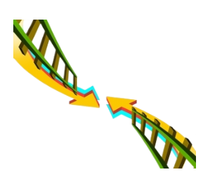


What is continuation writing?
读后续写的题型要求：
提供一段 以内的语言材料，以 为主，故事情节 、故事线索 比较强。
考生需依据 和所给 进行续写(高二高三150词左右,高一100词左右)，将其发展成一篇与给定材料 、 和
的短文。
350词
记叙文
输入
阅读
曲折起伏
逻辑性
段落开头语
材料内容
输出
有衔接
有合理情节
结构
续写
完整

Slide 5


0
写前注意事项

Slide 6

读后续写四大原则
要体现正能量，弘扬社会主义核心价值观
与原文时态一致
与原文
一致原则
正能量
原则
与原文语言风格一致
原文
与原文情节发展保持一致
曲折性
原则
两条线
与原文冲突/
矛盾一致
故事曲说：越是跌宕起伏的故事，越能激发读者的兴趣。比如：悬念法、巧合法、欧亨利式等等
情节线
情感线
与原文主题一致

Slide 7
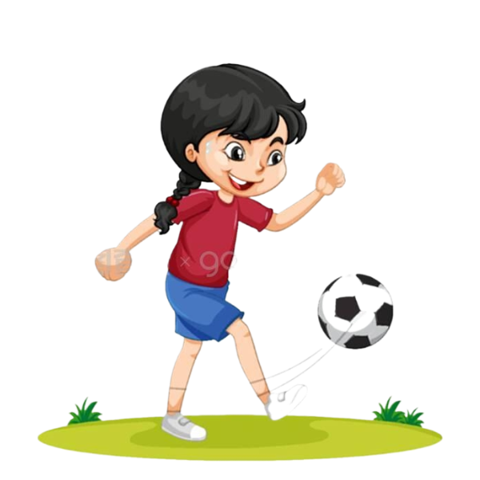
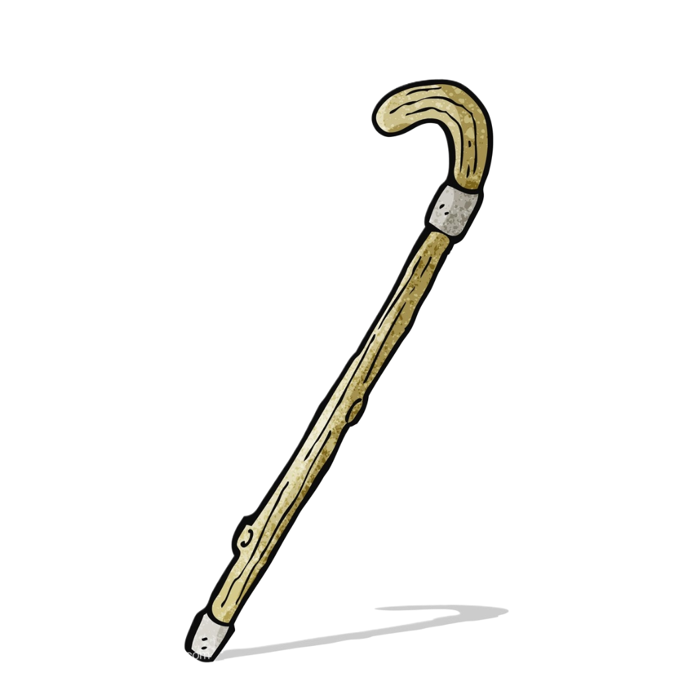
1
文本解读

Slide 8
第二节 读后续写（满分15分） 阅读下面材料，根据其内容和所给段落开头语续写一段，使之构成一篇完整的短文。
Once upon a time, there was a girl named Sara. She had a passion for soccer that burned brighter than any other flame in her heart. However, Sara faced a big challenge—her legs were not as strong as her friends, requiring her to rely on crutches (拐杖) for support.
Sara’s friends gathered on the soccer field every day, their laughter and shouts of excitement filling the air. She watched them with envy, longing to join in their games. But whenever she tried to play, the reality of her limitations would hit her hard, and she would feel a wave of disappointment. Despite this, Sara refused to let her dreams die. She loved soccer with all her heart, and she was determined not to give up.
One day, the school announced an important soccer match. Sara’s heart skipped a beat when she heard the news. She wanted to participate more than anything, but she knew that many kids would doubt her abilities because of her legs. Instead of giving up to their doubts, Sara chose to accept them as a source of strength.

Slide 9
She began practising hard every day after school. Using her crutches, she kicked the ball with all her strength, gradually mastering the art of balancing herself. Sometimes, she would fall down, but each time, she would pick herself up with determination. Her face would be sweaty and dirty, but her eyes would shine with determination.
Finally, the day arrived. Sara’s team had made it to the final match, and she had been given a chance to play. The crowd roared with excitement as she took her position on the field. Everyone cheered her on, their voices a mix of encouragement and admiration. Although Sara couldn’t run like the others, she used her skills and wisdom to pass the ball, her crutches becoming her secret weapon (武器) on the field.
注意：
1. 续写词数应为100左右；
2. 请按如下格式在答题纸的相应位置作答.
In the last moments, the ball came to Sara. _________________

Slide 10

扫除词汇障碍
English
Chinese
have a passion for
热衷于某事
the art of
……的技巧
face a big challenge
面对大挑战
made it to the final match
进入决赛
long to do sth.
渴望做某事
hit sb. hard
受到沉重打击
cheer sb. on
为某人加油

Slide 11
扫除词汇障碍
English
Chinese
let one’s dreams die
让梦想破灭
pick oneself up
振作起来
be determined to do sth.
下决心做某事
skip a beat
因某事紧张/兴奋
more than anything
非常/胜过一切
give up to sth.
屈服于……
take one’s position
就位

Slide 12
Please find the information below and finish the table
Who
Sara
基本
要素
When
During an important soccer match
Where
on the soccer field
The school announced an important soccer match. Sara, who relied on crutches to walk, wanted to participate in it…
核心
要素
What
The school announced a soccer match, how should Sara face the big challenge?
拓展
要素
Why
Because Sara’s legs required her to rely on crutches.
How

Slide 13
Read for summary: to fill in the approciate words (3mins)
Sara loved soccer more than any sport on the earth. She often watched her friends playing soccers, 1 (long) to join in them. However, she was
2 (physical) disabled, 3 required her to walk with a walking stick. Despite this, she never said never.
One day, word that her school would see an important soccer match made Sara
4 (excite). Instead of giving up 5 the physical limitations and friend’s doubts, she was determined to accept the challenge as a source of 6 (strong).
She set out to practise kicking the ball by means of her walking stick every day all out. She came to have 7 good knowledge of the skill of balancing herself. Hard as it was, she never complained(抱怨).
Finally, the match day arrived. Sara’s team 8 (make) it to the final match. Luckily, a chance 9 (play) visited Sara. During the match, she passed the ball with her skills and wisdom, her walking stick becoming her secret 10 (arm) on the field. In the end, Sara brought down the house.
longing
physically
which
excited
to
strength
a
had made
to play
arms

Slide 14
2
契诃夫法则的妙用
巧用契诃夫法则，
找出文中隐含的线索

Slide 15
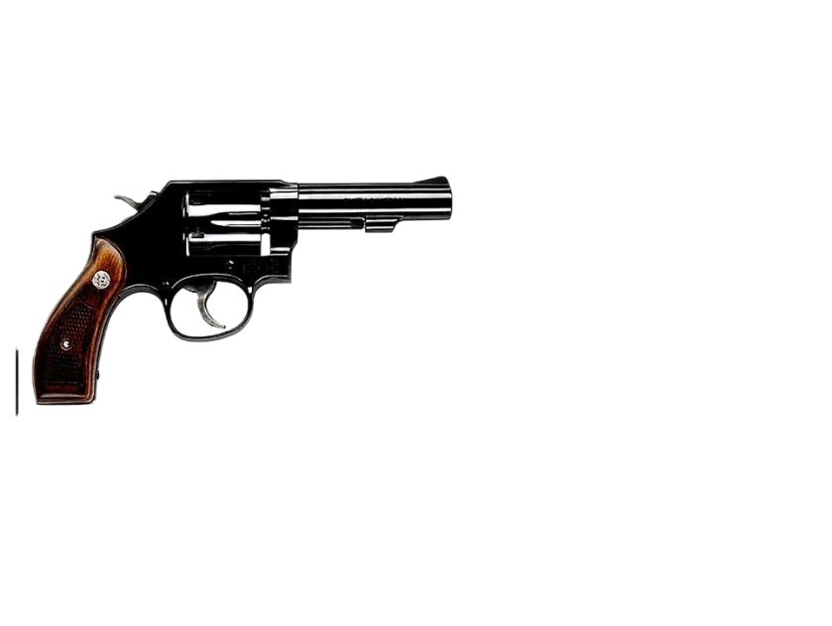

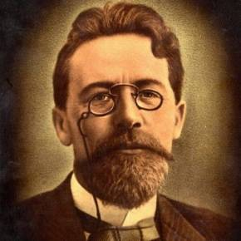

What is Chekhov's law?
契科夫法则作为一种文学技巧，用到读后续写中，可帮我们抓住隐含的线索，突破续写的困境。
“If it’s not going to be fired, it shouldn’t be hanging there.”
“如果你在第一幕里，写墙上挂着一把枪，那么接下来它就该开火。否则就不要把它放在那。”这是俄国剧作家安东·契诃夫提出过的一个戏剧原则。契诃夫的这句话意思就是戏剧、电影中的一切细节，包括人物形象、故事背景、环境都不应是虚设的，都应该有其用途，特别是在与后面情节的呼应方面要起到作用。

Slide 16
利用契诃夫法则找出原文的矛盾冲突
矛盾起因：
喜欢足球，但身体受限。
She had a passion for soccer that burned brighter than any other flame in her heart. However, Sara faced a big challenge—her legs were not as strong as her friends, requiring her to rely on crutches (拐杖) for support.
Sara’s friends gathered on the soccer field …… She watched them with envy, longing to join in their games. But whenever she tried to play, the reality of her limitations would hit her hard, and she would feel a wave of disappointment. Despite this, Sara refused to let her dreams die. She loved soccer with all her heart, and she was determined not to give up.
矛盾发展：羡慕别人，渴望加入，但身体受限。
……the school announced an important soccer match. She wanted to participate more than anything, but she knew that many kids would doubt her abilities because of her legs. Instead of giving up to their doubts, Sara chose to accept them as a source of strength.
矛盾达成：非常想参加学校举行的足球赛，但能力被怀疑。

Slide 17
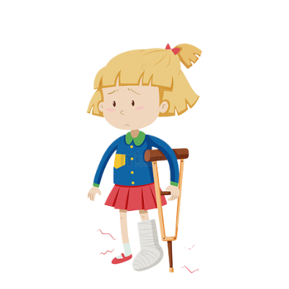


利用契诃夫法则推出人物性格
她该如何面对呢？
是放弃还是接受挑战？
She had a passion for soccer that burned brighter than any other flame in her heart. However, Sara faced a big challenge—her legs were not as strong as her friends, requiring her to rely on crutches (拐杖) for support.
确定主题
Sara’s friends gathered on the soccer field …… She watched them with envy, longing to join in their games. But whenever she tried to play, the reality of her limitations would hit her hard, and she would feel a wave of disappointment. Despite this, Sara refused to let her dreams die. She loved soccer with all her heart, and she was determined not to give up.
对于身体的缺陷，需要自己鼓掌来增加力量，增加成功的希望。与其受命运的摆布，不如做生活的强者。去找寻属于自己的一片天地。以乐观向上的精神去面对，全力以赴去解决人生的难题，不言弃、不放弃，不屈服，就有希望走出阴霾，迎来一片艳阳天。
determinded
Unwilling to give way to doubts, Sara decided to prove myself through actions.
化怀疑为力量
……the school announced an important soccer match. She wanted to participate more than anything, but she knew that many kids would doubt her abilities because of her legs. Instead of giving up to their doubts, Sara chose to accept them as a source of strength.

Slide 18

利用契诃夫法则，找出解决矛盾的方法
She began practising hard every day after school. Using her crutches, she kicked the ball with all her strength, gradually mastering the art of balancing herself. Sometimes, she would fall down, but each time, she would pick herself up with determination. Her face would be sweaty and dirty, but her eyes would shine with determination.
Finally, the day arrived. Sara’s team had made it to the final match, and she had been given a chance to play. The crowd roared with excitement as she took her position on the field. Everyone cheered her on, their voices a mix of encouragement and admiration. Although Sara couldn’t run like the others, she used her skills and wisdom to pass the ball, her crutches becoming her secret weapon (武器) on the field.
through effort
on crutches
什么是本文中
的契诃夫之枪？
因此，在续文中
一定要让拐杖起作用。
through skills
and wisdow
The crutches
are the key.

Slide 19

利用契诃夫法则，建构故事山
Story Mountain
Events
A. Sara chose to accept the challenge,
practising hard on crutches with friends.
B. Sara watched friend with envy, longing
to join in their games.
C. The match day arrived. In the last
moments, the ball came to Sara…
D. The school announced a soccer match,
Sara wanted to compete in it, fearing
other kids would doubt her.
E. She had a passion for soccer. However,
Sara’ legs were not as strong as her
friends’.
D
The Climax
Rising
Action
Falling
Action
B
A
The
Opening
The
Ending
E
C

Slide 20
3
语言协同
巧用契诃夫法则，使
续文与原文语言协同！

Slide 21
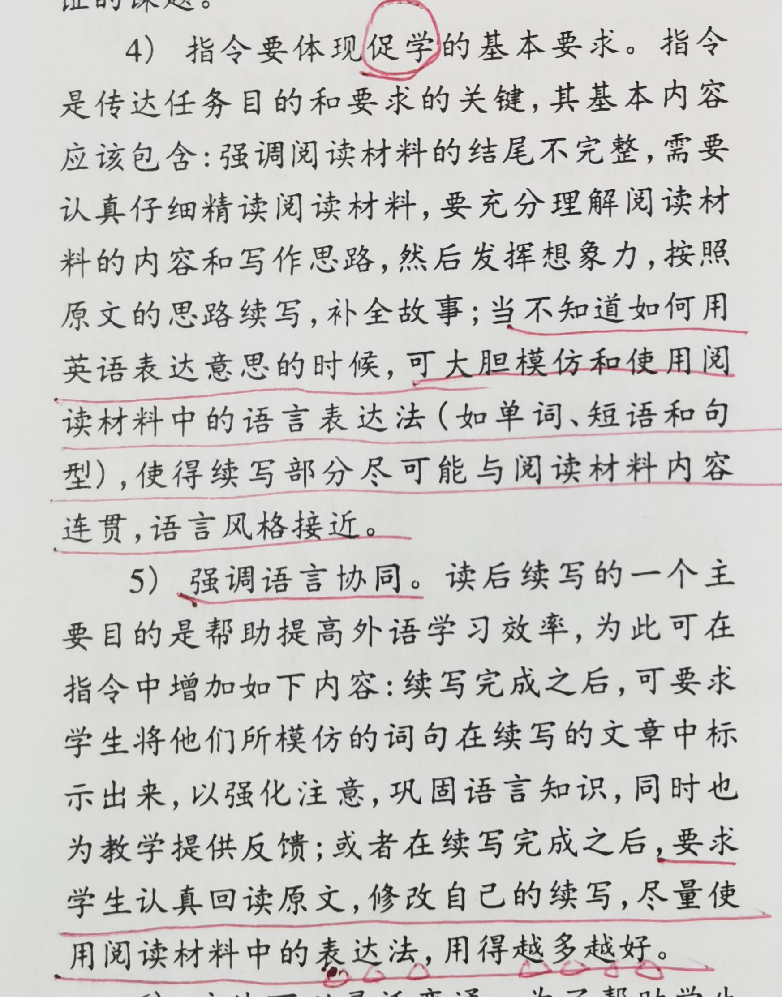

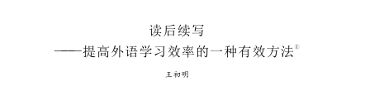
当你不知道如何用英语表达意思的时候，可大胆模仿和使用阅读材料中的语言表达法（如单词、短语和句型），使得续写部分尽可能与阅读材料内容连贯，语言风格接近。
王初明
……要求学生认真回读原文，修改自己的续写，尽量使用阅读材料中的表达法，用的越多越好。

Slide 22

第二节 读后续写（满分15分） 阅读下面材料，根据其内容和所给段落开头语续写一段，使之构成一篇完整的短文。
Once upon a time, there was a girl named Sara. She had a passion for soccer that burned brighter than any other flame in her heart. However, Sara faced a big challenge—her legs were not as strong as her friends, requiring her to rely on crutches (拐杖) for support.
Sara’s friends gathered on the soccer field every day, their laughter and shouts of excitement filling the air. She watched them with envy, longing to join in their games. But whenever she tried to play, the reality of her limitations would hit her hard, and she would feel a wave of disappointment. Despite this, Sara refused to let her dreams die. She loved soccer with all her heart, and she was determined not to give up.
One day, the school announced an important soccer match. Sara’s heart skipped a beat when she heard the news. She wanted to participate more than anything, but she knew that many kids would doubt her abilities because of her legs. Instead of giving up to their doubts, Sara chose to accept them as a source of strength.
分析原文语言特色
过分作定
定语从句
非谓语
独立主格
无灵主语

Slide 23
She began practising hard every day after school. Using her crutches, she kicked the ball with all her strength, gradually mastering the art of balancing herself. Sometimes, she would fall down, but each time, she would pick herself up with determination. Her face would be sweaty and dirty, but her eyes would shine with determination.
Finally, the day arrived. Sara’s team had made it to the final match, and she had been given a chance to play. The crowd roared with excitement as she took her position on the field. Everyone cheered her on, their voices a mix of encouragement and admiration. Although Sara couldn’t run like the others, she used her skills and wisdom to pass the ball, her crutches becoming her secret weapon (武器) on the field.
注意：
1. 续写词数应为100左右；
2. 请按如下格式在答题纸的相应位置作答.
In the last moments, the ball came to Sara. _________________
非谓语
无灵主语
独立主格

Slide 24



利用契诃夫法则，注重原文语言的协同
Finally, the day arrived.
…the reality of her limitations would hit her hard
… their laughter and shouts of excitement filling the air.
原文特点
Sara refused to let her dreams die.
无灵表达
一看到向自己飞来的球，Sara非常开心。
语言模仿
Happiness seized/gripped/took over/came over/visited her when seeing the soccer flying towards her.
用the sight of 造句
语言提升
The sight of the soccer flying toward her filled her with happiness.

Slide 25
利用契诃夫法则，注重原文语言的协同
原文语言
… she give up.
was determined to
not
她决定抓住机会向曾经怀疑她的人证明自己。
语言模仿
（原文）…but she knew that many kids would
doubt her abilities because of her legs.
她决定抓住机会证明自己。
she was determined to seize the opportunity to prove herself to those who had doubted her abilities because of her legs
She was determinded to seize/grip the opportunity to prove herself.
语言提升

Slide 26
利用契诃夫法则，注重原文语言的协同
原文语言
…requiring her to rely on crutches (拐杖) for support.
依赖拐杖，她用之前训练时掌握的技巧去踢球。
语言模仿
Relying on crutches, she applied the skills that she had mastered in training to kick the ball.
语言靓点
原文产出+定语从句

Slide 27
利用契诃夫法则，注重原文语言的协同
原文语言
She watched them with envy, longing to join in their games.
非谓语
球就像个听话的孩子，静静地听Sara的指挥,这使得一直无法抓住球的对手束手无策。
语言模仿
The ball was like a well-behaved child, quietly following Sara’s directions, leaving the competitors who failed to catch the ball all the time at a loss.
语言靓点
修辞+ 非谓语+定语从句

Slide 28
利用契诃夫法则，注重原文语言的协同
原文语言
Sara's heart skipped a beat when she heard the news.
地道语言
看到这一幕，观众们惊呆了/大为惊讶，兴奋地为她欢呼。
语言模仿
Seeing this, the crowd skipped a beat/dropped their jaws, roaring with excitement and cheering her on.
语言靓点
地道语言 + 非谓语

Slide 29
利用契诃夫法则，注重原文语言的协同
……she used her skills and wisdom to pass the ball, her crutches becoming her secret weapon (武器) on the field.
原文语言
独立主格结构
自信洋溢在Sara的脸上，她精神高涨，举起拐杖，用尽全身的力气踢球。
语言模仿
Confidence welling up on Sars’s face, she was in high spirits, lifting the crutches and kicking the soccer with all her strength.
语言靓点
独立主格结构 + 非谓语

Slide 30
利用契诃夫法则，注重原文语言的协同
非谓语
…… her legs were not as strong as her friends, requiring her to rely on crutches for support.
原文语言
球就像一只被驯服的(tamed)野兽，静静地待在球门里，这使得Sara笑得合不拢嘴。
语言模仿
The ball was like a tamed wild animal, quietly staying in the goal，which made Sara smile from ear to ear.
语言靓点
修辞 + 非谓语 + 定语从句

Slide 31
利用契诃夫法则，升华主题
主题升华
正是她的激情和决心让其他学生的怀疑变成了信任。
It was her passion and determination that made other kids’ doubt give way to belief.
语言靓点
强调句+原文语言+无灵表达

Slide 32
利用契诃夫法则，升华主题
主题升华
这有力的地证明了激情和决心可以克服任何看似不可逾越的障碍。
It was a vivid proof that passion and determination could overcome any seemingly unbeatable barrier.
语言靓点
同位语从句

Slide 33
利用契诃夫法则，升华主题
主题升华
这让我们明白了一个道理：身体的残疾不等于残废，通过努力同样可以获得成功。
It dawns on us that physical disability does not mean failure; Success can also be achieved through effort.
语言靓点
that引导主语从句

Slide 34
4
范文欣赏

Slide 35
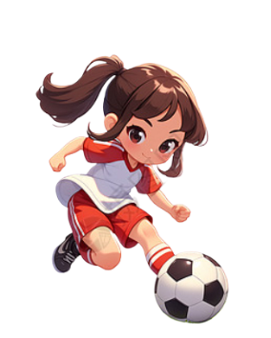

蓝色句子为修辞，tame 为非课标词汇
Original works
标红词为原文语言的产出，画线句为原文句式模仿
In the last moments, the ball came to Sara. The sight of it flying toward her filled her with excitement. She was determind to seize the chance to prove herself to those who had douted her abilities because of her legs. Relying on crutches, she applied the skills that she had mastered to kick the ball. The ball was like a well-behaved child, quietly following Sara’s directions, leaving the competitors who failed to catch the ball all the time at a loss. Seeing this, the crowd dropped their jaws, roaring with excitement and cheering her on. Confidence welling up on Sars’s face, she was in high spirits, lifting the crutches and kicking the soccer with all her strength. The ball was like a tamed wild animal, staying in the goal, which made Sara smile from ear to ear. It was her determination that made other kids’ doubt give way to belief.

Slide 36
Students’ works (李秉骋)
In the last moments, the ball came to Sara. Astonished and excited, she took a deep breath. Leaning on her trusty crutches, all her strength and skills were gathered together. Through the skills, the ball was skillfully controlled, making it as difficult as reaching for the stars for the opponents to take the ball away. On the field, her classmates looked in wide-eyed astonishment at her, as if they were witnessing a miracle. As she neared the goal, she raised her crutches and worked her fingers to the bones to kick the ball. Like a lightning bolt of hope, the ball flew. The goalkeeper dove, but in vain.The ball went in. Suddenly, like a volcano erupting, the stadium burst into thunderous shouts and cheers. Sara's school team won the game and she became a hero worthy of the name. It was a vivid proof that passion and determination could overcome any seemingly unbeatable barrier. Had it not been for her unwavering spirit, this moment of triumph would never have been achieved.

Slide 37
A possible answr
In the last moments, the ball came to Sara. She couldn’t believe that the ball would roll to her feet. She wanted to make full use of this opportunity and demonstrate to her classmates that despite relying on crutches, she could play soccer well. She used the skills she had acquired while practicing football to firmly control the ball under her feet. It was difficult for the opponent to snatch the ball from her feet. The classmates on the field had big eyes and were surprised by Sara’s ball control skills. As she approached the goal, Sara lifted her crutches and shot the perfect ball with all her strength. The ball was in the goal. In an instant, the crowd erupted with shouts and cheers. Sara’s school team won the game. She was a hero.

Slide 38


