Slide 1


感恩遇见，相互成就，本课件资料仅供您个人参考、教学使用，严禁自行在网络传播，违者依知识产权法追究法律责任。
更多教学资源请关注
公众号：溯恩英语
知识产权声明

Slide 2
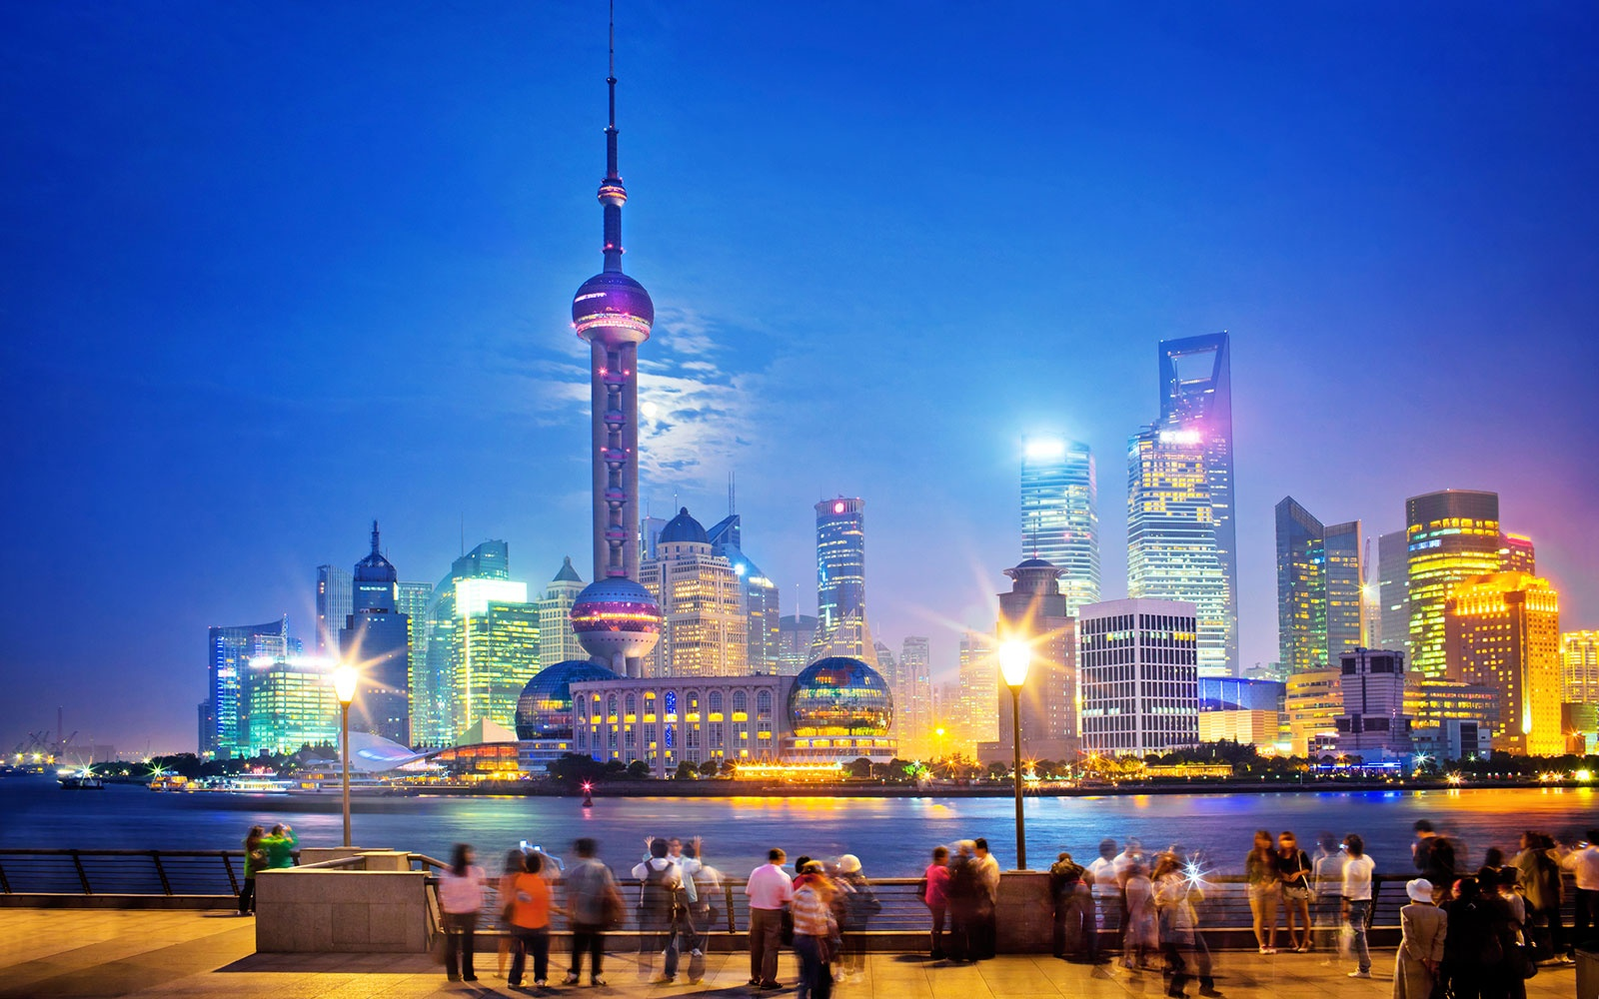
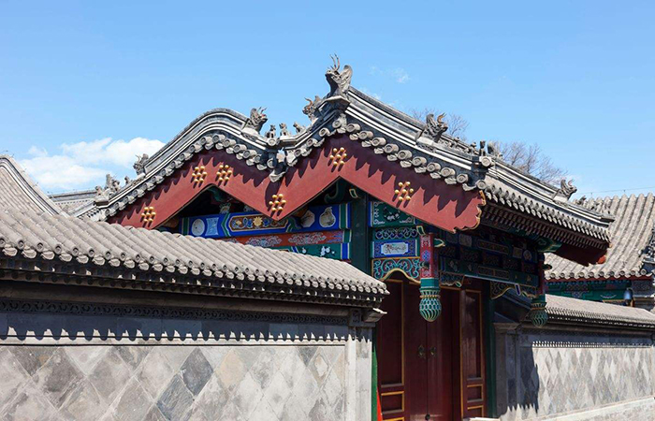
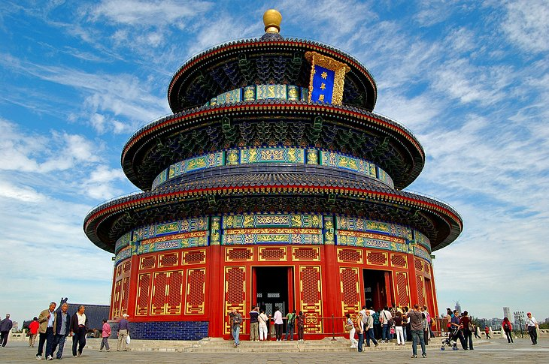
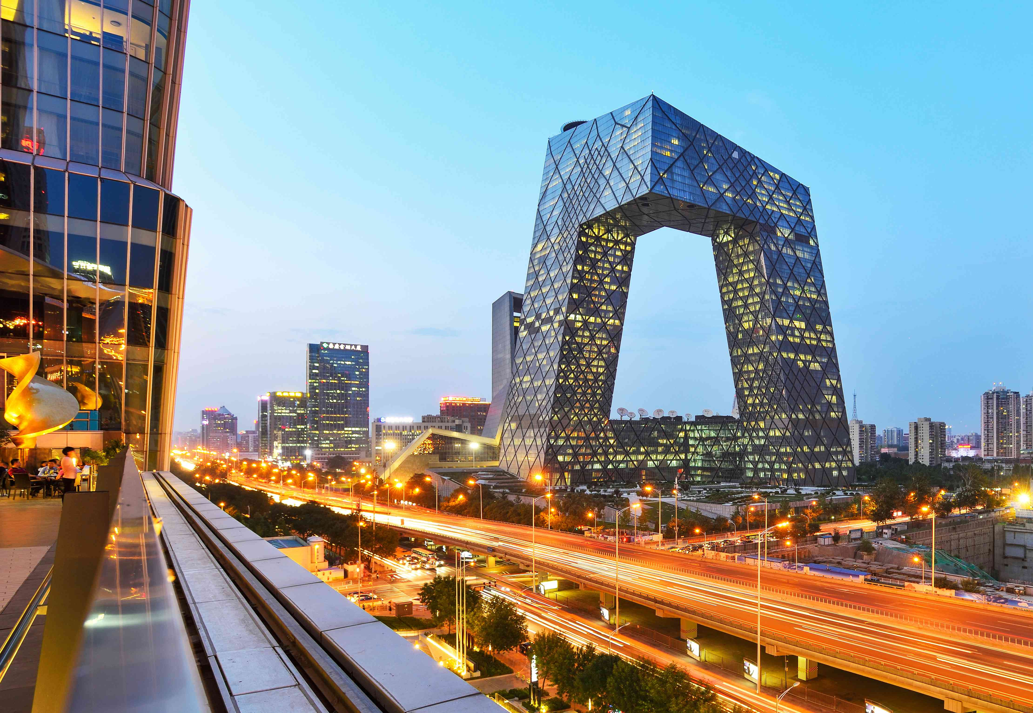
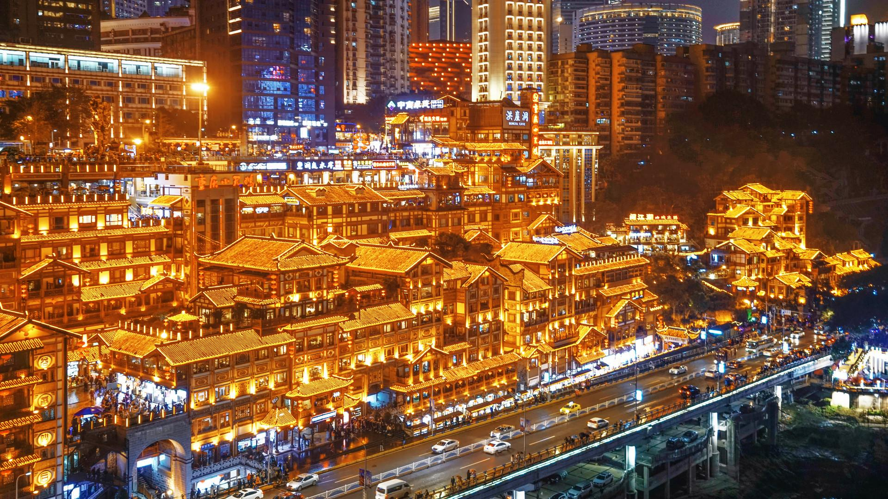

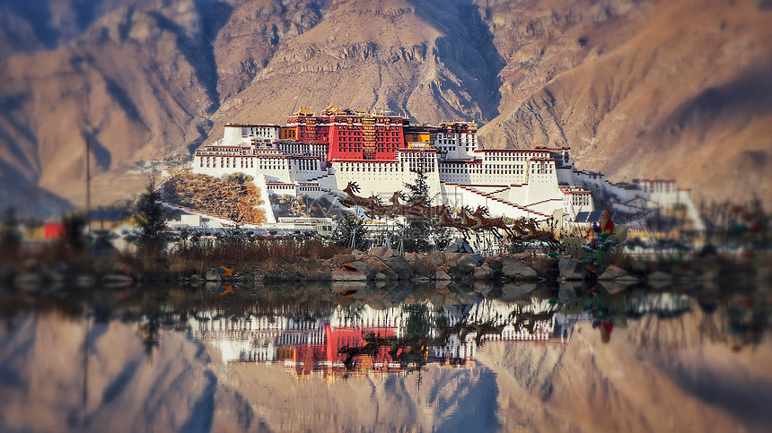
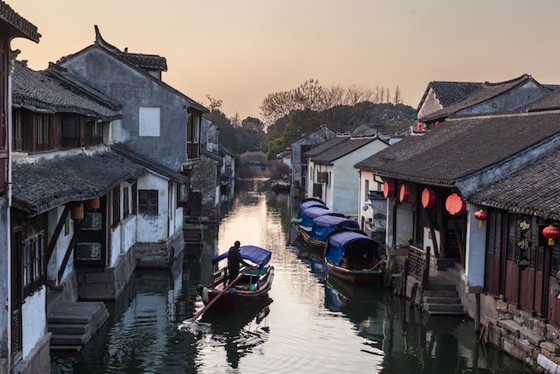

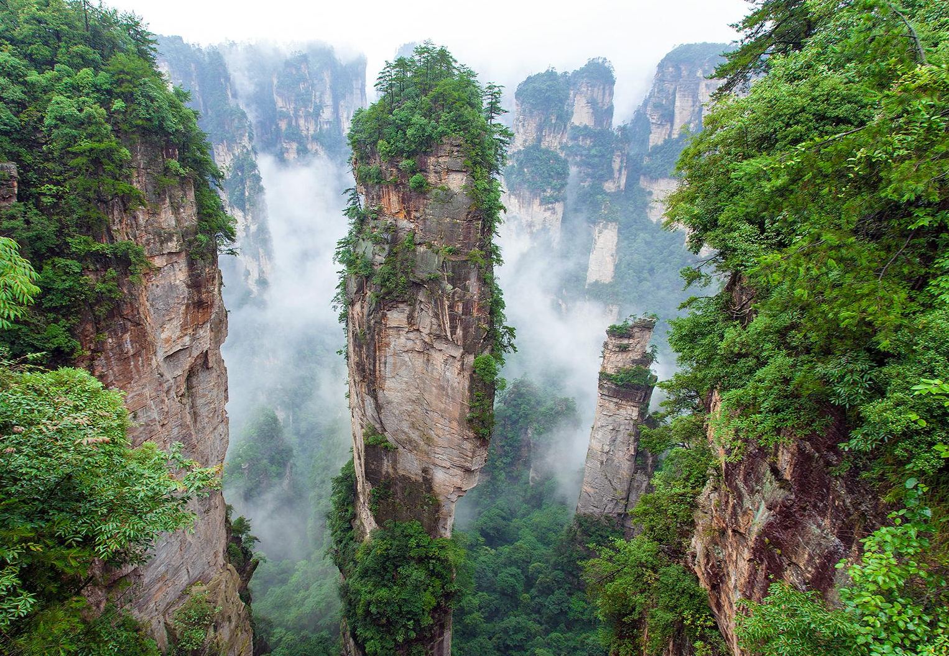
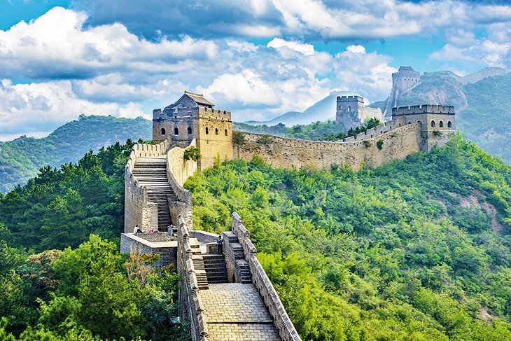
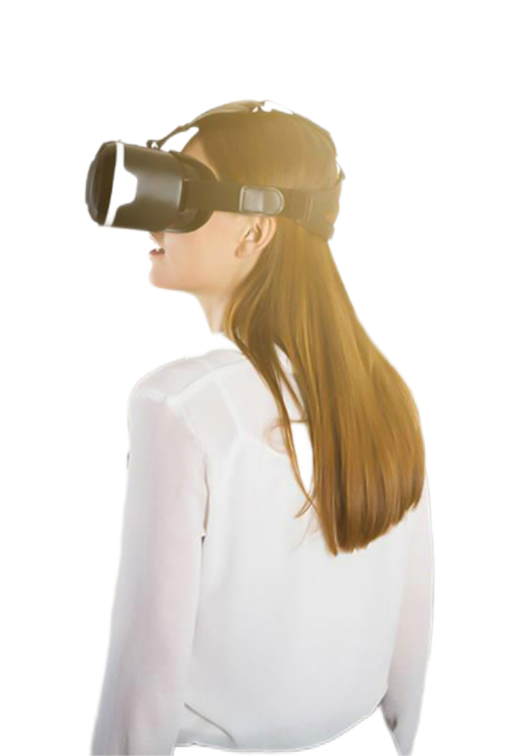
A Virtual Tour around China

Slide 3
假如你是校英文报编辑李华，你校科技社团在上周举行了一个“用VR 游中国”(A Virtual Tour around China)体验活动，让同学们能够通过VR眼镜游览祖国著名景点。请你在校英文报上撰写一则新闻稿，内容包括：
1．活动介绍；
2．活动反响。
文体：
人称：
时态：
要点：
a news report
3rd person-- the Science and Technology Association, the Tech Club
past tense-- did
introduction of the activity+ responses

Slide 4

列提纲：
Para. 1 Lead
Para. 2 Body
Para. 3 Ending
5W + 1H
introduction of this event
procedure? highlight?
responses+ supporting details

Slide 5
Para. 1 Lead 5W+ 1H
when
who
what
Last week, the Science and Tech Club of our school launched an exciting event “A Virtual Tour around China” on campus, which turned out an instant hit!
where
how
why
Aming to ignite/ fuel/ kindle students’ passion for technology, the Club of our school initiated an thrilling event “A Virtual Tour around China” on campus, which proved both engaging, educational and explorative!

Slide 6
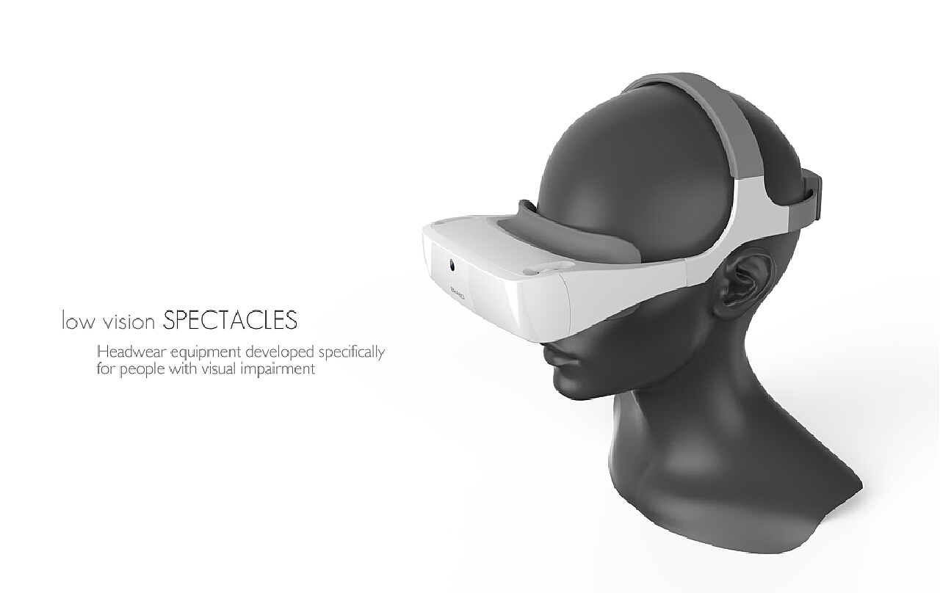
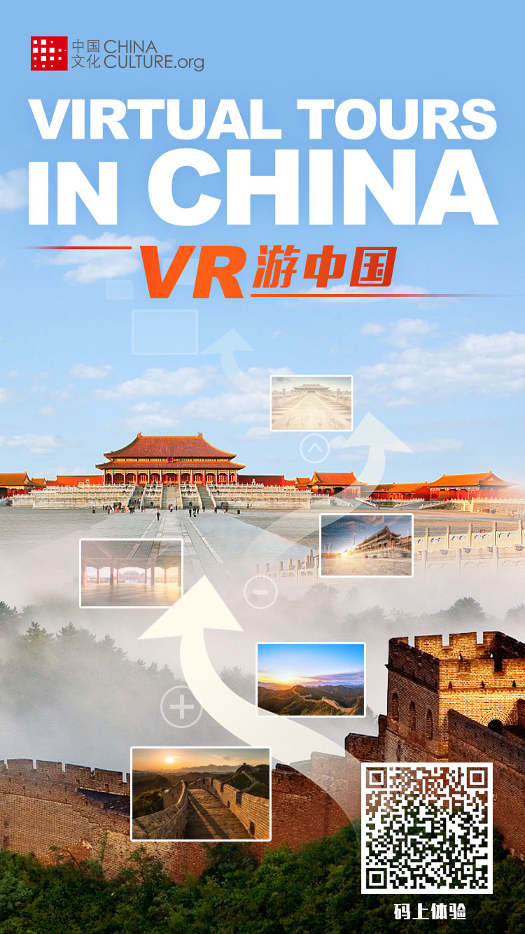
Para. 2 Body introduction of this event (procedure? highlight?)
A Virtual Tour around China
Virtual Reality (VR) technology, combined with 360-degree video streaming, enables the creation of immersive and interactive virtual tours. These tours allow participants to join from anywhere in the world, either in real-time or via pre-recorded content. With VR headsets or modern web browsers, attendees can experience a "place" as if they were physically present, looking around, exploring, and interacting with the environment.

Slide 7
Para. 2 Body introduction of this event (procedure? highlight?)
list the tourism attractions of China
use vivid and descriptive words (adj.)
Equipped with the 360-degree panoramic headsets, students, as they took turns, were exposed to the magnificent natural landscapes of Huangshan Mountain, exquisite architecture of the Summer Palace, splendid views of Jiuzhaigou and sacred serenity of Potala Palace, while also connecting with modern, bustling China at places like the Bund in Shanghai and the 798 Art District in Beijing. The latest VR technology and 3D filming made it possible for students to embark on a virtual and immersive journey of exploring China.

Slide 8
Para. 2 Body introduction of this event (procedure? highlight?)
general-- specific
Using VR technology, this event transported students to a variety of natural, historic, and cultural attractions.
With VR headsets, students delved into the intricate halls, gardens, and courts of the Forbidden City, gaining detailed insights into its exhibits and enhancing their historical knowledge.
Through “Digital Dunhuang,” students virtually toured classic caves and closely examined murals to feel the pulse of the Mogao Grottoes.
On the livestreaming platform, Jiuzhaigou National Park’s breathtaking waterfalls and serene lakes offered students a peaceful getaway to appreciate the natural beauty of China.
Meanwhile, the Great Wall’s architectural marvels, presented in the form of HD images, fascinated students, fostering a sense of awe and admiration for the incredible engineering feats of ancient China.

Slide 9
Para. 2 Body introduction of this event (procedure? highlight?)
specific--general
Students were grouped and given VR headsets, each equipped with software designed to simulate real-life tours of various attractions. From the majestic halls of the Forbidden City to the serene lakes of Jiuzhaigou National Park, from the intricate murals of the Mogao Grottoes to the awe-inspiring stretches of the Great Wall, no corner of China was left unexplored. The technology provided a 360-degree view, making it feel as if students were actually walking through these historic and natural wonders/ marvels.

Slide 10
Para. 3 Ending responses+ supporting details
It was such a huge success that it not only broadened students’ horizons but also sparked their interest in exploring more about our country.
With the integration of technology and education, this event turned out a hit for it has created a memorable and enriching experience for students.

Slide 11
老师下水作文：
A Wonderful Virtual Tour Across China
Last week was marked by an intriguing event “A Virtual Tour Around China” our school’s Science and Technology Club organized, granting students an opportunity to explore famous landmarks across the country without leaving campus.
The event utilized state-of-the-art VR technology to provide online tours of over 40 popular places of interest and some bucket-list destinations. With VR headsets, students could embark on fascinating personal journeys to historical sites like the majestic Forbidden City, magnificent Terracotta Warriors, and spectacular Dunhuang Mogao Grottoes. The voiced tours and 3D guide maps were also provided, ensuring a multimedia travel experience.
The response to the event was overwhelmingly positive. Students were amazed by the tours that allowed them to marvel at China’s profound history and brilliant culture as if they were there in person. Many praised it not only for breaking down geographical boundaries but also for sparking their interest in technology and China’s rich cultural heritage.
内容要点的准确性和完整性；
语言表达的丰富性和得体性；
组织结构的合理性和逻辑性。

Slide 12
A Possible Version
A Virtual Tour Around China
Last week, the Tech Club of our school held an exciting event “A Virtual Tour around China”, which turned out to be a huge hit!
With the help of VR headsets, students visited a series of iconic sites, starting with the Great Wall, which snaked majestically across the landscapes displayed in the headsets. They also explored the Forbidden City, appreciating its vast courtyards and grand halls that once housed ancient emperors. The experience ended up with a visit to the Terracotta Army in Xi'an and the details of each soldier in 3D truly stunned everyone.
This virtual tour provided students with a unique experience to appreciate the charm of China. Participants all marveled at the realistic visual effects and the thrill of this virtual tour.

