Slide 1
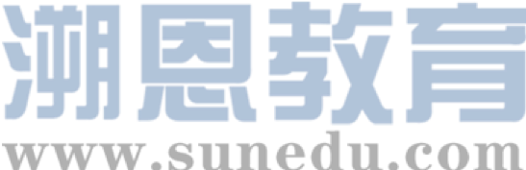


感恩遇见，相互成就，本课件资料仅供您个人参考、教学使用，严禁自行在网络传播，违者依知识产权法追究法律责任。
更多教学资源请关注
公众号：溯恩英语
知识产权声明

Slide 2

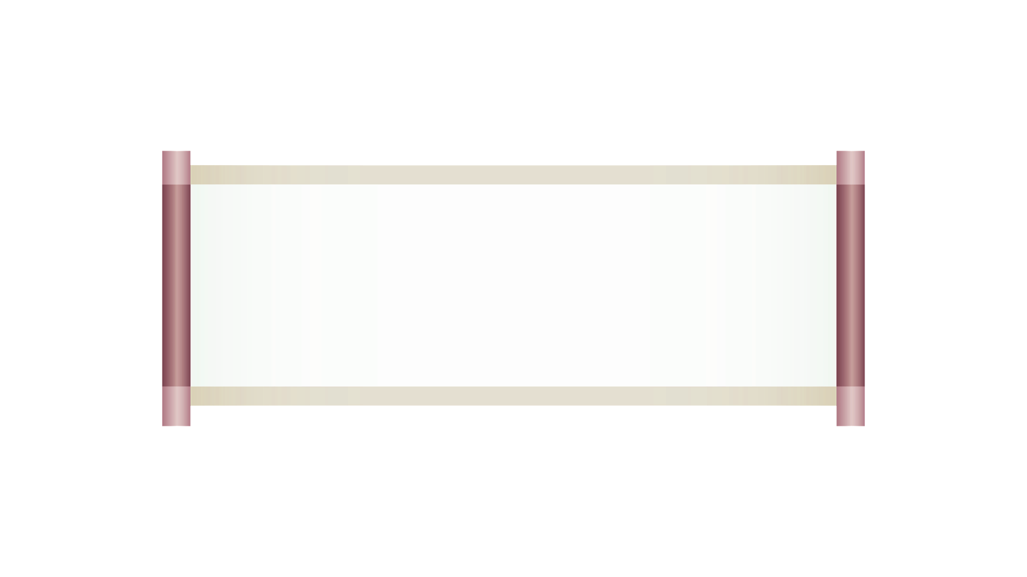
利用近5年高考真题突破
中国传统文化主题
语法填空题
华南师范大学附属惠阳学校：梁晓林

Slide 3

一．课程标准解读
文化知识涵盖物质和精神两个方面。物质方面主要包括饮食、服饰、建筑、交通等，以及相关的发明与创造；精神方面主要包括哲学、科学、教育、历史、文学、艺术，也包括价值观念、道德修养、审美情趣、社会规约和风俗习惯等。学习中外优秀文化，有助于学生在对不同文化的比较、鉴赏、批判和反思的过程中，拓宽国际视野，理解和包容不同文化，增强对中华优秀传统文化、革命文化和社会主义先进文化的认识，形成正确的价值观和道德情感，成为有文明素养和社会责任感的人。

Slide 4
普通高中英语文化知识内容要求摘录：
课程类别 | 文化知识内容要求
必修 | 1. 了解英美等国家的主要传统节日及其历史与现实意义；比较中外传统节日的异同，探讨中外传统节日对文化认同、文化传承的价值和意义； 2. 了解英美等国家的主要习俗；对比中国的主要习俗，尊重和包容文化的多样性； 3. 学习并初步运用英语介绍中国传统节日和中华优秀传统文化（如京剧、文学、绘画、园林、武术、饮食文化等），具有传播中华优秀传统文化的意识。
4. 选择性必修 | 1.使用英语简述中华文化基本知识，包括中华传统节日、中华优秀传统文化的表现形式（如京剧、文学、绘画、园林、武术、饮食文化等）及其内涵，主动传播和弘扬中华优秀传统文化。
5. 选修（提高类） | 1.运用中外典故和有代表性的文化标志表达意义和态度，有效进行跨文化沟通； 2.了解中国对外经济、政治、文化的积极影响，感悟中华文明在世界历史中的重要地位，树立中华文化自觉，坚定文化自信。

Slide 5
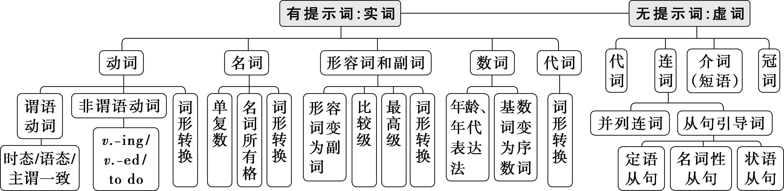
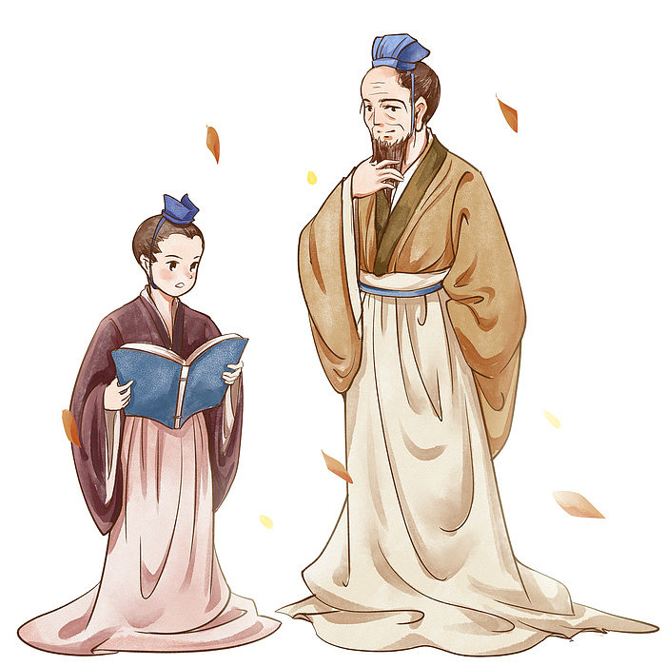

Slide 6
中国传统文化主题历年高考真题汇编与归类
中国传统文化高考真题
艺术形式
饮食文化
文化遗产
节日
五.2023年全国乙卷
Beijing——a city bridging the ancient and the modern
十.2020年全国II卷春节装饰品
一.2020年全国III卷
中国古代画家寻访大自然
三.2023年新课标I卷
中华美食“小笼包”
二.2024年新课标I卷
纪念汤显祖的中国文化元素进入莎士比亚的故乡
四.2024年全国甲卷短文改错
吃重庆火锅的经历
六.2023年浙江1月
北京胡同
十一.2022年全国乙卷国际茶日
七.2022年全国甲卷
徒步穿越古丝绸之路
八.2021年新高考I卷
游览黄山
九.2021年全国甲卷
在西安古城墙骑行

Slide 7
（一）艺术形式
语篇一 2020年全国III卷
中国古代画家寻访大自然

Slide 8
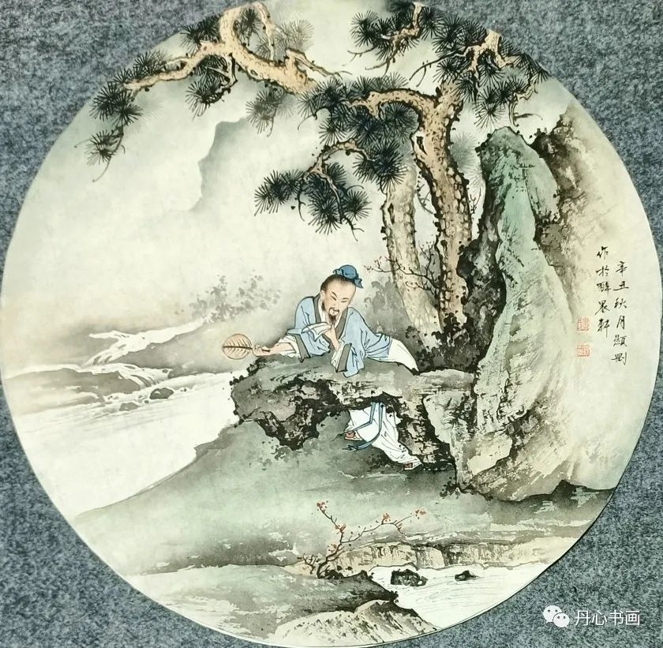
Task 1阅读下面短文，在空白处填入1个适当的单词或括号内单词的正确形式。
In ancient China lived an artist 61 paintings were almost lifelike. The artist’s reputation had made him proud. One day the emperor wanted to get his portrait (画像) done so he called all great artists to come and present their 62 (fine) work, so that he could choose the best. The artist was sure he would 63 (choose), but when he presented his masterpiece to the emperor’s chief minister, the old man laughed. The wise old man told him to travel to the Li River — perhaps he could learn a little from the greatest artist in the world.
whose
finest
be chosen

Slide 9
Task 1阅读下面短文，在空白处填入1个适当的单词或括号内单词的正确形式。
Filled with 64 (curious), the artist packed his bags and left. 65 he asked the villagers on the banks of the river where he could find the legendary (传奇的) artist, they smiled and 66 (point) down the river. The next morning he hired a boat and set out 67 (find) the well-known painter. As the small boat moved 68 (gentle) along the river he was left speechless by the mountains being silently reflected in the water. He passed milky white waterfalls and mountains in many shades of blue. And when he saw the mists rising from the river and the soft clouds 69 (surround) the mountain tops, he was reduced to tears. The artist was finally humbled (谦卑) by the greatest artist 70 earth, Mother Nature.
curiosity
When/As
pointed
to find
gently
surrounding
on

Slide 10
Task 2 Review the important phrases/sentences and translate.
1.in ancient China
2.lifelike adj.
3. reputation n.
4. present one’s work
5.presented his masterpiece
6.He was left speechless by the mountains being silently reflected in the water
7.He passed milky white waterfalls and mountains .
8.the mists rising from the river and the soft clouds
9.He was reduced to tears.
在古代中国
栩栩如生的；逼真的
名誉，名声
展示自己的作品
展示他的杰作
他被水中静静倒映的山景惊得说不出话来。
他经过了乳白色的瀑布和山脉
河上升起的薄雾和柔和的云
他潸然泪下。

Slide 11
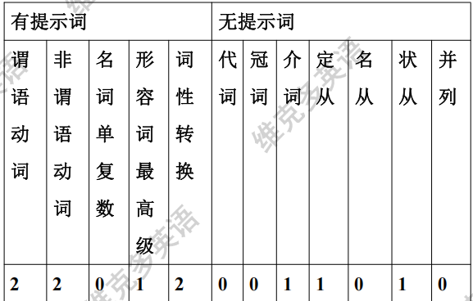
(表格摘选自维克多英语官网)
考点分析 （表格摘选自维克多英语官网）

Slide 12
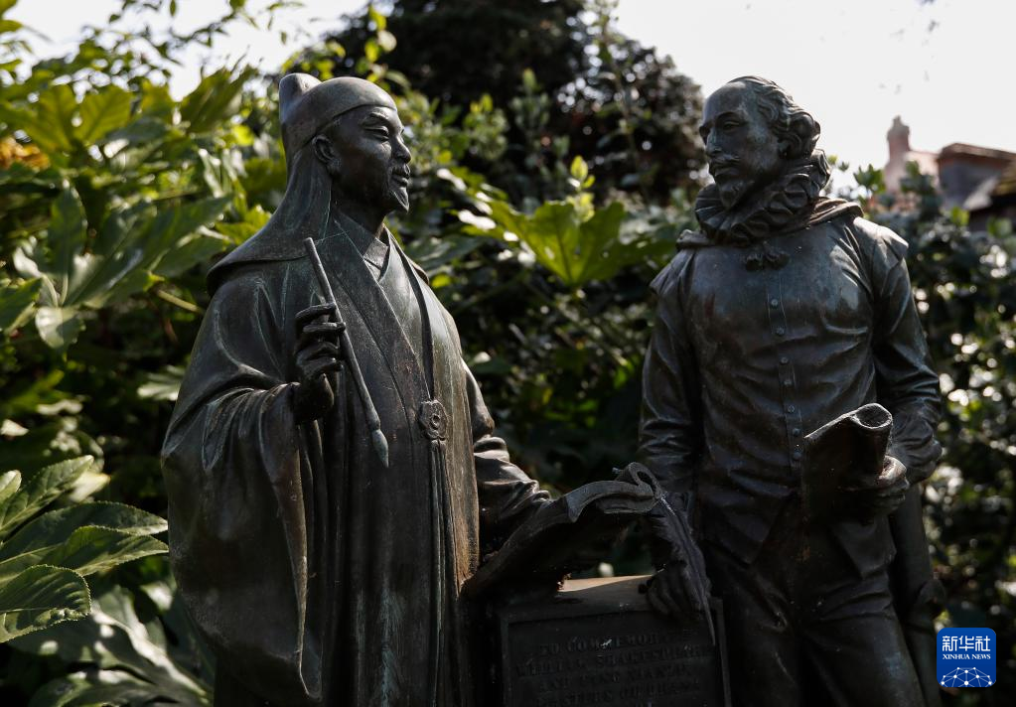
（一）艺术形式
语篇二2024年新课标I卷
纪念汤显祖的中国文化元素进入莎士比亚的故乡

Slide 13

Task 1阅读下面短文，在空白处填入1个适当的单词或括号内单词的正确形式。
Chinese cultural elements commemorating (纪念) Tang Xianzu, 56 is known as “the Shakespeare of Asia,” add an international character to Stratford-upon-Avon, William Shakespeare’s hometown.
Tang and Shakespeare were contemporaries and both died in 1616. Although they could never have met, there are common
57 (theme) in their works, said Paul Edmondson, head of research for the Shakespeare Birthplace Trust. “Some of the things that Tang was writing about 58 (be) also Shakespeare’s concerns. I happen to know that Tang’s play The Peony Pavilion (《牡丹亭》) is similar in some ways 59 Romeo and Juliet. ”
who
themes
were

Slide 14
Task 1阅读下面短文，在空白处填入1个适当的单词或括号内单词的正确形式。
A statue commemorating Shakespeare and Tang was put up at Shakespeare’s Birthplace Garden in 2017. Two years later, a six-meter-tall pavilion, 60 (inspire) by The Peony Pavilion, 61
(build) at the Firs Garden, just ten minutes’ walk from Shakespeare’s birthplace.
Those cultural elements have increased Stratford’s international 62 (visible), said Edmondson, adding that visitors walking through the Birthplace Garden were often amazed
63 (find) the connection between the two great writers.
inspired
was built
visibility
to find

Slide 15
Task 1阅读下面短文，在空白处填入1个适当的单词或括号内单词的正确形式。
64 (recall) watching a Chinese opera version of Shakespeare’s play Richard III in Shanghai and meeting Chinese actors who came to Stratford a few years ago to perform parts of The Peony Pavilion, Edmondson said, “It was very exciting to hear the Chinese language 65 see how Tang’s play was being performed.”
Recalling
and

Slide 16
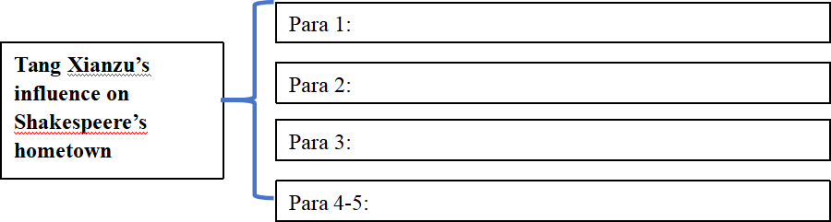
Task 1阅读下面短文，在空白处填入1个适当的单词或括号内单词的正确形式。
Task 2 Analyze the structure.
语篇类型 | 新闻报道
主题语境 | 人与社会：纪念汤显祖的中国文化元素进入莎士比亚的故乡
语篇结构
Introduction
Similarity between the 2 characters
A sattue and a pavilion were built
Edmondson’s comments on the influence

Slide 17
Task 2 Review the important phrases/sentences and translate.
1.Chinese cultural elements | 中国文化元素 | 2.is known as | 作为……出名
3.an international character | 一位国际性的人物 | 4.contemporary n.(熟词生义 ) | 同代人；同辈人；同龄人
5.statue n. | 塑像 | 6.visible adj. | 引人注目的
7.connection n. | 联系；连接 | 8.Chinese opera | 中国戏剧
9.version n. | 版本，改编形式 | 10.perform Tang’s play | 表演唐的戏剧
11.inspire vt. | 激励，鼓舞 | 12.concern n. | 关心的事

Slide 18
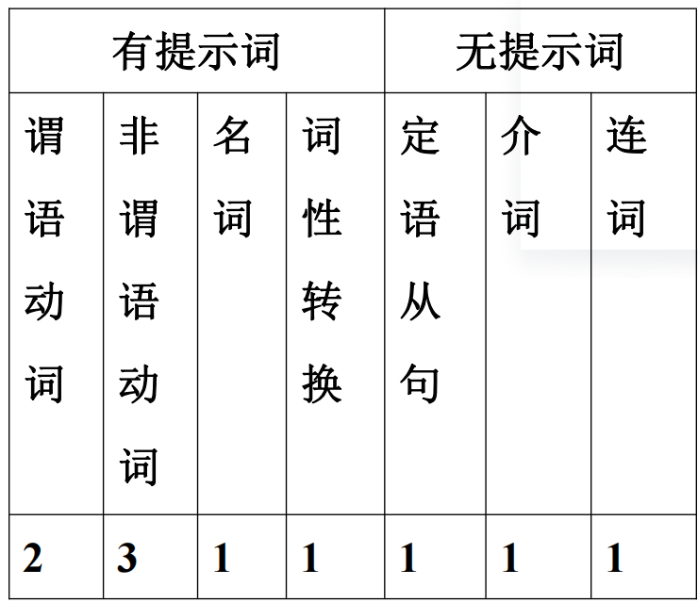
(表格摘选自维克多英语官网)
考点分析 （表格摘选自维克多英语官网）

Slide 19
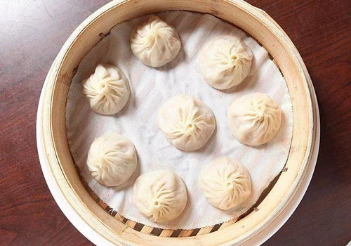
(二)饮食文化
语篇三2023年新课标I卷
中华美食“小笼包”

Slide 20
Task1 阅读下面短文，在空白处填入1个适当的单词或括号内单词的正确形式。
Xiao long bao (soup dumplings), those amazing constructions of delicate dumpling wrappers, encasing hot, 56 (taste) soup and sweet, fresh meat, are far and away my favorite Chinese street food. The dumplings arrive steaming and dangerously hot. To eat one, you have to decide whether 57
__________ (bite) a small hole in it first, releasing the stream and risking a spill (溢出)， 58 to put the whole dumpling in your mouth, letting the hot soup explode on your tongue.
Shanghai may be the 59 (recognize) home of the soup dumplings but food historians will actually point you to the neighboring canal town of Nanxiang as xiao long bao’s birthplace. There you will find them prepared differently — more dumpling and less soup, and the wrappers are pressed 60 hand rather than rolled.
tasty
to bite
or
recognized
by

Slide 21
Task1 阅读下面短文，在空白处填入1个适当的单词或括号内单词的正确形式。
Task 1阅读下面短文，在空白处填入1个适当的单词或括号内单词的正确形式。
Nanxiang aside, the best xiao long bao have a fine skin, allowing them 61 (lift) out of the steamer basket without tearing or spilling any of 62 (they) contents. The meat should be fresh with 63 touch of sweetness and the soup hot, clear and delicious.
No matter where I buy them, one steamer is64 (rare) enough, yet two seems greedy, so I am always left65 (want) more next time.
to be lifted
their
a
rarely
wanting

Slide 22
Task 1阅读下面短文，在空白处填入1个适当的单词或括号内单词的正确形式。
Task 2 Analyze the structure.
语篇类型 | 夹叙夹议文
主题语境 | “人与社会”之“历史、社会与文化”主题群
语篇结构
Para 1:
How tasty it is
Introduction to Xiao Longbao
Para 2:
How to eat it.
Xiao Longbao
Para 3:
Its birthplace.
Para 4:
Ialways want to eat more next time

Slide 23
Task 3 Review the important phrases/sentences and translate.
1. amazing constructions of delicate dumpling wrappers |  | 精致的饺子皮是令人惊艳的创造
2.Chinese street food | 中国街头美食 | 5.recognize vt. | 认可，承认；赞赏
3.steam v. | 蒸（食物） | 6.roll v. | （使）翻滚，滚动
4.let the hot soup explode on your tongue | 让热汤在你的舌头上爆开吧。 | 7.content n. | 所含物，容纳的东西

Slide 24
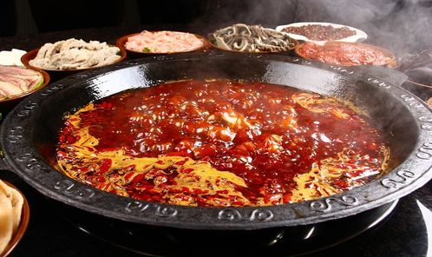
(二)饮食文化
语篇四2024年全国甲卷短文改错改编
吃重庆火锅的经历

Slide 25
Task1 阅读下面短文，在空白处填入1个适当的单词或括号内单词的正确形式。
Task 1阅读下面短文，在空白处填入1个适当的单词或括号内单词的正确形式。
Last week, I saw a program about Chongqing hotpot on TV. I was curious and planned a special one-day trip there with a friend of_____________(me). Our fast train was _____________(pack)with passengers. _________ attendant gave us some travel _______________(brochure) about Chongqing. When we arrived, we went straight_________ a famous restaurant and ordered dishes, _________ tasted great. The atmosphere here made the meal all the more ________________(enjoy). Hotpot is meant for families and friends _____________(sit) together, dip everything they like in one pot, ____________ share friendship and love.
mine
packed
An
brochures
to
which
enjoyable
to sit
and

Slide 26
(三)文化遗产
语篇五 2023年全国乙卷
Beijing——a city bridging the ancient and the modern

Slide 27
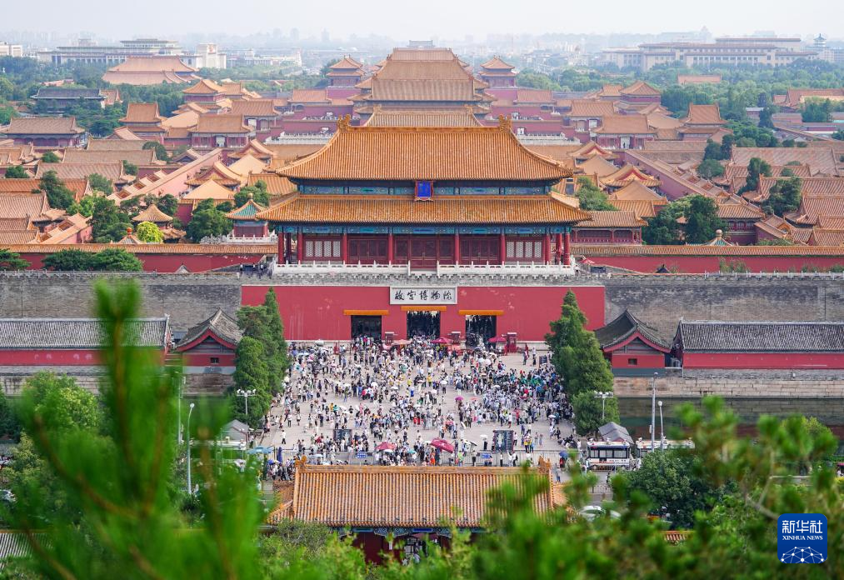
Task1 阅读下面短文，在空白处填入1个适当的单词或括号内单词的正确形式。
Task 1阅读下面短文，在空白处填入1个适当的单词或括号内单词的正确形式。
①Beijing is a city bridging the ancient and the modern. From Buddhist temples to museums, narrow hutong 61 royal palaces, it is home to more than 3,000 years of glorious history even down to its layout, with the city keeping its carefully 62 (build) system of ring roads.
②But for all its ancient buildings, Beijing is also a place 63
__________ welcomes the fast-paced development of modern life, with 21st-century architectural 64 (wonder) standing side by side with historical buildings of the past.
to
built
that/which
wonders

Slide 28
Task1 阅读下面短文，在空白处填入1个适当的单词或括号内单词的正确形式。
Task 1阅读下面短文，在空白处填入1个适当的单词或括号内单词的正确形式。
③It is a distinct visual contrast (反差) that shouldn’t work, 65
________somehow these two very different worlds make a good combination. 66 (visit) several times over the last 10 years, I 67 ___________ (amaze) by the co-existence of old and new, and how a city was able to keep such a rich heritage (遗产) while constantly growing. As a photographer, I have spent the last two years 68 _____________ (record) everything I discovered.
④The 69 ___________ (remark) development of this city, which is consciously designed to protect the past while stepping into the modern world, 70 ________ (mean) there is always something new to discover here, and I could be photographing Beijing for the next 50 years.
but/yet
Having visited
was amazed
recording
remarkable
means

Slide 29
Task 1阅读下面短文，在空白处填入1个适当的单词或括号内单词的正确形式。
Task 2 Analyze the structure.
语篇类型 | 说明文
主题语境 | “人与社会”之“历史、社会与文化”主题群
语篇结构
Part1
Para 1:
Introduction
Beijing——a city bridging the ancient and the modern
Beijing——a city bridging the ancient and the modern
Para 2:
Part2
Beijing——a place welcomes the fast-paced development of modern life
Detailed information
Para 3:
Its birthplace.
Beijing——a distinct visual contrast that make a good combination
Part3
conclusion
Para 4:
Beijing is consciously designed to protect the past while stepping into the modern world

Slide 30
Task 3 Review the important phrases/sentences and translate.
1.bridge the ancient and the modern 连接古代与现代 | 10. architectural adj.建筑学的
2.Buddhist temples佛教寺庙 | 11.historical buildings of the past 过去的历史建筑
3. is home to是…的家 | 12.make a good combination 做一个好的结合
4.glorious history辉煌历史 | 13.the co-existence of old and new 新旧共存
5.layout n.布局，设计 | 14.heritage n.遗产
6.ring roads环城公路/环形干道 | 15.photographer n. 拍照者，摄影师
7. system n.系统 | 16.protect the past保护过去
8.ancient buildings古建筑物 | 17. step into the modern world 步入现代社会
9.welcome the fast-paced development of modern life 拥抱快节奏发展的现代生活 | 18.photograph vt.拍照，照相

Slide 31
(三)文化遗产
语篇六2023年浙江1月
北京胡同

Slide 32
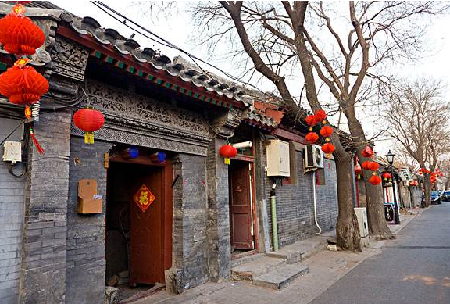
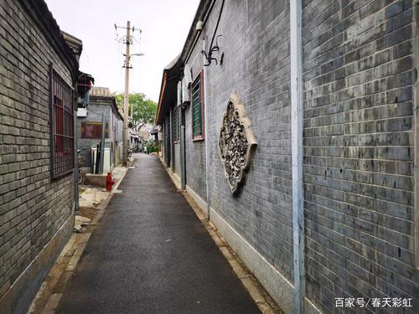
Task1 阅读下面短文，在空白处填入1个适当的单词或括号内单词的正确形式。
Task 1阅读下面短文，在空白处填入1个适当的单词或括号内单词的正确形式。
During China’s dynastic period, emperors planned the city of Beijing 56 arranged the residential areas according to social classes. The term “hutong”, 57 (original) meaning “water well” in Mongolian, appeared first during the Yuan Dynasty.
and
originally

Slide 33
Task1 阅读下面短文，在空白处填入1个适当的单词或括号内单词的正确形式。
Task 1阅读下面短文，在空白处填入1个适当的单词或括号内单词的正确形式。
In the Ming Dynasty, the center was the Forbidden City, 58
(surround) in concentric (同心的) circles by the Inner City and Outer City. Citizens of higher social classes 59
________ (permit) to live closer to the center of the circles. The large siheyuan of these high-ranking officials and wealthy businessmen often 60________ (feature) beautifully carved and painted roof beams and pillars (柱子). The hutongs they formed were orderly, lined by 61 (space) homes and walled gardens. Farther from the center lived the commoners and laborers. Their siheyuan were far smaller in scale and 62 (simple) in design and decoration, and the hutongs were narrower.
surrounded
were peimitted
featured
spacious
62 simpler/ more simple

Slide 34
Task1 阅读下面短文，在空白处填入1个适当的单词或括号内单词的正确形式。
Task 1阅读下面短文，在空白处填入1个适当的单词或括号内单词的正确形式。
Hutongs represent an important cultural element of the city of Beijing. Thanks to Beijing’s long history 63 _______capital of China, almost every hutong has its stories, and some are even associated with historic 64 (event). In contrast to the court life and upper-class culture represented by the Forbidden City, the Summer Palace, and the Temple of Heaven, the hutongs reflect 65 culture of grassroots Beijingers.
as
events
the

Slide 35
Task 1阅读下面短文，在空白处填入1个适当的单词或括号内单词的正确形式。
Task 2 Analyze the structure.
语篇类型 | 说明文
主题语境 | “人与社会”之“历史、社会与文化”主题群
语篇结构
Para 1 北京胡同的由来
Beijing Hutong
Para 2 北京胡同的由来
Para 3 北京胡同的历史意义

Slide 36
(表格摘选自维克多英语官网)
Task 3 Review the important phrases/sentences and translate.
1.emperor n 皇帝 | 8.orderly adj.有条理的，整齐的
2.arrange the residential areas 安排居住区 | 9. line (熟词生义) vt. 沿……形成行（或列、排）
3.social classes社会阶层 | 10.represent an important cultural element 代表一个重要的文化元素
4.the Forbidden City紫禁城 | 11.be associated with和…联系在一起
5.decoration n. 装饰，装饰品 | 12.the Summer Palace颐和园
6.high-ranking officials高层官员 | 13.the Temple of Heaven天坛
7.carve vt.雕，刻 | 14.grassroots Beijingers草根北京人

Slide 37
(表格摘选自维克多英语官网)
考点分析 （表格摘选自维克多英语官网）
有提示词（7个） |  |  | 无提示词（3个）
谓语动词 | 非谓语动词 | 名词单复数 | 介词 | 冠词 | 连词
2 | 1 | 1 | 1 | 1 | 1

Slide 38
(三)文化遗产
语篇七 2022年全国甲卷
徒步穿越古丝绸之路

Slide 39
Task1 阅读下面短文，在空白处填入1个适当的单词或括号内单词的正确形式。
Task 1阅读下面短文，在空白处填入1个适当的单词或括号内单词的正确形式。
①A visually-challenged man from Beijing recently hiked (徒步) 40 days to Xi’an, as a first step 61 (journey) the Belt and Road route (路线) by foot.
②On the 1,100-kilometer journey, the man Cao Shengkang, 62______ lost his eyesight at the age of eight in a car accident, crossed 40 cities and counties in three provinces. Inspired by the Belt and Road Forum for International Cooperation 63 (hold) in Beijing, Cao decided to cover the route by hiking as a tribute (致敬) to the ancient Silk Road. 64 friend of his, Wu Fan, volunteered to be his companion during the trip.
to journey
who
held
A

Slide 40
Task1 阅读下面短文，在空白处填入1个适当的单词或括号内单词的正确形式。
Task 1阅读下面短文，在空白处填入1个适当的单词或括号内单词的正确形式。
③Cao and Wu also collected garbage along the road, in order to promote environmental 65 (protect). Cao believes this will make the hiking trip even more 66 (meaning). The two of them collected more than 1,000 plastic bottles along the 40-day journey.
④In the last five years, Cao 67 (walk) through 34 countries in six continents, and in 2016, he reached the top of Kilimanjaro, Africa’s 68 (high) mountain.
protection
meaningful
has walked
highest

Slide 41
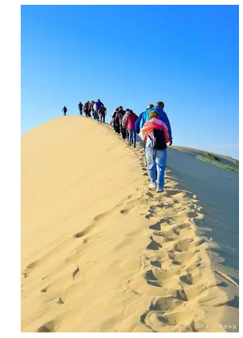
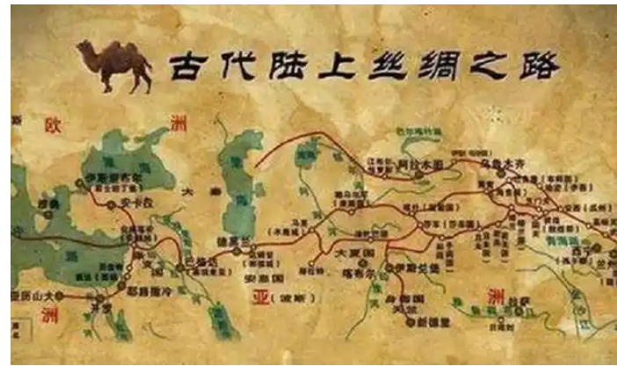
Task1 阅读下面短文，在空白处填入1个适当的单词或括号内单词的正确形式。
Task 1阅读下面短文，在空白处填入1个适当的单词或括号内单词的正确形式。
⑤Now, Cao has started the second part of his dream to walk along the Belt and Road route. He flew 4,700 kilometers 69 Xi’an to Kashgar on Sept. 20, 70 ____ (plan) to hike back to Xi’an in five months.
from
planning

Slide 42
Task 1阅读下面短文，在空白处填入1个适当的单词或括号内单词的正确形式。
Task 2 Analyze the structure.
语篇类型 | 记叙文
主题语境 | “人与社会”之“历史、社会与文化”主题群
语篇结构
Part1 Introduction
Para 1: first journey
Para 2: before：inspiration+his companion
Hiking the Belt and Road Route
Part2
Cao’s journey
Para 3: during
collecting garbage
Part3 Para 4
Second journey
Para 4: ending
34 countries in 6 continents

Slide 43
(表格摘选自维克多英语官网)
Task 3 Review the important phrases/sentences and translate.
1.A visually-challenged man 个有视觉障碍的人 | 7.the ancient Silk Road 古丝绸之路
2.journey vt.(熟词生义) 旅行 | 8.volunteer to do sth 自愿做某事
3.eyesight n.视力 | 9.companion n.同伴，伴侣
4.inspire vt.激励，鼓舞 | 10.collect garbage收集垃圾
5.forum n.论坛 | 11. 促进环境保护 promote environmental protection
6.international cooperation 国际合作 | 12.collect plastic bottles 收集塑料瓶子

Slide 44
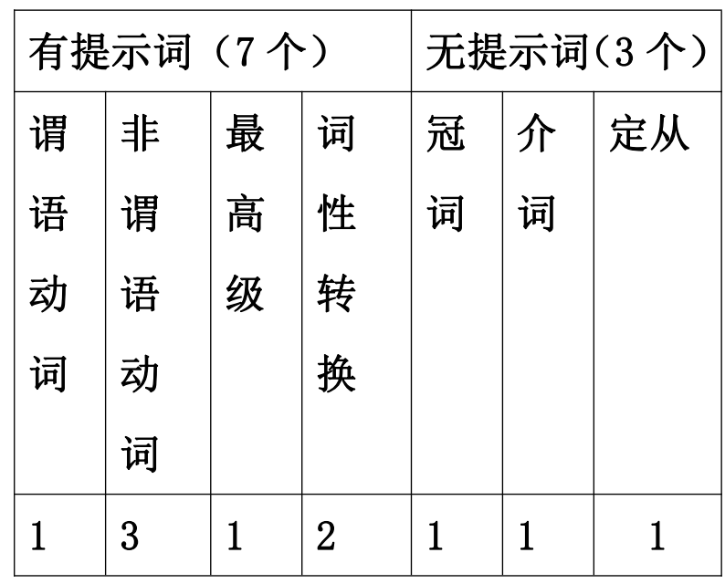
(表格摘选自维克多英语官网)
考点分析 （表格摘选自维克多英语官网）

Slide 45
(三)文化遗产
语篇八2021年新高考I卷
游览黄山

Slide 46
Task1 阅读下面短文，在空白处填入1个适当的单词或括号内单词的正确形式。
Task 1阅读下面短文，在空白处填入1个适当的单词或括号内单词的正确形式。
①Going to Mount Huangshan reminds me of the popular Beatles’ song “The Long and Winding Road”. 56 is so breathtaking about the experience is the out-of-this-world scenes. The rolling sea of clouds you see once you are at the top will remind you how tiny we 57 (human) are.
②The hot spring at the foot of the mountain is something you must try after the climb. It will 58 (undoubted) help you get refreshed! The amazing thing about the spring is that the colder the temperature gets, the 59 (hot) the spring! Strange, isn’t it? But that’s how nature is — always leaving us 60
(astonish).
What
humans
undoubtedly
hotter
astonished

Slide 47
Task1 阅读下面短文，在空白处填入1个适当的单词或括号内单词的正确形式。
Task 1阅读下面短文，在空白处填入1个适当的单词或括号内单词的正确形式。
③What comes next is the endless series of steps. You can’t help wondering how hard it 61 (be) for the people then to put all those rocks into place. Though it is the only unnatural thing on your way up the mountain, still it highlights the whole adventure 62
offers a place where you can sit down to rest your 63
(ache) legs.
④As the song goes, this long and winding road “will never disappear”, and it will always stick in the visitor’s memory. It sure does in 64 (I).While you’re in China, Mount Huangshan is 65 must to visit!
was
and
aching
mine

Slide 48
(表格摘选自维克多英语官网)
Task 3 Review the important phrases/sentences and translate.
语篇类型 | 说明文
主题语境 | “人与自然”下“自然生态主题群”
语篇结构
Part1 Introduction
Para 1: a breathtaking experience
Para 1 rolling sea of clouds
Para 2:The hot spring
Para3:
the endless series of steps
Going to Mount Huangshan
Part 2
3 typical sceneries
Part3
Conclusion
Para 4:Mount Huangshan is a must to visit!

Slide 49
(表格摘选自维克多英语官网)
Task 3 Review the important phrases/sentences and translate.
1.remind sb of sth使某人想起某事 | 7.undoubted adj.毫无疑问的
2.breathtaking adj.惊人的 /惊艳的 | 8.get refreshed恢复精神
3.experience n. 经历 | 9.astonish vt. 使吃惊，使惊讶 感到吃惊的astonished 令人吃惊的astonishing
4.the out-of-this-world scenes 超凡脱俗的场景 | 10.highlight vt.突出，强调
5.the rolling sea of clouds 翻滚的云海 | 11.adventure n. 冒险（经历），奇遇
6.the hot spring温泉 | 12.ache v.隐隐地、持续地）疼痛

Slide 50
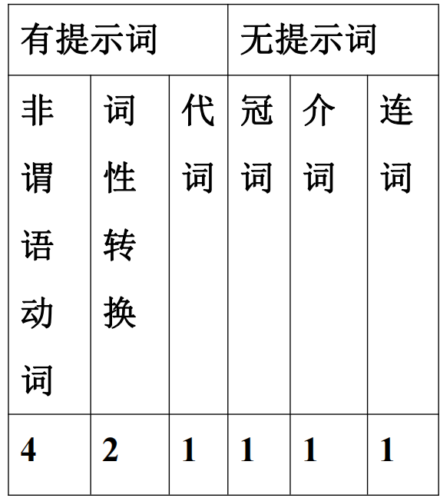
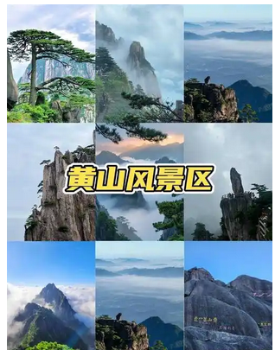
(表格摘选自维克多英语官网)
考点分析 （表格摘选自维克多英语官网）

Slide 51
(三)文化遗产
语篇九 2021年全国甲卷
在西安古城墙骑行

Slide 52
Task1 阅读下面短文，在空白处填入1个适当的单词或括号内单词的正确形式。
Task 1阅读下面短文，在空白处填入1个适当的单词或括号内单词的正确形式。
①The Xi’an City Wall is the most complete city wall that has survived China’s long history. It 41 (build) originally to protect the city 42 the Tang dynasty and has now been completely restored (修复). It is possible 43 (walk) or bike the entire 14 kilometers.
②We accessed the wall through the South Gate. The wall is 12 meters high and from here you can see streams of people moving inside and outside the City Wall.
③After 44 (spend) some time looking at all the defensive equipment at the wall, we decided it was time for some action and what 45 (good) than to ride on a piece of history!
was built
in
to walk
spending
better

Slide 53
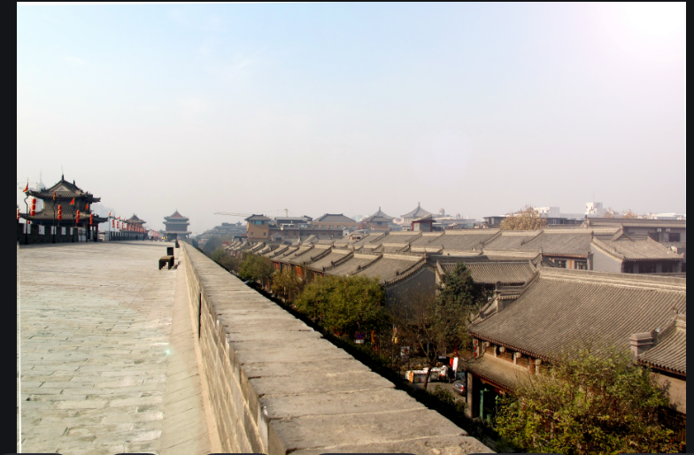
Task1 阅读下面短文，在空白处填入1个适当的单词或括号内单词的正确形式。
Task 1阅读下面短文，在空白处填入1个适当的单词或括号内单词的正确形式。
④We 46 (hire) our bikes from the rental place at the South Gate. My bike was old and shaky 47 did the job. It took us about 3 hours to go all 48 way around the Xi’an City Wall. Supposedly you can do it in two hours, but we stopped at the different gates and 49 (watchtower) to take pictures or just to watch the local people going about their 50
(day) routines.
hired
but/yet
the
watchtowers
daily

Slide 54
Task 1阅读下面短文，在空白处填入1个适当的单词或括号内单词的正确形式。
Task 2 Analyze the structure.
语篇类型 | 记叙文(个人经历)
主题语境 | “人与社会”之“历史、社会与文化”主题群
语篇结构
Part1 Introduction
Para 1:
Para 2:
Biking on the Xi’an City Wall
Part2
During the journey
Para 3:
Para 4:

Slide 55
(表格摘选自维克多英语官网)
Task 3 Review the important phrases/sentences and translate.
1.The Xi’an City Wall 西安城墙 | 9.streams of people 人流
2.complete adj.完整的 | 10.the defensive equipment防御装备
3.entire adj.整个的；完全的 | 11.hire vt.租用，租借
4.China’s long history中国悠久的历史 | 12.the rental place租赁地点
5.originally adv. 起初 | 13.shaky adj.不牢靠的，摇晃的
6.the Tang dynasty唐代；唐朝 | 14.watchtower n.瞭望塔
7.restore vt.修复，整修 | 15.the local people 当地人
8.We accessed the wall through the South Gate.我们从南门进入城墙。 | 16.routine n.常规，惯例 日常生活daily routines

Slide 56
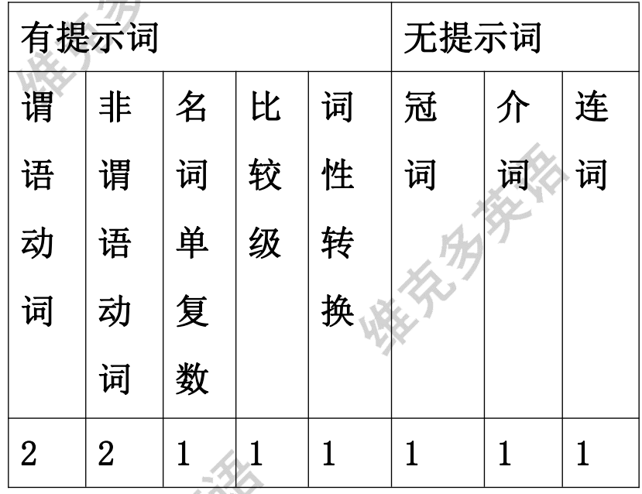
(表格摘选自维克多英语官网)
考点分析 （表格摘选自维克多英语官网）

Slide 57
（四）节日
语篇十2020年全国II卷
春节装饰品

Slide 58
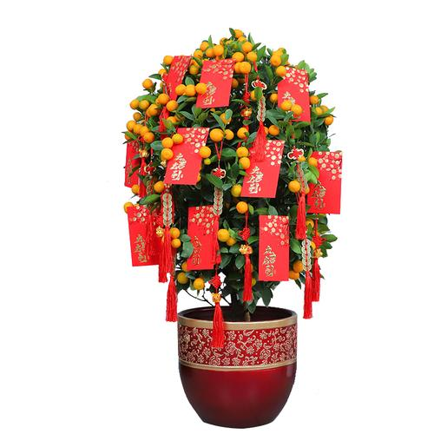
Task1 阅读下面短文，在空白处填入1个适当的单词或括号内单词的正确形式。
Task 1阅读下面短文，在空白处填入1个适当的单词或括号内单词的正确形式。
Decorating with Plants, Fruits and Flowers for Chinese New Year
Chinese New Year is a 61 (celebrate) marking the end of the winter season and the beginning of spring. This is why decorating with plants, fruits and flowers 62 (carry) special significance. They represent the earth 63 (come) back to life and best wishes for new beginnings.
These are some of the most popular in many parts of the country:
Oranges: Orange trees are more 64 decoration; they are a symbol of good fortune and wealth. They make great gifts and you see them many times 65 (decorate) with red envelopes and messages of good fortune.
celebration
carries
coming
than
decorated

Slide 59
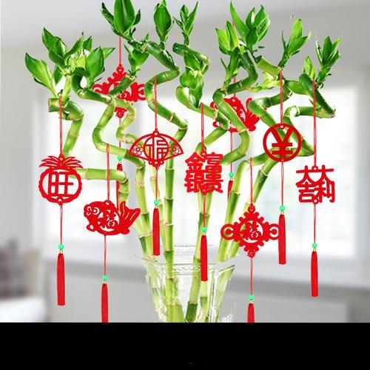
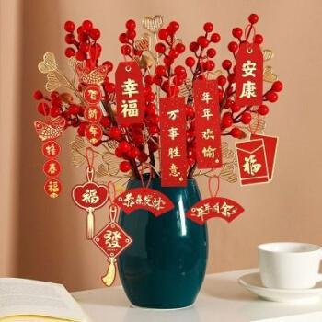
Task1 阅读下面短文，在空白处填入1个适当的单词或括号内单词的正确形式。
Task 1阅读下面短文，在空白处填入1个适当的单词或括号内单词的正确形式。
Bamboo: Chinese love their “Lucky Bamboo” plants and you will see them often in their homes and offices. 66 (certain) during the holiday period, this plant is a must. Bamboo plants are associated 67 health, abundance and a happy home. They are easy 68 (care) for and make great presents.
Branches of Plum Blossoms (梅花): The 69 (beauty) long branches covered with pink-colored buds (蓓蕾) make fantastic decorations. The plum trees are 70 first to flower even as the snow is melting (融化). They represent the promise of spring and a renewal of life.
Certainly
with
to care
beautiful
the

Slide 60
(表格摘选自维克多英语官网)
Task 2 Analyze the structure
语篇类型 | 说明文
主题语境 | “人与社会”之“历史、社会与文化”主题群
语篇结构
Part1 The meaning of Chinese New Year
Decorating with Plants, Fruits and Flowers for Chinese New Year
Part2 Decorations : Oranges
and their meanings Bamboo
Branches of Plum Blossoms

Slide 61
(表格摘选自维克多英语官网)
Task 3 Review the important phrases/sentences and translate.
1. 中国新年是一个庆祝活动，标志着冬天的结束和春天的开始 Chinese New Year is a celebration marking the end of the winter season and the beginning of spring.
2.significance n. 意义 /重要性 3.decoration n. 装饰，装饰品 decorate vt.装饰
4.它们代表着地球的重生和对新开始的最美好的祝愿。 They represent the earth comingback to life and best wishes for new beginnings.
5.a symbol of good fortune and wealth象征着好运和财富
6.red envelopes 红包 7. good fortune 好运8. a must不可缺少的东西
9.竹子与健康、富足和幸福的家相关。 Bamboo plants are associated with health, abundance and a happy home.
10.branch n. 树枝，分枝
11.它们代表着春天的希望和生命的新生。They represent the promise of spring and a renewal of life.

Slide 62
(表格摘选自维克多英语官网)
考点分析 （表格摘选自维克多英语官网）
有提示词 |  |  |  |  | 无提示词
谓语动词 | 非谓语动词 | 名词单复数 | 比较级 | 词性转换 | 代词 | 冠词 | 介词 | 连词 | 定从 | 名从 | 状从 | 并列
1 | 3 | 0 | 0 | 3 | 0 | 1 | 1 | 0 | 0 | 0 | 0 | 0

Slide 63
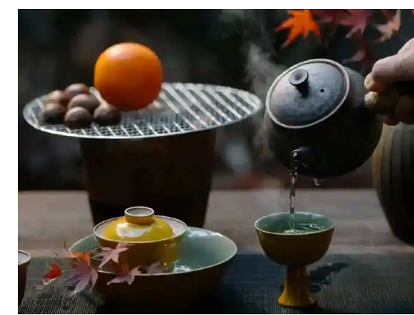
（四）节日
语篇十一2022年全国乙卷
国际茶日

Slide 64
Task1 阅读下面短文，在空白处填入1个适当的单词或括号内单词的正确形式。
Task 1阅读下面短文，在空白处填入1个适当的单词或括号内单词的正确形式。
①May 21st this year marks the first International Tea Day, which was named officially 61 the United Nations on November 27th, 2019. To celebrate 62 festival, a number of events took place at the Chinese Businessman Museum in Beijing on Thursday.
②The chairman of the China Culture Promotion Society 63
(address) the opening ceremony. “As a main promoter of the International Tea Day, the birthplace of tea and the 64__________ (large) tea-producing country, China has a 65 (responsible) to work with other countries to promote the healthy development of the tea industry. It can help to build a community with a 66 (share) future for mankind,” he said.
by
the
addressed
largest
responsibility
shared

Slide 65
Task1 阅读下面短文，在空白处填入1个适当的单词或括号内单词的正确形式。
Task 1阅读下面短文，在空白处填入1个适当的单词或括号内单词的正确形式。
③The “First International Tea Day Tea Road Cooperative Initiative” issued (发布) at the ceremony calls for people working in the tea industry to come together to promote international cooperation 67 cultural exchanges. A four-year tea promotion — Tea Road Cooperative Plan — was also issued in accordance with the initiative.
④ 68 (strengthen) the connection with young people, the event included a number of public promotional activities on social media, 69
(invite) twenty-nine tea professionals from around the world to have thirty-six hours of uninterrupted live broadcasts.
⑤The Chinese Ancient Tea Museum was officially unveiled (揭幕) at the ceremony, opening 70 (it) first exhibition: The Avenue of Truth — A Special Exhibition of Pu’er Tea.
and
To strengthen
inviting
its

Slide 66
(表格摘选自维克多英语官网)
Task 2 Analyze the structure.
语篇类型 | 说明文
主题语境 | “人与社会”之“历史、社会与文化”主题群
语篇结构
Part1
Introduction
Para 1:celebrate the first International Tea Day in Beijing
the first International Tea Day
Part2
Siginificance
Para 2:promote the healthy development of the tea +industrybuild a community with a shared future
Part3
Activities
Para 3 issue cooperative Initiative
Para 4 invite tea professionals
Para5 unveiled the Chinese Ancient Tea Museum officially

Slide 67
(表格摘选自维克多英语官网)
Task 3 Review the important phrases/sentences and translate.
1.the first International Tea Day | 第一个国际茶日
2.officially adv | 官方地
3.the Chinese Businessman Museum | 中国商人博物馆
4.the birthplace of tea | 茶的发源地
5.tea-producing country | 产茶国
6.中国文化促进会会长（致辞）开幕式。The chairman of the China Culture Promotion Society addressed the opening ceremony.
7. address vt. | 演说，演讲
8.promote the healthy development of the tea industry | 促进茶产业健康发展
9.issue vt. | 发表，颁布；分发
10.initiative n. | 措施，倡议
11.on social media | 在社交媒体上
12.professional n. | 专业人员
13.exhibition n. | 展览，展出

Slide 68
(表格摘选自维克多英语官网)
命题规律总结
1. 立足全面发展育人方向，加强全面考察德智体美劳。注重对考生在思维品质和文化意识等方面的培养。
2.重视高阶思维能力和辩证思维能力的考察。

Slide 69
(表格摘选自维克多英语官网)
备考策略与建议
1.熟练掌握词汇
2.夯实语法基础
3.剖析句子结构，分析句间逻辑
4.明确答题步骤和技巧

Slide 70
感谢观看
梁晓林

